Slide 1
Do Now

Slide 2
3. Eisenhower and Kennedy-Economic Prosperity Amidst Global and Domestic Upheaval
Mr. Winchell
APUSH 2018-2019
Period 8!

Slide 3
AP Prompt
Evaluate the extent to which 1950s domestic and foreign policies demonstrated both continuity and change in American society.

Slide 4
Key Concepts
8.1.II: Cold War policies led to public debates over the power of the federal government and acceptable means for pursuing international and domestic goals while protecting civil liberties.
C: Americans debated the merits of a large nuclear arsenal, the military- industrial complex, and the appropriate power of the executive branch in conducting foreign and military policy.
D: Ideological, military, and economic concerns shaped U.S. involvement in the Middle East, with several oil crises in the region eventually sparking attempts at creating a national energy policy

Slide 5
Outline
Eisenhower’s Policies-Domestic and Foreign
1950s Domestic Prosperity
The ‘Other’ Americas
Kennedy’s America

Slide 6
Harry Truman (D) (1945-1953)
Fair Deal
"Every segment of our population, and every individual, has a right to expect from his government a fair deal.“ – State of the Union (1949)
Labor Relations
Taft-Hartley Act (1947)
Prohibited closed shops, political contributions, sympathy strikes
Permitted “right to work” states
Social and Cultural Developments
Civil Rights
Executive Orders 9980 and 9981 (1948)
Desegregated the federal government and military

Slide 7
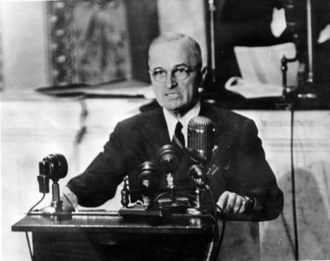
Harry S. Truman (D) (1945-1953) Containment
Marshall Plan
Aid to Western Europe to rebuild in capitalist model
Truman Doctrine
Provide economic and military support for nations threatened by communism
Greece and Turkey
National Security Act (1947)
Department of Defense
National Security Council (NSC)
Central Intelligence Agency (CIA)
NSC-68 (1950)
Justify defense spending and arms buildup as necessary
Establish alliances with non-communist nations

Slide 8
Eisenhower’s Modern Republicanism
Frustration with the stalemate in Korea & the Red Scare led to a Republican presidential takeover in the 1952
WW2 hero Dwight Eisenhower provided an antidote for “K₁C₂”
VP Richard Nixon attacked communism & corruption
Eisenhower vowed to go to Korea & personally end the war
Korean War
Communism
Gov’t Corruption
Once elected, Ike did go to Korea, overturned the U.N. battle plan, & threatened China with nuclear war to get an armistice signed in 1953

Slide 9
Eisenhower’s Modern Republicanism
Eisenhower labeled his politics “Modern Republicanism”:
“Ike” believed in conservative gov’t spending & a balanced budget but he had no desire to end New Deal programs
The affluent, postwar “good life” at home was dependent upon a strong Cold War foreign policy
“I’m conservative when it comes to money and liberal when it comes to human beings”

Slide 10
Eisenhower’s Modern Republicanism
In his 8 years as president, Ike had a modest domestic record:
Instead of ending New Deal programs, Eisenhower added to social security & minimum wage
Used FDR’s Federal Housing Admin to help finance building & purchasing of suburban homes
Created the Depts of Health, Education, & Welfare
During the Eisenhower era, the U.S. economy avoided spiraling inflation & brought middle-class prosperity to more Americans

Slide 11
Eisenhower’s Modern Republicanism
Interstate Highway System:
Highway Act of 1956 created 41,000 miles of divided highway to connect major U.S. cities
These highways helped promote national defense, interstate trade, & vacation travel
All funds were raised exclusively through gas, tire, & car taxes

Slide 12
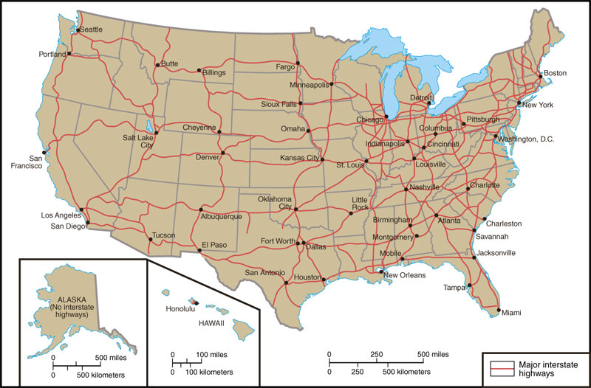

Slide 13
An Affluent Society
The Marshall Plan
The postwar boom was caused by
A desire for consumer goods (suppressed in the 1930s & 40s)
Gov’t spending during Cold War
Baby boom & movement to the suburbs increased the demand for consumer goods
But, this affluence led to a shift from individualism to conformity
The Korean War
Hi-fi record players
Refrigerators
Cars with automatic transmissions
Filter cigarettes
TVs
The American economy grew from crippling depression to the highest standard of living in all of world history in just 1 generation

Slide 14
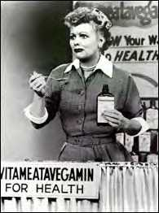
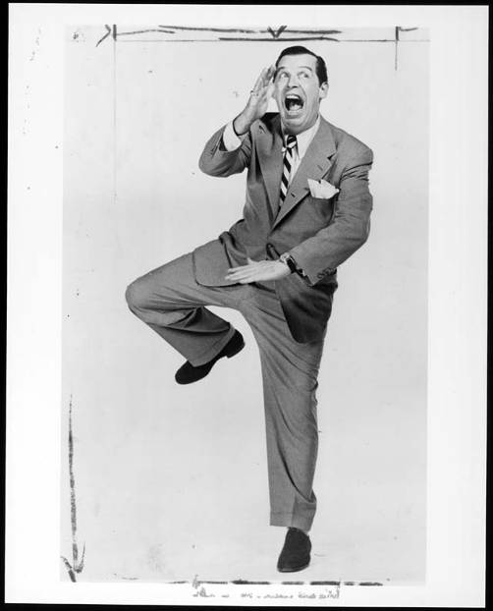
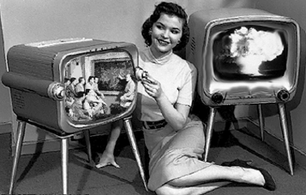
TV in the 1950s
“The Milton Berle Show”
“I Love Lucy”
$64,000 Question
21 Questions
Bonanza
The Untouchables
I Love Lucy
1950s TV networks
TV replaced radio & magazines as the primary conveyer of American consumer culture

Slide 15
Life in the Suburbs
The rapid growth of suburbs altered American life:
“Blue” & “white collar” workers lived in the same neighborhoods
Suburbs depended upon cars, grocery stores, & shopping malls
Suburbs allowed for the nuclear-family, not the extended family
“White-flight” to the suburbs left behind largely black urban cores

Slide 16
Areas of Greatest Growth
The rapid growth of suburbs led to
Increased church membership; Religious preference became the primary identifying feature of the suburbs (2nd RED SCARE)
Public schools grew & a college education was a goal for middle class children

Slide 17
Critics of the Consumer Society
Some criticized suburban culture:
William Whyte’s Organized Man & David Riesman’s Lonely Crowd criticized American conformity to social pressures
Jack Kerouac & the Beats (Beatniks) emerged as a new counter-culture by refusing to conform to 1950s culture
Gave rise to counter-culture reactionaries of 1960s
Inspired by Zen Buddhist state of inner grace called “beatitude”

Slide 19
OTHER “AMERICAS”: SOCIAL CRITICS
William H. Whyte, Jr., The Organization Man (1956)
conformity
David Riesman, The Lonely Crowd (1958)
“inner-directed” individuals → “other-directed” conformists.
John Kenneth Galbraith, The Affluent Society (1958)
failure to address significant social issues and common good (would influence JFK and LBJ)
Michael Harrington, The Other America
rural poverty, inner cities

Slide 20
Text Analysis- ‘The Other America’
“The entire invisible land of the other Americans became a ghetto, a modern poor farm for the rejects of society and the economy.”
--Michael Harrington

Slide 21
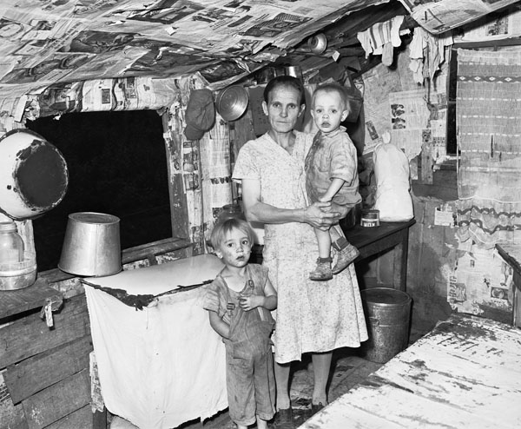
Bell County, Kentucky, August 31, 1946
Notes:
"Mrs. John Whitehead, wife of miner, and two of her children (or grandchildren) in the kitchen of her three room house. Mr. and Mrs. John Whitehead and their six children and six grandchildren live here. This house, built on company owned land, was built by Mrs. Whitehead's half brother at no expense for materials or labor to the company; the builder (half brother) was to receive the use of the house rent-free for three years and at the end of this period the ownership of the house would revert to the company. The brother moved away at the end of one year, receiving no cash settlement from the company. The house now rents for $6 monthly. It has no running water, no electricity, access is over a mountain trail; there are three rooms." By Russell Lee, Field, Bell County, Kentucky, August 31, 1946

Slide 22
Eisenhower’s Cold War
Brinksmanship

Slide 23
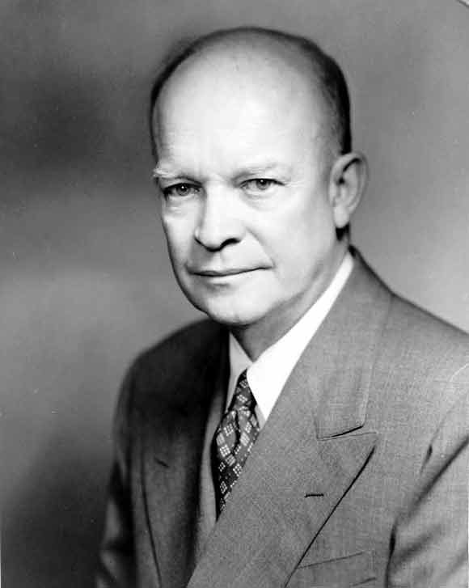
Eisenhower & the Cold War
Ike was unusually well-prepared to be a Cold War president
Ike’s foreign policy goals were to:
Take a strong stand against Communism by using “massive retaliation” with nuclear weapons & covert CIA operations
To reduce defense spending & relax Cold War tensions
WW2 military experience in Europe & Asia
Excellent diplomat & politician
Pragmatic & well organized
Chose hard-liner John Foster Dulles to be Sec of State

Slide 24
Massive Retaliation
“Massive retaliation” meant targeting civilian targets rather than military ones
Eisenhower wanted “more bang for the buck”:
Nuclear weapons & long-range delivery missiles were cheaper than conventional armed forces
“Massive retaliation” strategy made using nuclear weapons unlikely
But massive retaliation offered no intermediate course of action if diplomacy failed
Ike relied heavily on “brinksmanship” in which he used veiled threats of nuclear war to accomplish his goals
Notes:
(targeting civilian targets rather than military one)

Slide 25
Massive Retaliation
Chinese did not know if Ike was bluffing so China backed off this territorial expansion
In 1954, Eisenhower used a hard-line approach to stop Chinese expansion in Asia:
Chinese attempts to take over islands near Taiwan led Eisenhower to threaten nuclear war if China did not stop
Eisenhower hoped this pressure would drive a wedge between the USSR & communist China
…and the refusal of the USSR to aid China added a rift between Russia & China by the end of the 1950s

Slide 26
Massive Retaliation
In 1956, Egyptian leader Nasser nationalized the Suez Canal:
England & France invaded Egypt to take back the canal but the USSR opposed this intervention
Eisenhower did not want the USSR to attack so he threatened Russia with nuclear war
England, France, & the USSR left Egypt & the U.S. became the leader in Middle East
“If those fellows start something, we may have to hit ‘em—and, if necessary, with everything in the bucket”

Slide 27
Eisenhower Doctrine
The Suez Crisis revealed the vulnerability of the Middle East to Communism & Ike responded:
In 1957, the Eisenhower Doctrine recommended U.S. armed force to protect the Middle East from Communist aggression
In 1957, Ike sent the military to Lebanon to halt Communism & install a pro-Western gov’t
Like the Monroe Doctrine in Latin America, the United States emerged as a police power in a new part of the world

Slide 28
Covert Actions
Ike’s administration used covert CIA acts to expand U.S. control:
In 1953, the CIA overthrew Mohammed Mossadegh in Iran in favor of a U.S.-friendly shah
In 1954, the CIA overthrew a leftist regime in Guatemala
In 1959, the CIA took a hard-line against new Cuban dictator Fidel Castro after his coup
“The end justifies the means”
These interventions led to anti-American hostilities in the Middle East & Latin America

Slide 29
The Effects of Sputnik
The “space race” intensified the Cold War between USA & USSR
In 1957, the launch of the Soviet satellite Sputnik led to fears that the USSR was leading the race to create intercontinental ballistic missiles (ICBMs)
The U.S. sped up it plans to build ICBMs & IRBM submarines
Khrushchev used Sputnik to put the U.S. on the defensive: “We will bury you. Your grandchildren will live under Communism.”

Slide 30
The Effects of Sputnik
Sputnik led to fears that America was growing soft & was losing its competitive edge & work ethic
The U.S. gov’t responded with:
National Aeronautics & Space Administration in 1958
National Defense Education Act was created to promote math, science, & technology education
The advanced placement (AP) program is a byproduct of the NDEA!

Slide 31
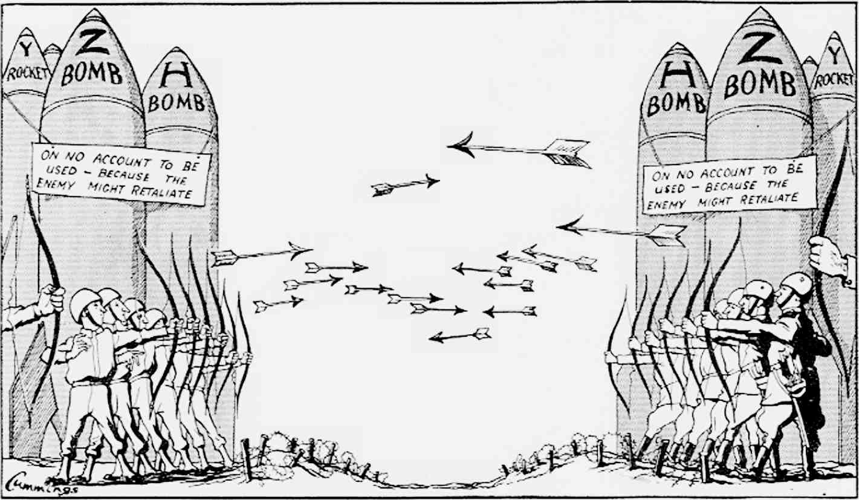

Slide 32
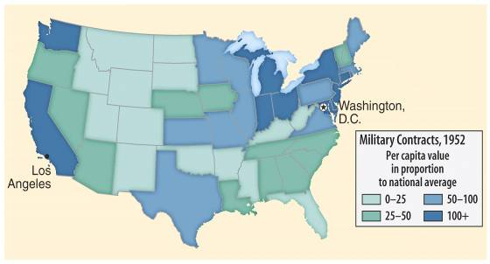
Military-Industrial Complex
This military-industrial complex is part of the reason for the Soviet demise in the late 1980s & end of the Cold War in 1991
In his farewell address in 1960, Eisenhower warned against the Military-Industrial Complex:
The massive military spending that dominate domestic & foreign politics

Slide 33
The Military-Industrial Complex
Until the latest of our world conflicts, the United States had no armaments industry. American makers of plowshares could, with time and as required, make swords as well. But now we can no longer risk emergency improvisation of national defense; we have been compelled to create a permanent armaments industry of vast proportions. Added to this, three and a half million men and women are directly engaged in the defense establishment. We annually spend on military security more than the net income of all United States corporations. This conjunction of an immense military establishment and a large arms industry is new in the American experience. The total influence…economic, political, even spiritual is felt in every city, every Statehouse, every office of the Federal government. We recognize the imperative need for this development. Yet we must not fail to comprehend its grave implications. Our toil, resources and livelihood are all involved; so is the very structure of our society. In the councils of government, we must guard against the acquisition of unwarranted influence, whether sought or unsought, by the military-industrial complex. The potential for the disastrous rise of misplaced power exists and will persist.”
“We must never let the weight of this combination endanger our liberties or democratic processes. We should take nothing for granted. Only an alert and knowledgeable citizenry can compel the proper meshing of the huge industrial and military machinery of defense with our peaceful methods and goals, so that security and liberty may prosper together.”

Slide 34
Conclusions
By 1960, the American people were more optimistic than in 1950
Americans were no longer afraid of a return of another Great Depression
Anxiety over the Cold War continued but was not as severe
But, American values & race relations were areas of concern

Slide 35
AP Prompt
Evaluate the extent to which US foreign policy during the early Cold War impacted the US’ role in the world, American identity, and the US economy from 1945-1960

Slide 36
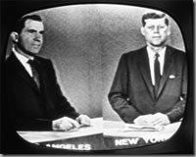
Election of 1960
John F. Kennedy (D)
Catholic
Lyndon Johnson as VP
Richard Nixon (R)
First nationally televised debate

Slide 37
JFK’s New Frontier
…the extension of Social Security…
Aid for public schools…
An increase in the minimum wage
…and medical insurance for the elderly were all shot down by Congress
JFK’s New Frontier promised a return of FDR-era liberal policies:
But, Conservatives in Congress opposed JFK’s social reforms in education & health care
Congress did help the poor
The modernization of industry, gov’t spending, & a major tax cut in 1963 stimulated the economy & created jobs
…unemployment benefits…
Increased funds for public housing

Slide 38
JFK’s New Frontier
One long-lasting achievement of the JFK-era was strengthening the presidency:
Eisenhower left many decisions to his staff, but JFK demanded more direct presidential control
JFK transferred much of the decision-making power from the cabinet to his White House staff
JFK appointed tough, pragmatic, & academic “New Frontiersmen” to his staff
Kennedy referred to his staff as the “the best & the brightest”

Slide 39
Kennedy Intensifies the Cold War
Addressing U.S. foreign policy & containing Communism was JFK’s top priority as president:
JFK believed Ike compromised with the USSR when the Cold War could have been won
JFK aimed to close the “missile gap” & increase U.S. defenses
Looked to solve issues in Berlin, Vietnam, & Cuba
“Let every nation know, whether it wishes us well or ill, that we shall pay any price, bear any burden, meet any hardship, support any friend, oppose any foe to assure the survival & success of liberty. We will do this & more.”
—JFK’s inaugural address

Slide 40
Flexible Response
JFK shifted from Ike’s “mutually assured destruction” to a “flexible response” capable of responding to a variety of future problems:
Increased nuclear arsenal to 1,000 ICBMs & 32 Polaris subs to create a “first-strike” capability
Increased the army & air force
Expanded covert operations & created the Green Berets
JFK was convinced that the USSR had more missiles, but really the U.S. had the lead with 600 B-52s, 2 Polaris subs, 2,000 warheads
To combat Communism & to help underdeveloped countries, JFK created the Peace Corps & the Alliance for Progress

Slide 41
Crisis over Berlin
JFK’s 1st confrontation with the Soviet Union came in Berlin:
Khrushchev was upset with the exodus of skilled workers from East Germany to West Berlin
The USSR threatened to remove all U.S. influence from West Berlin, but settled on building the Berlin Wall in 1961

Slide 42
Containment in Vietnam
Vietnam proved to be a tough test:
Since 1954, Communist leader Ho Chi Minh gained popularity in North Vietnam; By 1961, he gained a foothold in the South
The U.S. gave aid to unpopular South leader Ngo Dihn Diem
When Diem lost control of the South, JFK gave the OK for a coup against Diem in 1963
“Strongly in our mind is what happened in China at the end of World War II, where China was lost. We don’t want that.”
—JFK

Slide 43
Containing Castro: Bay of Pigs
Fidel Castro took over Cuba in 1959 & developed ties with Russia
The Eisenhower administration (directed by the CIA) had been training Cuban exiles for an invasion & overthrow of Castro
In 1961, JFK gave the OK for the CIA to initiate the Bay of Pigs invasion
JFK blamed the Republicans for allowing a “communist satellite” to arise on “our very doorstep”

Slide 44
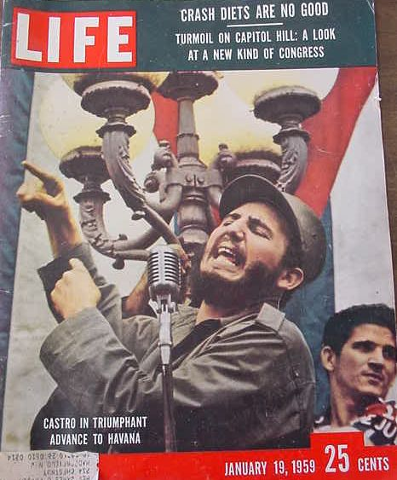
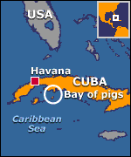
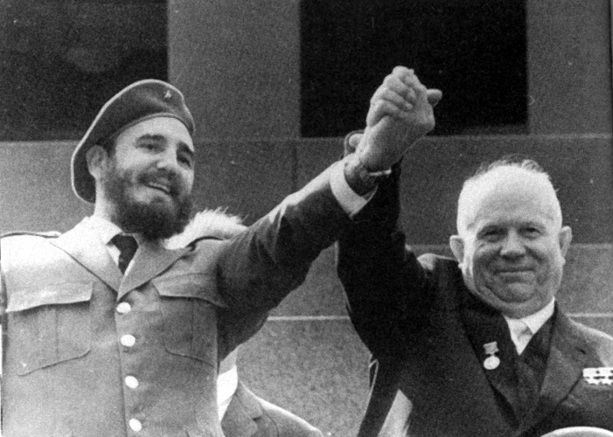
The invasion called for U.S. air support but JFK canceled the air strike; without air support, Castro squashed the invasion
Kennedy took full responsibility for the failure of Bay of Pigs, but did not apologize for coup

Slide 45
Cuban Missile Crisis
To protect Cuba from another U.S. invasion, the USSR began a secret build-up of nuclear missiles
On Oct 14, 1962 a U-2 spy plane discovered Cuban missile camps
How would the U.S. respond?
24 medium-range & 18 short range ICBMs
Immediate air strike?
Full-scale invasion?
Kennedy chose to “quarantine” Cuba to keep new missiles out & an invasion of Cuba if the USSR did not remove its nukes
Diplomacy: trade nukes in Cuba for nukes in Turkey?
Naval blockade to keep warheads out?

Slide 46
Cuban Missile Crisis
And…U.S. removal of nuclear weapons in Turkey
The standoff ended when Russia removed its Cuban missiles & the USA vowed to never invade Cuba
The impact of the crisis:
Seen as a political victory for JFK
Installed a “hot line” to improve US-Soviet communications
This near-nuclear war convinced both sides to move from confrontation to negotiation
“Our most basic common link is the fact that we all inhabit this planet. We all breathe the same air. We all cherish our children’s future. We are all mortal.”
—JFK

