Slide 1
Ideology and Issues
Mr. Winchell
AP GoPo
Unit 4: American Political Ideologies and Beliefs

Slide 2
Political Ideologies
A consistent set of political beliefs
Develop based on economic, political, and social issues
Political ideologies may change over time

Slide 3
Political Ideologies
Radical
Rapid fundamental changes; extreme methods such as revolution
Liberal
Supports political and social reforms; government regulations; minority support; equality
Moderate
More tolerant; shares liberal and conservative beliefs
Conservative
Support social and economic status quo; reluctant for change, and only gradual change; less government; liberty
Reactionary
Return to previous or historical system; extreme methods for accomplishment

Slide 4
The Political Spectrum as a Straight Line

Slide 6
Social/Political Spectrum
Extreme: Anarchy
Extreme: Fascism, Theocracy
Social and political liberals favor limited government regulation of individual behavior.
Examples:
Favor protection of offensive language.
Oppose censorship of film, music, etc.
Pro-choice abortion stance.
Oppose government sponsored religious activity.
Favor protection of homosexual rights.
Favor affirmative action programs.
Social and political conservatives favor broad government regulation of individual behavior
Examples:
Oppose protection of offensive language.
Favor regulation of film, music, etc.
Pro-life abortion stance.
Favor government-facilitated religious activity, particularly in school.
Oppose protection of homosexual rights.
Oppose affirmative action programs.
Notes:
Where do the parties align? Make sure students understand that these are all generalizations; nothing is hard and fast.

Slide 7
Economic Spectrum
Extreme: Socialism, Communism
Extreme: Laissez-Faire, Monopoly
Economic liberals favor broad government involvement in economic policymaking and regulation of business.
Favor higher taxes, particularly progressive (based on income level).
Programs assisting the poor such as Medicaid and Head Start.
Redistribution of income (welfare; social security).
Anti-trust legislation.
Sympathize with labor in Labor-Management issues.
Economic conservatives favor limited government involvement in economic policymaking and regulation of business.
Favor lower taxes, particularly regressive (flat tax, sales taxes).
Fewer programs with the goal of redistributing income (private charitable assistance; invest own money for retirement).
Oppose government regulation of market choices.
Sympathize with business in Labor-Management issues.

Slide 8
View of the constitution
Liberal
Conservative
Favor loose construction – a broad interpretation
Constitutional interpretation may change as modern society evolves
What are our standards today?
Favor strict construction – a narrow interpretation
Constitutional interpretation should remain constant through the years
What did the founders mean?

Slide 9
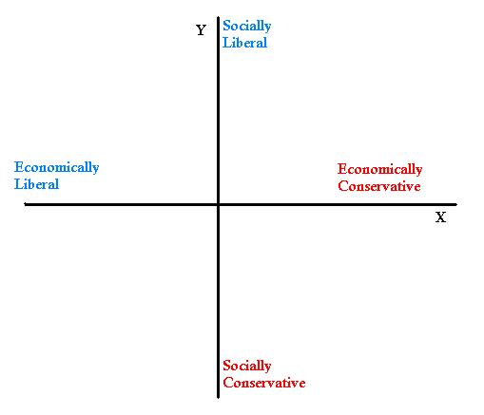

Slide 10
Definitions
Liberal
Support for greater government control/regulation in economic matters and less government control/regulation of individual matters.
Libertarian
Support for minimal government control of both economic and social issues
Conservative
Support for less government control/regulation in economic matters and greater government control/regulation of individual matters.
Authoritarian
Support for greater government control of economic and social issues

Slide 11
Tradition vs. change
Favor change over status quo
Favor tradition over change
Liberal
Conservative
Rights of the community are more important
Rights of the individual are more important
Community v. Individual

Slide 13
Putting It together Label your grid with these voters in the appropriate places.
Ideology?
Voter A: “I worked my way up from poverty to become the successful business owner I am today. I get frustrated when I think that my tax money goes to support people who won’t help themselves. I think part of the blame belongs with the media – they promote all the wrong values.”
Notes:
conservative

Slide 14
Putting It together Label your grid with these voters in the appropriate places.
Ideology?
Voter B: “I really don’t care what other people do in their free time, as long as they don’t bother me. I sure don’t like it when the government tells me what to do with my money or in my own home – I’m certainly not going to turn around and do the same thing to my neighbors.”
Notes:
libertarian

Slide 15
Two more to grid
Ideology?
Voter C: “I really worry about the state of the world today. It seems like more and more kids are growing up in poverty and there’s no one there to help them. I think we need to do more toward providing healthcare and education programs for our young people.”
Notes:
liberal

Slide 16
Two more to grid
Ideology?
Voter D: “These days, you can’t be too careful. I think we need to spend a lot more money on the national defense. I wish there was a police officer on every corner! The police could search my car all they want, since I don’t break the law. I also think the government should crack down on the media – their reporting gives our enemies an inside look at all our military preparations.”
Notes:
authoritarian

Slide 17
Ideology grid
Govt.
Control
Liberal
Authoritarian
Most people will fit somewhere within the parameters of this circle.
Economic Issues
Libertarian
Conservative
Govt.
Control
Freedom
Social/Political Issues

Slide 18
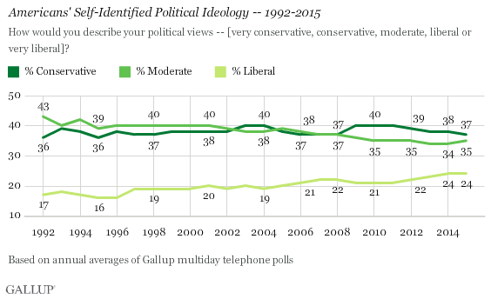

Slide 19
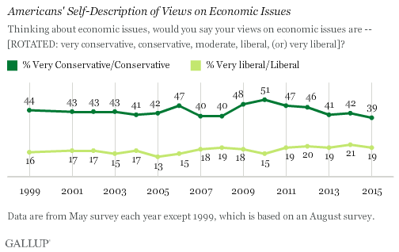

Slide 20
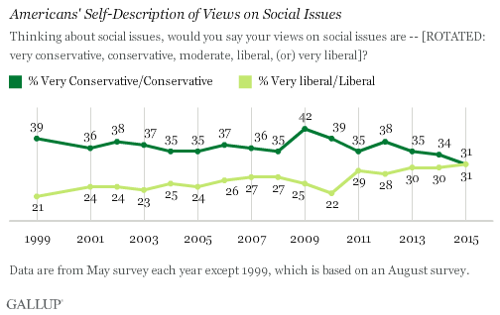

Slide 21
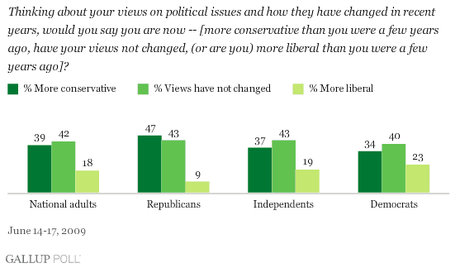

Slide 22
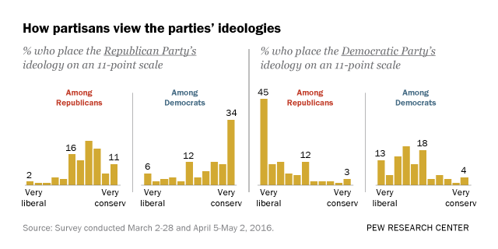

Slide 23
On American Issues
ISSUE | LIBERAL | CONSERVATIVE
Scope of Government | Large government to enforce liberties and equality | Limited government; states’ rights
Taxes | Increase for businesses and upper-class | Tax cuts for businesses and all classes
Government Spending | Increase to stimulate economy | Decrease to avoid debt; austerity policies
Defense Spending and Military | Decrease bureaucracy and spending | Increase for national security
Affirmative Action | Support and expand | Reduce or eliminate; “reverse racism”
Abortion | Pro-choice; include as part of health care | Pro-life; allowed only in cases of rape, incest, health of mother
Economy | Increased regulation; support Federal Reserve | Free enterprise and free market economy
Global Warming | Man-made consequence | Natural global cycle
Same-Sex Marriage | Support equality of marriage | Marriage between a man and woman; states decide
Global Affairs | Support the United Nations | American exceptionalism
Energy | Alternative and cleaner resources | Subsidies for natural gas, oil, coal
Social Security | Preserve the safety net | Needs reform; privatization
Health Care | Government-controlled low-cost care; single-payer option | Free market and private-run health care
Death Penalty | Inhumane | Crime deterrent
Immigration | Easier path to citizenship; multicultural | Secure the borders; English at official language
Prayer in Schools | Violates separation of church and state; secular government | Official practice; teach intelligent design
Global Market | Fair trade | Free trade
2nd Amendment (Right to bear arms) | Gun control | Gun rights
Equality | Fair chance | Equal opportunity

Slide 24
Why Does this Matter?
Ideology affects your perceptions of government and its appropriate role in a society.
As a result, it will affect how you act in the voting booth and outside the voting booth.
Elections have consequences!
Perceptions also affect our ability to act civilly to one another.

Slide 25
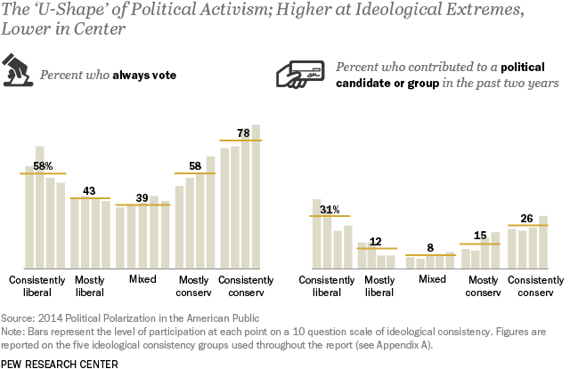

Slide 26
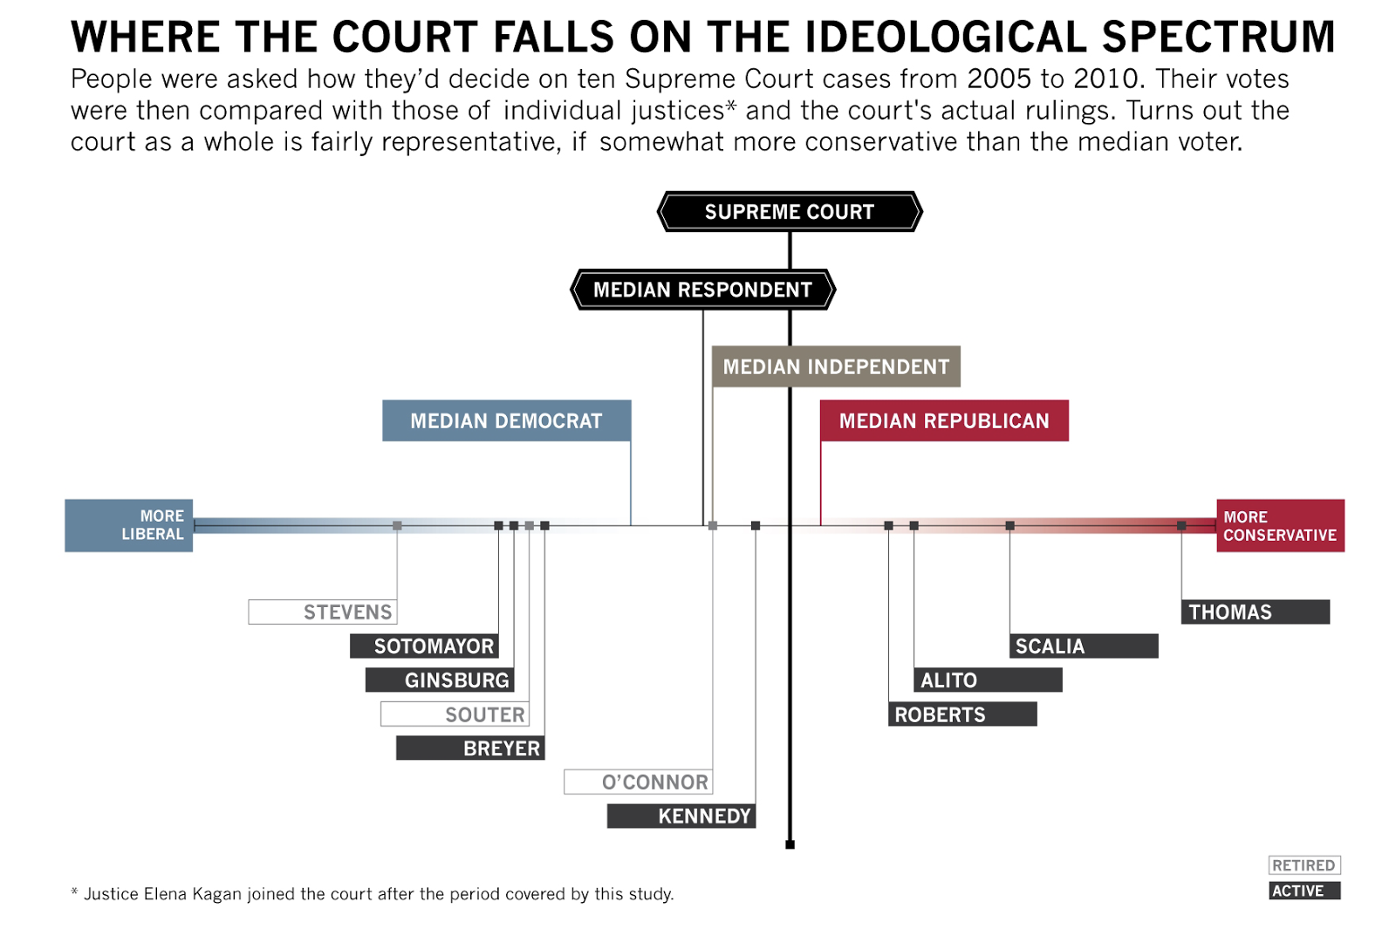

Slide 27
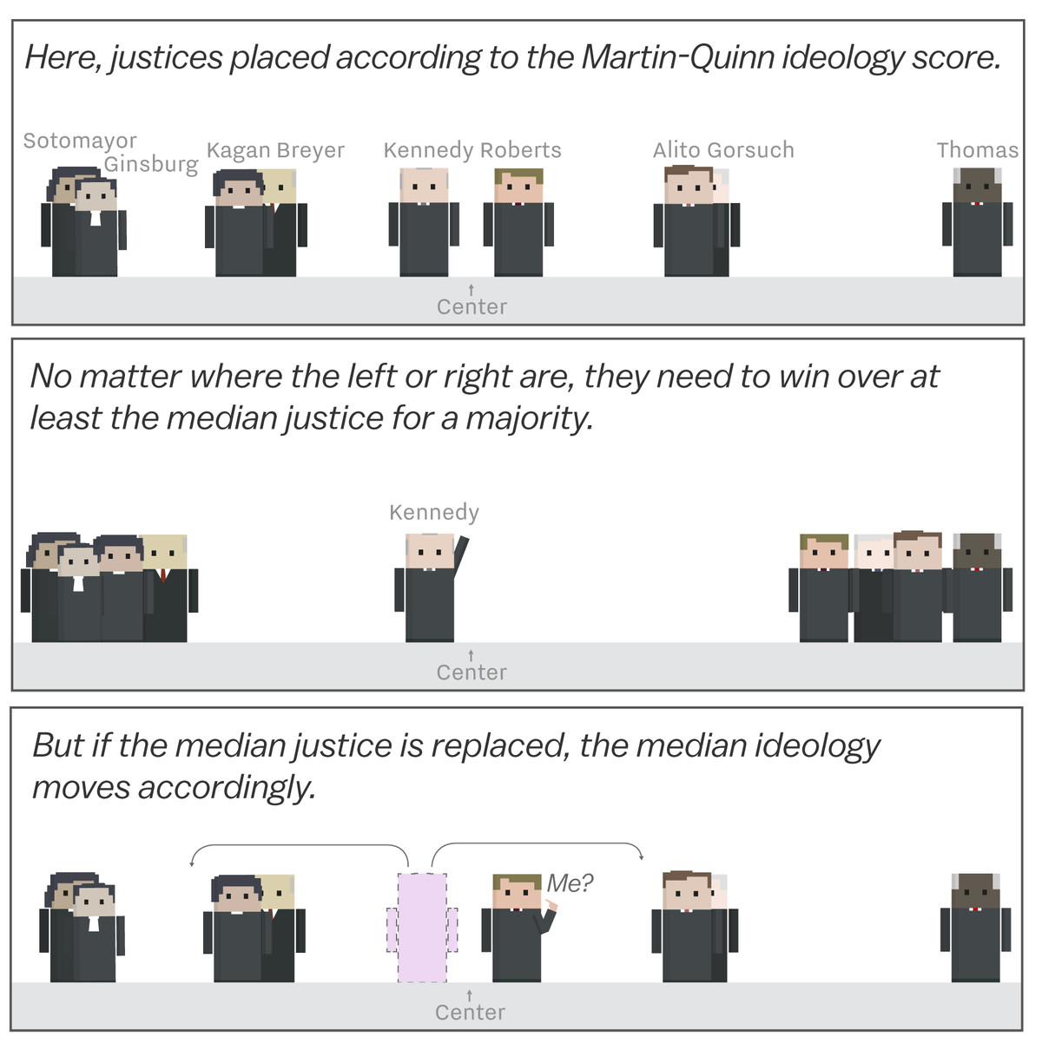

Slide 28
