Slide 1
Kennedy, Johnson and the Civil Rights Movement
Mr. Winchell
APUSH
Period 8

Slide 2
Discuss how the civil rights movement evolved during the 1950s and 1960s and explain each of the three developments.
For African Americans, the path from slavery to full civil rights was long and difficult. Several developments during the 1950s and 1960s legally guaranteed them full citizenship:
Montgomery Bus Boycott
Development:
Protests
sit-ins
24th Amendment
Civil Rights
for
African Americans
Development:
Warren Court
Development:
Johnson Presidency
Brown v. Board of Education
Voting Rights Act of 1965
Civil Rights Act of 1964

Slide 3
NAACP
SCLC
National Association for the Advancement of Colored People
Southern Christian Leadership Council
Civil Rights Organizations
Student Non-violent Coordinating Committee
Congress of Racial Equality
SNCC
CORE

Slide 4
The Jim Crow Era
Jim Crow laws created by state gov’ts legalized segregation:
  Poll taxes, literacy tests, & grandfather clauses were used to deprive blacks of voting rights
  Most blacks were sharecroppers
  KKK enforced racial inequality
In 1896, the Supreme Court declared “separate but equal” in the Plessy v Ferguson case

Slide 5
The Jim Crow Era
Civil rights leaders demanded black equality in the Jim Crow era:
  In the 1890s, WEB DuBois & Booker T Washington
  1909, NAACP was formed
  Marcus Garvey in 1910s
  Harlem Renaissance
The New Deal & military segregation in World Wars I & II promoted racial discrimination

Slide 6
The Jim Crow Era
The 1940s brought some success:
  The Great Migration helped break sharecropping in South
  In WW II, FDR created the Fair Employment Practices Committee
  A. Philip Randolph & “Double V”
  In 1947, Jackie Robinson became the 1st black major league baseball player

Slide 7
Civil Rights as a Political Issue
Truman was the 1st president to attempt to end any racial discrimination
  Created a new commission on civil rights in 1946
  Called for an end to lynching
  Truman’s lasting legacy was the desegregation of the armed forces in 1948
Notes:
Fair Employment Practices Commission (FEPC)

Slide 8
The Modern Civil Rights Movement (1954-1965)

Slide 9
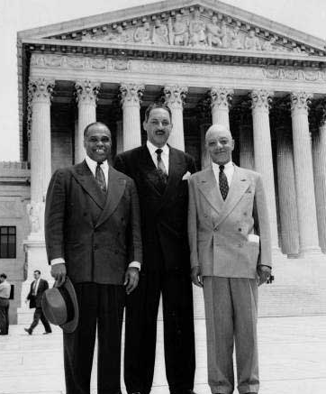
Desegregating the Schools
Even “equal” schools, if separate, inflict profound psychological damage to black children
Schools became the primary target of early civil rights advocates in the 1950s
  The NAACP 1st targeted unfair university graduate admissions
  Thurgood Marshall, a NAACP lawyer, used the 14th Am. to attack school segregation & Plessy v Ferguson precedent

Slide 10
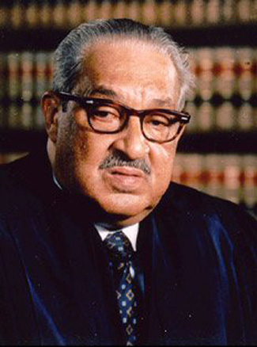
Desegregating the Schools
The Supreme Court’s unanimous decision in Brown v Board of Education (1954) ruled “separate facilities are inherently unequal”
  Called for desegregation at “deliberate speed” by states
  Border states complied quickly but the Deep South resisted—by 1960 less than 1% of blacks attended school with whites
But…Pupil Placement Laws allowed for separate schools based on “aptitude” & “morality”
Thurgood Marshall’s success in Brown made him the most famous black lawyer in America; In 1967, LBJ made him the 1st black justice to the Supreme Court

Slide 11
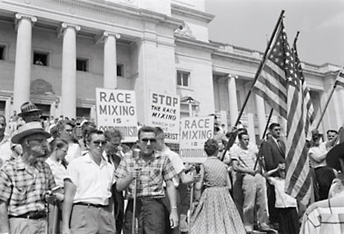
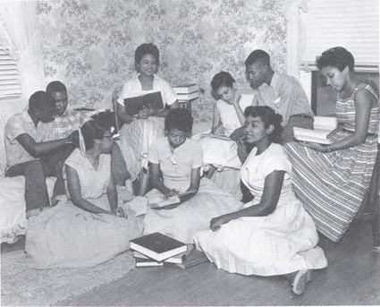
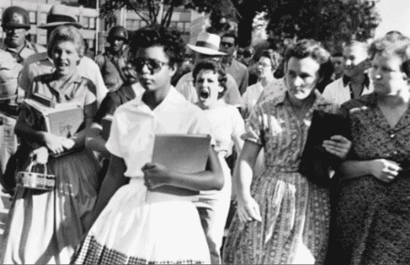
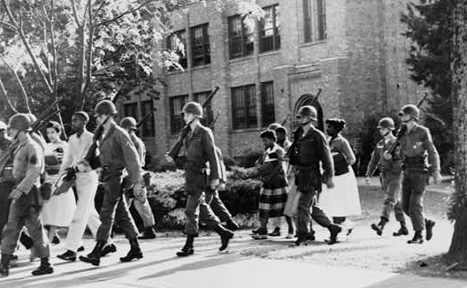
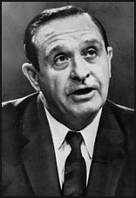
Integrating Central High School in Little Rock, Arkansas (1957)
Governor Orval Faubus

Slide 12
The Beginnings of Black Activism
Instead of waiting for the gov’t to help, blacks pressed the issue
Montgomery Bus Boycott (1955) began after the Rosa Parks arrest
  Effective carpool system forced buses to stop segregation
  Supreme Court ruled AL bus segregation unconstitutional
  This success led to the rise of MLK as a civil rights leader

Slide 13
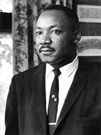
The Beginnings of Black Activism
“If cursed, do not curse back. If struck, do not strike back, but evidence love and goodwill at all times”
“We will match your capacity to endure suffering. We will meet your physical force with soul force. We will not hate you, but we will not obey your evil laws. We will wear you down by pure capacity to suffer.”
MLK’s popularity led to the formation of the Southern Christian Leadership Conference to directly attack segregation:
  MLK’s passionate oration inspired blacks to support cause
  Peaceful resistance & appeal to Christian love were the basis of these resistance efforts

Slide 14
The Beginnings of Black Activism
In 1960, students from NC A&T led a sit-in at a segregated lunch counter in Greensboro, NC:
  Inspired similar sit-ins, wade-ins, & kneel-ins across the South
  Led to the Student Nonviolent Coordinating Committee
SCLC & SNCC soon surpassed the NAACP for leadership of the civil rights movement
Nonviolent Protest
Legal Action
Nonviolent Protest
Notes:
() (legal action)

Slide 15
Not only were there sit-ins. . .
Swim-ins (beaches, pools)
Kneel-ins (churches)
Drive-ins (at motels)
Study-ins (universities)

Slide 16
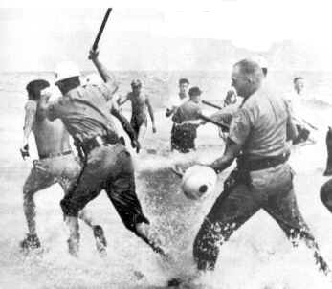
Swim-In

Slide 17
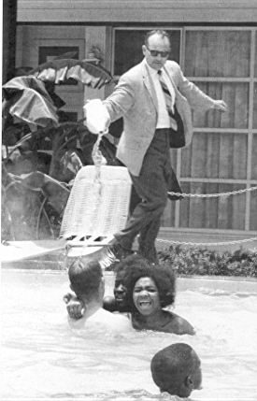
St. Augustine, Florida 1964 Swim In

Slide 18
Moving Slowly on Civil Rights
JFK campaigned for civil rights, but his fear of alienating southern Democrats forced a retreat:
  JFK deferred to Congress & sent his brother, Attorney Gen RFK, to help blacks in the South
  The Justice Dept helped with voting rights lawsuits, but the FBI could not protect civil rights activists in the South

Slide 19
Moving Slowly on Civil Rights
Civil Rights leaders refused to wait for JFK & the gov’t to respond
  Congress of Racial Equality led a freedom ride in 1961 to protest segregated buses
  Activists attempted to break a ban on black enrollment at Ole Miss & University of Alabama

Slide 20
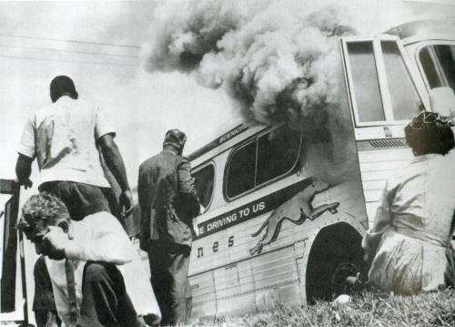
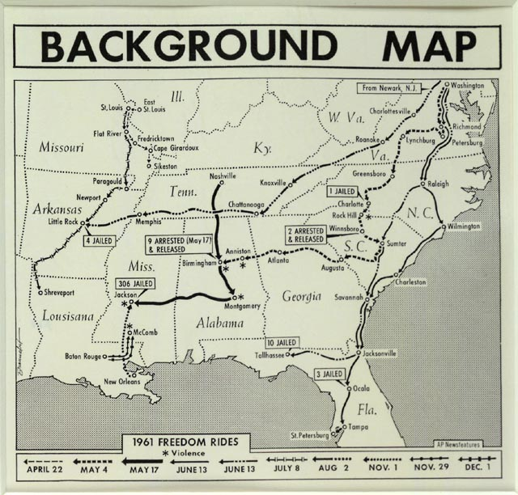
Freedom Rides, 1961

Slide 21
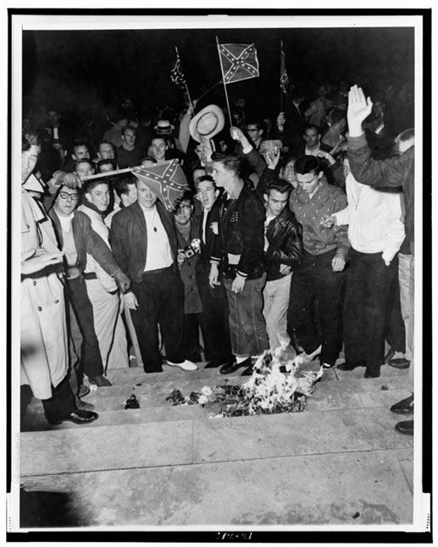
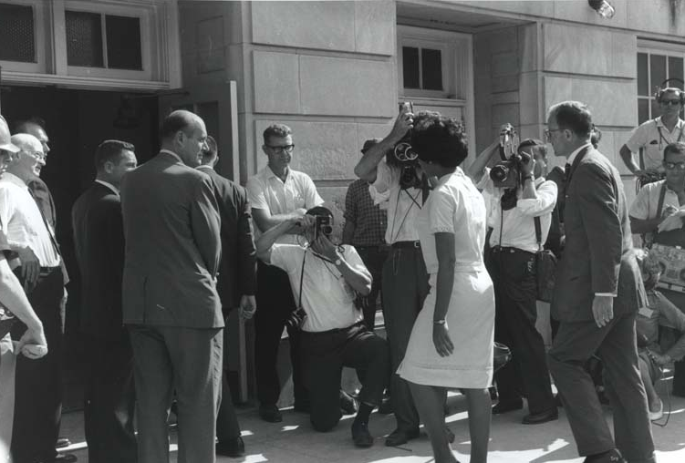
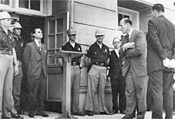
University of Alabama students burn desegregation notice
Alabama Governor George Wallace blocks black students’ entrance into University of Alabama

Slide 22
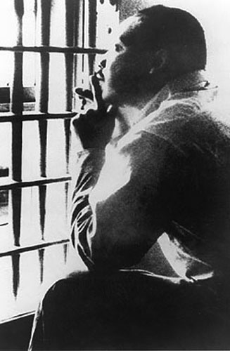
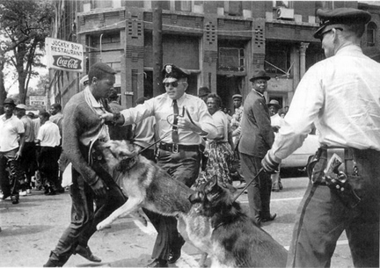
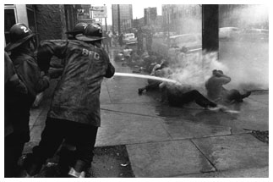
Birmingham Marches, 1963
MLK forced JFK to openly support the plight of African-Americans in 1963, via the Birmingham march
  Police commissioner “Bull” Connor used brutal force to end the protests & MLK was jailed
  Police brutality helped sway public sentiment & allowed JFK to begin civil rights legislation
MLK’s Letter From Birmingham Jail (1963) articulated the non-violent protest of the civil rights movement

Slide 23

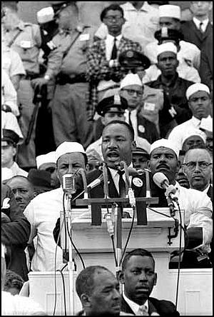
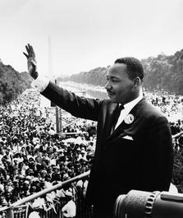
"I Have a Dream"
In 1963, CORE, SCLC, NAACP, & SNCC organized a March on Washington to pressure the gov’t to pass a civil rights act
200,000 civil rights protesters heard MLK give the “I Have a Dream” speech for racial equality
The Kennedy Administration responded by laying framework for a Civil Rights Act

Slide 24
Civil Rights under LBJ
Lyndon Johnson made civil rights the major component of his presidency:
  In 1964, the 24th Amendment was ratified banning poll taxes
  The Civil Rights Act of 1964 declared segregation in public facilities illegal & officially ended the majority of Jim Crow laws

Slide 25
Civil Rights Act of 1964
1963 - supported by President Kennedy; after his assassination, President Johnson called for its passage as a tribute to JFK
Outlawed segregation in businesses, banned discriminatory practices in employment on the basis of race, color, religion, sex and national origin, and ended segregation in public places

Slide 26
Civil Rights under LBJ
Civil rights groups were not content & continued for equality:
  Freedom Summer in 1964 led to the registration of thousands of Mississippi blacks to vote
  The 1965 protest march from Selma, Alabama to Montgomery led to police violence; “Bloody Sunday” shocked people in the North more than any other event

Slide 27
Civil Rights under LBJ
After the Selma march, LBJ & Congress passed the Voting Rights Act (1965)
  Banned literacy tests & sent federal voting officials into the South to protect voters
  The act finally accomplished what Radical Republicans had envisioned when the 15th Amendment was enacted in 1870

Slide 28
Voting Rights Act of 1965
Prohibits the use of voting laws, practices or procedures, such as poll taxes, literacy tests, intimidation…that discriminate in either purpose or effect on the basis of race, color, or membership in a minority language group

Slide 29
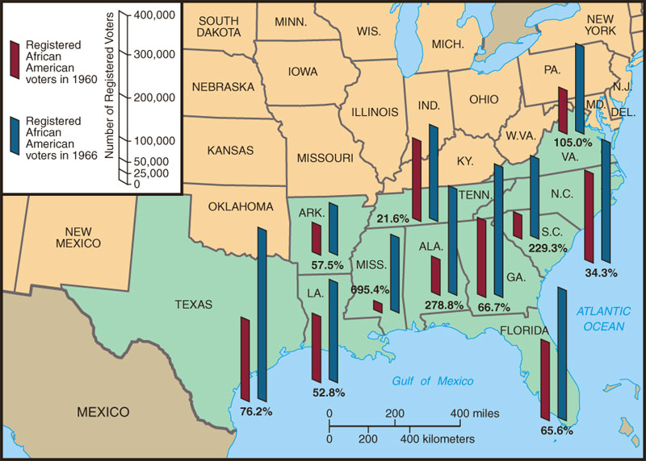
Black Voter Registration in South
Blacks became a voting force in Southern politics for the 1st time since Reconstruction

Slide 30
Conclusions
The Civil Rights movement of the 1950s & 1960s finally brought black Americans political equality
  The fight for social & economic equality saw a departure from nonviolent protest to a more radical movement in late 1960s
  Black civil rights success inspired other groups to strive for equality

Slide 31
Civil Rights Groups
National Association for the Advancement of Colored People (NAACP) - achieved victories and supported court cases to provide equal protection under the law and end segregation
Congress of Racial Equality (CORE) – used sit-ins to try and desegregate public facilities
Southern Christian Leadership Conference (SCLC) – attempted to eliminate segregation and encourage African Americans to register to vote

Slide 32
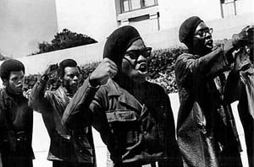
Black Panthers
Influenced by Malcolm X
Believed a revolution was
necessary in the United States to gain equality
Adopted a “Ten-Point Program” that called for black empowerment, an end to racial oppression, and control of major institutions and services in the African American Community
Openly carried weapons in public and were prepared to use violence

Slide 33
Martin Luther King, Jr. v. Malcolm X
MLK, Jr.
Raised in a middle class family
Earned a Ph.D. from Boston University
Advocated nonviolent direct action
Called for integration; whites supported and financed the movement
African Americans felt his protests were not assertive enough
Malcolm X
Emerged from the black underclass in northern ghettos
Dropped out of school
Advocated self defense
Wanted Blacks to love themselves and unite to control their communities
Black Muslims accused him of seeking personal glory

Slide 34
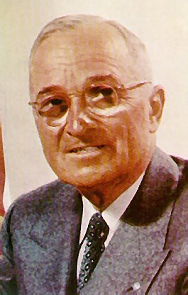
Civil Rights legal achievements
Harry Truman ordered the armed forces AND the government to be desegregated.

Slide 35
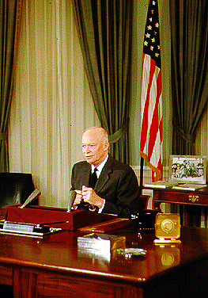
Dwight D. Eisenhower
Sent 101st airborne to Little Rock Central High School to maintain order

Slide 36
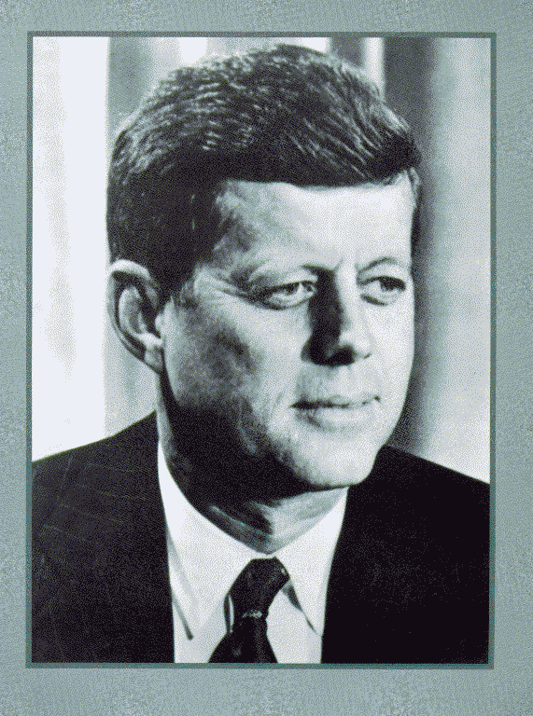
John F. Kennedy
Called Coretta Scott King to pledge support while MLK was in jail.
Eventually sent federal protection of freedom riders
Proposed need for civil rights legislation

Slide 37
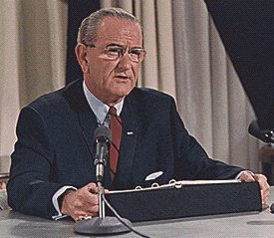
Lyndon Baines Johnson (LBJ)
Civil Rights Act of ’64
Civil Rights Act of ’68
Voting Rights Act of ’65
24th Amendment banning poll taxes

Slide 38
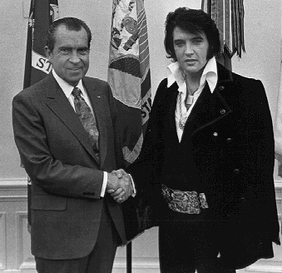
Richard Nixon 1969-1973
Nixon quietly pushed civil rights without much violence or headlines, especially housing discrimination

Slide 39
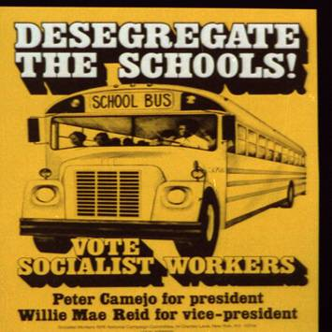
School Desegregation
In May 1954, the Warren Court issued its landmark ruling in Brown v. Board of Education of Topeka, stating racially segregated education was unconstitutional and overturning the Plessy decision.
White Southerners were shocked by the Brown decision.
Desegregate the schools! Vote Socialist Workers : Peter Camejo for president, Willie Mae Reid for vice-president.
Library of Congress Prints and Photographs Division Washington, D.C.; LC-USZ62-101452
Contents

Slide 40
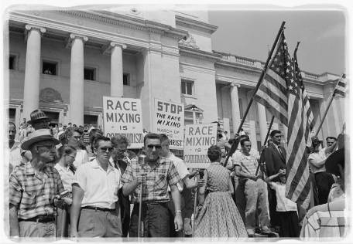
School Desegregation
Virtually no schools in the South segregated their schools in the first years following the Brown decision.
In Virginia, one county actually closed its public schools.
In 1957, Governor Orval Faubus defied a federal court order to admit nine African American students to Central High School in Little Rock, Arkansas.
President Dwight Eisenhower sent federal troops to enforce desegregation.
Protesters against integration in Little Rock, Arkansas, 1959
Contents

Slide 41
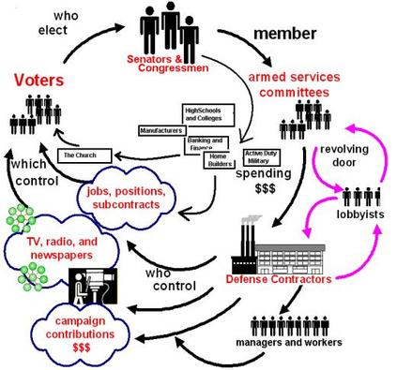
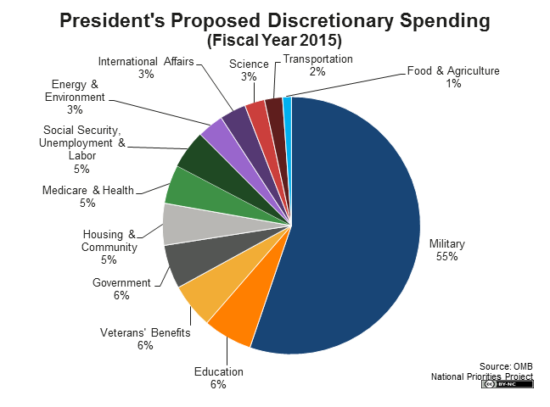
The Military-Industrial Complex
Until the latest of our world conflicts, the United States had no armaments industry. American makers of plowshares could, with time and as required, make swords as well. But now we can no longer risk emergency improvisation of national defense; we have been compelled to create a permanent armaments industry of vast proportions. Added to this, three and a half million men and women are directly engaged in the defense establishment. We annually spend on military security more than the net income of all United States corporations. This conjunction of an immense military establishment and a large arms industry is new in the American experience. The total influence ñ economic, political, even spiritual ñ is felt in every city, every Statehouse, every office of the Federal government. We recognize the imperative need for this development. Yet we must not fail to comprehend its grave implications. Our toil, resources and livelihood are all involved; so is the very structure of our society.In the councils of government, we must guard against the acquisition of unwarranted influence, whether sought or unsought, by the military-industrial complex. The potential for the disastrous rise of misplaced power exists and will persist.”
“We must never let the weight of this combination endanger our liberties or democratic processes. We should take nothing for granted. Only an alert and knowledgeable citizenry can compel the proper meshing of the huge industrial and military machinery of defense with our peaceful methods and goals, so that security and liberty may prosper together.”

