Slide 1
Do Now

Slide 2
Popular Sovereignty and the Politics of Slavery-The Kansas Nebraska Act and the Aftermath
Mr. Winchell
APUSH
Period 5

Slide 3
Key Concepts

Slide 4
AP Prompt

Slide 5
Outline
End of Compromise
Kansas and Popular Sovereignty
Dred Scott
Sectional Gaps Widen
Lincoln Douglas Debates

Slide 6
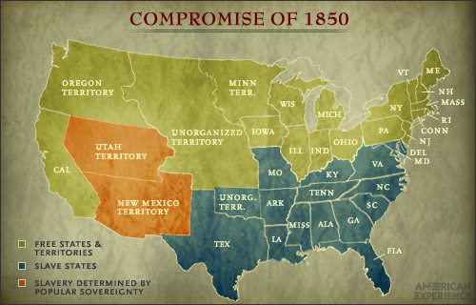
The United States in 1850

Slide 7
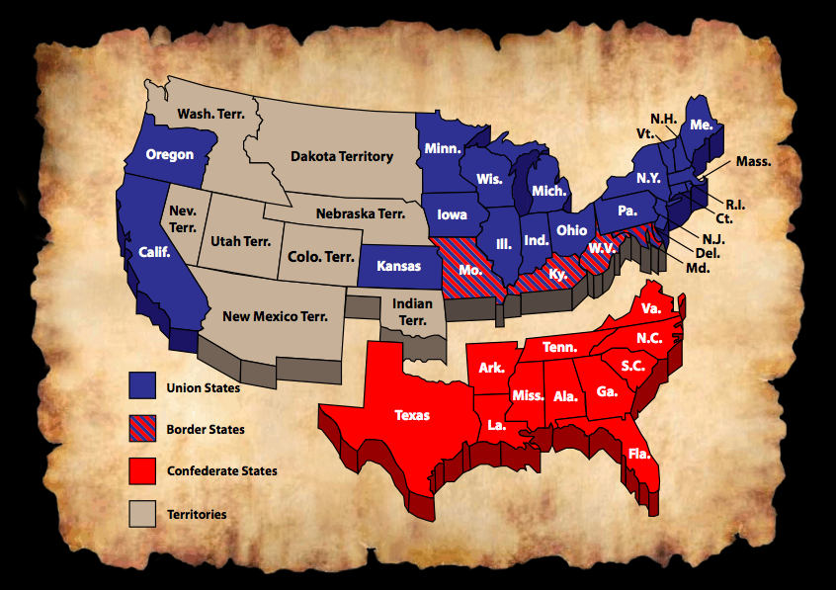
The Disunited States in 1861

Slide 8
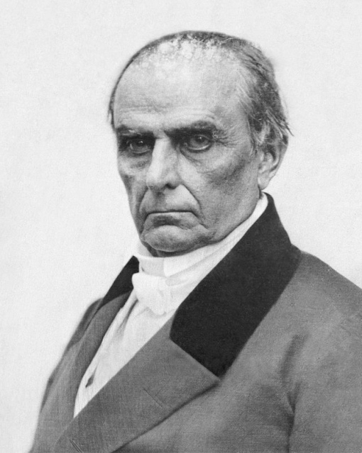
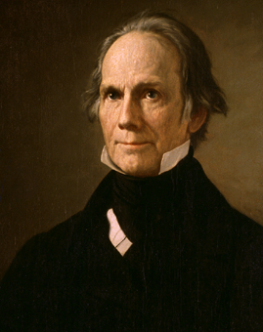
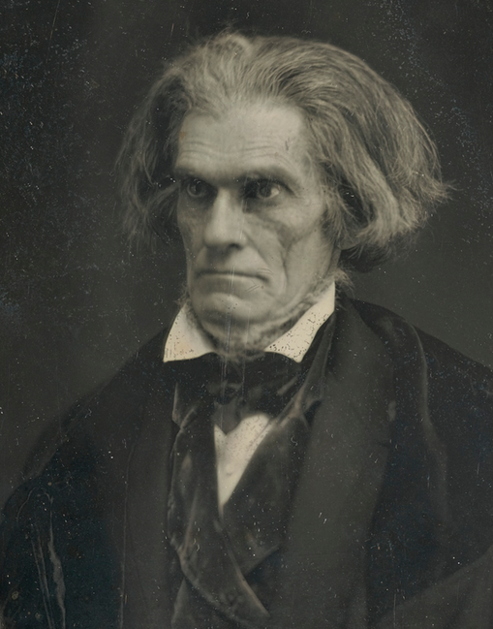
End of the “Great Triumvirate”
Daniel Webster
North
Died 1852
Henry Clay
West
Died 1852
John C. Calhoun
South
Died 1850

Slide 9
Sectionalism & Compromise to 1850
Constitutional Convention
3/5 Compromise
Slave trade compromise
Early Republic
Formation of first two political parties
First Nullification Crisis (Alien & Sedition Acts)
Hartford Convention (War of 1812)
Missouri Compromise of 1820 (36°30’ line)
Jacksonian Era
Second Nullification Crisis (Tariff of Abominations of 1828, Force Bill & Compromise Tariff of 1833)
Jackson’s Bank War (“pet banks”)
Disagreements over federal funding of internal improvements (roads & canals)
Manifest Destiny
Texas Annexation
Mexican War
“Spotty Lincoln”
Thoreau’s Civil Disobedience
Wilmot Proviso
Compromise of 1850
California (free state)
Slave trade banned in D.C.
New fugitive slave act
Popular sovereignty in S.W.

Slide 10
Daniel Webster
Believed first and foremost in national unity
“Liberty and Union, now and forever, one and inseparable”
Criticized Federalist secessionists during War of 1812
Opposed Calhoun and Hayne during 1828-1833 nullification crisis
Prosecuted northern violators of the Fugitive Slave Act

Slide 11
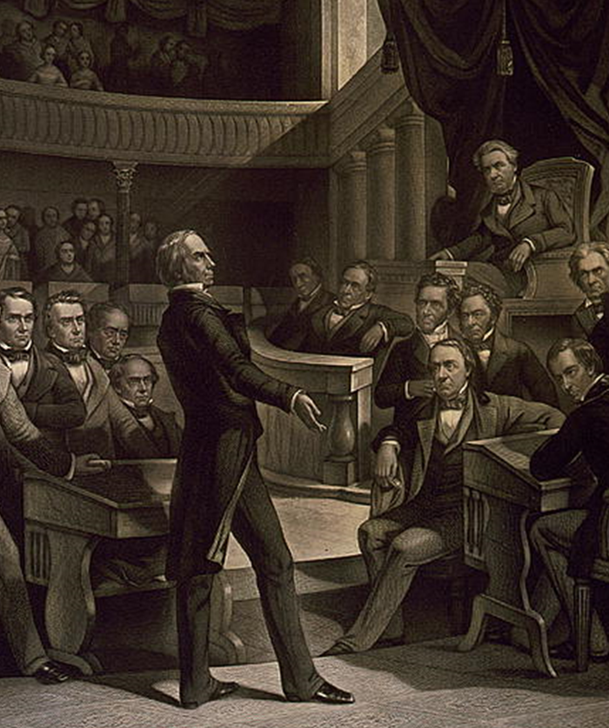
Henry Clay’s Compromises
Missouri Compromise, 1820
Settled issue of slavery in Louisiana Purchase
Tariff Compromise, 1833
Ended S.C. Nullification Crisis
Compromise of 1850
Settled issue of slavery in Mexican Cession

Slide 12
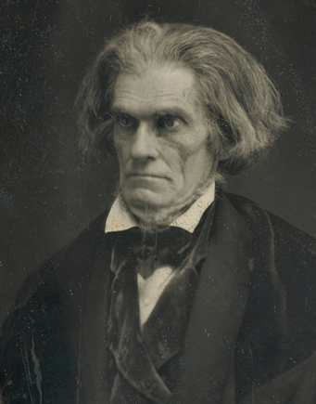
John C. Calhoun
Vigorous defender of slavery and states’ rights
Backed down from tariff crisis of 1828-1833
Opposed Compromise of 1850

Slide 13
Northerners Violate the Fugitive Slave Act
Harriet Beecher Stowe
Uncle Tom’s Cabin, 1852
Created northern sympathy for slaves
Abolitionist newspapers
Frederick Douglass’ The North Star
William Lloyd Garrison’s The Liberator
Underground Railroad
Aided slaves to freedom
Harriet Tubman
Activity increased in 1850s
Some northerners ignored or nullified the 1850 Fugitive Slave Act
Hinton R. Helper
The Impending Crisis of the South, 1857
Argued that slavery harmed the south

Slide 14
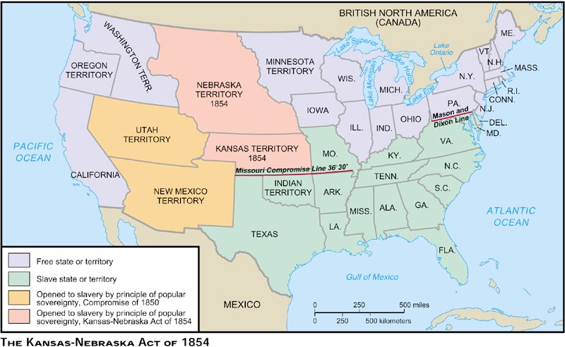
Kansas-Nebraska Act, 1854

Slide 15
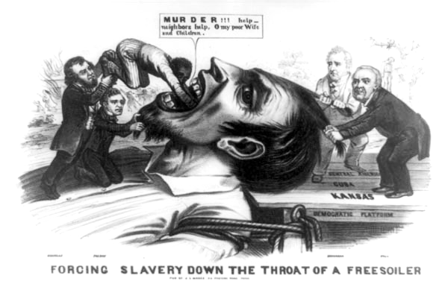

Slide 16
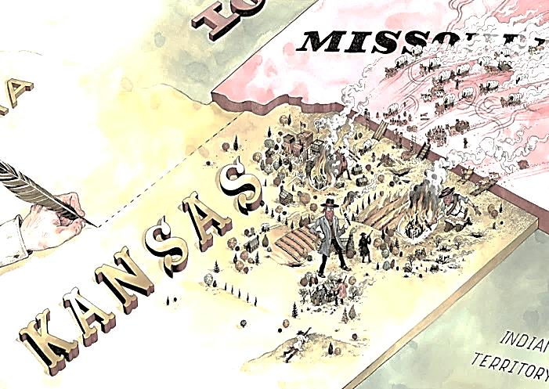
Pro-Slavery Border Ruffians

Slide 17
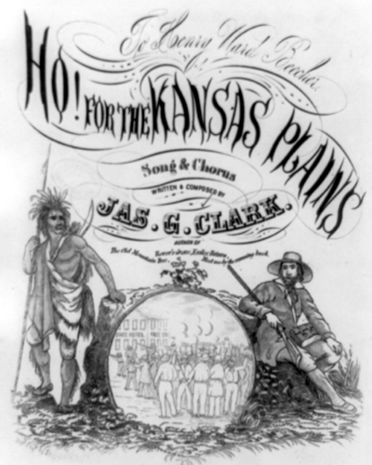
Anti-Slavery New England Emigrant Aid Company
Aided Free-Soilers who wanted to move to Kansas

Slide 18
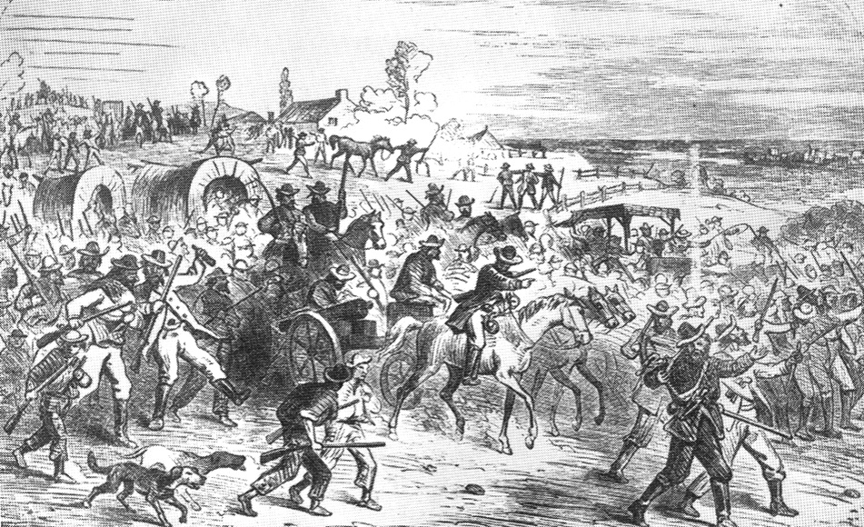
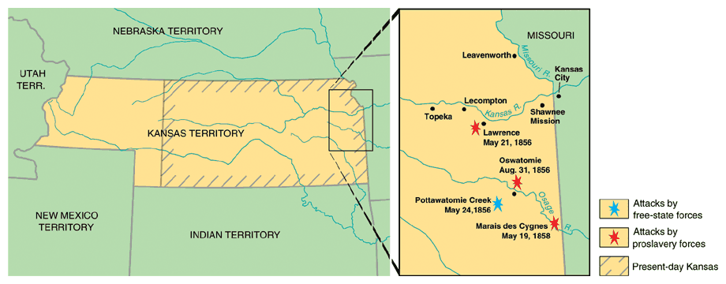
“Bleeding” Kansas
Anti-slavery and pro-slavery forces both organized in opposition to each other, leading to violence.
Ex: Proslavery men (800) burned down the Abolitionist headquarters, printing presses, and looted homes/stores in Lawrence (anti-slavery town) – called the Sack of Lawrence.
John Brown (abolitionist who stated God had sent him to fight slavery) - attacked the settlement of Pottawatomie and killed 5 men.
Known as the Pottawatomie Massacre - led to more violence and guerilla warfare (200+ deaths as a result!).
Nicknamed Bleeding Kansas!
Lecompton Constitution v. Topeka Constitution (1856)

Slide 19
“Bleeding” Kansas bleeds into Washington DC
May 1854 - Violence from Bleeding Kansas makes its way to DC!
Sen. Charles Sumner (Mass) gave a speech attacking slavery.
Sen. Andrew Butler (SC) a slavery defender - enraged by the speech.
A few days later… Butler’s nephew (Preston Brooks) attacks Sumner on the floor of the Senate with a cane until he was unconscious – known as the Sumner Caning.
Sumner - injured so severely that he couldn’t return to the Senate for four years.
Both Sumner and Brooks became heroes in their own regions (N & S).
Violence over slavery is everywhere and further splits the N and S.

Slide 20
Brooks-Sumner Incident May 22, 1856
Senator Charles Sumner (R) (MA)
‘Crime Against Kansas’ Speech
Rep. Preston Brooks (D) (SC)
Becomes a Southern hero
Enjoy!

Slide 21
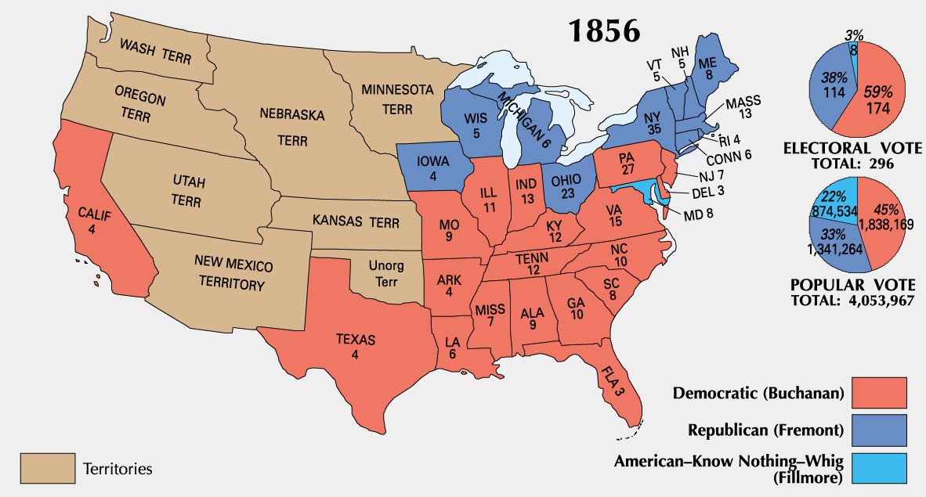
The Election of 1856
Franklin Pierce – not popular due to “Bleeding Kansas.”
Democrats - nominate James Buchanan.
Republicans - nominated John C Fremont .
Whig Party and Know-Nothing Party alliance - nominated Millard Fillmore.
Buchanan wins - who won with only 45% of the popular vote (3rd party ticket election).
Buchanan - timid and indecisive…would be one of the weakest Presidents (not good in a time of national crisis.
Rep’s stick around, Know-nothings decline – nation is still split N and S.

Slide 22
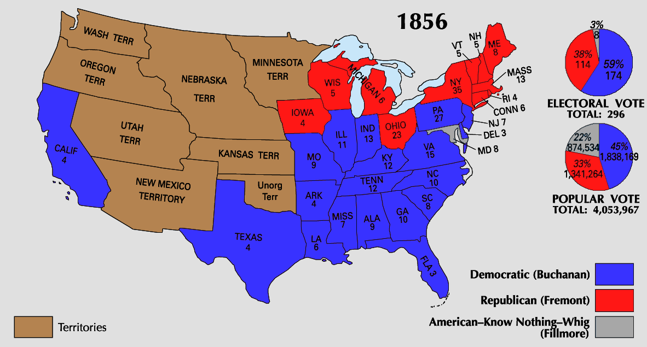
The Election of 1856
Southerners were relieved by the victory but were threatened by the existence of a party devoted to ending slavery
Northerners realized that the free-states had a large majority in the Electoral College so a Republican could become president by only campaigning in the North

Slide 23
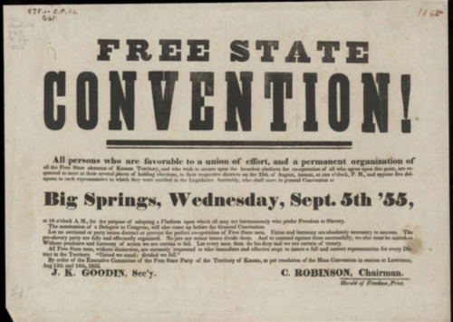
Back In Kansas - The Lecompton Constitution
Proslavery government (in Lecompton) - wrote a constitution that protected slavery.
Voted down by Free-soilers (greatly outnumbered slave supporters).
Pres. Buchanan - supported Lecompton Constitution.
Stephen Douglas angry! – pro popular sovereignty.
Douglas - convinced Congress to authorize another referendum (population vote) on the Lecompton Constitution - voted down again.
Northern Democrats - Douglas is a hero!
Southern Democrats - Douglas is a traitor!
Kansas was eventually admitted as a free state in 1861.

Slide 24
The New Order: Sectional Parties
Free-Soil Party, 1848-1854
Homestead act for settlers in west
Opposed expansion of slavery
Know-Nothing Party, 1845-1859
Opposed immigration
Death of Whig Party after loss in 1852 election
Ostend Manifesto, 1854
Buchanan’s proposal to add Cuba as a slave state
Kansas-Nebraska Act, 1854
eventually shattered Democrats into northern and southern wings
united Free-Soilers, Know-Nothings, old Whigs and others into the new, northern Republican Party
Sectional developments
Low Tariff of 1857, Panic of 1857, and weak president James Buchanan tarnished Democrats
John Brown’s raid on Harper’s Ferry raised southern fears

Slide 25
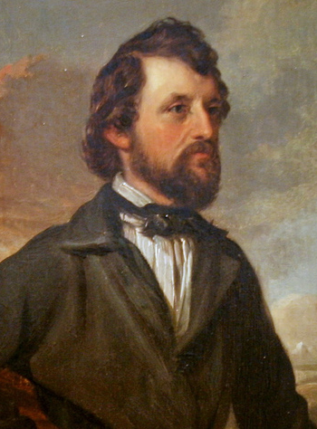
Birth of the Republican Party, 1854
Opponents of KS-NE Act
Northern Whigs
Free-Soilers
Know-Nothings (by 1860)
Republican Party
Industri-alists
John C. Fremont

Slide 26
The Republican Party
Makeup
Disillusioned Northern Democrats
Frustrated Conscience Whigs
Free Soil Party members
Platform:
Increasingly against expansion of slavery
Protective tariffs
Homestead Act/sale of federal lands
Funding for transcontinental railroad

Slide 27
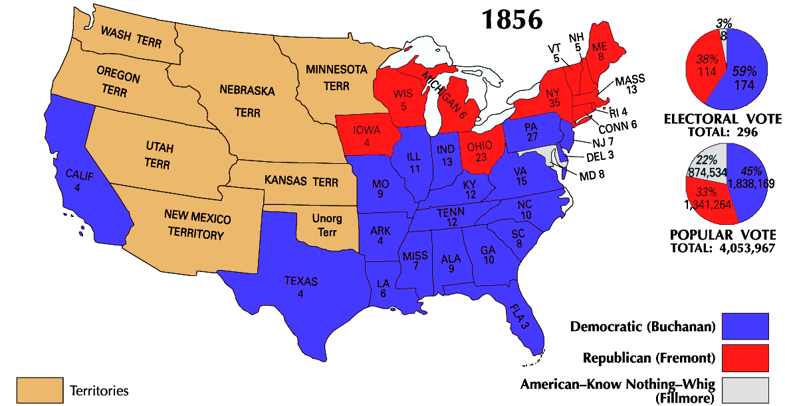
The election of 1856 was the first time in which political parties represented regions of the country, not the nation
Slavery became the most important political issue in American politics
Republicans in the North
Democrats in the South
Even though the Republicans lost in 1856, they realized that they had enough electoral votes to win the presidency without Southern support

Slide 28
Hinton R. Helper
The Impending Crisis of the South, 1857
Southerner
Argued that slavery was detrimental to the south
Slaveholders oppressed poor whites as well as blacks
Plantation system stymied economic development

Slide 29
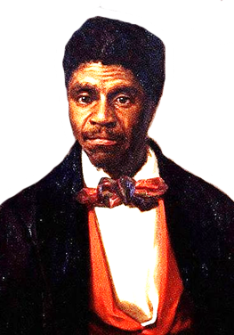
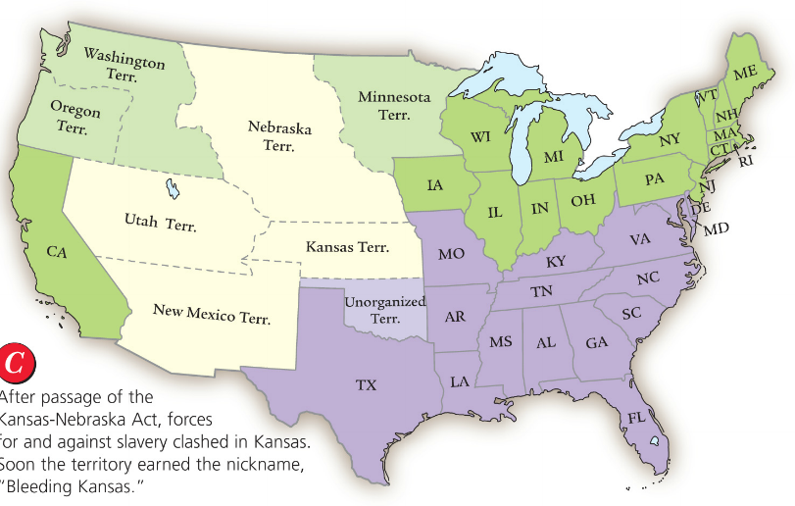
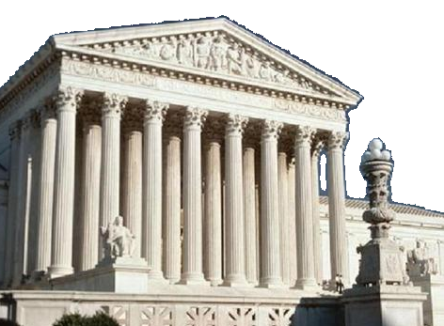
In 1857, a slave named Dred Scott sued for his freedom after traveling with his master from Missouri to Wisconsin
The Dred Scott case presented the Supreme Court with two questions
Does Congress have the power to decide on slavery in the territories?
Is the Missouri Compromise constitutional?

Slide 30
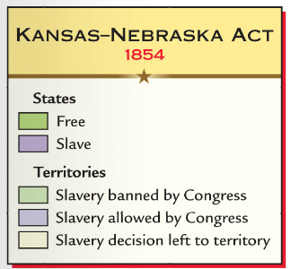
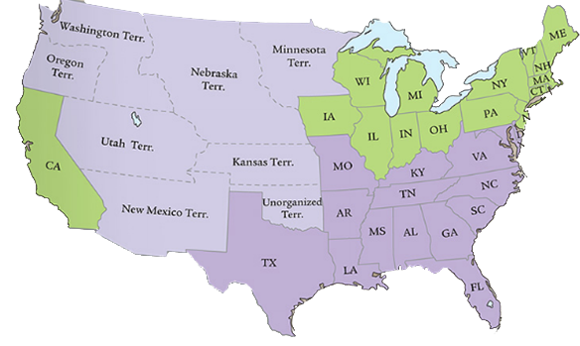
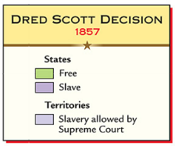
In Dred Scott v. Sanford (1857), the Supreme Court ruled
Dred Scott had no right to sue because blacks are not citizens
Congress did not have the power to stop slavery in western territories so the Missouri Compromise was unconstitutional
Northern abolitionists were furious

Slide 31
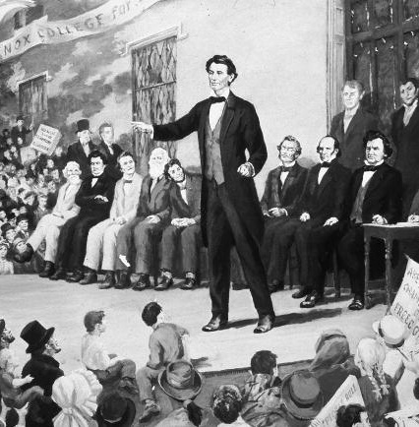
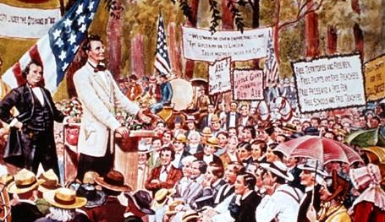
In 1858, Democrat Stephen Douglas ran against Republican Abraham Lincoln for the Illinois Senate
Lincoln was unknown at the time, but during the campaign he argued that Congress must stop the spread of slavery (free soil argument)
Lincoln lost the Senate election, but his argument against slavery made him a popular national figure
“A house divided against itself cannot stand. I believe this gov’t cannot endure, permanently half slave and half free.” —Abraham Lincoln, 1858

Slide 32
Lincoln-Douglas Debates (1858)
“A House Divided” - Abraham Lincoln
Freeport Doctrine - Stephen A. Douglas
If we could first know where we are and whither we are tending, we could better judge what to do and how to do it. We are now far into the fifth year since a policy was initiated with the avowed object and confident promise of putting an end to slavery agitation. Under the operation of that policy, that agitation has not only not ceased but has constantly augmented. In my opinion, it will not cease until a crisis shall have been reached and passed. "A house divided against itself cannot stand." I believe this government cannot endure, permanently, half slave and half free. I do not expect the Union to be dissolved; I do not expect the house to fall; but I do expect it will cease to be divided. It will become all one thing, or all the other. Either the opponents of slavery will arrest the further spread of it and place it where the public mind shall rest in the belief that it is in the course of ultimate extinction, or its advocates will push it forward till it shall become alike lawful in all the states, old as well as new, North as well as South.
The next question propounded to me by Mr. Lincoln is, can the people of a Territory in any lawful way, against the wishes of any citizen of the United States, exclude slavery from their limits prior to the formation of a State Constitution? I answer emphatically, as Mr. Lincoln has heard me answer a hundred times from every stump in Illinois, that in my opinion the people of a Territory can, by lawful means, exclude slavery from their limits prior to the formation of a State Constitution. Mr. Lincoln knew that I had answered that question over and over again. He heard me argue the Nebraska bill on that principle all over the State in 1854, in 1855, and in 1856, and he has no excuse for pretending to be in doubt as to my position on that question. It matters not what way the Supreme Court may hereafter decide as to the abstract question whether slavery may or may not go into a Territory under the Constitution, the people have the lawful means to introduce it or exclude it as they please, for the reason that slavery cannot exist a day or an hour anywhere, unless it is supported by local police regulations. Those police regulations can only be established by the local legislature, and if the people are opposed to slavery they will elect representatives to that body who will by unfriendly legislation effectually prevent the introduction of it into their midst. If, on the contrary, they are for it, their legislation will favor its extension. Hence, no matter what the decision of the Supreme Court may be on that abstract question, still the right of the people to make a slave Territory or a free Territory is perfect and complete under the Nebraska bill. I hope Mr. Lincoln deems my answer satisfactory on that point.

Slide 33
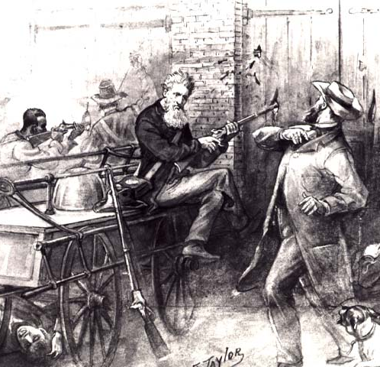
John Brown at Harpers Ferry, 1859
Failed effort to incite a slave uprising
Brown was executed
South began militia drills, preparing for civil war

Slide 34
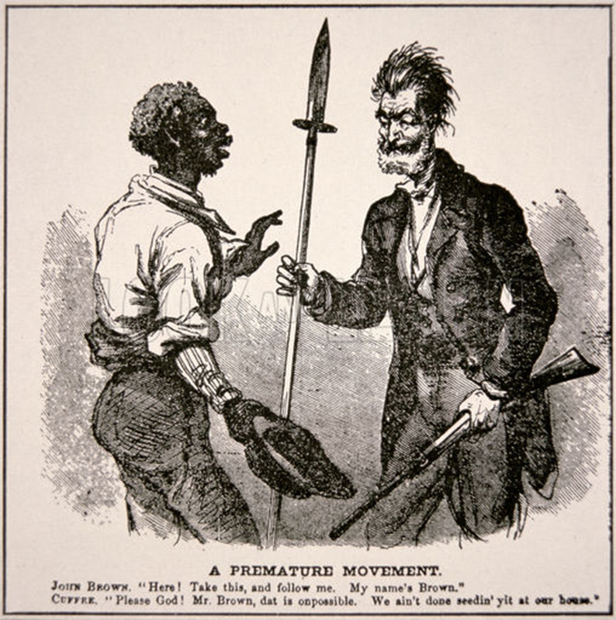
John Brown: Too Soon?

Slide 35
Sectionalism in the Antebellum Era
These regional differences increased sectionalism–placing the interests of a region above the interests of the nation
1820-1850: Sectionalism was mild & resolved by compromise
1850-1856: The growth of abolitionism & westward expansion intensified the question of the “morality” of slavery
1856-1860: The slave issue became “irreconcilable” & led to the Civil War

Slide 36
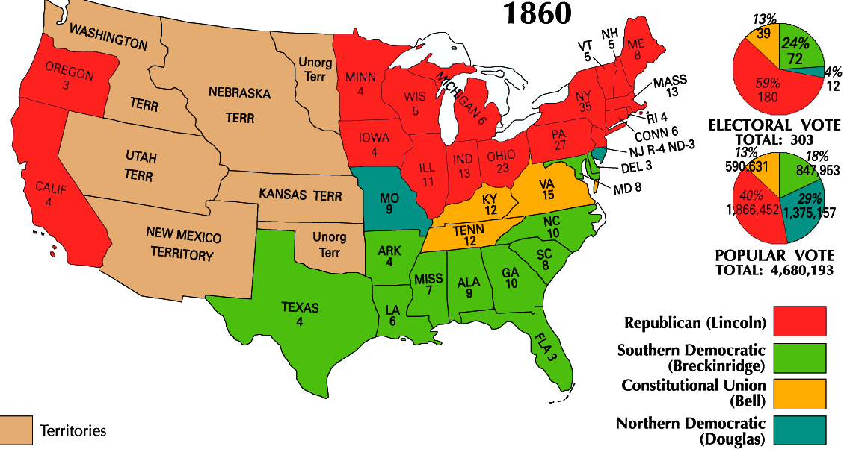
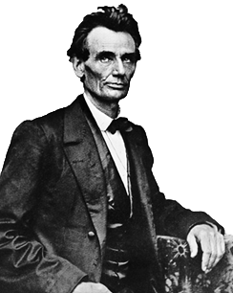
The Election of 1860 was the final straw for the South
Republicans nominated Abraham Lincoln who argued for “free soil” and a strong national gov’t
Democrats in the North and South were split over the issue of slavery
Northern Democrats nominated Stephen Douglas who argued for popular sovereignty
Southern Democrats nominated John Breckenridge who argued for states rights and the protection of slavery

Slide 37
Political Upheaval in the 1850s
Dred Scott decision in 1857
The Lecompton Controversy in 1857
Lincoln-Douglas debates in 1858
John Brown’s raid on Harper’s Ferry in 1859
Manifest Destiny intensified sectional differences between the North & the South regarding slavery in the 1840s & early 1850s
But…the sectional quarrel between the North & the South became “irreconcilable” in the mid-1850s, especially under James Buchanan (1857-1860)
Impending Crisis in 1857
Lincoln’s election in 1860
Texas & Oregon in 1845 & 1846
The Mexican Cession in 1848
Popular sovereignty & the Kansas-Nebraska Act in 1854
The Compromise of 1850

