Slide 1
Do Now
‘Stop and Jot…’
Read and annotate the quick intro essay on new government in the new United States and respond in the margins:
Similarities in the Articles of Confederation & Constitution
Differences in the Articles of Confederation & Constitution

Slide 2
Lecture Starter
OPINION-Can a nation be too democratic?
What features of the British government are the newly independent Americans going to avoid? Why?

Slide 3
The Challenges of New Government: The Articles of Confederation & Shays’ Rebellion
Mr. Winchell
APUSH Period 3

Slide 4
AP Prompt
Evaluate the extent to which the government under the Articles of Confederation solved the problems identified by the colonists in the Declaration of Independence.

Slide 5
Key Concepts
3.2.II.B-
The Articles of Confederation unified the newly independent states, creating a central government with limited power. After the Revolution, difficulties over international trade, finances, interstate commerce, foreign relations, and internal unrest led to calls for a stronger central government.

Slide 6
Refresher
Identify w/ your partner…the 5 MOST important events that have taken place in our study of US History UP TO this point.
Now tie them together

Slide 7
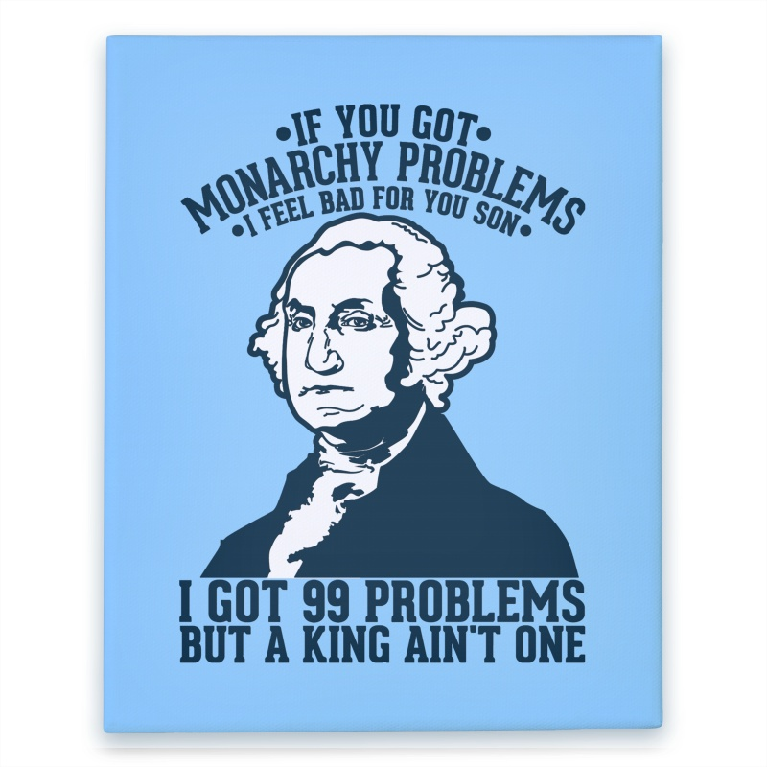

Slide 8
The war is over, now what?
“Which one of us should be the rulers?”
-Philadelphia newspaper during the war

Slide 9
Articles of Confederation
Outset of the war, 2nd Continental Congress urged states to create their own constitution.
“Oppose everything that leans to aristocracy or power in the hands of the rich”

Slide 11
America after the Revolution
Local ties remain predominant.
Most Americans still consider themselves as citizens of their states, not as Americans.
Belief that the sovereignty of the state was more important than that of the power of the central government.
Would prove to be a problem later.

Slide 12
Pennsylvania
Pennsylvania Constitution of 1776
Unicameral Legislature
One house with complete power.
No governor
Elementary education provided by state gov.
NO property requirement to serve
John Adams: “TOO MUCH DEMOCRACY!”

Slide 13
Thoughts on Government-Adams
In response to state governments, Adams publishes his thoughts in 1776:
3 branch government (what a concept…)
2 houses in the legislature
Judiciary appointed, not elected.

Slide 14
Thoughts on Gov -Adams Quote 1
“A single assembly is liable to all vices of an individual, subject to fits of humor, starts of passion…and all these errors ought to be corrected and defects supplied by some controlling power.”
What problem with representative government is Adams pointing out? Is his concern legitimate?

Slide 15
Thoughts on Gov -Adams
“A single assembly is apt to grow ambitious, and after a time will not hesitate to vote itself perpetual.”
What problem with representative government is Adams pointing out? Is his concern legitimate?

Slide 16
Thoughts on Gov -Adams
“A representative assembly, although extremely well qualified, and absolutely necessary, as a branch of the legislative, is unfit to exercise the executive power.
What problem with representative government is Adams pointing out? Is his concern legitimate?

Slide 17
Problems after the War
The 2nd Continental Congress faced numerous issues in the final years of the war.
1. The former colonies (now states) needed a new form of government.
They chose a republic (representative democracy) but had no modern day example to follow.
2. What laws would govern the land?
Every state had some type of constitution, but could all 13 states agree on which one to choose?

Slide 18
Problems after the War
3. State Representation and Sharing of Power
How would the states be represented in the new national government? Equally or by population?
Who would have more power and authority? The states? Or the national govt?
4. Land Issues and Debt
Who owned and controlled new land in the west? How would the nation and states pay their debts to citizens and foreign countries?

Slide 19
Major Features of the Articles

Slide 20
Weaknesses of the Articles
Provided a weak national government
Congress had no power to tax or regulate trade between the states
Provided for no common currency (money)
Gave each state one vote, regardless of size/pop
Provided for no executive or judicial branches (no president or national court system)

Slide 21
Successes of the Articles of Confederation
Land settlement was the only real success of the AoC.
Land Ordinance of 1785
Since the govt could not tax, it needed a source of $$$.
Sold land to settlers west of the Appalachians, used the $$ to run govt.
Northwest Ordinance - 1787
Opened up the Northwestern territories to settlement
Established the process for territories to become states
Banned slavery in those territories and made the Ohio River the dividing line between free and slave states.

Slide 22
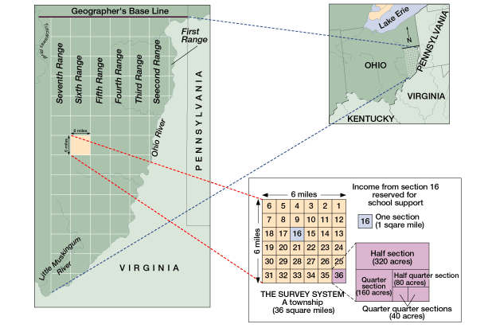

Slide 24
Northwest Territory Legislation
Significance: Allowed for orderly settlement of western territories.
Not colonies!
Pros: Outlawed Slavery, allowed for education, created systems for democracy.
Cons: Created a dividing line between slaves and non-slave states, invalidated Native American claims to the land.

Slide 25
The New Nation’s $$$ Problems… Too much for the Articles of Confederation?
Foreign debt
The nation owed 190 million dollars to foreign countries for their assistance during the war. How to pay it back?
Foreign Relations
Because the U.S. owed money to Loyalists for property damage and were in debt to British merchants, Britain stationed troops and built forts in the Great Lakes area.
Spain closed the Mississippi River to US trade because the U.S. government owed Spain money.
State Debts and Economic Recession
Shays’ Rebellion

Slide 26
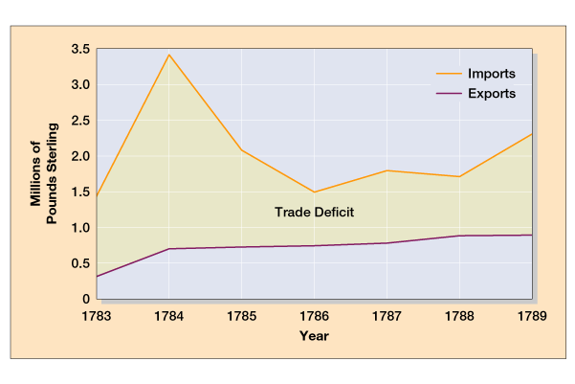
U.S. Trade with Britain, 1783-1789
America could not pay off debts from the Revolutionary War
Debt

Slide 27
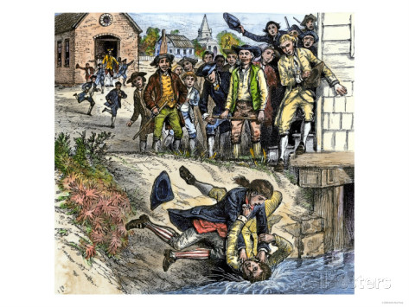
Shays’ Rebellion (1786-1787)
Tensions rise
Jay-Gardoqui Treaty
Spain’s rights to Mississippi River
New England’s depression
Mercantilist policies
Foreign manufacturing competition
States refusing/unable to pay debts
Weak defenses
Massachusetts farmers in serious debt
Held meetings protesting “tyrannical Mass. government”
Daniel Shays led 2,000 men to shut down western courts to avoid foreclosures
Virtual civil war in Massachusetts led to Annapolis Convention

Slide 28
How to Fix This?
A delegation meeting was called at Annapolis to discuss the weaknesses of the Articles.
Only 12 delegates from 5 states showed up and nothing was accomplished.
The failure of the Annapolis Convention prompted Alexander Hamilton to call for another convention to be held in Philadelphia in 1787 to discuss amending the Articles.
(This convention would lead to the writing and signing of the Constitution.)

Slide 29
Toward a Constitution
Annapolis Convention (1786)
After a meeting run by Washington, delegates from five states meet in Maryland to discuss interstate commerce
Decide to reform Articles with other delegates
Constitutional Convention at Philadelphia
All states but Rhode Island
Held in secrecy
Common nationalist viewpoint
Reform Articles or devise new government altogether?
The Delegates
55 total delegates; all white males
Mostly wealthy, middle-aged, professional (especially lawyers or politicians)
19 delegates owned slaves
George Washington, Alexander Hamilton, James Madison, Benjamin Franklin

Slide 30
Check for Understanding
What were the 2 main successes of the Articles of Confederation?
What were the major economic failures of the Articles of Confederation?
What was the cause and effect of Shays’ Rebellion and the Annapolis Convention?
What was called for in 1789 in Philadelphia? WHY?

