Slide 1
Do Now
On your notecard, respond to the following prompt with contextualization and a thesis statement:
Evaluate the impact of the French and Indian War on the relationship between the American colonies and the British government.

Slide 2
The New Colonial Policy: Acts and Responses
Mr. Winchell
APUSH 2018-2019
Period 3

Slide 3
AP Prompt
Evaluate the extent of change in ideas about American independence from 1763 to 1775

Slide 4
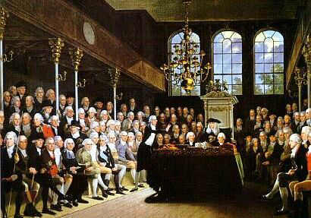
Salutary Neglect/Benign Neglect
British absenteeism
Distance between England and America
Political turmoil and relative peace
English Civil War (1642-1651)
Glorious Revolution (1688)
Colonies virtually on their own
Developed unique economies based on region
Economic growth
Colonial GNP was 25 million pounds ($2.25 billion)
1/3 of the Great Britain’s GNP
GDP per capita was highest in the world by 1775
Self-government
Proud British loyalists
High life expectancy and literacy rates

Slide 5
Parliamentary Sovereignty
1763 proved to be a critical year in colonial history:
The end of the French & Indian War forced England to reexamine its colonial policies
New political & economic restrictions emerged as England attempted to profit off its colonies
Colonial resentment ultimately led to the American Revolution

Slide 6
Timeline of Parliamentary Acts
Sugar Act of 1764
Revenue tax
Quartering Act of 1765
Stamp Act of 1765
First direct tax
Declaratory Act of 1766
Parliament’s right to tax whatsoever
Townshend Acts of 1767
Pay royal colonial officials
Writs of assistance
Tea Act of 1773
Support British East India Company
“Intolerable Acts”
Coercive Acts of 1774
Massachusetts Government Act (royal appointments)
Port Act (Boston closed)
Administration of Justice Act (trial of royal officials moved)
Quebec Act of 1774
Appointed government; Catholicism recognized
Prohibitory Act of 1775
Colonies in open rebellion

Slide 7
The Sugar Act
The Sugar Act redefined the relationship between America & England
Navigation Acts were based on mercantilism; The Sugar Act was an attempt to raise revenue
Chief Minister George Grenville assessed England’s debt after the French & Indian War & concluded that Americans needed to contribute to maintain the army:
Sugar Act of 1764
Currency Act of 1764
Quartering Act of 1765
Stamp Act of 1765
The Stamp Act led to the 1st real colonial protest against new British controls

Slide 8
Parliamentary Acts The Sugar Act (1764)
Purpose
Increased regulation of colonial trade
Raise revenue for war debt
Lowered tax rate
Sugar, spices, lumber
Vice-admiralty courts
Colonial Reaction
Colonial merchants and shippers
Boycotts
Repealed in 1766

Slide 9
The Quartering Act of 1765 required certain colonies to provide food and quarters for British troops.
After the French and Indian War and Pontiac’s Rebellion were over, the colonists saw no need for the presence of a standing army in the colonies, and that the real reason for their presence was to oppress them.

Slide 10
The Stamp Act
One year later, the Stamp Act required colonists to buy a royal stamp to validate legal documents
Colonial protest changed from a gentry movement to a mass protest by common citizens
Massachusetts called for a Stamp Act Congress (an inter-colonial meeting) to petition the King & Parliament for a repeal
By taxing marriage licenses, property deeds, & playing cards, this duty affected common folks
Notes:
7

Slide 11
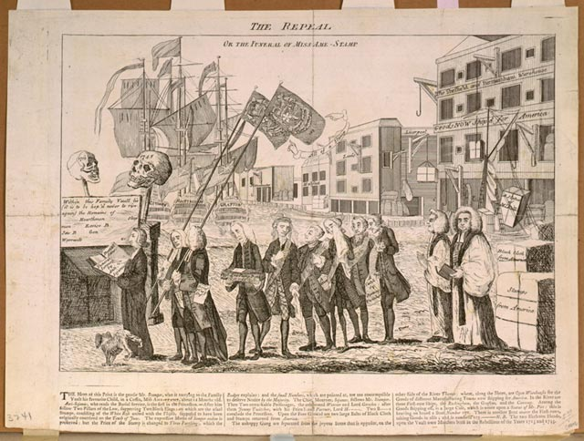
The Stamp Act Congress
27 delegates from 9 colonies met in N.Y. to denounce the Stamp Act in 1765.
Drew up a statement of their rights and asked the King and Parliament to repeal the Stamp Act.
It was important in that it brought together different and rival colonies for the same purpose.
A tiny step toward colonial unity.
Nonimportation agreements worked great to combat the Stamp Act.
The American colonists were united against a common problem.
Home woven handicrafts were encouraged and popular over British imports.

Slide 12
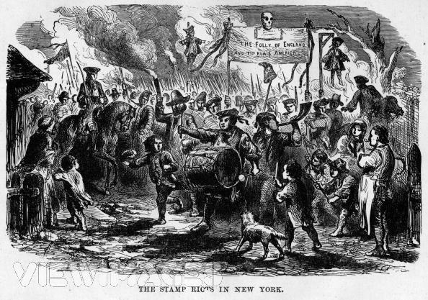
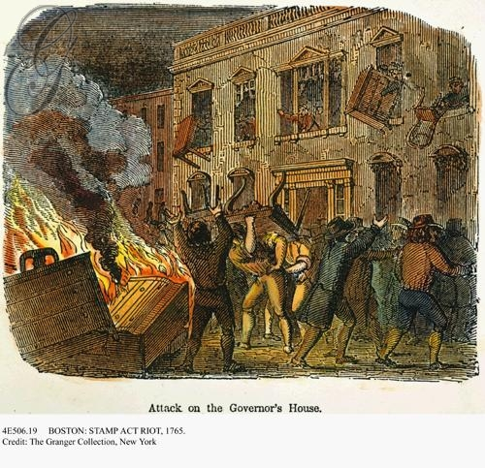
The “Sons of Liberty” & “Daughters of Liberty” were formed to protest British restrictions & became the leaders of colonial resistance
Mob reaction to the Stamp Act
The colonial boycotts were effective & Britain repealed the Stamp Act
For the 1st time, many colonists refer to fellow boycotters as “patriots”

Slide 13
Text Analysis
Ben Franklin Testifies Against the Stamp Act (TAS 133)

Slide 14
Many colonists argued that the new imperial policy was instituting “taxation without representation.”
Americans believed that only their colonial legislatures had any legal right to impose taxes on their people.
P.M. Grenville dismissed the Americans’ complaints and stated enjoyed virtual representation in that Parliament represented all British subjects all over the empire.
Representation in Parliament would actually have not benefited the American colonists because they would have almost always been outvoted by the more populous regions of the empire, namely England.

Slide 15
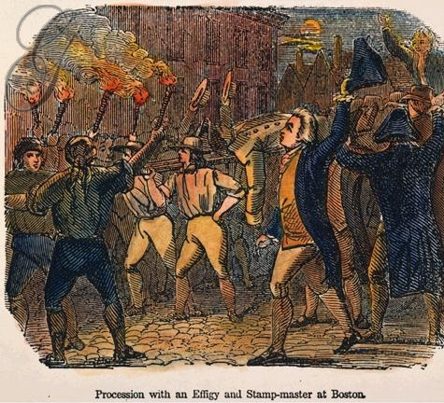
The Declaratory Act
Due to effective colonial protest, England revoked the Stamp Act in 1766
However, Parliament issued the Declaratory Act of 1766 which reaffirmed Parliament’s sovereignty over the America colonies "in all cases whatsoever”
Notes:
8

Slide 16
Parliamentary Acts Townshend Acts (1767)
Purpose
Raise revenue for royal colonial officials
Glass, tea, paper, lead, paint
Writs of assistance
Colonial Reaction
Boycotts-Sons of Liberty
Massachusetts Circular Letter
James Otis and Samuel Adams
Letters from a Farmer in Pennsylvania - John Dickinson
“If they may be legally deprived… of the privilege of legislation, why may they not, with equal reason, be deprived of every other privilege? Or why may not every colony be treated in the same manner, when any of them shall dare to deny their assent to any impositions that shall be directed?”
Engraving by Paul Revere, 1768

Slide 17
Text Analysis
Letter from a Pennsylvania Farmer John Dickinson

Slide 18
3 Reasons for Resistance
English Common Law
Centuries old body of legal rules and procedures.
Magna Carta
Liberties and Privileges
Natural Rights
Enlightenment
Separation of Powers
Glorious Revolution
Constitutional Monarchy took away power from the King to just levy taxes at will.

Slide 19
The Boston Massacre
England’s failure to remove the army from Boston heightened English-American tensions:
Colonists resented the presence of this standing army
In 1770, British soldiers fired into a crowd of colonists
This “Boston Massacre” revealed the deterioration of Anglo-American relations
Notes:
11

Slide 20
Boston Massacre (1770)

Slide 21
The Boston Massacre
This tea tax was a symbolic reference to Parliamentary sovereignty
Tensions were defused by Lord North who repealed Townshend Acts in 1770; except a tax on tea:
Most Americans backed off their radical protests
Except the Sons of Liberty who continued their committees of correspondence to build up a communication network independent of the royal gov’t

Slide 22
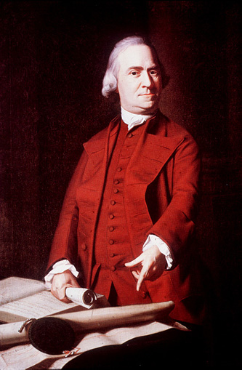
Samuel Adams, of Boston was a failure at pretty much everything but politics.
He organized the Massachusetts Committees of Correspondence.
After Boston formed theirs in 1772, 80 more sprung up in neighboring communities.
Spread ideas of resistance to British authority through interchanging letters

Slide 23
Tea Act (1773)
British East India Co.:
Monopoly on Br. Tea imports.
Many members of Parl. held shares.
Permitted the Co. to sell tea directly to cols. without col. Middlemen (cheaper tea!)
Oliver North expected the cols. to eagerly choose the cheaper tea.

Slide 24
1773 Tea Act
British Action:
Britain gives the East India Company special concessions (prices) in the colonial tea business and shuts out colonial tea merchants.
Colonial Reaction:
Colonists in Boston rebel, dumping 18,000 pounds of East India Company tea into Boston Harbor

Slide 25
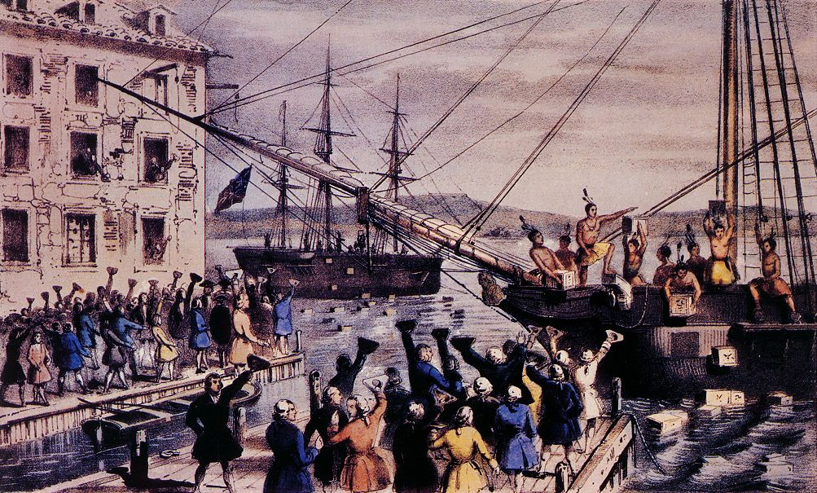
Boston Tea Party (1773)

Slide 26
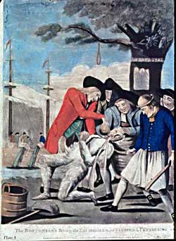
Parliamentary Acts “Intolerable” Acts (1774)
Purpose
Boston Port Act
Quartering Act
Administration of Justice Act
Massachusetts Government Act
Quebec Act*
Colonial Reaction
Suffolk Resolves
“Liberty will reign!”
First Continental Congress
Bostonians paying the exciseman
Tar and Feathering
Notes:
The Quebec Act created a gov’t for newly ceded Canada…but it lacked a colonial assembly
Colonists interpreted this as final proof of a Parliamentary plot to “enslave” America
“Canada” extended into the Ohio Valley & Mississippi which threatened all colonists

Slide 27
Which Side Are You On?
British Colonies
British Empire/Parliament
Fought and died in wars with Natives and European enemies
Risk life and health in a new environment
Proud and loyal English subjects entitled to rights
Developed economies which benefit the Empire
Familiar with life in colonies more so than in England
God-given liberty
Provide protection from Natives and Europeans
Benefit exceptionally well from success of British Empire with little contribution
Abide by the rule of law
Colonists as second-class citizens
“virtual representation”
Britons pay 2-3 times taxes than colonists

Slide 28
First Continental Congress
1774: Response to the Intolerable/Coercive Acts.
Each colony represented (except GA)
John Adams, George Washington, John Jay
Declaration of Rights
Loyal to GB, but dispute of right to tax by Parliament
Articles of Association
Organized Resistance
Boycott of British goods/Nonimportation

Slide 29
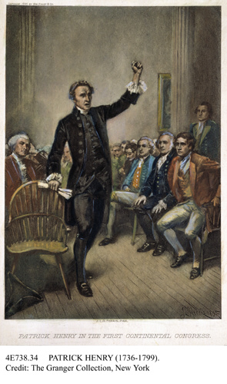
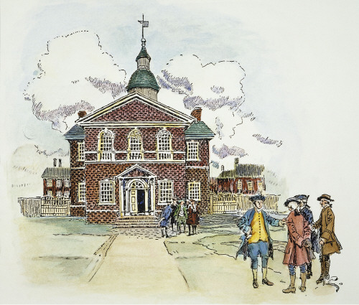
First Continental Congress
“We have to help Boston”

Slide 30
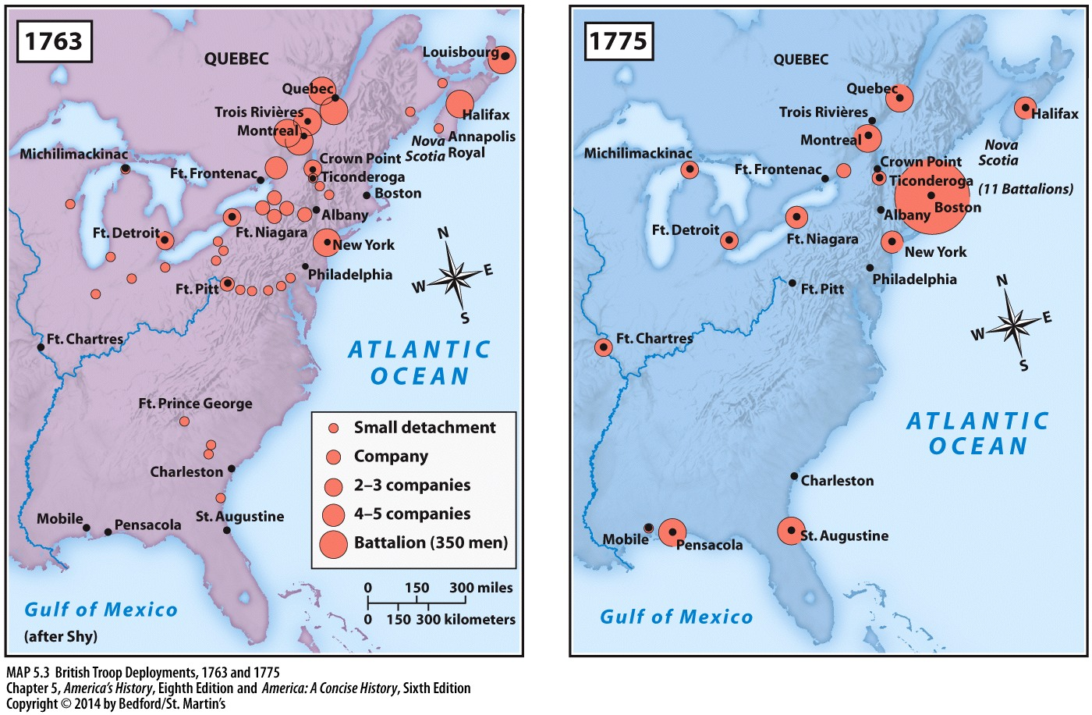

Slide 31
Opposing Views
Leonard
Patrick Henry
TAS 144

