Slide 1
The Responses to Industrialization:
Labor Unrest, Distribution of Wealth, and Government Intervention
Mr. Winchell
APUSH
Period 6

Slide 2
Question to Consider
Causation: What factors led to the growth of the labor movement in the years 1865-1900?
Labor union: an organized association of workers, often in a trade or profession, formed to protect and further their rights and interests.

Slide 3
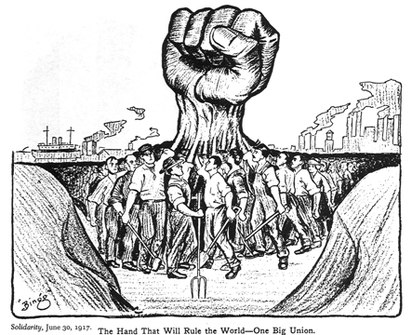
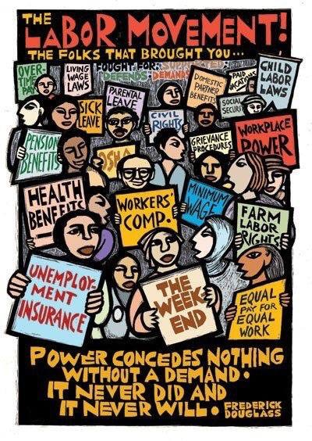
Unionization
Robberbarons and Monopolists – take advantage of cheap labor and treat workers poorly!
  Long hours, dangerous conditions, women and children paid less than men.
Formed unions (groups to fight for workers’ rights).
  Noble Order of Knights of Labor (KofL) by Uriah Stephens (1886 – 700k members and won with arbitration – third party or mediation was used for the decision)
  Craft unions - American Federation of Labor by Samuel Gompers (used collective bargaining – negotiation between representatives of labor and management).
  Eugene Debs – skilled and unskilled workers can be protected based on the industry (trade unions) – adopted idea of socialism (“radicals”).

Slide 4
Beliefs of Labor Unions
Opposed unrestricted immigration
  Immigration = cheap labor
Refused women and African-Americans as members
Supported free compulsory education
  Remove child labor from the workforce
Notes:
4

Slide 5

Management vs. Labor
“scabs”
P. R. campaign
Pinkertons
lockout
blacklisting
yellow-dog contracts
court injunctions
open shop
boycotts
sympathy
demonstrations
informational
picketing
closed shops
organized
strikes
“wildcat” strikes
“Tools” of
Management
“Tools” of
Labor

Slide 6
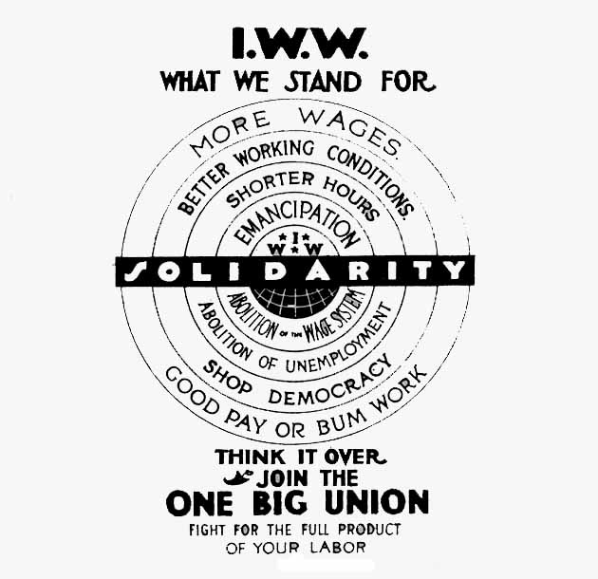
Unionization in Action – Strikes!
Great Strike of 1877 – RR workers strike due to cut in wages – stopped transportation for a week –
  Hayes stopped the strike (interfered with interstate commerce) and called in federal troops.
Haymarket Riot – 3k gathered to protest death and injury in a McCormick Harvester Plant.
  Bomb thrown at the police and they opened fire on crowd.
Pullman Strike – wages cut and Debs boycotted Pullman trains and org’d a strike.
  Pullman called in scabs (strikebreakers) – Debs jailed and workers fired or blacklisted (can’t find work).
Homestead Strike – strike due Carnegie Steel conditions and wage cuts –
  Pinkerton detective agency protected the plant, called in scabs, and continued to run the plant.

Slide 7
Haymarket Square Riot - 1886
Knights of Labor led a strike for 8 hour work day
A bomb was thrown during the protest meeting held by striker and the police were called in.
Impact:
  Knights of Labor are identified as anarchists and associated with violence
  American public turned against them, and against labor unions in general

Slide 8
Homestead Strike - 1892
Carnegie Steel Company threatened to cut wages
Workers picketed and management called in the Pinkerton Guards. Violence erupted.
Strike lasted 9 months. President of Carnegie Steel shot in the neck.
Public opinion turned against on the protesters.
Workers returned to work on the company’s terms.

Slide 9
Pullman Strike 1894
Pullman Palace (Rail) Car Company had cut wages
Strike spread and brought railroad traffic west of Chicago to a standstill
Strikers received help from Eugene V. Debs and American Railway Union
President Cleveland sent troops and Supreme Court obtained a court injunction to stop the strike.
  Why? Court said the federal government may intercede when interstate commerce is affected.

Slide 10
https://www.youtube.com/watch?v=njBIcYa4F6M

Slide 11
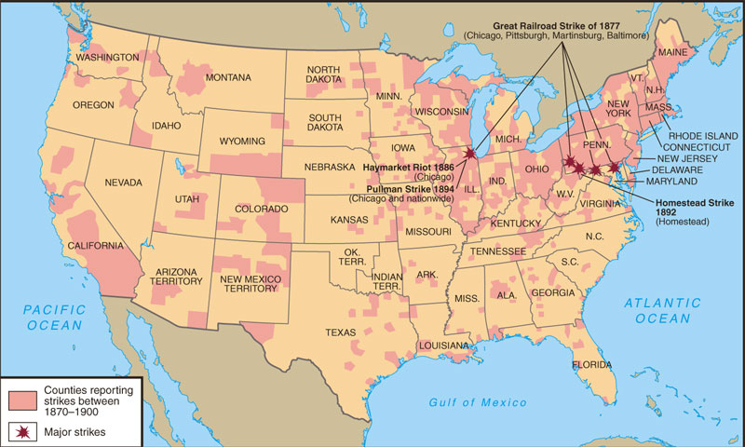

Slide 12
Struggles and Conflict
1881-1900 – 24,000 strikes in the US
many blamed labor unrest on infiltration of socialists and anarchists
Notes:
12

Slide 13
Socialism: a political and economic theory of social organization that advocates that the means of production, distribution, and exchange should be owned or regulated by the community as a whole.
Anarchism: belief in the abolition of all government and the organization of society on a voluntary, cooperative basis without recourse to force or compulsion.

Slide 14
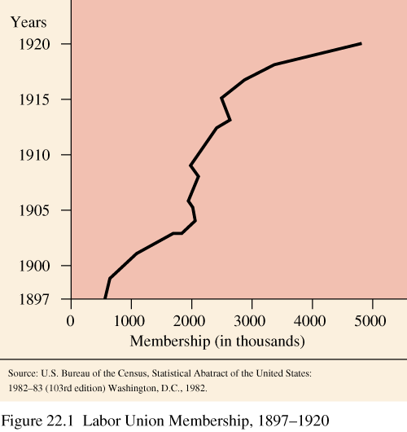
Labor Union Membership

Slide 15
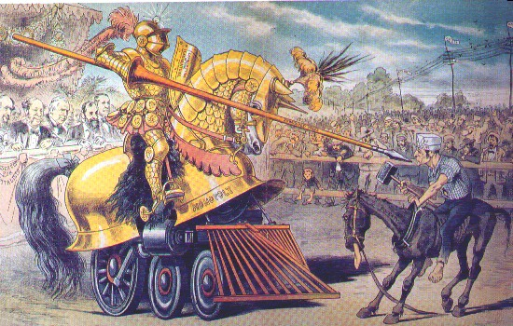
Unions Vs. Big Business – Who is Winning?

Slide 16
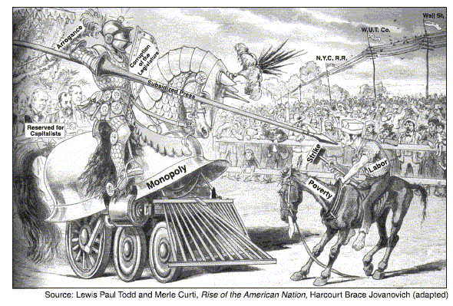

Slide 17
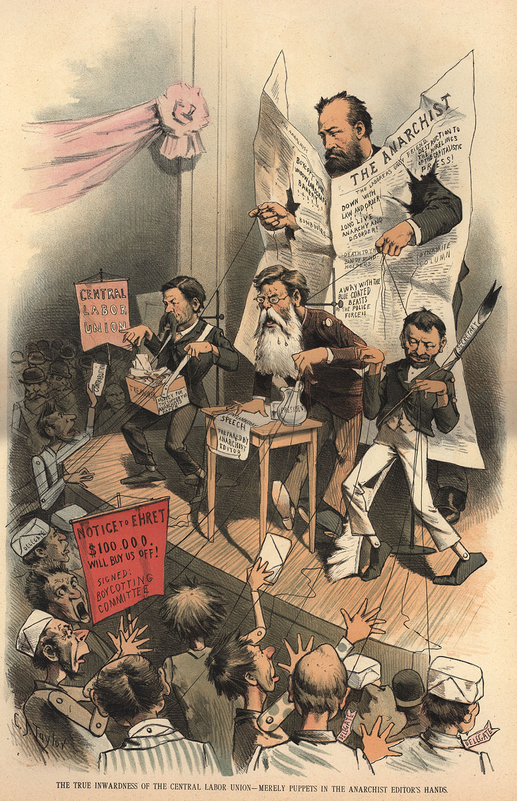
Industrial and Governmental Response
Generally – government supports big business!
Strikes – not overly effective!
Union activity banned by owners.
  Forced workers to sign yellow-dog contracts - can’t join a union.
  Created closed shops (non-union workers only), locked out workers.
  Placed injunctions (can’t strike) on workers.
It will take several decades for unions to gain ground…what is going to be necessary for this happen????

Slide 18
The Wage Earners
The labor of millions of men and women built the new industrial society – mainly immigrants
Low wages/long hours/unskilled jobs
Old work practices not applicable
Work is impersonal/routine/supervised
No job stability – mobile work force
Child labor
Notes:
15

Slide 19
Working Men, Working Women, Working Children
Chronically low wages
  Average wages: $400–500 per year
  Salary required for decent living: $600 per year
Dangerous working conditions
  Railroad injury rate: 1 in 26, death rate 1 in 399
  Factory workers suffer chronic illness from pollutants

Slide 20
Working Men, Working Women, Working Children
Composition of the labor force by 1900:
  20% women
  Women represented in 296 of 303 occupations
  10% of girls employed, 20% of boys
Working children
  “Child labor” means under 14
  All children poorly paid
  Girls receive much lower wage than boys

Slide 21
Working Men, Working Women, Working Children
Working women’s characteristics:
  Most young and single
  25% of married African American women work in 1900
Working women’s jobs
  Many move into clerical positions or other traditional female jobs
  A few occupy professional positions
Working women’s earnings unequal to men’s

Slide 22
Working Men, Working Women, Working Children
Discriminatory wage structure
  Adults earn more than children
  Men earn nearly twice as much as women
  Whites earn more than blacks or Asians
  Protestants earn more than Catholics or Jews
  Black workers earn less at every level and skill

Slide 23
Working Men, Working Women, Working Children
Chinese suffer periodic discrimination
  1879: California constitution forbids corporations to hire Chinese
  1882: Federal Chinese Exclusion Act prohibits Chinese immigration for 10 years

Slide 24
Industrialization’s
Benefits and Costs
Benefits of rapid industrialization
  Rise in national power and wealth
  Improving standard of living
Negative human cost of industrialization
  Exploitation
  Social unrest
  Growing disparity between rich and poor
  Increasing power of giant corporations
Notes:
19

Slide 25
Knights of Labor
  Founder: Uriah Stevens and Terrance V. Powderly
  What they wanted: 8 hour workday, higher wages
  Who could join: skilled and unskilled workers
  Methods they used: strikes
  Declined by 1886

Slide 26
The American Federation of Labor 1881
Founder: Samuel Gompers
What they wanted: 8 hour work day, improved working conditions, higher wages
Who could joined: different skilled craft workers
Methods used: Strikes and Boycotts
Successes:
  won the closed shop (where factories could only hire union workers)
  Abolished yellow-dog contracts (companies had required workers to sign contracts promising NOT to join a union)
Notes:
Cigar makers, blacksmiths, shoe makers etc.

Slide 27
American Railway Union
Founder Eugene V. Debs
What they wanted: 8 hour work day, improved working conditions, higher wages
Who could join: skilled and unskilled workers
Won a major striker for better wages but lost another major strike and ended up struggling for members.

Slide 28
Quote…
‘The only counterweight to capitalism is government. Labor wants to be the counterweight but cannot.’

Slide 29
Wealth’s Response to Wealth
Gospel of Wealth
  View of Wealthy
  God rewards work with wealth
  Individual should work hard to get ahead
Philanthropy-wealthy return wealth to up lift society- Universities, libraries, the arts
“It’s your duty to get rich and do something with it”
Social Darwinism
  Led by English social philosopher Herbert Spencer, some people argued that Darwin’s ideas of natural selection and survival of the fittest should be applied to the marketplace.
  Spencer believed that concentrating wealth in the hands of the most ‘fit’ benefited everyone.
  An American Social Darwinist, Professor William Graham Sumner of Yale, argued that helping the poor was misguided because it interfered with the laws of nature and would only weaken the evolution of the species by preserving the unfit.
  Social Darwinism gave some during this period a ‘scientific’ justification for their racial intolerance.
Notes:
GoW: Carnegie distributed more than 350 million dollars of his fortune to causes he cared about on this justification
SD:

Slide 30
Origins of Progressivism
Reaction to “extremes” of modern life
Capitalism & individualism
Urbanization & Industrialization
Labor conflict
Immigration
Environmental exploitation
Social “problems”

Slide 31
Progressives=Reform Movement
Progressive movement a reaction to the excesses of industrialization.
  (negative effects of Industrialization)
  Poverty
  Corruption- Municipal, State and Federal
  Working conditions
  Organizing the Economy
  Immigrant living conditions
  Immigrant “social issues associated with immigrants, pejorative- dirty, non-English speakers, Alcohol abuse…
  WASP movement- concerned with changes- a movement to regain control…

Slide 32
Progressives Rise Because…
Rapid industrialization (Laissez Faire economics) and urbanization (Social Darwinism) causes intolerable problems
Middle class WASPs were driving force behind movement
Need for reform
Need for order
Need to remedy industrial problems
Psychological view= “Tension Frustration Thesis” desire to regain power lost due to changes in society, corporations, immigrants, urbanization”

Slide 33
Central Ideas
  Bi-Partisan- Both parties had members
  Progress – things are getting better
  Society was capable of improvement
  Government Intervention was needed-
    to limit big Business
    To end political corruption
    Solve social problems of alcohol abuse

