Slide 1
Do Now
‘The only counterweight to capitalism is government. Labor wants to be the counterweight but cannot.’

Slide 2
The Response to Industry-The Early American Labor Movement and Big Business’ Response
Mr. Winchell
APUSH 2018-2019
Period 6

Slide 3
Key Concepts
6.1.II: A variety of perspectives on the economy and labor developed during a time of financial panics and downturns.
  C: Labor and management battled over wages and working conditions, with workers organizing local and national unions and/ or directly confronting business leaders.

Slide 4
AP Prompt
Evaluate the extent to which organized labor was successful in improving the position of workers in the period 1875-1900.

Slide 5
Outline
Labor in the Gilded Age
Unionization
Big Business’ Justifications for Wealth

Slide 6
Laissez Faire: the ideology of the Industrial Age.
Individual as a moral and economic ideal.
Individuals should compete freely in the marketplace.
The market was not man-made or invented.
No room for government in the market!

Slide 7
Progress and Poverty, Henry George

Slide 8
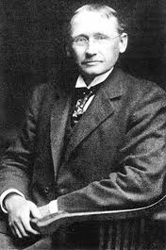
Scientific Management
“Taylorism”
Frederick W. Taylor
Designed hierarchies and subdivisions of labor
  Managers plan, schedule, train, and supervise
  Workers perform assigned tasks best suited to skills
Time management
Effects
  Managerial class
  Efficiency
  Labor resentment

Slide 9
Taylorism= Scientific Management
Production process should be divided into specialized tasks
Each task speeds up production
Train all workers to do unskilled jobs
“Makes workers interchangeable”

Slide 10
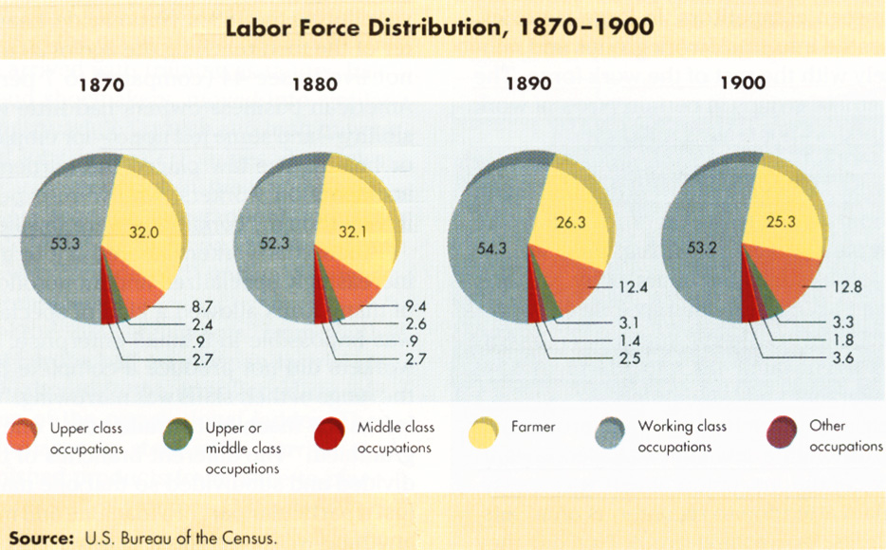
Labor changes…

Slide 11
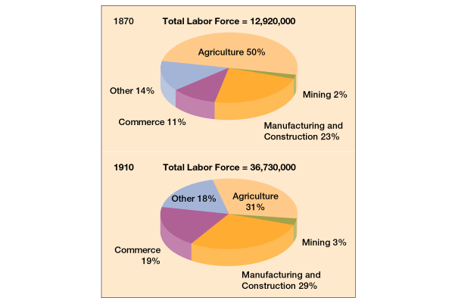
Labor changes…

Slide 12
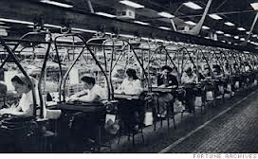
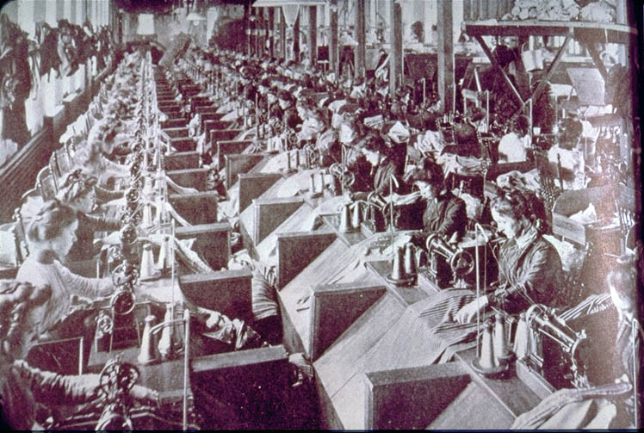
The workforce
Women tended to work in textile mills, garment factories, tobacco factories
  Usually paid less than half the wages of men in the same jobs
By 1870, 1/3 of factory workers foreign born
  Hired because they would work for much less $

Slide 13
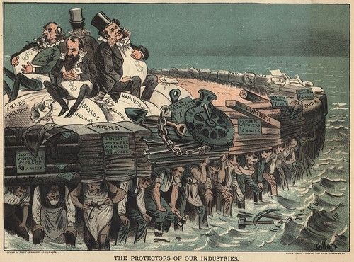
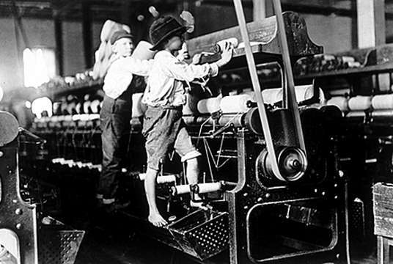
Labor Wages and Conditions
Time and Pay
  Average work week for industrial worker: 60 hours
  Average hourly rate for unskilled industrial worker: $0.10
Conditions
  Poor ventilation and heavy equipment
  In 1882, average of 675 workers killed each week
No benefits
  No vacation days, sick leave, health insurance, workers’ compensation, pensions
Child Labor
  As young as 5 years old
  12-14 hours for $.27 ($6.65)

Slide 14
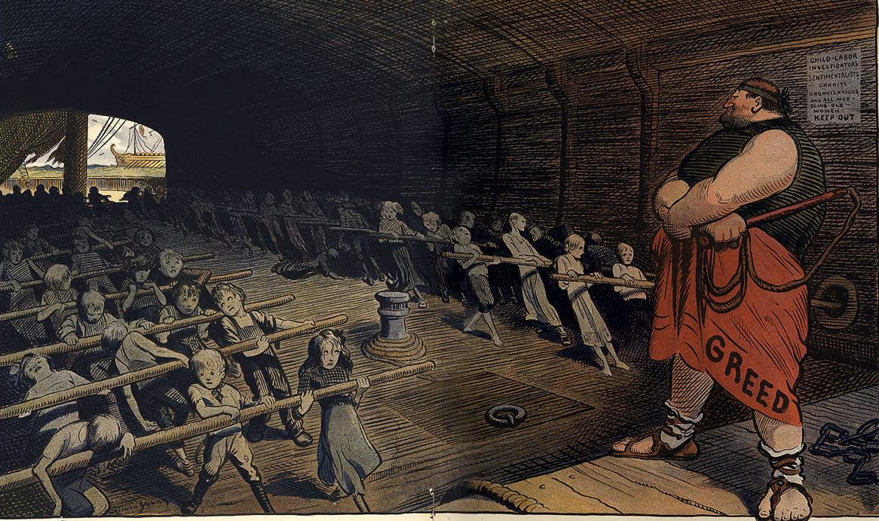

Slide 15
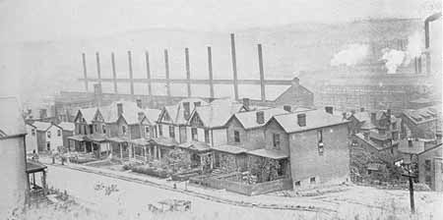
Company Town
The company owned the town and rented homes to workers
Workers paid with scrip – company “money”

Slide 16
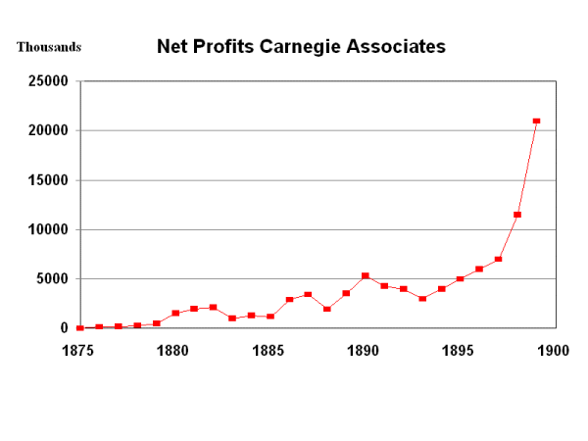
Big Corporate Profits!

Slide 17
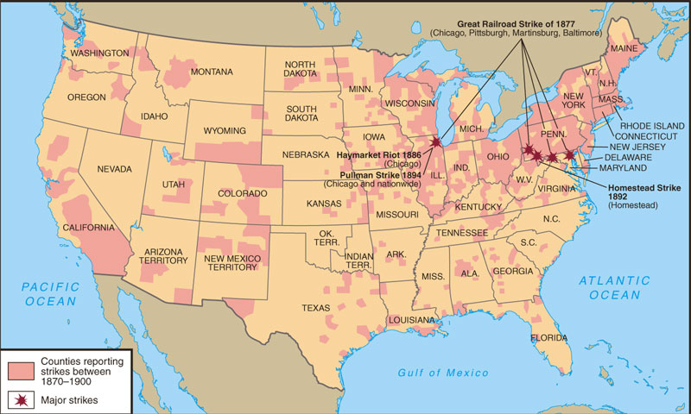
Labor Unrest: 1870-1900

Slide 18
Views of
Labor vs. Management
Industrialization, mass production, use of semiskilled workers = devalued labor
Poor and dangerous working conditions, immigrants, and meager salaries = upset workforce
Collective bargaining to appeal for better conditions, higher salaries, benefits
Union Methods
  political action and efficacy, strikes, picketing, boycotts, slowdowns
Industrialization, mass production, use of semiskilled workers = increased profits
Poor and dangerous working conditions, immigrants, and meager salaries = increasing profits and satisfied management
Developed image of unions and organized labor as un-American, socialist, anarchist
Management Methods
  lockouts, scabs, blacklists, yellow-dog contracts, government/private force, court injunctions

Slide 19
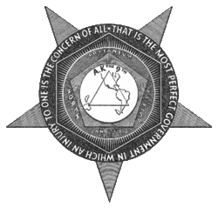
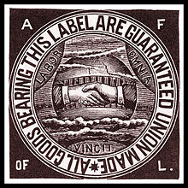
Labor Unions
Knights of Labor (1869)
Terence V. Powderley
Platform
  Open to blacks, women, most immigrants, Catholics, unskilled and semi-skilled workers
  Cooperatives and anti-trusts
  8-hour workday, child labor laws
Tactics
  Arbitration and strikes
American Federation of Labor (AFL) (1886)
Organization of national craft unions of skilled workers
Samuel Gompers
“Bread and Butter”
  Higher wages
  Shorter working hours
  Better working conditions
Tactics
  Arbitration and strikes
  Political lobbying with Democratic Party

Slide 20
Knights of Labor Goals
Eight-hour workday.
Workers’ cooperatives.
Worker-owned factories.
Abolition of child and prison labor.
Increased circulation of greenbacks.
Equal pay for men and women.
Safety codes in the workplace.
Prohibition of contract foreign labor.
Abolition of the National Bank.

Slide 21
American Federation of Labor Goals
Catered to the skilled worker.
Represented workers in matters of national legislation.
Maintained a national strike fund.
Evangelized the cause of unionism.
Prevented disputes among the many craft unions.
Mediated disputes between management and labor.
Pushed for closed shops.

Slide 22
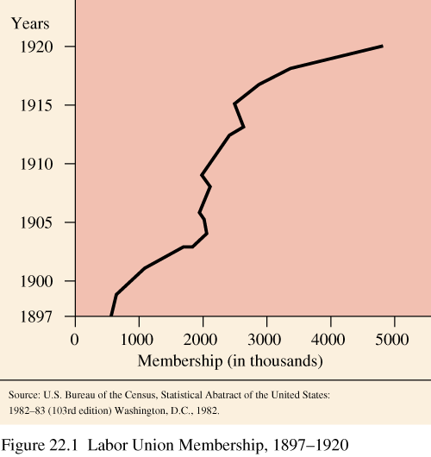
Labor Union Membership

Slide 23
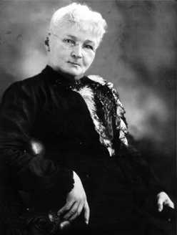
Mother Jones:
“The Miner’s Angel”
Mary Harris.
Organizer for the
United Mine
Workers.
Founded the Social
Democratic Party
in 1898.
One of the founding members of the I. W. W. in 1905.

Slide 24
The IWW
IWW = Industrial Workers of the World
Most radical of the unions
Led by Bill Haywood
Organized the most ignored workers, including migrant workers
Believed in strikes and work slow-downs
Violence was justified to overthrow capitalism.

Slide 25
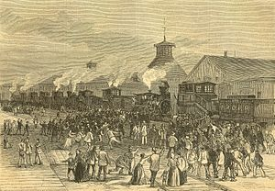
Great Railroad Strike of 1877
July 14-September 4, 1877
Causes
  Panic of 1873
  Class conflict with wage cuts and unemployment
Events
  Strikers forced rail stoppages
  Federal troops engaged strikers
  Riots and massacres
Impact
  Would lead to better organization of workers and labor unions
  Legislation to limit unions and preparations for potential conflicts

Slide 26
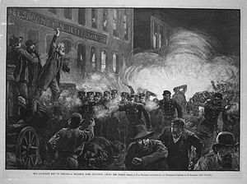
Haymarket Riot of 1886
May Day (May 1st)
  Strike begins of harvesting workers
May 3rd
  Police sent to protect strikers
  Fight broke out and one person killed and several injured
May 4th Protest
  Anarchists planned demonstration against police brutality
  Police dispersed crowd of 2,000
Bombing
  A pipe bomb exploded and killed 7 police officers
  Police fired into crowd killing 4
Trial
  8 innocent anarchists convicted of murder in a show trial
  4 hanged, 1 committed suicide, 3 pardoned by governor

Slide 27
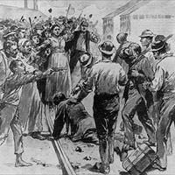
Homestead Strike
June 30-July 6, 1892
Henry Frick
  Manager of Carnegie Steel
  Pursued wage cuts due to lower steel prices
  Attempted to weaken steel workers union
Events
  Frick orders a lockout and hires scabs
  Use of Pinkertons to disperse strikers
  Pennsylvania state militia ultimately ends strike
Impact
  Weakened steel workers union
  Tarnished Carnegie’s reputation

Slide 28
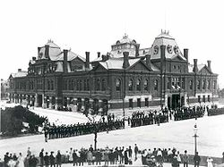
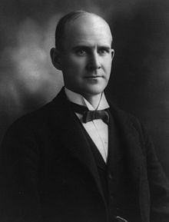
Pullman Strike (1894)
Pullman Palace Car Company
  Established “model town” for workers
  In response to Panic of 1893, wages cut but not rents and town costs
Strike
  Eugene V. Debs
  Workers blocked transport of Pullman cars
  Pullman Co. linked them to mail cars
  President Grover Cleveland deployed federal troops and court injunctions to enforce postal service
Opinion
  Most Americans opposed the strike
    Including AFL and Samuel Gompers
In Re Debs (1895)
  Supreme Court ruled federal court injunctions to enforce interstate commerce constitutional

Slide 29
The Organizing of Labor into Unions Is Dangerous;
Labor Unions Are Essential
Henry Clews – “The Folly of Organized Labor” (1886)
Samuel Gompers – “Open Letter to Judge Peter Grosscup” (1894)
The organizations have sacrificed the sympathy which lately was entertained for them on account of inequities existing in certain employments; they stand discredited and distrusted before the community at large as impracticable, unjust, and reckless; and, occupying this attitude before the public, their cause is hone and their organization doomed to failure. They have opened the floodgates to the immigration of foreign labor, which is already pouring in by the thousands; and they have set a premium on nonunion labor, which will be more sought for than ever, and will not be slow to secure superior earnings by making arrangements with employers upon such terms and for such hours as may best suit their interests… There have been numerous vacanies created by the strikers voluntarily resigning. There has been no difficulty in filling these vacancies by those that are equally capable, if not more so, from other countries flocking to our shores...Strikes may have been justifiable in other nations but they are not justifiable in our country, and there is where the mistake was in organizing such a movement. The Almighty has made this country for the oppressed of other nations, and therefore this is the land of refuge for the oppressed, and the hand of the laboring man should not be raised against it.
You say that “labor cannot afford to attack capital.” Let me remind you that labor has no quarrel with capital, as such. It is merely the possessors of capital who refuse to accord to labor the recognition, the right, the justice which is the laborers’ due with whom we contend… Are you aware that all the legislation ever secured for the ventilation or safety of mines, factory, or workshop is the result of the efforts of organized labor? Do you know that the trade unions were the shield for the seven-year-old children from being the conqueror’s trophy until they become somewhat older? And that the reformatory laws now on the statute books protecting or defending the trophies of both sexes, young and old from the fond care of the conquerors were wrested from congresses, legislatures, and parliaments despite the Pullmans, the Jeffries, the Ricks, the Tafts, the Williams, the Woods, or the Grosscups... Year by year man’s liberties are trampled underfoot at the bidding of corporations and trusts, rights are invaded, and law perverted. In all ages, wherever a tyrant has shown himself, he has always found some willing judge to clothe that tyranny in the robes of legality, and modern capitalism has proven no exception to the rule.

Slide 30
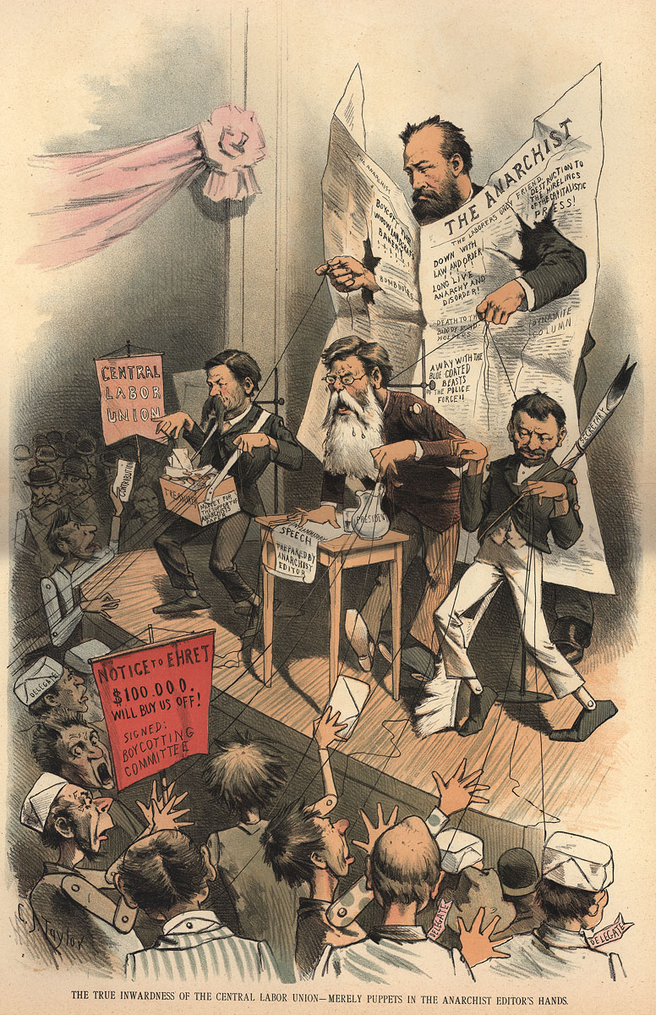
Industrial and Governmental Response
Generally – government supports big business!
Strikes – not overly effective!
Union activity banned by owners.
  Forced workers to sign yellow-dog contracts - can’t join a union.
  Created closed shops (non-union workers only), locked out workers.
  Placed injunctions (can’t strike) on workers.
It will take several decades for unions to gain ground…what is going to be necessary for this happen????

Slide 31
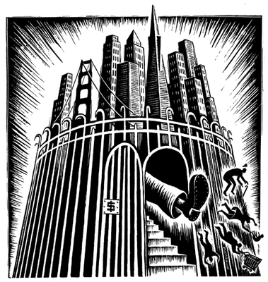
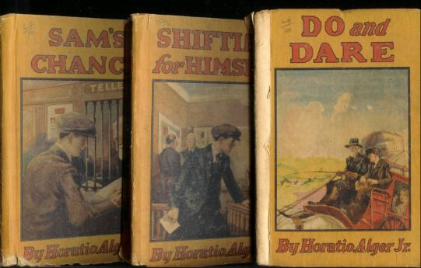
Social Darwinism
Herbert Spencer
  “Survival of the fittest”
  Wealth a result of hard work and brilliance
  Poor and unfortunate were lazy
Fueled and Influenced…
  Laissez-faire economics
  Racism
  Nativism
  Imperialism
  Eugenics
  Horatio Alger Myth

Slide 32
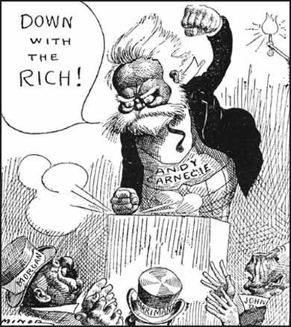
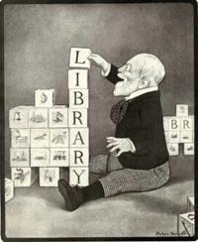
Gospel of Wealth
Based on an article written by Andrew Carnegie
Guardians of the nation’s wealth
“All revenue generated beyond your own needs should be used for the good of the community.”
“In bestowing charity, the main consideration should be to help those who will help themselves; to provide part of the means by which those who desire to improve may do so; to give those who desire to use the aids by which they may rise; to assist, but rarely or never to do all. Neither the individual nor the race is improved by alms-giving.”

Slide 33
Conclusions
America was changed by the Industrial Revolution:
  The United States led the world in industry, innovation, and wealth
  Laissez-faire gov’t policies and new business tactics led to monopolies
  But the gap between the wealthy monopolists and their poor immigrant workers grew wider

