Slide 1
Do Now
‘The only counterweight to capitalism is government. Labor wants to be the counterweight but cannot.’

Slide 2
3. The Rise of Industry-Big Business and Labor in the Gilded Age
Mr. Winchell
APUSH 19-20
Period 6

Slide 3
AP PROMPT
In the post-Civil War US, corporations grew significantly in number, size, and influence. Evaluate the impact of big business on the economy and politics.

Slide 4
Outline
Growth of Industry
Impact of industrial growth
Gospel of Wealth/Social Darwinism
Responses to Industry

Slide 5
Free Enterprise: Capitalism
Adam Smith: The Wealth of Nations (1776)
Laissez-faire Capitalism: “Let it Be”
The Market System:
Laws of supply and demand determine prices (The Invisible Hand)
According to Smith’s ideas:
  Business should be free of government interference.
Smith understood that:
  Business owners or Entrepreneurs, as a rule, want to make as much money or profit as possible.
  They don’t want to pay taxes.
  They want to provide goods or services at the lowest possible price and creating the most profit.
According to Smith a Pure Market Economic System would achieve the maximum good for society:
Characteristics
  No government control
  Freedom of choice
  Private Property
  Profit
  Competition

Slide 6
THE RISE OF BIG BUSINESS
The Old Business Format
Proprietorship:
A single owner business OR
Partnership:
Small group
ownership
of a business
Notes:
The Rise of Big Business
[This slide if for background only—not for notes]

Slide 7
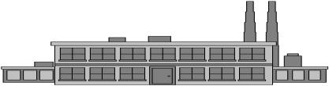




THE RISE OF BIG BUSINESS
The New Format—
The Corporation
Capital
Shares &
Dividends
Limited Liability
Shareholders
Notes:
The Corporation
Shareholders invest in a company by buying shares (stock)
Financial capital to build and grow a company comes—in part—from the sale of shares
The new kind of business is a corporation—a legal entity rather than a person or partnership—that runs the company
In return for financial capital, the corporation issues shares of ownership, and many also share a portion of profits by paying dividends per share at regular intervals
Limited liability protects shareholders from legal action if the company does something wrong

Slide 8
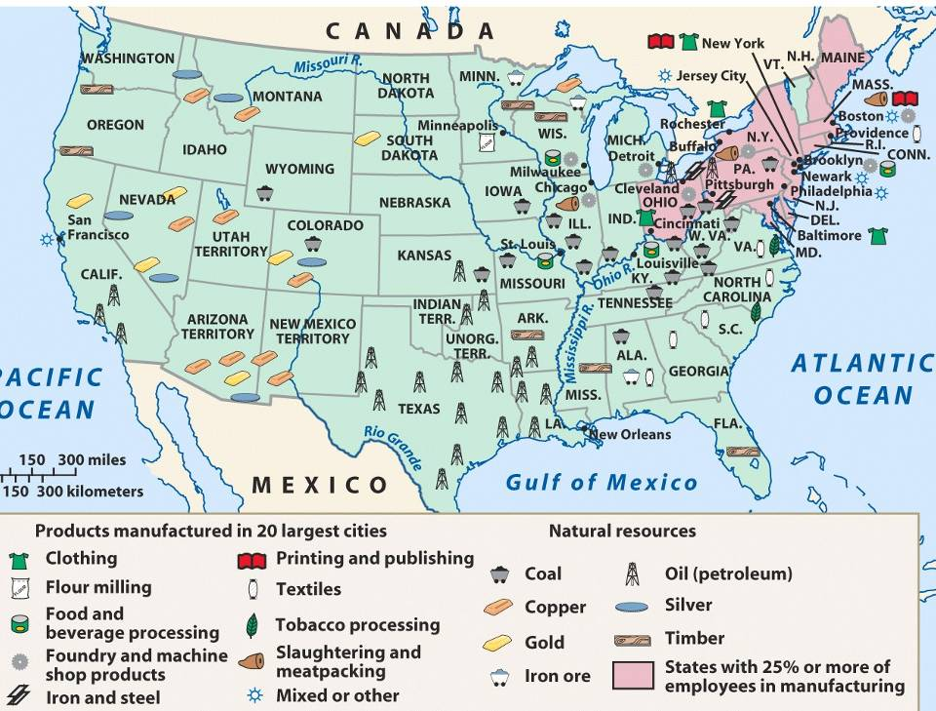
America’s industrial revolution was
fueled by 4 major industries (R.O.S.E.)
Railroads, Oil, Steel, Electricity

Slide 9
Gilded Age Industrialization
During the Gilded Age, American businesses were transformed:
  Massive corporations replaced small, family businesses
  New technology, transportation, marketing, labor relations, & efficient mass-production
  By 1900, the U.S. was the most industrialized country in the world

Slide 10
Factors Encouraging Industrial Growth
Natural Resources
Favorable Government Policies (Pro Corp-Dartmouth v. Woodward & Tariffs)
Growing Population
New Sources of Power
Introduction of Machinery
Improved Transportation & Communication
Effect of Wars
Notes:
Natural resources available in the U.S. included coal, iron, lumber.
Also fertile soil for growing food and cash crops as well as swift running water for waterpower.
The Constitution was written in a way that helped industry.
Coining of money provided a stable currency for trade.
Regulation of interstate commerce made possible nationwide laws to regulate industry and transportation.
Levying tariffs on imports protected domestic industry against foreign competition.
A system of patents protected inventors.
The 5th and 14th Amendments also provided that no person could be deprived of property without due process of law. This encouraged domestic and foreign investors to provide capital for American Industry.
The govt. also spurred growth by providing land grants and cash subsidies to railroads, levying high protective tariffs, and maintaining a laissez-faire approach to business.
A high birthrate and considerable migration led to a steady increase in the U.S. population (about 76 million in 1900) which provided sufficient workers for industry and expanding markets for goods.
New sources of power included electricity and petroleum.
Electricity first used for communication and later for lighting and driving motors.
Petroleum first used for lubrication and lighting and later for transportation.

Slide 11
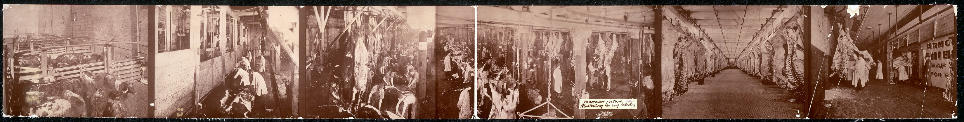
Chicago Meatpackers:
The 1st “Disassembly Line”

Slide 12
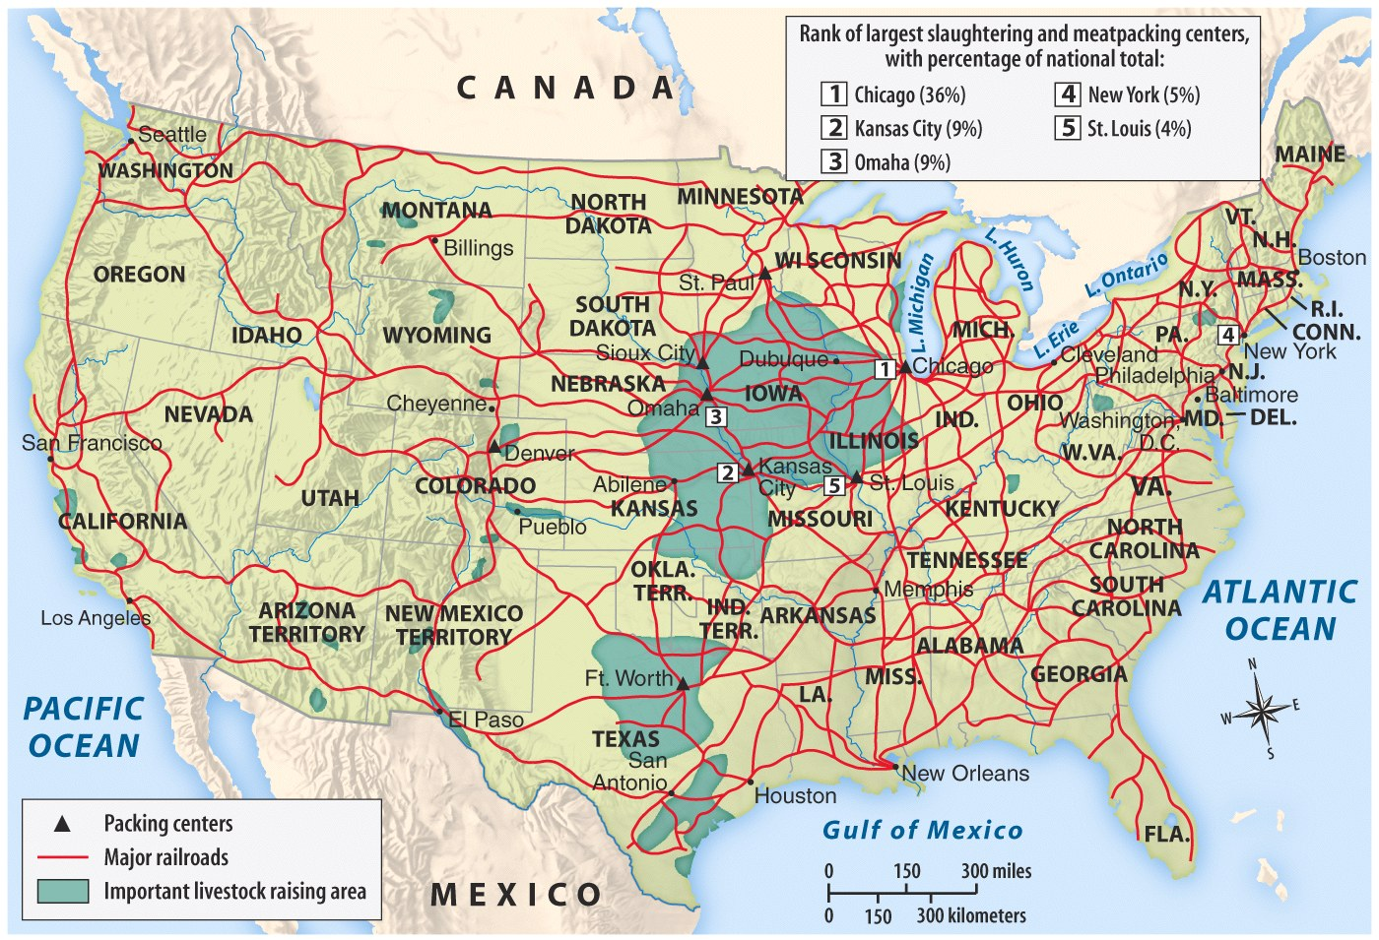
The Midwest Made Meat for America
A new-and-improved “market revolution”: More regional specialization made mass production & mass consumption possible
Notes:
(Chicago→meat, St Louis→beer, & Minneapolis→grain)

Slide 13
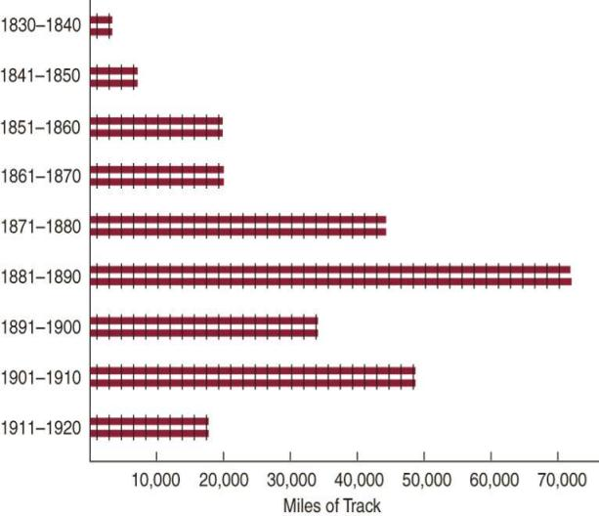
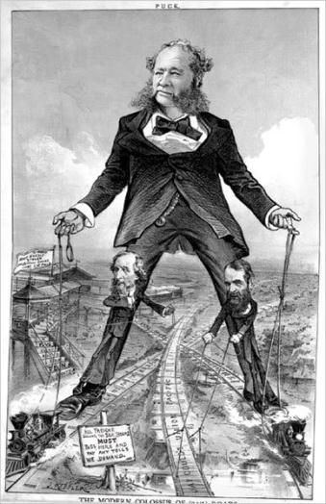

During the Gilded Age, railroad construction boomed, led by tycoons like Cornelius Vanderbilt
Large companies
bought small railroads, standardized gauges and schedules, and pooled cars

Slide 14
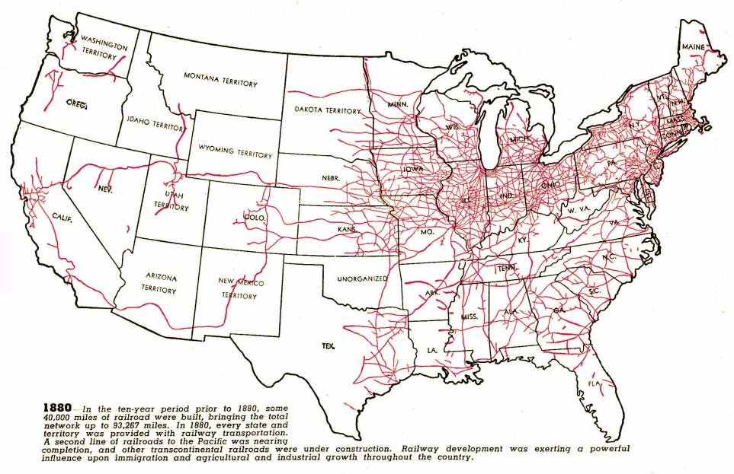
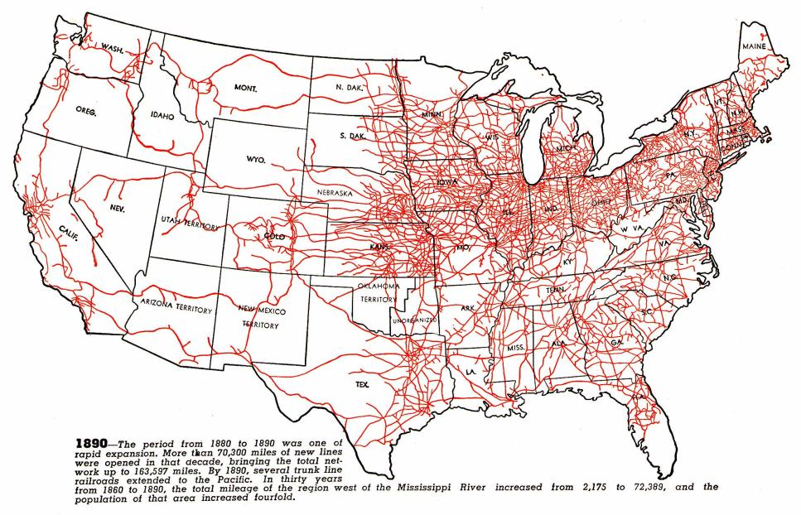
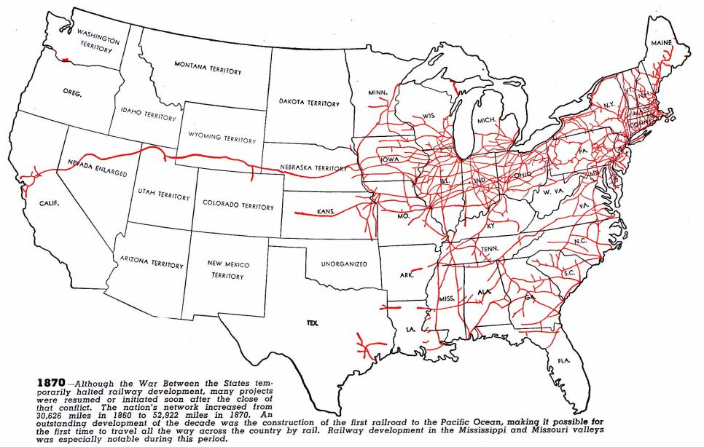
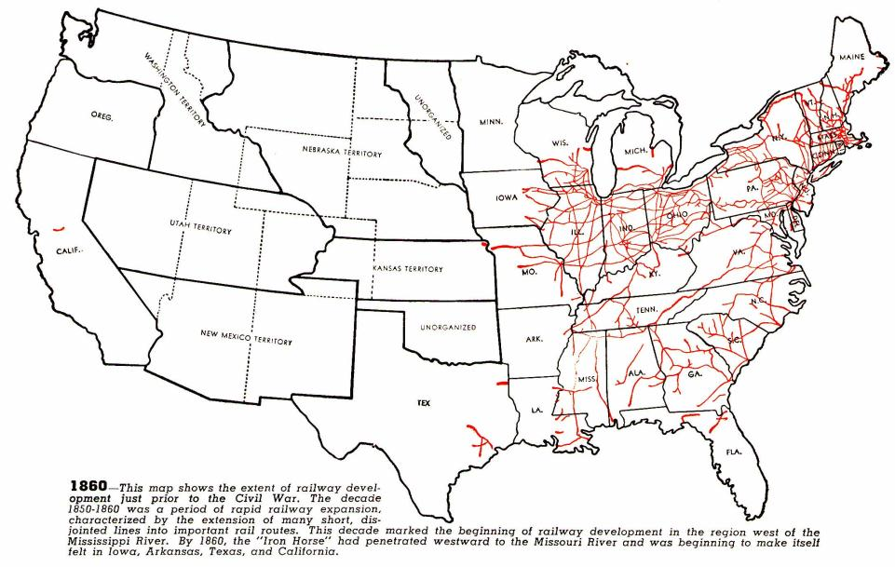
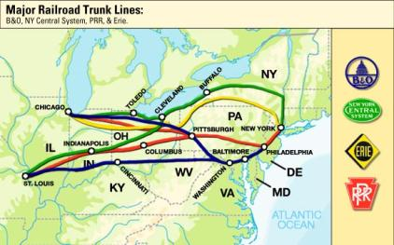
Railroad expansion led to a boom in the economy
Railroads connected the East, South, and West and allowed for national trade and regional specialization
The 1st transcontinental railroad was finished in 1869
Eastern railroads were connected to the West by 4 great trunk lines
Railroads stimulated demand for coal, oil, iron, and steel

Slide 15
Problems of Growth
Speculators like Jay Gould built & bought rail lines to profit with little concern for efficient use
But, the railroad industry faced problems due to overbuilding in the 1870s & 1880s:
  Mass competition among RRs
  RR lines offered special rates & rebates (secret discounts) to lure passengers & freight on their lines
  Pooling & consolidation failed to help over-speculation
  Regulating the Railroads:
  Munn v. Illinois (1879)
  Wabash v. Illinois (1886)
  Interstate Commerce Act
Notes:
8

Slide 16
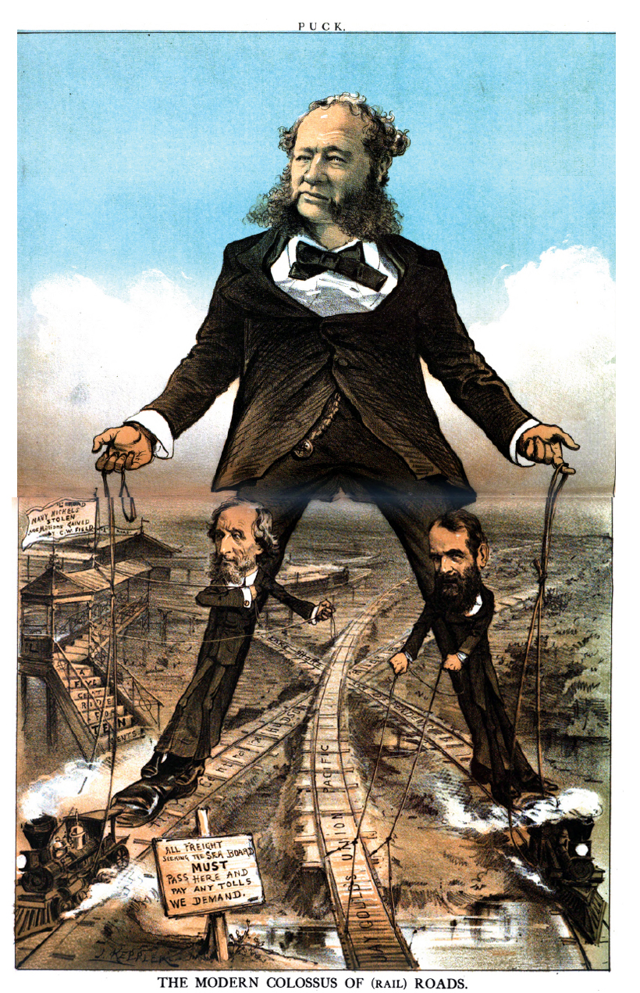

Slide 17
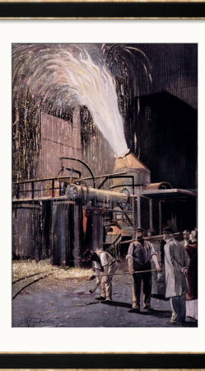
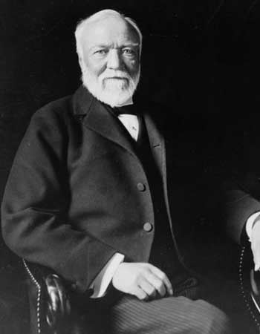
Big Steel
Andrew Carnegie led the industry in the late 1800s thanks to the introduction of:
1. the Bessemer steel process → high-quality steel
2. cost-analysis → cut back costs, higher profits
3. vertical integration → control of every stage of steel production from mining iron ore and coal to selling the finished product → reduced costs and allowed Carnegie to under-price the competition through economy of scale→ monopoly control of the industry
Overall result: More steel produced and at lower cost ($65/ton in 1875 vs. $11.50/ton in 1900)
Carnegie sold Carnegie Steel to J.P. Morgan and other investors in 1900 for $500 million and became a major philanthropist, advocated the “Gospel of Wealth”

Slide 18
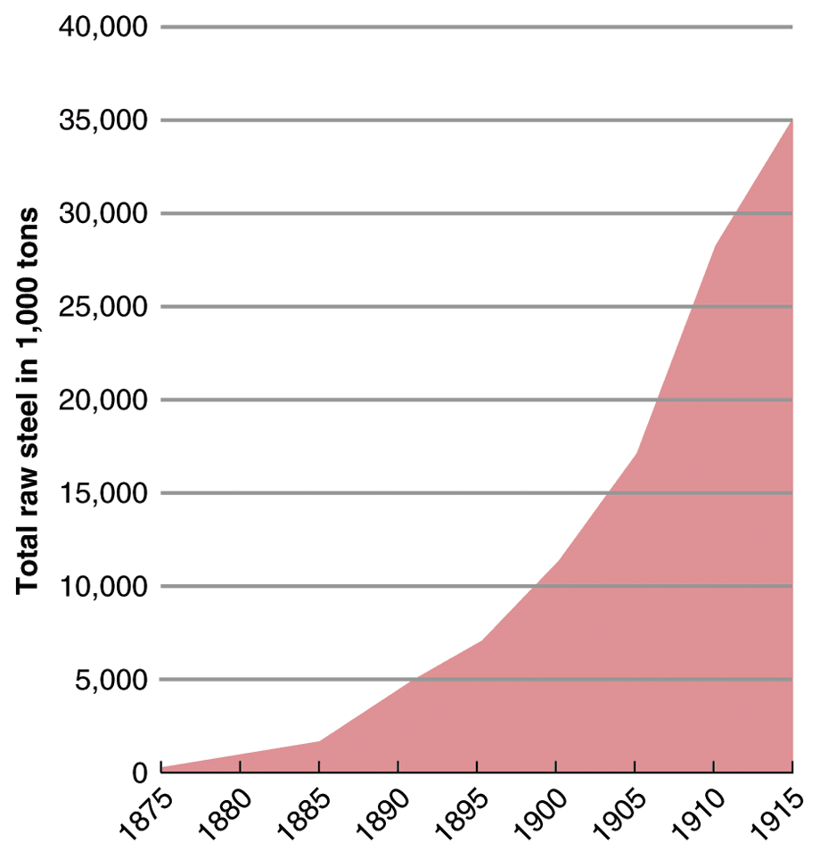
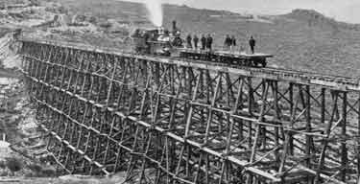
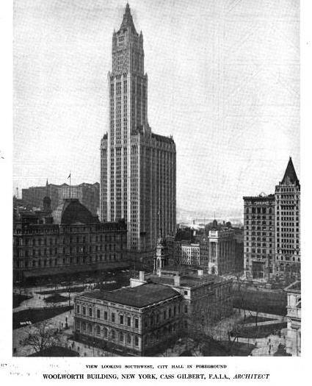
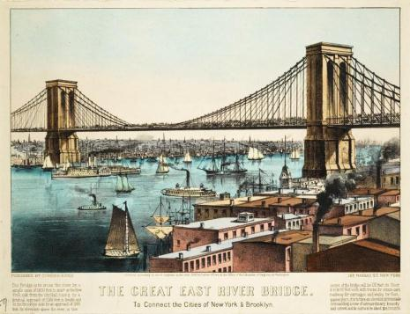
Steel led to skyscrapers, longer bridges,
stronger railroads, and heavier machinery

Slide 19
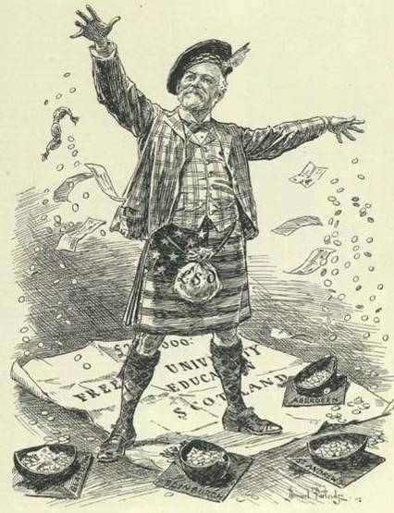
Carnegie paid his employees terribly and did not allow unions in his factories…
…but he was a philanthropist who gave money to New York City libraries, colleges,
and performing arts institutions
Andrew Carnegie (2.11)
Notes:
9
Henry Bessemer (& William Kelly) turned iron into steel in 1850s—process allowed for mass production of steel

Slide 20
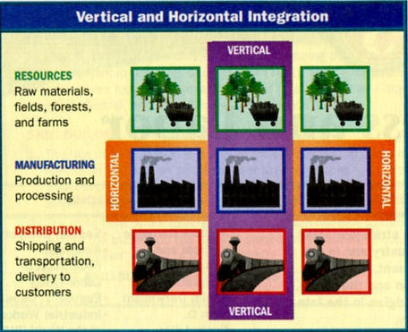

Slide 21
Big Oil
John D. Rockefeller sought control of the expanding industry through horizontal integration → control of one stage of production (transportation and then refineries)
Rockefeller established the Standard Oil Trust (1882) to control companies that had previously participated in price fixing arrangements (controlled 90% of the industry through horizontal and vertical integration) – emulated by other industries

Slide 22
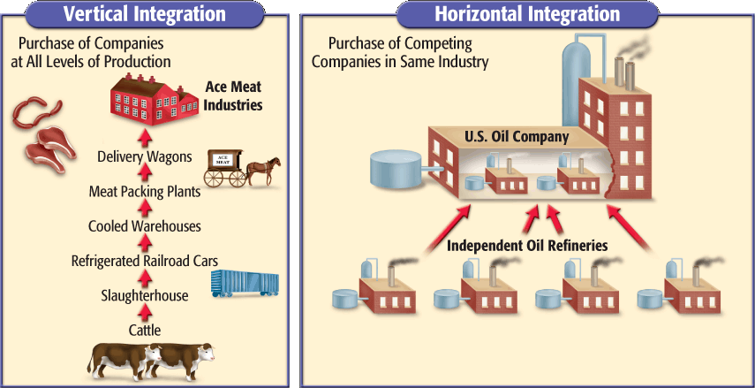
Horizontal Integration

Slide 23
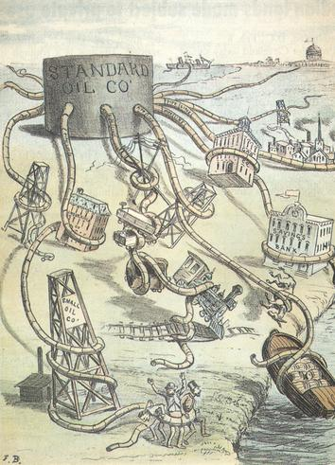
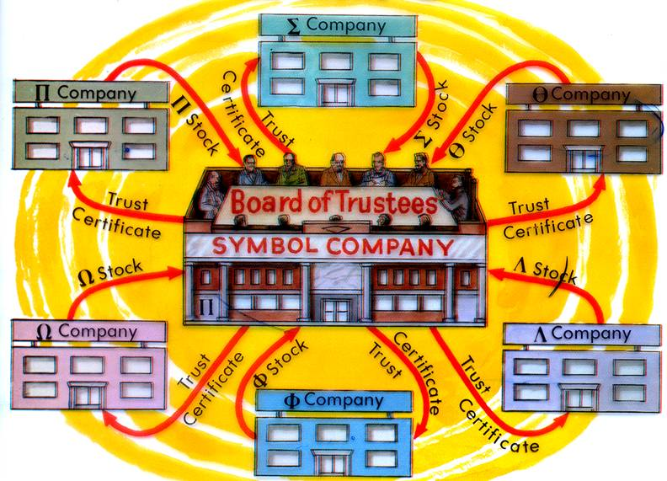
Standard Oil Trust
Tactics
  Lowered prices to drive out competitors (rate wars)
  Threatened companies to sell to Standard Oil (buyouts)
  Bribed railroads to buy Standard Oil fuel (rebates, kickbacks)
  Bribed Congress members
Trusts and Monopolies
  Controls prices
  Limits competition

Slide 24
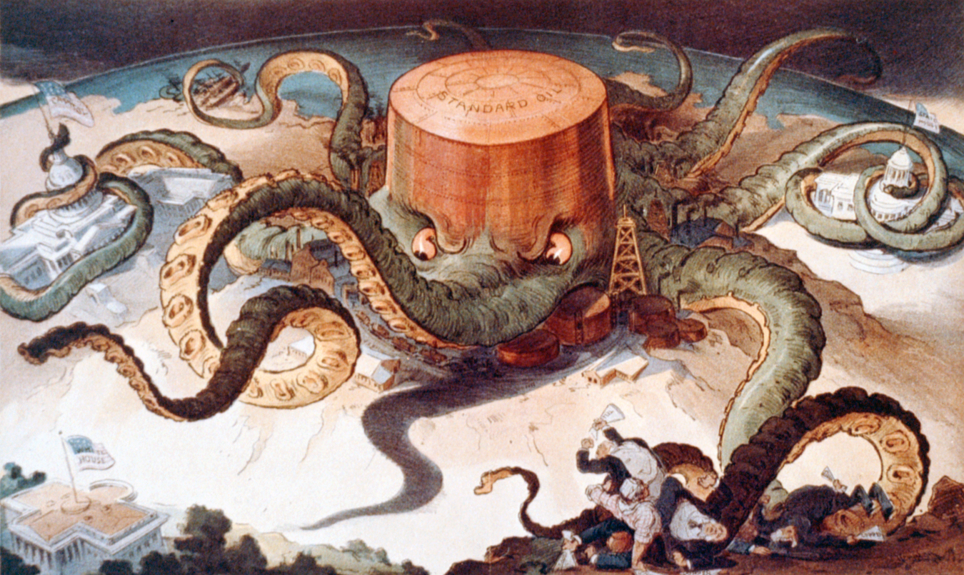

Slide 25
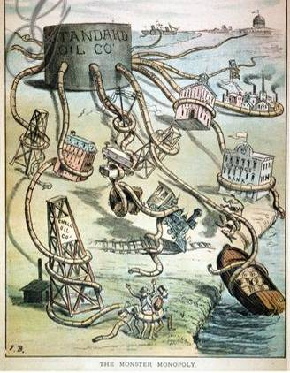

Rockefeller took advantage of his workers and used his fortune to influence
the national gov’t…
…but Rockefeller gave away $500 million
to charities, created the Rockefeller Foundation, and founded the University of Chicago

Slide 26
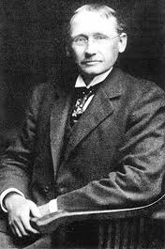
Scientific Management
“Taylorism”
Frederick W. Taylor
Designed hierarchies and subdivisions of labor
  Managers plan, schedule, train, and supervise
  Workers perform assigned tasks best suited to skills
Time management
Effects
  Managerial class
  Efficiency
  Labor resentment

Slide 27
Taylorism= Scientific Management
Frederick W. Taylor
Designed hierarchies and subdivisions of labor
  Managers plan, schedule, train, and supervise
  Workers perform assigned tasks best suited to skills
Production process should be divided into specialized tasks
Each task speeds up production
Train all workers to do unskilled jobs
“Makes workers interchangeable”
Effects
  Managerial class
  Efficiency
  Labor resentment

Slide 28
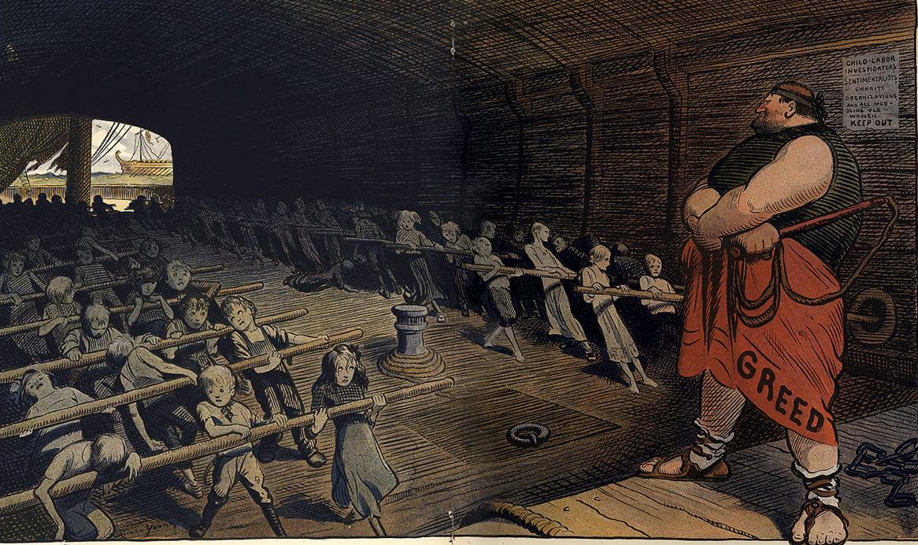

Slide 29
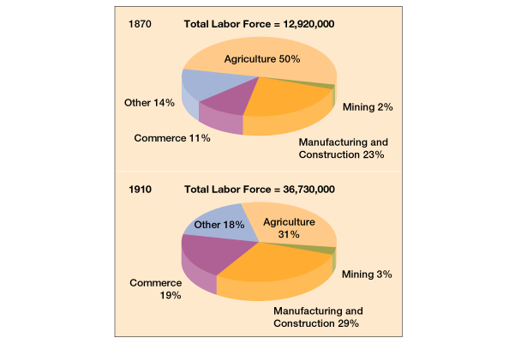
Labor changes…

Slide 30
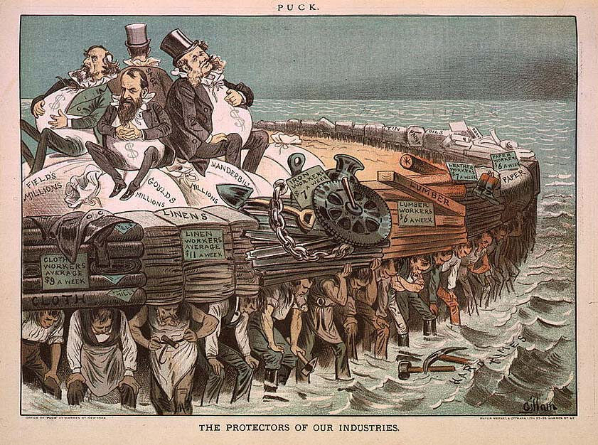

Slide 31
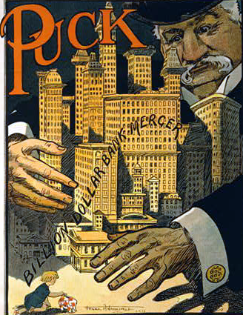
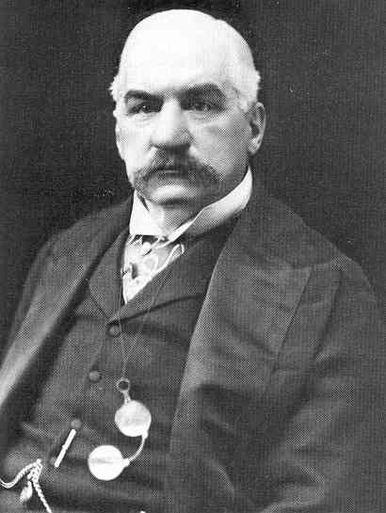
Industrialization led to a demand for financing so banking became a significant part of the Gilded Age
American finance was dominated by JP Morgan
He was so influential that he bailed out the railroad industry when companies were in trouble
He helped ease an economic depression during the Panic of 1907

Slide 32
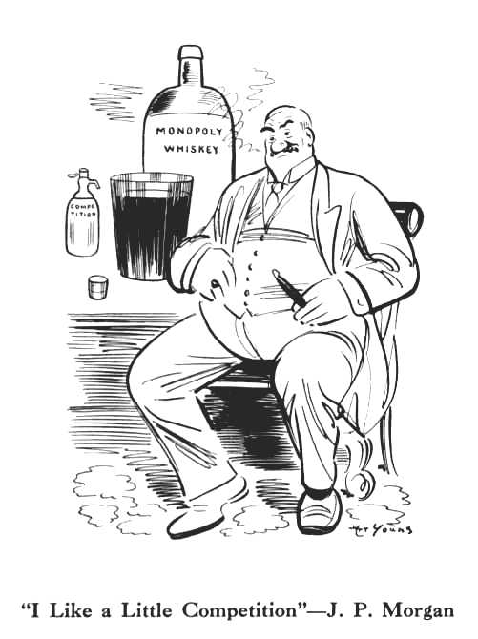
Corporations
American Telephone and Telegraph Co. (1885)
  J.P. Morgan Co. financed merger of Bell and communication companies
General Electric (1892)
  J.P. Morgan merged Edison General Electric and Thomas-Houston Electric Company
U.S. Steel (1901)
  J.P. Morgan bought Carnegie Steel and merged with other steel companies
  Becomes first billion dollar company in world

Slide 33
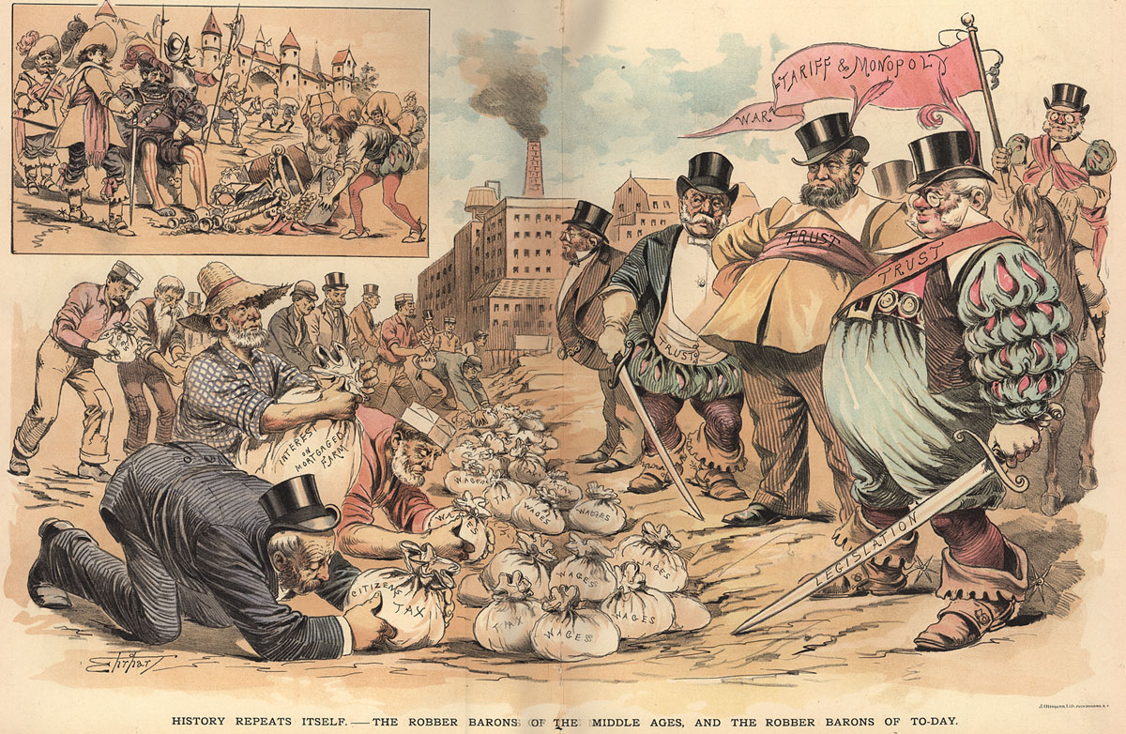

Slide 34
The development of factory production has consequences for virtually every portion of society.
Industrialization brings positives effects:
Inventions are created-→More products--→produced faster--→ produced cheaper
Jobs are created---→ people have money to buy more goods-→economy gets better for everyone
Rich people get richer--→ create more factories or businesses --→ create more jobs--→economy gets better for everyone
Immigration-→when jobs are available-------→people move to the location of jobs-→industrialization causes immigration--→
Factories are built where people live-------→cities grow

Slide 35
The development of factory production has consequences for virtually every portion of society.
Industrialization brings negative effects:
Industrialization causes--→pollution-→air, water
Industrialization causes---→poverty-→ government doesn’t protect workers at first-→ workers compete with other workers for low skill jobs-→ workers work long hours-→ get low pay-→ unsafe working conditions
Poverty is so bad-→children need to work
Massive wealth is created by factory owners-→ causes corruption-→ business owners use money to influence government officials

Slide 36
Changing Public Opinion
Americans wanted the federal govt. to deal
with growing soc. & eco. problems & to curb
the power of the trusts:
  Interstate Commerce Act – 1887
  Sherman Antitrust Act – 1890
    US v. EC Knight Co. - 1895

Slide 37
Progress and Poverty, Henry George

Slide 38
Societal Justifications
Social Darwinism
Gospel of Wealth
Herbert Spencer
  “Survival of the fittest”
  Wealth a result of hard work and brilliance
  Poor and unfortunate were lazy
Fueled and Influenced…
  Laissez-faire economics
  Racism
  Nativism
  Imperialism
  Eugenics
  Horatio Alger Myth
Based on an article written by Andrew Carnegie
Guardians of the nation’s wealth
“All revenue generated beyond your own needs should be used for the good of the community.”
“In bestowing charity, the main consideration should be to help those who will help themselves; to provide part of the means by which those who desire to improve may do so; to give those who desire to use the aids by which they may rise; to assist, but rarely or never to do all. Neither the individual nor the race is improved by alms-giving.”

Slide 39
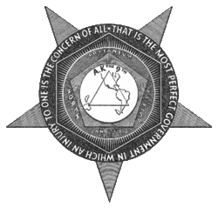
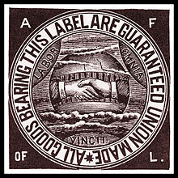
Labor Unions
Knights of Labor (1869)
Terence V. Powderley
Platform
  Open to blacks, women, most immigrants, Catholics, unskilled and semi-skilled workers
  Cooperatives and anti-trusts
  8-hour workday, child labor laws
Tactics
  Arbitration and strikes
American Federation of Labor (AFL) (1886)
Organization of national craft unions of skilled workers
Samuel Gompers
“Bread and Butter”
  Higher wages
  Shorter working hours
  Better working conditions
Tactics
  Arbitration and strikes
  Political lobbying with Democratic Party

Slide 40
The IWW
IWW = Industrial Workers of the World
Most radical of the unions
Led by Bill Haywood/Eugene Debs
Organized the most ignored workers, including migrant workers
Believed in strikes and work slow-downs
Violence was justified to overthrow capitalism.

Slide 41
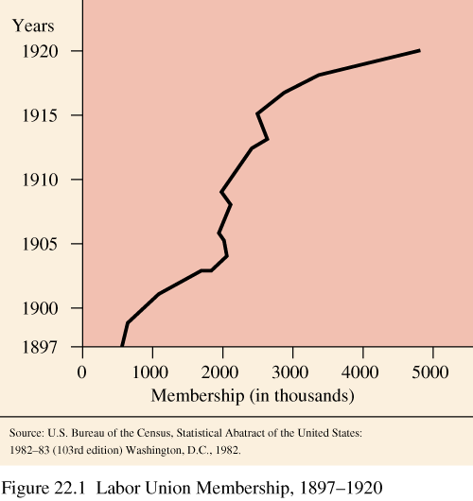
Labor Union Membership

Slide 42
Strikes
Great Railroad Strike of 1877
Homestead Strike, 1892
Causes
  Panic of 1873
  Class conflict with wage cuts and unemployment
Events
  Strikers forced rail stoppages
  Federal troops engaged strikers
  Riots and massacres
Impact
  Would lead to better organization of workers and labor unions
  Legislation to limit unions and preparations for potential conflicts
Henry Frick
  Manager of Carnegie Steel
  Pursued wage cuts due to lower steel prices
  Attempted to weaken steel workers union
Events
  Frick orders a lockout and hires scabs
  Use of Pinkertons to disperse strikers
  Pennsylvania state militia ultimately ends strike
Impact
  Weakened steel workers union
  Tarnished Carnegie’s reputation

Slide 43
Strikes
Haymarket Riot of 1886
Pullman Strike (1894)
May Day (May 1st)
  Strike begins of harvesting workers
May 3rd
  Police sent to protect strikers
  Fight broke out and one person killed and several injured
May 4th Protest
  Anarchists planned demonstration against police brutality
  Police dispersed crowd of 2,000
Bombing
  A pipe bomb exploded and killed 7 police officers
  Police fired into crowd killing 4
Trial
  8 innocent anarchists convicted of murder in a show trial
  4 hanged, 1 committed suicide, 3 pardoned by governor
Pullman Palace Car Company
  Established “model town” for workers
  In response to Panic of 1893, wages cut but not rents and town costs
Strike
  Eugene V. Debs
  Workers blocked transport of Pullman cars
  Pullman Co. linked them to mail cars
  President Grover Cleveland deployed federal troops and court injunctions to enforce postal service
Opinion
  Most Americans opposed the strike
    Including AFL and Samuel Gompers
In Re Debs (1895)
  Supreme Court ruled federal court injunctions to enforce interstate commerce constitutional

Slide 44
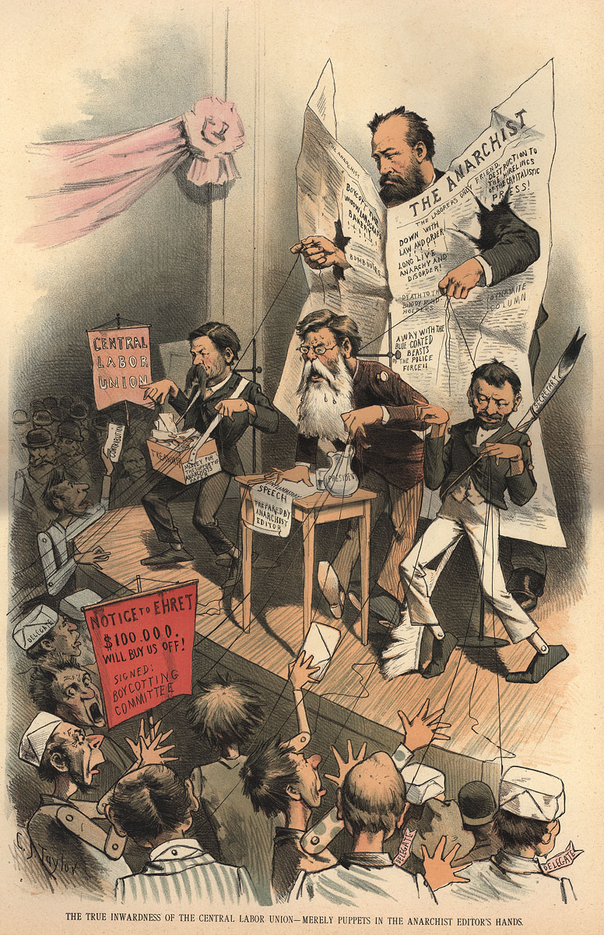
Industrial and Governmental Response
Generally – government supports big business!
Strikes – not overly effective!
Union activity banned by owners.
  Forced workers to sign yellow-dog contracts - can’t join a union.
  Created closed shops (non-union workers only), locked out workers.
  Placed injunctions (can’t strike) on workers.
It will take several decades for unions to gain ground…what is going to be necessary for this happen????

Slide 45
The Organizing of Labor into Unions Is Dangerous;
Labor Unions Are Essential
Henry Clews – “The Folly of Organized Labor” (1886)
Samuel Gompers – “Open Letter to Judge Peter Grosscup” (1894)
The organizations have sacrificed the sympathy which lately was entertained for them on account of inequities existing in certain employments; they stand discredited and distrusted before the community at large as impracticable, unjust, and reckless; and, occupying this attitude before the public, their cause is hone and their organization doomed to failure. They have opened the floodgates to the immigration of foreign labor, which is already pouring in by the thousands; and they have set a premium on nonunion labor, which will be more sought for than ever, and will not be slow to secure superior earnings by making arrangements with employers upon such terms and for such hours as may best suit their interests… There have been numerous vacanies created by the strikers voluntarily resigning. There has been no difficulty in filling these vacancies by those that are equally capable, if not more so, from other countries flocking to our shores...Strikes may have been justifiable in other nations but they are not justifiable in our country, and there is where the mistake was in organizing such a movement. The Almighty has made this country for the oppressed of other nations, and therefore this is the land of refuge for the oppressed, and the hand of the laboring man should not be raised against it.
You say that “labor cannot afford to attack capital.” Let me remind you that labor has no quarrel with capital, as such. It is merely the possessors of capital who refuse to accord to labor the recognition, the right, the justice which is the laborers’ due with whom we contend… Are you aware that all the legislation ever secured for the ventilation or safety of mines, factory, or workshop is the result of the efforts of organized labor? Do you know that the trade unions were the shield for the seven-year-old children from being the conqueror’s trophy until they become somewhat older? And that the reformatory laws now on the statute books protecting or defending the trophies of both sexes, young and old from the fond care of the conquerors were wrested from congresses, legislatures, and parliaments despite the Pullmans, the Jeffries, the Ricks, the Tafts, the Williams, the Woods, or the Grosscups... Year by year man’s liberties are trampled underfoot at the bidding of corporations and trusts, rights are invaded, and law perverted. In all ages, wherever a tyrant has shown himself, he has always found some willing judge to clothe that tyranny in the robes of legality, and modern capitalism has proven no exception to the rule.

