Slide 1
Do Now
Identify and summarize the foreign policy approaches of the first three presidents of the United States.

Slide 2
3. The War of 1812 and the Era of Good Feelings-Madison and Monroe
Mr. Winchell
APUSH 2019-2020
Period 4

Slide 3
AP Prompt
Evaluate the effects of the War of 1812, accounting for economic, political, and social outcomes.

Slide 4
Outline

Slide 5
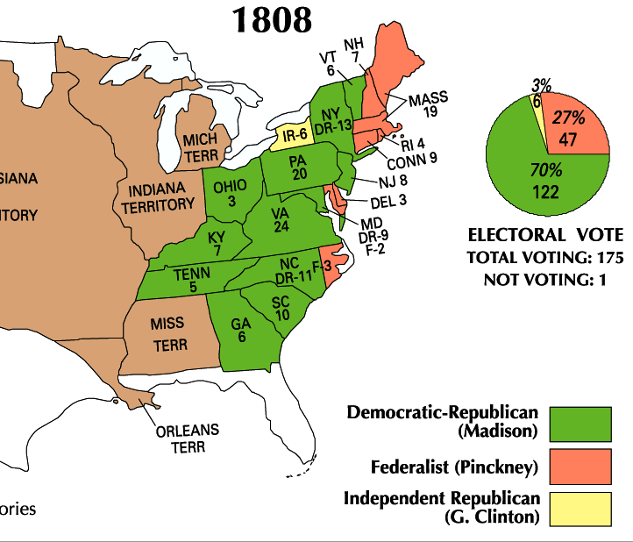
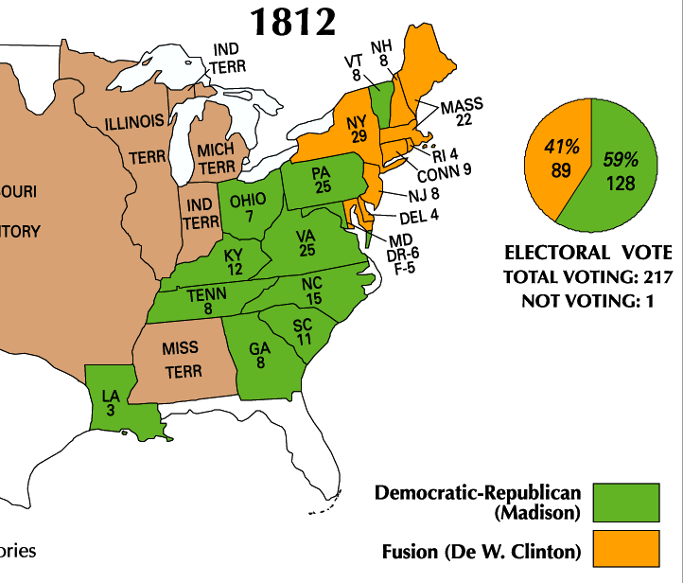
Jefferson’s hand-picked successor, James Madison, won the presidency in 1808 & 1812
Madison was well-qualified: He was the architect of the Constitution, served in Congress, & served as Jefferson’s Secretary of State

Slide 6
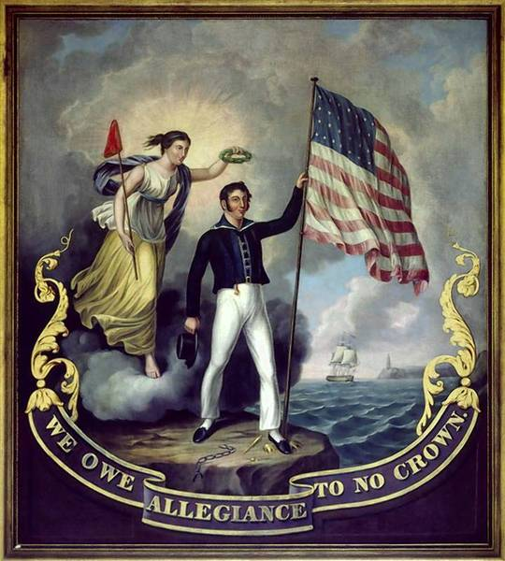
Problem: Since 1793, Britain and France have been at war, violated free trade, and used impressment against American merchants. Attempts to resolve these issues did not solve these problems
Washington’s Proclamation of Neutrality (1793)
Adams’ XYZ Affair (1798)
Jefferson’s embargo (1807)
Brainstorm three solutions President Madison could use to solve this problem and select the 1 best alternative. Be sure to explain your decision

Slide 7
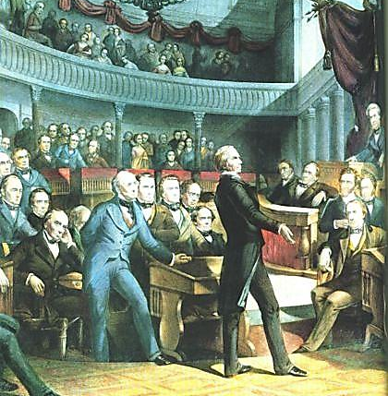
Many Congressmen called “War Hawks” demanded war with Britain to defend U.S. honor
“Free Trade and Sailors' Rights” was a popular battle cry

Slide 8
War Hawks
Young Democratic-Republican leaders
Wanted to protect American interests
Webster, Clay, Calhoun
Northerners
Seize Canada
Southerners
Seize Florida
All War Hawks
Stop impressment
Protect trade
Expand westward

Slide 9
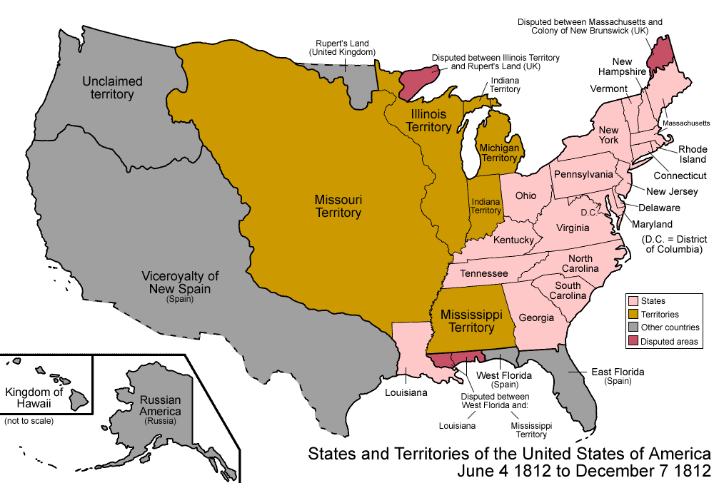
Which region would have supported a declaration of war the most?
Patriotism surged as War Hawks claimed the War of 1812 the “Second American Revolution”
Americans in the West & South wanted war to gain Canada & Spanish Florida
Madison eventually gave in & asked Congress for a declaration of war in June 1812
NE Federalists thought war with Britain as a mistake: they feared the U.S. could not defeat England & a war would bankrupt the country
Most calls for war centered on British interference with U.S. trade rights.
"Free Trade & Sailors' Rights" was a popular battle cry
By 1810, War Hawks in Congress, led by Henry Clay (KY) & John C. Calhoun (SC), demanded war with England
Notes:
23

Slide 10
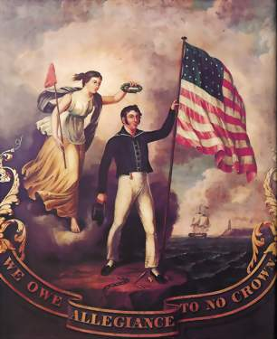
Text Analysis: Madison’s War Message

Slide 11
War for U.S. maritime (ocean trade) rights or a war for territory?
Northeasterners most directly concerned with maritime rights were largely opposed to the war
South & West, most strongly for territorial expansion, favored the war

Slide 12
Text Analysis
Federalist Opposition

Slide 13
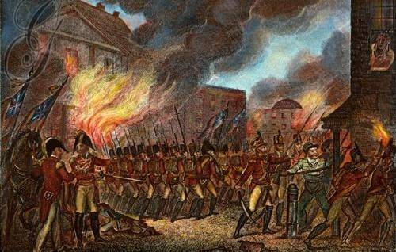
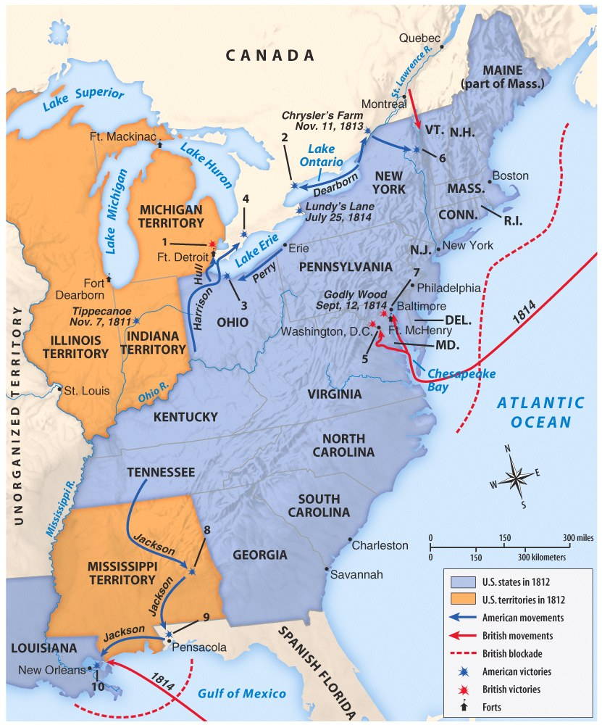
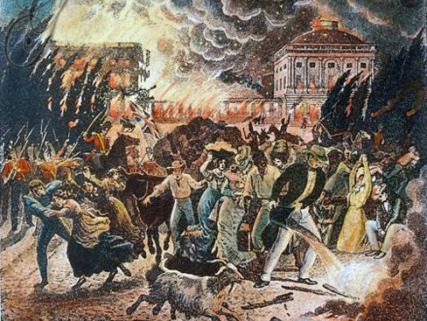
The War of 1812 (1812—1815)
The U.S. had a small navy and poorly trained army when the war began
Meanwhile, Britain’s well-trained army had been fighting France for a decade
The war went badly in the early years
The British attacked and burned the national capital Washington, D.C.
Notes:
12 ships vs. 800 ships!

Slide 14
War of 1812 Battles with Frontier Natives
Tecumseh’s War
Battle of Tippecanoe (1811)
Battle of the Thames (1813)
Creek War
Battle of Horseshoe Bend (1814)

Slide 15
Though Britain was winning, they were also fighting France and wanted to quickly end the War of 1812
In 1814, Britain and the United States signed the Treaty of Ghent ending the war

Slide 16
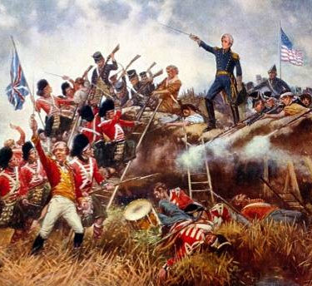
The War of 1812 (1812—1815)
Before news arrived, the Americans beat the British at the Battle of New Orleans
General Andrew Jackson emerged as a war hero
The victory at New Orleans led many Americans to feel as though they won the war

Slide 17
Death of Federalist Party
New England states opposed war
Dec. 15, 1814 - leading Federalists held Hartford Convention
Proposed 7 amendments to Const. to strengthen states rights (ironic!) & protect northern interests
Some hinted at secession though did not have support
Convention ill-timed – Americans thought we won and Federalists came off as weak

Slide 18
Text Analysis
Hartford Convention Resolutions

Slide 19
Hartford Convention (1814)
In order to reduce southern control of Congress
The War of 1812 is still going on!!
Platform
Federal economic assistance for New England
2/3 congressional majority for embargoes, state admission, and declaration of war
Rescind the Three-Fifths Compromise
One-term president and no same-state successor
Talk of secession by radicals
After War of 1812
Perceived as traitors
Effectively weakened as a national party
In order to break the Virginia presidential dynasty

Slide 20
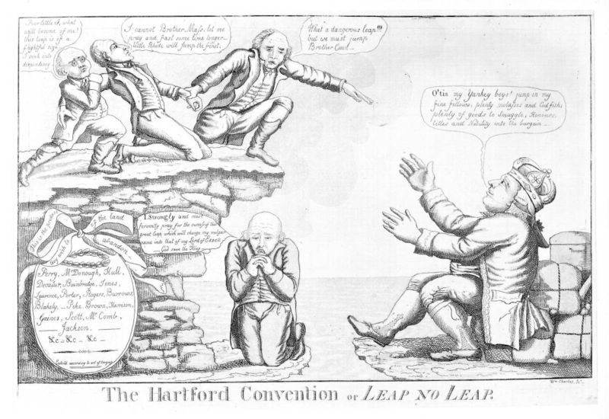

Slide 21
Treaty of Ghent
Treaty of Ghent did not address U.S. neutrality but was ratified unanimously by the Senate
Effects of the war:
Ended all Indian-British alliances in western lands
Scared Spain into signing the Adams-Onis Treaty in 1819
The lack of Federalist loyalty was the fatal blow to the party
‘Status Quo Antebelllum’
Spain ceded Florida to the USA
Notes:
27

Slide 22
Adams-Onis Treaty (1819)

Slide 23
War of 1812’s Impact
Growth of nationalism
Ushered in an “Era of Good Feelings”
Domestic industrial and manufacturing development
Emphasis on national infrastructure
Promotion of professional military
International respect
Natives significantly weakened
Increased drive to expand west

Slide 24
A National Perception
Fourth of July Celebration in Centre Square
John Lewis Krimmel, 1819

Slide 25
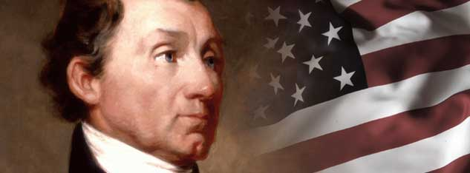
Era of Good Feelings James Monroe (D-R) (1817-1825)

Slide 26
The Era of Good Feelings: 1817-1825
Death of the Federalist Party
Adoption of many Federalist ideas
Monroe (Demo. Rep.) wins 1816 election
Americans nationalistic following War of 1812
U.S. foreign policy successes
Rush-Bagot Treaty (1817) – limit naval armaments on Great Lakes
Convention of 1818 – allowed joint occupation of Oregon territory with GB
Purchase of Florida (1819) – Adams-Onís Treaty
Notes:
Phrase coined by a Boston reporter
Federalist party dies out after Hartford Convention fiasco (1814)
Leaves Democratic-Republicans as the only major party
Demo-Reps under Madison had adopted Federalist ideas
Federal support for internal improvements (roads, etc.)
Tariff protection of new industries created during embargo
Creation of new national bank
1st Bank of U.S. charter expired in 1811
Monroe elected to two terms of office
Well-liked - even in one-time Federalist stronghold New England
“Victory” in war of 1812 made Americans enthusiastic supporters of the Natl. govt.
Gives Monroe a freer hand in foreign policy matters
Rush-Bagot Treaty between the U.S. & GB called for naval disarmament of the Great lakes
To this day - U.S./Canadian border is unfortified
Convention of 1818 fixes U.S./Canadian border at 49th parallel from Minnesota to Rockies
Florida purchased from Spain with Adams-Onis Treaty for $5 million
U.S. gives up on claim to Texas
Spain recognizes border between Mexico & Oregon Territory at 42nd Parallel
The South benefits most but treaty is widely supported

Slide 27
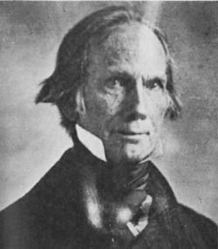
Era of Good Feelings The Great Triumvirate
WEST
Henry Clay of Kentucky
NORTH
Daniel Webster of Massachusetts
SOUTH
John C. Calhoun of South Carolina

Slide 28
Politics After the War of 1812
The Dem-Repubs traditionally represented limited gov’t, states' rights, & strict construction
But, without Federalist opposition, the Dem-Repubs adopted many traditionally Federalist policies:
National economic development
A permanent army
Transportation improvements
A national university in D.C.

Slide 29
Henry Clay’s American System
All were proposed by Hamilton & opposed by Republicans in the 1790s
1st significant protective tariff in U.S. history
Jefferson let the charter of the 1st BUS expire in 1811
Henry Clay’s American System in 1816 proposed the creation of:
The 2nd Bank of the U.S. to stabilize U.S. currency
Tariff of 1816 to promote U.S. industry & limit the importation of British manufactured goods
A nat’l system of roads & canals
The “American System” helped unify North, South, & West
Helped pave the way for future RR construction & western Indian removal

Slide 30
The American System
Brainchild of Henry Clay
Inspired by Hamilton’s economic plans
Fundamentals
Protective Tariffs
National Bank
Internal Improvements/Infrastructure
“Henry Clay's "American System," devised in the burst of nationalism that followed the War of 1812, remains one of the most historically significant examples of a government-sponsored program to harmonize and balance the nation's agriculture, commerce, and industry. This "System" consisted of three mutually reinforcing parts: a tariff to protect and promote American industry; a national bank to foster commerce; and federal subsidies for roads, canals, and other "internal improvements" to develop profitable markets for agriculture. Funds for these subsidies would be obtained from tariffs and sales of public lands. Clay argued that a vigorously maintained system of sectional economic interdependence would eliminate the chance of renewed subservience to the free-trade, laissez-faire "British System.”

Slide 31
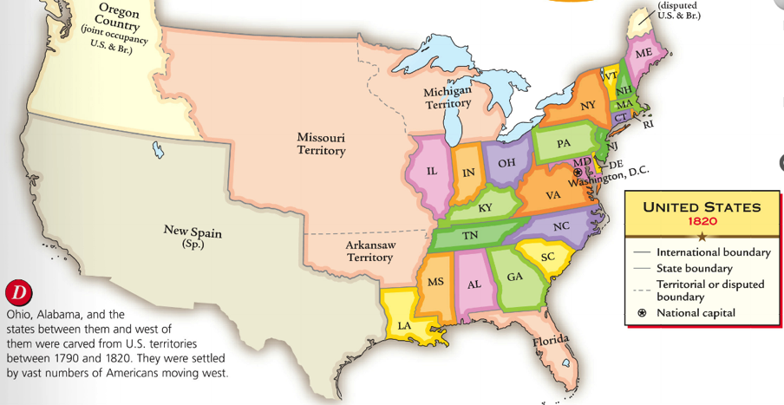
In the early Antebellum era (1800-1840), the U.S. economy grew rapidly
The South, North, and West each developed specialized regional economies that became connected into a national market economy

Slide 32
The American System Protective Tariffs
Purpose
Promote domestic industries
Generate federal revenue
Support
Northern industries expanded
Revenue mostly subsidized infrastructure in the North
South and West can benefit from Northern consumption of raw materials and crops
Opposition
West and South suffered through higher prices on manufactured goods
Southern plantations and farmers dealt with foreign competition

Slide 33
The American System Bank of the United States (BUS)
Purpose
Manage federal revenue
Regulate national credit and limit risky state/local banking
Facilitate commerce and trade
Stabilize and regulate national currency
Support
Democratize credit system between Eastern banking and credit-seeking Western and Southern farmers
Avoid speculation and economic panics
Opposition
Constitutional legitimacy
Perceived consolidation of wealth among baking and industrial elites

Slide 34
The American System Internal Improvements/Infrastructure
Purpose
More efficient commercial transportation
Roads, canals, turnpikes, harbors
Connect regional markets
Subsidized by federal revenue generated by land sales and tariffs
Support
Fulfilling the public good and general welfare
Opposition
Expansion of federal power over states
Benefits the wealthy at the expense of common man

