Slide 1
Do Now
Compare and contrast progressive policies of Roosevelt and Taft in their respective presidencies.

Slide 2
3. Wilsonian Progressivism
Mr. Winchell
APUSH 2018-2019
Period 7

Slide 3
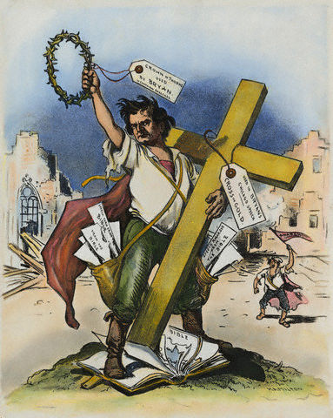
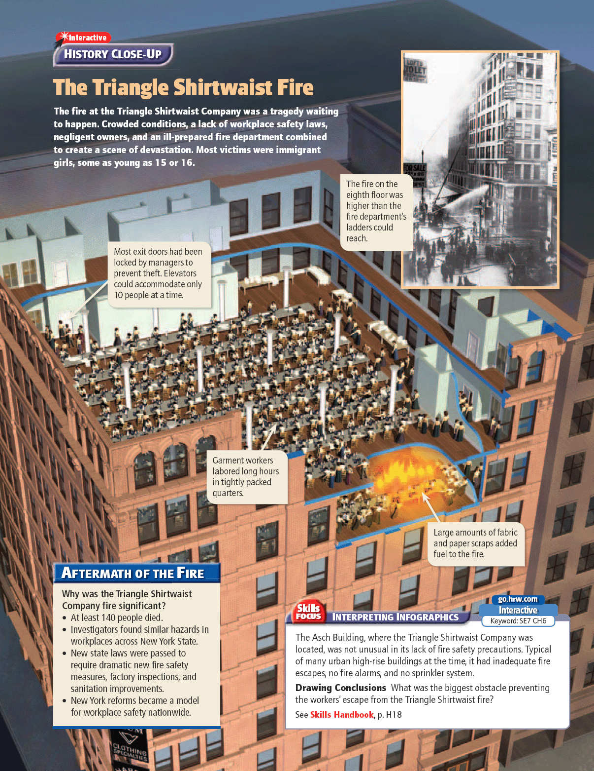
Roots of the Progressive Movement:
Origins can be traced to:
Populist era (Think: William Jennings Bryan and the Silver controversy, the Depression of 1893)
Sparks for dramatic activism:
Triangle Shirtwaist Factory Fire in 1911
Who were progressives, generally?
A mix of privileged, elite, middle class intellectuals, angry writers, and activists
They organized to educate the public , and lobby for new reforms to many problems in our country related to industrialization and rapid urbanization.
3

Slide 4
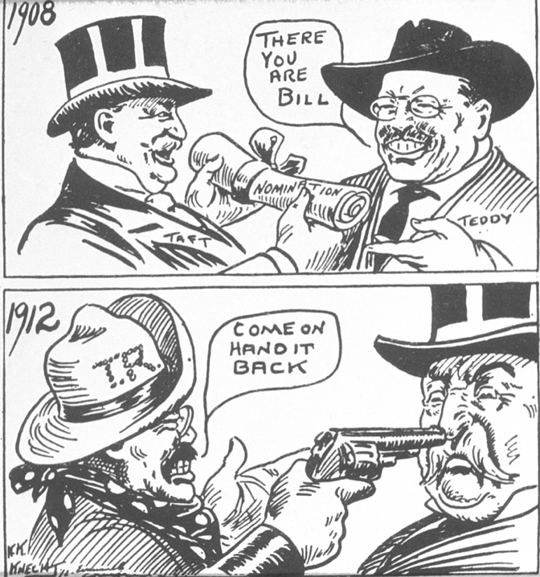

Slide 5
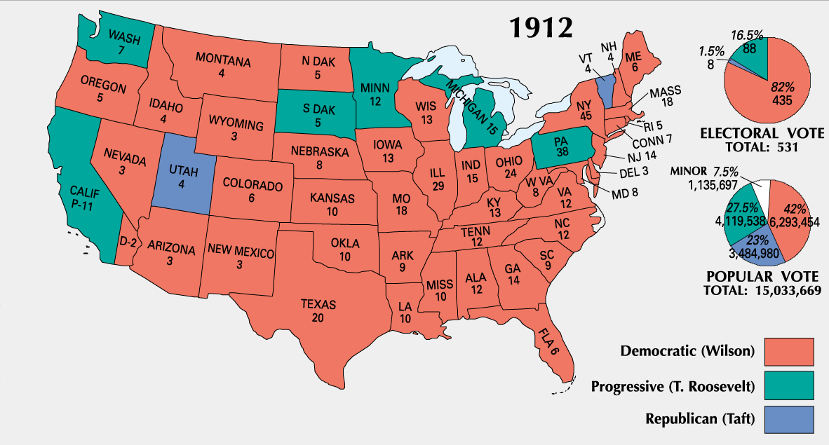

Slide 6
Woodrow Wilson’s ‘New Freedom’ 1913
Text Analysis Questions

Slide 7
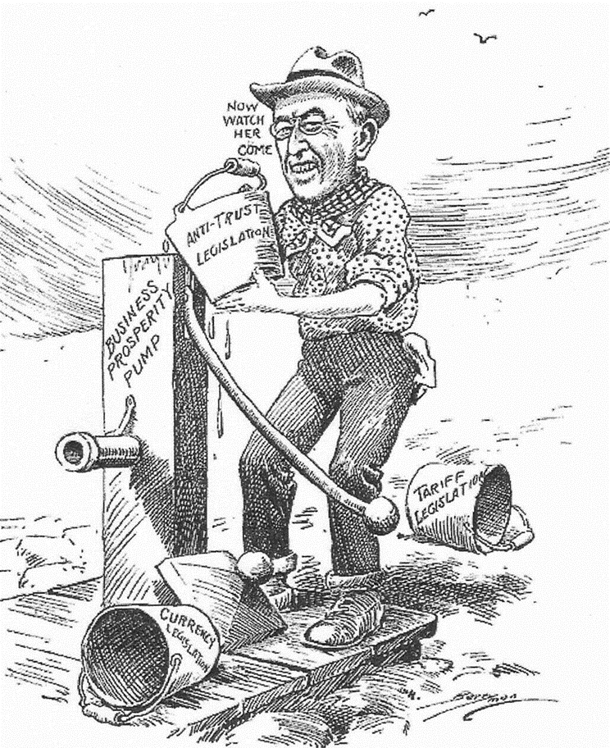
The “New Freedom”
Tear down the “triple wall of privilege”
Lower high tariffs
Regulate big business
Reform the banking system
“Priming the pump” for business growth

Slide 8
Woodrow Wilson/New Freedom
Lowers Tariffs
Wilson does not believe that any trusts were “good” trusts:
found it impossible to break them all up and so worked to control big corporations
Federal Trade Commission: Could investigate companies and order them to stop using unfair business practices
Clayton Anti Trust Act: Prohibited business practices that tried to destroy competition. It also protected Unions and Workers right to organize. (reinforced/clarified Sherman Anti-Trust Act)
Federal Reserve Act – regulated and centralized banking
Began Graduated Federal Income Tax

Slide 9
Woodrow Wilson's New Freedom
Wilson believed in strong, activist leadership & helped push through many “New Freedom” ideas:
Underwood Tariff Act (1913) reduced tariffs & created the 1st graduated income tax
Federal Reserve Act (1913): the Federal Reserve regulates the economy by adjusting the money supply & interest rates
1% tax for all, but 2% for the rich
The 1st efficient national banking system since Jackson destroyed the BUS in 1832
Notes:
(1913) was;

Slide 10
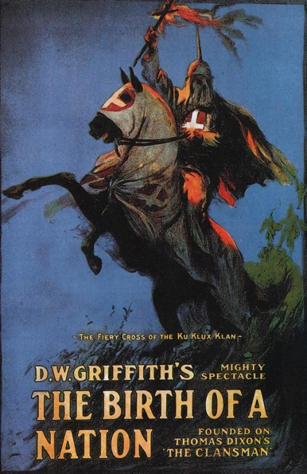
Wilson & African Americans
Segregation of federal offices
Discouraged African Americans from applying for federal employment
Praise for the Confederacy & KKK
The Birth of a Nation
1st film screened at the White House

Slide 11
Gov Steps in to Attack business: Laws Passed
Interstate Commerce Commission: Gov Agency to oversee = regulate on RR. (TR)
Elkins Act- regulate RR – no specials to friends (TR)
Hepburn Act- regulate RR- no free passes- Bribery (TR)
Meat Inspection Act-
Pure Food and Drug Act- Gov regulate food industry, and drugs- The Jungle- Upton Sinclair-
Clayton Anti-Trust Act- attacks Big Business (Wilson)
Federal Trade Commission-
Federal Reserve System- Organizes the Banking system, regulate the money supply
Federal Income Tax

Slide 12
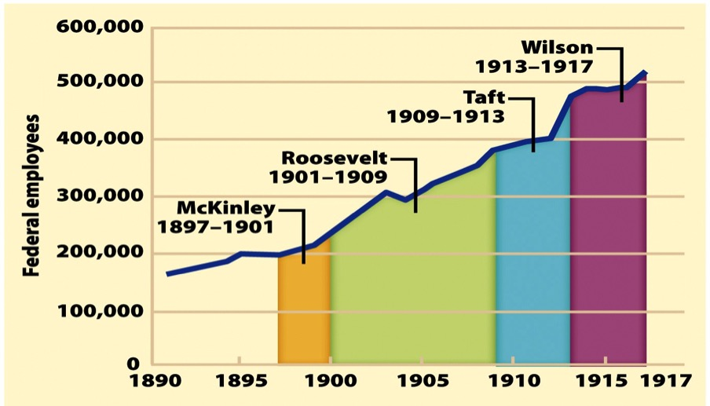
Look over the chart. How are these Presidents’ progressive reforms changing the federal government?

Slide 13
Progressive Constitutional Amendments
16th Amendment= Income Taxes
17th Amendment= Direct Election of Senators
Government of the People
Initiatives
Petition of enough voter signatures to force an election
Referendums
Legislative proposals determined by electorate
Recalls
Remove elected officials through local/state elections
18th Amendment= Prohibition of Alcohol
19th Amendment= Women’s Right to Vote

Slide 14
The Waning of the Progressive Movement
Progressive movement peaks by 1917
Success of the movement led to its decline
Advent of World War I also hurt progressive activism
Progressives themselves began to weary of their reform zeal—as did the nation as a whole
Ironically, voter participation has steadily declined since the election of 1912

Slide 15
Progressive Era: An Analysis
How could it be seen as effective?
Reforms: child labor, women’s labor
Increased participation in politics
17th amendment, 19th amendment, initiative, referendum, reform
Trusts were broken up
Ineffective?
African American Civil Rights Lacking

Slide 16
Overview of American Progressivism
Progressivism was not an organized movement; it was a general spirit of reform (or CHANGE) embraced by Americans with diverse goals and backgrounds during the early 20th century.
Progressives sought the advancement of humanity
(progress = improvement of mankind in an evolutionary sense. Think: Darwin) through reform of government , the economy, and society.
It first emerged as a response to the vast changes brought by industrialization.
It was an alternative to the traditional conservative response to social and economic issues (e.g. Pres. McKinley); then and, even today, it’s been associated with left-wing politics, and even more radical streams of communism or anarchism.
Progressivism was, thus, both forward-looking and backward-looking in its outlook.
2

