Slide 1
Do Now
Evaluate Wilson’s POV on business and the role of government.

Slide 2
3. Wilson’s America-Democratic Progressivism, World War I and the First Red Scare
Mr. Winchell
APUSH 19-20
Period 7

Slide 3
AP PROMPT
Evaluate the extent to which the role of the government changed from 1900-1920.

Slide 4
Outline
Wilson and Progressivism
US ‘Neutrality’ as War Begins
US Enters the Conflict
The War ‘Over Here’
Economic Policies
Political Policies
Nativism
Great Migration
Conclusions and an Opportunity Missed

Slide 5
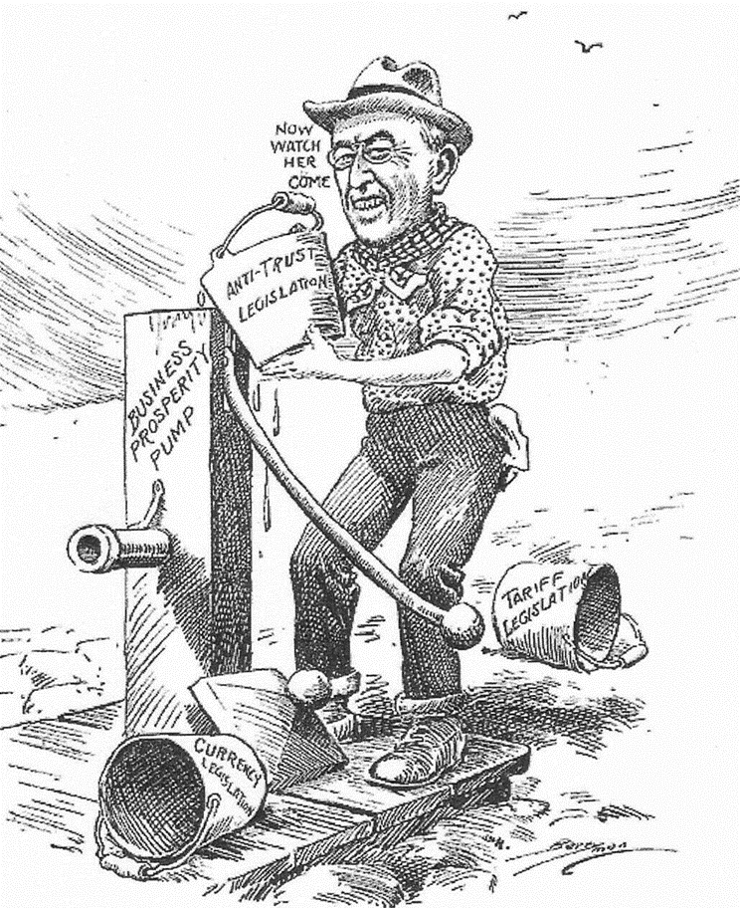
The “New Freedom”
Tear down the “triple wall of privilege”
Lower high tariffs
Regulate big business
Reform the banking system
“Priming the pump” for business growth

Slide 6
Woodrow Wilson/New Freedom
Lowers Tariffs
Wilson does not believe that any trusts were “good” trusts:
found it impossible to break them all up and so worked to control big corporations
Federal Trade Commission: Could investigate companies and order them to stop using unfair business practices
Clayton Anti Trust Act: Prohibited business practices that tried to destroy competition. It also protected Unions and Workers right to organize. (reinforced/clarified Sherman Anti-Trust Act)
Underwood Tariff Act (1913) reduced tariffs & created the 1st graduated income tax
Federal Reserve Act – regulated and centralized banking
1% tax for all, but 2% for the rich
The 1st efficient national banking system since Jackson destroyed the BUS in 1832

Slide 7
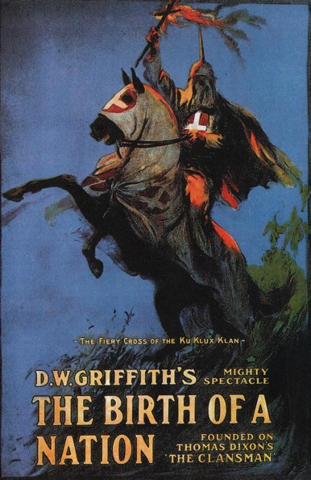
Wilson & African Americans
Segregation of federal offices
Discouraged African Americans from applying for federal employment
Praise for the Confederacy & KKK
The Birth of a Nation
1st film screened at the White House

Slide 8
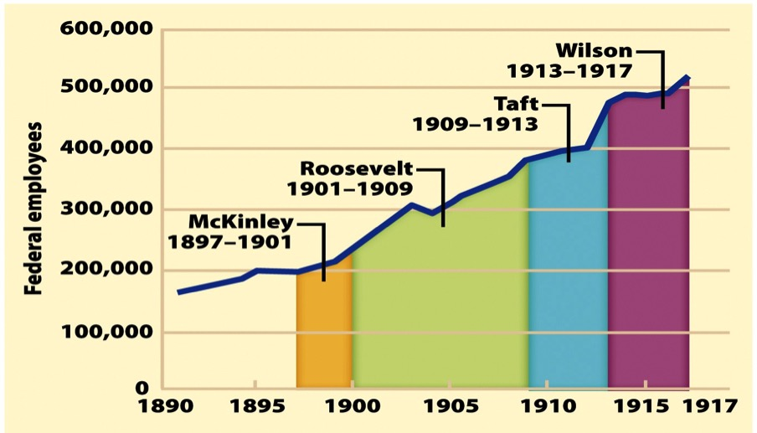
Look over the chart. How are these Presidents’ progressive reforms changing the federal government?

Slide 9
Progressive Amendments:
Political Reforms
16th Amendment
17th Amendment
18th Amendment
19th Amendment
This gave Congress the power to levy (impose) an income tax.
This called for direct election of Senators.
Prohibited the manufacture and sale of alcoholic beverages.
This gave women the right to vote.

Slide 10
Progressive Era: An Analysis
How could it be seen as effective?
Reforms: child labor, women’s labor
Increased participation in politics
17th amendment, 19th amendment, initiative, referendum, reform
Trusts were broken up
Ineffective?
African American Civil Rights Lacking

Slide 11
The Waning of the Progressive Movement
Progressive movement peaks by 1917
Success of the movement led to its decline
Advent of World War I also hurt progressive activism
Progressives themselves began to weary of their reform zeal—as did the nation as a whole
Ironically, voter participation has steadily declined since the election of 1912

Slide 12
Thesis Check
Evaluate the extent to which the Progressive Era changed the role of government from 1900-1920.

Slide 13
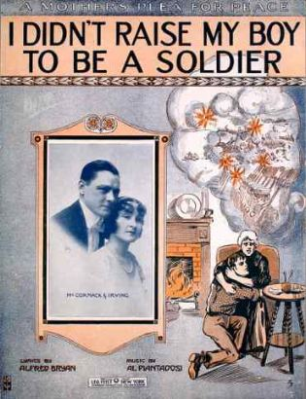
War breaks out in Europe in 1914
Most Americans saw no reason for involvement in a European war
No direct threat to U.S.
Most favored allies but not strongly enough to help
German invasion of neutral Belgium viewed negatively – especially slaughter of civilians

Slide 14
Freedom of the Seas
England began a blockade around Germany to cut off war supplies:
Wilson protested that the blockade infringed on America’s right to trade as a neutral nation
But the flood of Allied war orders helped fuel the U.S. economy
Loans & trade drew the U.S. closer to the Allies while trade with Germany all but ended
By 1916, the U.S. was a “neutral” nation in name only
The U.S. gave $2.5 billion in loans to the Allies, but only $27 million to the Central Powers
Trade with the Allies caused U.S. trade to jump from $2 billion to $6 billion from 1913 to 1916
Notes:
11

Slide 15
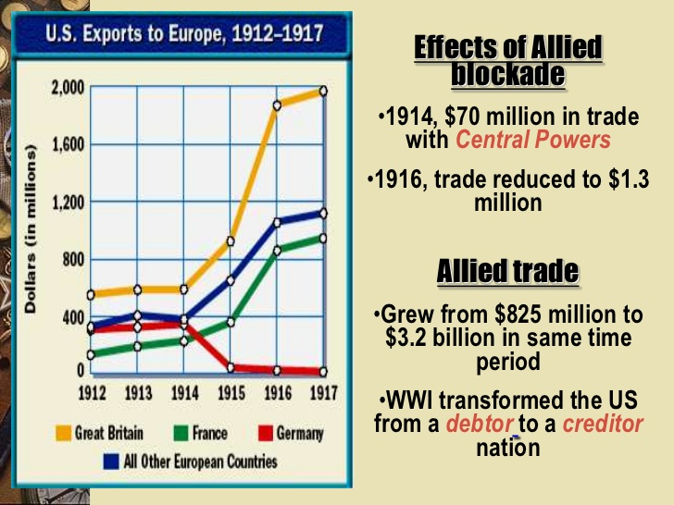
US War Policy
Neutral militarily, not economically

Slide 16
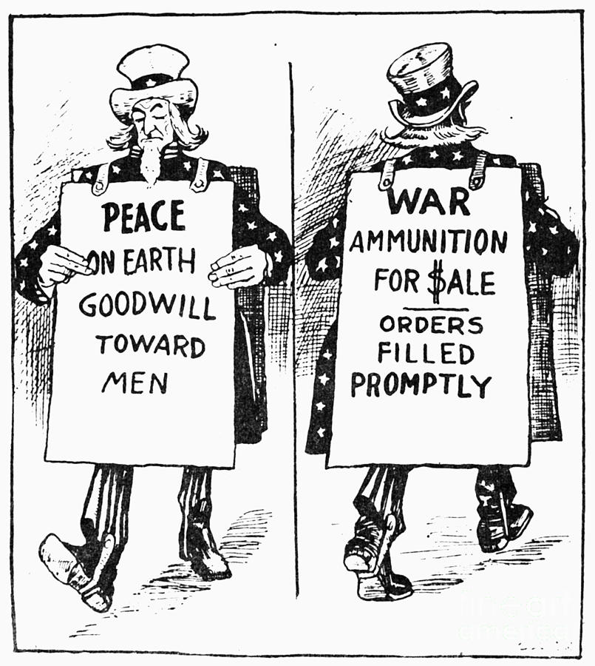

Slide 17
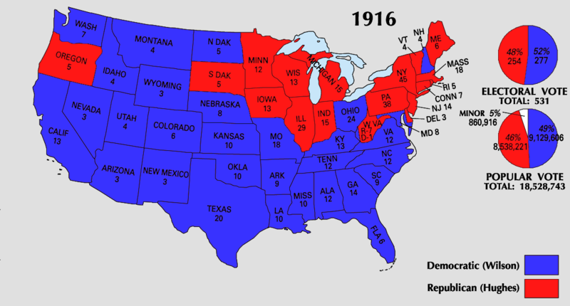
Election of 1916
In the 1916 election, Wilson balanced contrasting stances:
He appealed to progressives & anti-war voters with the slogan “He kept us out of war”
But argued for “preparedness” by building up the military in case the U.S. joins the war
Wilson won by affirming 2 goals: freedom of the seas & neutrality
Notes:
13

Slide 18
The Final Straw(s)
Unrestricted Submarine Warfare (Feb. 1917)
Early February 1917 -- Germany decided to pursue “unrestricted submarine warfare”
Tell Wilson on January 31st, he cuts off diplomatic ties

Slide 19
The Final Straw(s)
Zimmerman Telegraph (March 1, 1917)
Coded message from Germany to Mexico.
Says if Mexico attacks US, Germany will help Mexico take back Arizona, New Mexico and Texas.
British intercepted, decoded and sent to the US

Slide 20
The Final Straw(s)
Russian Revolution (March 15, 1917)
Czar Nicholas II of Russia is toppled from power and Russia is taken over by a republican government (no communists yet) Russia not a monarchy -- now it is a war between democracy & autocratic rule

Slide 21
America Enters the War
Wilson asks Congress for a declaration of war-April 2, 1917
‘War has been thrust upon America by the German Empire…’
Senate 62-6
House 373–50
What impact did US soldiers have on the war?
American Expeditionary Forces-SMALL role in combat
America’s military resources of soldiers and war materials tipped the balance of the war and led to Germany’s defeat.

Slide 22
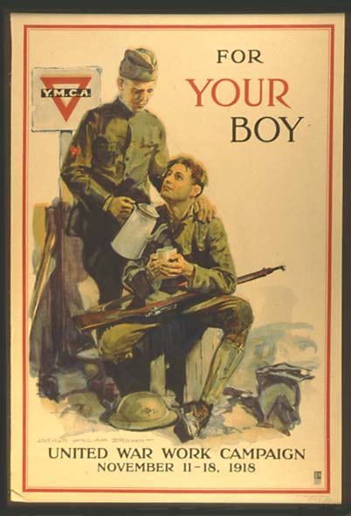
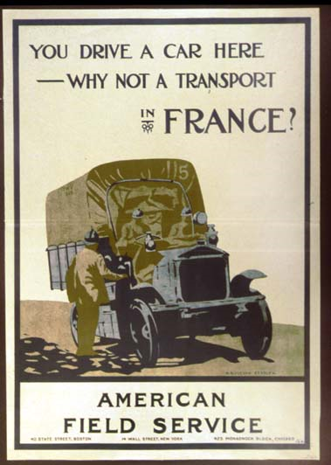
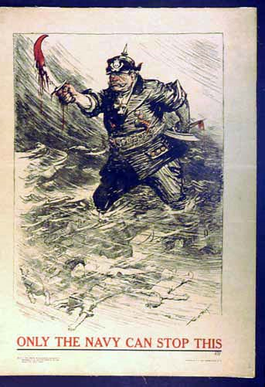
The Yanks are coming! US “Doughboys”

Slide 23
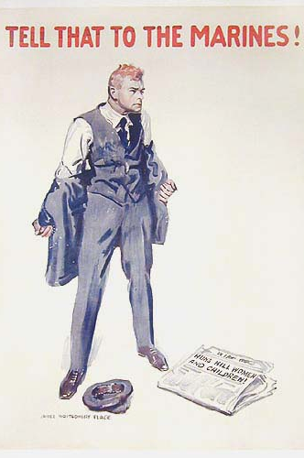

Slide 24
Wilson’s ‘Fourteen Points’
Text Analysis Questions

Slide 25
A Bureaucratic War
To coordinate the war effort, 5,000 new gov’t agencies were created:
War Industries Board (WIB) oversaw all factories, determined priorities, fixed consumer prices
Food Admin supplied food to soldiers by appealing to civilians
Fuel Admin rationed coal & oil
RR Admin, War Shipping Board, & War Trade Board helped move resources to troops
Imposed “gasless” days & shut down factories for days to divert or conserve fuel
WIB director Bernard Baruch became the “dictator of the American economy”
Asked for a spirit of self-sacrifice, imposed “meatless” & “wheat-less” days & encouraged Americans to plant “victory gardens”
Notes:
18

Slide 26
Workers in the War
The war called for more laborers:
8 million women found new, better-paying jobs in war industry (but few housewives entered the workforce, unlike WW2)
450,000 Southern African Americans moved north for new industrial jobs & better pay (led to race riots)
100,000 Mexican-Americans laborers worked in SW farms & ranches
Notes:
20

Slide 27
Workers in the War
WWI led to a new alliance between the gov’t & labor unions:
AFL headman Gompers was named to the Council of Nat’l Defense to help enlist union support for the war effort
War Labor Board (WLB) was formed to standardize wages & hours, protect union rights, & give equal pay for women
Notes:
19

Slide 28
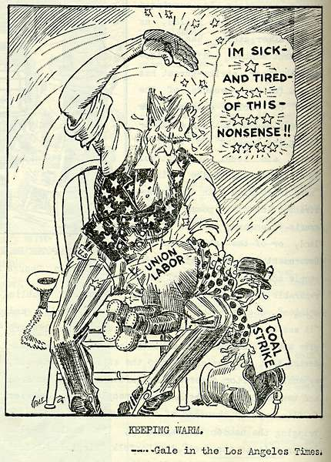
Coal Miner’s Strike 1919
But the WLB seized companies during strikes (national interests come first!)
“Keeping Warm” Los Angeles Times

Slide 29
Homefront Propaganda
Wilson formed the Committee on Public Information (CPI) & hired muckraker George Creel to publicize the U.S. war effort:
Voluntary censorship in press
75,000 “4-minute men” gave speeches (facts or emotions?)
Propaganda motion picture films
Led to sweeping anti-German sentiment & some vigilantism
RACE AND THE 18th AMENDMENT
“Why We Are Fighting” & “The Meaning of America”
Sauerkraut was renamed “Liberty Cabbage” & pretzels were no longer served in bars
The Prussian Curse &
The Kaiser, the Beast of Berlin
Bach, Beethoven, & Brahms were not played in symphonies
Notes:
17

Slide 30
American Domestic Insecurity
American Protective League (APL)
Espionage Act of 1917
Prohibition of:
Interfere in military operations
Interfere in military recruitment
Support of U.S. enemies
Promote insubordination
"The question in every case is whether the words used are used in such circumstances and are of such a nature as to create a clear and present danger that they will bring about the substantive evils that the United States Congress has a right to prevent. It is a question of proximity and degree. When a nation is at war, many things that might be said in time of peace are such a hindrance to its effort that their utterance will not be endured so long as men fight, and that no Court could regard them as protected by any constitutional right.“
Schenk v. United States (1919)
Abrams v. United States (1919)
Sedition Act of 1918
In times of war:
Prohibit disloyal, profane, scurrilous, abusive language against U.S. government, military, and flag
Wilson set out to encourage U.S. unity (like Lincoln during the Civil War, Wilson was willing to use force if needed)

Slide 31
Homefront Censorship
Schenk was sentenced for conspiracy to circulate pamphlets encouraging soldiers to mutiny
Eugene V. Debs was jailed when his Socialist newsletter Appeal to Reason encouraged Americans to resist enlisting in the military to fight a “capitalists’ war”
First Amendment restrictions were upheld by the Supreme Court:
3 cases were decided in 1919: Schenk v US, Debs v US, Abrams v US that supported gov’t convictions under the Espionage Act of 1917
The gov’t used the wartime climate to undermine radical labor unions (IWW) & socialism
Socialism in the U.S. never recovered from WWI attacks
Defendants passed out documents that denounced the sending of U.S. troops to Russia (to resist the Bolshevik Revolution) & that called for a general strike & other “revolutionary actions”
1st Amendment rights can be restricted when it presents a “clear & present danger”
(Like “yelling ‘fire’ in a crowded theater”)
Notes:
Schenck v. United States
Citation: 249 U.S. 47 (1919) Concepts: Clear & Present Danger/Free Speech v. Congressional War Powers
Facts
Charles T. Schenck and Elizabeth Baer, charged with conspiring to print and circulate documents intended to cause insubordination within the military, were convicted of violating the Espionage Act of 1917. The act made it a crime to “willfully cause or attempt to cause insubordination, disloyalty, mutiny, or refusal of duty in the military ... or to willfully obstruct the recruiting service of the United States.” Schenck appealed the conviction to the Supreme Court of the United States, claiming all his actions were protected by the First Amendment.
Issue
Whether Schenck’s and Baer’s First Amendment right to freedom of speech were violated when they were convicted of conspiring to obstruct the recruitment and enlistment of service.
Opinion
The Court unanimously upheld the conviction of Schenck, not for violation of the Espionage Act, but rather for conspiracy to violate it. The Court found that the First Amendment did not apply in this case, and that Schenck’s speech was not constitutionally protected because it posed a “clear and present danger” to the country. The nation was involved in World War I, and the Court saw Schenck’s speech and action as counter-productive to the national war effort. The Court reasoned that certain speech could be curtailed, using the example of a situation where one cannot yell “fire” in a crowded theatre.
Debs v. United States
Citation: 249 U.S. 211 (1919) Concepts: Free Speech v. Congressional War Powers
Facts
Eugene V. Debs, a well-known socialist, gave a public speech to an assembly of people in Canton, Ohio. The speech was about the growth of socialism and contained statements which were intended to interfere with recruiting and advocated insubordination, disloyalty, and mutiny in the armed forces. Debs was arrested and charged with violating the Espionage Act of 1917.
Issue
Whether the United States violated the right of freedom of speech given to Debs in the First Amendment of the United States Constitution.
Opinion
The Supreme Court of the United States upheld the lower court’s decision in favor of the United States. The Court said that Debs had actually planned to discourage people from enlisting in the Armed Forces. The Court refused to grant him protection under the First Amendment freedom of speech clause, stating that Debs “used words [in his speech] with the purpose of obstructing the recruiting service.” Debs’ conviction under the Espionage Act would stand, because his speech represented a danger to the safety of the United States.
Abrams v US
Facts of the Case
The defendants were convicted on the basis of two leaflets they printed and threw from windows of a building. One leaflet signed "revolutionists" denounced the sending of American troops to Russia. The second leaflet, written in Yiddish, denounced the war and US efforts to impede the Russian Revolution. The defendants were charged and convicted for inciting resistance to the war effort and for urging curtailment of production of essential war material. They were sentenced to 20 years in prison.
Question
Do the amendments to the Espionage Act or the application of those amendments in this case violate the free speech clause of the First Amendment?
Conclusion
No and no. The act's amendments are constitutional and the defendants' convictions are affirmed. In Clarke's majority opinion, the leaflets are an appeal to violent revolution, a call for a general strike, and an attempt to curtail production of munitions. The leaflets had a tendency to encourage war resistance and to curtail war production. Holmes and Brandeis dissented on narrow ground: the necessary intent had not been shown. These views were to become a classic libertarian pronouncement.

Slide 32
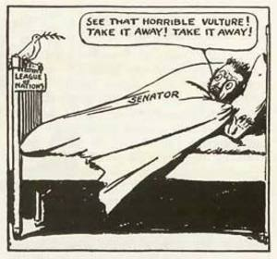
Wilson and Peace
Fourteen Points
“peace without victory”
Freedom of the seas
Self-determination
League of Nations
Treaty of Versailles
German guilt, reparations
League of Nations
Wilson and Senate Treaty Ratification
Senate Opposition
Irreconcilables
Strongly opposed the Treaty of Versailles
Reservationists
Henry Cabot Lodge
Amendments to Treaty to limit American involvement
Wilson’s Public Campaign
Wilson debilitated by a stroke from exhaustion
Senate rejects Treaty and League of Nations
U.S. will eventually negotiate separate treaties

Slide 33
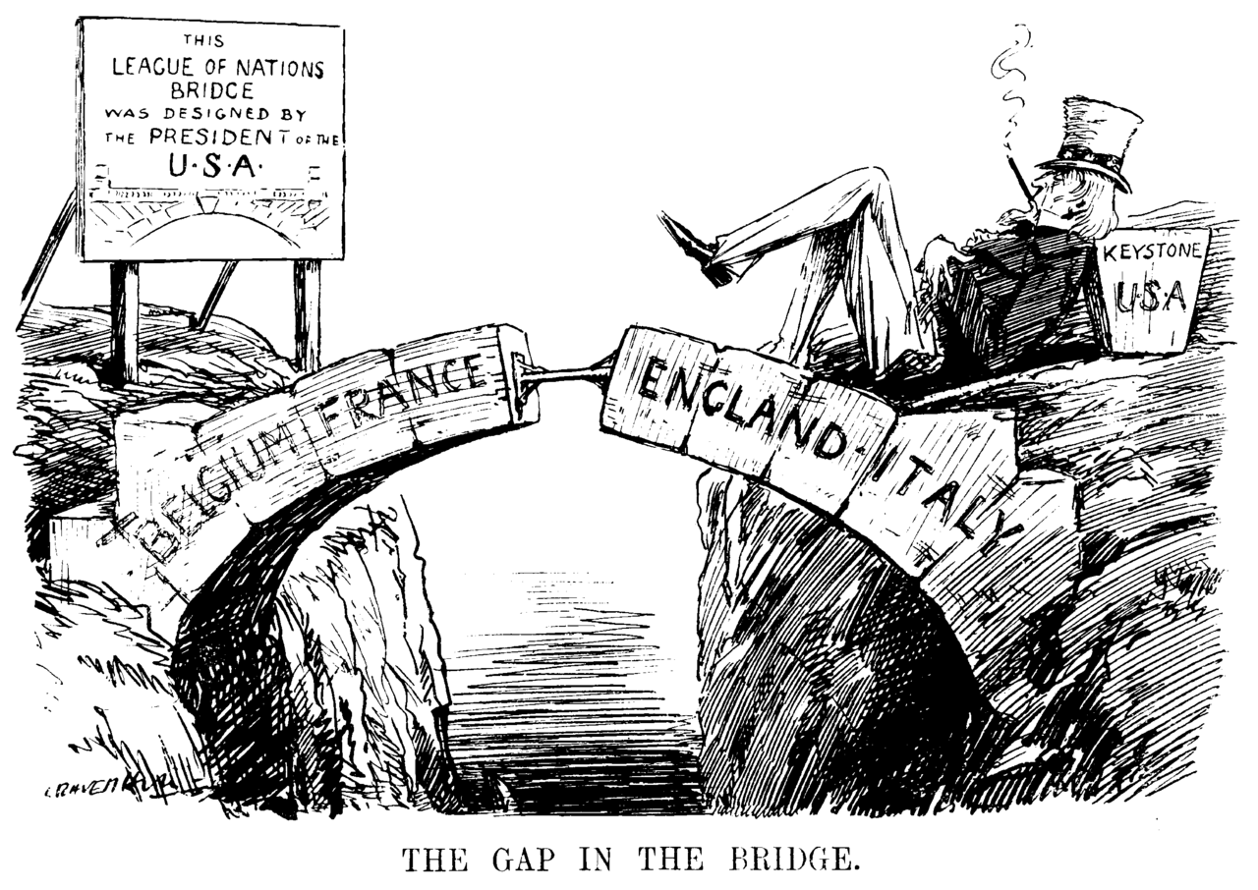

Slide 34
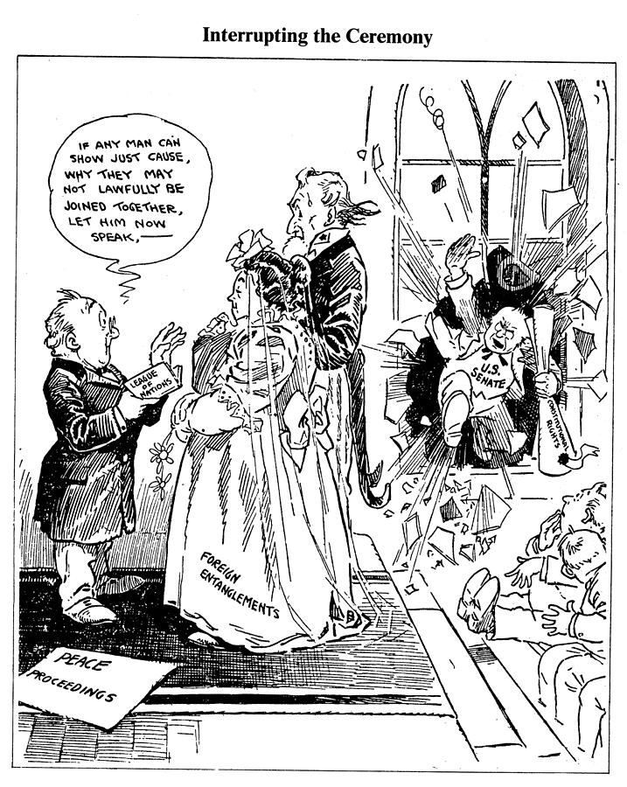

Slide 35
Postwar America Labor Unions and Strikes
Causes
Unions wanted to preserve labor gains during war
Post-war inflation demanded higher wages
Union Membership
AFL supported WWI
AFL reached 4 million by 1920
IWW opposed WWI
Lost membership
Strikes of 1919
Seattle General Strike
Boston Police Strike
Steel Strike
Coal Strike
Public Perception
Association with radicals
Strikes causes product shortages

Slide 36
Postwar America Race Riots
Red Summer of 1919
Three dozen cities experienced race riots
Economic competition and First Red Scare
Chicago (July-August)
Blacks react to stoning of young man
Omaha (September)
Brutal lynching of William Brown

Slide 37
Postwar America First Red Scare
Causes
War Propaganda
Overman Committee
Russian Revolution
Strikes and Riots
Targets
Anarchists, Bolsheviks, Socialists, Communists, Wobblies
1919 Bombings
Attorney General A. Mitchell Palmer
Palmer Raids
Deportations

