Slide 1
Do Now
What was popular sovereignty and how was it intended to solve the sectional problem of expansion of slavery on a national level?

Slide 2
Bleeding Kansas
Mr. Winchell
APUSH 2018-2019
Period 5

Slide 3
AP Prompt
SAQ Practice

Slide 4
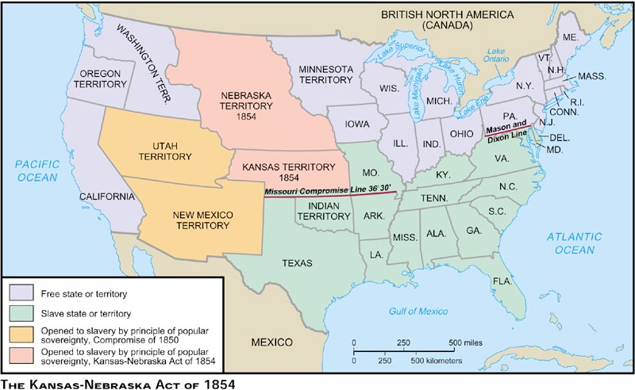
Kansas-Nebraska Act, 1854

Slide 5
“Bleeding Kansas” (1854-1858)
The Kansas-Nebraska Act (1854) proposed popular sovereignty
The vote to determine slavery in Kansas turned into a bloody small-scale civil war
Republicans benefited from the fighting by using “Bleeding Kansas” propaganda to support their anti-slave cause
Pro-slavery residents created Kansas’ first territorial legislature & wrote laws protecting slavery
Free soilers created a rival territorial gov’t that was not recognized by President Pierce
Notes:
13

Slide 6
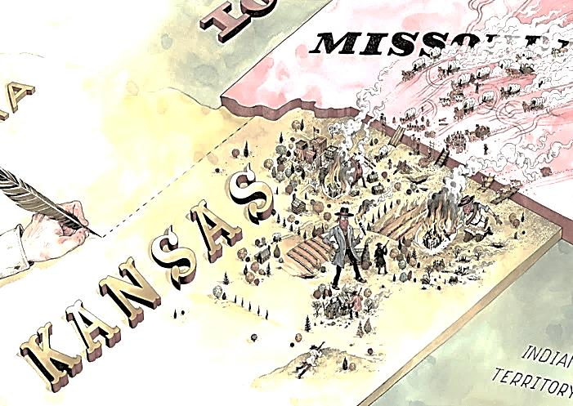
Pro-Slavery Border Ruffians

Slide 7
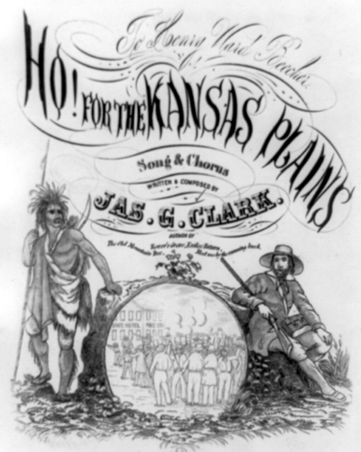
Anti-Slavery New England Emigrant Aid Company
Aided Free-Soilers who wanted to move to Kansas

Slide 8
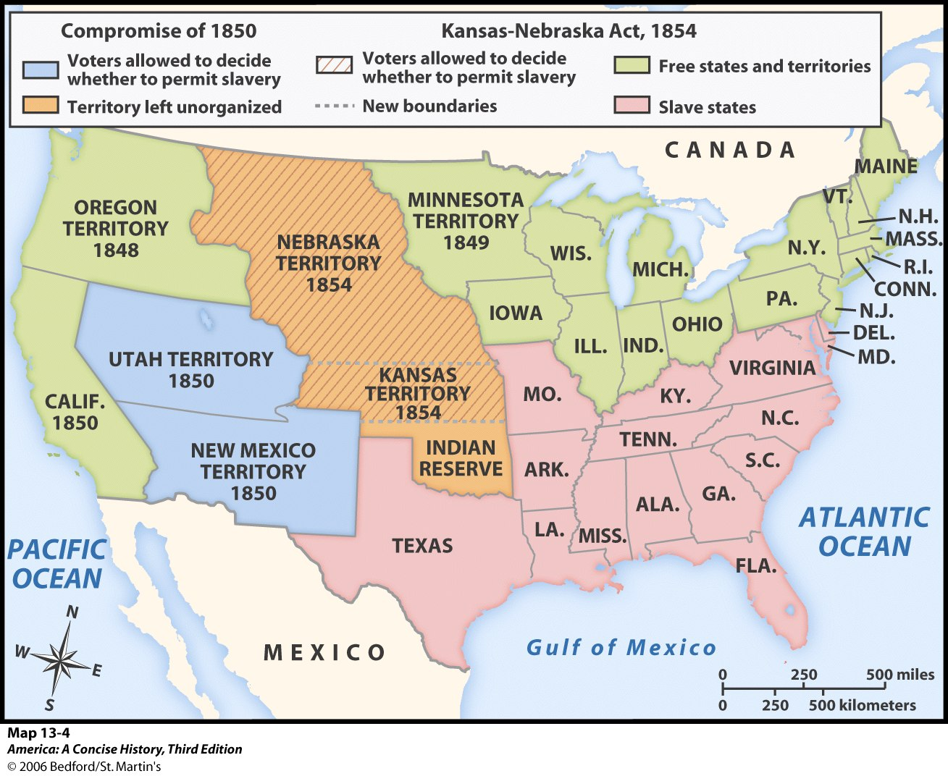
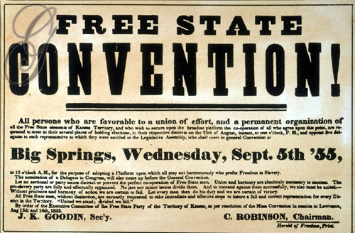
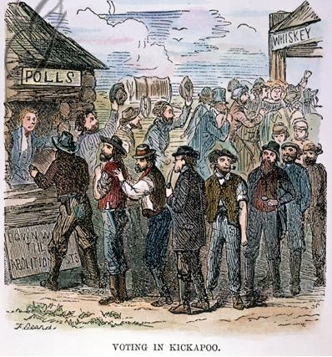
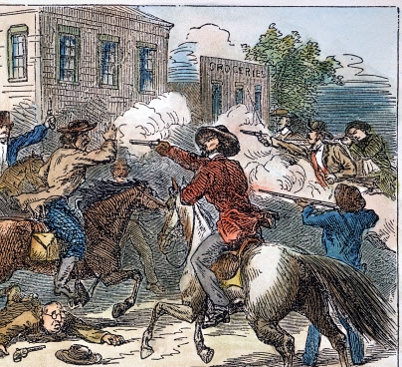
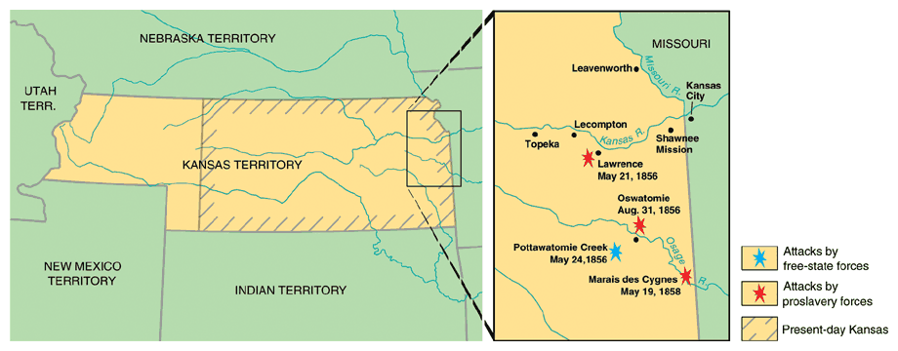
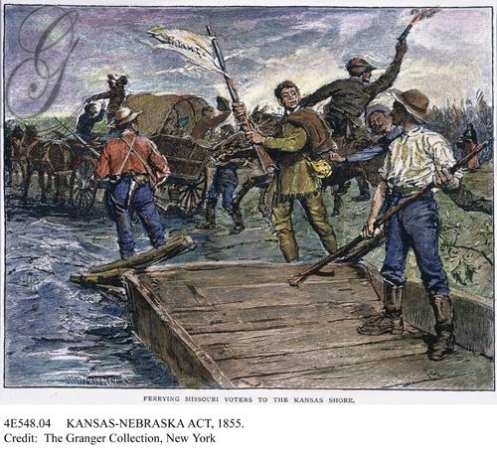
The vote revealed a pro-slavery victory which led to a violent civil war in Kansas
This incident became known as “Bleeding Kansas”
Thousands of pro-slavery Missouri residents crossed the border & voted for slavery
Free-soilers from Kansas voted against slavery
Notes:
The resulting pro-slavery victory, led to

Slide 9
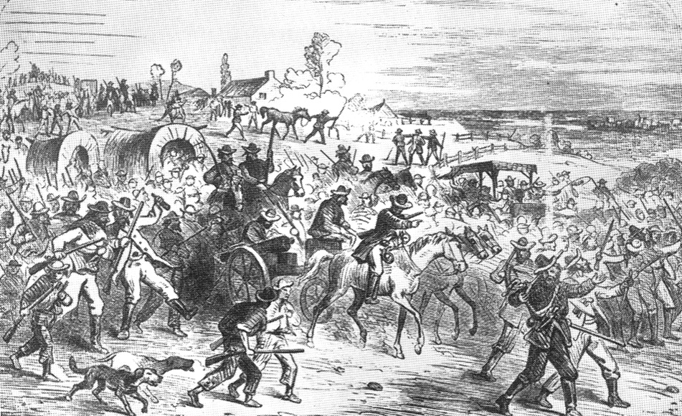
“Bleeding” Kansas
Anti-slavery and pro-slavery forces both organized in opposition to each other, leading to violence.
Ex: Proslavery men (800) burned down the Abolitionist headquarters, printing presses, and looted homes/stores in Lawrence (anti-slavery town) – called the Sack of Lawrence.
John Brown (abolitionist who stated God had sent him to fight slavery) - attacked the settlement of Pottawatomie and killed 5 men.
Known as the Pottawatomie Massacre - led to more violence and guerilla warfare
(200+ deaths as a result!).
Nicknamed Bleeding Kansas!
Lecompton Constitution v. Topeka Constitution (1856)

Slide 10
“Bleeding” Kansas bleeds into Washington DC
May 1854 - Violence from Bleeding Kansas makes its way to DC!
Sen. Charles Sumner (Mass) gave a speech attacking slavery.
Sen. Andrew Butler (SC) a slavery defender - enraged by the speech.
A few days later… Butler’s nephew (Preston Brooks) attacks Sumner on the floor of the Senate with a cane until he was unconscious – known as the Sumner Caning.
Sumner - injured so severely that he couldn’t return to the Senate for four years.
Both Sumner and Brooks became heroes in their own regions (N & S).
Violence over slavery is everywhere and further splits the N and S.

Slide 11
Brooks-Sumner Incident May 22, 1856
Senator Charles Sumner (R) (MA)
‘Crime Against Kansas’ Speech
Rep. Preston Brooks (D) (SC)
Becomes a Southern hero
Enjoy!

Slide 12
