Slide 1
Culture, Politics and Economics of the 1920s
Mr. Winchell
APUSH
Period 7

Slide 2
1920s Politics

Slide 3
Politics of the 1920s
The 1920s were dominated by Republicans in the White House & in both houses of Congress:
Limited Progressive reforms
Developed a close relationship between the gov’t & business that promoted private enterprise
Advocated a foreign policy based on economic investment of U.S. business in the world
Notes:
Although divided into rural & urban sects, Democrats were setting stage for future dominance, especially among urban voters

Slide 4
Republican Presidents of the 1920s
Warren Harding won the 1920 election promising “a return to normalcy”; his presidency is remembered for two things:
Corruption: prohibition bribery, graft in the Veterans Admin, & the Teapot Dome scandal
Treasury Sec Andrew Mellon’s cutback on gov’t spending, increase in protective tariffs, & reduction of income taxes
TR set aside oil fields in WY & CA for the navy; Harding’s Sec of the Interior Albert Fall accepted $400,000 to “lease” oil reserves to businesses
Notes:
Background: Origins of the scandal date back to the popular conservation legislation of presidents Teddy Roosevelt, William Taft and Woodrow Wilson, specifically as to the creation of naval petroleum reserves in Wyoming and California. Three naval oil fields, Elk Hills and Buena Vista Hills in California and Teapot Dome in Wyoming, were tracts of public land that were reserved by previous presidents to be emergency underground supplies to be used by the navy only when the regular oil supplies diminished. The Teapot Dome oil field received its name because of a rock resembling a teapot that was located above the oil-bearing land. Many politicians and private oil interests had opposed the restrictions placed on the oil fields claiming that the reserves were unnecessary and that the American oil companies could provide for the U.S. Navy.

Slide 5
Republican Presidents of the 1920s
Harding died in 1923 & VP Calvin Coolidge became president & won his own term in 1924:
Coolidge’s honesty & integrity was reassuring, but “Silent Cal” was not much of a leader
Coolidge continued Harding’s policies of less gov’t spending, lowering income taxes, & limiting Congressional legislation
“Four-fifths of our troubles in this life would disappear if we would just sit down & be still”
“Coolidge aspired to become the least president the country ever had; he attained his desire”

Slide 6
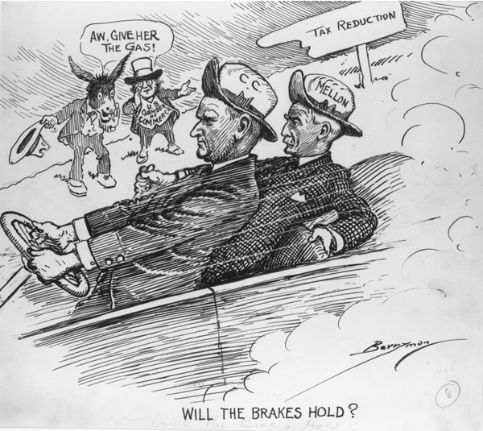
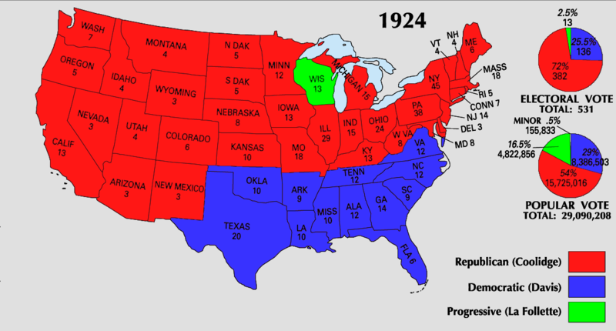

Slide 7
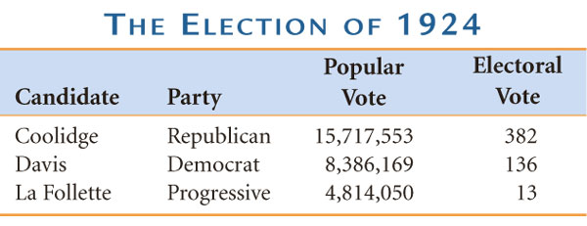
The Divided Democrats
But urban voters had clearly had turned to the Democratic Party, they just needed a charismatic leader to unite the party
While the Republicans dominated the gov’t, Democrats were split:
Rural Dems in the south & west favored prohibition, traditional Protestant values, & the Klan
Urban Democrats were mostly immigrants
The Democratic Nat’l Convention in NYC for the 1924 presidential nomination exposed this polarity
Neither urban nor rural Dem candidate could win majority so compromise candidate, John Davis of WV
Davis received fewest popular votes of any Democratic candidate in 20th century

Slide 8
The 1928 election reflected a divided USA:
Herbert Hoover
Republican
Protestant
For prohibition
Native-born
Self-made millionaire committed to business & volunteerism
A new urban voting bloc was revealed in 1928: For the 1st time, Democrats won the majority of votes in the 12 largest U.S. cities
Alfred Smith
Democrat
Catholic
“Wet”
Of immigrant parents
Rose through Tammany Hall to be a progressive NY governor
Smith appealed to new voters in cities but alienated old-line Democrats; Catholicism hurt Smith more than anything else

Slide 9
Herbert Hoover
Instead of the laissez-faire of Gilded Age, the Republican presidents of the 1920s pioneered a close relationship with business
Herbert Hoover proved to be the most effective of the Republican presidents of the 1920s:
He believed in free enterprise & tried to strengthen U.S. trade by allying business with the gov’t
He doubled the size of the U.S. bureaucracy by creating bureaus to oversee housing, transportation, & mining
He was experienced having served as head of Wilson’s Food Admin & as Commerce Sec for Harding & Coolidge

Slide 10
Economics of the 1920’s

Slide 11
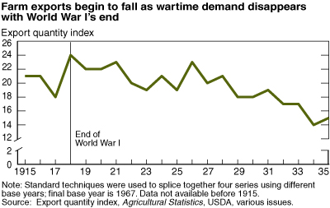
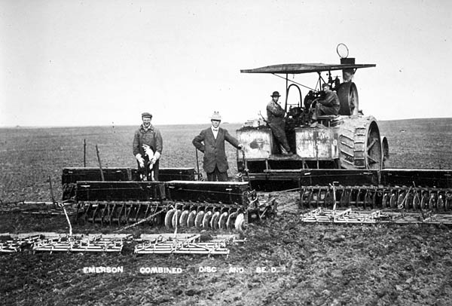
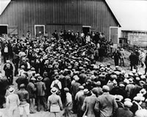
an agri. depression in early 1920's contributed to this urban migration
U.S. farmers lost agri. markets in postwar Europe
at same time agri. efficiency increased so more food produced (more food = lower prices) and fewer labourers needed
so farming was no longer as prosperous, and bankers called in their loans (farms repossessed)
so American farmers enter the Depression in advance of the rest of society

Slide 12
Economic Weaknesses
The “Roaring 20s” was not as prosperous as it appeared:
RR, cotton textile, coal industries suffered due to new competition
Farmers boomed during WWI but a decline in demand after the war deflated farm prices
Farm per capita income was $273 per year vs. the U.S. average of $681 per year

Slide 13
Economic Weaknesses
Union membership dropped due to improved conditions & links to Debs’ “radical socialism”
Northern migration of blacks grew but workers gained menial jobs & faced racism
Growth in income was unequal with middle-class managers, bankers, engineers benefiting the most from the new affluence

Slide 14
The Second Industrial Revolution
The increase of national name brands (rather than locally produced goods) linked Americans more than ever
From 1922 to 1929, the U.S. had a 2nd industrial boom:
Mostly in consumer durable goods like appliances, cars, radios, furniture, & clothing
Electricity replaced steam power
Corporations used salaried executives, plant managers, & engineers to increase efficiency

Slide 15
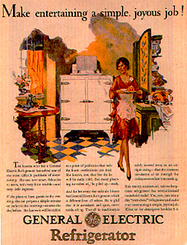
Glenwood Stove Ad
1920s consumerism led to luxury living:
New appliances like refrigerators, washing machines, & vacuums

Slide 16
Problem w/ Consumer Culture?
Buying on credit
Buying on margin

Slide 17
Culture of the 1920s

Slide 18
The Old and the New
Urban culture & industrial production dominated the 1920s:
Mass-produced consumer goods, mass media, advertising spread a new American culture
Much to the dismay of a rural America trying to cling to traditional values
Progressive reforms were no match for technology & prosperity

Slide 19
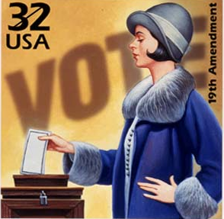
Women and the Family
Change (& continuity) for women:
Female workers after WW I were limited to teachers, nurses, & other low-paying jobs
The 19th
Amendment gave
women the right
to vote but few
women voted

Slide 20
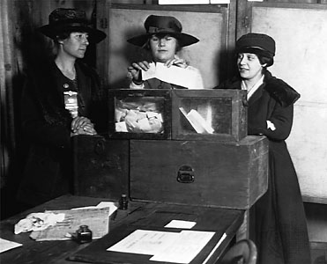
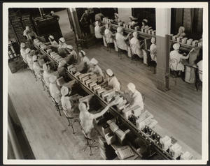
1920's also brought about great changes for women...
1920 - 19th Amendment gave them the federal vote
after 1920, social circumstances changed too as more women worked outside the home
and more women went to college and clamoured to join the professions
women didn't want to sacrifice wartime gains - amounted to a social revolt
characterized by the FLAPPER/ "new woman"
(bobbed hair, short dresses, smoked in public...)

Slide 21
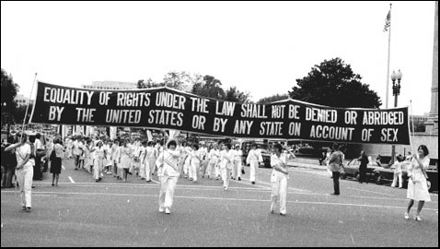
Alice Paul’s National Women’s Party (NWP) failed to pass an Equal Rights Amendment

Slide 22
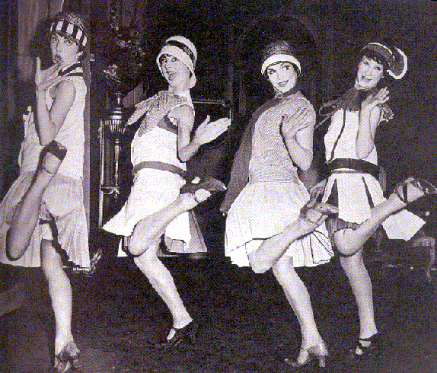
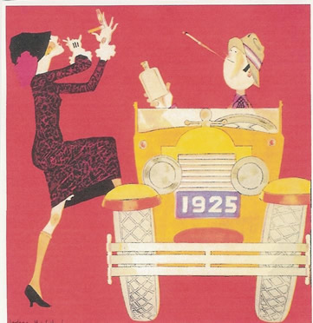
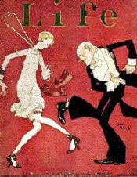
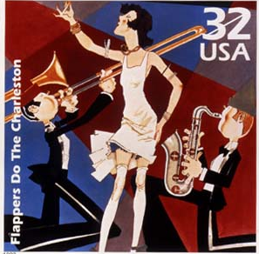
Women and the Family
“Flappers” rebelled against Victorian customs
Divorce rates doubled
But…most women looked forward to lives as a mother and a wife
“The creation and fulfillment of a successful home…compares favorably with building a beautiful cathedral.”
—Ladies Home Journal

Slide 23
Women and the Family
Families became smaller due to greater access to birth control
Children were no longer need to work to support their families
Teens began to “discover” their adolescence & revolt against their parents by drinking, having premarital sex, & searching for new forms of excitement
“I have been kissed by dozens of men. I suppose I’ll kiss dozens more.”
—character in F. Scott Fitzgerald novel

Slide 24
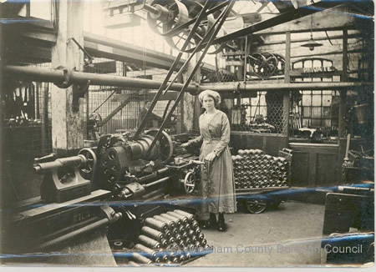
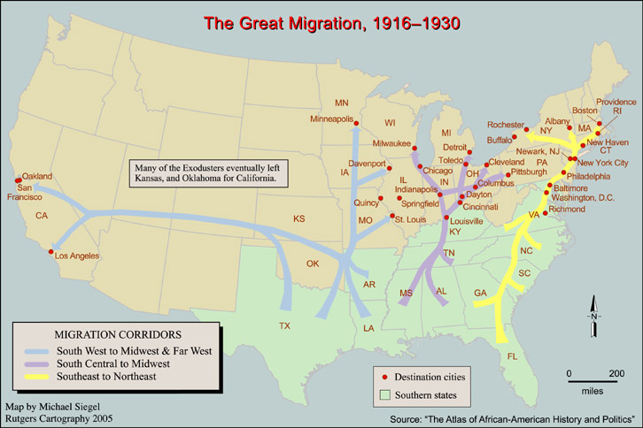
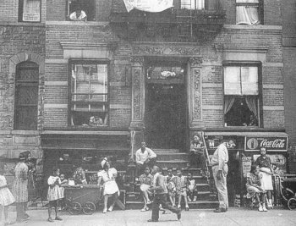
Blacks moved north to take advantage of booming wartime industry (= Great Migration) - Black ghettoes began to form, i.e. Harlem
within these ghettoes a distinct Black culture flourished
But both blacks and whites wanted cultural interchange restricted

Slide 25
The Flowering of the Arts
The Harlem Renaissance reflected the explosion of black culture & the “New Negro”:
Jazz & Blues expressed the social realities of blacks; Louis Armstrong became very popular
Langston Hughes’ poetry, novels, & plays promoted equality, condemned racism, & celebrated black culture

Slide 26
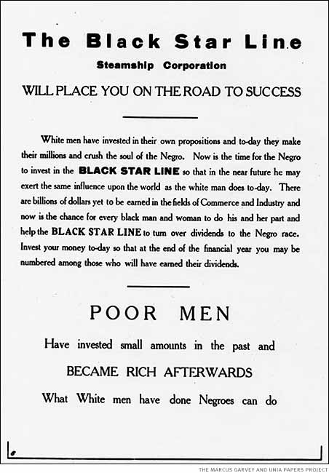
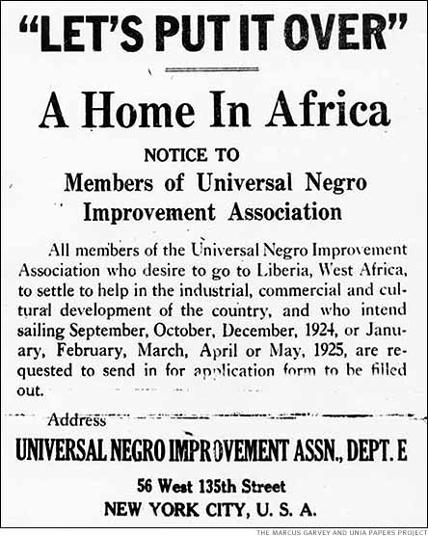
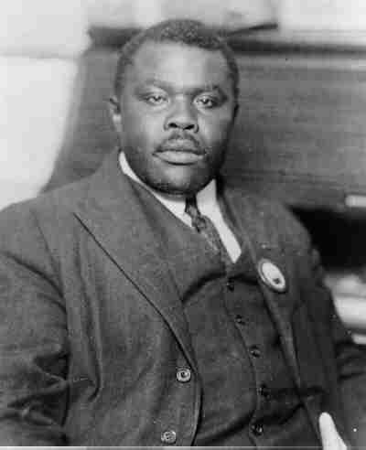
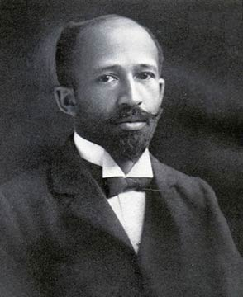
Marcus Garvey
Marcus Garvey was the preeminent civil rights activist of the 1920s
Oppression in the U.S. necessitated strict segregation & black nationalism
He formed the United Negro Improvement Assoc & advocated a return to Africa
“The most dangerous enemy of the Negro race”
—W.E.B. DuBois

Slide 27
“The Lost Generation”
“The Waste Land” focused on a sterile U.S. society
The 1920s gave rise to a new class of intellectuals who condemned the new American industrial society & materialism:
Pessimistic Literature: TS Eliot, Ezra Pound, Sinclair Lewis, F Scott Fitzgerald, Hemingway
Playwrights: Eugene O’Neill
Music: Gershwin & Copeland
Poetry discussed a “botched wasteland”
“Main Street”–narrow-minded small towns
“Great Gatsby”—human emptiness
Romantic individualism & violence
Plays of tragic pipedreams

Slide 28
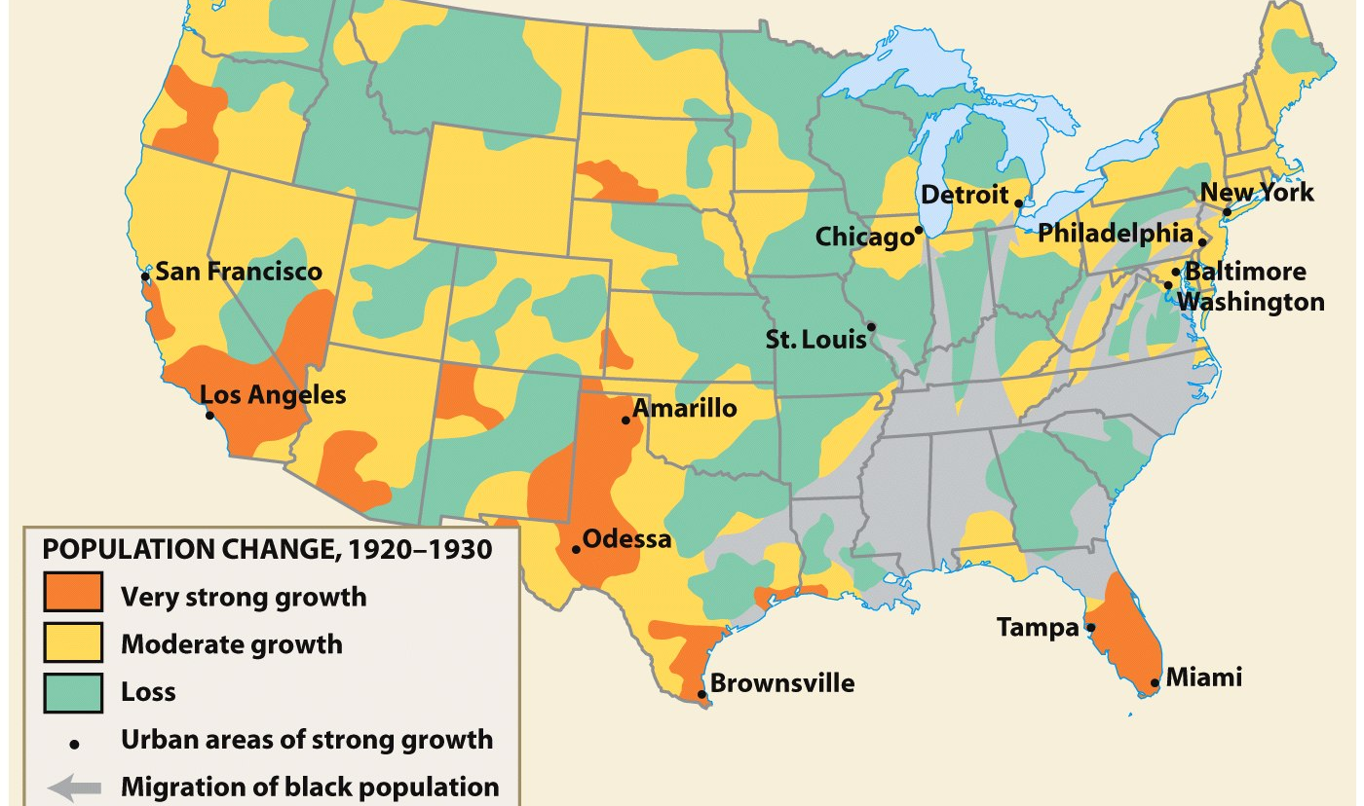
City Life in the Jazz Age
The shift in focus from the countryside revealed that urban life was different; traditional ties of home, church, schools were absent
The 1920 census revealed for the 1st time that more Americans lived in cities than the countryside
The New York City skyline in 1930: Skyscrapers gave cities a unique architectural style

Slide 29
The Rural Counterattack
Rural Americans identified cities with saloons, whorehouses, communist cells, & immorality
The 1920s saw an attempt to restore a “Protestant” culture in America & an attack on any “un-American” behavior like drinking, illiteracy, & immigration

Slide 30
Prohibition
In Jan 1920, Congress passed the Volstead Act to enforce the 18th Amendment (1919)
26 states had already banned alcohol but the real conflict came when prohibition was applied to urban ethnic groups
Rural America became dry & urban consumption dropped but was severely resisted
A rural, Protestant attack on the “social disease of drunkenness”

Slide 31
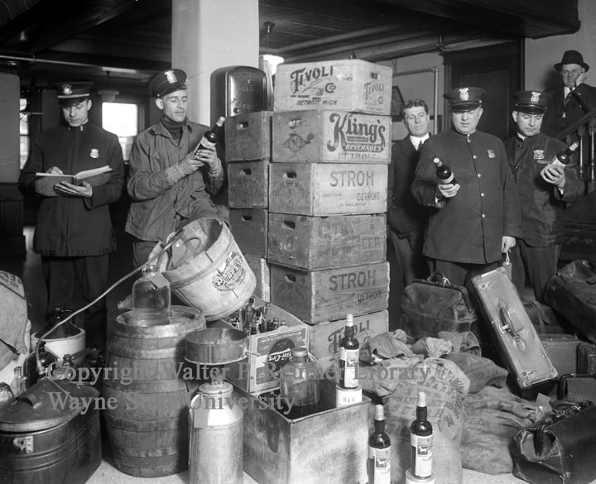
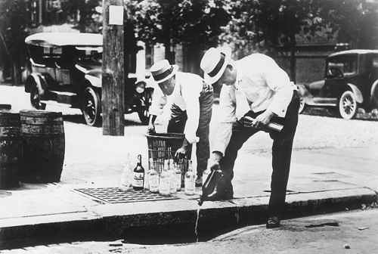
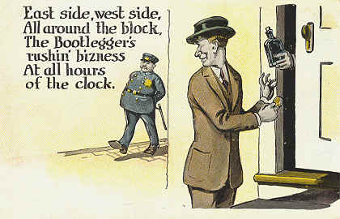
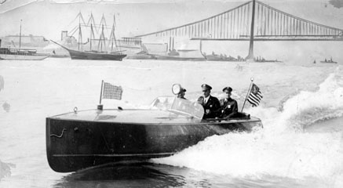
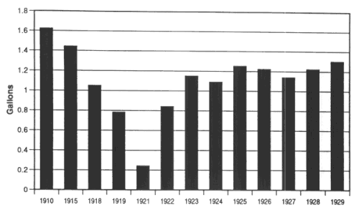
Per capita consumption of alcohol (1910-1929)

Slide 32
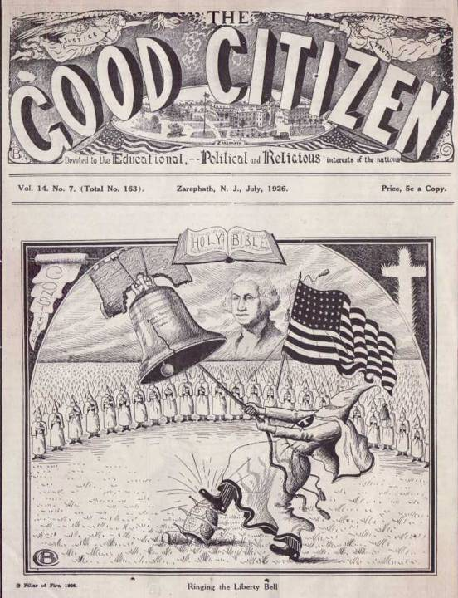
The 1st KKK disbanded when Reconstruction ended in the 1870s, but the 2nd KKK formed in 1915 to protect rural, Christian values

Slide 33
The Ku Klux Klan
The rebirth of the Ku Klux Klan in 1915 (Stone Mtn, GA) was aimed at blacks, immigrants, Jews, Catholics, & prostitutes
The “Invisible Empire” sought to ease rural anxieties in the face of changing cultural attitudes
Used violence, kidnapping, murder, & politics to affect change
Notes:
3 distinct lives of the KKK: 1st Klan aimed at Reconstruction was disbanded in 1869. 2nd Klan aimed at cultural changes of early 20th century existed from 1915 to 1944; 3rd Klan emerged in 1946 aimed at growing civil rights movement & communism

Slide 34
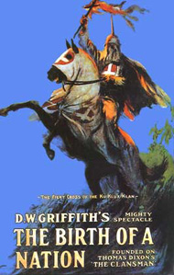
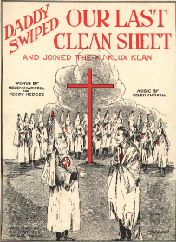
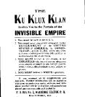
The Ku Klux Klan
Great increase
In power
Anti-black
Anti-immigrant
Anti-Semitic
Anti-Catholic
Anti-women’s suffrage
Anti-bootleggers

Slide 35
The Fundamentalist Challenge
Pentecostals, Church of Christ, Jehovah’s Witnesses all grew in membership
The most long-lasting reaction of rural America was a retreat to Christian beliefs
Aggressive fundamentalist churches provided a haven for rural American values
The Scopes “Monkey Trial” revealed the rural attack on evolution in schools

Slide 36
Conclusions
Urban America came to define all of the United States in the 1920s:
Radio, movies, advertising reflected urban culture
Consumer goods were made in American cities
Small-town whites, blacks, & immigrants moved to cities
But, conservative rural Americans (religious fundamentalists & KKK) attacked these new, urban ideas

Slide 37
Themes of the 1920s
Theme #1: Politics reflected less gov’t & a retreat to neutrality
Theme #2: A new consumer culture developed
Theme #3: New cultural ideas expressed celebrity & fun
Theme #4: Conflict between urban & rural Americans
Theme #5: The widening gap between the rich & poor

