Slide 1
Do Now
Identify characteristics that all colonies in British North America shared and characteristics that were specific to one colony and/or region:

Slide 2
Development of an American Identity: Mercantilism, Salutary Neglect, the Great Awakening and Enlightenment
Mr. Winchell
APUSH
Period 2

Slide 3
AP Prompt
Compare and contrast the Enlightenment and First Great Awakening, accounting for similarities and differences in their origin and effect on colonial perspectives.
AP SKILL: Comparison

Slide 4
Key Concepts

Slide 5
Video!
Historian Eric Foner on Colonial Society in the 17th Century

Slide 6
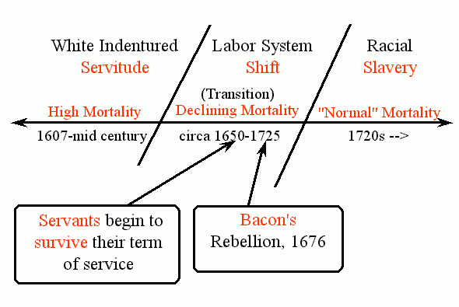
BACON'S REBELLION

Slide 7
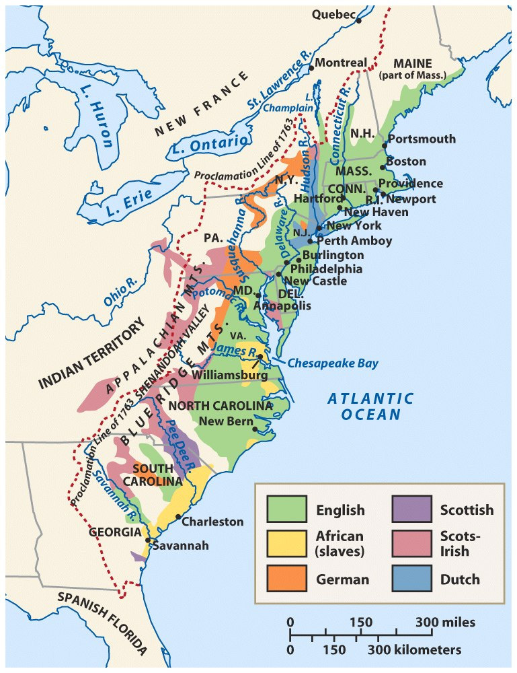
Population: Ethnic & Racial Diversity
Notes:
Roark, American Promise 3e from http://www.bedfordstmartins.com/mapcentral

Slide 8
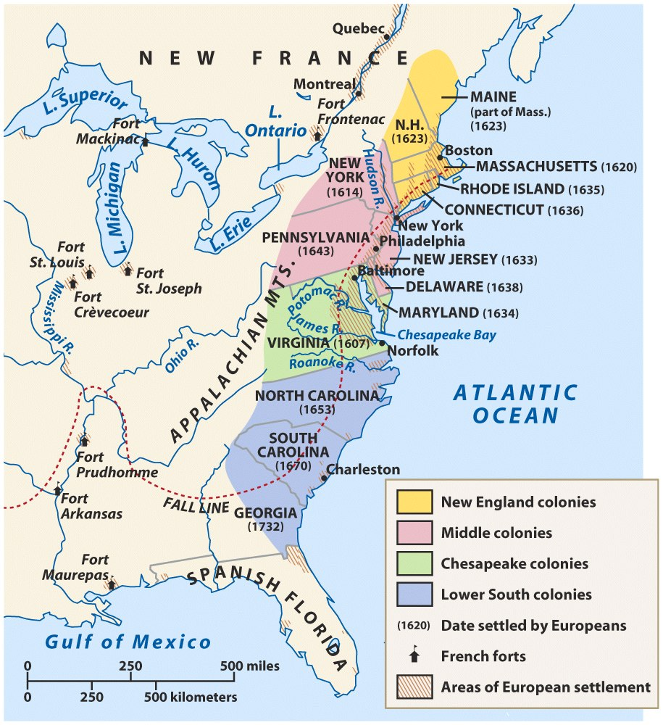
American Colonies at the End of the Seventeenth Century
Notes:
Roark, American Promise 3e from http://www.bedfordstmartins.com/mapcentral

Slide 9
Reasons for Slavery
Decrease in indentured servants
English economy - rising wages
Increase in availability of slaves
End of Royal African company monopoly
Decrease in price
Fears of growing number of landless freemen
Available supply from Caribbean

Slide 10
Colonial Lifestyle
About 80% of colonists were farmers!
Compared to Europeans, American colonists had a higher standard of living.
Land was cheap
Wages were 3x that of Europe

Slide 11
Similarities Among Colonies
Mostly English
Possessed British freedoms
Self-government
Religious toleration (in most cases)
Educational opportunities
Economic opportunities
Unique from the British monarchy in character

Slide 12
Demographics
Population rose rapidly
Women & Family Life
Class in the New World vs. Old World
Ethnic Diversity
Northern: Mostly English, few slaves, families
Middle: VERY DIVERSE- English, German, Swedes, Dutch, Irish, Scotch-Irish, Jews, some slaves, families
Southern & Chesapeake: English & some German; Huguenots in Carolinas; more men, some families, many indentured servants & slaves

Slide 13
Colonial Politics
New England: town meetings; direct democracies
Middle colonies: assemblies reflected basic democratic principles & rights of Englishmen.
Southern colonies: wealthy planters played leading roles in representative colonial legislatures.
Development of Colonial Democracy!

Slide 14
Rise of a Commercial Empire
English government largely ignored the colonies until the 1650s (salutary neglect); the colonies were not state-funded nor state protected
But…Charles II initiated colonial intervention in 1660 to maximize exports, decrease imports, & generate more gov’t revenue
Notes:
17

Slide 15
Mercantilism
Mercantilism was an economic policy that looked upon trade, colonies, and the accumulation of wealth as the basis for a country’s military and political strength.
Mercantilist doctrine required that a government regulate trade and production to enable it to become self- sufficient.
Colonies were to provide raw materials to the parent country so the parent country could make products to send back to the colony.

Slide 16
Response to Economic Competition
“Enumerated goods (tobacco, sugar, cotton, rice, rosin, tar) could only be sent to English ports
“Mercantilism” became the blueprint for England’s empire:
Wanted more money & a favorable balance of trade
Wanted to eliminate Dutch rivals
Wanted a stronger navy
Began to restrict colonial trade:
Navigation Act of 1660
Navigation Act of 1663
No ship could trade in colonies unless it was made in England
Goods shipped to English colonies must pass through England (increased the price paid by colonial consumers)
Notes:
but gov’t regulations emerge as individual responses to particular problems rather than an integrated agenda

Slide 18
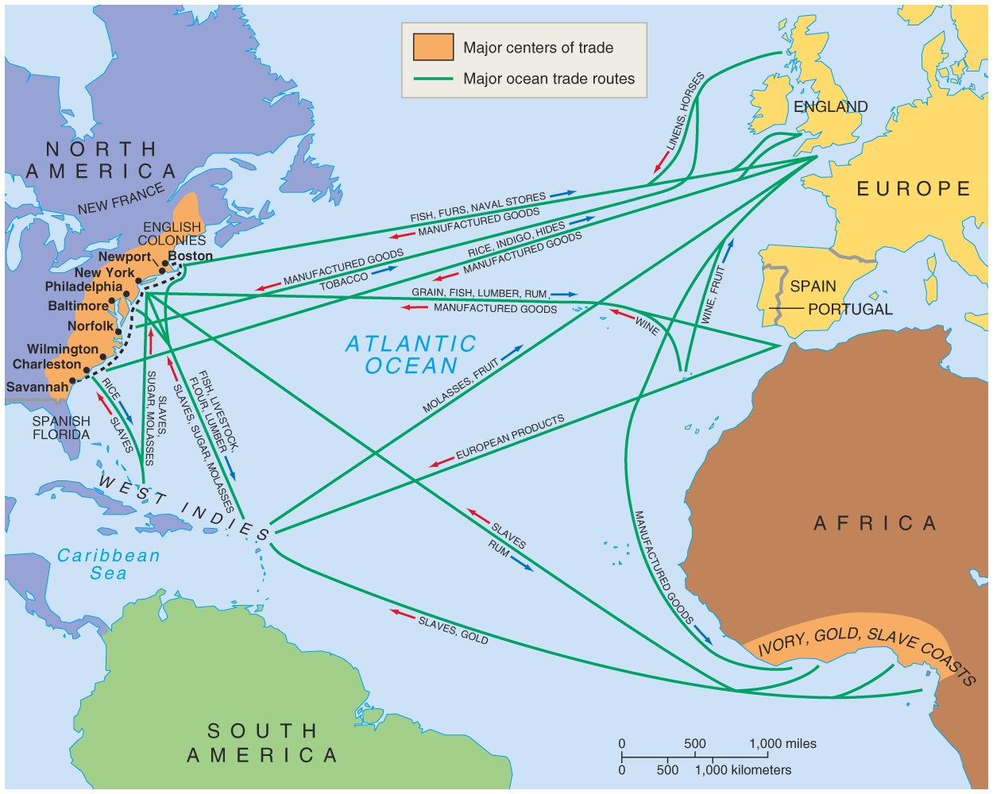
Trade
Raw Materials
Lumber
Tobacco
Rice
Indigo
Furs
To England from Colonies

Slide 19
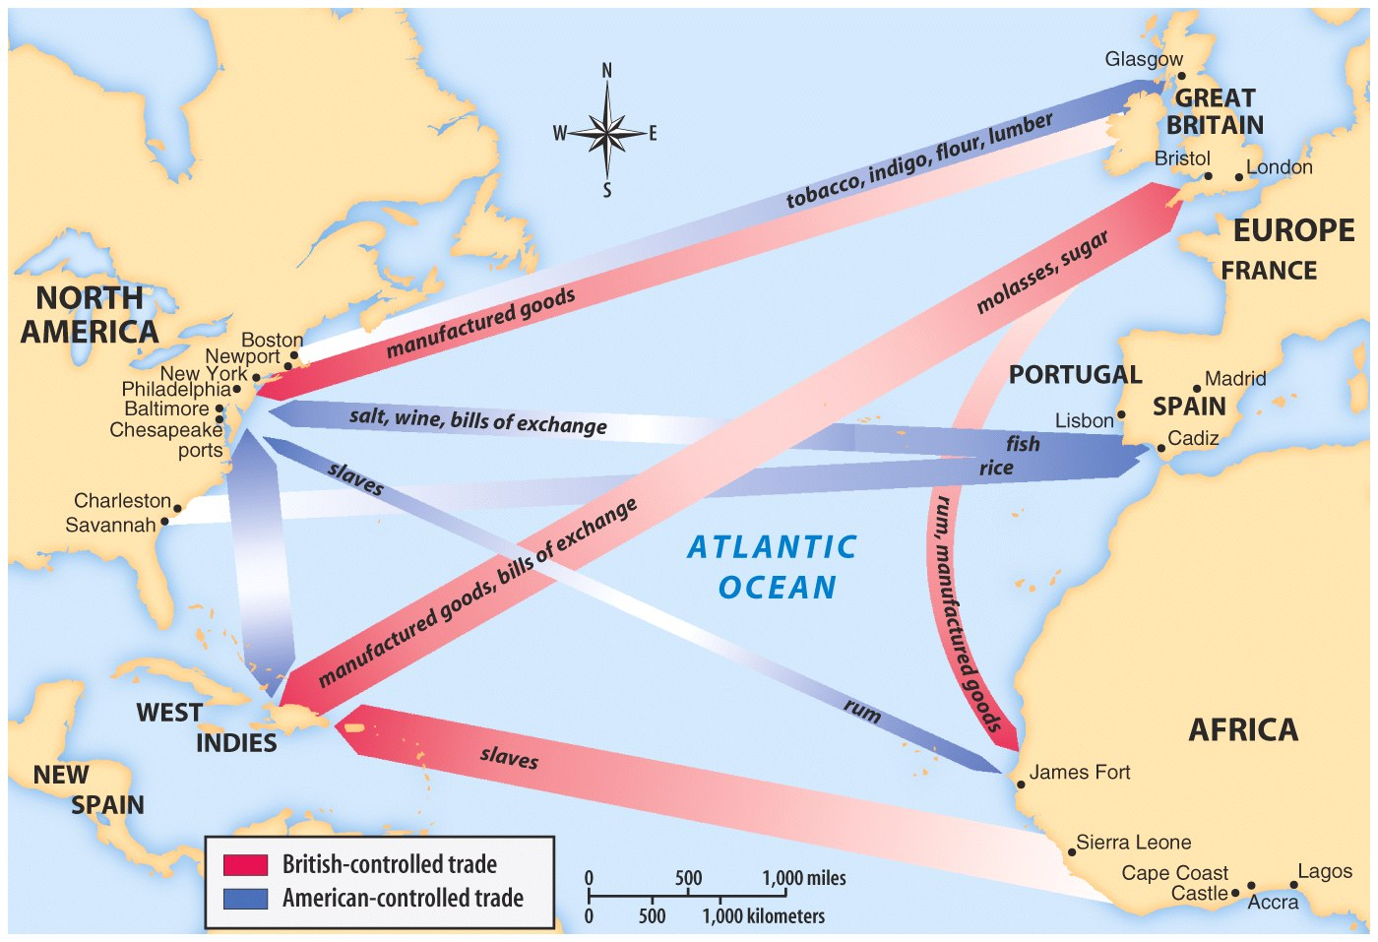
Manufactured Goods
Furniture
Clothing
Colonials had not factories.
From England to Colonies

Slide 20
The Acts of Trade and Navigation
The Navigation Acts had a mixed effect on the colonies.
allowed New England ship building to prosper
provided English military forces to protect the colonies from the French and Spanish
severely limited the development of colonial manufacturing
caused colonists to pay high prices for manufactured goods

Slide 21
 | Enlightenment | Great Awakening
Type of movement?
Leaders?
Ideas?
Actions?
Intellectual
Reason-based
Philosophical
Religious movement that sweeps through England and the colonies
Colonies: Ben Franklin and Thomas Jefferson
Europe: John Locke
Jonathan Edwards
George Whitefield
All have Natural Rights: Life & Liberty
Can understand the world through reason and logic
Salvation does not come from following the church’s rules, but is between you and God
Challenge & question authority
Think for yourself
Challenge the authority of the church (Puritans, Quakers, Anglican)
New churches formed (Methodist, Baptist)

Slide 22
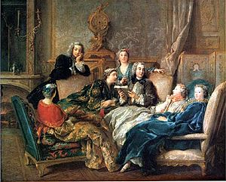
Enlightenment
Where the Great Awakening dealt with a spiritual revival, the Enlightenment dealt with scientific and intellectual reason
The Enlightenment is often referred to as the age of reason
Began with intellectuals in Europe and moved over to America

Slide 23
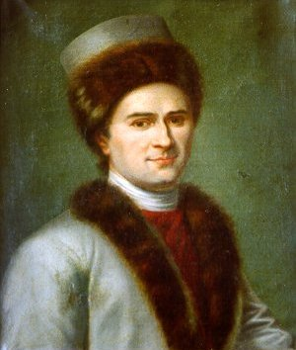
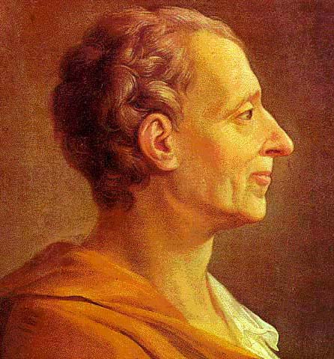
Major Enlightenment Ideas
Every social, political and economic problem could be solved through the use of reason and scientific method
Governments are created to secure an orderly society and promote individual welfare (Hobbes, Rousseau, and Locke)
Separation of powers is the best way to protect human liberties (Montesquieu in Spirit of Laws)

Slide 24
Major Ideas of Enlightenment Thinkers
Idea | Thinker | Impact
Natural rights—life, liberty, property | Locke | Fundamental to U.S. Declaration of Independence
Separation of powers | Montesquieu | France, United States, and Latin American nations use separation of powers in new constitutions
Freedom of thought and expression | Voltaire | Guaranteed in U.S. Bill of Rights and French Declaration of the Rights of Man and Citizen; European monarchs reduce or eliminate censorship
Religious freedom | Voltaire | Guaranteed in U.S. Bill of Rights and French Declaration of the Rights of Man and Citizen; European monarchs reduce persecution

Slide 25
Overview of Great Awakening
1st Mass Social Movement in America
Two issues:
Crisis within the ministry
Crisis between clergy and the laity
Reaction to the elaborate theological doctrines and emotional stagnation
Arminianism - Directly challenged Calvinism’s predestination saying that man was not helpless in achieving salvation

Slide 26
The Great Awakening
Who:
Jonathan Edwards:
preacher that is thought to start the revivals in Massachusetts and set the stage for other preachers to follow in the other colonies
George Whitefield:
a traveling preacher from London that spurred the causes of the Great Awakening in the southern colonies

Slide 27
Significance of the Great Awakening
Split denominations thus increasing the competitiveness of American churches
Converted many thousands of people
Undermined the powerful older clergy
Encouraged a new wave of missionary work among Amerindians and slaves
Founding of “new light” colleges

Slide 28
Enlightenment/Great Awakening Compare and Contrast
Enlightenment focuses more on thought and scientific ideas as opposed to religious ideas
Enlightenment plays major impact on government and society whereas Great Awakening focuses more on religious prosperity
Both play a major role in developing individualism where people can think on their own and determine what is best for them, not what is passed down from religious or governmental authorities.

Slide 29
Zenger Trial
John Peter Zenger - NY Printer
1733 - accused of libel (criticizing the government)
Found not guilty
Significance: Newspaper publishers felt more free to print honest views

Slide 30
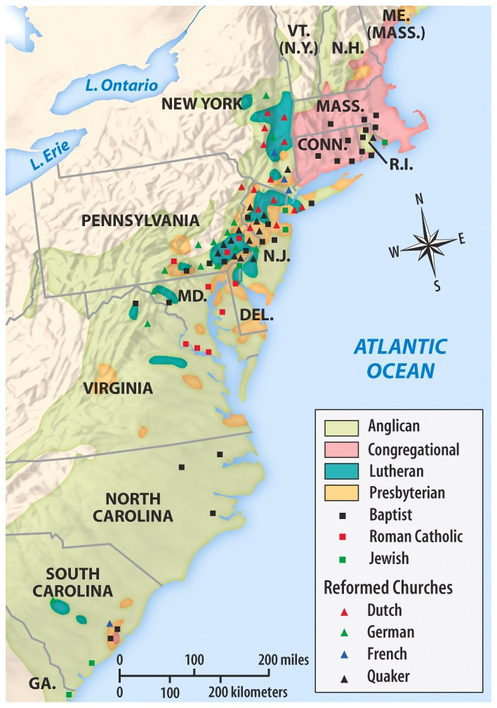
Religion: Diversity
Tolerance?
Great Awakening
George Whitefield
Religious Diversity in 1750
Notes:
Henretta, America’s History 5e from http://www.bedfordstmartins.com/mapcentral

Slide 31
Compare the Two
The Enlightenment
The Great Awakening
The Enlightenment spread where the Great awakening remained isolated

