Slide 1
Do Now
George Wallace, Governor of Alabama

Slide 2
4. LBJ’s 60s-The Civil Rights Movement and the Great Society
Mr. Winchell
APUSH 2018-2019
Period 1-2

Slide 3
AP Prompt
Evaluate the extent to which the Civil Rights Movement and Great society demonstrated change in American society and politics.

Slide 4
Outline
Civil Rights Pre-1954
Civil Rights Movement
LBJ and the Civil Rights Movement
LBJ and the Great Society: The War on Poverty
Warren Court

Slide 5
The Jim Crow Era
Jim Crow laws created by state gov’ts legalized segregation:
Poll taxes, literacy tests, & grandfather clauses were used to deprive blacks of voting rights
Most blacks were sharecroppers
KKK enforced racial inequality
In 1896, the Supreme Court declared “separate but equal” in the Plessy v Ferguson case

Slide 6
The Jim Crow Era
Civil rights leaders demanded black equality in the Jim Crow era:
In the 1890s, WEB DuBois & Booker T Washington
1909, NAACP was formed
Marcus Garvey in 1910s
Harlem Renaissance
The New Deal & military segregation in World Wars I & II promoted racial discrimination

Slide 7
The Jim Crow Era
The 1940s brought some success:
The Great Migration helped break sharecropping in South
In WW II, FDR created the Fair Employment Practices Committee
A. Philip Randolph & “Double V”
In 1947, Jackie Robinson became the 1st black major league baseball player

Slide 8
Civil Rights as a Political Issue
Truman was the 1st president to attempt to end any racial discrimination
Created a new commission on civil rights in 1946
Called for an end to lynching
Truman’s lasting legacy was the desegregation of the armed forces and government in 1948 (Ex. Order 9980/9981)
Notes:
Fair Employment Practices Commission (FEPC)

Slide 9
Civil Rights Movement Background
Postwar Reconstruction
13th Amendment
end slavery
15th Amendment
black suffrage
Freedmen’s Bureau
Ku Klux Klan and White League
Disenfranchisement
Plessy v. Ferguson
Separate, but equal
Jim Crow Laws in the South
Progressive Era Gains
Booker T. Washington and W.E.B. DuBois
NAACP and National Urban League
Great Migration
1920s Setbacks and Hope
Race riots after WWI
Lynchings
KKK returns
Marcus Garvey
Harlem Renaissance
1930s Developments
New Deal Coalition
New Deal provided some relief programs
Limited civil rights legislation

Slide 10
The Modern Civil Rights Movement (1954-1965)

Slide 11
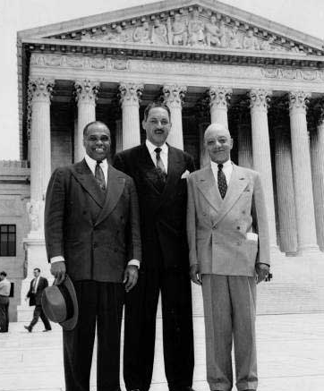
Desegregating the Schools
Schools became the primary target of early civil rights advocates in the 1950s
The NAACP 1st targeted unfair university graduate admissions
Thurgood Marshall, a NAACP lawyer, used the 14th Am. to attack school segregation & Plessy v Ferguson precedent
Even “equal” schools, if separate, inflict profound psychological damage to black children

Slide 12
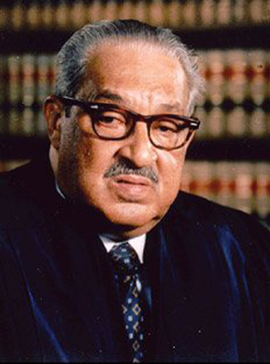
Desegregating the Schools
The Supreme Court’s unanimous decision in Brown v Board of Education (1954) ruled “separate facilities are inherently unequal”
Called for desegregation at “deliberate speed” by states
Border states complied quickly but the Deep South resisted—by 1960 less than 1% of blacks attended school with whites
But…Pupil Placement Laws allowed for separate schools based on “aptitude” & “morality”
Thurgood Marshall’s success in Brown made him the most famous black lawyer in America; In 1967, LBJ made him the 1st black justice to the Supreme Court

Slide 13
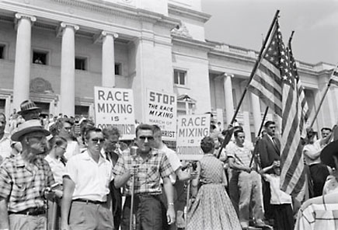
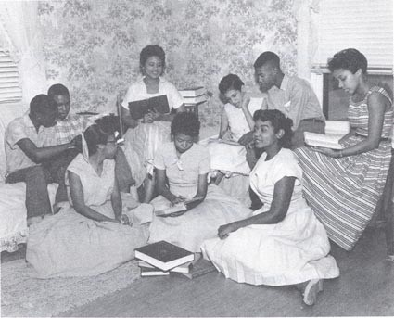
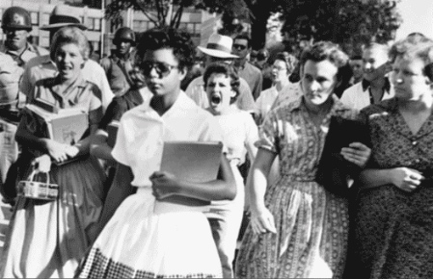
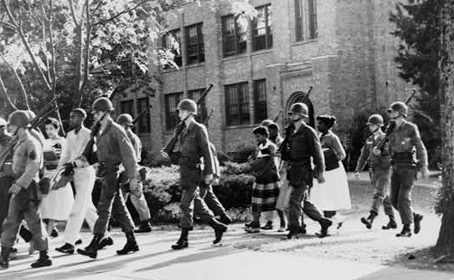
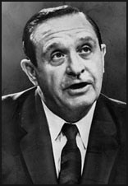
Integrating Central High School in Little Rock, Arkansas (1957)
Governor Orval Faubus
Notes:
START CLIP at 954

Slide 14
The Beginnings of Black Activism
Instead of waiting for the gov’t to help, African Americans pressed the issue
Montgomery Bus Boycott (1955) began after the Rosa Parks arrest
Effective carpool system forced buses to stop segregation
Supreme Court ruled AL bus segregation unconstitutional
This success led to the rise of MLK as a civil rights leader

Slide 15
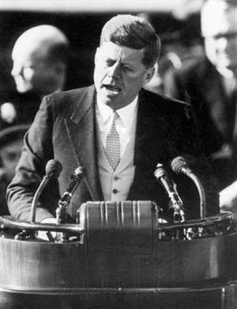
John F. Kennedy (D) (1961-1963)
New Frontier
Expansion of social welfare
Clean Air Act (1963)
Peace Corps
“Ask not what your country can do for you--ask what you can do for your country.”
23rd Amendment (1961)
Electoral votes for D.C.
Social and Cultural Developments
Civil Rights Movement
Freedom Rides
Stand in the Schoolhouse Door (June 1963)
March on Washington (Aug 28, 1963)
Feminism
The Feminine Mystique (1963)
Silent Spring by Rachel Carson (1962)
Foreign Developments
Bay of Pigs Invasion (1961)
Berlin Wall
Cuban Missile Crisis (1962)

Slide 16
Moving Slowly on Civil Rights
Civil Rights leaders refused to wait for JFK & the gov’t to respond
Congress of Racial Equality (CORE) led a freedom ride in 1961 to protest segregated buses
Activists attempted to break a ban on black enrollment at Ole Miss & University of Alabama

Slide 17
Text Analysis
Freedom Riders (TAS 480)

Slide 18
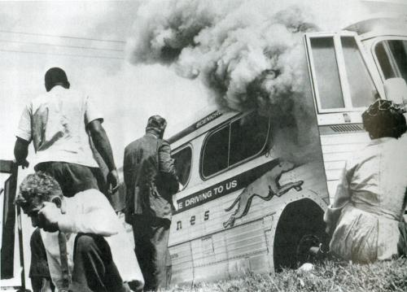
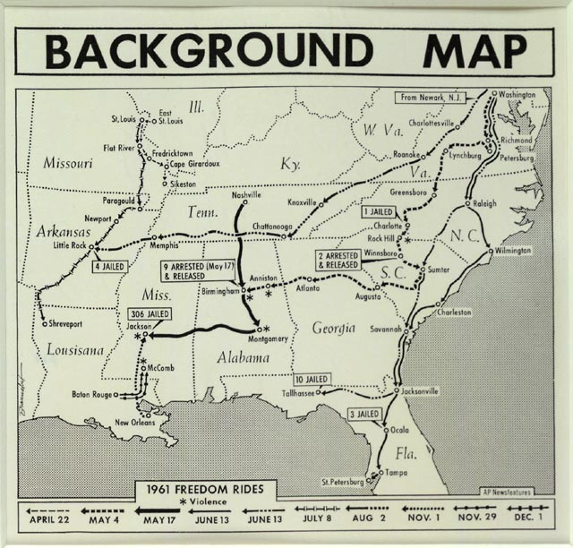
Freedom Rides, 1961

Slide 19
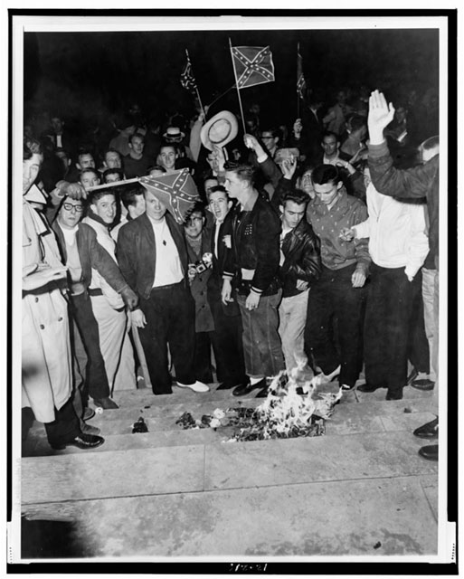
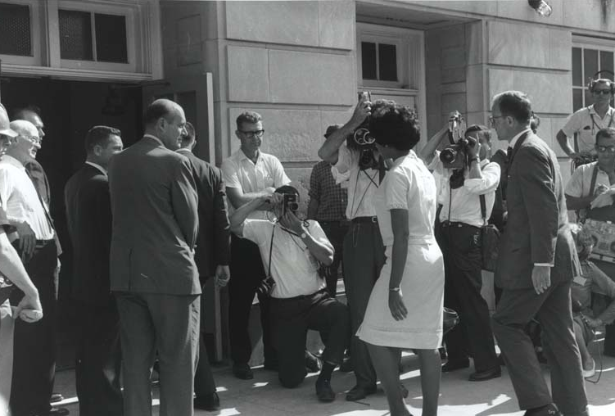
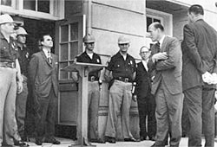
University of Alabama students burn desegregation notice
Alabama Governor George Wallace blocks black students’ entrance into University of Alabama

Slide 20
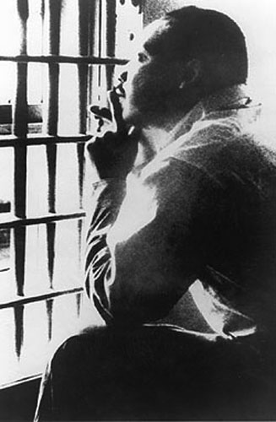
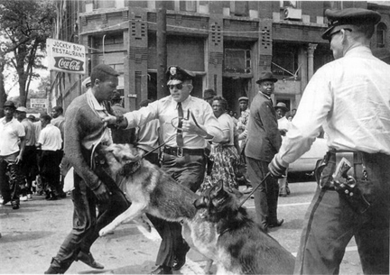
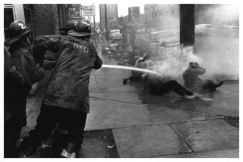
Birmingham Marches, 1963
MLK forced JFK to openly support the plight of African-Americans in 1963, via the Birmingham march
Police commissioner “Bull” Connor used brutal force to end the protests & MLK was jailed
Police brutality helped sway public sentiment & allowed JFK to begin civil rights legislation
MLK’s Letter From Birmingham Jail (1963) articulated the non-violent protest of the civil rights movement

Slide 21
"I Have a Dream"
In 1963, CORE, SCLC, NAACP, & SNCC organized a March on Washington to pressure the gov’t to pass a civil rights act
200,000 civil rights protesters heard MLK give the “I Have a Dream” speech for racial equality
The Kennedy Administration responded by laying framework for a Civil Rights Act

Slide 22
"Let Us Continue"
On Nov 22, 1963 in Dallas, JFK was assassinated & VP Lyndon Johnson became president:
LBJ was a master politician with a reputation for getting results
LBJ promised to continue Kennedy's liberal agenda
LBJ ultimately exceeded JFK’s record on providing economic & racial equality
LBJ helped push through the greatest array of liberal legislation in U.S. history (“Great Society”), surpassing FDR’s New Deal

Slide 23
Lyndon B. Johnson (D) (1963-1969)
Great Society
War on Poverty
24th Amendment (1964)
Poll taxes unconstitutional
25th Amendment (1967)
Presidential succession
Social and Cultural Developments
Civil Rights Movement
Civil Rights Act of 1964
March to Selma (March 1965)
Voting Rights Act of 1965
Counterculture Movement
Free Speech Movement (1964)
Woodstock Music Festival (1969)
Feminism
National Organization for Women (NOW) (1966)
Foreign Developments
Vietnam
Gulf of Tonkin Incident

Slide 24
Lyndon Johnson in Action
LBJ quickly pushed through Congress 2 key “Kennedy” bills:
A $10 billion reduction in income taxes that led to increased consumer spending & new jobs
The Civil Rights Act of 1964 that declared segregation in public facilities illegal & protected black voting rights
The most significant legislation on race since the Reconstruction Amendments

Slide 25
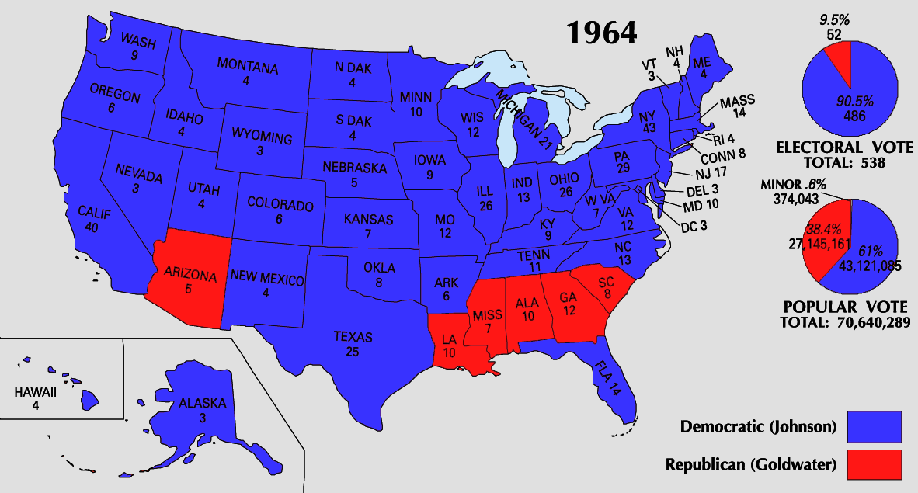
The Election of 1964
In 1964, LBJ ran against:
Conservative Republican Barry Goldwater rejected LBJ’s liberal welfare programs & called for a stronger foreign policy stance
Segregationist George Wallace
LBJ won in a landslide & the Democrats took control of Congress for 1st time in 25 years

Slide 26
Civil Rights under LBJ
Civil rights groups were not content & continued for equality:
Freedom Summer in 1964 led to the registration of thousands of Mississippi blacks to vote
The 1965 protest march from Selma, Alabama to Montgomery led to police violence; “Bloody Sunday” shocked people in the North more than any other event

Slide 27
Text Analysis
LBJ Supports Civil Rights TAS 488

Slide 28
Civil Rights under LBJ
After the Selma march, LBJ & Congress passed the Voting Rights Act (1965)
Banned literacy tests & sent federal voting officials into the South to protect voters
The act finally accomplished what Radical Republicans had envisioned when the 15th Amendment was enacted in 1870
24th Amendment-banned poll taxes (1964)

Slide 29
Black Voter Registration in South
Blacks became a voting force in Southern politics for the 1st time since Reconstruction

Slide 30
Discuss how the civil rights movement evolved during the 1950s and 1960s and explain each of the three developments.
Montgomery Bus Boycott
Development:
Protests
sit-ins
24th Amendment
Civil Rights
for
African Americans
Development:
Warren Court
Development:
Johnson Presidency
Brown v. Board of Education
Voting Rights Act of 1965
Civil Rights Act of 1964

Slide 31
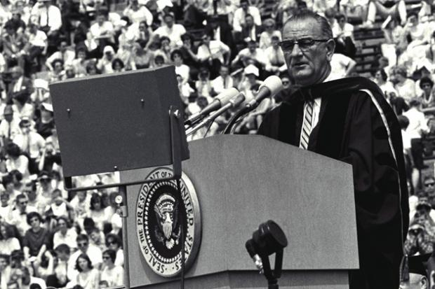
The Great Society
The Great Society Speech
Lyndon Johnson and the Great Society

Slide 32
Lyndon B. Johnson (D) (1963-1969) The Great Society
War on Poverty
Economic Opportunity Act/Office of Economic Opportunity
Job Corps
Vocational training for young people
Community Action Program
Food Stamp Act (1964)
Supplemental Nutrition Assistance Program (SNAP)
Civil Rights Legislation
Civil Rights Act of 1964
Prohibits discrimination based on race, color, religion, sex, national origin in public accommodations
Voting Rights Act of 1965
Prohibits racial discrimination in voting
Prohibits literacy tests
Civil Rights Act of 1964
Prohibits discrimination in housing opportunities
Immigration
Immigration Act of 1965
Abolished the national origins and quota system
Education
Elementary and Secondary Education Act (1965)
Head Start (1965)
Preschool education for low-income children
Higher Education Act (1965)
Bilingual Education Act (1968)
Health Care
Medicare
Health services for elderly
Medicaid
Health services for low-income families
Housing
Department of Housing and Urban Development (HUD)
Department of Transportation
National Traffic and Motor Vehicle Safety Act
Safety belts, redesigns for protection, drunk driving awareness
Environmental Protection
Wilderness Act
Endangered Species Act
Cultural Promotion
National Historic Preservation
National Endowment for the Arts AND the Humanities
Public broadcasting (PBS) and public radio (NPR)
Consumer Protection
Fair Packaging and Labeling Act
Wholesome Meat Act
Child Safety Act
Truth-in-Lending Act

Slide 33
The Great Society
Once elected, LBJ initiated his “Great Society” domestic agenda as part of his War on Poverty:
Medicare & Medicaid extended health insurance to the elderly & the poor
Extended $1 billion to improve public & parochial schools
The Voting Rights Act of 1965 banned literacy tests & provided for federal registrars for polls

Slide 34
Lyndon Johnson in Action
In 1964, LBJ waged a “war on poverty in America” & created the Office of Economic Opportunity:
Created the Job Corps for high school dropouts
Head Start for preschoolers
Adult education & technical training opportunities
As a result, America had 10 million fewer poor people by 1970
In 1964, the U.S. had 35 million poor people

Slide 35
The Great Society
Passed bills increasing funding for education; the first major federal aid package for education in the nation’s history
LBJ created Medicare and Medicaid
Created the Department of Housing and Urban Development (HUD)
First Black Cabinet Secretary in US History-Robert Weaver
Medicare: give low-cost medical insurance to Americans age 65 years and up
Medicaid: extends health care insurance to people on welfare.

Slide 36
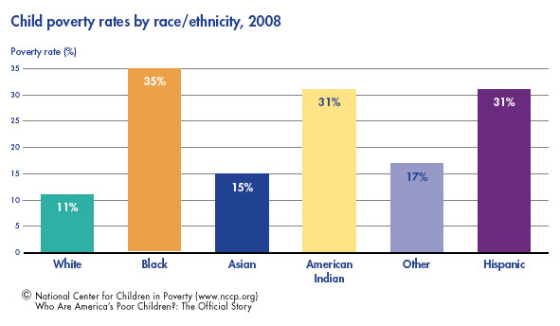
Poverty in America

Slide 37
Johnson and Immigration Reform
The Immigration and Nationality Act of 1965
Abolished quota system (1920s)
No more discrimination against non-Northern/Western Europeans
Focused on skills and family relationships of potential immigrants

Slide 38
The Triumph of Reform
By 1965, Congress passed 89 laws or reforms as part of LBJ’s social agenda:
The Great Society was the most comprehensive agenda of social reform since FDR
But…the American people did not respond well to LBJ
Soon…events in Vietnam, would taint his presidency

Slide 39
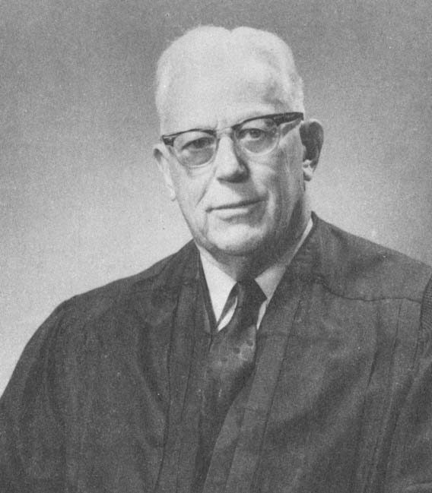
The Warren Court
The Warren Court also greatly expanded the rights of people accused of crimes. Earl Warren →
Illegally seized evidence couldn’t be used in court
Required criminal courts to provide free legal counsel
(Gideon v. Wainwright)
Right to a lawyer during questioning
People must be read their Miranda rights before questioning
(Miranda v. Arizona - 1966)

Slide 41
The Warren Court (1953-1969)
Equality
Brown v. Board of Education (1954)
Baker v. Carr (1962)
Criminal Justice
Mapp v. Ohio (1961)
Gideon v. Wainwright (1963)
Escobedo v. Illinois (1964)
Miranda v. Arizona (1966)
First Amendment
Engel v. Vitale (1962)
Brandenburg v. Ohio (1969)
Tinker v. Des Moines (1969)
New York Times v. Sullivan (1964)
Privacy
Griswold v. Connecticut (1965)

