Slide 1
Political Socialization & Influences on Ideology
Mr. Winchell
AP GoPo
Unit 4: American Political Beliefs and Behaviors

Slide 2
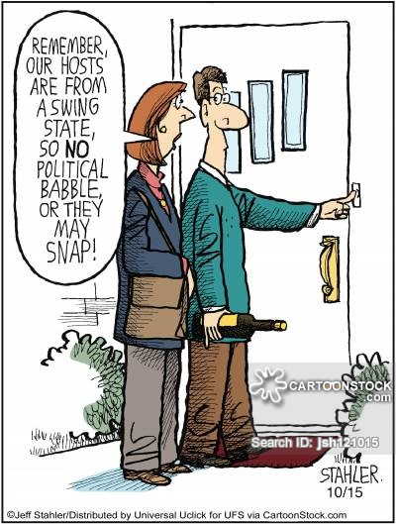

Slide 3
Essential Question
How does one’s environment or experience shape political opinions?

Slide 4
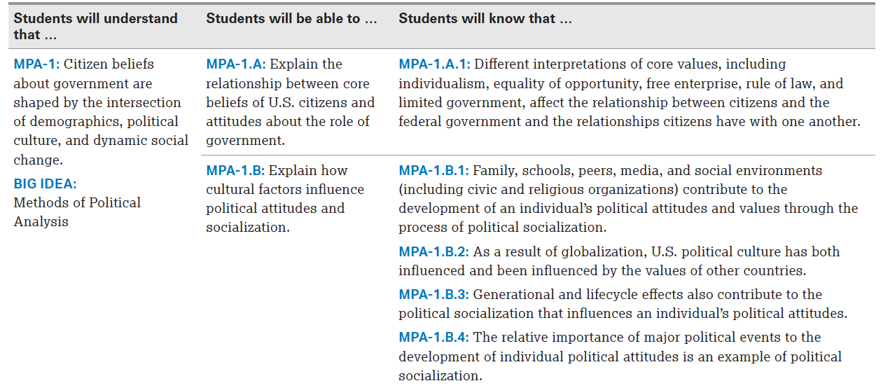

Slide 5
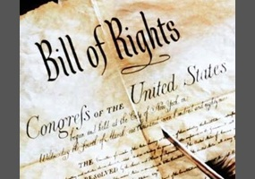
Basic American Values
Individualism
Liberty
Equality
Majority Rule
Limited Government
Rule of Law
Civic Duty
Private Property
Free Enterprise
Equality of opportunity

Slide 6
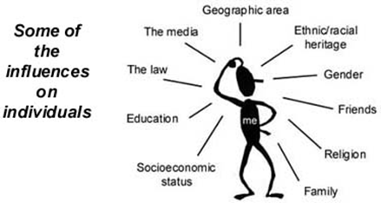
Political Socialization
process by which political culture is transmitted through society
occurs at both the individual and community level
life long process
variety of agents contribute to shaping
attitudes & values formed early in life

Slide 7
Influences on Political Identity
Family and Home
Education and Schools
Group Affiliations
Demographic Factors
Mass Media
Opinion Leaders
Events

Slide 8
Main Agents of Socialization:
Primary (direct influence) - family, peer groups
Secondary (less personal, indirect) - media, educational institutions, religious institutions, workplace, state actors

Slide 9
The Family and Home
Arguably the strongest and lasting influence on one’s political identity
Strongest when both parents identify with same political party
60% of adults still had party affiliation of parents

Slide 10
Education and Schools
Schools and colleges tend to make citizens more liberal
More access to information
Atmosphere conducive for exploration of new ideas

Slide 11
Religion
Social Status
Catholics and Jews suffered discrimination
Democrats appealed to them and gained their support
Religious Tradition
Evangelical protestants emphasize personal salvation therefore more conservative in social policies

Slide 12
Religious Affiliation of 115th Congress

Slide 13
Gender
Gender Gap - difference in political views between men and women
Women tend to vote Democrat; pro-choice issues
Men more conservative; voting more Republican
2000 Election
55% women voted Gore (D)
54% men voted Bush (R)

Slide 14
Social Class
Lower-class
Limited education
Prefer more government economic intervention
Tend to vote Democrat, but low voter turnout
41% voter turnout for $15,000 or less
Working-class (blue-collar)
Tend to vote Democrat, but subject to other influences
White blue-collar workers tend to vote more Republican
Middle-class (white-collar)
Tend to be split and dependent on other influences
Upper-class
Tend to vote Republican with pro-business policies and less government economic intrusion
78% voter turnout

Slide 15
Race and Ethnicity
Whites
64.1% voter turnout in 2012
Vote more Republican
Blacks
66.2% voter turnout in 2012
Vote more Democrat
Hispanics
48.0% voter turnout in 2012
Vote more Democrat
Asians
47.3% voter turnout in 2012
Recent trend of Democratic
2008 Democratic primary campaign between Barack Obama and Hillary Clinton

Slide 16
Race and Social Class

Slide 17
Region
New England - more liberal
Southeast/Bible Belt - more conservative
Midwest - more conservative
Pacific - more liberal
Urban - more liberal/Democratic
Suburbs/small towns - more conservative
Rural - more conservative/Republican

Slide 18
Sexual Orientation
Homosexuals tend to side with liberal policies especially regarding social issues
Homosexuals concentrated in urban areas
Strong religious affiliations compel most heterosexuals to deny equal rights to homosexuals

Slide 19
Cleavages in Public Opinion
Public opinions are never absolute and always overlap
Examples:
Blacks vote Democrat due to support on affirmative action and equality policies, but most blacks are against gay marriage
Cubans vote Republican despite majority of Hispanics voting Democrat for immigration policies
A blue-collar worker would vote Democrat for pro-union policies, but votes Republican due to conservative religious traditions
Though men tend to vote more Republican than women, most men support pro-choice policies

Slide 20
Socialization & Polling
Companies and candidates attempt to gain an understanding of the public’s political culture in order to better market their products and candidate’s campaign.

Slide 21
How do those values impact…
Relationships between citizens and the federal government?
Relationships citizens have with one another?

