Slide 1
Politics of the 1960’s
Mr. Winchell
APUSH
Period 8

Slide 2
JFK’s New Frontier
Kennedy’ administration reflected youth, energy, & sharp break from Eisenhower
JFK promised a New Frontier:
Domestic reforms in education, health care, & civil rights
A foreign policy committed to defeating the Soviet Union & winning the Cold War

Slide 3
JFK’s New Frontier
Aid for public schools…
…the extension of Social Security…
JFK’s New Frontier promised a return of FDR-era liberal policies:
But, Conservatives in Congress opposed JFK’s social reforms in education & health care
Congress did help the poor
The modernization of industry, gov’t spending, & a major tax cut in 1963 stimulated the economy & created jobs
An increase in the minimum wage
…and medical insurance for the elderly were all shot down by Congress
…unemployment benefits…
Increased funds for public housing

Slide 4
JFK’s New Frontier
One long-lasting achievement of the JFK-era was strengthening the presidency:
Eisenhower left many decisions to his staff, but JFK demanded more direct presidential control
JFK transferred much of the decision-making power from the cabinet to his White House staff
JFK appointed tough, pragmatic, & academic “New Frontiersmen” to his staff
Kennedy referred to his staff as the “the best & the brightest”

Slide 5
Kennedy Intensifies the Cold War

Slide 6
Kennedy Intensifies the Cold War
Addressing U.S. foreign policy & containing Communism was JFK’s top priority as president:
JFK believed Ike compromised with the USSR when the Cold War could have been won
JFK aimed to close the “missile gap” & increase U.S. defenses
Looked to solve issues in Berlin, Vietnam, & Cuba
“Let every nation know, whether it wishes us well or ill, that we shall pay any price, bear any burden, meet any hardship, support any friend, oppose any foe to assure the survival & success of liberty. We will do this & more.”
—JFK’s inaugural address

Slide 7
Flexible Response
JFK shifted from Ike’s “mutually assured destruction” to a “flexible response” capable of responding to a variety of future problems:
Increased nuclear arsenal to 1,000 ICBMs & 32 Polaris subs to create a “first-strike” capability
Increased the army & air force
Expanded covert operations & created the Green Berets
To combat Communism & to help underdeveloped countries, JFK created the Peace Corps & the Alliance for Progress

Slide 8
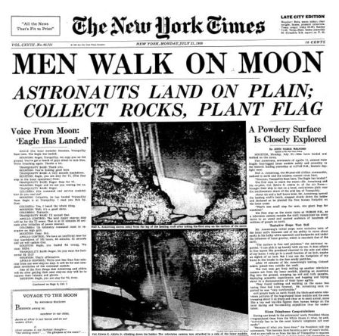
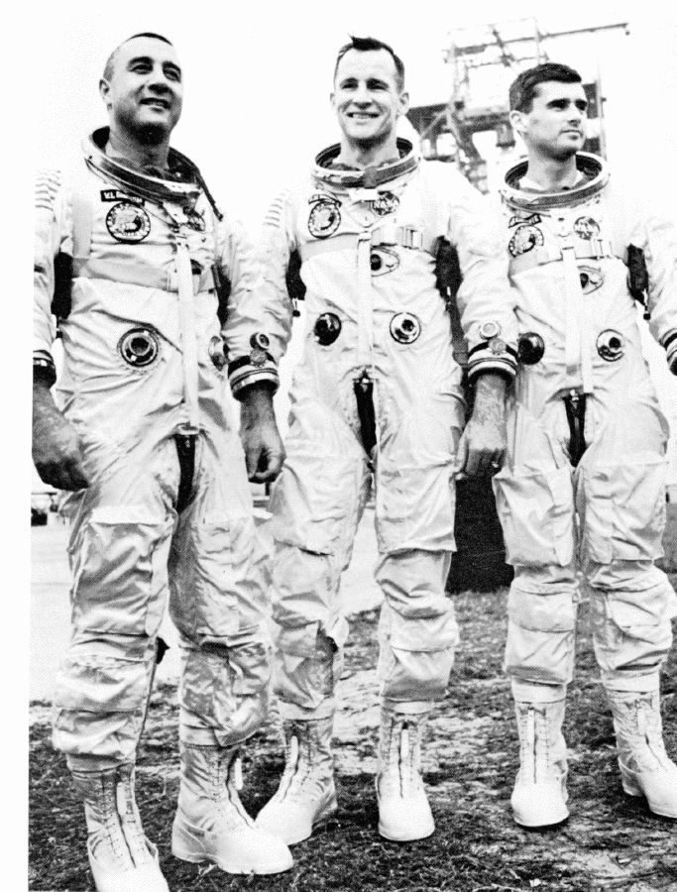
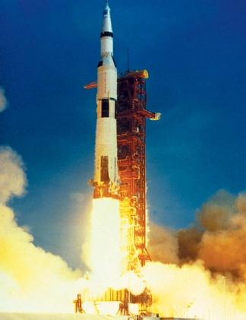
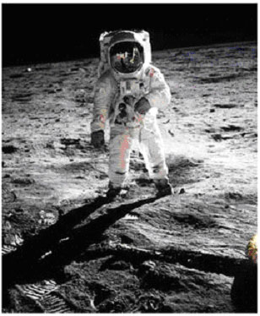
The Space Race
The Apollo Program
JFK hoped to avoid another Sputnik & hoped to beat the Soviets to the moon:
JFK greatly expanded NASA & announced that the U.S. would get to the moon by 1970
The U.S. landed a man on the moon in 1969

Slide 9
Crisis over Berlin
JFK’s 1st confrontation with the Soviet Union came in Berlin:
Khrushchev was upset with the exodus of skilled workers from East Germany to West Berlin
The USSR threatened to remove all U.S. influence from West Berlin, but settled on building the Berlin Wall in 1961

Slide 10
Containing Castro: Bay of Pigs
Fidel Castro took over Cuba in 1959 & developed ties with Russia
The Eisenhower administration (directed by the CIA) had been training Cuban exiles for an invasion & overthrow of Castro
In 1961, JFK gave the OK for the CIA to initiate the Bay of Pigs invasion
JFK blamed the Republicans for allowing a “communist satellite” to arise on “our very doorstep”

Slide 11
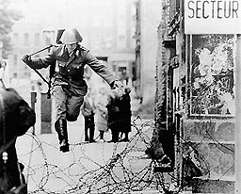
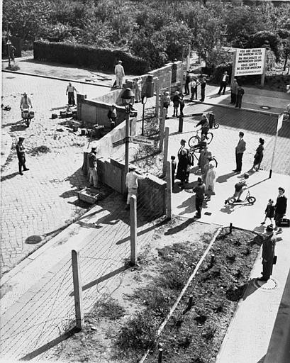
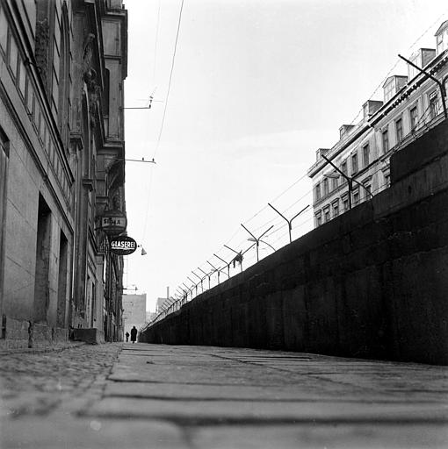
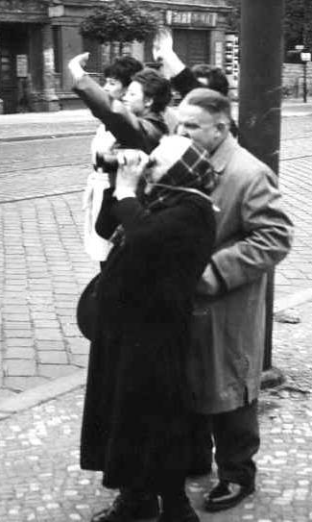
“Ich bin ein Berliner”
—JFK, 1963

Slide 12
Cuban Missile Crisis
24 medium-range & 18 short range ICBMs
To protect Cuba from another U.S. invasion, the USSR began a secret build-up of nuclear missiles
On Oct 14, 1962 a U-2 spy plane discovered Cuban missile camps
How would the U.S. respond?
Immediate air strike?
Full-scale invasion?
Kennedy chose to “quarantine” Cuba to keep new missiles out & an invasion of Cuba if the USSR did not remove its nukes
Diplomacy: trade nukes in Cuba for nukes in Turkey?
Naval blockade to keep warheads out?

Slide 13
Cuban Missile Crisis
And…U.S. removal of nuclear weapons in Turkey
The standoff ended when Russia removed its Cuban missiles & the USA vowed to never invade Cuba
The impact of the crisis:
Seen as a political victory for JFK
Installed a “hot line” to improve US-Soviet communications
This near-nuclear war convinced both sides to move from confrontation to negotiation
“Our most basic common link is the fact that we all inhabit this planet. We all breathe the same air. We all cherish our children’s future. We are all mortal.”
—JFK

Slide 14
"Let Us Continue"
On Nov 22, 1963 in Dallas, JFK was assassinated & VP Lyndon Johnson became president:
LBJ was a master politician with a reputation for getting results
LBJ promised to continue Kennedy's liberal agenda
LBJ ultimately exceeded JFK’s record on providing economic & racial equality
LBJ helped push through the greatest array of liberal legislation in U.S. history (“Great Society”), surpassing FDR’s New Deal

Slide 15
Lyndon Johnson in Action
LBJ quickly pushed through Congress 2 key “Kennedy” bills:
A $10 billion reduction in income taxes that led to increased consumer spending & new jobs
The Civil Rights Act of 1964 that declared segregation in public facilities illegal & protected black voting rights
The most significant legislation on race since the Reconstruction Amendments

Slide 16
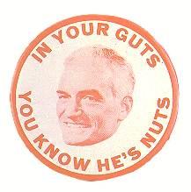
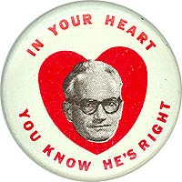
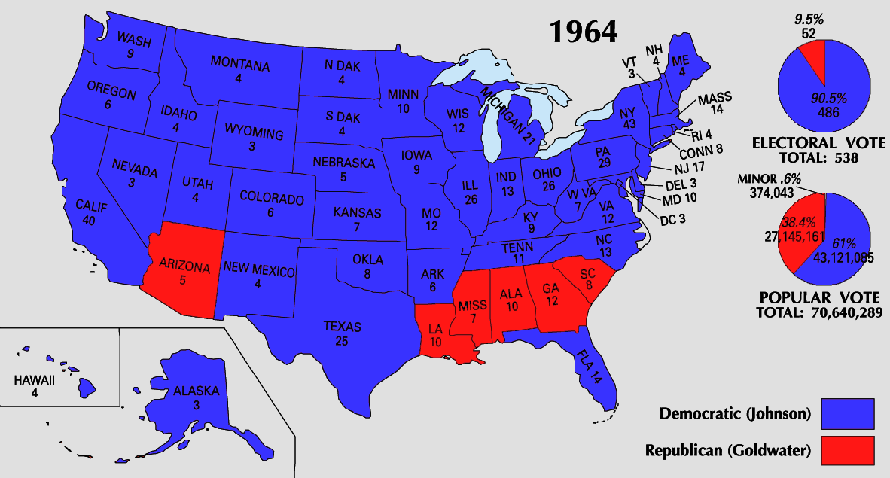
The Election of 1964
In 1964, LBJ ran against:
Conservative Republican Barry Goldwater rejected LBJ’s liberal welfare programs & called for a stronger foreign policy stance
Segregationist George Wallace
LBJ won in a landslide & the Democrats took control of Congress for 1st time in 25 years

Slide 17
The Great Society
Once elected, LBJ initiated his “Great Society” domestic agenda:
Medicare & Medicaid extended health insurance to the elderly & the poor
Extended $1 billion to improve public & parochial schools
The Voting Rights Act of 1965 banned literacy tests & provided for federal registrars for polls

Slide 18
Lyndon Johnson in Action
In 1964, LBJ waged a “war on poverty in America” & created the Office of Economic Opportunity:
Created the Job Corps for high school dropouts
Head Start for preschoolers
Adult education & technical training opportunities
As a result, America had 10 million fewer poor people by 1970
In 1964, the U.S. had 35 million poor people

Slide 19
`

Slide 20
The Great Society
Passed bills increasing funding for education; the first major federal aid package for education in the nation’s history
LBJ created Medicare and Medicaid
Created the Department of Housing and Urban Development (HUD)
First Black Cabinet Secretary in US History-Robert Weaver
Medicare: give low-cost medical insurance to Americans age 65 years and up
Medicaid: extends health care insurance to people on welfare.

Slide 21
The Triumph of Reform
By 1965, Congress passed 89 laws or reforms as part of LBJ’s social agenda:
The Great Society was the most comprehensive agenda of social reform since FDR
But…the American people did not respond well to LBJ
Soon…events in Vietnam, would taint his presidency

Slide 22
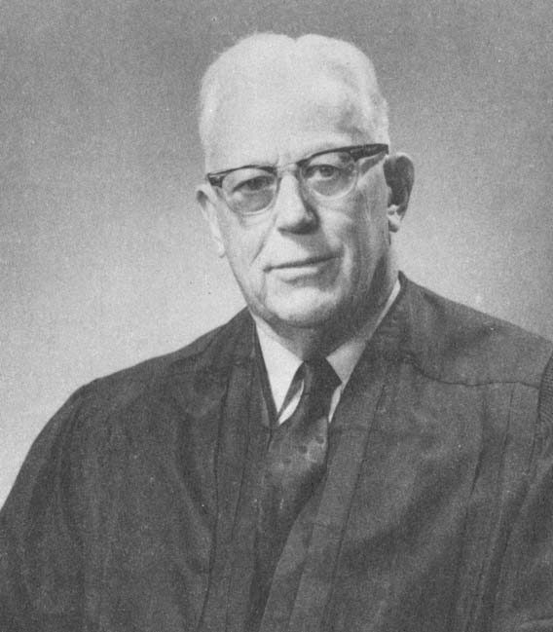
The Warren Court
The Warren Court also greatly expanded the rights of people accused of crimes. Earl Warren →
Illegally seized evidence couldn’t be used in court
Required criminal courts to provide free legal counsel
(Gideon v. Wainwright)
Right to a lawyer during questioning
People must be read their Miranda rights before questioning
(Miranda v. Arizona - 1966)

