Slide 1
In the momentous step which our State has taken of dissolving its connection with the government of which we so long formed a part, it is but just that we should declare the prominent reasons which have induced our course. Our position is thoroughly identified with the institution of slavery – the greatest material interest of the world. Its labor supplies the product which constitutes by far the largest and most important portions of commerce of the earth. These products are peculiar to the climate verging on the tropical regions, and by an imperious law of nature, none but the black race can bear exposure to the tropical sun. These products have become necessities of the world, and a blow at slavery is a blow at commerce and civilization. That blow has been long aimed at the institution, and was at the point of reaching its consummation. There was no choice left us but submission to the mandates of abolition, or a dissolution of the Union, whose principles had been subverted to work out our ruin. That we do not overstate the dangers to our institution, a reference to a few facts will sufficiently prove. The hostility to this institution commenced before the adoption of the Constitution, and was manifested in the well-known Ordinance of 1787, in regard to the Northwestern Territory. The feeling increased, until, in 1819-20, it deprived the South of more than half the vast territory acquired from France. The same hostility dismembered Texas and seized upon all the territory acquired from Mexico. It has grown until it denies the right of property in slaves, and refuses protection to that right on the high seas, in the Territories, and wherever the government of the United States had jurisdiction. It refuses the admission of new slave States into the Union, and seeks to extinguish it by confining it within its present limits, denying the power of expansion. It tramples the original equality of the South under foot. It has nullified the Fugitive Slave Law in almost every free State in the Union, and has utterly broken the compact which our fathers pledged their faith to maintain. It advocates negro equality, socially and politically, and promotes insurrection and incendiarism in our midst. It has enlisted its press, its pulpit and its schools against us, until the whole popular mind of the North is excited and inflamed with prejudice. It has made combinations and formed associations to carry out its schemes of emancipation in the States and wherever else slavery exists. It seeks not to elevate or to support the slave, but to destroy his present condition without providing a better. It has invaded a State, and invested with the honors of martyrdom the wretch whose purpose was to apply flames to our dwellings, and the weapons of destruction to our lives. It has given indubitable evidence of its design to ruin our agriculture, to prostrate our industrial pursuits and to destroy our social system.

Slide 2
The Election of 1860 and Secession
Mr. Winchell
APUSH
Period 5

Slide 3
Key Concepts
5. 2: Intensified by expansion and deepening regional divisions, debates over slavery and other economic, cultural, and political issues led the nation into civil war.

Slide 4
Outline
The Three Souths
Election Math and Election Maps
Secession of the Deep South
Political Cartoon Analysis

Slide 5
Slavery Over Time

Slide 6
The Three Souths: Border South: Delaware, Maryland, Kentucky, & Missouri
Plantations scarcer; cotton cultivation almost nonexistent; Tobacco main slave crop (as in Middle South); More grain production (as in Middle South)
1850, Slaves = 17% of population.; Avg. 5 slaves per slaveholder
1850, over 21% of Border South’s blacks free; 46% of South’s free blacks
22% of white families owned slaves
Of all who owned more than 20 slaves in South: 6%; Ultra-wealthy = 1%
Produced over 50% of South’s industrial products

Slide 7
The Three Souths: Middle South: Virginia, North Carolina, Tennessee, and Arkansas.
Each state had one section resembling more the Border South and another resembling the Lower South.
Unionists would prevail after Lincoln elected; Dis-unionists would prevail after war began
Many plantations in eastern Virginia and western Tennessee
1850, slaves = 30% of population; Avg. 8 slaves per slaveholder
36% of white families owned slaves
Of all who owned more than 20 slaves in South: 32%; Ultra-wealthy = 14%

Slide 8
The Three Souths: Lower South: South Carolina, Florida, Georgia, Alabama, Mississippi, Louisiana, Texas
Plantations prevalent; cotton was king; grew 95% of Dixie’s cotton & almost all of its sugar, rice, and indigo
Disunionists (secessionists) would prevail after Lincoln was elected
1850, slaves = 47% of population; Avg. 12 slaves per slaveholder
Less than 2% of blacks free; only 15% of South’s free blacks
43% of white families owned slaves
Of all who owned more than 20 slaves in South: 62%; Ultra-wealthy = 85%
Produced less than 20% of South’s industrial products

Slide 9
Election of 1860
Abraham Lincoln (R)
Stephen Douglas (D)
Northern Democrats
John Breckinridge (D)
Southern Democrats
John Bell (CU)
Coalition of Cotton Whigs and Know-Nothing

Slide 10
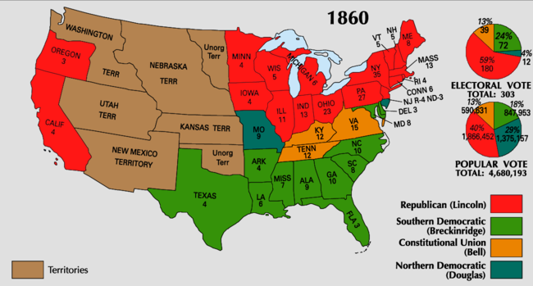
Available Electoral College Votes:
Non-slaveholding North (Including CA): 183
Border South: 32
Middle South: 41 Total Slaveholding South: 120
Deep South: 47
Notes:
South still had majorities in the Supreme Court and Democrats (states’ rights supporters) still had advantage in the House of Representatives.

Slide 11
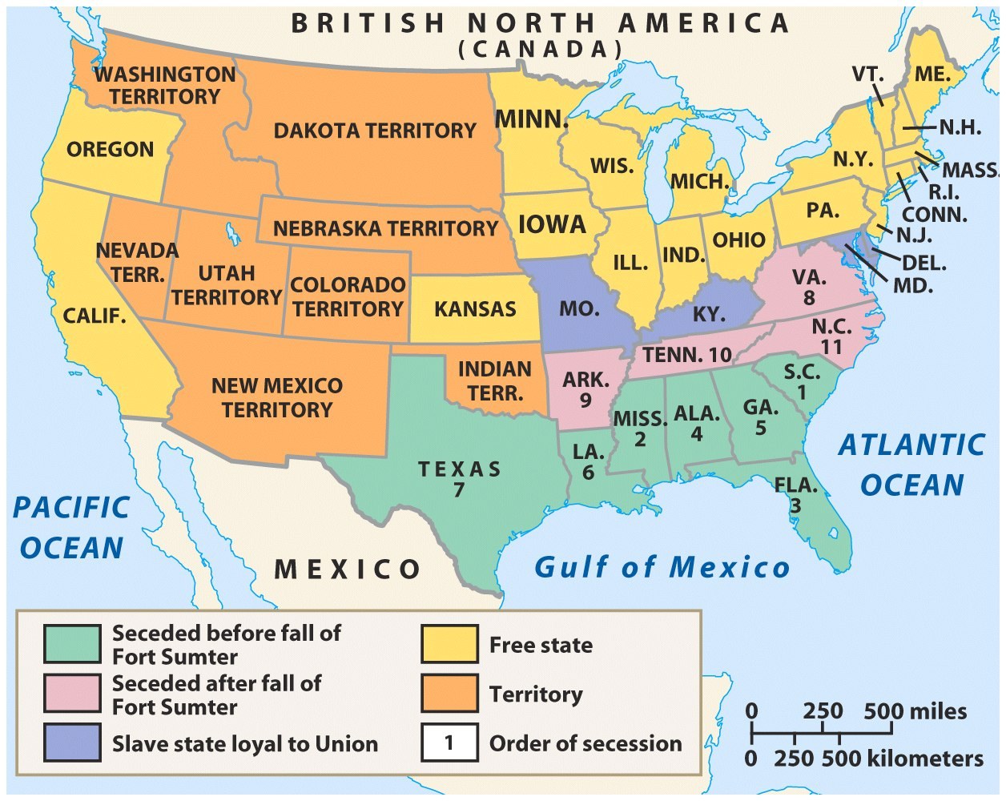
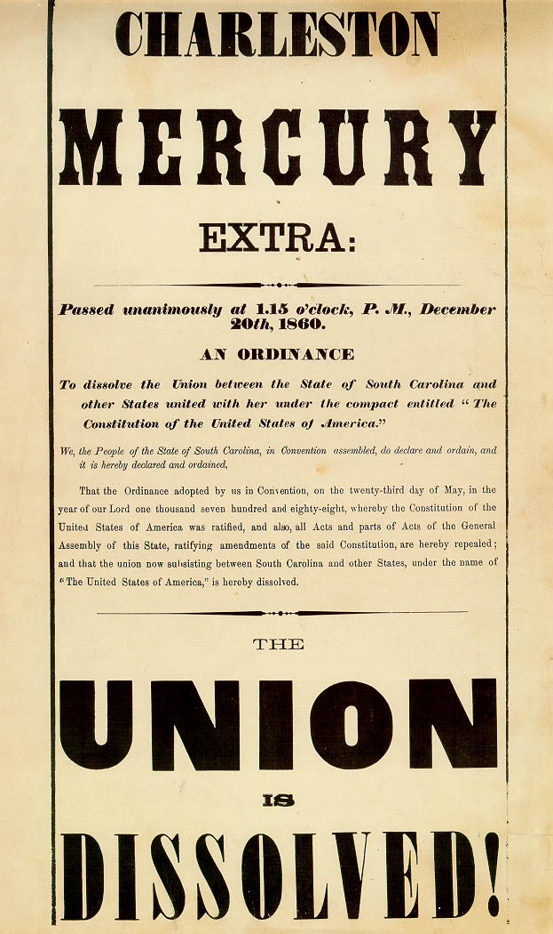
Abraham Lincoln’s election in 1860, was the first step towards the outbreak of the Civil War
South Carolinians feared the victory of a Republican president would bring an end to slavery & seceded from the USA
By early 1861, 7 Southern states seceded and formed the Confederate States of America

Slide 12
South Carolina Order of Secession
For twenty-five years this agitation has been steadily increasing, until it has now secured to its aid the power of the common Government. Observing the forms of the Constitution, a sectional party has found within that Article establishing the Executive Department, the means of subverting the Constitution itself. A geographical line has been drawn across the Union, and all the States north of that line have united in the election of a man to the high office of President of the United States, whose opinions and purposes are hostile to slavery. He is to be entrusted with the administration of the common Government, because he has declared that that "Government cannot endure permanently half slave, half free," and that the public mind must rest in the belief that slavery is in the course of ultimate extinction.

Slide 13
Abraham Lincoln’s election in 1860, was the first step towards the outbreak of the Civil War
The entire Deep South seceded by February 1861
The Upper South did not view Lincoln’s election as a death sentence and did not secede immediately

Slide 14
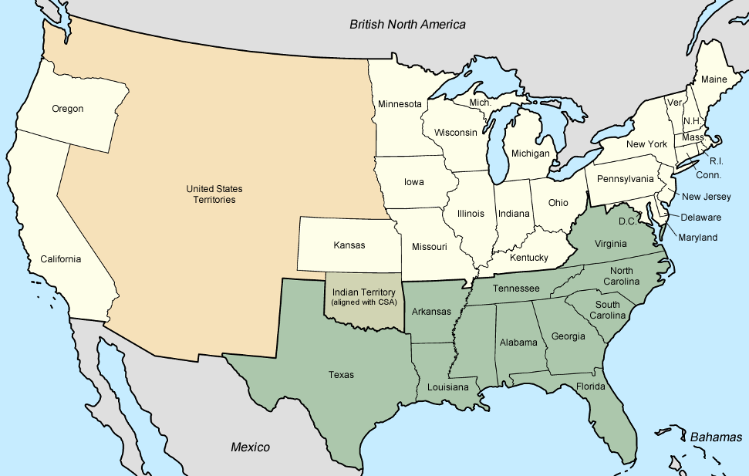
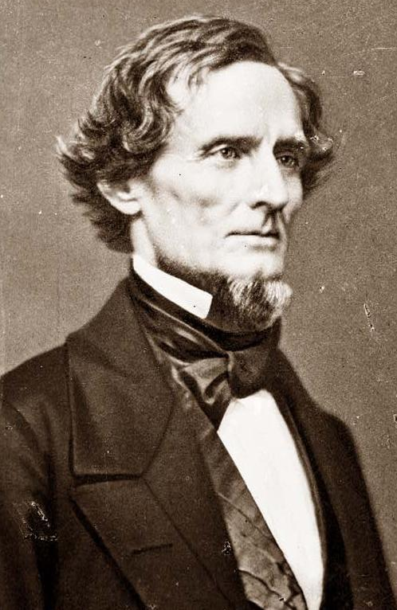
The constitution of the Confederacy was similar to the U.S. Constitution except that it:
Protected slavery and states’ rights
Outlawed tariffs
Created a weak national government
Elected Jefferson Davis as Confederate president

Slide 15
Confederate Constitution (Excerpted)
We, the people of the Confederate States, each State acting in its sovereign and independent character, in order to form a permanent federal government, establish justice, insure domestic tranquility, and secure the blessings of liberty to ourselves and our posterity invoking the favor and guidance of Almighty God do ordain and establish this Constitution for the Confederate States of America.
Three-Fifths Clause
The House of Representatives shall choose their Speaker and other officers; and shall have the sole power of impeachment; except that any judicial or other Federal officer, resident and acting solely within the limits of any State, may be impeached by a vote of two-thirds of both branches of the Legislature thereof.
Line-item veto for President
To lay and collect taxes, duties, imposts, and excises for revenue, necessary to pay the debts, provide for the common defense, and carry on the Government of the Confederate States; but no bounties shall be granted from the Treasury; nor shall any duties or taxes on importations from foreign nations be laid to promote or foster any branch of industry; and all duties, imposts, and excises shall be uniform throughout the Confederate States.
Congress cannot “facilitate commerce”
The importation of negroes of the African race from any foreign country other than the slaveholding States or Territories of the United States of America, is hereby forbidden; and Congress is required to pass such laws as shall effectually prevent the same.
No bill of attainder, ex post facto law, or law denying or impairing the right of property in negro slaves shall be passed.
Single six-year term for President
The citizens of each State shall be entitled to all the privileges and immunities of citizens in the several States; and shall have the right of transit and sojourn in any State of this Confederacy, with their slaves and other property; and the right of property in said slaves shall not be thereby impaired.
State legislatures solely responsible for amendments

Slide 17
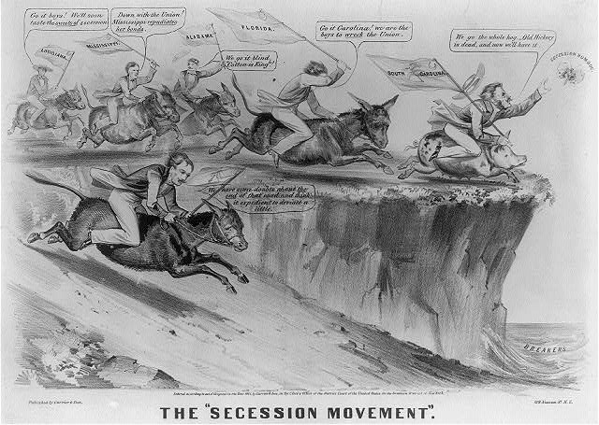

Slide 18
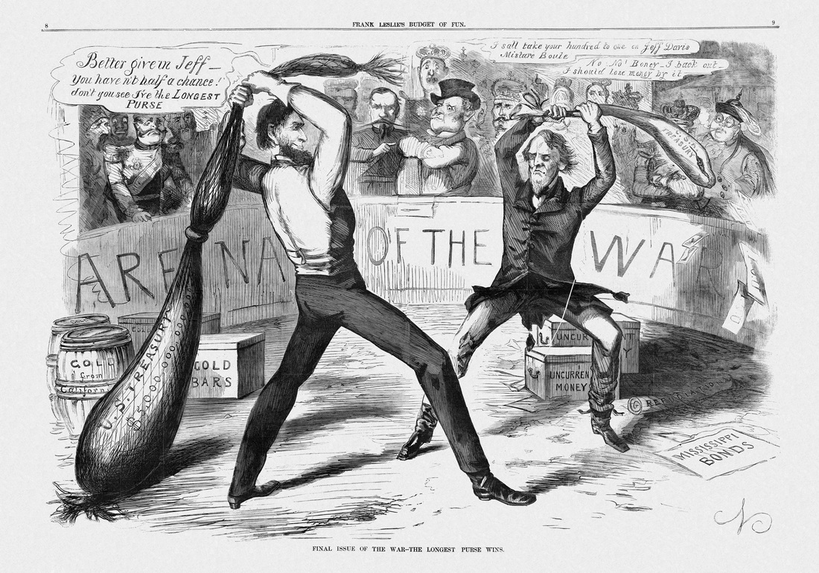

Slide 19
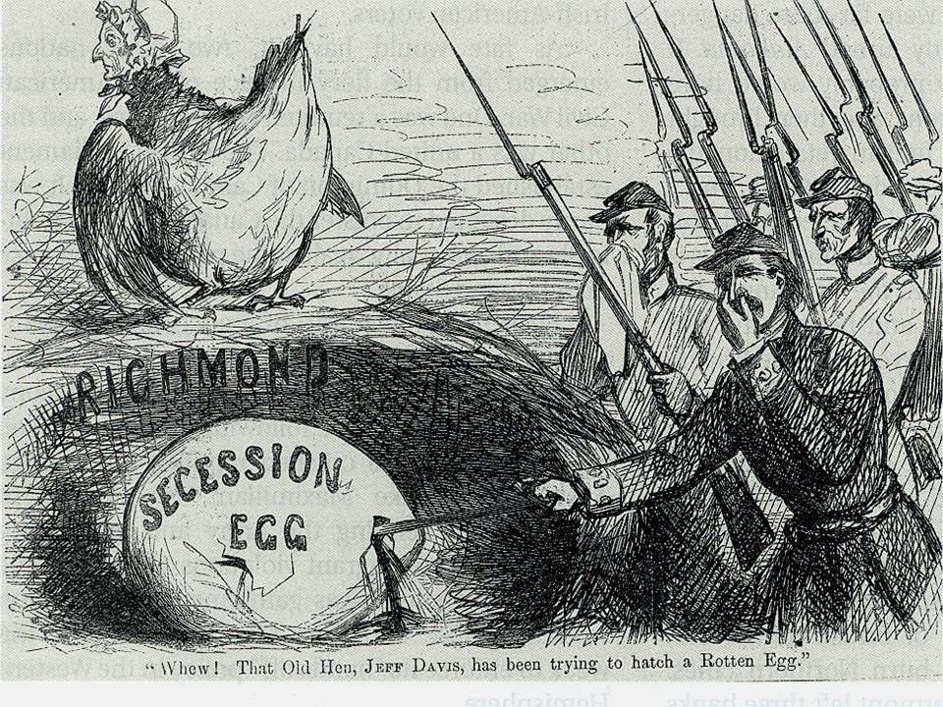
Cartoon: North thought of secession

Slide 20
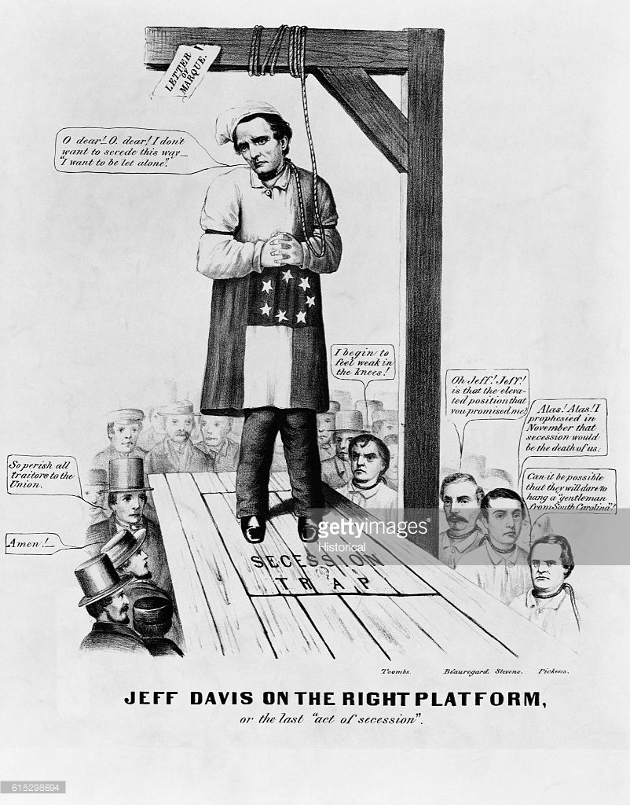

Slide 21
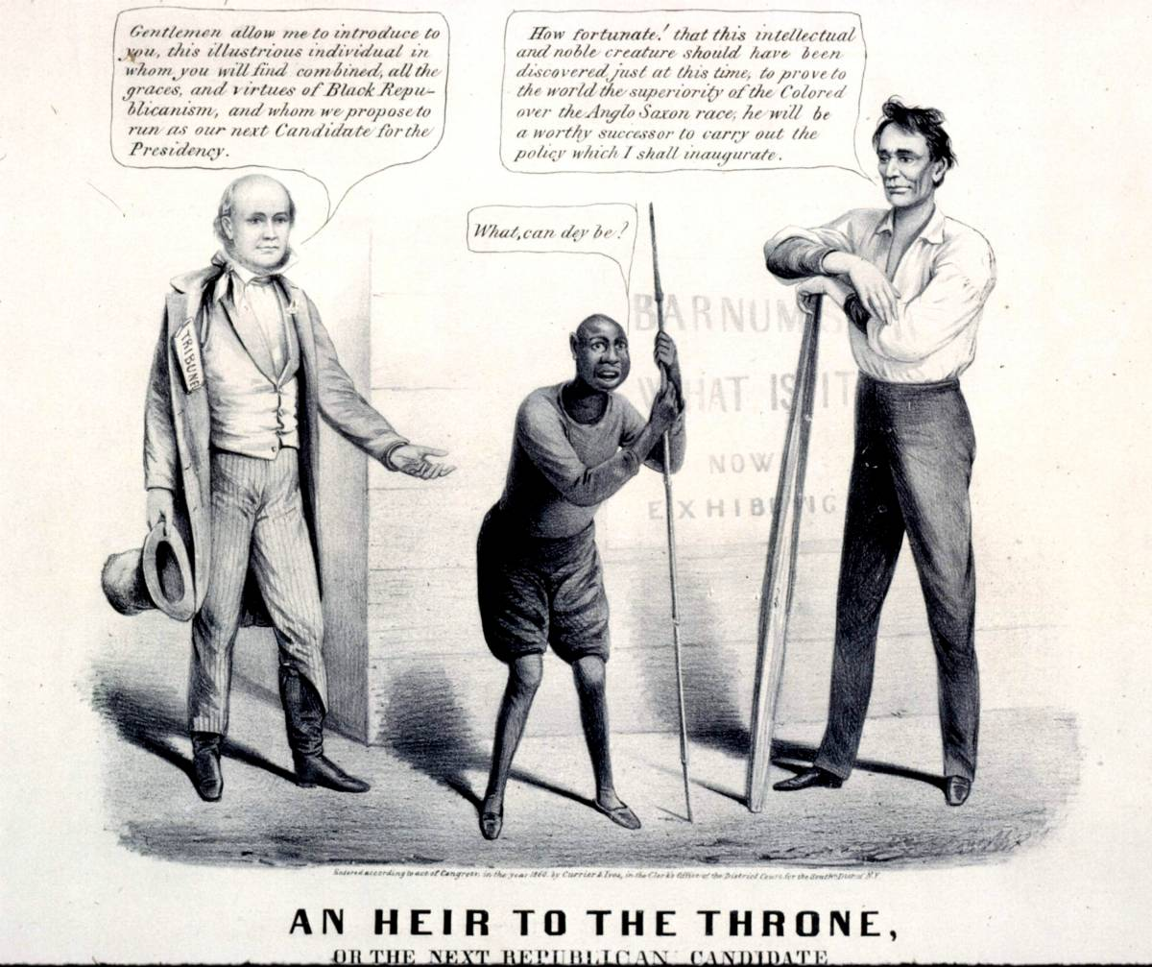

Slide 23
“My paramount object in this struggle is to save the Union, and is not either to save or to destroy slavery. If I could save the Union without freeing any slave I would do it, and if I could save it by freeing all the slaves I would do it; and if I could save it by freeing some and leaving others alone I would also do that.” —Abraham Lincoln, 1862

