Slide 1
DO NOW
What was the goal of Clay’s American System?
What was the effect of the Market Revolution on the US?

Slide 2
The Era of Good Feelings, Monroe’s Presidency and the Missouri Compromise
Mr. Winchell
APUSH Period 4

Slide 3
Key Concepts
4.1.I.A: In the early 1800s, national political parties continued to debate issues such as the tariff, powers of the federal government, and relations with European powers.
4.1.I.B: Supreme Court decisions established the primacy of the judiciary in determining the meaning of the Constitution and asserted that federal laws took precedence over state laws.
4.3.I.A. Following the Louisiana Purchase, the United States government sought influence and control over North America and the Western Hemisphere through a variety of means, including exploration, military actions, American Indian removal, and diplomatic efforts such as the Monroe Doctrine.

Slide 4
AP Prompt
Evaluate the extent to which government actions, economic development, and foreign policy demonstrated continuity or change over time in the years after the War of 1812

Slide 5
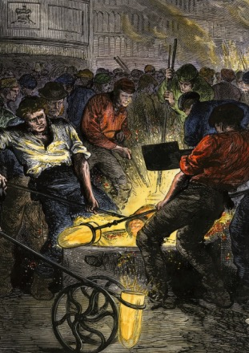
Results of the War of 1812
Growth of American Nationalism
“Second War for American Independence”
Strengthened Isolationism
Increased Westward Migration
more land opened after Indian defeats
Growth of U.S. industry
response to loss of British imports during war

Slide 6
Death of Federalist Party
New England states opposed war
Dec. 15, 1814 - leading Federalists held Hartford Convention
Proposed 7 amendments to Const. to strengthen states rights (ironic!) & protect northern interests
Some hinted at secession though did not have support
Convention ill-timed – Americans thought we won and Federalists came off as weak

Slide 7
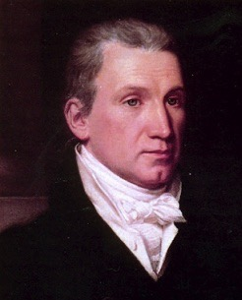
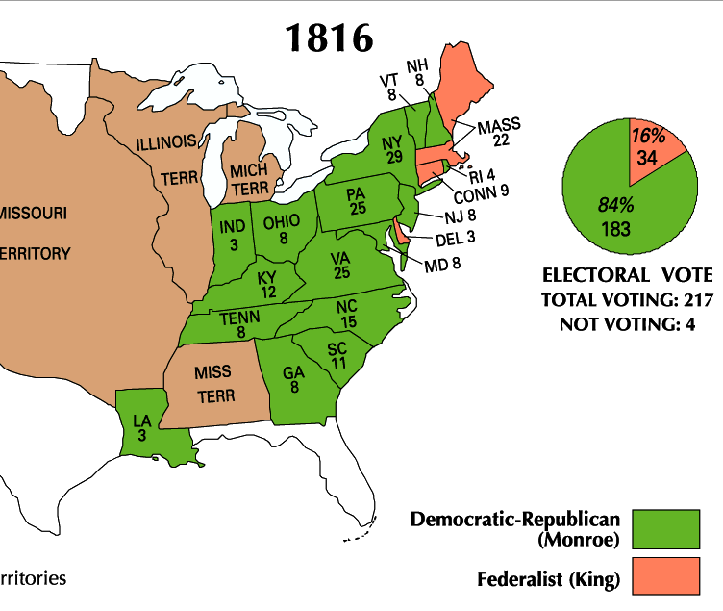
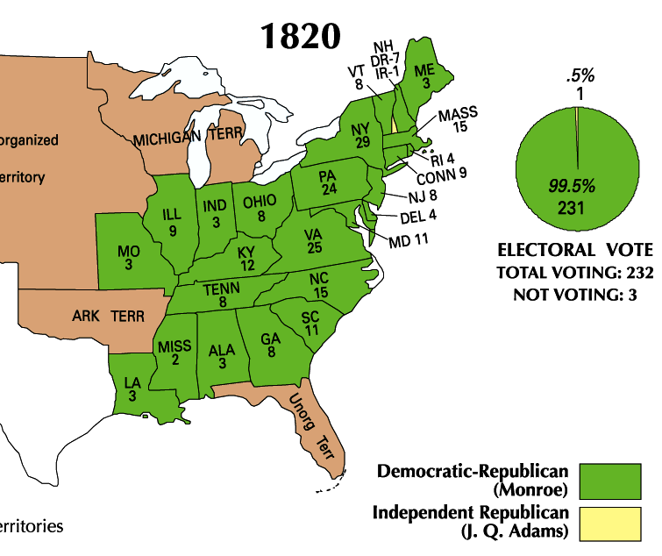
James Monroe was overwhelmingly elected president in 1816 and 1820
Monroe’s presidency began during an era of increased nationalism after the War of 1812 known as the “Era of Good Feelings” (1815-1825)

Slide 8
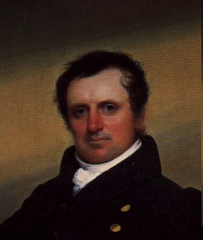
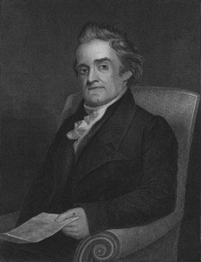
Nationalism in Culture
Nationalism also influenced art & literature
Literature – American Renaissance
James Fenimore Cooper
The Last of the Mohicans
First American to make a career as a novelist
Webster’s American Dictionary
Novelists expressed pride in the new nation and its immense potential

Slide 9
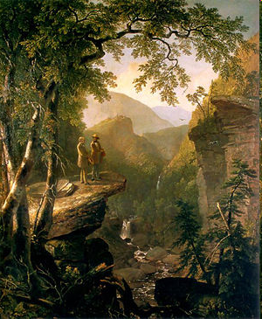
Cultural
Artists – Depicted America’s beautiful landscape
Hudson River School
Group of landscape painters who used realistic detail to depict the beauty of nature and reflect the spirit of nationalism
How do these images reflect nationalism?

Slide 10
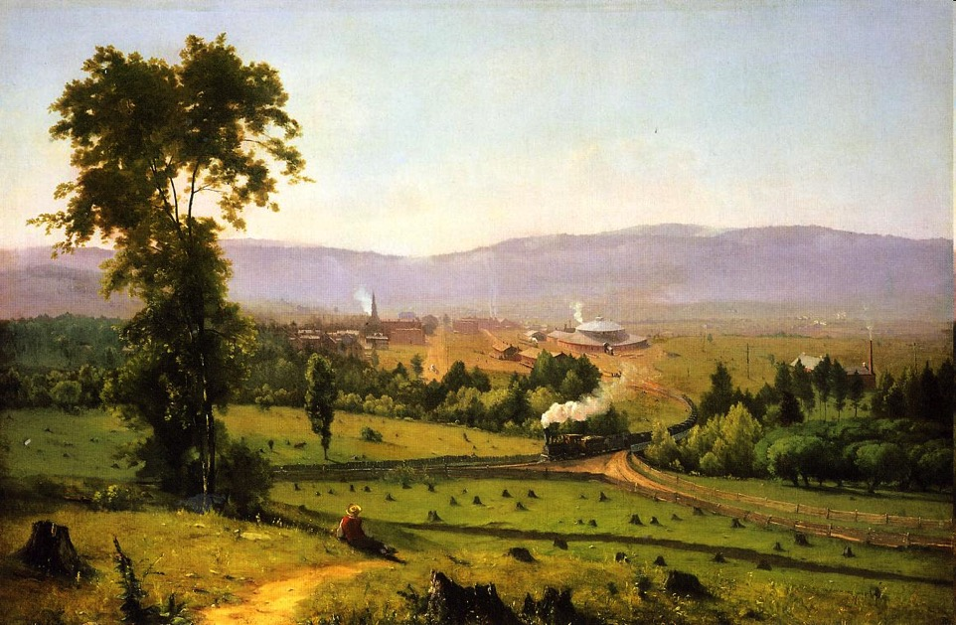

Slide 11
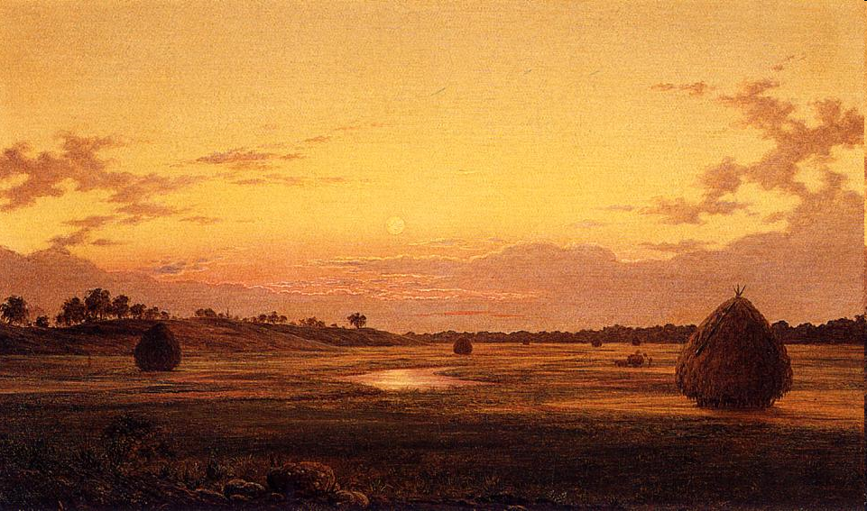

Slide 12
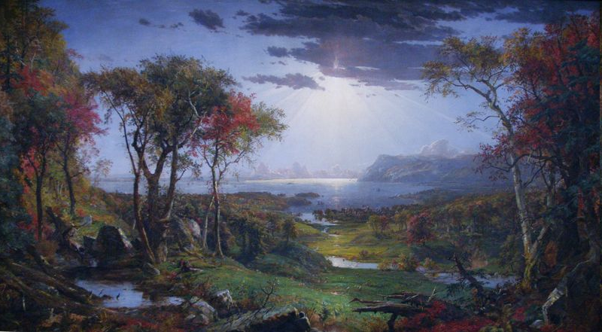

Slide 14
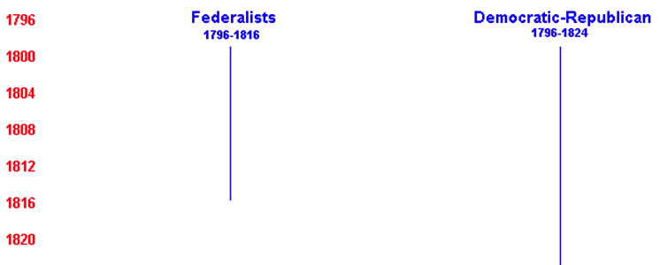
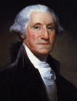
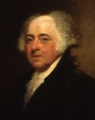
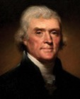
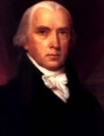
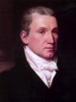
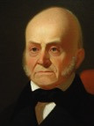
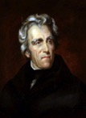
Monroe’s goals as president were to promote national unity and America’s place in the world
By 1816 the Federalists were so weak that the Democratic-Republicans could do almost anything
Monroe and the Republicans in Congress used this time to promote American nationalism
8 yrs
George Washington
(1789-1797)
4 yrs
John Adams
(1797-1801)
8 yrs
Thomas Jefferson
(1801-1809)
8 yrs
James
Madison
(1809-1817)
8 yrs
James Monroe
(1817-1825)
4 yrs
John Quincy Adams
(1825-1829)
8 yrs
Andrew Jackson
(1829-1837)
Federalist Party
Democratic-Republican Party
Democratic Party

Slide 15
The Era of Good Feelings: 1817-1825
Death of the Federalist Party
Adoption of many Federalist ideas
Monroe (Demo. Rep.) wins 1816 election
Americans nationalistic following War of 1812
U.S. foreign policy successes
Rush-Bagot Treaty (1817) – limit naval armaments on Great Lakes
Convention of 1818 – allowed joint occupation of Oregon territory with GB
Purchase of Florida (1819) – Adams-Onís Treaty
Notes:
Phrase coined by a Boston reporter
Federalist party dies out after Hartford Convention fiasco (1814)
Leaves Democratic-Republicans as the only major party
Demo-Reps under Madison had adopted Federalist ideas
Federal support for internal improvements (roads, etc.)
Tariff protection of new industries created during embargo
Creation of new national bank
1st Bank of U.S. charter expired in 1811
Monroe elected to two terms of office
Well-liked - even in one-time Federalist stronghold New England
“Victory” in war of 1812 made Americans enthusiastic supporters of the Natl. govt.
Gives Monroe a freer hand in foreign policy matters
Rush-Bagot Treaty between the U.S. & GB called for naval disarmament of the Great lakes
To this day - U.S./Canadian border is unfortified
Convention of 1818 fixes U.S./Canadian border at 49th parallel from Minnesota to Rockies
Florida purchased from Spain with Adams-Onis Treaty for $5 million
U.S. gives up on claim to Texas
Spain recognizes border between Mexico & Oregon Territory at 42nd Parallel
The South benefits most but treaty is widely supported

Slide 16
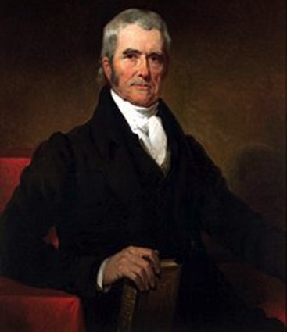
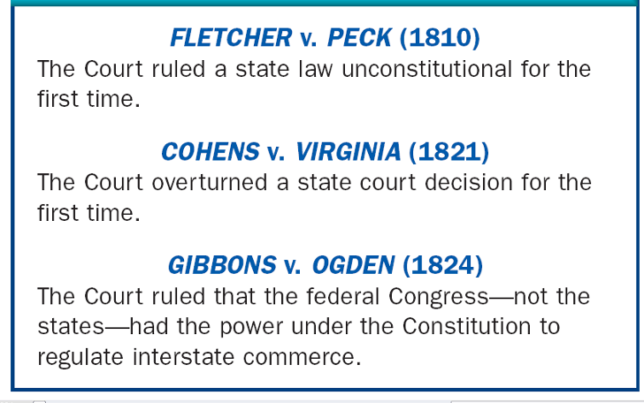
The Era of Good Feelings promoted nationalism & American unity in three ways:
Government: Increase the power of the national gov’t over the states
John Marshall (1801-1835) used the Supreme Court to strengthen the power of the national government
Notes:
Fletcher Peck: Land Sale

Slide 17
Marshall Cases cont.
McCulloch vs. Maryland (1819)
Upheld the “implied powers” of Congress
Affirms broad interpretation of the Constitution - making it flexible
Maryland tried to tax Bank of U.S. branch in MD - court rules that states can’t interfere w/ fed govt.
‘The power to tax is the power to destroy’
John Marshall

Slide 18
Marshall’s Legacy
Established primacy of federal govt. over states, especially in exercising control of economy
Affirmed protection for corporations from local/state govt. interference
promotes growth of capitalist economy

Slide 19
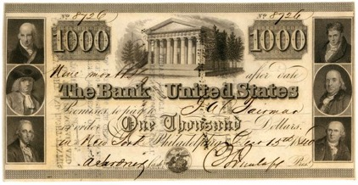
The Era of Good Feelings promoted nationalism & American unity in three ways:
Government: Increase the power of the national gov’t over the states
In 1816, Congressman Henry Clay proposed the American System to unify the economies of the North, South, and West
Economy: Encourage industry and transportation to link the South, North, and West
Create a Second Bank of the United States
Create a tariff to encourage industry and limit British manufactured goods
Improve transportation with roads and canals

Slide 21
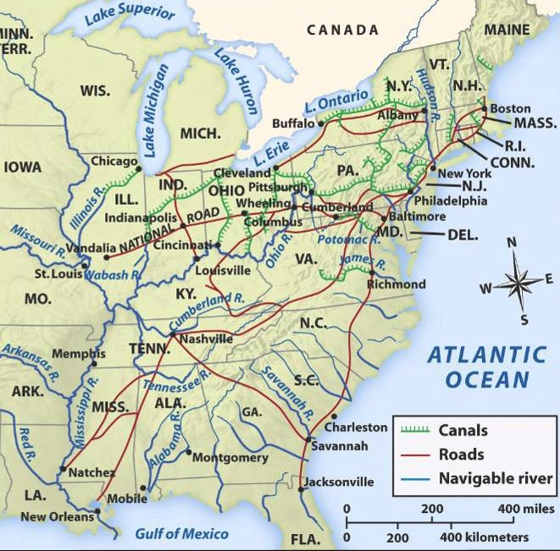
The American System allowed the USA to create a national market economy for the first time
Western farms grew grains
and raised livestock that fed the nation
Northern factories made manufactured goods that were sold throughout the country
Southern cotton was used in northern textiles factories
Notes:
The emphasis here is on the politics of the era, which should help students understand how the national government promoted a national market economy that, by the 1810s, had emerged as strong regional economies due to new technological innovations (cotton gin, interchangeable parts, Singer sewing machines, Slater mills, McCormick reaper, Deere steel plow, etc.)

Slide 22
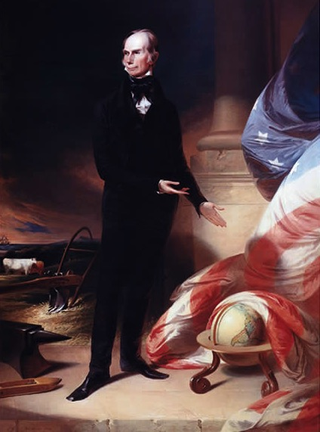
Kentucky Congressman Henry Clay
What aspects of this portrait reveal parts of Henry Clay’s “American System”?

Slide 23
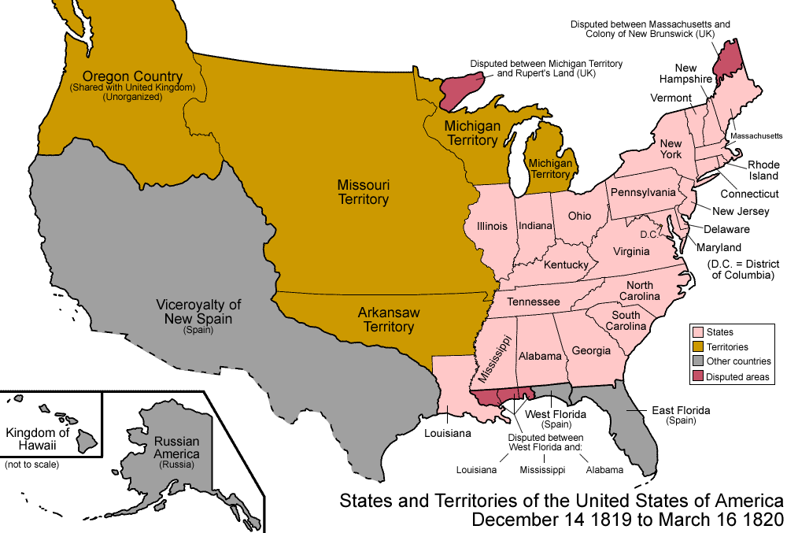
The Era of Good Feelings promoted nationalism & American unity in three ways:
Government: Increase the power of the national gov’t over the states
After the War of 1812, Americans flooded into the West; By 1840 over ¹/3 of the population lived in the West
Congress quickly admitted 5 new states to the Union
Economic and territorial growth created a need to settle America’s national borders
Economy: Encourage industry and transportation to link the South, North, and West
Indiana (1816)
Illinois (1818)
Alabama (1819)
Mississippi (1817)
Foreign Policy: Expanding America’s borders and increasing America’s role in world affairs
Louisiana (1812)

Slide 24
President Monroe and his Secretary of State John Quincy Adams used foreign policy to promote nationalism & territorial expansion
In 1818, the USA and Britain agreed to establish the Canadian border at the 49°
In 1819 the USA gained Florida from Spain with the Adams-Onis Treaty

Slide 25
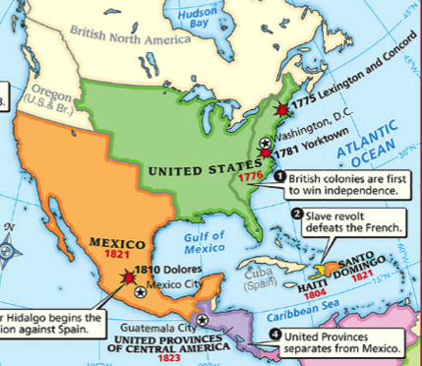
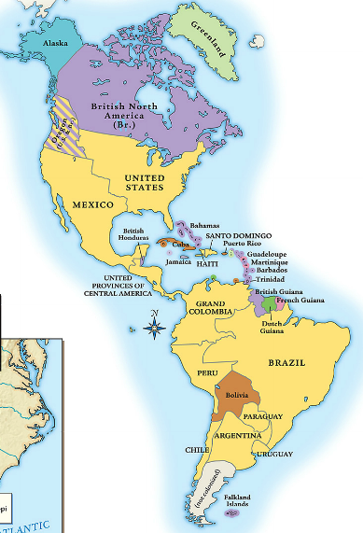
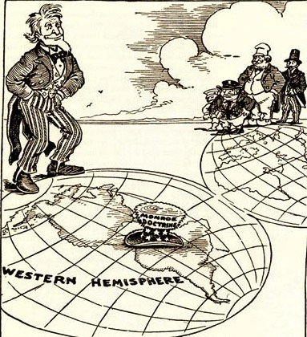
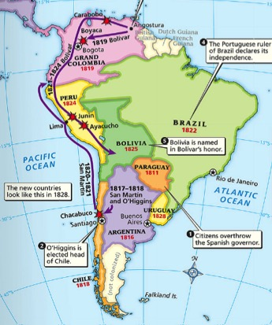
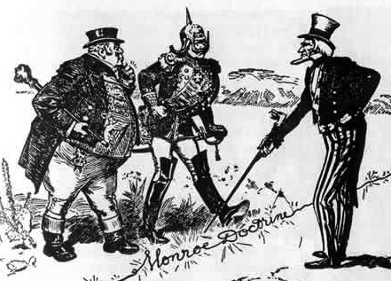
In 1823, the Monroe Doctrine warned European nations that the USA would protect the Western Hemisphere and that the U.S. would not interfere in Europe
When Latin American nations gained independence, the USA wanted to support the new republics and keep European nations from colonizing Latin America

Slide 26
Significance of Monroe Doctrine
Expressed American nationalism & desire to be a world player
Effective?
Russia halted expansion at 54° 40’
Europe did not attempt re-conquest of Latin America
No major or lasting violations even though U.S. not powerful enough to back it up until the 1860’s

Slide 27
Panic of 1819
High demand for American farm goods=high prices
High prices=land boom in Western US
Easy credit from state banks=fueled land boom
New management at 2nd Bank of US=tighter credit
State banks fail=financial panic
Blame=National Bank
Six year financial depression

Slide 28
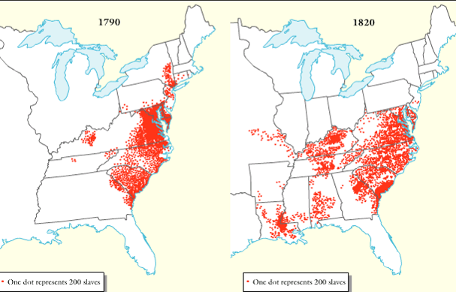
The Era of Good Feelings was a time of nationalism, but there were growing problems between the North and South (called sectionalism)
American Slave Population, 1790-1820

Slide 29
Northerners & Southerners disagreed over slavery, taxes, and the role of government
These disagreements dominated politics from 1820 to 1860
American Slave Population, 1790-1820

Slide 30
Slavery & the Sectional Balance
Sectional tensions increased (1819) when Missouri applied for statehood
H of Reps. passed anti-slavery Tallmadge amendment to Missouri Bill
Would ban further slavery in MO
Children born to slaves would be emancipated at age 25

Slide 31
Tallmadge Amendment
Southerners & Westerners opposed
South viewed it as threat to sectional balance between N & S
North had pop. advantage in H of R
South = in Senate (11 states per)
Equality in Senate means N can’t interfere w/ slavery
Tallmadge Act defeated in Senate

Slide 32
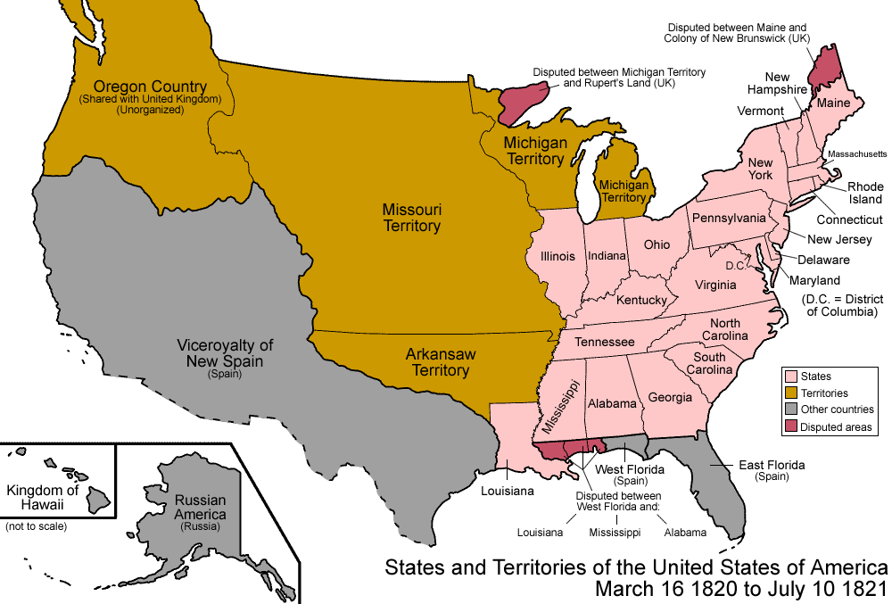
When Missouri applied to become a U.S. state, sectionalism emerged
Northerners did not want Southern states to increase power in the national gov’t
If Missouri entered as a slave state, the South would have 2 more Senators than the North
Notes:
Because of the 3/5 Compromise, the South had more members of the House of Representatives; President Monroe was from Virginia, so the South controlled the presidency too

Slide 33
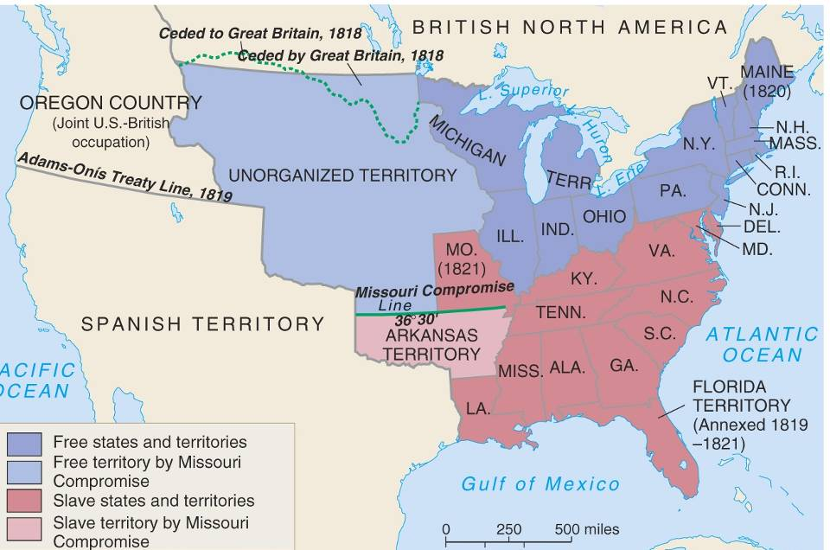
In 1820, Henry Clay negotiated the Missouri Compromise (Compromise of 1820)
Maine broke from Massachusetts and became a free state
Missouri became a slave state
Slavery was outlawed in all western territories above the latitude of 36°30'

Slide 34
Mutual benefits & displeasure
North - remainder of Lou. Terr. free
South - a new slave state
& potential for more south of line
Deal only lasts 30 years
MO Comp. did nothing to resolve the slavery issue
Increase in sectional nationalism

Slide 35
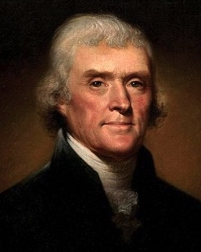
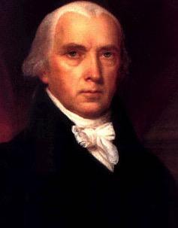
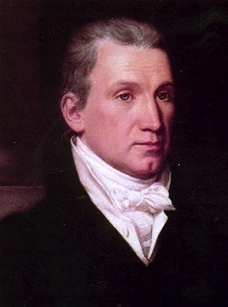
Jefferson (1801-1809)
Madison (1809-1817)
Monroe (1817-1825)
For each president, provide a list of achievements and failures:
Which of the following was most successful?
Which of the following was most successful at upholding the Democratic Republican ideology?

