Slide 1
MONDAY QUIZ
Sit down, shut up, and go to the following link. You have 6 minutes.
bit.ly/quiz911

Slide 2
Do Now
‘Stop and Jot’
“Liberty may be endangered by the abuse of liberty, but also by the abuse of power.”
James Madison

Slide 3
The Need for Stability: The Constitution, The Bill of Rights, Constitutional Interpretations and the Roots of the 2-Party System
Mr. Winchell
APUSH
Period 3

Slide 4
AP Prompt
Compare and contrast the federal governments under the Articles of Confederation and the Constitution. (1st hour)
Analyze the reasons for the Anti-Federalist opposition to the ratification of the Constitution. (2nd hour)

Slide 5
Key Concepts
3.2.II.C: Delegates from the states participated in a Constitutional Convention and through negotiation, collaboration, and compromise proposed a constitution that created a limited but dynamic central government embodying federalism and providing for a separation of powers between its 3 branches.
3.2.II.D: The Constitutional Convention compromised over the representation of slave states in Congress and the role of the federal government in regulating both slavery and the slave trade, allowing the prohibition of the international slave trade after 1808.
3.2.II.E: In the debate over ratifying the Constitution, Anti-Federalists opposing ratification battled with Federalists, whose principles were articulated in the Federalist Papers (primarily written by Alexander Hamilton and James Madison). Federalists ensured the ratification of the Constitution by promising the addition of a Bill of Rights that enumerated individual rights and explicitly restricted the powers of the federal government.

Slide 6
Govt. gets its authority from the citizens.
A selfless, educated citizenry.
Elections should be frequent.
Govt. should guarantee individual rights & freedoms.
Govt.’s power should be limited [checks & balances].
The need for a written Constitution.
“E Pluribus Unum.” [“Out of many, one”]
An important role for women → raise good, virtuous citizens. [“Republican Womanhood”].
Classical view of a model republic
Enlightenment Thinking
The “Virtuous Republic”
Ideal citizen [Cincinnatus]
“City on a hill” [John Winthrop]

Slide 7
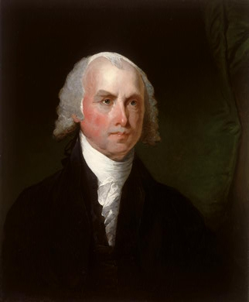
The Constitutional Convention, 1787
Key leaders at the Convention:
George Washington:
President (chairman) of the Convention
Quiet but very respected;
Kept tempers cool
James Madison: “The Father of the Constitution”
Author of the Virginia Plan (three branches of govt)
Kept detailed notes! Brilliant!
Would later write the Bill of Rights
Constitutional Compromises
They had to balance a lot of competing interests.

Slide 8
A Stronger National Government
Articles Problems
Constitution Solution
No power to tax
No power to regulate interstate and foreign commerce
No executive branch
No judicial branch
Amendments need unanimous consent
Supermajority to pass laws
Lay and collect taxes
Interstate and foreign commerce clause
No export taxes
President
Electoral College
4 year terms
U.S. Supreme Court
Article V – Amendments
2/3 of both houses of Congress
¾ of state legislatures
Presentment Clause
Simple majority by both houses
President’s signature

Slide 9
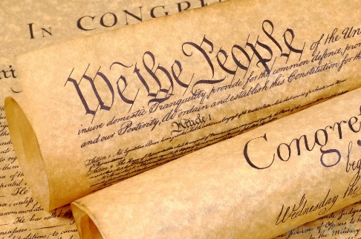
Basic Principles of the Constitution
Federal law is the supreme law of the land, as long as it follows the Constitution. States have a lot of power to govern themselves, but they can’t go against a Federal law.
Popular Sovereignty (Rule by the people)
Power comes from the people’s consent
Limited Government
Limited the powers of the Government to those powers in the Constitution

Slide 10
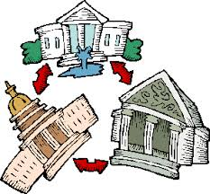
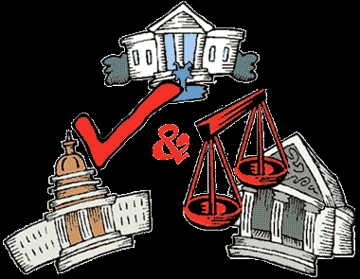
Basic Principles of the Constitution
Separation of Powers
Three co-equal branches of government
Legislative: Congress (makes the law)
Senate and House of Representatives
Executive: President (enforces the law)
Judicial: Supreme Court (interprets the law)
Checks and Balances
Each branch has some control over the others
No branch can get too powerful

Slide 11
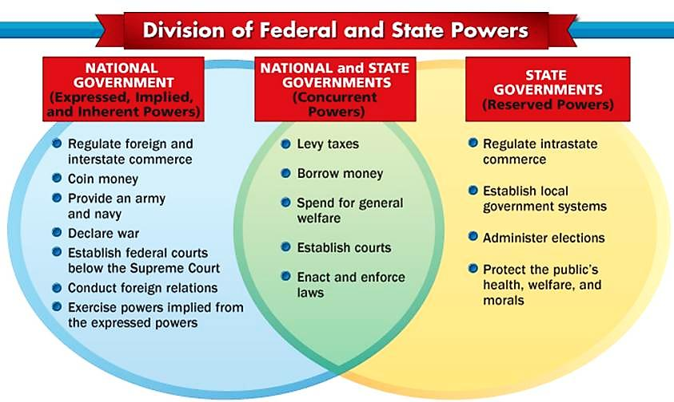

Slide 12
Constitutional Compromises:
Balancing Power Between Large and Small States
Virginia Plan:
2 houses of Congress (bicameral):
House of Representatives
Senate
Representation determined by population size in both houses
More people → more reps!
Big states liked this!
New Jersey Plan:
1 house of Congress (unicameral):
House of Representatives only
Representation determined by state: equal representation (like the AoC)
One state → one vote!
Small states liked this!
The Great Compromise
How should states be represented in the govt?
Also called Connecticut Compromise
2 houses of Congress (bicameral): House of Representatives and a Senate
Senate: House of Reps
Equal representation in Senate - Representation based on pop
Each State gets two Senators - More people → more reps!
Elected by the state legislature/assembly - Reps elected by the people

Slide 13
Constitutional Compromises:
Balancing Sectional (Regional) Interests of the States
Constitutional Convention – Conflicts and Compromises
Three-Fifths (3/5th) Compromise
How should population be counted for representation and taxation?
Northern States:
Slaves should NOT be counted for representation, but SHOULD be counted for taxation.
This position was best for the non-slavery states (mostly northern and smaller).
Southern States:
Slaves SHOULD be counted for representation, but they should NOT be counted for taxation.
This position was best for the slave-holding states (mostly southern with large #’s of slaves).
Count some of the slaves.
For every 5 slaves, 3 would be counted for population and taxation.

Slide 14
Trade Compromise
vs.
North -
wanted government to have power to regulate trade
South -
Feared interference with slave trade, taxes on exports

Slide 15
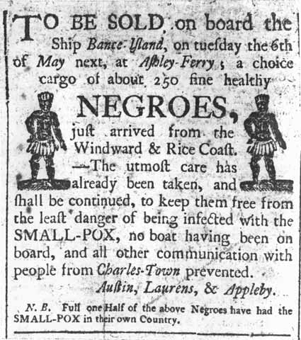
Trade?
The Solution:
Congress gets power to regulate trade
Congress cannot tax exports; Congress cannot regulate/ban the slave trade for 20 years
The importation of slaves continued until 1808

Slide 16
Ratification
Before the Constitution could be put into practice, it must be ratified, or officially approved by the states.
Each state set up a convention to approve or reject the Constitution
Nine states had to accept the Constitution for it to be ratified
Debate over Constitution -- (Federalists and Anti-federalists) – What were their arguments?

Slide 17
bb
Federalists | Anti-Federalists
Supporters of Constitution Wanted strong national government Thought a strong central government would protect the country from foreign nations Would also provide protection, maintain order, regulate trade, guarantee rights of citizens, guarantee the nation’s debts were paid, and that American money had a stable value Thought a Bill of Rights listing citizen’s rights was unnecessary because the Constitution had already limited the government’s powers Thought that a national government that represented everyone would not be able to ignore the rights of everyone else | Opponents of Constitution Wanted a weak national government and powerful state governments Thought strong central government would endanger people’s liberties Thought having a government so far away wouldn’t meet needs of people > needed governments that were local to protect people’s interests Thought the Constitution needed a Bill of Rights to specifically state the rights of citizens that the government must respect Didn’t like “necessary and proper” statement in Constitution because the wording was open to interpretation and could leave door open for Congress to abuse its power

Slide 18
The Constitution Needs a Bill of Rights; The Constitution Does Not Need a Bill of Rights
Patrick Henry – Speech Before the Virginia Ratifying Convention (1788)
Alexander Hamilton – The Federalist No. 84 (1788)
It was expressly declared in our Confederation that every right was retained by the States respectively, which was not given up to the Government of the United States. But there is no such thing here. You therefore by a natural and unavoidable implication, give up your rights to the General Government… A Bill of Rights may be summed up in a few words. What do they tell us? – That our rights are reserved. – Why not say so? Is it because it will consume too much paper?... A Bill of Rights is a favorite thing with the Virginians, and the people of the other States likewise. It may be their prejudice, but the Government ought to suit their geniuses, otherwise its operation will be unhappy. A Bill of Rights, even if its necessity be doubtful, will exclude the possibly of dispute, and with great submission, I think the best way is to have no dispute.
Here, in strictness, the people surrender nothing, and as they retain every thing, they have no need of particular reservations. “We the people of the United States, to secure the blessing of liberty to ourselves and our posterity, do ordain and establish this constitution for the United States of America.”... I go further, and affirm that bills of rights, in the sense and in the extent in which they are contended for, are not only unnecessary in the proposed constitution, but would even be dangerous. They would contain various exceptions to powers which are not granted; and on this very account, would afford a colourable pretext to claim more than were granted. For why declare that things shall not be done which there is no power to do?... The truth is…that the constitution is itself in every rational sense, and to every useful purpose, a Bill of Rights...And the proposed constitution, if adopted, will be the bill of rights of the union.
Notes:
PUT ON PAPER

Slide 20
The Bill of Rights
After the Federalists promise to add a Bill of Rights, states begin to ratify the Constitution (Delaware is 1st)
Bill of Rights is written by James Madison (a Federalist)
Heavily influenced by two Virginia documents:
The Virginia Declaration of Rights (1776) by George Mason
The Virginia Statute of Religious Freedom (1786) by Thomas Jefferson

Slide 21
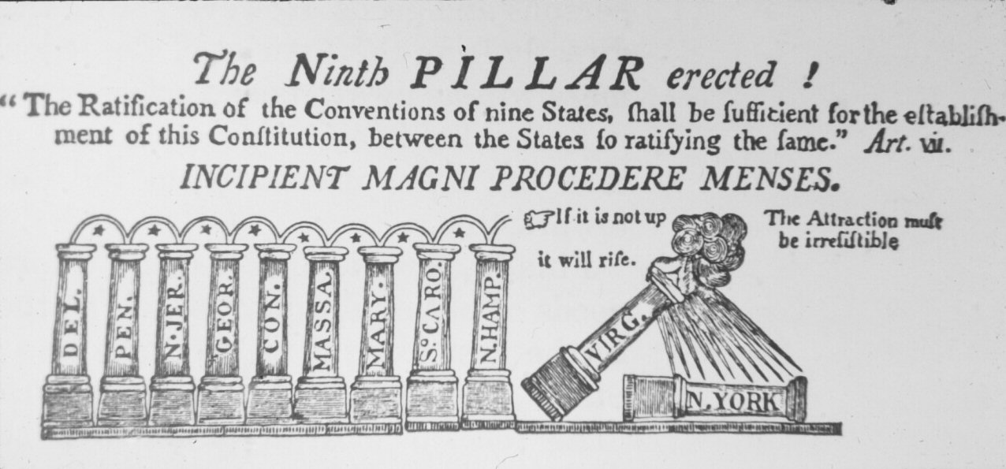
The Constitution is Created
June 1788
New Hampshire = 9th state needed for ratification
NY (hardest fought) = 11th state
RI = last to ratify (1790)
Took 3 years to gain full ratification (1878-1790)
Bill of Rights added 1791
James Madison = principle author
Motivation: protect rights not specified in Constitution

Slide 22
First Ten Amendments
First Amendment
Establishment Clause
Free Exercise Clause
Speech, Press, Assembly, Petition
Fourth Amendment
Searches and Seizures
Fifth Amendment
Due Process
Sixth Amendment
Speedy and fair trial
Counsel
Tenth Amendment
Reserved powers of the states

Slide 23
Articles
A COMPARISON
Sovereignty?
Foreign Relations?
Taxation?
Commerce & Trade?
Representation?
To Legislate?
To Amend?
Constitution
States
SHARED
Federal
Federal
States
Federal & State
Federal (Interstate) State (Intrastate)
States
1 Vote Per State
Proportional (House)
Two Each (Senate)
2/3
Concurrent Majority + President’s Signature
UNANIMOUS
2/3 + 3/4

