Slide 1
Do Now
Identify the changes Foner points to that characterize this era of “Jacksonian Democracy.”

Slide 2
4. The Rise of Jackson and the Birth of Modern Democracy
Mr. Winchell
APUSH 2019-2020
Period 4

Slide 3
AP Prompt
Evaluate the extent to which the election of Jackson in 1828 demonstrated change in American politics.

Slide 4
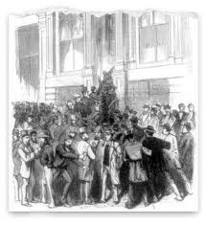
America’s Market Economy
Panic of 1819
Causes
  Western land speculation
  War inflation then post-war deflation
  BUS pursued contractionary monetary policy
Aftermath
  First recession of market economy
  Northern manufacturers demanded high tariffs
  Southern farmers demanded low tariffs
  Westerners criticized speculators and bankers

Slide 5
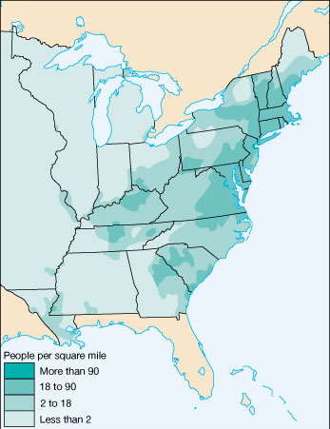
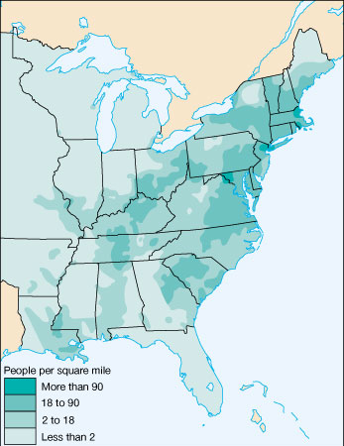
US Population Density
1810
1820

Slide 6
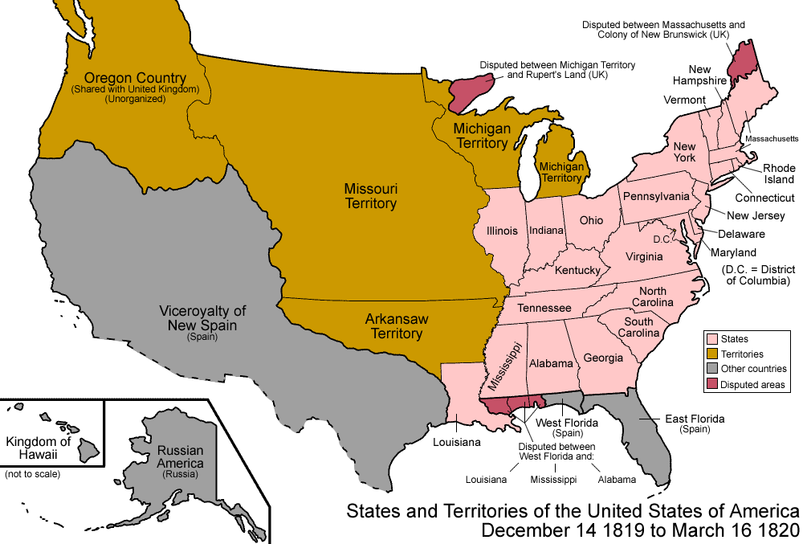
Settlement of the Trans-Mississippi
By 1810, 1/7th of the U.S. population lived in the West; By 1840 over 1/3rd lived in the West
Congress quickly admitted 5 states to the Union:
Indiana (1816)
Illinois (1818)
Alabama (1819)
Mississippi (1817)
Louisiana (1812)

Slide 7
Sectional Disputes
The Era of Good Feelings started with a wave of national unity, but sectional disputes between the North & South emerged & would dominate politics for next 40 years
  Disagreed over the use of protective tariffs, especially when cotton prices fell in 1820s
  Disagreed over slavery in the western territories & states

Slide 8
Missouri Compromise
Population was growing more rapidly in North, so House of Reps favored Northerners
In 1817, Missouri applied for statehood as a slave state & revealed U.S. sectional rivalries:
  North resented Southern control of presidency & its 3/5-inflated representation in House of Reps
  South feared a Northern conspiracy to end all slavery
  Equality had been maintained by alternating admission of “free” & “slave” states added to the US
NY rep Tallmadge wanted Missouri only if its state constitution provided for the gradual elimination of slavery

Slide 9
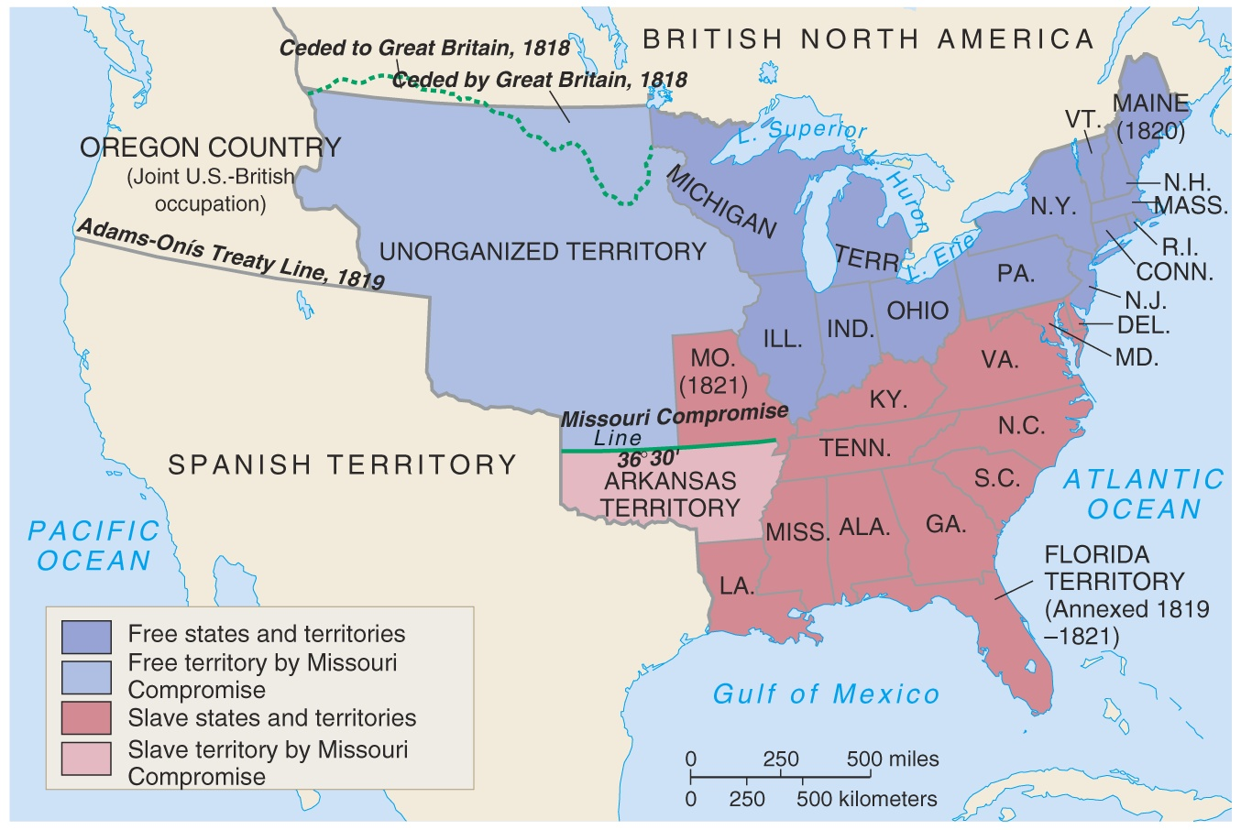
Missouri Compromise, 1820-1821

Slide 10
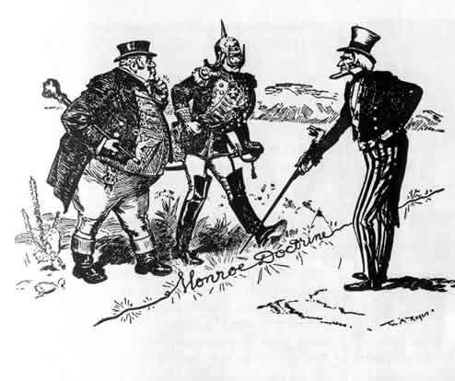
Era of Good Feelings
Monroe Doctrine (1823)
U.S. and Great Britain concerned about European expansion into Americas
Points
  “In the discussions to which this interest has given rise and in the arrangements by which they may terminate the occasion has been judged proper for asserting, as a principle in which the rights and interests of the United States are involved, that the American continents, by the free and independent condition which they have assumed and maintain, are henceforth not to be considered as subjects for future colonization by any European powers.”
  “We owe it, therefore, to candor and to the amicable relations existing between the United States and those powers to declare that we should consider any attempt on their part to extend their system to any portion of this hemisphere as dangerous to our peace and safety. With the existing colonies or dependencies of any European power we have not interfered and shall not interfere. But with the Governments who have declared their independence and maintain it, and whose independence we have, on great consideration and on just principles, acknowledged, we could not view any interposition for the purpose of oppressing them, or controlling in any other manner their destiny, by any European power in any other light than as the manifestation of an unfriendly disposition toward the United States.”

Slide 11
Conclusions
The “Era of Good Feelings” led to:
  An improved American economy
  Better transportation
  More territory & more clearly-defined borders
  A foreign policy in Latin America
  But…sectional problems between the North & South

Slide 12
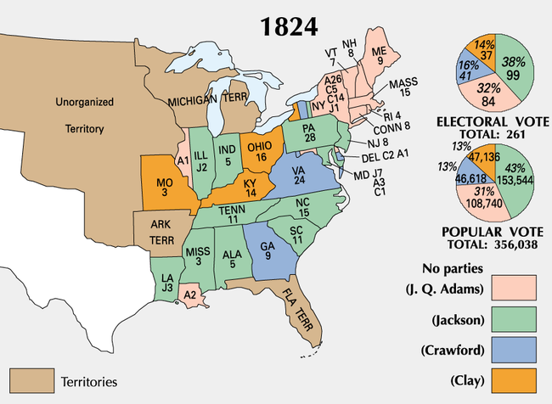
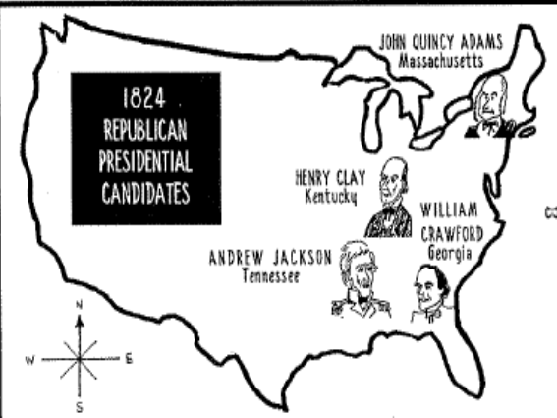
The Election of 1824:
“The Corrupt Bargain”
Jackson ran in a 4-way race for Pres in 1824 (all the same party!)
4 candidates were in the running, each with sectional support: William Crawford (GA), John Quincy Adams (MA), Andrew Jackson (TN), Henry Clay (KY)
In such cases, the top 3 candidates are voted on in House of Representatives, with each state getting 1 vote
Even though Jackson won the popular vote, he didn’t receive a majority of electoral votes.
Henry Clay gives his support to JQ Adams and the House of Reps chooses Adams as President
Adams names Clay Sec. of State 2 weeks later….hmmmm
AJ is furious: The Corrupt Bargain
AJ Publicly supports changes in state laws
about who can vote

Slide 13
A “Corrupt Bargain”?
YEARS | PRESIDENT | SEC OF STATE | VICE PRESIDENT
1789-1797 | George Washington | Thomas Jefferson | John Adams
1797-1801 | John Adams |  | Thomas Jefferson
1801-1809 | Thomas Jefferson | James Madison
1809-1817 | James Madison | James Monroe
1817-1825 | James Monroe | John Quincy Adams
1825-1829 | John Quincy Adams | Henry Clay | John C. Calhoun

Slide 14
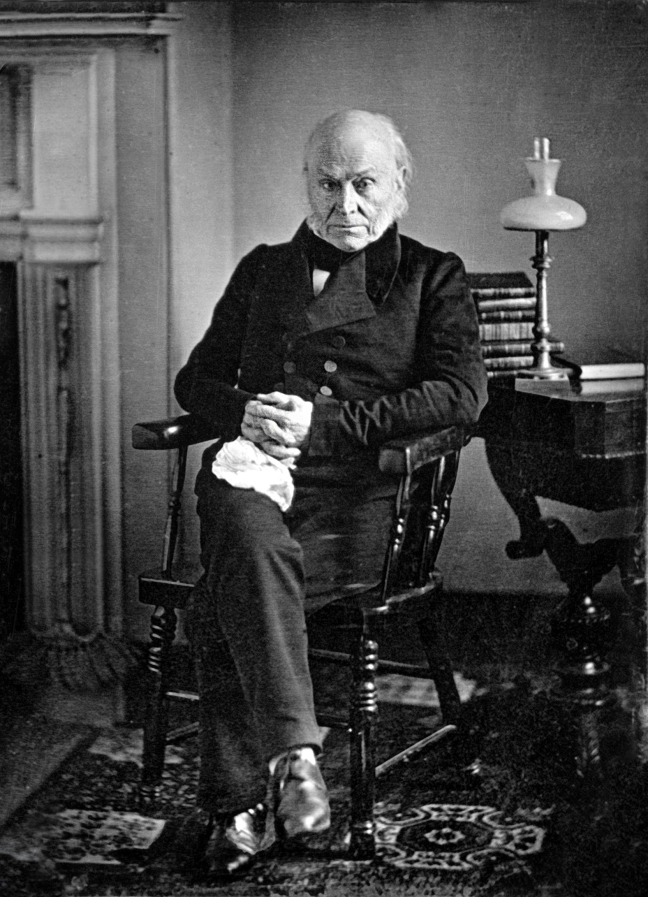
Adams’ Administration
Clay’s American System
1828 “Tariff of Abominations”
Generous Indian policy
All of which angered Jacksonian Democrats

Slide 15
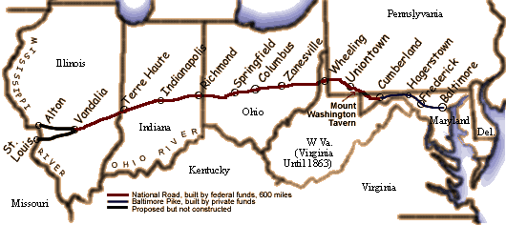
J. Q. Adams' Administration
One exception: the National Road
Adams had a difficult presidency:
  JQ Adams wanted to continue the nationalist programs of the “Era of Good Feelings”
  The depression of 1819 limited the nationalist agenda & few of Adams’ policies became law
  A protective tariff was passed to help farmers & industry, but this angered the South

Slide 16
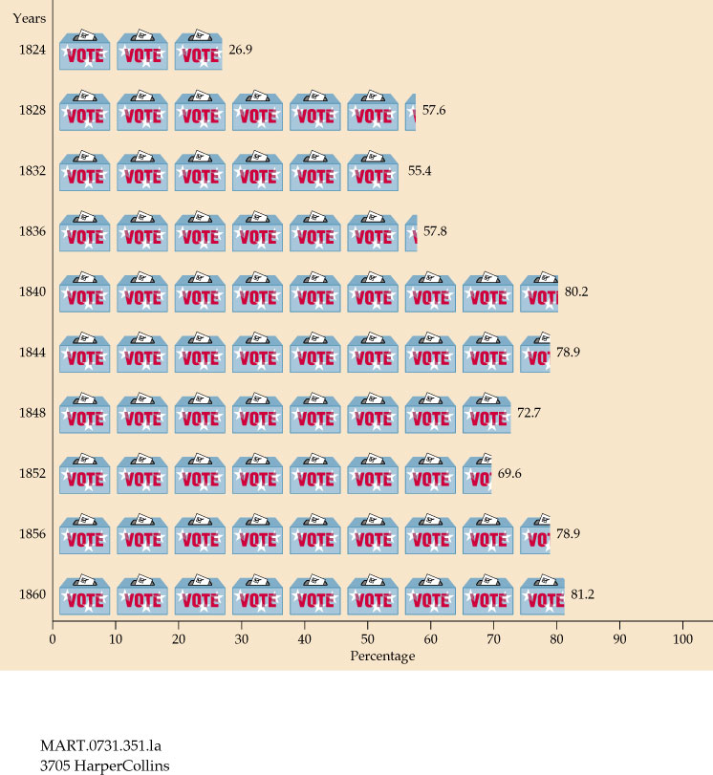
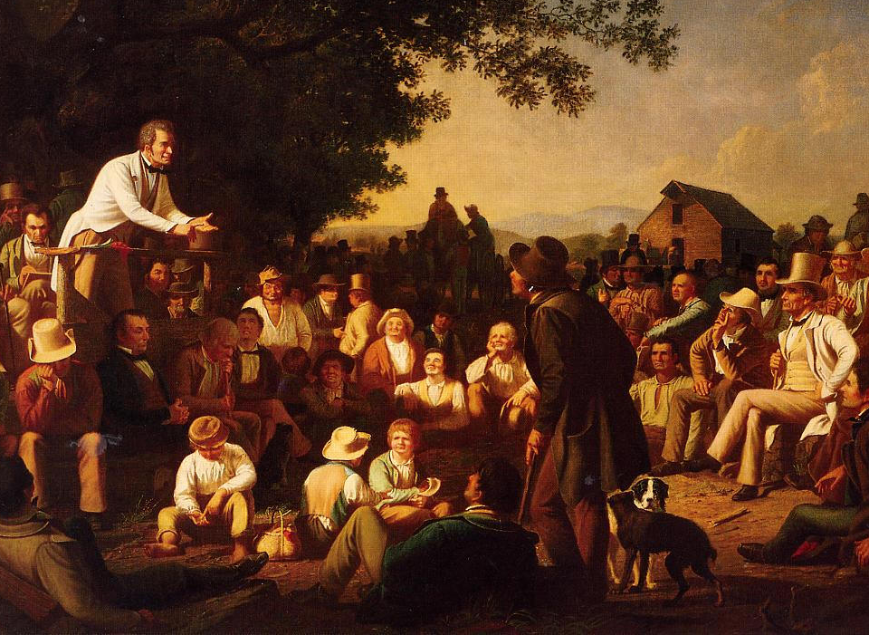
From 1800 to 1840, states removed property and
tax restrictions which allowed 90% of “common” white men to vote (“universal white male suffrage”)

Slide 17
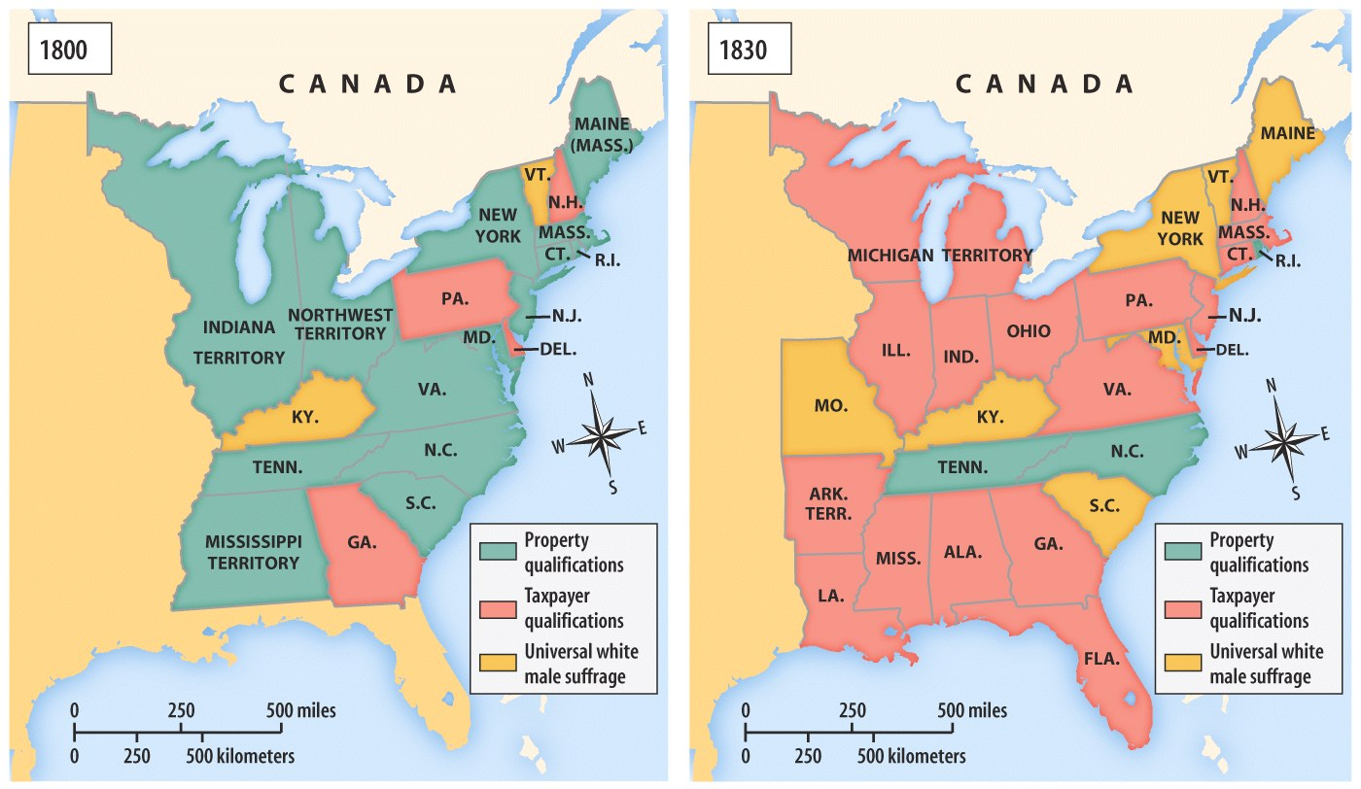
Universal White Male Suffrage

Slide 18
Direct Balloting for President
President
The New System
Direct Election
(Democracy)
The Old System
Indirect Election
(Aristocracy)
Presidential Electors
By 1836, voters in all states except for South
Carolina were casting
direct ballots for presidential electors.
South Carolina continued to select electors indirectly until 1860.
State Legislature
Voters
Notes:
Which arrangements

Slide 19
Jackson Comes to Power
But, these “Jacksonian Democrats” are not going to mirror the “Jeffersonian Republicans”
“Jacksonians” prepared for the election of 1828 by creating a well-organized, national campaign
  Jackson (TN) formed a coalition with Adams’ VP Calhoun (SC), Van Buren (NY), & 2 newspaper editors (KY) to rival JQ Adams
  Formed the basis of 1st modern political party, calling themselves the “Democrats”
“Democrats” distinguished themselves as different from the “Nationalist Republicans” who has strayed from the Jeffersonian ideal

Slide 20
Jackson Comes to Power
Democrats presented Jackson as “Old Hickory,” uneducated, a hero, a dueler & a man of the people
Democrats painted Adams as an out-of-touch aristocrat
The election of 1828 changed American politics:
  Showed the effectiveness of political parties in elections
  It was the 1st election with overt mudslinging & propaganda
  Exciting appeals to average the man (public rallies & barbeques)
Jackson won the election as a “common man of the people”
“Ms. Jackson is a bigamist” & “Ms. Adams is a bastard”

Slide 21
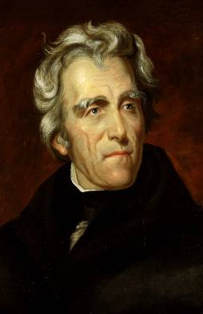
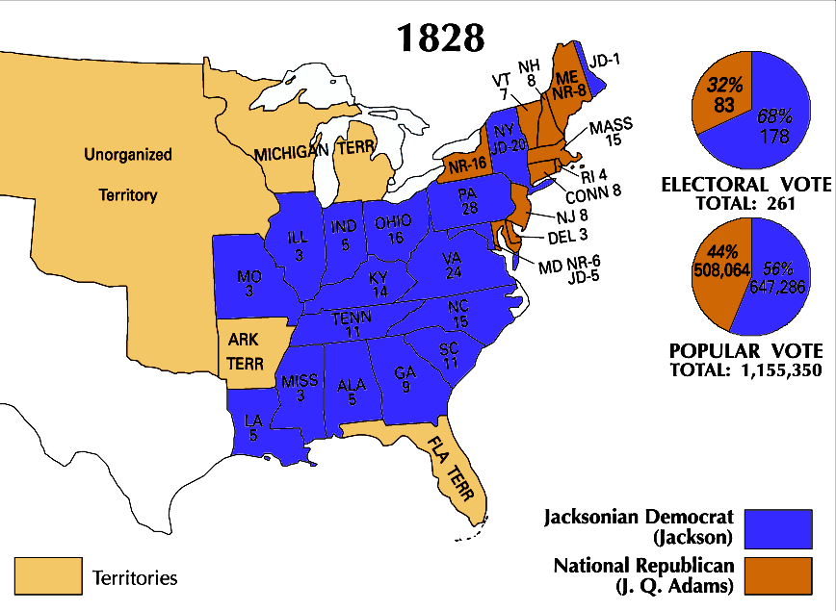
Andrew Jackson’s victory in the
election of 1828 changed American politics

Slide 22
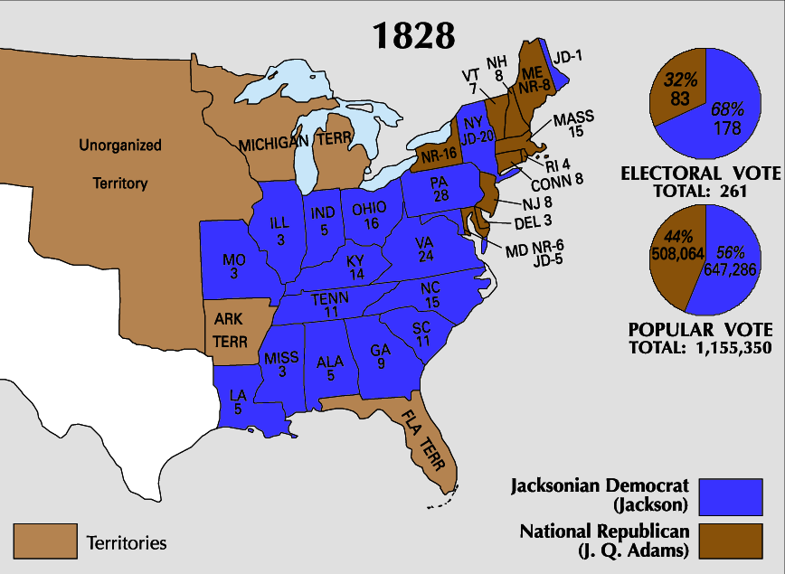
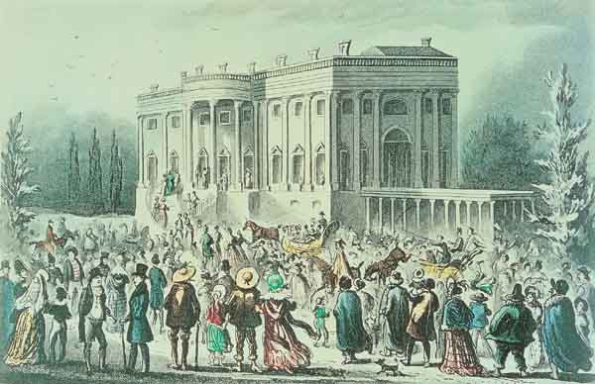
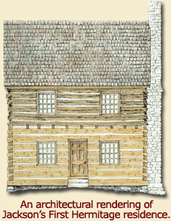
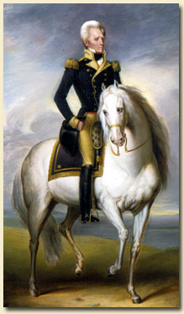
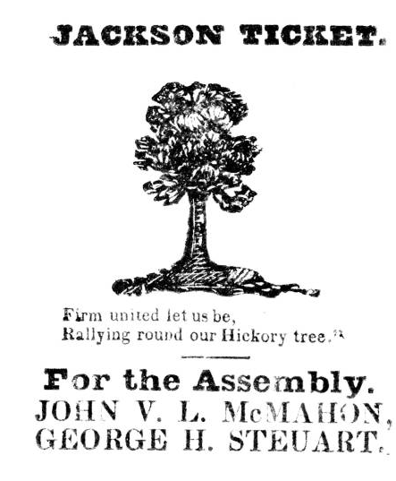
Who is Andrew Jackson?
Jackson’s wild & rowdy inauguration

Slide 23
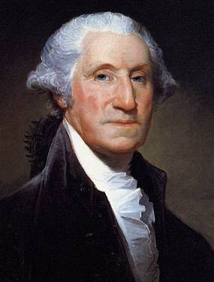
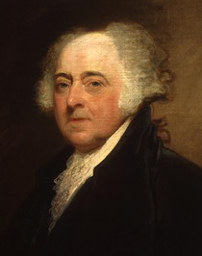
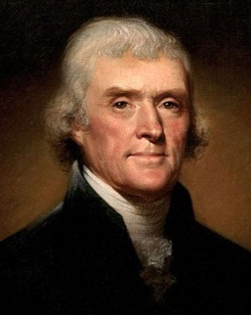
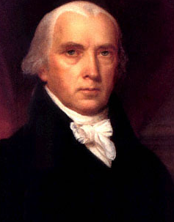
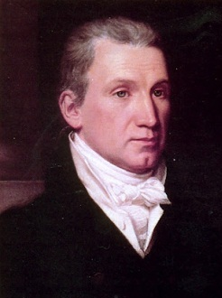
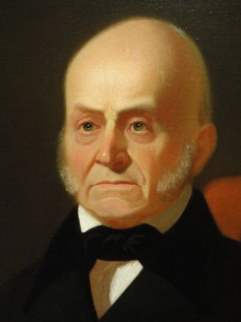
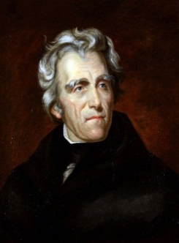
Jackson’s victory split the Democratic-Republicans and led to the formation of the Democratic Party
Jackson and his supporters hoped to return
to the Jeffersonian ideas of states’ rights,
protection of liberty, and westward expansion
8 yrs
George Washington
(1789-1797)
4 yrs
John
Adams
(1797-1801)
8 yrs
Thomas
Jefferson
(1801-1809)
8 yrs
James
Madison
(1809-1817)
8 yrs
James
Monroe
(1817-1825)
4 yrs
John Quincy
Adams
(1825-1829)
8 yrs
Andrew Jackson
(1829-1837)
Federalist Party
Democratic-Republican Party
Democratic Party

Slide 24
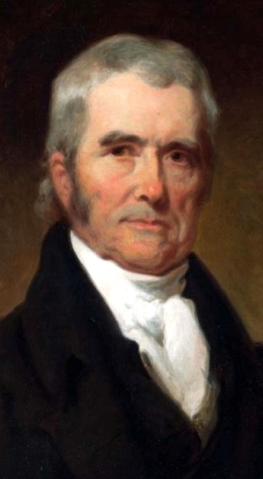
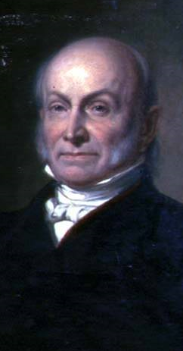
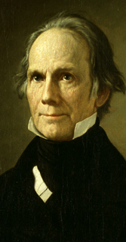

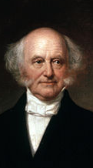
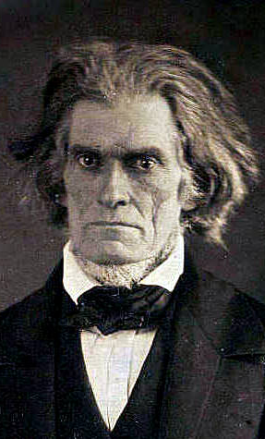
Parties & Leaders
Old Federalists
National Republicans/ Whigs
Jacksonian Democrats
Southern Democrats
John Marshall
John Q. Adams
Henry Clay
Andrew Jackson
Martin Van Buren
John C. Calhoun
National Supremacy States’ Rights

Slide 25
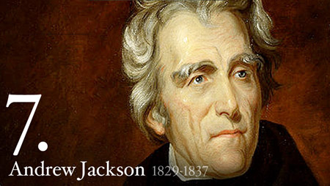
Andrew Jackson’s two term presidency (1829-1837) was defined by three major conflicts and many minor ones, including within his own government
2 Big Issues for today: Spoils System and Indian Removal

Slide 26
Spoils System
When Jackson was elected, he rewarded loyal supporters with gov’t jobs (the spoils system)
  Massive turnover in the civil service had not yet occurred
  Rotation in office began to be seen as a very democratic way to reduce gov’t corruption & incompetence
Jackson was not the 1st to do this… he just extended it to more people!
“Get their rascals out…and our rascals in”

Slide 27
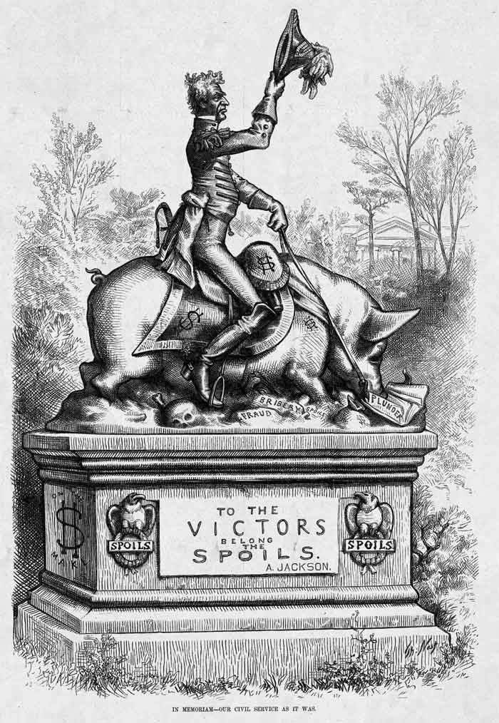

Slide 28
Maysville Road Project
Kentucky was home of Henry Clay, who Jackson never forgave for the “Corrupt Bargain”
The “National” Republicans led by Clay & JQ Adams split with the old-style Democratic-Republicans
President Jackson dealt a blow to the American System:
  He was OK with national projects but did not like spending federal money for state projects
  In 1830, Jackson vetoed funds for the Maysville Road because it was exclusively in Kentucky
Jackson vetoed 7 other bills of public works projects, including roads and canals

Slide 29
Indian Removal
Southerners were disappointed with JQ Adams’ slow movement in dealing with Indians
Jackson promised to act quickly but the Cherokee were a problem:
  They were not “uncivilized” because they had a republican gov’t, an agrarian lifestyle, & a formal alphabet (Sequoyah)
  They refused to move from GA

Slide 30
Indian Removal
Two more John Marshall decisions!!
When gold was discovered in GA, the GA gov’t abolished Cherokee tribal rule & defied the Constitution
  Jackson supported the states & asked Congress for the Indian Removal Act of 1830
  But…the Supreme Court ruled in Cherokee Nation v GA (1831) & Worcester v GA (1832) that the states have no power over tribes
GA defied the Supreme Court’s decisions & continued to take Cherokee lands
Jackson supported GA’s defiance:“Marshall has made his decision, now let him enforce it”

Slide 31
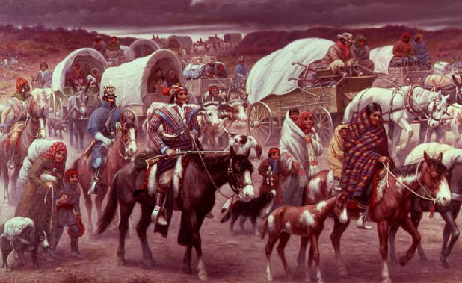
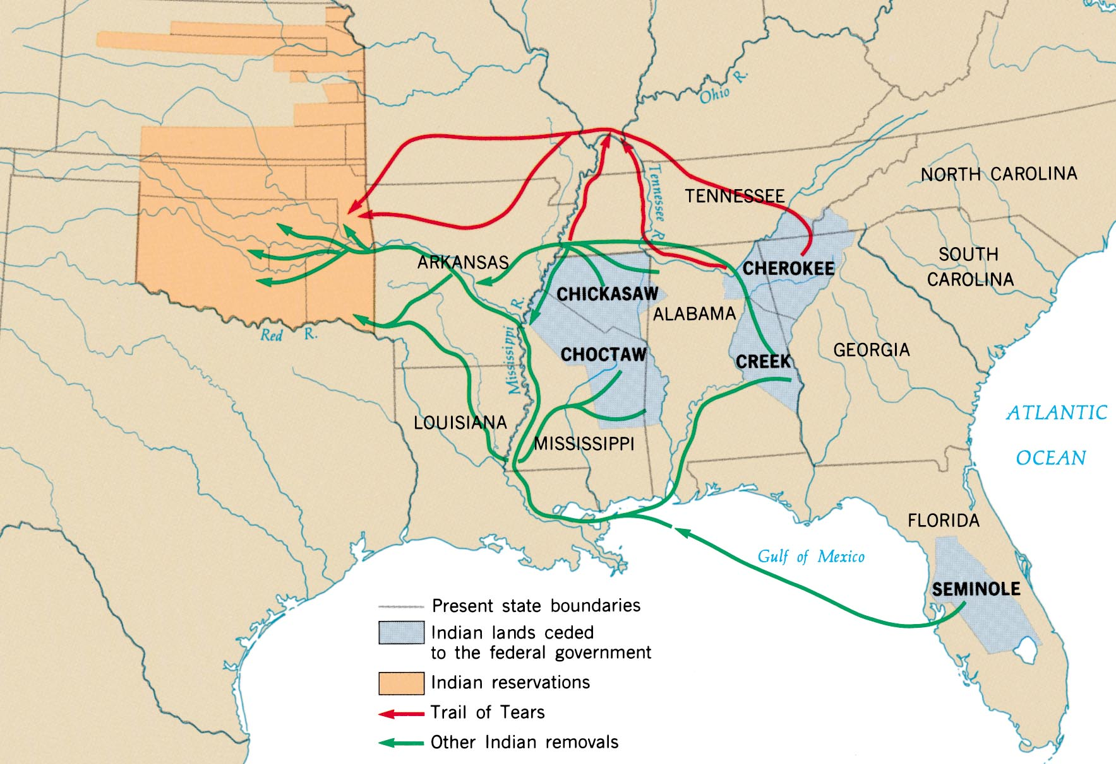
In 1838, the U.S. Army forced the Cherokees west on the “Trail of Tears”

Slide 32
Jacksonian Democracy
Social Vision
  Champion the Common Man
  People can “arrive at right conclusions” and “instruct their agents and representatives”
Voting and Elections
  Universal male suffrage
  Election of local and state judges
  “Popular” selection of presidential electors
Role of Government
  States rights and sovereignty
  Strict constructionists
  Strong executive branch
    “It was settled by the Constitution, the laws, and the whole practice of the government that the entire executive power is vested in the President of the United States.” – Andrew Jackson
    Veto power
  Rotation of office
    Prevent elite bureaucracy
Party Politics
  Professional politicians
  Patronage/Spoils System
  Nominations
    As opposed to party caucuses
  Local/state organizations
  Rise of third parties
  Popular campaigning
    Appeals to popular interests and concerns
    Parades and large rallies
    Mudslinging and character assassinations
Economics
  Laissez-faire policies
  Distrust of banks
  Pay off national debts/no debt
  Incorporation laws
Manifest Destiny
  Provide opportunity for yeoman farmers
  Native removal
  Mixed on expansion of slavery

