Slide 1
Do Now
If motivation for migration impacts the development of colonial identity, how do the Northern and Middle Colonies differ from the Chesapeake and Southern regions, from strictly a motivational standpoint…?

Slide 2
4. The Settlement and Growth of the Northern and Middle Colonies: An Identity Rooted in Religion and Trade
Mr. Winchell
APUSH 2019-2020
Period 1-2

Slide 3
AP Prompt
Compare and contrast the three colonial regions, accounting for economic, political, and social similarities and differences.

Slide 4
Outline
New England’s Push/Pull
New England Society Foundations
Religion and Massachusetts
Native Conflict in New England
Middle Colonies Economy and Society

Slide 5
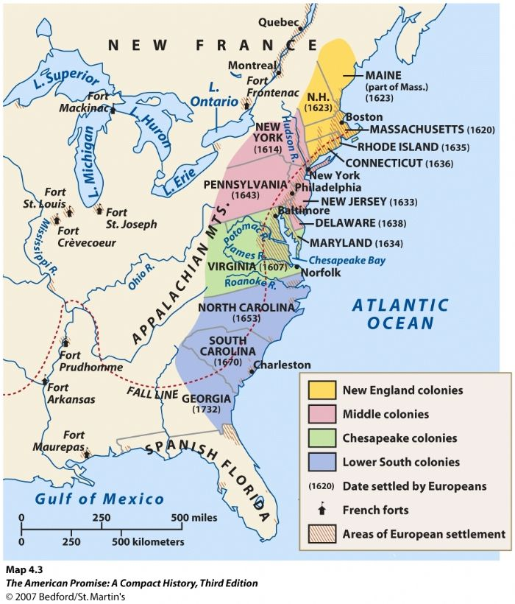

Slide 6
Four Colonial Subcultures
The different values of the migrants dictated the “personality” of the newly created colonies; led to distinct (not unified) colonies
The Chesapeake
New England
Middle Colonies
The Lower South

Slide 7
The Mayflower
1620 → a group of 102 people [half Separatists/half Puritans]
Refused to worship in the Anglican Church, fled to Holland, migrated to America to maintain DISTINCT IDENTITY
Negotiated with the Virginia Company to settle in its jurisdiction.
Plymouth Bay way outside the domain (control) of the Virginia Company.
Became squatters without legal right to land & specific authority to establish a govt.
Notes:
Puritans:
Want to totally reform [purify] the Church of England.
Separatists:
Believed in a total break from the Church of England.

Slide 8
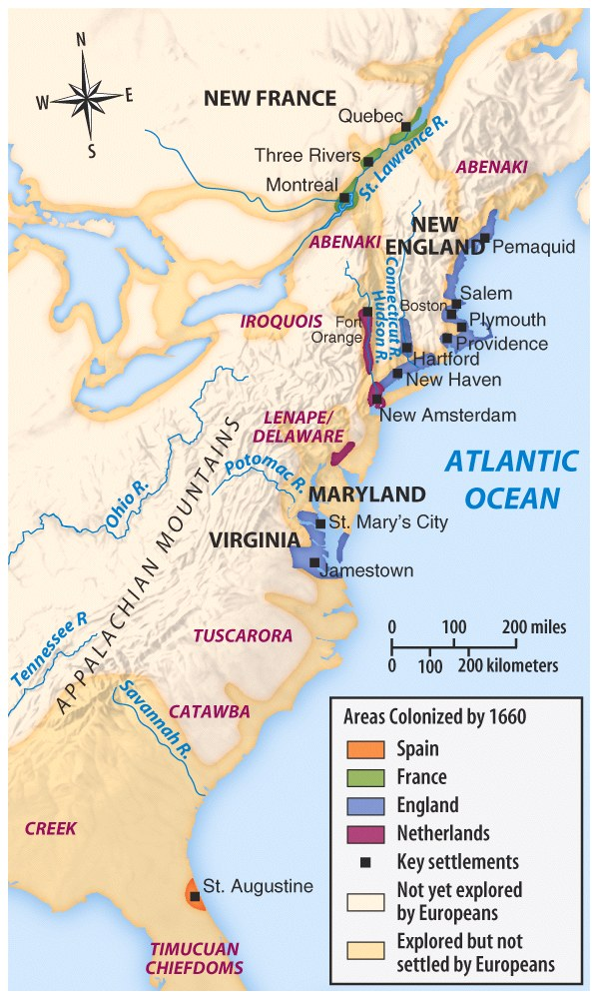
European Settlements in North America by 1660

Slide 9
Mayflower Compact
In the name of God, Amen. We whose names are under-written, the loyal subjects of our dread sovereign Lord, King James, by the grace of God, of Great Britain, France, and Ireland King, Defender of the Faith, etc.
Having undertaken, for the glory of God, and advancement of the Christian faith, and honor of our King and Country, a voyage to plant the first colony in the northern parts of Virginia, do by these presents solemnly and mutually, in the presence of God, and one of another, covenant and combine our selves together into a civil body politic, for our better ordering and preservation and furtherance of the ends aforesaid; and by virtue hereof to enact, constitute, and frame such just and equal laws, ordinances, acts, constitutions and offices, from time to time, as shall be thought most meet and convenient for the general good of the Colony, unto which we promise all due submission and obedience. In witness whereof we have hereunder subscribed our names at Cape Cod, the eleventh of November [New Style, November 21], in the year of the reign of our sovereign lord, King James, of England, France, and Ireland, the eighteenth, and of Scotland the fifty-fourth. Anno Dom. 1620.

Slide 10
Covenant Theology
“Covenant of Grace”:
between Puritan communities and God.
“Social Covenant”:
Between members of Puritan communities with each other.
Required mutual watchfulness.
No toleration of deviance or disorder.
No privacy.

Slide 11
The Massachusetts Bay Colony
1629 → Puritans got a royal charter to form the MA Bay Co.
Wanted to escape attacks by conservatives in the Church of England.
They didn’t want to leave the Church, just its “impurities.”
1630 → 1,000 people set off in 11 well-stocked ships
Established a colony with Boston as its hub.
“Great Migration” of the 1630s
Turmoil in England [leading to the English Civil War] sent about 70,000 Puritans to America.

Slide 12
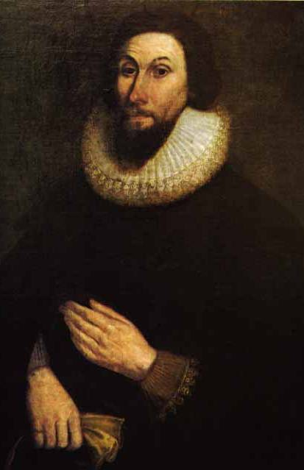
John Winthrop
Well-off attorney and manor lord in England.
Became 1st governor of Massachusetts.
Believed that he had a “calling” from God to lead there.
Served as governor or deputy-governor for 19 years.
We shall be as a city on a hill…
Notes:
Read City On A Hill

Slide 13
John Winthrop’s
‘A Model of Christian Charity’ or ‘The City on a Hill’

Slide 14
“A City on a Hill”
Winthrop emphasized a common spiritual goal: to create a “city on a hill” as beacon of righteousness
New England experienced unique demographic & social trends:
Settlers usually came as families
NE was a generally healthy place to live
Settlers sacrificed self-interest for the good of the community

Slide 15
“A City on a Hill”
As Mass Bay colony grew beyond Boston, towns began to develop their own unique personalities:
Each town was independently governed by local church members (Congregationalism)
Allowed voting by all adult male church members (women & blacks joined but could not vote)
Officials were responsible to God, not their constituents

Slide 16
“A City on a Hill”
NE town gov’ts were autonomous & most people participated due to common religious values
Massachusetts Bay was more peaceful than other colonies:
Passed a legal code called the Lawes and Liberties in 1648 to protect rights & order
Created civil courts to maintain order & mediate differences

Slide 17
Characteristics of
New England Settlements
Low mortality → average life expectancy was 70 years of age.
Many extended families.
Average 6 children per family.
Average age at marriage:
Women – 22 years old
Men – 27 years old.
Notes:
INVENTED GRANDPARENTS!

Slide 18
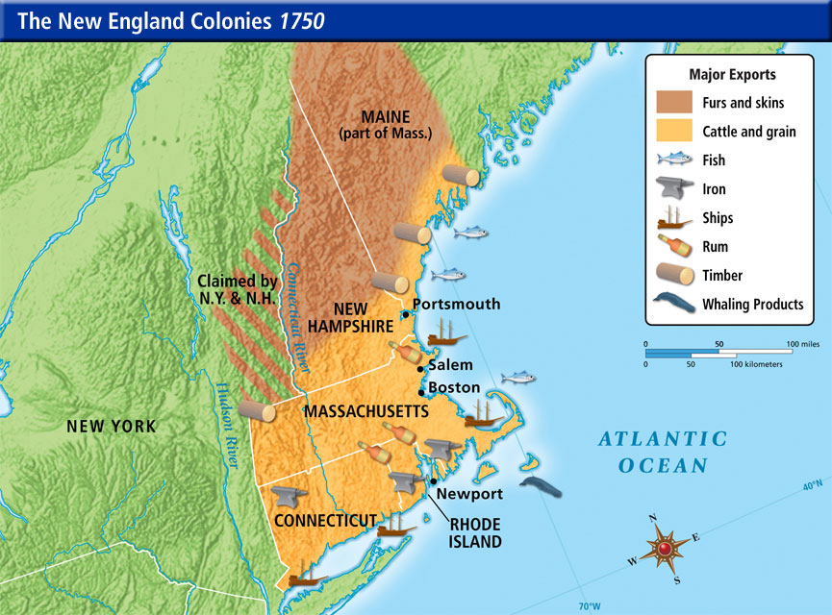

Slide 19
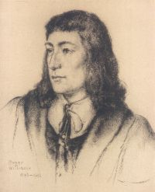
Puritan “Rebels”
Young, popular minister in Salem.
Argued for a full break with the Anglican Church.
Condemned MA Bay Charter.
Did not give fair compensation to Indians.
Denied authority of civil govt. to regulate religious behavior.
1635 → found guilty of preaching new & dangerous opinions and was exiled.
Roger Williams

Slide 20
Rhode Island
1636 → Roger Williams
MA Bay Puritans had wanted to exile him to England to prevent him from founding a competing colony.
Remarkable political freedom in Providence, RI
Universal manhood suffrage → later restricted by a property qualification.
Opposed to special privilege of any kind → freedom of opportunity for all.
RI becomes known as the “Sewer” because it is seen by the Puritans as a dumping ground for unbelievers and religious dissenters → More liberal than any other colony!

Slide 21
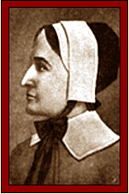
Puritan “Rebels”
Intelligent, strong-willed, well-spoken woman.
Threatened patriarchal control.
Antinomianism [direct revelation]
Means “against the law.”
Carried to logical extremes Puritan doctrine of predestination.
Holy life was no sure sign of salvation.
Truly saved didn’t need to obey the law of either God or man.
Also banished to Rhode Island
Killed in an Indian attack in NY (John Winthrop: this was God’s doing
Anne Hutchinson
Notes:
Def: one who rejects a socially established morality.

Slide 22
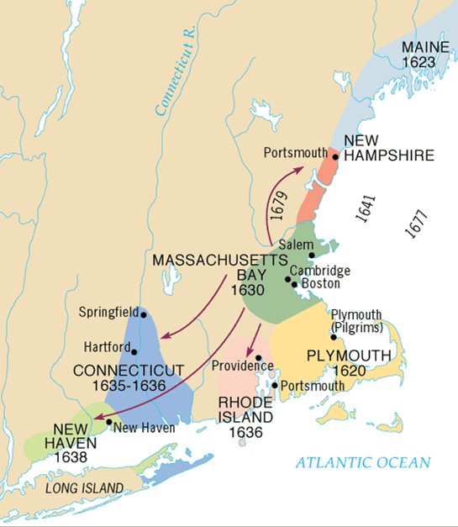

Slide 23
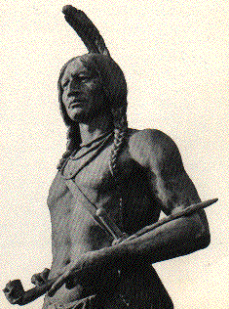
Puritans vs.
Native Americans
Indians especially weak in New England → epidemics wiped out ¾ of the native population.
Wampanoags [near Plymouth] befriended the settlers.
Cooperation between the two helped by Squanto.
1621 → Chief Massasoit signed treaty with the settlers.
Autumn, 1621 → both groups celebrated the First Thanksgiving.

Slide 24
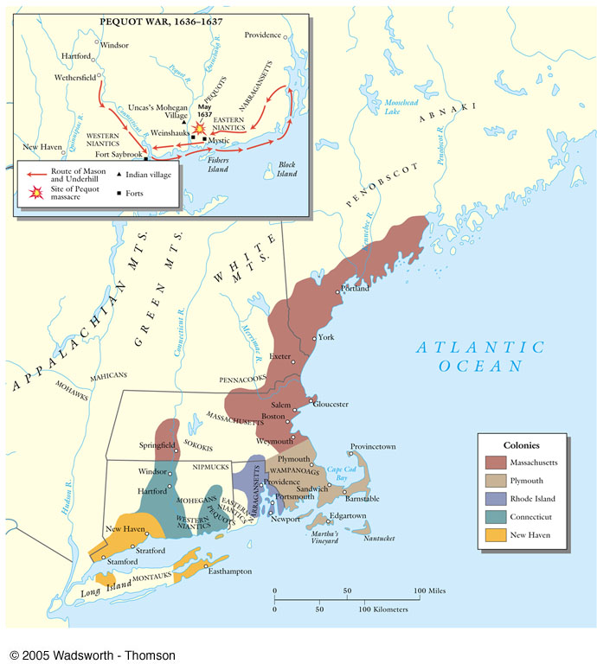
The Pequot Wars: 1636-1637
Pequots → very powerful tribe in CT river valley.
1637 → Pequot War
Whites, with Narragansett Indian allies, attacked Pequot village on Mystic River.
Whites set fire to homes & shot fleeing survivors!
Pequot tribe virtually annihilated→ an uneasy peace lasted for 40 years.

Slide 25
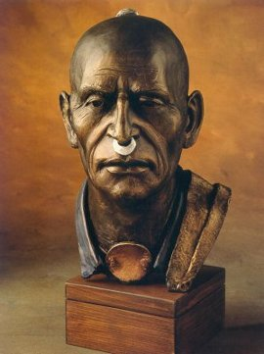
King Philip’s (Metacomet) War (1675-1676}
Only hope for Native Americans to resist white settlers was to UNITE.
Metacom (King Philip to white settlers)
Massasoit’s son united Indians and staged coordinated attacks on white settlements throughout New England.
Frontier settlements forced to retreat to Boston.

Slide 26
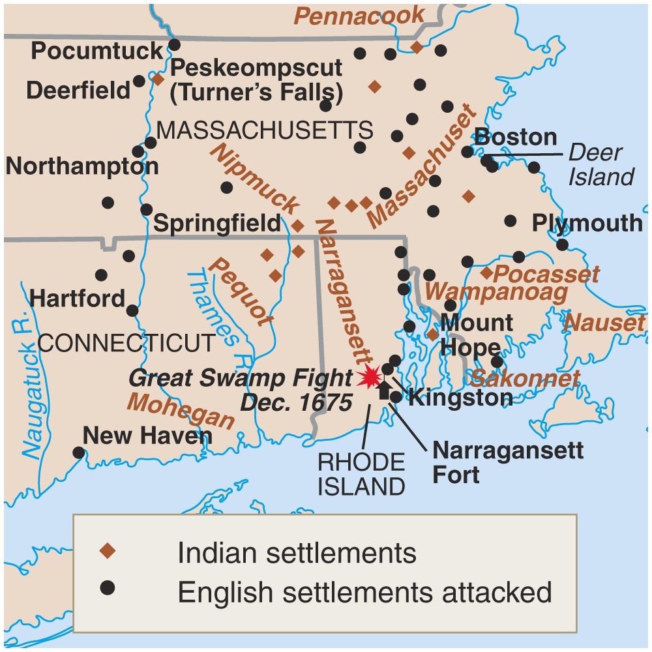
King Philip’s War (1675-1676)
The war ended in failure for the Indians
Metacom beheaded and drawn and quartered.
His son and wife sold into slavery.
Never a serious threat in New England again!!

Slide 27
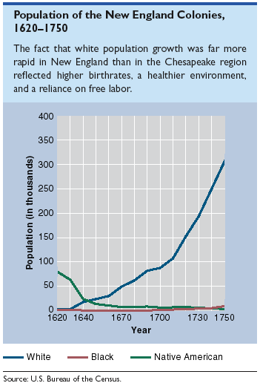

Slide 28
The Middle Colonies, 1685

Slide 29
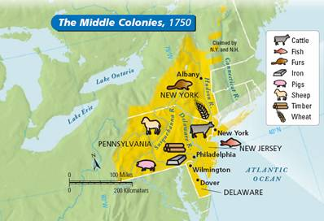
Middle Colonies Society & Economy
Shipbuilding, small-scale farming, and trading.
New York and Philadelphia grew as seaports and commercial centers
Developed wheat and corn farms
“bread basket” of colonies
Eventually transition into manufacturing and trade

Slide 30
New York
Founded
1626
Founder
Dutch settlers
Purpose
Economic gain
Economy
Fur, patroonships
Manhattan port
Hudson River farming
Government
Royal colony
Peter Stuyvesant
Ethnic/Social/Religious
Lenape & Iroquois
“New Amsterdam”
Limited slavery
English took control during Anglo-Dutch Wars
Dutch Reformed & Anglican Churches

Slide 31
Pennsylvania
Founded
1682
Founder
William Penn
Purpose
Haven for Quakers
Economy
Wheat, oats, Philadelphia port
Government
“Restoration” colony
Ethnic/Social/Religious
Lenape, peaceful (early) Indian relations
English (later, Germans and Scots-Irish)
Tolerance: Quakers, Mennonites, Amish
Limited slavery

Slide 32
Penn's "Holy Experiment"
Quakers were persecuted in New England for their beliefs; William Penn founded Pennsylvania in 1681 as a “holy experiment”
As a society run on Quaker principles that promoted religious toleration & protection of the rights of property-less
Appealed to English, Welsh, Irish, German immigrants

Slide 33
Settling Pennsylvania
Immigration to PA led to a very ethnically, nationally, & religiously diverse population
Quarrels were common (unlike homogeneous VA & Mass Bay colonies), but PA prospered
In 1701, Penn granted self-rule to PA colonists & independence to Delaware counties

Slide 34
Early Settlers in Pennsylvania
Text Analysis

Slide 35
Thesis Check
Compare Penn and Pennsylvania's ‘Holy Experiment’ with Winthrop and Massachusetts’ “City on a Hill.”

Slide 36
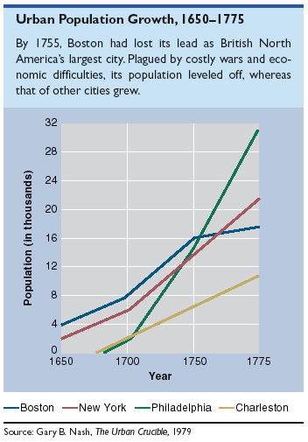
Ports & Growing Cities

Slide 37
Conclusions
All the colonies faced early an struggle to survive
Distinct regional differences intensified & persisted throughout the colonial period
It was not until the American Revolution that colonists began to see themselves as a distinct “American” people

