Slide 1
Do Now-Discuss
What specific factors led to an increase in immigration into the United States towards the end of the 19th century?
In what ways were immigration and urbanization connected?

Slide 2
Henry George Explained why poverty existed.
“This association of poverty with progress is the great enigma of our times. So long as all the increased wealth which modern progress brings goes but to build up great fortunes, to increase luxury and make sharper the contrast between the house of have & the house of want… Progress is not real and cannot be permanent.”
From Poverty and Progress

Slide 3
American Urbanization and New Immigration
“The measure of a civilization is how it treats its weakest members.”
- Mahatma Gandhi

Slide 4
How did/do people react to immigrants coming to America?
They were looked down upon and discriminated against.
Xenophobia- anti foreigner attitudes
Nativism- The idea of blaming immigrants for problems.
Established groups blamed the new groups for problems:
Taking Jobs, Lazy -Famous Slogan: “No Irish Need Apply”
People said they were responsible for: Crime
Immorality- alcohol abuse
Catholics- not loyal to America
Dirty-
Inferior, Damaging to the United States
Whenever a new group enters into an established community tension is caused and a pattern of development can be seen.
Examples:
When the Irish came in the 1840’s the established groups of British and Germans did not like the new Irish.
Irish where different:
Language- Irish/Gaelic
Religion Roman Catholic
Culture different from British
Lifestyles-

Slide 5
Rise of Cities
Between 1830-1860 Urban population of the US grew by 552%
1830- 1.1 million
1860 6.2 million
Cities grow because of
Immigration
Rural to urban migration- people leave the farm due to decreased opportunity- mechanization of agriculture, more opportunity in cities

Slide 6
New Immigrants Second Wave of Immigration 1870-1914, 25 million European Immigrants by 1920, 40% of pop-foreign born
1870- 1 in 7 were Irish Immigrants (New York)
Southern and Eastern Europe
Italians 3.6 million come.
Greeks
Russian (Jews)
Turks
Polish
Serbian
In the West- Chinese and then Japanese/Mexican
1880- 457,000 Immigrants landed in Boston, New York, Philadelphia, Baltimore, New Orleans
Most were unskilled:
Worked in Factories
Construction
Docks
Warehouses
Domestic Servants

Slide 7
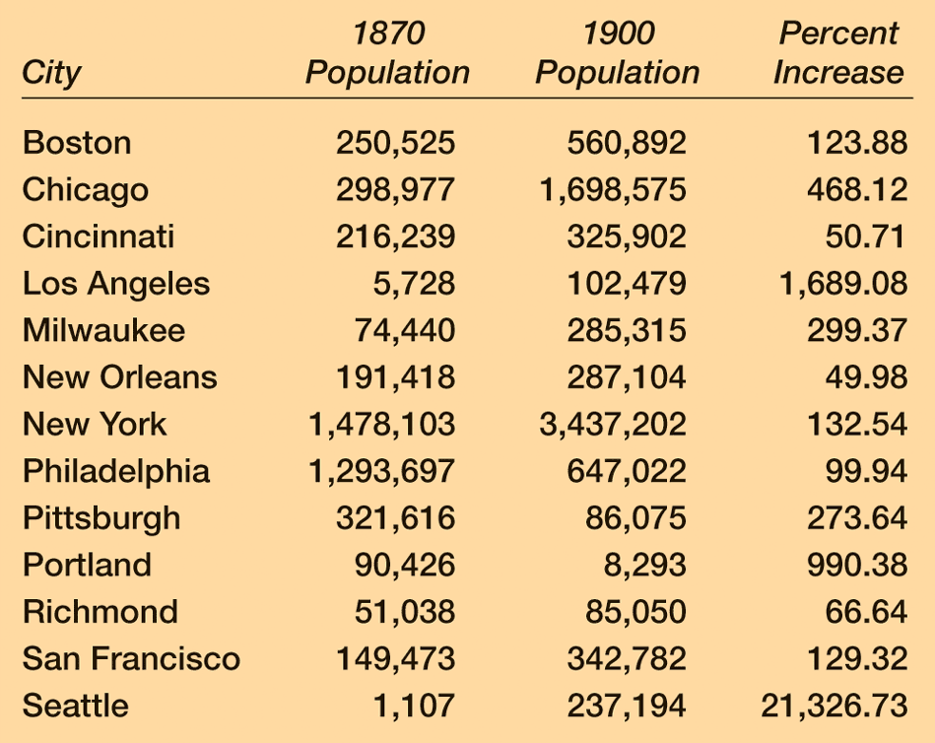
Cities in the late 1800’s
New Technology = rapid industrialization and increase to farming techniques (less workers needed on the farm).
More Food Grown + Railroads to Ship it = Feeding Cities.
Urbanization increased - people moved to the cities and immigrants poured into the country.
Cities were the cheapest and most convenient place to live - access to jobs (esp. for unskilled laborers).
1910 - immigrants 50% in US cities!
1890 - twice as many Irish in NYC as there were in Dublin (capital of Ireland).
New People = new cultures to America. The
Concept of a “melting pot” - all cultures melding together.

Slide 8
East Coast: The New Immigrant
S/E European immigrants (20 million from 1870 - 1920) - seeking a better life (job opportunities, cheap land for farming, or religious freedom)
Before 1880 - immigrants from Great Britain and Western Europe.
Protestant, educated (literate), and were used to representative govt.
Catholics from Germany and Ireland
After 1880 - immigrants Southern and Eastern Europe (nicknamed “New Immigrants”)
Italy, Greece, Poland, Russia, and the Balkans - often Catholic or Orthodox.
Little history of democratic government - used to authoritarian govt.

Slide 9
New Immigrant – Ellis Island
Came by steamship in Steerage (cheapest tickets – in cargo holds) – no fresh air, crowded, disease infested.
Processed at Ellis Island, NY – immigration station where you had to pass physical exam, checked legal docs (can work, weren’t convicts, had some money)
Almost all immigrants were allowed entry.
1892 to 1924 – 17M immigrants were processed!
Now what? – find a place to live and a job!
Created Ethnic Islands or neighborhoods and hyphenated American identities – grouped themselves ethnically for comfort and safety.
Went through culture shock due to pressure to Americanize – didn’t want to!
Most stayed in cities where job opportunities were available.
Received the lowest wages and poor conditions.

Slide 10
New Immigrant – Dream vs. Reality
City populations skyrocketed – created HUGE infrastructure problems!
Housing (not enough available) – had to stay in the city due to limited mass transit – lived in row houses and dumbbell tenements (small apartments – overcrowded and poor ventilation).
Transportation - Eventually built transit systems – Streetcars in CA, Subway in Boston.
Water and Sanitation – no indoor plumbing, few sewage systems, human waste in streets.
Crime – rampant crime – Robber’s Roost and Murderer’s Alley.
Disasters – The Great Chicago Fire of 1871 and San Francisco Earthquake.
Zoning – slaughter houses and factories next to housing – unsanitary!

Slide 11
Tenement Housing
The resulting slums and tenement apartments could cram more than 4,000 people into one city block.
NYC passed a law in 1879 that required each bedroom to have a window.
The cheapest way for landlords to respond to the law was to build dumbbell tenements, with ventilation shafts in the center of the building.
Overcrowding and filth in these tenements continued to promote the spread of deadly diseases.

Slide 12
American Response
Social Gospel movement formed - preached the importance of service to the poor (as a part of service to God).
Middle class educated women – volunteered to help the poor as teachers and nurses. (THIS IS IMPORTANT).
Settlement houses were formed in slums to help people in the area, especially immigrants. (Hull House, Jane Addams, 1889).
Used family money to create a community center for women in inner city Chicago – received Nobel Peace Prize and on Communist threat list.
Churches - helped with urban problems (slow to act).

Slide 13
American Response
Nativism – favored native borns and WASPs (White Anglo Saxon Protestants)
Disliked Catholics (esp. Irish Catholics - NINA), Jews, “New immigrants”, and Asians (yellow peril).
Some native Borns wanted a melting pot or cultural pluralism - all cultures blended into an American one.
Americanization Movement - assimilate people of differing cultures into one primary American culture.
Administered through schools, churches, and other civic organizations.
Taught English, US History and Gov’t, but also cooking and social etiquette
Some immigrants clung to their cultures – creates conflict.

Slide 14
West Coast: The Chinese
Most West Coast immigration - came from China.
Poor conditions in China - leave their homes in search of a better life.
At 1st - Americans welcomed the Chinese - viewed as being hard working, clean, industrious, etc.).
Chinese success = whites began to look at them as a threat – take American jobs!
Process station - Angel Island, CA – same thing for West Coast but much harsher questioning.
Now what…find a place to live and a job! – received very harsh discrimination.
Found work on the trans. Railroad (very dangerous!)
After completion - many found work as laborers or farmers.
1900 - moved to cities where “Chinatowns” were set up.
Set up societies - benefit of the Chinese people (led by powerful merchants).
Some where criminal and corrupt (ex: “tongs”) - pushed opium and other drugs.

Slide 15
A Review: American Response
As Chinese communities grew larger - anti-Chinese sentiment all along the Pacific Coast.
1882 - Congress passed the Chinese Exclusion Act (banned immigration from China for 10 years).
Renewed in 1892 - made permanent in 1902.
Schools were segregated – the Chinese were treated worse than most every other immigrant population!

Slide 16
Other Immigration
Japanese (first to Hawaii) - seeking jobs.
prompted the Gentleman’s Agreement between the US and Japan. - Japan limit US immigration.
Mexicans - Political turmoil and cheap land.
Encouraged farm settlement in the west (convenient for Mexicans).
Contributed to the cowboy culture in the west.
Mexican laborers – major workforce in mining and agriculture – forced into debt peonage (system of slavery b/c worker must work off a debt to an employer).

Slide 18
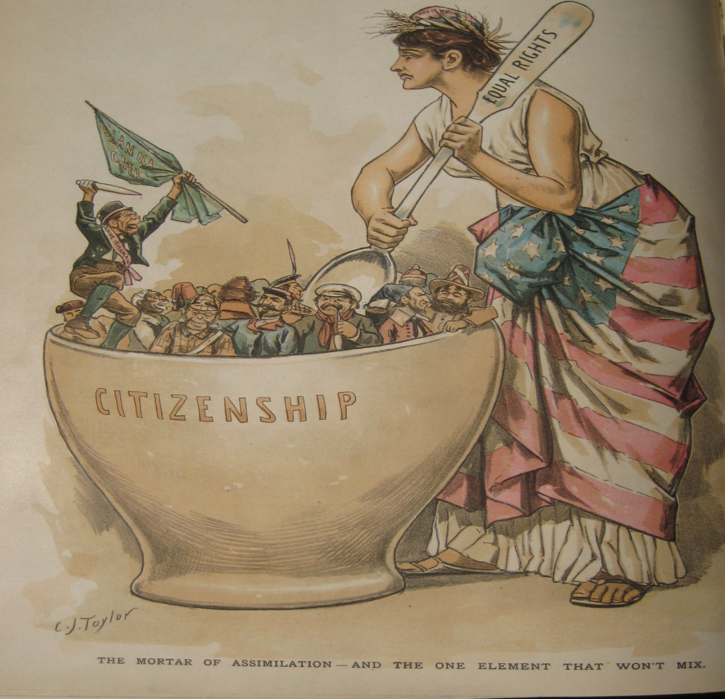

Slide 19
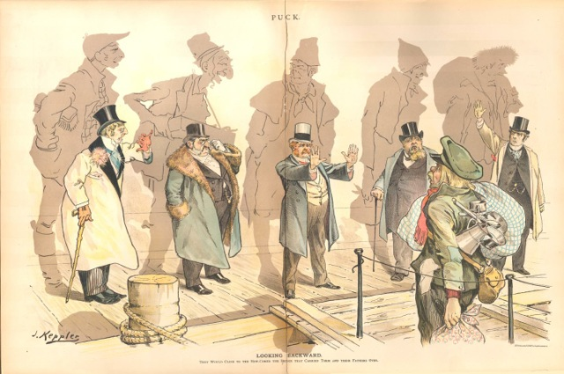

Slide 20
Thomas Jefferson:
“When we get piled up in great cities, we will become as corrupt as Europe…”
Was he right? Why or why not?

