Slide 1
Do Now-Notecard Thesis Quiz
Thesis Practice (INCLUDE CONTEXT): Compare and contrast new and old immigration, accounting for similarities and differences?

Slide 2
4. Urbanization, Immigration, and Social Reform
Mr. Winchell
APUSH 19-20
Period 6

Slide 3
AP PROMPT
Evaluate the impact of international migration on American identity, politics, and society in the Gilded Age.

Slide 4
Outline
Urbanization
New Immigration
Political Machines
Nativism Round 2
Social Reform in Cities

Slide 5
Old vs. New Immigration
Old Immigration | New Immigration
Northern and Western Europe British Isles, Germany, Scandinavia (Norway, Sweden, etc.). Protestants Mostly English-speaking. High levels of literacy. Occupational skills (farming, sewing, etc.) Fit EASILY into American rural society. Did not stand out as different. Immigration was more expensive, so the lowest class largely did not come (still not upper class) | Southern and Eastern Europe. Italy, Greece, Croatia, Poland, Russia. Many were poor and illiterate peasants. Came from autocratic countries, and were unfamiliar with democracy. Largely Roman Catholic, Greek Orthodox, Russian Orthodox, and Jewish. Upon arrival, most crammed into poor ethnic neighborhoods in NYC, Chicago, and other major US cities. 25% were ‘birds of passage.’

Slide 6
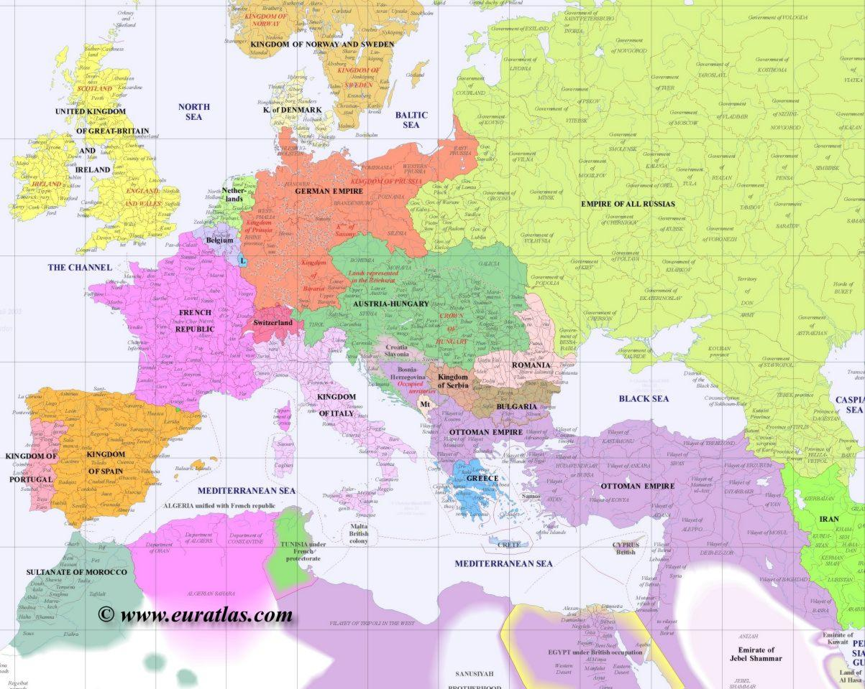
Old Immigration

Slide 7
New Immigration

Slide 8
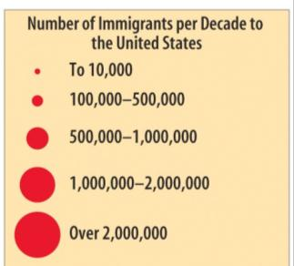
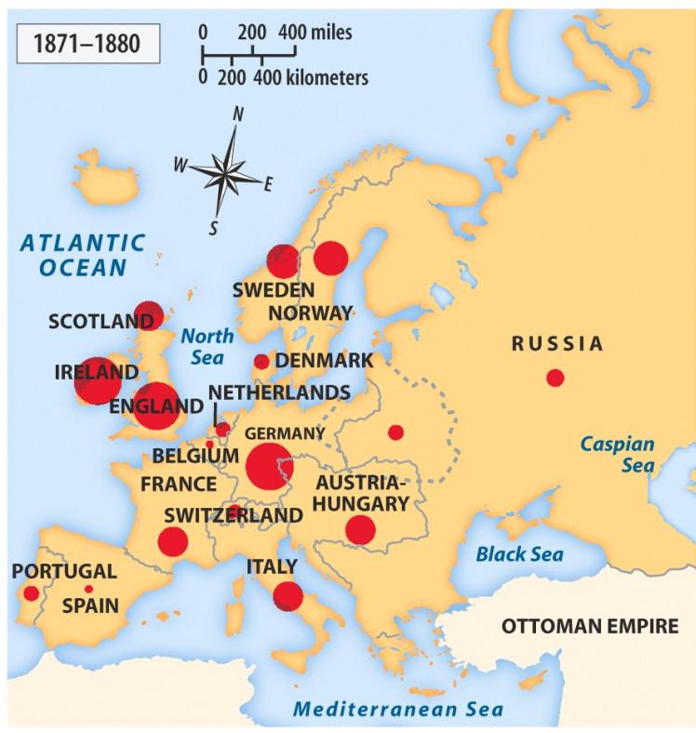
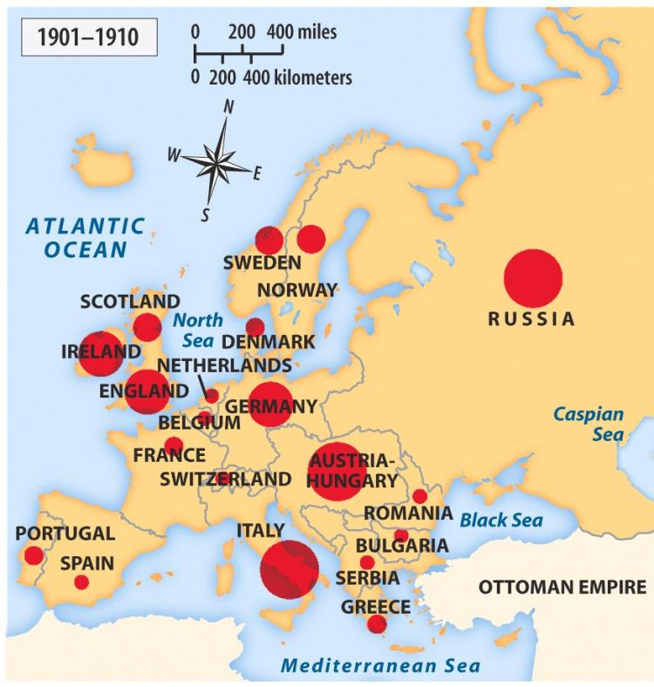
Where?

Slide 9
Growth of Immigration
Push Factors (Reasons Immigrants LEFT their homes) | Pull Factors (Reasons Immigrants CAME to America)
Poverty of displaced farmworkers driven from their land by political turmoil. Mechanization of farm work (thanks industrialization). Overcrowding and joblessness in cities as a result of a population boom. Religious persecution (particularly with Jews in Eastern Europe). | Reputation for political and religious freedom. Economic opportunities by settling in the new West (farming, mining, etc.) Abundance of industrial jobs in US cities. Large steamships and inexpensive 1-way trips made it easier for poor people to come.

Slide 10
Immigration
The United States is a nation of immigrants. By 1860 1/4 of population was born in another country.
Immigration to the United States occurs in waves.
The First Wave of Immigrants: 1820-1860-
Irish- 2 million
German- 1.5 million
British- 750,000
Scandinavia
1825- 10,000 immigrants
1845- 100,000 per year
1854- 428,000
Second Wave of Immigration 1860-1920
1865-1890- 9 million arrive
1890-1915 16 million arrive
1910 ½ the people of cities are Immigrants

Slide 11
Ellis Island
“…Give me your tired, your poor,
Your huddled masses yearning to breathe free,
The wretched refuse of your teeming shore…”
Emma Lazarus - The New Colossus, 1883

Slide 12
Urbanization
Urbanization and Industrialization developed simultaneously.
Cities provided laborers to work in factories and a market to sell mass-produced goods.
By 1900, almost 40% of Americans lived in cities.
Both immigrants and internal migrants moved to cities in this time period, leaving farms for industrial and commercial jobs.

Slide 13
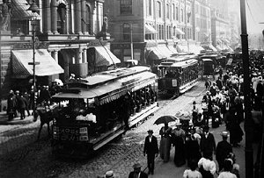
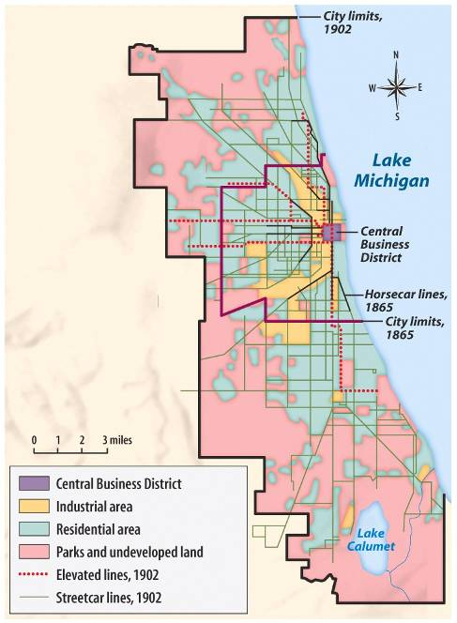
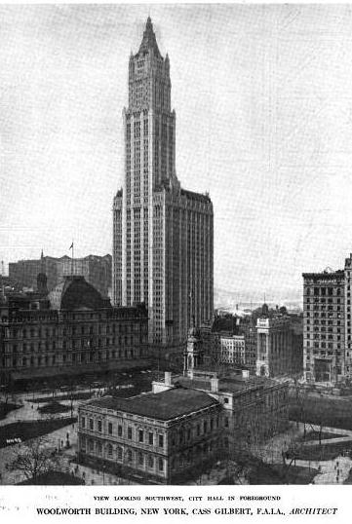
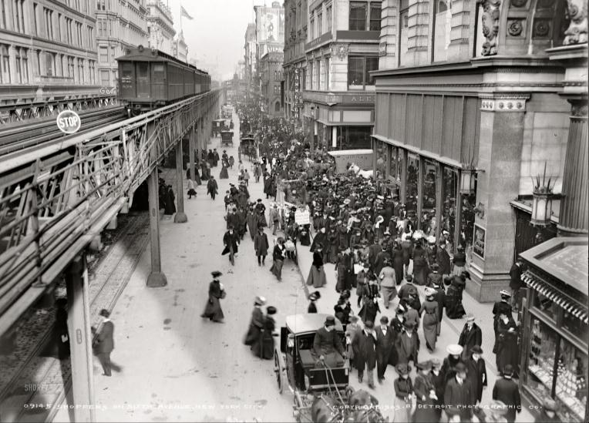
Engineering innovations, such as expansive bridges and skyscrapers, led to modern American cities
Cities expanded outward from industrial centers in the central business districts to a ring of outer suburbs
As cities grew larger and beyond walking distance, trolley lines, elevated rail lines, and subways were created

Slide 14
Gilded Age Urbanization
20% of Americans lived in cities by 1860
40% of Americans lived in cities by 1900

Slide 15
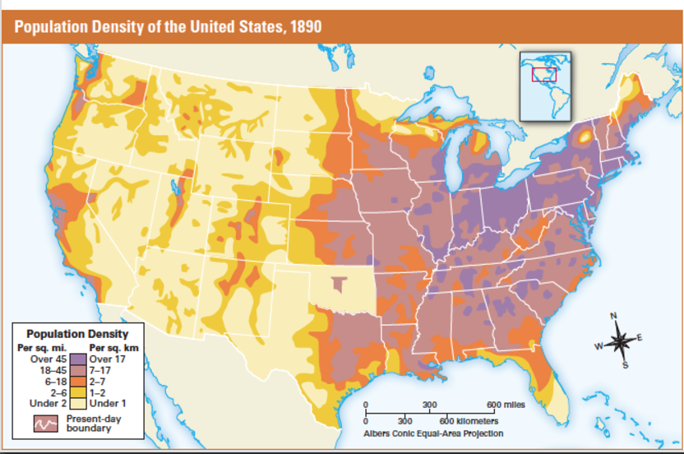

Slide 16
Urban Changes
Improvements in urban transportation made the growth of cities possible.
Electric trolleys, elevated railways, subways transported people from urban jobs to suburban residences.
This allowed the upper class to move out of residences near factories and other business centers, which poor immigrants than inhabited.
This created ethnic neighborhoods with terrible living conditions.

Slide 17
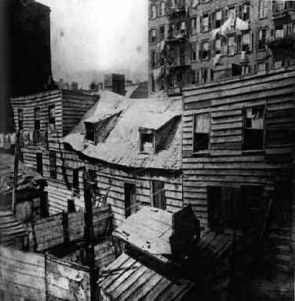
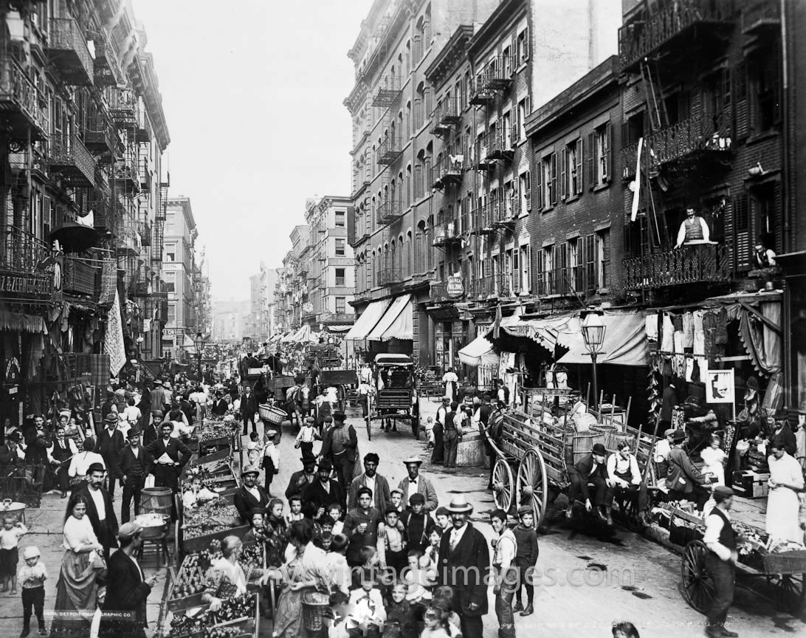
Ethnic Neighborhoods
Different immigrant groups created distinct ethnic neighborhoods.
Here, each group could maintain its own language, culture, church, temple, and social clubs.
Many groups supported their own newspapers and schools.
While often crowded, unhealthy, and crime-ridden, these neighborhoods (often called ghettos) often served as springboards for ambitious and hardworking immigrants and their children to achieve the American Dream.
Overcrowding
Tenement Living
Pollution
Crime
Sanitation/Water Treatment
Disease

Slide 18
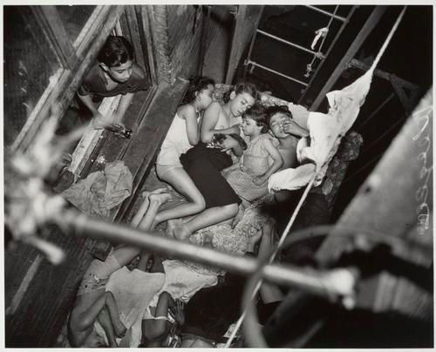
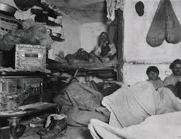
Tenement Housing
To increase profits, landlords took advantage of demand for urban housing by dividing up inner-city housing into small, windowless rooms.

Slide 19
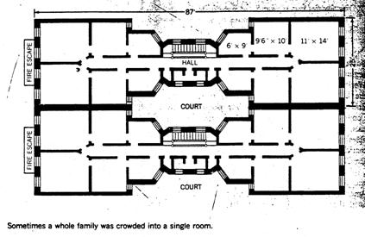
Tenement Housing
The resulting slums and tenement apartments could cram more than 4,000 people into one city block.
NYC passed a law in 1879 that required each bedroom to have a window.
The cheapest way for landlords to respond to the law was to build dumbbell tenements, with ventilation shafts in the center of the building.
Overcrowding and filth in these tenements continued to promote the spread of deadly diseases.

Slide 20
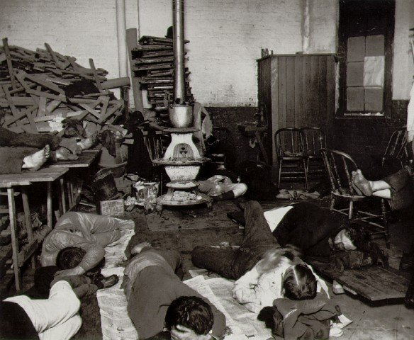
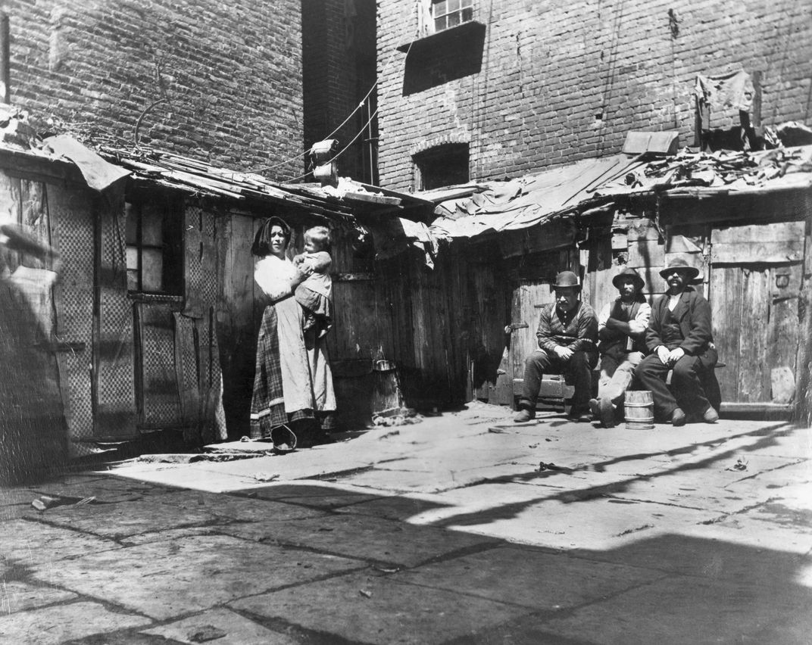
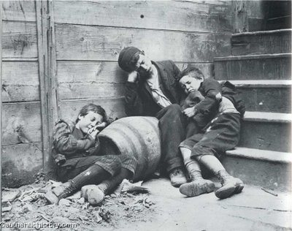
Urban Problems Exposed
Jacob Riis
How the Other Half Lives (1889)

Slide 21
Problems Lead to Political Machines
Problem: Cities grow so fast their gov’t (municipal) can’t keep up with needs of people
Solution: Political Machine steps in and provides services in exchange for votes and money
Goal of Pol. Mach: work to get their candidates elected
Transit, water & sewage systems, sanitation, protection

Slide 22
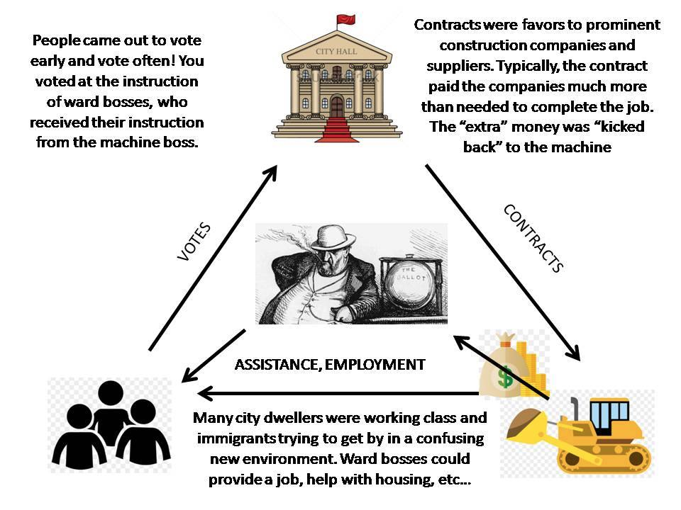

Slide 23
Machine Politics
Political machines brought modern services to cities, including a crude form of welfare for urban newcomers.
The political organization would find jobs and apartments for recently arrived immigrants and show up at a poor family’s door with baskets of food during hard times.
On the negative side, machine politics negatively impacted democracy and often stole money from taxpayers in the form of graft and fraud.

Slide 24
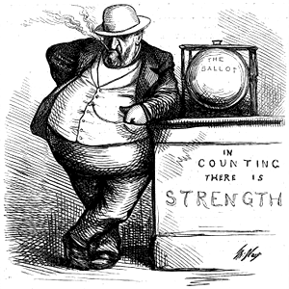
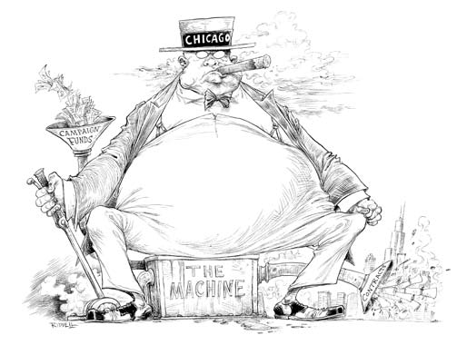
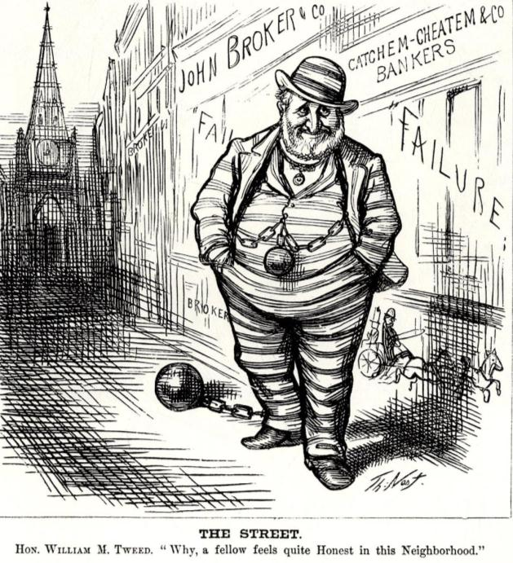
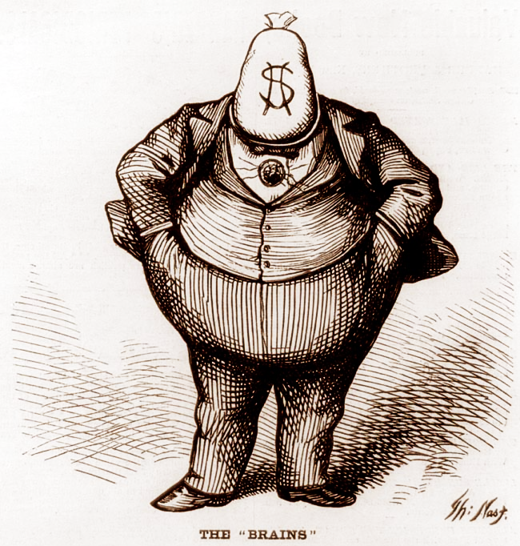
Many city governments were run by political machines
Because machine politicians controlled access to city jobs, business licenses, and building projects, they tended to be corrupt
Many politicians used fraud to win elections, used their influence for personal gain (graft), or took bribes
The most notorious urban politician was Boss Tweed of New York’s Tammany Hall political machine
The “Tweed Ring” defrauded New York City of millions of dollars until it was exposed by reporter Thomas Nast
Notes:
“Tweed Courthouse”—NY County Courthouse was supposed to cost $250,000 but cost $13 million

Slide 25
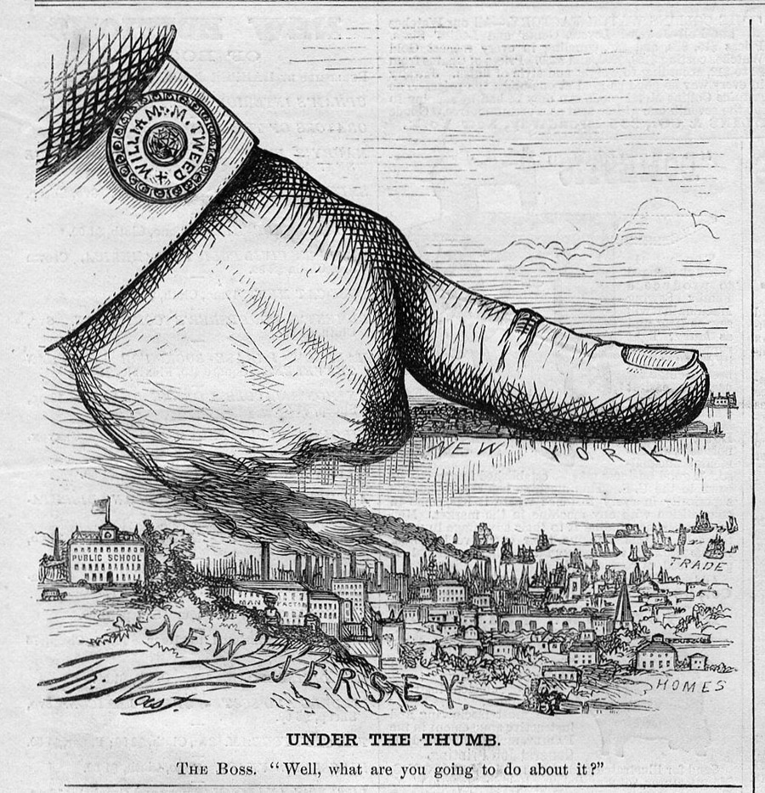

Slide 26
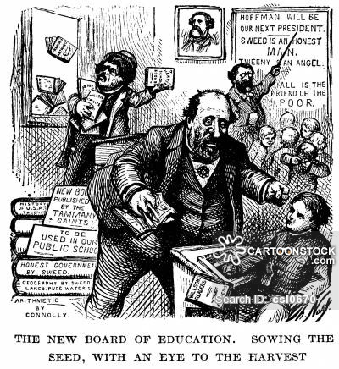

Slide 27
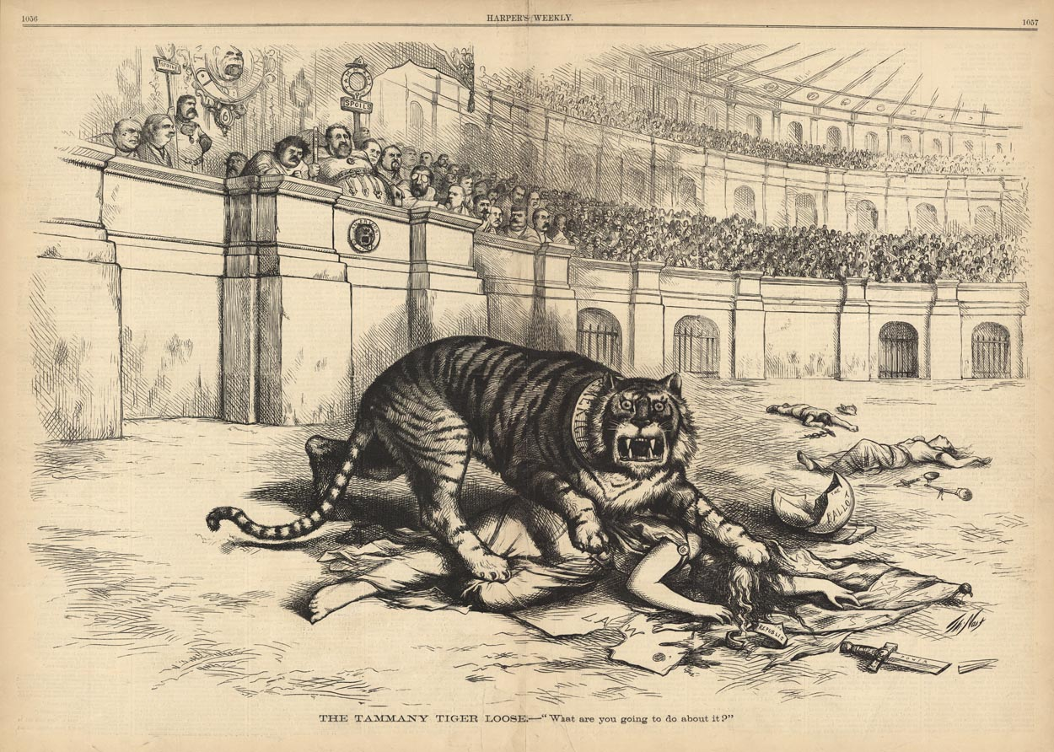

Slide 28
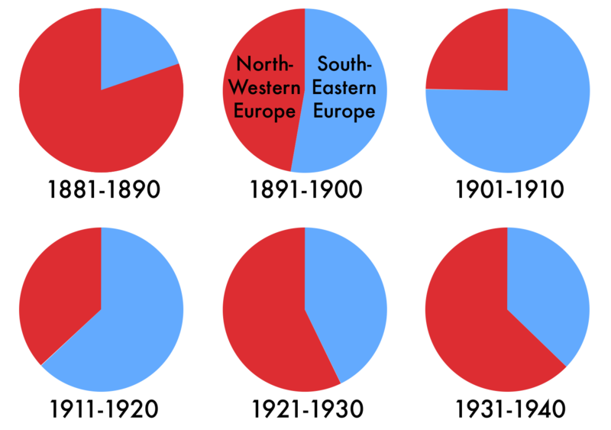
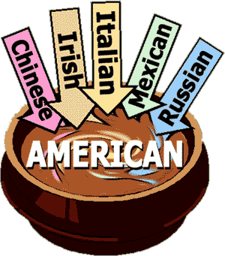
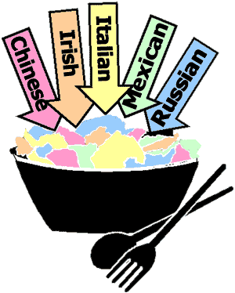
Theories of Culture
Melting Pot Assimilation
Salad Bowl Pluralism

Slide 29
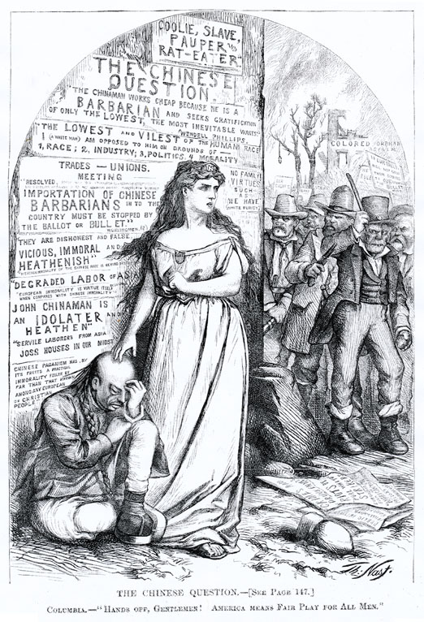
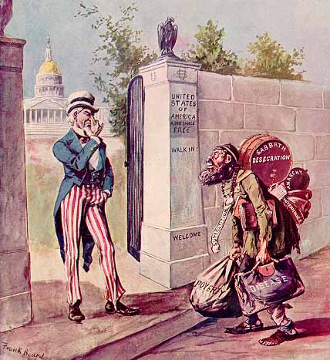
Immigrant Issues
Sociopolitical Enemies
Nativists
Fear, distrust, and hatred of foreigners
Causes of Nativism
“taking jobs”
Fear of the Pope
Different government ideas – socialism and anarchism
Josiah Strong - Our Country
Legislation
Immigration Acts of 1882, 1891
Forbid convicts, lunatics, idiots, diseased, disabled
Chinese Exclusion Act (1882)
Chinese immigration ban for 10 years
Chinese prevented from becoming citizens
Political Machines
Employment, housing, social services for votes
Ethnic Neighborhoods
Little Italy
Chinatown

Slide 30
Restricting Immigration
Chinese Exclusion Act of 1882
Ban on all new immigrants from China.
Support came largely from Western States, who feared Chinese competition for jobs.
1st major act of Congress to restrict immigration on the basis of race and nationality.
Immigration from China was severely restricted until 1965.
Restrictions also came in 1882 on the immigration of ‘undesirable’ people, like the very poor, criminals, convicts, and mentally ill.
Contract Labor Law of 1885
Restricted temporary workers to protect American workers.
Literacy Test for immigrants (vetoed by President Cleveland but passed in 1917)
Medical examinations and a tax became a part of the immigrant centers in Ellis Island (NYC) and Angel Island (SF)

Slide 31
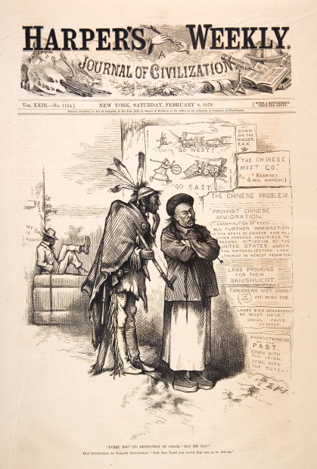
Who Restricted Immigration?
Labor Unions
Feared employers would use immigrants to depress wages and break strikes.
Nativist Society
The American Protective Association was openly prejudiced against Roman Catholics.
Social Darwinists
Viewed new immigrants as biologically inferior to English and Germanic individuals.
Severe economic depression in the 1890s
Foreigners became a convenient scapegoat for jobless workers as well as employers

Slide 32
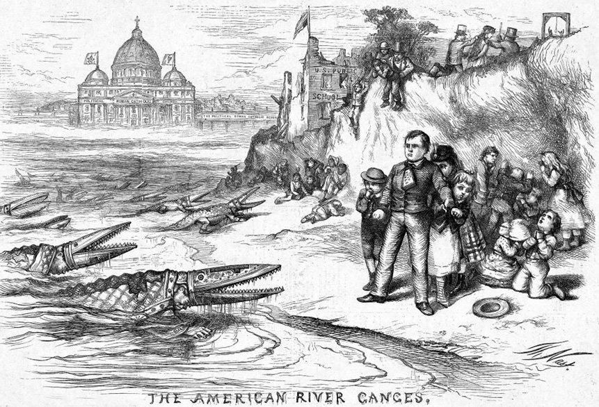

Slide 33
Urban and Social Reform
Social Gospel
Post-millenialism
Based on Matthew 6:10 “Thy kingdom come, Thy will be done on earth as it is in heaven”
“What would Jesus do?” (1896)
New Denominations
Christian Science
Pentecostals
Jehovah’s Witness
Salvation Army
BIG PICTURE: Change the world, not politics

Slide 34
Urban and Social Reform
Settlement House
Established in poor urban neighborhoods
Provided education, daycare, and health services
Middle class volunteers
Jane Addams and Hull House
Based in Chicago

Slide 35
Main Ideas
Immigration
Push & pull factors
Ellis & Angel Island
Ethnic neighborhoods
“Melting Pot” vs. “Salad Bowl”
Backlash against immigration
Urbanization
Population explosion
Growth in city size
New opportunities for both men & women
Tenement slums
Mass transit
Skyscrapers

Slide 36
