Slide 1
1. Interest Groups
Mr. Winchell
AP GoPo
Unit 5: Political Participation

Slide 2
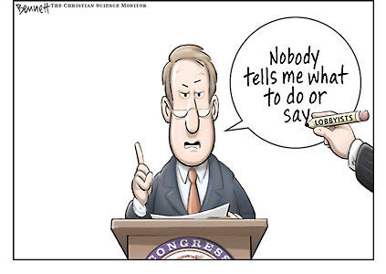

Slide 3
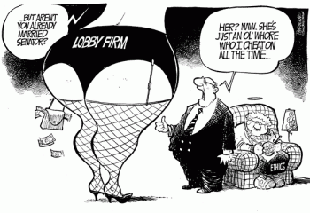

Slide 4
Alexis de Tocqueville
“Americans of all ages, all conditions, and all dispositions constantly form associations.”

Slide 5
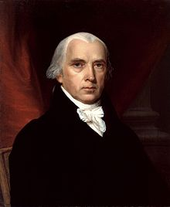
Historical Insight on Interest Groups
Federalist #10 by James Madison
Factions
Pluralism
Constitutional Backing
First Amendment
Freedom of speech, freedom of assembly, and freedom to petition government

Slide 6
Interest Group
Any organization designed to influence public policy
Collective action by individuals on specific issues to influence policymaking in all levels of government
Prevent action, add/subtract/change policies
Unlike political parties, do not nominate candidates for public office

Slide 7
Pluralist theory
Believe that groups compete, each pushing its’ policy agenda
IG’s provide a necessary link between institutions and citizens
Unlikely that any group will become dominant (Madison, factions)
Most play by the rules

Slide 8
Elite theory
Power is held by a few key players
Corporations dominate the interest group landscape
Even lobbying pits David against Goliath only Goliath usually wins

Slide 9
Hyper pluralist theory
Believe that the pluralist system is out of control
There are simply too many competing groups for the system to work affectively
Also believe that the relationship between IG’s and government is too “cozy”
Too many groups to keep happy – government can’t do everything
Iron Triangles make it worse

Slide 10
Incentives to Join an Interest Group
Solidary Incentives
A sense of belonging and companionship
Material Incentives
Direct Material Incentive
Money or monetary-based services
Purposive Incentive
Ideological motivation and ethical actions
Free Rider Problem
Benefits for non-members

Slide 11
Strategies of Interest Groups
Influencing Elections
Lobbying
Litigation
Going Public

Slide 12
Influencing Elections (Electioneering)
Encourage members to vote
Influence party platforms and nominating conventions
Ratings
Political Action Committees (PACs) and Super PACs and 501c4 non-profits
Colbert's Super PAC

Slide 13
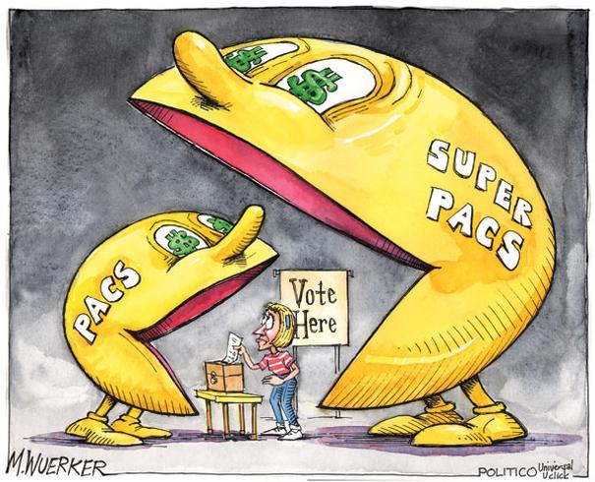
Electioneering (PACs) Help get the right people in office-people that support your cause

Slide 14
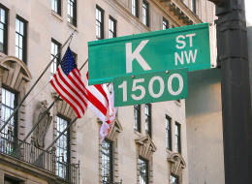
Lobbying/Lobbyists
Paid representatives of an interest group
Usually lawyers, former congressional staffers, ex-legislators
Tactics
Provide data and information to influence policymakers
Congressional Testimony
Wining and Dining
Campaign Contributions
Grassroots Lobbying
Astroturfing
Coalition Lobbying
K Street is a D.C. street home to numerous lobby firms

Slide 15
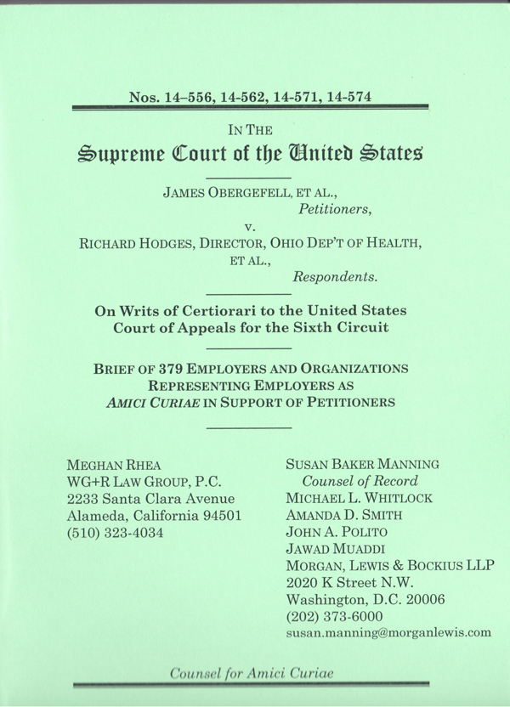
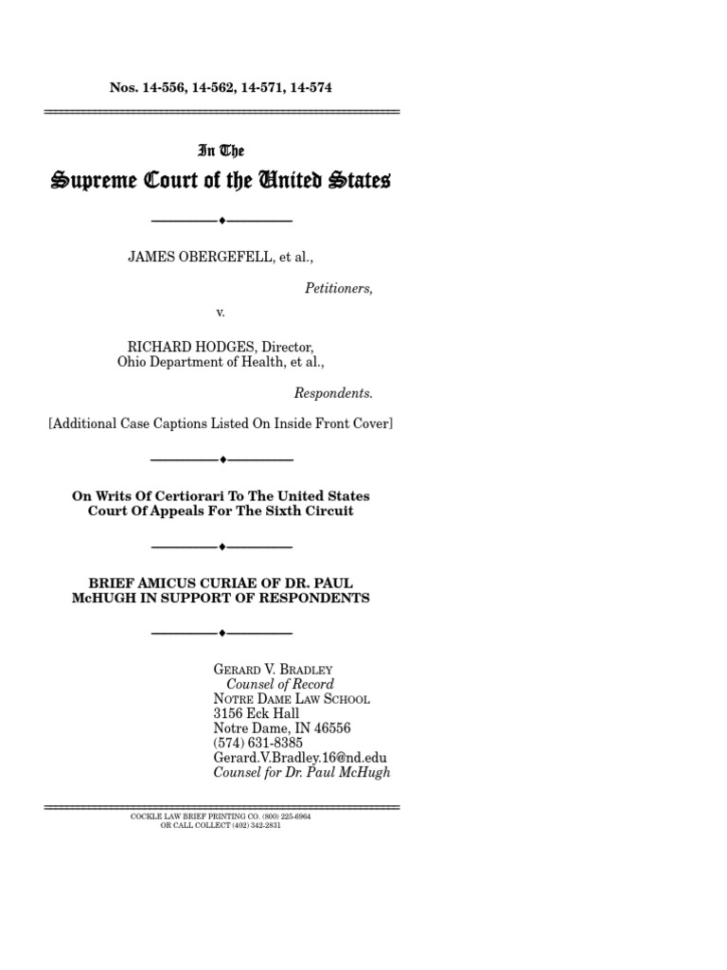
Litigation/Legal Maneuvers
Interest groups and their lobbyists may threaten to sue or sue in court
NAACP sued against segregation leading to landmark Brown v. Board of Education decision
File amicus curiae (friend of the court) briefs to influence judicial decisions

Slide 16
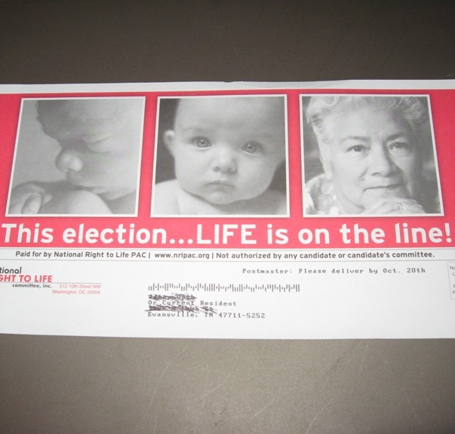
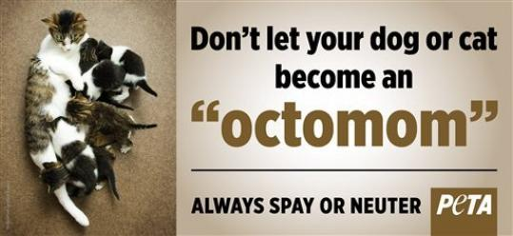
Going Public – Issue Advocacy
Direct mailings, media ads, internet blogs
May address issue through criticism
May address issue with favorable promotions
Increase attention and support to issues

Slide 17
Quick Read
5 Takeaways from the Latest Campaign Finance Reports

Slide 18
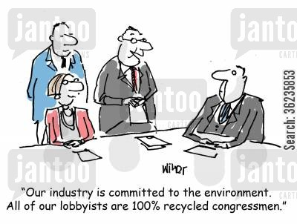
Regulating Interest Groups
Federal Regulation of Lobbying Act of 1946
Required lobbyists to register with Congress if influenced legislation
United States v. Harriss (1954)
Lobbying Disclosure Act of 1995
Required lobbyists to register if influencing congressional members, congressional staffers, and executive agencies
Disclose information on members, activities, and finances
Honest Leadership and Open Government Act (2007)
“Cooling Off Period”
Former Representatives must wait a year before registering as a lobbyist
Formers Senators and executive officials must wait two years before registering as a lobbyist

Slide 19
Economic Interest Groups
Labor Groups
AFL-CIO
Teamsters Union
Business Groups
National Association of Manufacturers (NAM)
U.S. Chamber of Commerce
Energy Lobby (umbrella term for energy corporations and industries)
Agricultural Groups
American Farm Bureau Federation
National Grange
National Farmers’ Union
Professional Groups
National Education Association (NEA)
American Medical Association (AMA)
American Bar Association (ABA)
Screen Actors Guild (SGA)

Slide 20
Ideological & Single Issue Groups
American Civil Liberties Union (ACLU)
National Association for the Advancement of Colored People (NAACP)
National Organization for Women (NOW)
American Association of Retired Persons (AARP)
National Rifle Association (NRA)
National Coalition to Ban Handguns (NCBH)
Veterans of Foreign Wars (VFW)
National Right To Life Committee (NRLC)
Planned Parenthood
Mothers Against Drunk Driving (MADD)
Christian Coalition
Anti-Defamation League
Sierra Club
Greenpeace
People for the Ethical Treatment of Animals (PETA)
American Israel Public Affairs Committee (AIPAC)

Slide 21
Public Interest Groups
Common Cause
League of Women Voters
Mothers Against Drunk Driving (MADD)
American Red Cross
American Automobile Association (AAA)

Slide 22
Advocacy Groups* and Think Tanks
Lean Liberal
Lean Conservative
Brookings Institution
Economic Policy institute
Center for American Progress
Center on Budget and Policy Priorities
Human Rights Watch
Common Cause*
Center for Media and Democracy*
MoveOn.org
Independent/Centrist
Heritage Foundation
Cato Institute
American Enterprise Institute
Hoover Institution
Manhattan Institute for Policy Research
Heartland Institute
American Legislative Exchange Council (ALEC)*
State Policy Network*
RAND Corporation
Kaiser Foundation (health care)
Council on Foreign Affairs
Center for Immigration Studies
Freedom House

Slide 23
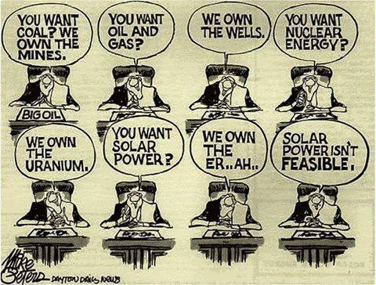

Slide 24
Interest Groups
6o Minutes

