Slide 1
Political Parties
Mr. Winchell
AP GoPo
Unit 5: Political Participation

Slide 2
Do Now
Video 1
Video 2

Slide 3
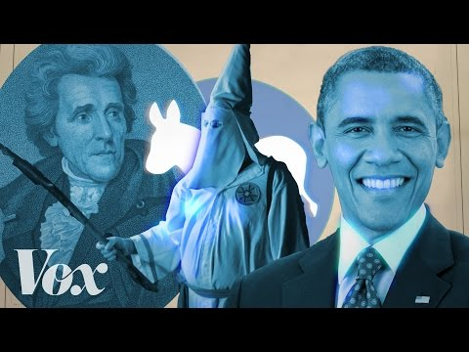
Democrats
How did the Democratic Party start and what was at least one early policy between 1800-1840?
Describe the Democrat’s views on race from the 1900s-1950s.
In what ways did the Democrats change their platform in the 1960s?
Notes:
*answer each question on lined paper in at least two complete sentences.

Slide 4
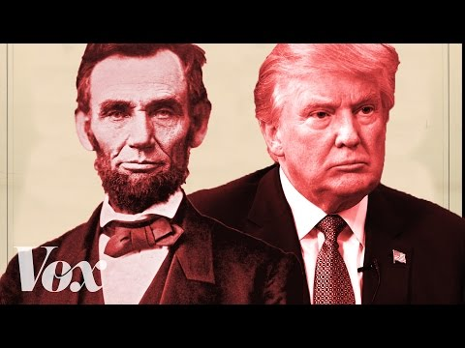
Republicans
How did the Republican Party start and what was at least one early policy during the late 1800s?
Describe the Republican’s views on economics during the 1900-1930s. How does this work out for them?
How does Republican demographics (voter base) & ideology differ in the 1960s when compared to the 1860s?
Notes:
*answer each question on lined paper in at least 3 complete sentences.

Slide 5
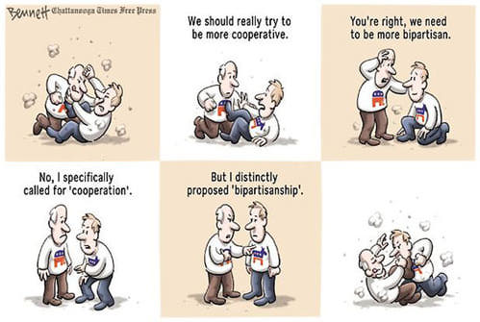

Slide 6
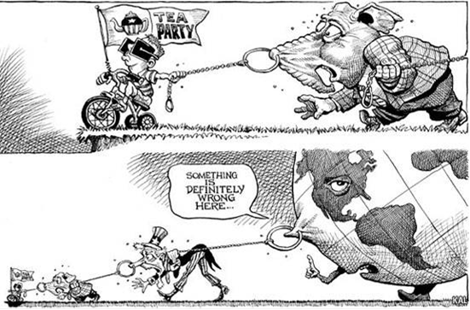

Slide 7
Political Parties
Political Parties: group of people organized to influence govt. through the winning of elections and the setting of policy (LINKAGE INSTITUTION)
Group of citizens organized to:
Win elections, hold public offices, operate the government, determine public policy
A group of political activists organized to secure and operate the government and determine public policy
A permanent organization based on broad objectives and issues in order to attract support, power, and voters

Slide 8
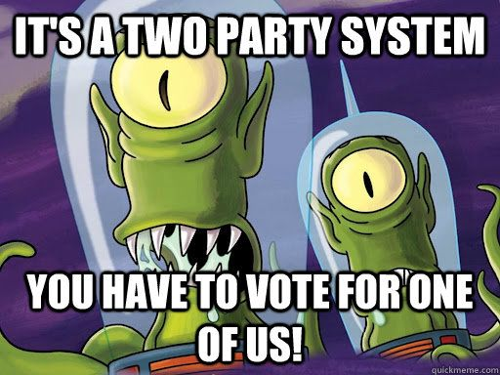
Party Systems
One-Party System
Little to no choice in party affiliations; leaders choose candidates
Typical of dictatorial governments
Two-Party System
Dominated by two major parties; minor parties have little effect
Electoral College and single-member districts promote two-party system
Plurality system/winner-take-all system
American voters tend to choose between Democrat or Republican
Multi-Party System
Multiple major parties and influential minority parties
Proportional representation promotes this system
Securing majority power often difficult leading to coalitions among parties
Tend to be unstable

Slide 9
Political Parties
Functions:
Recruit/Nominate candidates
Run political campaigns and win
Activate members; mobilize/register voters
Raise funds
Provide cues to their voters; articulate platform on issues
Critique policies of opposing party; watchdog;
How do you join?
Declare self a member—register w/ party (closed primary)
3 Types of Party Members:
Voter, Party Worker, Elected Official
Notes:
Linkage Institutions: the means by which individual can express preferences regarding the development of pubic policy (The FOUR MAIN LINKAGE INSTITUTIONS are 1. Political parties, 2. Elections, 3. Media, and 4 Interest Groups)
Have any of these roles changed? Why or why not?

Slide 10
Political Party Components
Party in the Electorate
Individual members of the party who identify with the party platform and/or vote based on party lines
Party in the Government
Elected and appointed officials identified with a political party
Party Organization
Party professionals responsible for recruitment (volunteers, candidates), organizing grassroots and conventions, and running campaigns and fundraisers

Slide 11
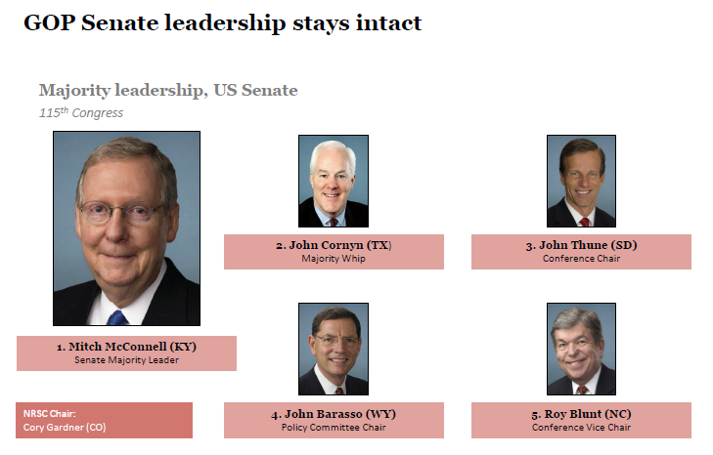
Party in the Government
Executive
Appoint political party officials to enforce laws based on party platforms
Coerce Congress to implement party platform agendas
Legislative
Establish congressional and committee leadership to implement party platform legislation
Develop coalitions to ensure party platforms and electoral victories

Slide 12
Party in the Government
Unified Government
Political party controls executive and legislative branches
Passage of party platform legislation relatively easy
Divided Government
Opposing political party holds majority in House, Senate, White House or two of those
Prevents relative dominance of one party
Gridlock leads to compromise or delay in addressing national issues

Slide 13
Political Party Organization
National Convention:
Held Every 4 yrs
Nominate Pres. & VP
Write Party Platform
National committee:
Made of delegates from states. Manage affairs between conventions
Congressional campaign committees:
Support congressional candidates
National Chair:
Manages daily work of the party
States & localities:
Foundation of party. Have the most people & the greatest involvement.
National, State, Local party organizations are independent and NOT centrally controlled
Leads to fragmentation (Dem. Party WA v. WV)
Notes:
Organization—specialized functions, hierarchy of authority, fixed rules

Slide 15
Political Party Organization Responsibilities
National Party Level
Elect National Party Chairperson
National party spokesperson
Influential in determining preferred party candidates
Leads on fundraising campaigns
Determines how state delegates to the national convention are selected
Select National Party Committee members
Organize national conventions every four years
Fundraise for presidential candidate and political party candidates at federal levels
Produce advertisements and websites for federal party candidates
State Party
Chooses state delegates to participate in national convention
Works with national party committee to schedule presidential primaries/caucuses calendars
Local Party
Guided by planks/platform but ultimately determine best strategies to elect local and congressional district party candidates and ballot issues
Primarily responsible for electing party candidates to locally elected offices and state legislative offices

Slide 16
Local Party Organization Political Machines and Grassroots
Political Machine
Party organization that recruits members through incentives
Money, jobs, patronage, support
Tammany Hall in New York City
Modern Local Party Organizations
More restrictions established through voter registration and end of patronage
Grassroots
From-the-ground-up building of political support
Local campaigning and fundraising

Slide 17
Pol. Parties and Congress
Role of Parties in Congress: Leadership/Organization
Leadership positions in Congress are assigned on a party basis.
Speaker of the House; Senate Majority Leader
Majority party appoints and controls all Congressional standing committees
Majority party gets to select standing committee chairs in Congress
Role of Party’s in Congress: Promoting Party Agenda
Party leaders articulate legislative policy priorities of the party.
Party leaders facilitate legislative policy priorities of the party.
Committee chairs who promote the party’s legislative priorities in committee.
Majority party controls floor debates.
Majority party controls the rules and legislative calendar; making it favorable to majority party’s policy priorities

Slide 18
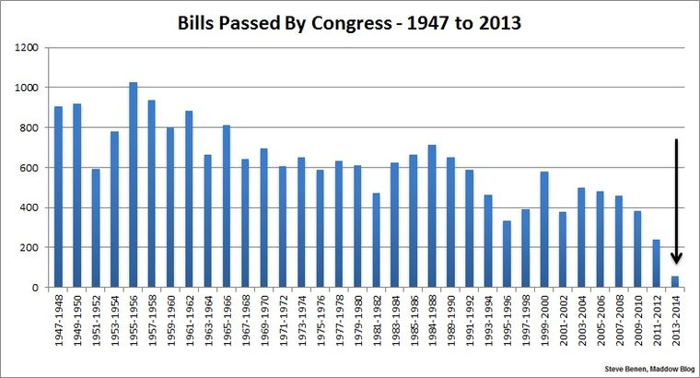
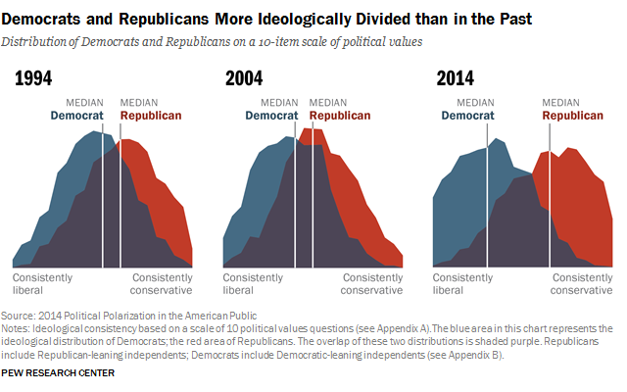
Political Parties and Congress
Increasing role of Party’s in Polarized Climate
Members of political parties vote along party line
Members today are less likely to cross party lines to vote with the other party
What role does gerrymandering play in this?
What role does the influence of special interest groups play in this?

Slide 19
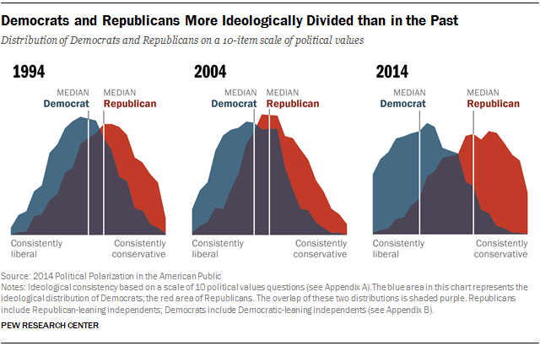
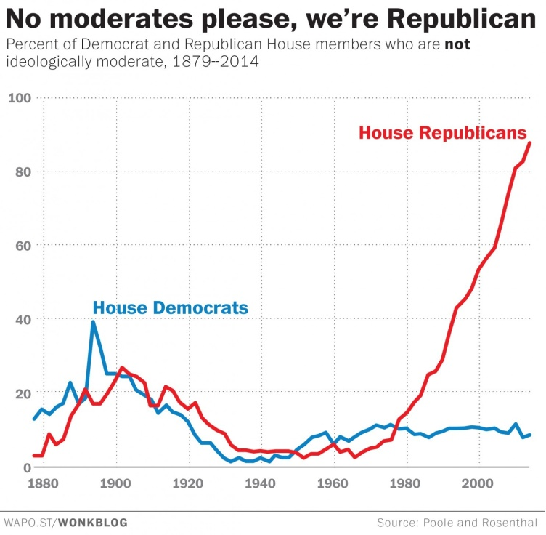
Party Polarization
Ideological distance between the political parties
Causes
Gerrymandering
“Primaried”
Media-Driven Ideological Conflicts
Single-Issue Interest Groups
Citizens United / Rise of Super PACs
Effects
Gridlock
Lack of compromise

Slide 20
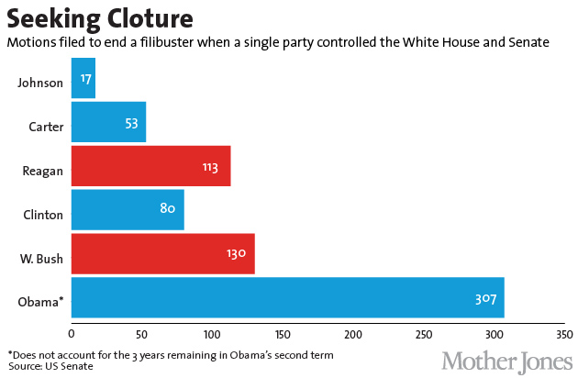
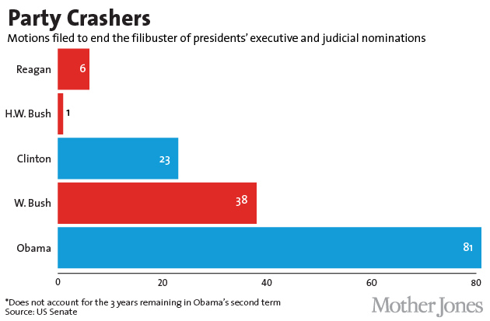
Political Gridlock
By Constitutional Design or Obstructionism
Filibuster used a record number of times by Republican Senators against Pres. Obama
Current Event; Supreme Court Vacancy

Slide 21
Effects of Divided Government
Effects of Divided Government
↑partisanship = less compromise…when compromise needed
Impact of gerrymandering?
Legislative Gridlock
Can’t get anything major passed
Gun control; debt ceiling; tax policy; climate change; infrastructure; immigration reform…and the list goes on…
President difficulties getting nominations approved
More distrust of govt.

Slide 22
Washington’s Farewell Address
Why was Washington against political parties?
FACTIONS
"It serves to distract the Public Councils, and enfeeble the Public Administration....agitates the Community with ill-founded jealousies and false alarms; kindles the animosity of one....against another” -- G.W.

Slide 23
Constitutionality of Political Parties
The U.S. Constitution does not include any reference to political parties
Federalist #10 by James Madison warned of factions
George Washington’s Farewell Address warned of partisan politics
Threatens national unity and popular government
Federalists and Anti-Federalists originated two-party system in U.S.

Slide 24
Party Platforms
DEMOCRATS | REPUBLICANS
Minimum wages; tax increases on upper-class | Wages based on free market; no tax increases
Support Roe v. Wade; pro-choice; support Planned Parenthood | Overturn Roe v. Wade; pro-life; eliminate funding for Planned Parenthood
Decrease defense spending; make military more efficient | Defense and security a priority; increase defense spending
Support equality and affirmative action programs; support same-sex benefits | Against racial quotas; support ”traditional” marriage and family roles
Favor gun control | Favor gun rights
Against the Patriot Act based on restrictions of civil liberties | Favor security measures of the Patriot Act
Preserve welfare programs; oppose privatization of social security | Privatize social security; reduce government welfare programs
Support environmental regulations; endorse climate change | Reduce government regulation of energy-based industries; questionable on climate change
Expand national health care coverage | Health care controlled by industries

Slide 25
Major Political Party Bases
Democratic Party
Republican Party (GOP)
African-Americans
LGBTQ
Jews
Progressive liberals
Anti-war
Support United Nations
Environmentalists
Social justice/civil rights
Keynesian economics
Protestant evangelicals/Christian Right
Neoconservatives
War hawks
International interventionists
Expansion of American military and defense spending
Traditionalists/ Paleoconservatives
Pro-life
“traditional” marriage and family roles
Economic nationalists
Cultural conservatives
Supply-Side Economics
Low income and corporate taxes
Limited government regulation

