Slide 1
Campaigns and Voting
Mr. Winchell
AP GOPO
Unit 5: Political Participation

Slide 2
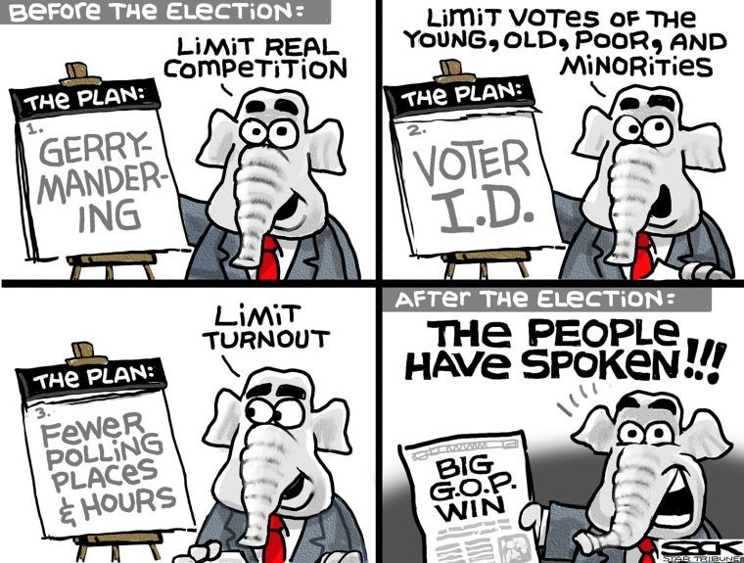

Slide 3
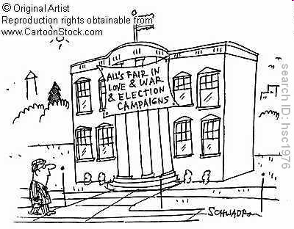

Slide 4
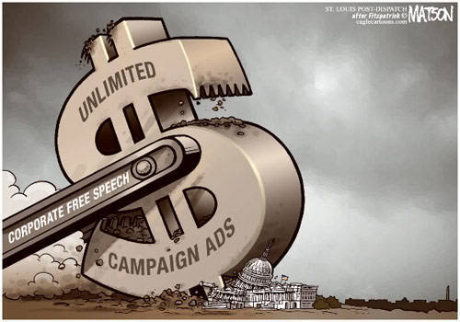
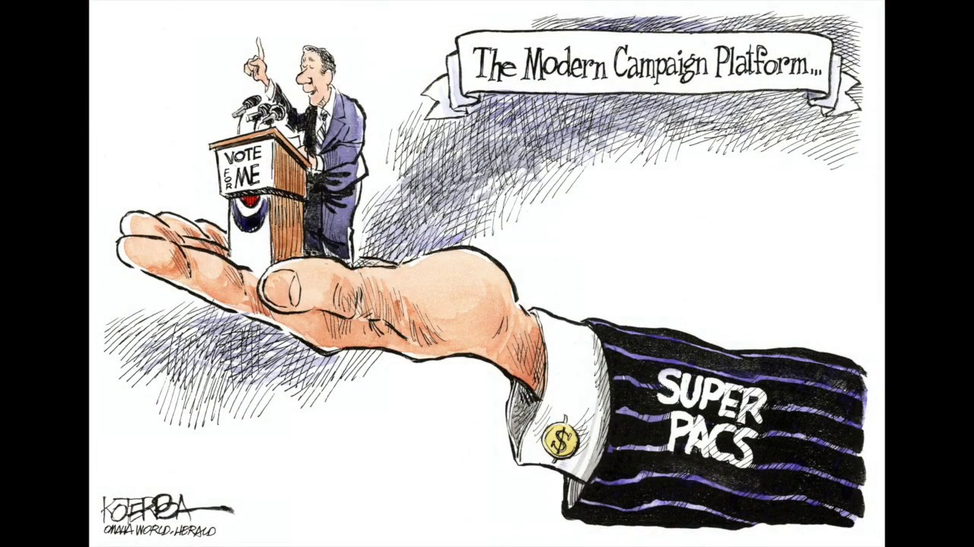

Slide 5
Campaigns: Then and Now
Parties are less important – getting nominated is an individual effort in America today
Media, polling, and money are more important – today’s candidates spend the most on media
The plurality of political ads designed to appeal to voters’ fears
People are hired to perform campaign tasks
Media consultants, direct mail firms, polling firms. political technology firms

Slide 6
Modern Campaign Benefits and Drawbacks
Heavily dependent on professional consultants
Costs UP, Fundraising UP
Election Cycles LONG
Social Media

Slide 7
Campaigns and Campaign Issues
The balancing act
Being conservative (or liberal) enough to get nominated
Move to center to get elected
True nationwide in states where activists are more polarized than average voter
The "clothespin vote": neither candidate is appealing
Types of Issues
Position issues
Valence issues

Slide 8
Presidential and Congressional Campaign Differences
Two phases for each: getting nominated and getting elected
Presidential races are more competitive.
House races have often become one-sided either party.
Presidential winner rarely gets more than 55 percent of vote
Most House incumbents are reelected (more than 90 percent)
Fewer people vote in congressional elections
Unless election coincides with presidential election
Gives greater importance to partisan voters (party regulars)

Slide 9
Presidential and Congressional Campaign Differences
Congressional incumbents can service their constituents.
Can take credit for governmental grants, programs, and so forth
President can't: power is not local
Congressional candidates can duck responsibility.
"I didn't do it; the people in Washington did!"
President is stuck with blame
But local candidates can suffer when leader's economic policies fail
Benefit of presidential coattails has declined
Congressional elections have become largely independent
Reduces meaning (and importance) of party

Slide 10
Running for President
Getting mentioned :
Using reporters, trips, speeches, and name recognition
Sponsoring legislation, governing large state
Setting aside time to run
Money
Individuals can give $2,000, political action committees (PACs) $5,000
Organization
Need a large (paid) staff, volunteers, and advisers on issues: position papers
Strategy and themes
Incumbent versus challenger, setting the tone (positive or negative) and developing a theme: trust, confidence,
Choosing a target voter: who's the audience?

Slide 11
Television, Debates, and Direct Mail
Paid advertising (spots)
Has little (or a very subtle) effect on outcome: spots tend to cancel each other out
Most voters rely on many sources of information.
News broadcasts (visuals)
Cost little
Rely on having TV camera crew around
May be less informative than spots
May have greater credibility with voters
Debates
Usually an advantage only to the challenger
Reagan in 1980: reassured voters
Primary debates: the "dating game" in 1988

Slide 12
Television, Debates, and Direct Mail
Risk of slips of the tongue on visuals and debates
Ford and Poland, Carter and lust, Reagan and trees
Forces candidates to rely on stock speeches
Must sell yourself, not your ideas
Free television time to major presidential candidates in 1996
The computer
Makes direct mail campaigns possible and creates importance of mailing lists
Allows candidates to address specific voters
The gap between running a campaign and running the government
Party leaders had to worry about reelection
Today's political consultants don't

Slide 13
Why do national conventions matter?
National convention: an official gathering of a political party to officially nominate a candidate
They attempt to unify the party, mobilize their voters, & reveal their party platform for the coming election
Video 1: CNN explains national conventions
Video 2: Fox News explains national conventions

Slide 14
Campaign Funding (The Basics)
Hard money is direct contributions to presidential candidates, which has been regulated and restricted in recent years.
Soft money is indirect contributions given to political parties for “general use,” which can then be channeled through the party directly to candidates. (This form of contribution is difficult to trace).
Political Action Committees (PACs) and Super PACs were established in 1974 as another method through which interest groups try to influence policy through campaign contributions.

Slide 15
PACs and Super-PACs
PACs and Super-PACs act independently of candidates and can run campaign ads without the candidate’s approval [independent expenditures].
Example: Swift boat Veterans for Truth, a conservative 527 group, ran a smear ad in the 2004 election attempting to destroy the image of John Kerry. They painted him as a liar and an un-American for his anti-war efforts during the Vietnam era.
Electioneering communications
Candidates often rely on PACs to help with the financial costs of campaigns.

Slide 16
Campaign Money
Money: How important is it?
"Money is the mother's milk of politics."
Presidential candidates spent $286 million in 1992; up from $177 million in 1988
Are candidates being "sold" like soap? Answer is not so obvious
Presidential primaries: part private, part public money
Federal matching funds
Only match small donors: less than $250; $5,000 in twenty states
Gives incentive to raise money from small donors
Government also gives lump-sum grants to parties to cover conventions
Presidential general elections: all public money

Slide 17
Campaign Legislation
Bipartisan Campaign Reform Act (2002)
Ban soft money
‘Stand by Your Ad’
Citizens United v. FEC (2010)
Free speech vs. fair elections

Slide 18
Voting Rights Over Time
15th
17th
19th
24th
26th

Slide 19
Types of Voting
Rational Choice Voting
Retrospective Voting
Prospective Voting
Party Line Voting

Slide 20
Factors That Impact Voting Behavior
Party identification tends to drive people to vote a certain way
Candidate’s personalities have increasingly become an important piece of voter’s decision… The mass media has increasingly focused on candidate’s personalities creating personality centered election coverage.

Slide 21
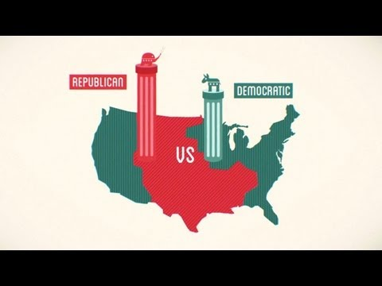
Video: Gerrymandering & Rigging Electoral Districts

