Slide 1
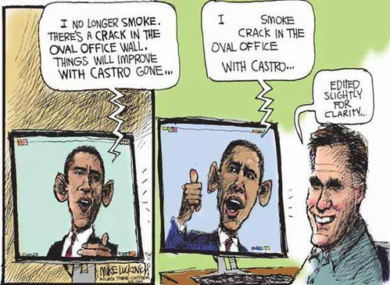

Slide 2
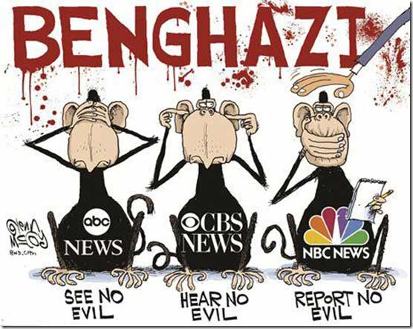

Slide 3
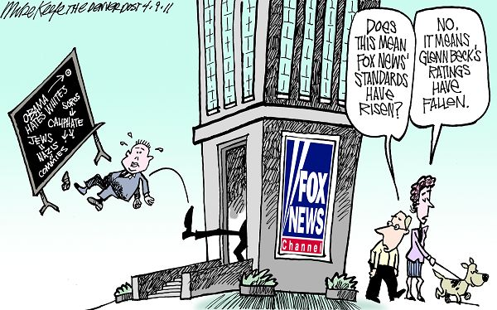

Slide 4
The Mass Media

Slide 5
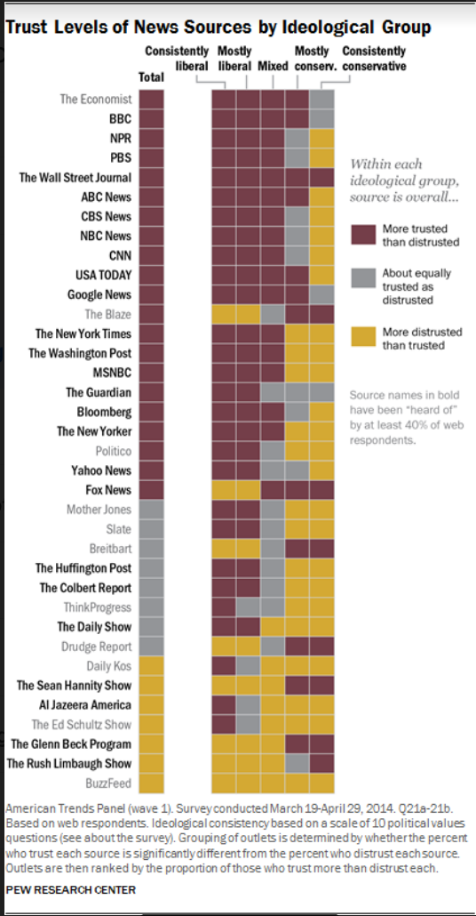

Slide 6
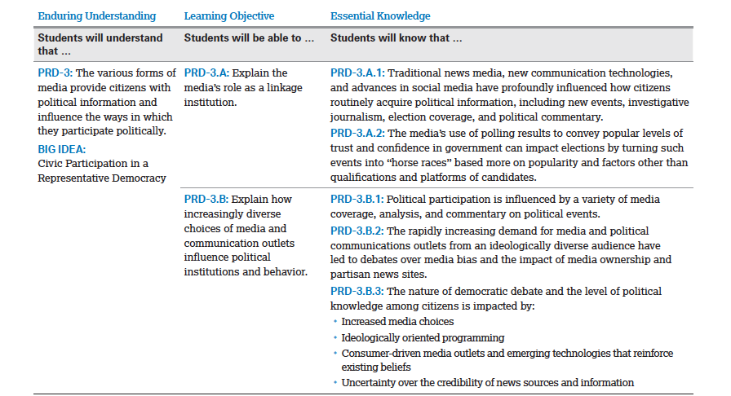

Slide 7
Mass Media
Includes all forms and aspects of communication to the general public
Linkage institution between the electorate and government institutions
“The Fourth Estate”

Slide 8
Function of Mass Media
Link the government and the electorate
Communicate information and awareness to the public and government officials on issues, problems, situations in development of public policy
Gatekeeper
Agenda setting
Priming
Framing
Watchdog
Fact-checking
Investigative journalism
Muckraking
Whistleblowing
Scorekeeper
“Horse-race journalism”

Slide 9
Media and the Institutions
Media and the President
Media Events
Press Secretary
Media and Congress
C-SPAN
Committee hearings
Media and the Supreme Court
Only audio recordings of oral arguments and decisions
Sources of Information
News/press releases
News briefings
News conferences
Leaks

Slide 10
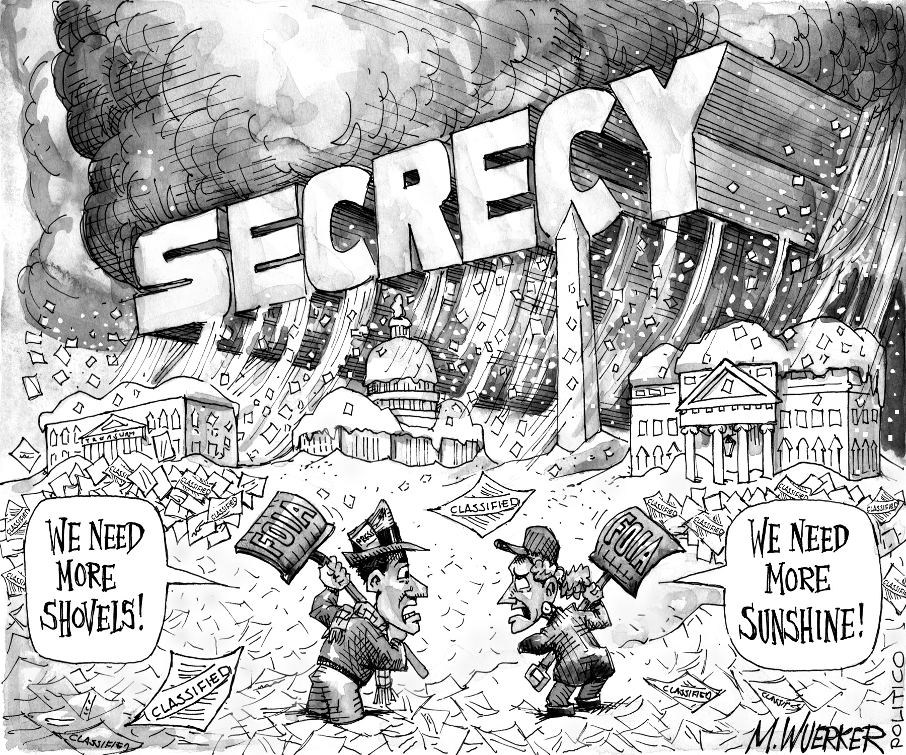
The Media and First Amendment
Prior Restraint
Government prohibited from censoring or refusing publication/broadcast
Near v. Minnesota (1931)
New York Times v. United States (1971)
Pentagon Papers
Libel
Malicious printed material is not protected
New York Times v. Sullivan (1964)
Slander
Malicious oral material is not protected
Freedom of Information Act (1966)
Citizens and media outlets may request public records
Sunshine Laws
Public policy must be developed in the public sphere
No backroom secret negotiations

Slide 11
Federal Communications Commission (FCC)
Federal Communications Act of 1934 established FCC as independent regulatory agency on interstate communication
Enforces technical, structural, and content regulations

Slide 12
Technical Regulation of Media
Public owns the airwaves
Anything transmitted over the airwaves is subject to regulation
Radio and television broadcasters must obtain a license renewable every 5 years
Subject to hearing if a group objects/complains
Digital conversion
Digital Transition and Public Safety Act of 2005
All over-the-air broadcasts must end analog transmissions and convert to digital

Slide 13
Structural Regulation
Media Consolidation
Before 1980s, media monopolies were strictly enforced and prohibited
A corporation could not monopolize an entire market
Telecommunications Act of 1996
Deregulated limitations on corporations
Led to fewer but larger media conglomerates

Slide 16
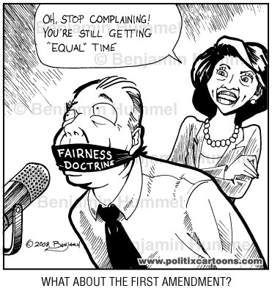
Content Regulation Media and Political Campaigns
Fairness Doctrine
Mandated broadcast of opposing views on issues
Abandoned by FCC in 1987 due to First Amendment concerns
Equal Time Rule
Media time must be equally granted, media costs must be equal, commercial ads must be the same during candidate air time
Right of Rebuttal/Reply
Candidates have the right to opportunity to respond to allegations made by an opposing candidate
Miami Herald v. Tornillo (1974)
“Liberal Bias (TV, Newspapers, Internet) vs. Conservative Bias (Talk Radio)”

Slide 17
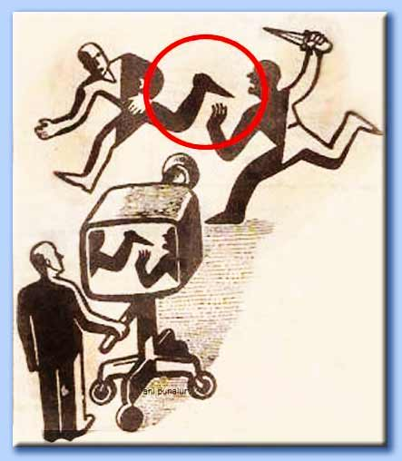
Media Bias
Corporate and Establishment Media
Campaign contributions
Credibility
Sensationalism over objectivity
“If it bleeds, it leads.”
“Liberal Bias (TV, Newspapers, Internet) vs. Conservative Bias (Talk Radio)”
Facebook Left and Right
Analysis of Magazines, Newspapers
Actual News Headlines vs. Fox News Headlines
Confirmation Bias

Slide 18
Media and Ideology
Lean Liberal
Independent
Lean Conservative
Print Media
New York Times
Washington Post
Huffington Post
Slate
The Guardian
Mother Jones
Broadcast Media
MSNBC
CNN
Print Media
The Hill
NPR
Politico
The Economist
AP
Reuters
USA Today
Broadcast Media
PBS News Hour
NBC News
CBS News
ABC News
NPR
Bloomberg
Print Media
Wall Street Journal
National Review
Drudge Report
Breitbart
InfoWars
Broadcast Media
Fox News

