Slide 1
Do Now
Read the letter home from an indentured servant and identify the struggles they face…what does this reveal about indentured servitude as a labor system?

Slide 2
Dissent and Upheaval in Colonial American Society-Being a British American
Mr. Winchell
APUSH 2018-2019
Period 1-2

Slide 3
AP Prompt
Evaluate the extent to which Bacon’s Rebellion brought change in the Southern Colonial labor system and social classes.

Slide 4
Outline
Bacon’s Rebellion & Colonial Slavery
Half-Way Covenant & Salem Witch Trials
Atlantic System
Mercantilism
Colonial Politics

Slide 5
Bacon's Rebellion in Virginia
Former indentured servants living in the VA frontier suffered due to:
Poor tobacco prices in 1660s
Indian attacks in 1675
These farmers blamed VA’s royal governor Berkeley who did little to help; Nathaniel Bacon led a rebellion in 1676 against Berkeley & was joined by small farmers, blacks, & women
Notes:
22

Slide 6
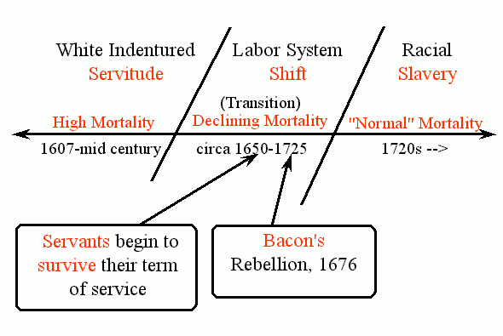
BACON'S REBELLION

Slide 7
Results
The rebellion failed and several rebels were killed.
Significance: Plantation owners sought large numbers of black slaves instead of indentured servants
White indentured servants were now seen as too troublesome
Socio-economic class differences/clashes between rural and urban communities would continue throughout American history
Planters used racism to manipulate poor whites
Eric Foner on the Origins of Slavery in North America
Eric Foner on The Difference in American Slavery

Slide 8
Text Analysis
Morgan and Ira Berlin (Secondary Source Analysis)
By The People p. 38

Slide 9
Reasons for Slavery
Decrease in indentured servants
English economy - rising wages
Increase in availability of slaves
End of Royal African company monopoly
Decrease in price
Fears of growing number of landless freemen
Available supply from Caribbean

Slide 10
The Slave Population
Widespread resentment of their slave status led to resistance in the 18th Century:
Armed resistance such as the Stono Rebellion of 1739 (SC)
In 1741, 106 slaves were hung or deported due to a rumor that slaves planned to burn NYC
Runaway slaves were common
Notes:
16

Slide 11
The Slave Population
40% in VA
60% in SC
In the Chesapeake & Southern colonies with large black populations, slaves found it easier to maintain their African culture
By 1720, the African population became self-sustaining:
Fertility rates exceeded immigration rates for the 1st time
Did not occur in the Caribbean or in South America
Free & enslaved blacks were much less numerous in NE & Middle colonies
Notes:
14

Slide 12
Slave Demographics

Slide 13
Halfway Covenant
1662: Liberalization and relaxation of church requirements and rules
Compromise from earlier strict regulations
1st Generation Puritans dying off…
2nd and 3rd Gen. less radical

Slide 14
New England and Religion Salem Witch Trials (1691-1693)
Young women acted strangely and accused Tituba (African slave woman) and two local white women of witchcraft
Judges ignored ban on subjective evidence
185 accused
141 women; 44 men
19 executed
14 women; 5 men
Result of hysteria and controversial trials weakened Puritan influence and control in New England

Slide 15
Dominion of New England (1686-1689)
Established by King James II to consolidate colonies
Administrative union of Massachusetts, New Hampshire, Connecticut, Rhode Island, New York, New Jersey
Governor Edmund Andros
Dissolution

Slide 16
Historiography ”The Puritans: Orthodoxy or Diversity?”
Perry Miller and Thomas H. Johnson – The Puritans (1938)
David D. Hall – Worlds of Wonder, Days of Judgment (1989)
Thus Puritanism appears, from the social and economic point of view, to have been a philosophy of social stratification, placing the command in the hands of the properly qualified and demanding implicit obedience from the uneducated; from the religious point of view it was the dogged assertion of the unity of intellect and spirit in the face of a rising tide of democratic sentiment suspicious of the intellect and intoxicated with the spirit. It was autocratic, hierarchical, and authoritarian… that in the social realm holy writ were to be the mentors of farmers and merchants.
Let me return to the crucial question of the clergy and their role in shaping popular religion... they had too much in common with the people, and too prominent a part to play in teaching certain structures of belief... I refuse to represent the clergy as so dominating in the churches that their way of thinking always prevailed...the power of the clergy was too mediated to make them really dominant, and "domination" is a word that simply doesn't fit in the pluralistic structure of New England towns and churches.

Slide 17
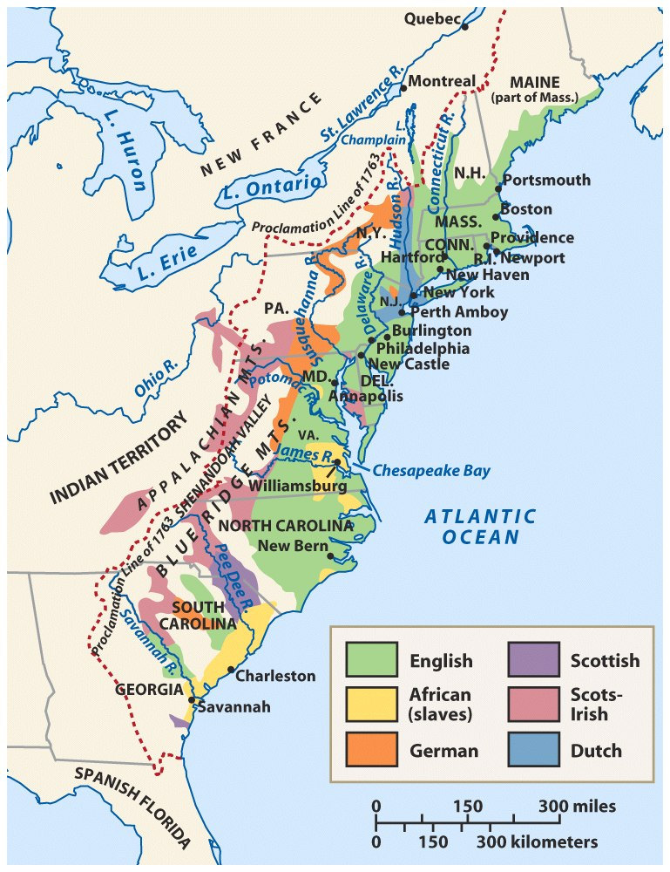
Population: Ethnic & Racial Diversity
Notes:
Roark, American Promise 3e from http://www.bedfordstmartins.com/mapcentral

Slide 18
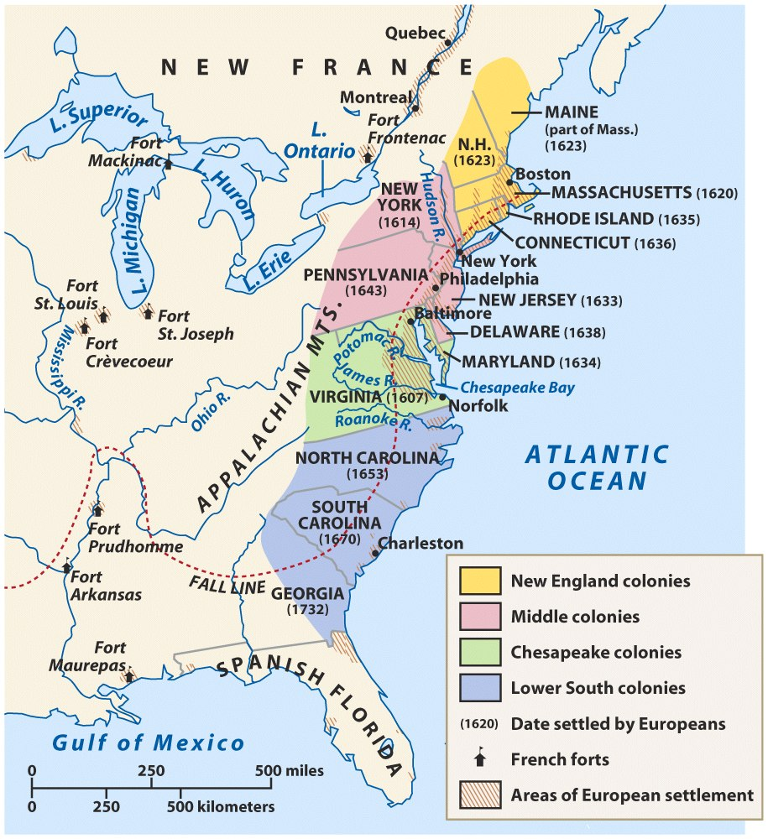
American Colonies at the End of the Seventeenth Century
Notes:
Roark, American Promise 3e from http://www.bedfordstmartins.com/mapcentral

Slide 19
Settlement and Migration
250,000 in 1701 to 2.5 million in 1775
Europeans and Africans along with a high birth rate
Reasons: religion; economics; political turmoil
English, Germans (Pennsylvania Dutch), Scottish, Irish, Dutch, Swedish ← OLD IMMIGRANTS
Africans forced to America; suffered discrimination and slave labor

Slide 20
Colonial Lifestyle
About 80% of colonists were farmers!
Compared to Europeans, American colonists had a higher standard of living.
Land was cheap
Wages were 3x that of Europe

Slide 21
Similarities Among Colonies
Mostly English
Possessed British freedoms
Self-government
Religious toleration (in most cases)
Educational opportunities
Economic opportunities
Unique from the British monarchy in character

Slide 22
Demographics
Population rose rapidly
Women & Family Life
Class in the New World vs. Old World
Ethnic Diversity
Northern: Mostly English, few slaves, families
Middle: VERY DIVERSE- English, German, Swedes, Dutch, Irish, Scotch-Irish, Jews, some slaves, families
Southern & Chesapeake: English & some German; Huguenots in Carolinas; more men, some families, many indentured servants & slaves

Slide 23
Colonial Politics
New England: town meetings; direct democracies
Middle colonies: assemblies reflected basic democratic principles & rights of Englishmen.
Southern colonies: wealthy planters played leading roles in representative colonial legislatures.
Development of Colonial Democracy!

Slide 24
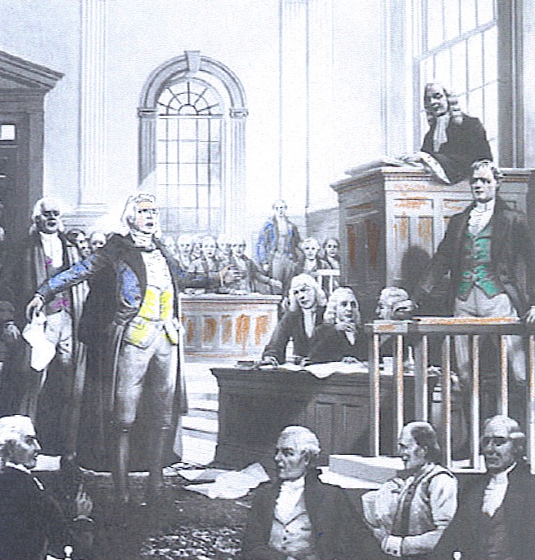
Colonial Politics
Limited Self-Government
Elected bicameral legislative assemblies
Governors
Local governments
Voting
Limited to adult male educated and/or property owners
Freedom of Expression
John Peter Zenger Case (1735)

Slide 25
Rise of a Commercial Empire
English government largely ignored the colonies until the 1650s (salutary neglect); the colonies were not state-funded nor state protected
But…Charles II initiated colonial intervention in 1660 to maximize exports, decrease imports, & generate more gov’t revenue
Notes:
17

Slide 26
Mercantilism
Mercantilism was an economic policy that looked upon trade, colonies, and the accumulation of wealth as the basis for a country’s military and political strength.
Mercantilist doctrine required that a government regulate trade and production to enable it to become self- sufficient.
Colonies were to provide raw materials to the parent country so the parent country could make products to send back to the colony.

Slide 27
Response to Economic Competition
“Enumerated goods (tobacco, sugar, cotton, rice, rosin, tar) could only be sent to English ports
“Mercantilism” became the blueprint for England’s empire:
Wanted more money & a favorable balance of trade
Wanted to eliminate Dutch rivals
Wanted a stronger navy
Began to restrict colonial trade:
Navigation Act of 1660
Navigation Act of 1663
No ship could trade in colonies unless it was made in England
Goods shipped to English colonies must pass through England (increased the price paid by colonial consumers)
Notes:
but gov’t regulations emerge as individual responses to particular problems rather than an integrated agenda

Slide 29
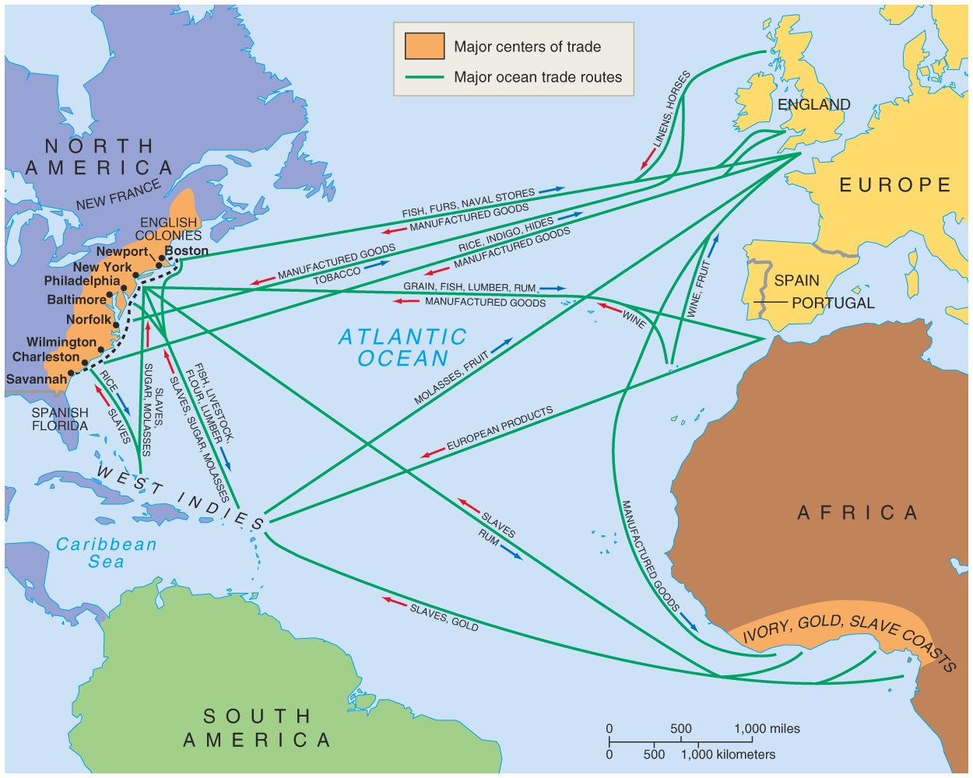
Trade
Raw Materials
Lumber
Tobacco
Rice
Indigo
Furs
To England from Colonies

Slide 30
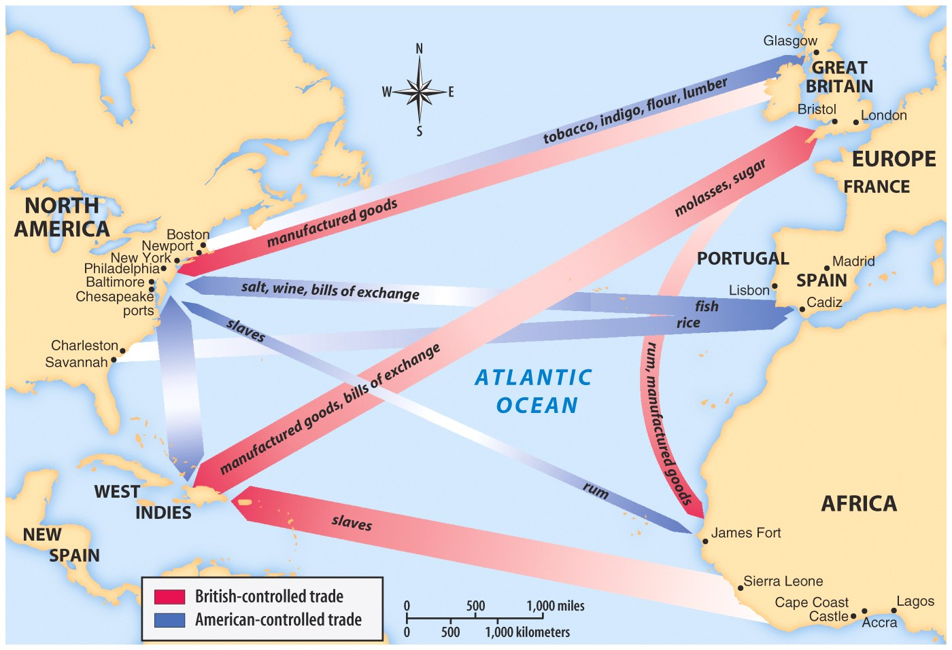
Manufactured Goods
Furniture
Clothing
Colonials had not factories.
From England to Colonies

Slide 31
The Acts of Trade and Navigation
The Navigation Acts had a mixed effect on the colonies.
allowed New England ship building to prosper
provided English military forces to protect the colonies from the French and Spanish
severely limited the development of colonial manufacturing
caused colonists to pay high prices for manufactured goods

Slide 32
Being a British American
‘Dukes Don’t Emigrate’
Social Classes in Britain
Diversity in Britain
Democracy in Britain
Property in Britain
Social Classes in America
Diversity in America
Democracy in America
Property in America

Slide 33
SAQ
Short Answer Question Introduction Assessment

