Slide 1
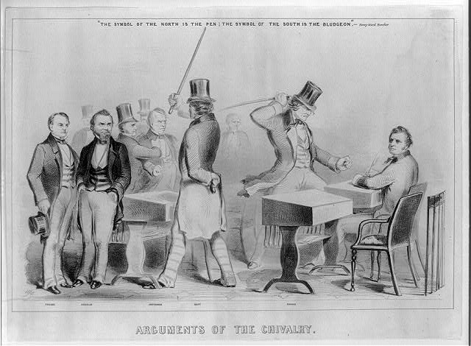

Slide 2
Drifting Towards Disunion: The Politics and Economics of the Late 1850s and Election of 1860
Mr. Winchell
APUSH 2018-2019
Period 5

Slide 3
AP Prompt

Slide 4
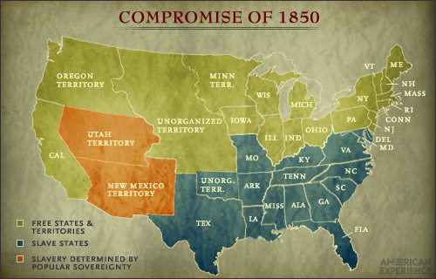
The United States in 1850

Slide 5
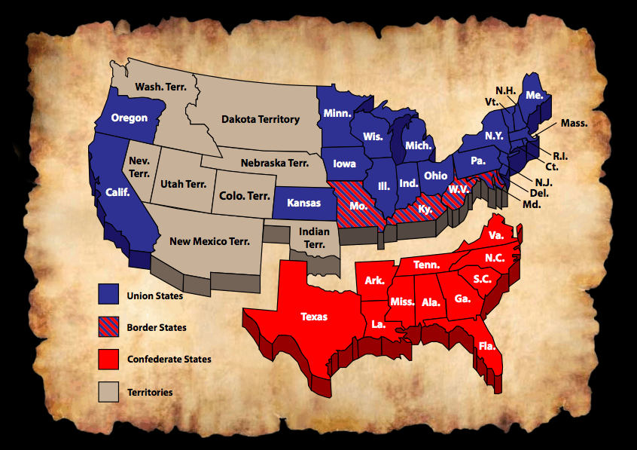
The Disunited States in 1861

Slide 6
Sectionalism & Compromise to 1850
Constitutional Convention
3/5 Compromise
Slave trade compromise
Early Republic
Formation of first two political parties
First Nullification Crisis (Alien & Sedition Acts)
Hartford Convention (War of 1812)
Missouri Compromise of 1820 (36°30’ line)
Jacksonian Era
Second Nullification Crisis (Tariff of Abominations of 1828, Force Bill & Compromise Tariff of 1833)
Jackson’s Bank War (“pet banks”)
Disagreements over federal funding of internal improvements (roads & canals)
Manifest Destiny
Texas Annexation
Mexican War
“Spotty Lincoln”
Thoreau’s Civil Disobedience
Wilmot Proviso
Compromise of 1850
California (free state)
Slave trade banned in D.C.
New fugitive slave act
Popular sovereignty in S.W.

Slide 7
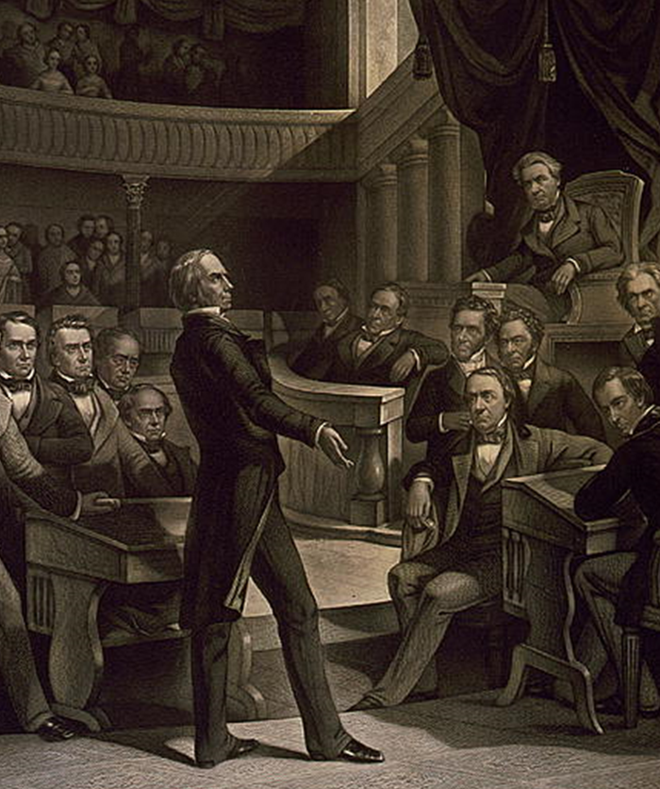
Henry Clay’s Compromises
Missouri Compromise, 1820
Settled issue of slavery in Louisiana Purchase
Tariff Compromise, 1833
Ended S.C. Nullification Crisis
Compromise of 1850
Settled issue of slavery in Mexican Cession

Slide 8
The New Order: Sectional Parties
Free-Soil Party, 1848-1854
Homestead act for settlers in west
Opposed expansion of slavery
Know-Nothing Party, 1845-1859
Opposed immigration
Death of Whig Party after loss in 1852 election
Ostend Manifesto, 1854
Buchanan’s proposal to add Cuba as a slave state
Kansas-Nebraska Act, 1854
eventually shattered Democrats into northern and southern wings
united Free-Soilers, Know-Nothings, old Whigs and others into the new, northern Republican Party
Sectional developments
Low Tariff of 1857, Panic of 1857, and weak president James Buchanan tarnished Democrats

Slide 9
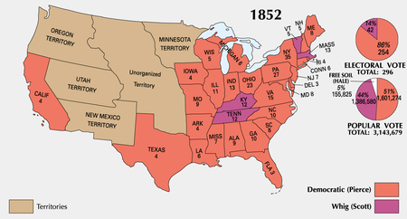
The Birth of the Republican Party
New parties emerge due to rifts over slavery
Whigs are weak (losing members over the issue of slavery) – lost 1852 election and Democrat Franklin Pierce wins.
Know-Nothing Party – pro native-born Americans (nativism) - split over the slavery issue.
Free-Soil Party – anti-extension of slavery into the territories and pro white laborer.
Republican Party – created in opposition to the K-N Act and opposed the extension of slavery (wanted the Missouri Compromise back) and were pro North (Tariffs and industry).
A combination of ex-Whigs, antislavery Democrats, and Free-Soilers.

Slide 10
The Election of 1856
Franklin Pierce – not popular due to “Bleeding Kansas.”
Democrats - nominate James Buchanan.
Republicans - nominated John C Fremont .
Whig Party and Know-Nothing Party alliance - nominated Millard Fillmore.
Buchanan wins - who won with only 45% of the popular vote (3rd party ticket election).
Buchanan - timid and indecisive…would be one of the weakest Presidents (not good in a time of national crisis.
Rep’s stick around, Know-nothings decline – nation is still split N and S.

Slide 11
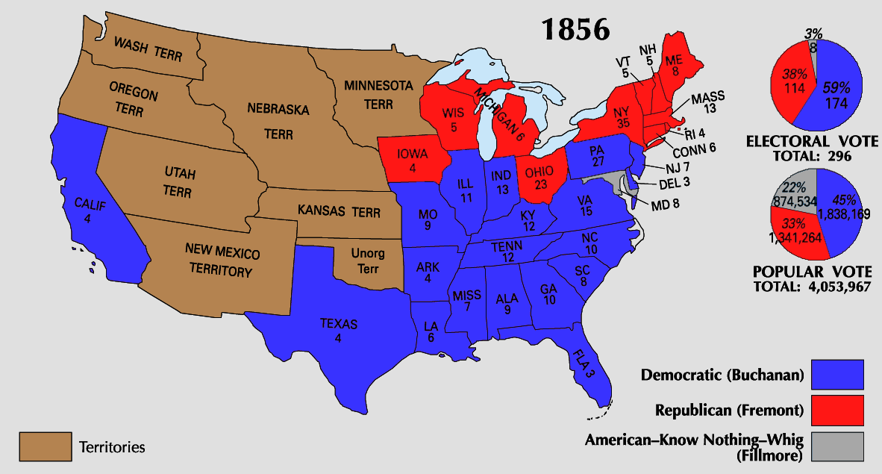
The Election of 1856
Southerners were relieved by the victory but were threatened by the existence of a party devoted to ending slavery
Northerners realized that the free-states had a large majority in the Electoral College so a Republican could become president by only campaigning in the North

Slide 12
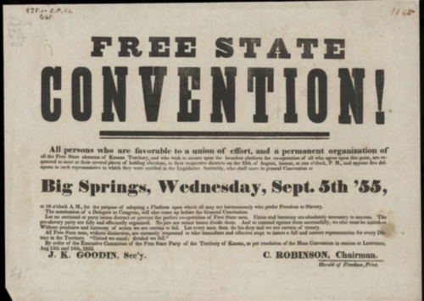
Back In Kansas - The Lecompton Constitution
Proslavery government (in Lecompton) - wrote a constitution that protected slavery.
Voted down by Free-soilers (greatly outnumbered slave supporters).
Pres. Buchanan - supported Lecompton Constitution.
Stephen Douglas angry! – pro popular sovereignty.
Douglas - convinced Congress to authorize another referendum (population vote) on the Lecompton Constitution - voted down again.
Northern Democrats - Douglas is a hero!
Southern Democrats - Douglas is a traitor!
Kansas was eventually admitted as a free state in 1861.

Slide 13
Hinton R. Helper
The Impending Crisis of the South, 1857
Southerner
Argued that slavery was detrimental to the south
Slaveholders oppressed poor whites as well as blacks
Plantation system stymied economic development

Slide 14
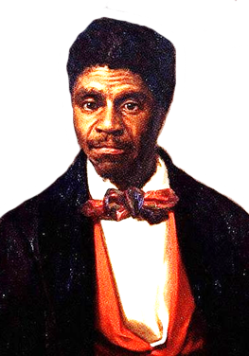
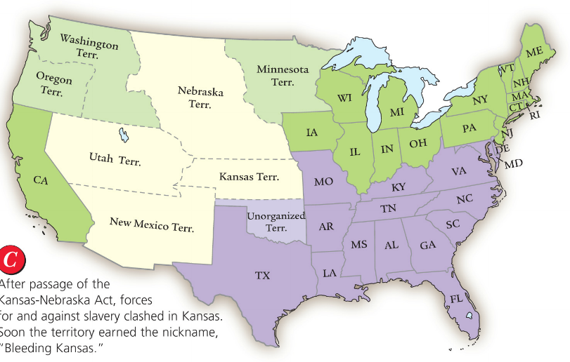
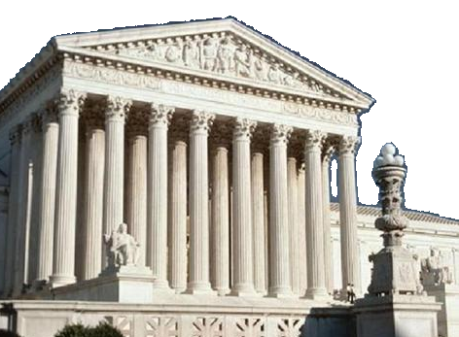
In 1857, a slave named Dred Scott sued for his freedom after traveling with his master from Missouri to Wisconsin
The Dred Scott case presented the Supreme Court with two questions
Does Congress have the power to decide on slavery in the territories?
Is the Missouri Compromise constitutional?

Slide 15
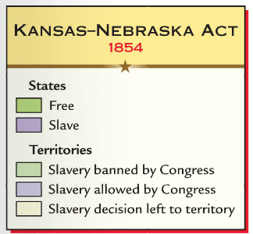
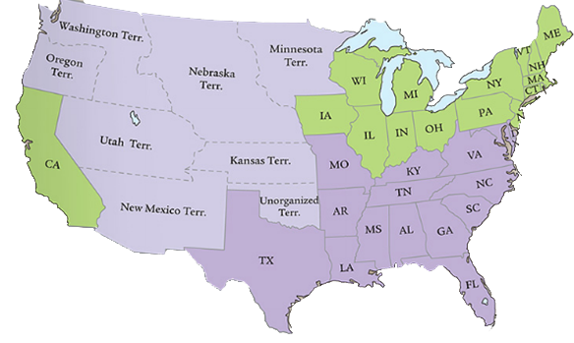
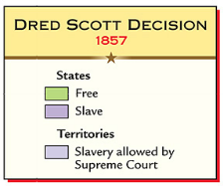
In Dred Scott v. Sanford (1857), the Supreme Court ruled
Dred Scott had no right to sue because blacks are not citizens
Congress did not have the power to stop slavery in western territories so the Missouri Compromise was unconstitutional
Northern abolitionists were furious

Slide 16
Lincoln-Douglas Debates
During this crisis…Congressional elections of 1858.
One important Race: Illinois Senate Race.
Held 7 debates around the state.
Difference between candidates.
Democrat S. Douglas – experienced and poised for a run for President.
Republican A. Lincoln – newbie and one time congressman.
Views on slavery.
Douglas
Popular sovereignty – let states choose.
Lincoln
Did not think the two races could live together as equals.
Opposed expansion of slavery – but not an abolitionist.
Thought it would die a natural death

Slide 17
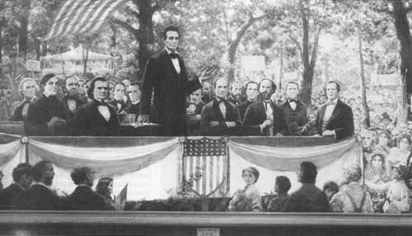
The Freeport Doctrine
In the Second Debate…
Lincoln asked how Douglas could reconcile popular sovereignty with Dred Scott ruling.
His answer: Freeport Doctrine – Slavery could not exist anywhere without support from the local police, regardless of what the SC says.
Douglas won the Senate seat – Lincoln had made himself nationally prominent.

Slide 18
Lincoln-Douglas Debates (1858)
“A House Divided” - Abraham Lincoln
Freeport Doctrine - Stephen A. Douglas
If we could first know where we are and whither we are tending, we could better judge what to do and how to do it. We are now far into the fifth year since a policy was initiated with the avowed object and confident promise of putting an end to slavery agitation. Under the operation of that policy, that agitation has not only not ceased but has constantly augmented. In my opinion, it will not cease until a crisis shall have been reached and passed. "A house divided against itself cannot stand." I believe this government cannot endure, permanently, half slave and half free. I do not expect the Union to be dissolved; I do not expect the house to fall; but I do expect it will cease to be divided. It will become all one thing, or all the other. Either the opponents of slavery will arrest the further spread of it and place it where the public mind shall rest in the belief that it is in the course of ultimate extinction, or its advocates will push it forward till it shall become alike lawful in all the states, old as well as new, North as well as South.
The next question propounded to me by Mr. Lincoln is, can the people of a Territory in any lawful way, against the wishes of any citizen of the United States, exclude slavery from their limits prior to the formation of a State Constitution? I answer emphatically, as Mr. Lincoln has heard me answer a hundred times from every stump in Illinois, that in my opinion the people of a Territory can, by lawful means, exclude slavery from their limits prior to the formation of a State Constitution. Mr. Lincoln knew that I had answered that question over and over again. He heard me argue the Nebraska bill on that principle all over the State in 1854, in 1855, and in 1856, and he has no excuse for pretending to be in doubt as to my position on that question. It matters not what way the Supreme Court may hereafter decide as to the abstract question whether slavery may or may not go into a Territory under the Constitution, the people have the lawful means to introduce it or exclude it as they please, for the reason that slavery cannot exist a day or an hour anywhere, unless it is supported by local police regulations. Those police regulations can only be established by the local legislature, and if the people are opposed to slavery they will elect representatives to that body who will by unfriendly legislation effectually prevent the introduction of it into their midst. If, on the contrary, they are for it, their legislation will favor its extension. Hence, no matter what the decision of the Supreme Court may be on that abstract question, still the right of the people to make a slave Territory or a free Territory is perfect and complete under the Nebraska bill. I hope Mr. Lincoln deems my answer satisfactory on that point.

Slide 19
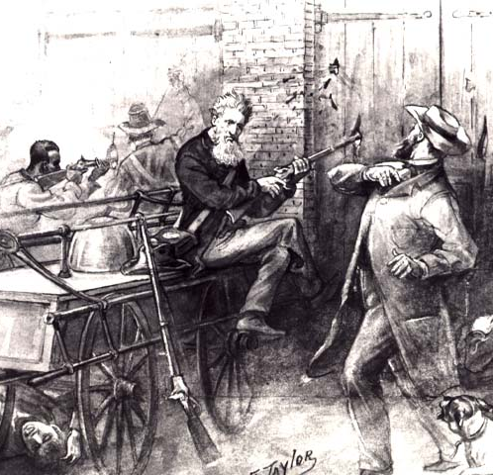
John Brown at Harpers Ferry, 1859
Failed effort to incite a slave uprising
Brown was executed
South began militia drills, preparing for civil war

Slide 20
The Three Souths: Border South: Delaware, Maryland, Kentucky, & Missouri
Plantations scarcer; cotton cultivation almost nonexistent; Tobacco main slave crop (as in Middle South); More grain production (as in Middle South)
1850, Slaves = 17% of population.; Avg. 5 slaves per slaveholder
1850, over 21% of Border South’s blacks free; 46% of South’s free blacks
22% of white families owned slaves
Of all who owned more than 20 slaves in South: 6%; Ultra-wealthy = 1%
Produced over 50% of South’s industrial products

Slide 21
The Three Souths: Middle South: Virginia, North Carolina, Tennessee, and Arkansas.
Each state had one section resembling more the Border South and another resembling the Lower South.
Unionists would prevail after Lincoln elected; Dis-unionists would prevail after war began
Many plantations in eastern Virginia and western Tennessee
1850, slaves = 30% of population; Avg. 8 slaves per slaveholder
36% of white families owned slaves
Of all who owned more than 20 slaves in South: 32%; Ultra-wealthy = 14%

Slide 22
The Three Souths: Lower South: South Carolina, Florida, Georgia, Alabama, Mississippi, Louisiana, Texas
Plantations prevalent; cotton was king; grew 95% of Dixie’s cotton & almost all of its sugar, rice, and indigo
Disunionists (secessionists) would prevail after Lincoln was elected
1850, slaves = 47% of population; Avg. 12 slaves per slaveholder
Less than 2% of blacks free; only 15% of South’s free blacks
43% of white families owned slaves
Of all who owned more than 20 slaves in South: 62%; Ultra-wealthy = 85%
Produced less than 20% of South’s industrial products

Slide 23
Election of 1860
Abraham Lincoln (R)
Stephen Douglas (D)
Northern Democrats
John Breckinridge (D)
Southern Democrats
John Bell (CU)
Coalition of Cotton Whigs and Know-Nothing

Slide 25
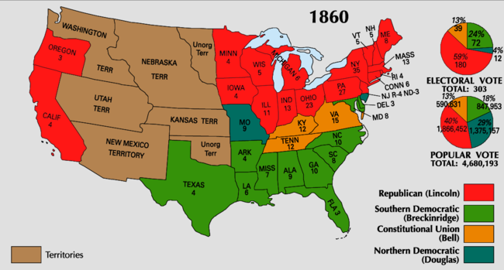
Available Electoral College Votes:
Non-slaveholding North (Including CA): 183
Border South: 32
Middle South: 41 Total Slaveholding South: 120
Deep South: 47
Notes:
South still had majorities in the Supreme Court and Democrats (states’ rights supporters) still had advantage in the House of Representatives.

Slide 26
Southern Secession
Secession Convention held - “Republic of South Carolina” is declared on Dec 20th, 1860.
Question: Can a state legally secede?
Response:
Buchanan’s response - Believed the south couldn’t constitutionally succeed, but…
Lame Duck president and surrounded by pro-slavery advisors – therefore ineffectual.
Last attempt at compromise…Crittenden Compromise- Guaranteed protection south below 36-30 and allow expansion above the line (by popular sovereignty).
Lincoln rejects it!

Slide 27
South Carolina Order of Secession
For twenty-five years this agitation has been steadily increasing, until it has now secured to its aid the power of the common Government. Observing the forms of the Constitution, a sectional party has found within that Article establishing the Executive Department, the means of subverting the Constitution itself. A geographical line has been drawn across the Union, and all the States north of that line have united in the election of a man to the high office of President of the United States, whose opinions and purposes are hostile to slavery. He is to be entrusted with the administration of the common Government, because he has declared that that "Government cannot endure permanently half slave, half free," and that the public mind must rest in the belief that slavery is in the course of ultimate extinction.

Slide 28
Secession Continued
By Feb 1861 - 6 other states had seceded (Fl, Ga, Ms, Al, La, Tx).
Seized all federal property within their boundaries - Forts, arsenals, govt. offices, etc.
Formed Confederate States of America ( Jefferson Davis elected as President).
Montgomery, Al - capital (later moved to Richmond, VA).
March 1861 – Lincoln enters the oval office…NOW WHAT!?
Stay Tuned!

Slide 29
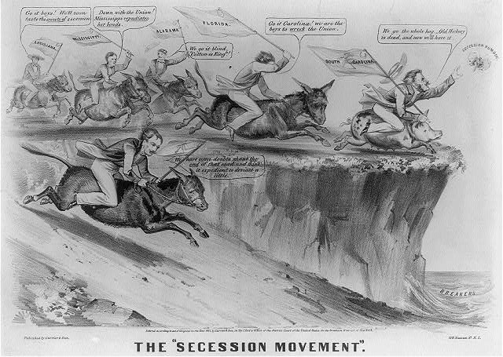

Slide 30
