Slide 1
Let our government be like that of the solar system. Let the general (national) government be like the sun and the states the planets, repelled yet attracted, and the whole moving regularly and harmoniously in their several orbits.
John Dickinson, 1787

Slide 2
5. Governing the New Nation-The Articles of Confederation
Mr. Winchell
APUSH 2019-2020
Period 1-2

Slide 3
AP Prompt
Evaluate the extent to which the Articles of Confederation provided an effective system of governance in the new United States during and after the Revolutionary War.

Slide 4
Outline
State Governments and Localized Power
The Structure of the Articles of Confederation
Successes Under the Articles
Shortcomings Under the Articles
Shays’ Rebellion and Consequences

Slide 5
Thought Question…
Liberty vs. Order
If you have too much liberty, then you have…
If you have too much order, then you have…

Slide 6
The war is over, now what?
“Which one of us should be the rulers?”
-Philadelphia newspaper during the war

Slide 7
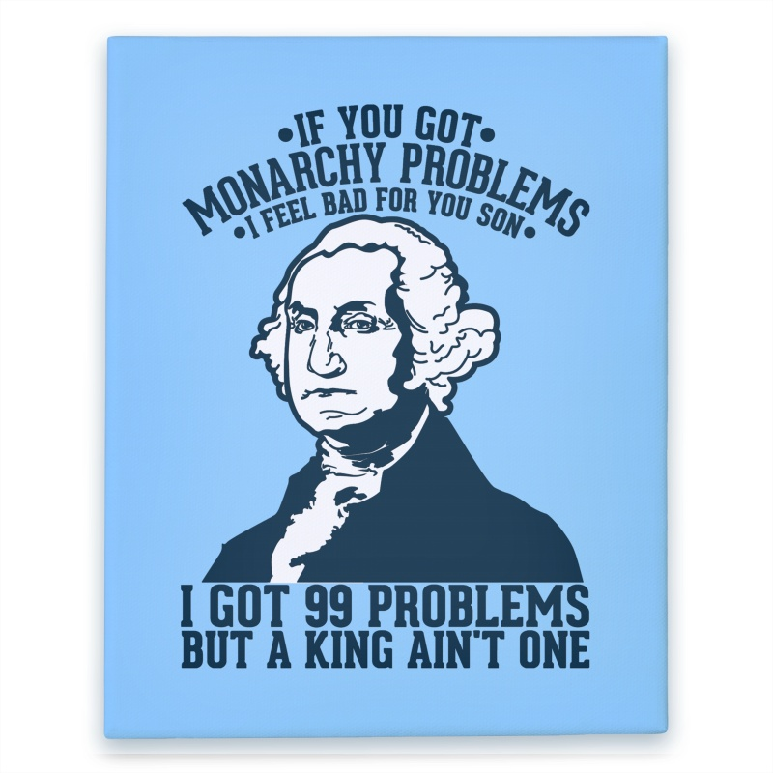

Slide 8
Changes to American Society
Blacks demanded the right to freedom in petitions & lawsuits
The American Revolution led to unintended social changes by forcing many Americans to question the meaning of “equality”
Many wanted to eliminate the idea of an American aristocracy
Fighting British tyranny made slavery seem hypocritical; Abolitionist sentiment grew
Women gained increased status
Many states lowered property qualifications to vote; but none offered universal male suffrage
Franklin, Jay, Hamilton founded abolition societies; Washington manumitted his slaves
VT, PA, MA abolished slavery
“Republican Motherhood”—mothers should instill virtue in their children
Most states clearly separated church & state
Notes:
In North, slavery not economically necessary; immigrants resented competing against slave labor
VT, PA slavery was abolished; in MA slavery “unconstitutional”
But…freed blacks discriminated
In South, some slave owners privately free slaves, but economic motives too powerful (plantations, cotton gin in 1793, & opening of AL & Miss frontier)

Slide 9
Forming New Governments
When independence was declared from England in 1776, colonists considered themselves a new nation & needed a new gov’t:
Colonies became individually sovereign states governed by written state constitutions
A national gov’t was needed to provide basic services like sign treaties & develop a military
In 1776, the American Revolution has just started; The colonists did not wait to gain British recognition of their independence before creating new governments!

Slide 10
States Constitutions
In 1776, the new states created written constitutions which:
Clearly defined the citizens’ rights & the limits of government
Guaranteed natural rights; Eight states had bills of rights
Almost all states reduced the powers of the governor & kept most power in the hands of the people via state legislatures
Notes:
7

Slide 11
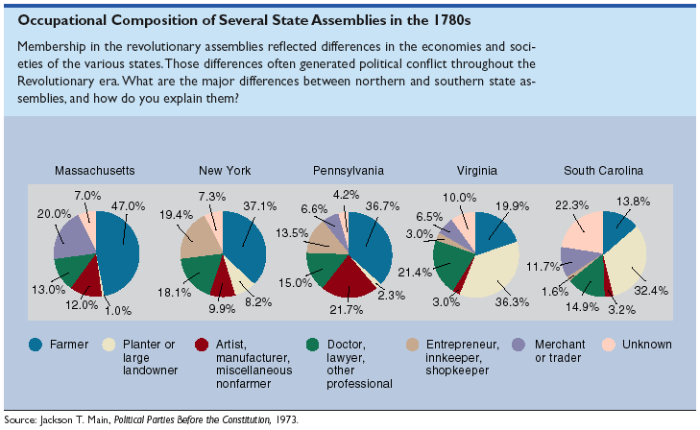
Pennsylvania
Pennsylvania Constitution of 1776
Unicameral Legislature
One house with complete power.
No governor
Elementary education provided by state gov.
NO property requirement to serve
John Adams: “TOO MUCH DEMOCRACY!”

Slide 12
Text Analysis
John Adams-Thoughts on Government

Slide 13
Thoughts on Government-Adams
In response to state governments, Adams publishes his thoughts in 1776:
3 branch government (what a concept…)
2 houses in the legislature
Judiciary appointed, not elected.

Slide 14
Defining Republican Culture
But, creating a national gov’t that met everyone’s needs was hard:
How to balance individual liberty with maintaining order?
How to balance property rights with equality?
How to create a centralized gov’t without creating a new tyrannical authority?
Notes:
2

Slide 15
Articles of Confederation
Outset of the war, 2nd Continental Congress urged states to create their own constitution.
“Oppose everything that leans to aristocracy or power in the hands of the rich”

Slide 16
Articles of Confederation
The Articles of Confederation was adopted as America’s 1st national gov’t in 1777 (but ratified in 1781)
The Articles established an intentionally weak central gov’t in order to protect state power
The confederation-style gov’t gave all 13 states 1 vote in a unicameral congress
There was no national president
Each state was treated as a pseudo-nation
Too similar to a monarch
Notes:
The war is still going on (will not end until 1781 with Cornwallis surrender & 1783 Treaty of Paris)

Slide 17
America after the Revolution
Local ties remain predominant.
Most Americans still consider themselves as citizens of their states, not as Americans.
Belief that the sovereignty of the state was more important than that of the power of the central government.
Would prove to be a problem later.

Slide 18
The Articles of Confederation
The Articles were created to loosely tie the states together
The only powers granted to the national government were to
Settle disputes between states, negotiate treaties, handle Indian affairs, oversee a military
It could not tax citizens or states; could only request contributions
Laws required 9 of the 13 states
Amending the gov’t required agreement by all 13 states
“A firm league of friendship”

Slide 19
Major Features of the Articles

Slide 20
Weaknesses of the Articles
Provided a weak national government
Congress had no power to tax or regulate trade between the states
Provided for no common currency (money)
Gave each state one vote, regardless of size/pop
Provided for no executive or judicial branches (no president or national court system)

Slide 21
Successes of the Articles of Confederation
Land settlement in the Northwest Territory was the only real success of the AoC.
Land Ordinance of 1785
Since the govt could not tax, it needed a source of $$$.
Sold land to settlers west of the Appalachians, used the $$ to run govt.
Northwest Ordinance - 1787
Opened up the Northwestern territories to settlement
Established the process for territories to become states (leg. Assembly 1t 5,000, state at 60,000)
Banned slavery in those territories and made the Ohio River the dividing line between free and slave states.
‘No less than 3, no more than 5 new states’

Slide 22
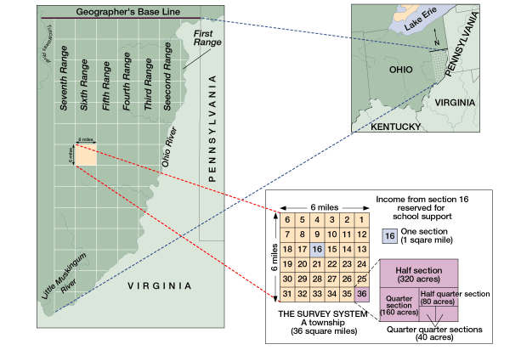

Slide 24
Northwest Territory Legislation
Significance: Allowed for orderly settlement of western territories.
Not colonies!
Pros: Outlawed Slavery, allowed for education, created systems for democracy.
Cons: Created a dividing line between slaves and non-slave states, invalidated Native American claims to the land.

Slide 25
Economic Problems
During the American Revolution, colonial boycotts hurt trade
Everyone expected the economy to improve after independence, but the Confederation Congress had a difficult time:
Paying off debt & collecting taxes
Halting inflation
Generating a favorable balance of trade (foreign & domestic)
Notes:
14

Slide 26
Debt, Taxes, & Inflation
The gov’t could request, but not require, states to send money to Congress
The U.S. was burdened with $40 million in war debt in 1783:
The Confederate Congress could not ease the national debt because it had no power to tax
Congress printed $200 million in new currency to pay off debt but this led to massive inflation
Creditors demanded repayment of debts at market value

Slide 27
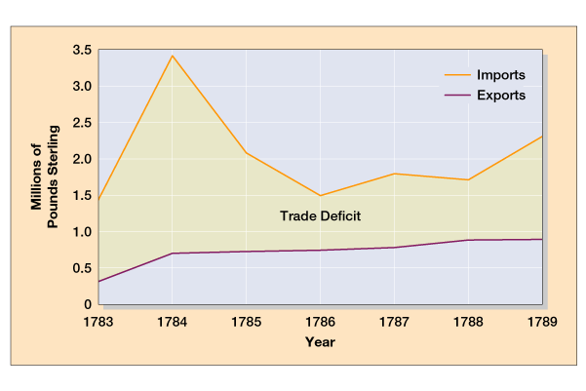
U.S. Trade with Britain, 1783-1789
America could not pay off debts from the Revolutionary War
Debt

Slide 28
Trade Problems under the Articles
Connecticut levied heavier duties on Massachusetts goods than on British goods
Congress was unable to create a favorable balance of trade:
To raise revenue, states created tariffs on goods from other states
The lack of hard currency made trade difficult
Desire for cheap British goods hurt infant American industries
England prohibited its Caribbean colonies from trading with USA
This especially hurt the North
This especially hurt Southern planters

Slide 29
Foreign Policy Problems
Congress & the army were too weak to resist
The Articles proved inadequate to handle interstate & foreign affairs:
When Americans did not repay legitimate war debts, Britain kept troops in the Ohio Valley
Spain refused to recognize the southern U.S. border & closed access to the Mississippi River
Algerian pirates attacked & enslaved American merchants
States argued over river rights
John Jay’s Jay-Gardoqui Treaty was met with regional resistance & was rejected in Congress
Notes:
16

Slide 30
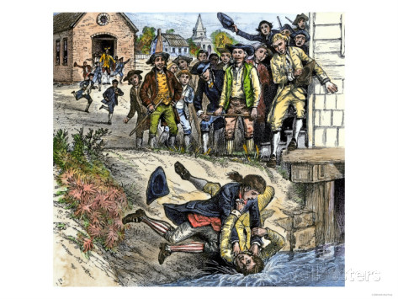
Shays’ Rebellion (1786-1787)
Massachusetts farmers in serious debt
Held meetings protesting “tyrannical Mass. government”
Daniel Shays led 2,000 men to shut down western courts to avoid foreclosures
Virtual civil war in Massachusetts led to Annapolis Convention
Tensions rise
Jay-Gardoqui Treaty
Spain’s rights to Mississippi River
New England’s depression
Mercantilist policies
Foreign manufacturing competition
States refusing/unable to pay debts
Weak defenses

Slide 31
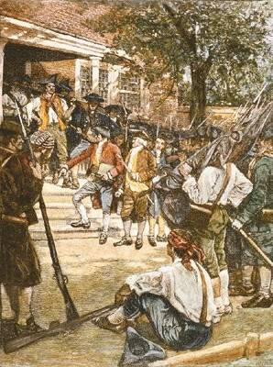
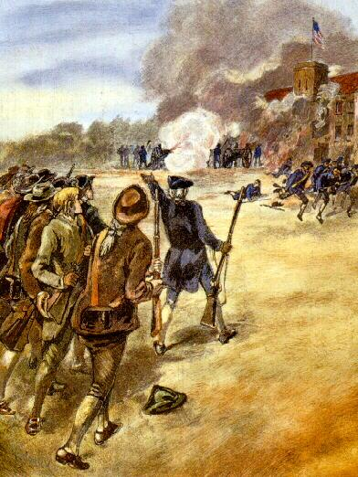
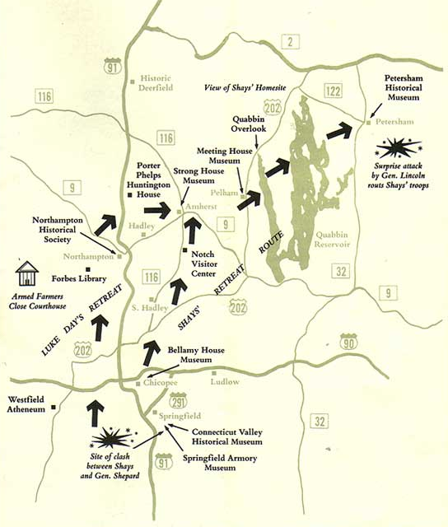
Shay’s Rebellion in Western Massachusetts
Poor farmers in western MA were angered over high taxes & prospect of debtors jail
Daniel Shays led an uprising & closed debt courts & threatened a federal arsenal
Notes:
In 1786, nearly 2,000 debtor farmers in western Massachusetts were threatened with foreclosure of their mortgaged property. The state legislature had voted to pay off the state's Revolutionary War debt in three years; between 1783 and 1786, taxes on land rose more than 60 percent. Desperate farmers demanded a cut in property taxes and adoption of state laws to postpone farm foreclosures. The lower house of the state legislature passed relief measures in 1786, but creditors persuaded the upper house to reject the package.
When lower courts started to seize the property of farmers such as Daniel Shays, a Revolutionary War veteran, western Massachusetts farmers temporarily closed the courts and threatened a federal arsenal. Although the rebels were defeated by the state militia, they were victorious at the polls. A new legislature elected early in 1787 enacted debt relief.
By the spring of 1787, many national leaders believed that the new republic's survival was at risk. The threat of national bankruptcy, commercial conflicts among the states, Britain's refusal to evacuate military posts, Spanish intrigues on the western frontier, and armed rebellion in western Massachusetts underscored the weaknesses of the Articles of Confederation. The only solution, many prominent figures were convinced, was to create an effective central government led by a strong chief executive.

Slide 32
How to Fix This?
A delegation meeting was called at Annapolis to discuss the weaknesses of the Articles.
Only 12 delegates from 5 states showed up and nothing was accomplished.
The failure of the Annapolis Convention prompted Alexander Hamilton to call for another convention to be held in Philadelphia in 1787 to discuss amending the Articles.
(This convention would lead to the writing and signing of the Constitution.)

Slide 33
Economic Problems
“Nationalists” called for a stronger central gov’t & a constitutional amendment to allow create a 5% import tax & a national bank
12 states agreed, but a group of Rhode Island “Localists” refused & killed the amendment
The failure to reform the Articles led Nationalists to consider the Articles hopelessly defective
Led by Alexander Hamilton,
James Madison, & Robert Morris
“A national debt if not excessive, will be a national blessing”—Hamilton
Notes:
15

Slide 34
Toward a Constitution
Annapolis Convention (1786)
After a meeting run by Washington, delegates from five states meet in Maryland to discuss interstate commerce
Decide to reform Articles with other delegates
Constitutional Convention at Philadelphia
All states but Rhode Island
Held in secrecy
Common nationalist viewpoint
Reform Articles or devise new government altogether?
The Delegates
55 total delegates; all white males
Mostly wealthy, middle-aged, professional (especially lawyers or politicians)
19 delegates owned slaves
George Washington, Alexander Hamilton, James Madison, Benjamin Franklin

Slide 35
“Have We Fought for This?”
“Have we fought for this? Was it with these expectations that we launched into a sea of trouble?”
—George Washington, 1785

Slide 36
AP Prompt
Evaluate the extent to which the Articles of Confederation provided an effective system of governance in the new United States during and after the Revolutionary War.

