Slide 1
Do Now
I consider, then, the power to annul a law of the United States, assumed by one State, incompatible with the existence of the Union, contradicted expressly by the letter of the Constitution, unauthorized by its spirit, inconsistent with every principle on which it was founded, and destructive of the great object to which it was formed. - Andrew Jackson

Slide 2
5. Jackson and Nullification
Mr. Winchell
APUSH 2019-2020
Period 4

Slide 3
AP Prompt
Evaluate the extent to which Jackson’s response to nullification demonstrate conflict in state vs. federal authority.

Slide 4
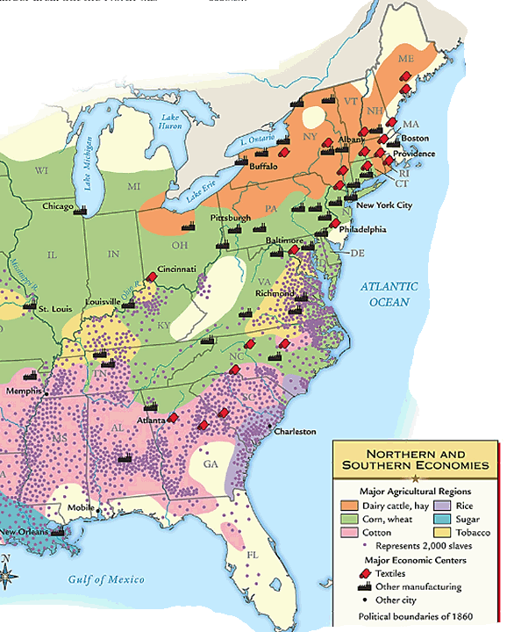
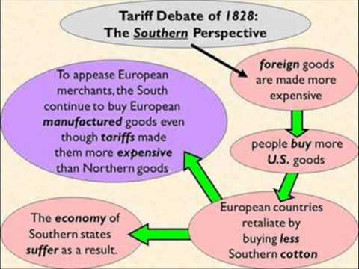
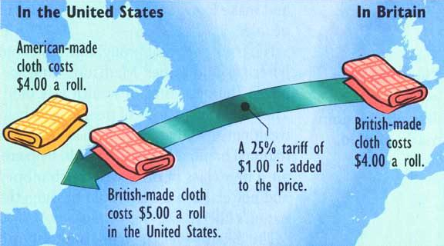
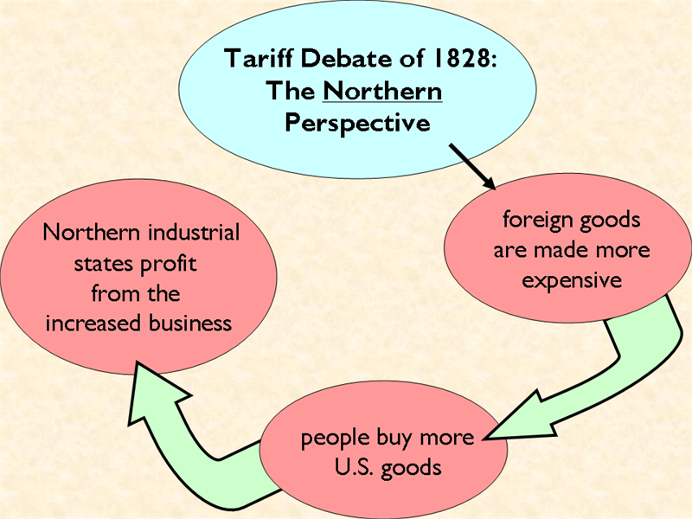
By the late 1820s and 1830s, sectionalism was becoming more obvious, especially over the issue of tariffs
Northern states favored tariffs because they profited when people bought more American-made goods

Slide 5
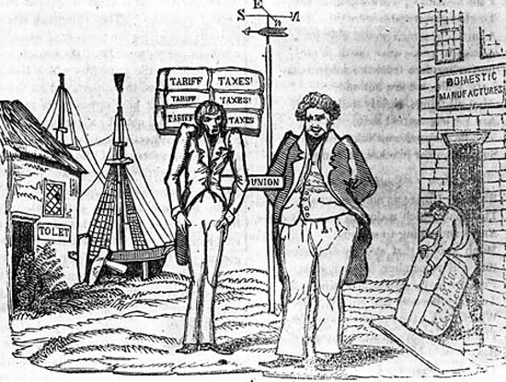

Slide 6
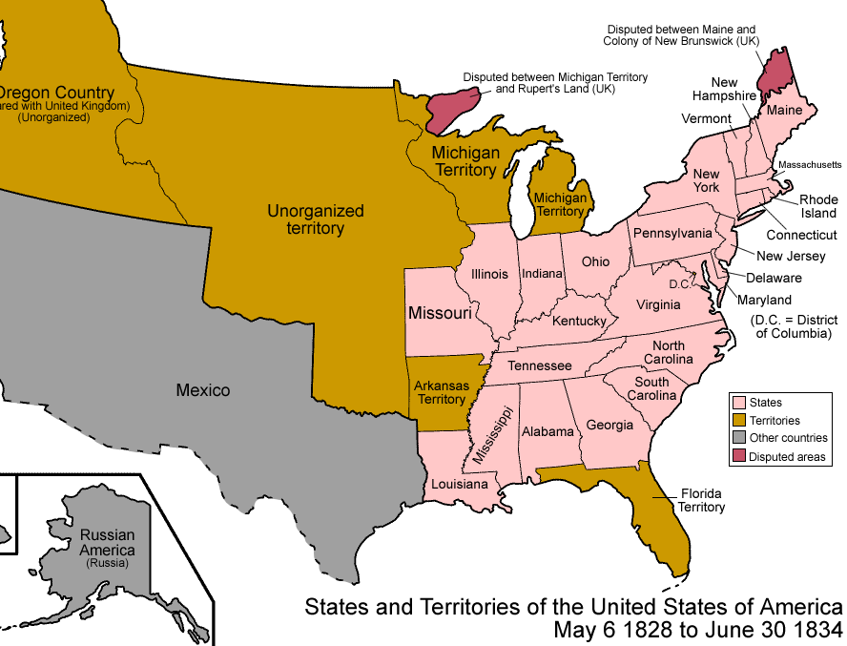
The tariff debates among the North, South, & West increased sectional rivalries in the 1830s
In 1829, a NE Congressmen introduced a bill to slow western land sales (this bill was really an effort to keep NE’s power in Congress from slipping)
Daniel Webster (MA) countered: “Liberty & Union, now & forever, one & inseparable”
Robert Hayne (SC) proposed nullification & an alliance between South & West against NE
This bill led to sectional tensions, culminating in the Webster-Hayne Debate in 1830
“Liberty first & Union afterwards”
Notes:
Daniel Webster of Massachusetts answered Hayne in one of the most famous speeches in American history. The United States, Webster proclaimed, was not simply a compact of the states. It was a creation of the people, who had invested the Constitution and the national government with ultimate sovereignty. If a state disagreed with an action of the federal government, it had a right to sue in federal court or seek to amend the Constitution, but it had no right to nullify a federal law. That would inevitably lead to anarchy and civil war. It was delusion and folly to think that Americans could have “Liberty first and Union afterwards,” Webster declared. “Liberty and Union, now and forever, one and inseparable.”

Slide 7
Webster-Hayne Debate
Daniel Webster presented one of the most significant arguments against states’ rights & nullification
The U.S. was more than just a compact of states…it was a creation of the people
The Constitution gave the national gov’t ultimate power & supremacy over the states
Nullification would lead to anarchy & civil war

Slide 8
Text Analysis
Webster-Hayne Debates

Slide 9
The Nullification Crisis
Southerners hated tariffs for 2 main reasons: tariffs increase the costs of foreign industrial goods (which are usually cheaper than those made in America) so goods are more expensive AND countries reciprocate with high tariffs on American cotton
By 1820, the South was anxious about federal powers over states:
VP Calhoun became the defender of “states’ rights”
He wanted to protect slavery & hated industrial protective tariffs
After the Tariff of 1828 passed, the South affirmed nullification (the right of an individual state to ignore federal laws)
Calhoun (SC) led the argument for nullification in Exposition & Protest in 1828 to protect Southern rights against Northern self-interest

Slide 10
Nullification Crisis over Tariff of 1828 and 1832
Many in South Carolina viewed the “Tariff of Abominations” as a wedge for federal interference
Updated Tariff of 1832 fell short of meeting Southern demands for lower rates
Touched off new nullification crisis
Notes:
The Tariff of Abominations continued to rankle hot-blooded South Carolinians
They saw it as not only being economically damaging in the short run, but also as a possible wedge for later federal interference with slavery in the Southern states
The nullifiers -known as “nullies” - tried strenuously to muster the necessary 2/3 vote for nullification in the South Carolina legislature
The measure was blocked by a minority of Unionists who were scorned as “submission men”
Congress touched off the fuse of this bomb by passing the Tariff of 1832
The measure failed to lower rates to levels demanded by the South
The measure did pare away the worst of the “abominations” of 1828, and it did lower the imports to about the level of the more moderate Tariff of 1824
A 10% reduction to roughly 35% duties
The law was still protective and to the South, it suggested a permanent condition.
Nullies in SC were ready for drastic action.

Slide 12
Jackson’s Reaction
Jackson prepared to respond with force
South Carolina initially refused to back down
If no compromise was reached, it would mean civil war
Notes:
President/General Jackson reacted to the South Carolina convention in anger.
Hating Calhoun and pledging to uphold the Union, Jackson privately threatened to hang the nullifiers.
He dispatched modest naval and military reinforcements to SC and quietly put together a sizable army.
He issued a proclamation against nullification
I consider, then, the power to annul a law of the United States, assumed by one State, incompatible with the existence of the Union, contradicted expressly by the letter of the Constitution, unauthorized by its spirit, inconsistent with every principle on which it was founded, and destructive of the great object to which it was formed. - Andrew Jackson
SC governor Robert Hayne responded with a counter-proclamation asserting South Carolina’s rights.
In order to avoid a civil war, one side would have to surrender, or both would have to compromise.

Slide 13
The Compromise Tariff of 1833
Brokered by Sen. Henry Clay (KY)
Known as the “Olive Branch and the Sword”
Gradually reduced rates by 10% over 8 years - addressing SC demands
Hotly debated but passed 2/20/1833
The face-saving “Force Bill” by Congress
Authorized force to collect duties
SC able to back away with dignity
Notes:
Clay an old foe of Jackson who had no desire to see his old enemy win new support by crushing the Carolinians and getting Calhoun’s head.
Clay used his influence to broker a compromise bill that would gradually reduce the Tariff of 1832 by about 10% over a period of 8 years.
That would lower the rate to the mildly protective level of the 1816 tariff - about 20% to 25% on the value of dutiable goods.
The measure squeezed through Congress after bitter debate.
Strongest opposition came from New England
Calhoun and the Southern states favored the compromise so Jackson would not have to use guns and ropes in SC
In a face-saving move, Congress passed the Force Bill (AKA in the South as the Bloody Bill), authorizing the President to use the army and navy, if necessary, to collect federal tariff duties
Militant South Carolinians welcomed the opportunity to get out trouble without losing face
No other Southern state had come to their defense, though VA & GA thought about it
The Unionist minority in SC was prepared to go to civil war over the issue
Faced with civil war and invasion by the feds., the Columbia Convention met again and revoked the ordinance of nullification, though not without proclaiming the unnecessary Force Bill nullified.

Slide 14
Jackson and the ideal of Union
Though a Westerner (and States’ Rights advocate) himself, Jackson was a Unionist
He was a foe of nullification
He would soon be willing to use force, if necessary, to preserve the Union
Notes:
Old Hickory was strangely silent on the Southern Grievances
States rights leaders, at a Jefferson Day banquet in 1830, hoped to get Jackson to come out publicly on the side of nullification
They proposed a series of toasts to Jefferson - a longtime foe of centralization - that would lean toward states’ rights and nullification
They thought Jackson the Southerner would speak out for states’ rights
Jackson was forewarned about the plan and carefully prepared his response
He waited for the proper moment then rose to his feet, stood straight upright, fixed his eyes on Calhoun (their relationship now strained) and dramatically proclaimed, “Our Union: It must be preserved!”
The Southerners were stunned - Calhoun weakly replied, “The Union, next to our liberty, most dear!”
Party over!
In two years time, Jackson would use the threat of force to rein in the states

