Slide 1
The 2nd Great Awakening
Mr. Winchell
APUSH
Period 4

Slide 2
Importance of Popular Religion in America
In France, I had almost always seen the spirit of religion and the spirit of freedom pursuing courses diametrically opposed to each other; but in America, I found that they were intimately united, and that they reigned in common over the same country… Religion was the foremost of the political institutions of the United States.
-- Alexis de Tocqueville, 1832

Slide 3
Essential Questions
How did 19th century religious and reform movements redefine American concepts of freedom, equality and morality?
How successful were these movements?
What role did women play?

Slide 4
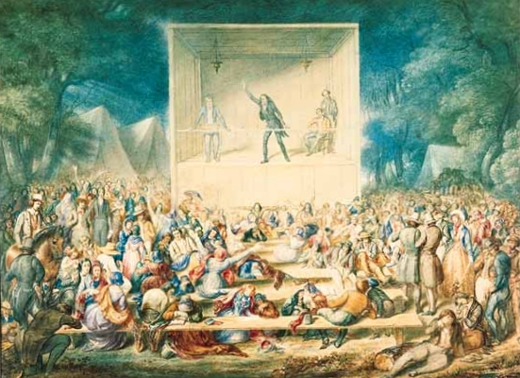
Second Great Awakening
New York frontier
Protestant revivalism
Religion for the common man
Encouraged moralistic reform

Slide 5
Big Picture
1st Great Awakening-reaction to Enlightenment
2nd Great Awakening-reaction to Market Revolution & Deism
2nd Great Awakening leads to REFORM MOVEMENTS
Prison
Temperance
Women’s Rights
Slavery
Abolition

Slide 6
Reviving Religion
Religion in the 1790-1860:
Church attendance was still a regular ritual with ¾ of the 23 million Americans in 1850
Alexis de Tocqueville declared there was “no country in the world where the Christian religion retains a greater influence over the souls of men than in America.”
“Religion is the most important political institution in America”
Yet religion of these years was not the old-time religion of colonial days:
Austere Calvinism was seeping out of the American churches

Slide 7
Reviving Religion
2nd Great Awakening inspired Americans to ‘battle evils.’
Puritan vision of a perfected society: no cruelty, war, ‘intoxicating drink,’ discrimination, and slavery
Women played a key role in reform movements: could escape the confines of the home
Other changes in society:
Prison reform, imprisonment for debt, mental health reform (DOROTHEA DIX!)
Notes:
Lot of similarities. First GA didn’t inspire reform movements, second one did

Slide 8
Reviving Religion
Charles Grandison Finney was the greatest of the revival preachers:
Had a deeply moving conversion experience
Led massive revivals in Rochester and New York City in 1830 and 1831
He preached a version of the old-time religion, but he was also an innovator:
He devised the “anxious bench” where repentant sinners could sit in full view of the congregation
He encouraged women to pray aloud in public
He denounced both alcohol and slavery
He served as president of Oberlin College in Ohio, where he helped to make a hotbed of revivalist activity and abolitionism.

Slide 9
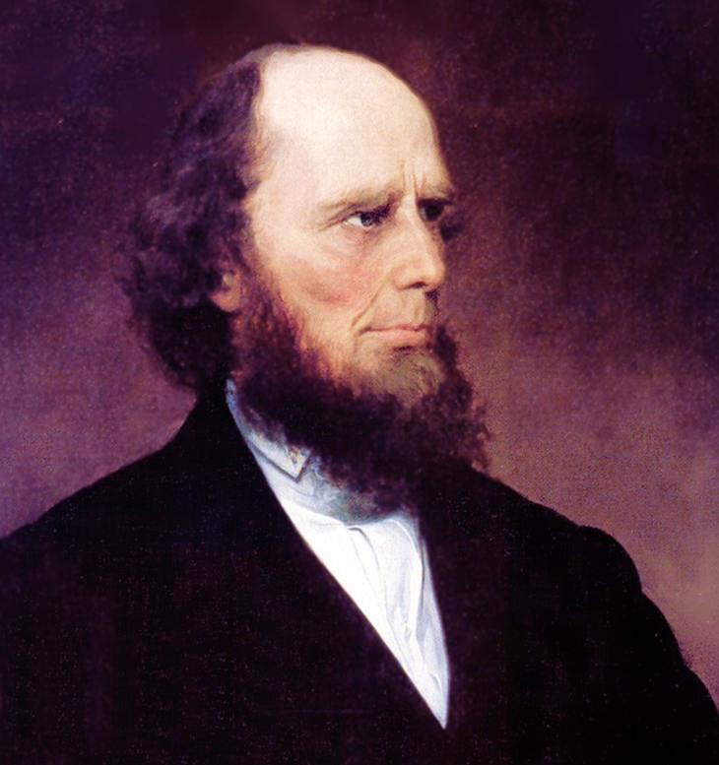
Charles G. Finney
Traveling revivalist preacher

Slide 10
Reviving Religion
A key feature of the Second Great Awakening was the feminization of religion, both in church membership and theology:
Middle-class women were the first and most fervent enthusiasts of religious revivalism

Slide 11
Denominational Diversity
Religious diversity reflected social cleavages facing the slavery issue:
By 1844-45 the southern Baptists and southern Methodists split with their northern brethren
In 1857 the Presbyterians, North and South parted company
The secession of the southern churches foreshadowed the secession of southern states
First the churches split, then the political parties split, and then the Union split.

