Slide 1
Social & Cultural Developments of the Gilded Age
Mr. Winchell
APUSH
Period 6

Slide 2
Civil Rights
Populism
Roots of Progressivism
Social Reform
Social Darwinism
Gospel of Wealth
Urban Reform
Women
Political Response to Industrialism

Slide 3
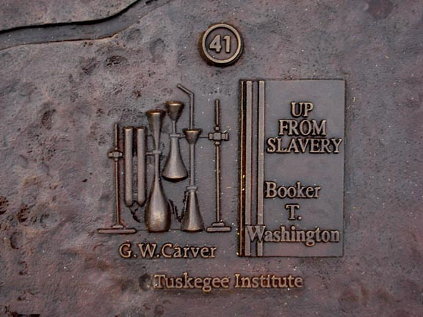
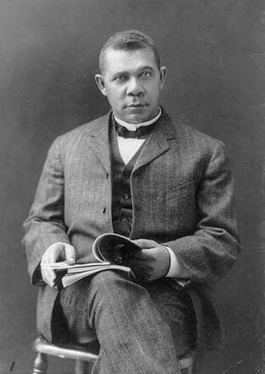
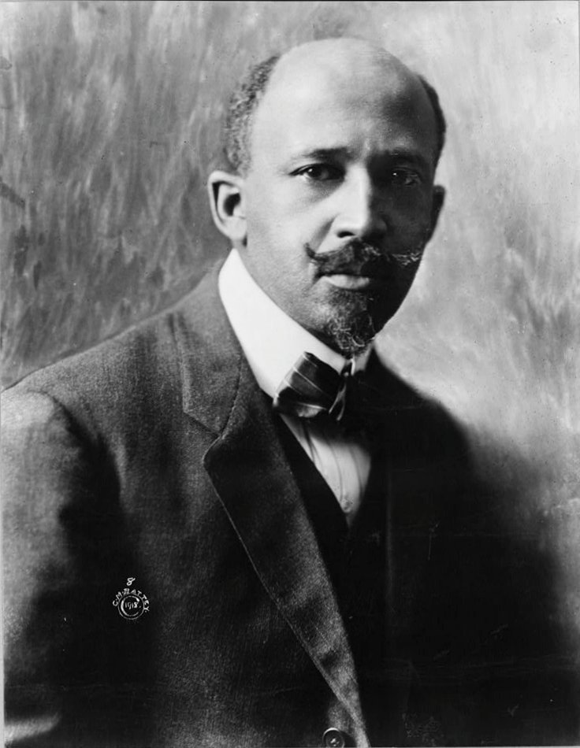
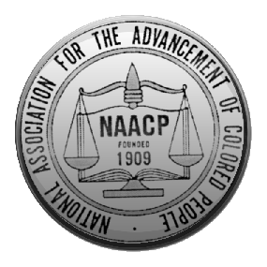
New Civil Rights Leaders
Ida Wells – Teacher and editor wrote about the violence against Afams – Nationwide Lynching (1882-1892 1400 killed)
The Great Migration of A-A’s to the NE cities - just as bad as the south (New York City Race Riot of 1900)
Booker T. Washington - Created the Tuskegee Institute to train AA’s in technical skills.
Gave the Atlanta Compromise Speech (AA’s would be happy living by the “production of their hands”).
Believed in technical education for ALL AA’s providing gradual, positive change.
WEB Dubois - Created the National Association for the Advancement of Colored Peoples (NAACP) and
Wrote a newspaper called The Crisis to educate about injustices.
Believed in the “talented tenth” education in liberal arts to stop oppression quicker.

Slide 4
New Movements: Education, Media, Art, Literature
Universities – 1180-1920 - 4X the applicants.
African American Universities – Howard and Fisk Universities.
Women in higher attendance – new reformers in training!
Public education - Secondary schools, Education in the South, Kindergarten created.
Museums and Libraries grew – “Poor Man’s University”
Fiction books – Mark Twain (Huck Finn and Tom Sawyer) and Dime Novels (Deadwood Dick).
Charles Darwin – theories of evolution and “survival of the fittest” – challenged Christian ideals.
Pragmatism – experiential learning and practice to create best outcomes.
Dewey – education, William James – lab psychology.
Newspapers – Joseph Pulitzer (NY world) vs. William Randolph Hearst (NY Morning Journal) – exaggerated the news – Yellow Journalism

Slide 5
New Movements: Morality & Women
Remember those middle class, educated women…they start to get politically active!
Women in the Workforce - Factories hiring more women – conditions are bad!
Start protesting these conditions – but remember, they can’t vote…
Leads to the resurgence of the Suffrage Movement – creation of the National American Woman Suffrage Association (NAWSA)
Leaders: Susan B. Anthony and Carrie Mott
Conditions in the slums = more unhappiness = more alcohol consumption = more domestic violence.
Creation of the Women’s Cristian Temperance Union (WCTU)
Carrie Nation – would carry hatchet and smash saloons bottles/bars.

Slide 6
Women & Urban Reform
Social Gospel
Religious duty to help assist the poor/immigrant population
Settlement Housing
Health care
Education
Job assistance
English
Culture
ALL DUE TO EDUCATED AND RELIGIOUS MIDDLE TO UPPER CLASS WOMEN

Slide 7
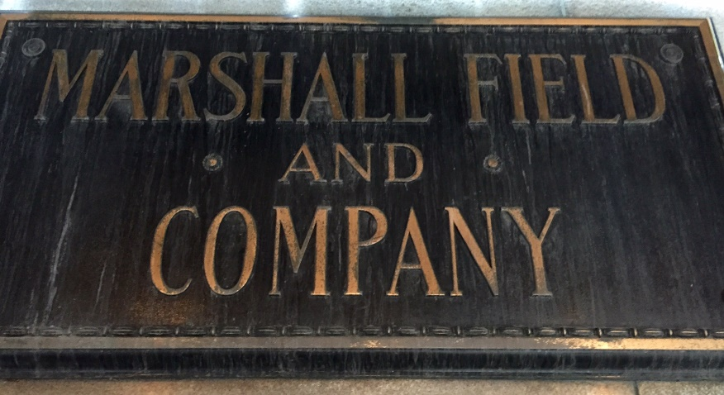
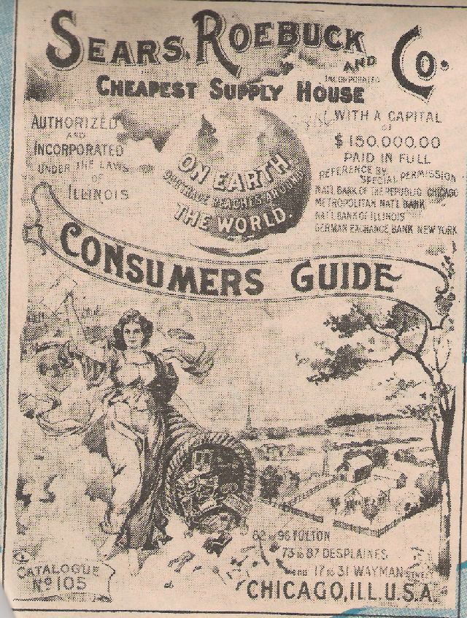
New Movements: Consumerism
Shopping Centers (Cleveland, OH) and Dept. Stores (Marshall Fields of Chicago).
Motto - “Give the Lady what she wants” and “bargain basement”
Chains – FW Woolworth’s – “only a nickel” slogans.
Advertising – 1865 - 10M to 1900 – 95M (painted them on houses and barns, newspapers, magazines, etc.)
Mail order Catalogs – retail to small towns – Montgomery Ward and Sears (used Rural Free Delivery).
Bring the city to the country!
Made Chicago a consumerism mecca!
Ex: Sears tower!/Largest post office in the world!

Slide 8
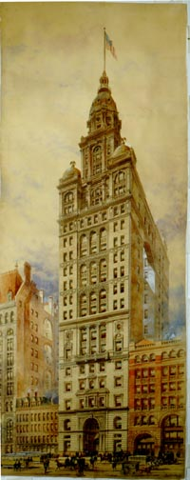
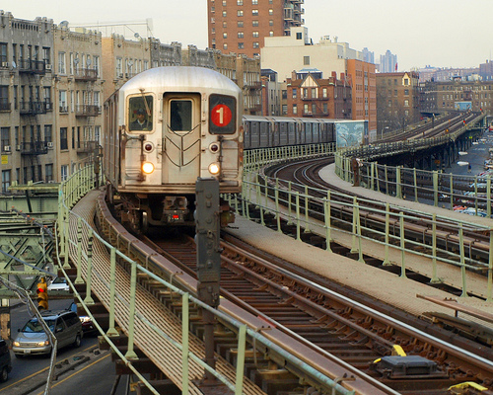
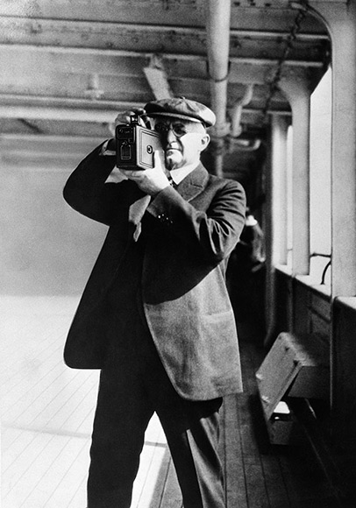
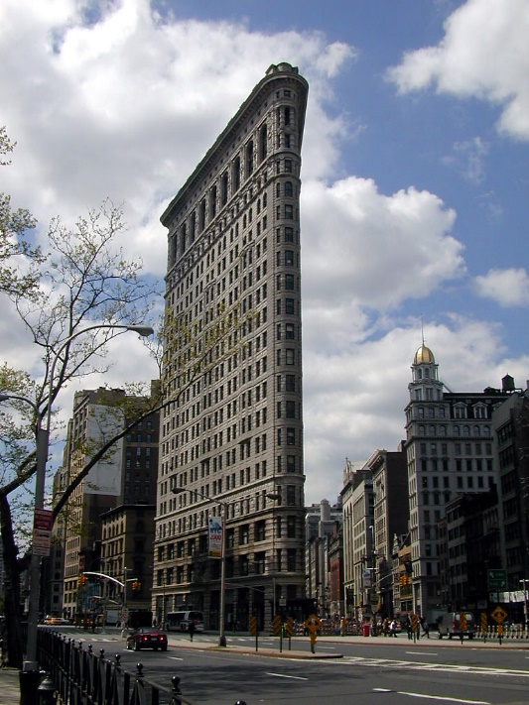
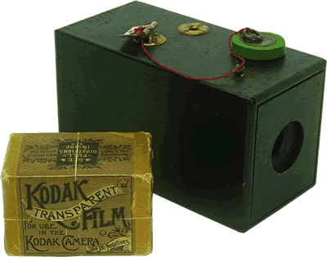
Urban Improvements
New City Life Technology
Skyscrapers – by Louis Sullivan (Wainwright Building).
Also Daniel Burnham – Flat Iron Building - Created the need for the elevator.
Electric Streetcars (trolleys), EL Trains, and Subways.
Suspension bridges – Brooklyn Bridge!
Urban Parks – Fredrick Law Olmstead – Greensward or Central Park (City Beautiful Movement).
George Eastman – creation of amateur, leisure photographers and photojournalists.
Kodak camera (25$ for camera and 100-picture roll of film; 10$ for development).

Slide 9
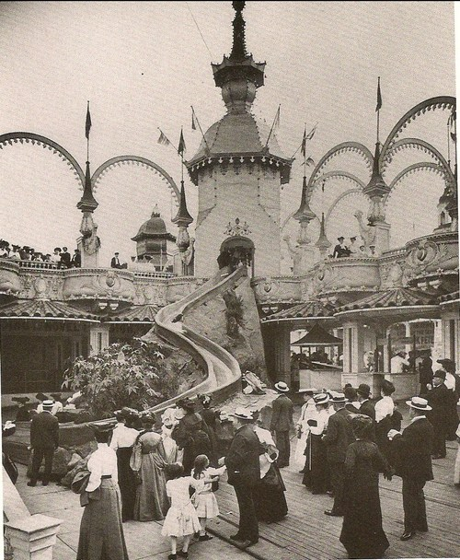
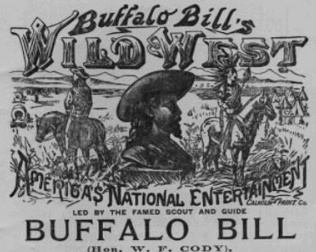
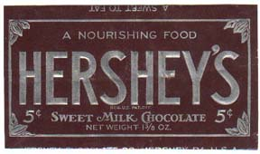
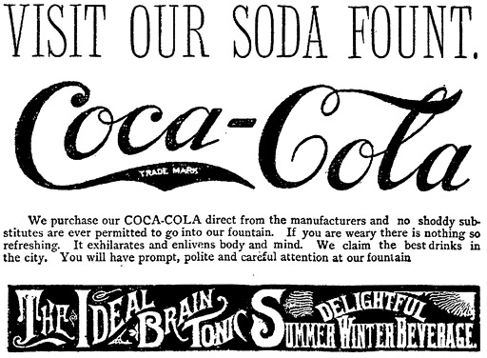
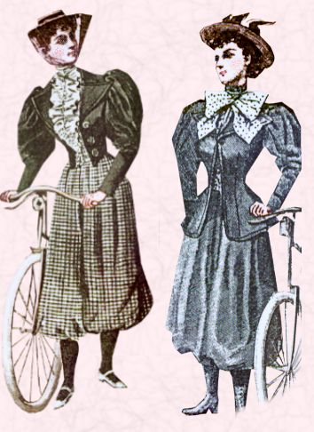
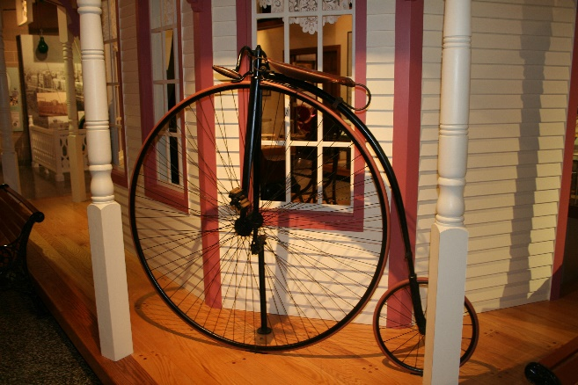
Leisure in the Cities
Amusement Parks – Coney Island in 1884 (first Ferris wheel).
PT Barnum created the “Greatest show on Earth” Circus.
Wild west shows were very popular (Buffalo Bill’s Wild West Show with Annie Oakley, etc.).
Bicycling (safety bicycle) and Tennis – allowed women to participate actively.
Gained a sense of independence and freedom.
Changed clothing (split skirts and shirtwaists).
Revolutionized the life of the middle class woman!
Hershey’s and Coca-Cola (originally for headaches – made of Peruvian coca leaves and cola nuts).
Spectator Sports – Baseball (called Rounders by Alex Cartwright) and Boxing.

Slide 10
Farmers
Grange:
Early social/educational movement
Farmer’s Alliance/Colored Farmers National Alliance
More political, less social
Candidates for office
State legislatures/reps to Congress in 1890s
Leads to Populist Party
True ‘People’s’ Party (3rd)
Hostile to McKinley Tariff and farmer/labor issues
Anti industrial/financial trusts

Slide 11
Populists (1892)
Nationalization of the railroad
Low tariff
Government owned warehouses for crops
More gov. control of economy
Direct election of Senators
Treasury purchase of silver for backing of money (gov. created inflation)
Panic of 1893 heightened this issue
Democrats who supported Silver moved to Populist Party
Election of 1896-Democrats and Populists supported same candidate: William Jennings Bryan

Slide 12
Cross of Gold Speech
Having behind us the producing masses of this nation and the world, supported by the commercial interests, the laboring interests and the toilers everywhere, we will answer their demand for a gold standard by saying to them: You shall not press down upon the brow of labor this crown of thorns, you shall not crucify mankind upon a cross of gold.
William Jennings Bryan

Slide 13
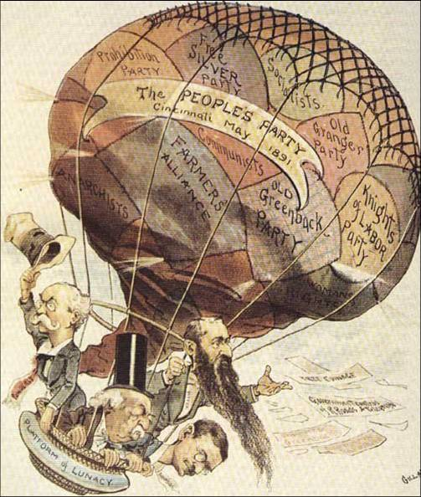

Slide 14
Election of 1896

Slide 15
Election of 1896
McKinley (Republican) defeats WJB (Democrat-Populist) 271-176.
Republicans would control the White House for most of next 30 years.
Populism disappears but platform lives on in Progressives.
McKinley’s platform for industrial growth lives on, but he’s assassinated.
Teddy!

Slide 16
Period 6:
Politics and Power
Work, Exchange, Tech
Migration and Settlement
Culture and Society
Gilded Age/Patronage
Presidents – generally ineffective
- Grant
- Credit Moblier Scandal
- Panic of 1873
- Garfield/Arthur
- Assassination
- Pendleton Civil Service Act
- Cleveland
- Billion Dollar Congress
- Interstate Commerce Act
- Sherman Anti-Trust Act
Political Machines
- Boss Tweed/Tammany Hall
- Thomas Nast
Monopolies and Robberbarons
- Vanderbilt and RR’s
- Carnegie and Steel
- Rockefeller and Standard Oil Co.
- Trusts, Mergers, Horizontal/Vertical Integration, Interlocking directorates.
Strikes and Unions
- Homestead Strike, Haymarket Riot, Pullman Strike
- National Labor Union, Knights of Labor, Am. Federation of Labor
New Inventions
- Edison’s Light bulb
- Bell’s Telephone
- Bessemer’s Steel
Urbanization
- New wave of immigration
- Southern/Eastern Immigrants
- Tenements housing
- Poor living/working conditions
- Settlement Houses (Hull House)
Capitalist Beliefs - Social Darwinism, Laissez Faire
Women
- Increased education, independence,
new professions
- WCTU – Carrie Nation
NAWSA – Susan B. Anthony
Helping the Poor
- Social Gospel Movement
- Role of the Church
Entertainment/Art
- Baseball, Golf, Bicycles
- City Beautiful Movement, Parks
- Realism, Naturalism
North
Populism
- RR’s and Plight of the farmer
- The Grange
- Farmer’s Alliance
- Omaha Platform
- Cross of Gold Speech/Bimetallism
- Gold Standard Act
- 1896 Election
Western Work
- Homestead Act/Homesteaders
- Bonanza Farms
- The Cattle Industry/Cowboys
- Buffalo Hunting/RR’s
- Mining Industry
New Inventions
- Barbed Wire, Refrigerator Car
- New farming equipment
Chinese Immigration
- Chinese Exclusion Act
Free Land – Western Settlement
- Homestead Act, Ok. Land Rush.
Am. Indians Reservation System
- Custer and the Battle of Little Bighorn
- The Sioux and Battle of Wounded Knee
- Joseph Smith
- Dawes Act
Farmers Culture
- Land Grant Colleges
- Role of Women
- Independent and Simple Life
Entertainment/Art
- Wild west shows – Buffalo Bill
- Regionalism
West
Jim Crow South
- Disenfranchisement
- Literacy Tests, Poll Tax, Grandfather Clause
- Civil Rights of 1875
- Plessy v. Ferguson
Southern Economy
- Sharecropping
- Manufacturing Industry
Southern Migration
- Western movement
- Former slaves, vets
- Great Migration
Education of African Americans
- Booker T. Washington – Tuskegee
Institute
- WEB DuBois – “talented tenth”,
NAACP
- Ida Tarbell – anti-lynching
South

