Slide 1
Do Now
Cartoon of the Day!

Slide 2
Ideology and Social/Economic Policy
Mr. Winchell
AP GoPo
Unit 4: American Political Ideologies and Beliefs

Slide 3
Essential Question
How do political ideology and core values influence government policy making?

Slide 4
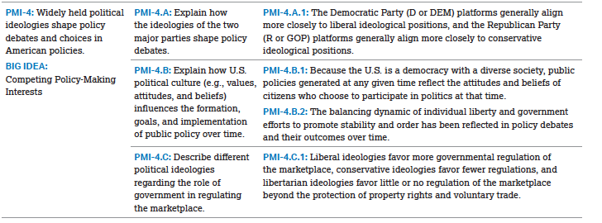
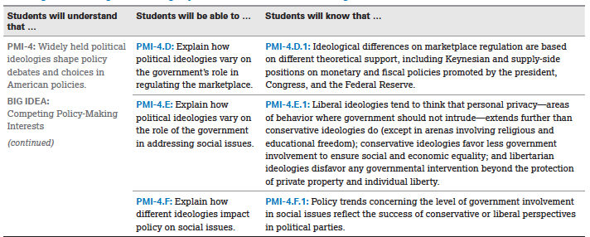

Slide 5
Quickwrite…
Why and how are social and economic policy linked?

Slide 6
Polarization
Why?

Slide 7
WHAT SHOULD GOVERNMENTS ROLE IN THE ECONOMY BE?
Business Cycles
Laissez-Faire
Adam Smith and the Invisible Hand Theory of the Marketplace
John Maynard Keynes and the Theory of Deficit Spending
Ronald Reagan and the Theory of Deregulation

Slide 8
Comparison of the “Big Three”
 | Laissez-faire Capitalism | Keynesianism | Monetarism
Primary Concern | Economic Growth | Economic Equality | Economic Stability
Govt. Role | Minimal | Major | Moderate
Govt. “Tools” | None | Tax rates, government spending | Control money and interest rates

Slide 9
Goals of Economic Policy
Fundamental goals of U.S. economic policy
  Promote stable markets
  Stimulate economic growth
  Promote business development
  Protect employees and consumers
Notes:
1. Naturally, there are many ways to achieve these ends that are diametrically opposed.
2. Students can talk in small groups about different views on each of these four and share with the class.
3. Essential differences between ideological groups and political parties are found in these four aspects of economic policy, which may be familiar having read the parties chapter.

Slide 10
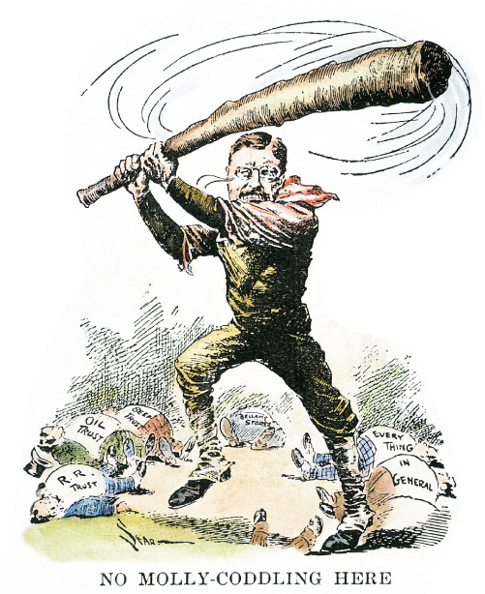
Promoting Stable Markets
Notes:
One way that the government promotes economic stability is by regulating competition and preventing monopolies. Monopolistic “trusts” became a particular concern in the late 1800s, and in 1904 President Teddy Roosevelt was depicted taking a swing at the railroad trust, the oil trust, and others that he believed were stifling competition.

Slide 11
Question: Keynesian economic contends that:
the market works best when left to the invisible hand
government spending is necessary to reduce the deficit
governments work best when they work the least
government intervention is always an obstacle to efficiently functioning economies.
government intervention is often necessary to resolve the inefficiencies of the private sector.
Notes:
11

Slide 12
Question: Keynesian economic contends that:
the market works best when left to the invisible hand
government spending is necessary to reduce the deficit
governments work best when they work the least
government intervention is always an obstacle to efficiently functioning economies.
government intervention is often necessary to resolve the inefficiencies of the private sector.
Notes:
12

Slide 13
Goals of Economic Policy
Public policy: an officially expressed purpose or goal backed by a sanction or reward
  Can be a law, a rule, a regulation, or an order
  There may be rewards for compliance.
  There may be penalties for failure to comply.

Slide 14
Government and the Economy
Government role in the economy
  Policy options that shape economic performance
  Balance between support for economic prosperity and environmental, labor, and safety concerns
  Economic policy is frequently controversial.
    Many have ideas about spending, priorities, and economic theories that are at odds with a given administration’s and Congress’s approach to the national economy.
Notes:
Lets not kid ourselves, the economy is a complex topic that even the best experts get wrong.
Students should not feel uncomfortable engaging this topic despite its complexity.
The idea here is to outline these broad aspects, not to develop models or theories!

Slide 15
Income, Poverty, and Public Policy

Slide 16
Government and the Economy
Elements to economic policy, focus on three specific tools for improving the economy
  Spending
  Tax cuts
  Interest rate changes
Though these tools may be sophisticated, the choice of how and when to use them is very political.
Notes:
Again, this list of topics highlights party and ideological differences.
This list shows how these tools are important to both parties and have important implications for the national economy.

Slide 17
Political Ideology and Economics
Fiscal Policy
Monetary Policy
Taxing and Spending
Interest Rates and Money Supply
Economic stability
Inflation
  US Federal Reserve
Liberal Conservative
Notes:
Liberals:
Larger government
Higher Taxes
More government Programs
Higher Spending
Safety Net in a Wealthy Society
Ideas of Fairness
Protection of people via regulation
Conservatives:
Smaller Government
Lower Taxes
Lower Spending
Less Government Regulation
The less government, the better the economy, businesses do well, competition improves everyone
Pro-Business (by being pro business, pro individual)

Slide 18
FDR CHANGES EVERYTHING
The Depression of the 1930s required drastic action and the following was done:
  1. Glass-Steagall Act (FDIC)
  2. SEC
  3. AAA
  4. Wagner Act (collective bargaining and right to organize)
  THE NEW DEAL MEANS THAT GOVERNMENT WOULD NOW BE PRIMARY SOURCE OF ECONOMIC SOLUTIONS INSTEAD OF THE MARKETPLACE

Slide 19
Economic Regulation is government regulation of business practices
Social Regulation is government regulation of safety of products and conditions of production
Four Reasons for surge of these regulations:
  1. 1960s/70s increase in activism
  2. More public awareness of dangers and safety
  3. Congress wants visibility and prominence
  4. Presidents support them
  BUT IN THE 1980S A REVERSE TREND WILL TAKE PLACE (Deregulation)

Slide 20
During which era did the U.S. government first adopt interventionist policies?
the 19th century
the Progressive era
the Great Depression and the New Deal
the 1960s
the 1980s
Notes:
20

Slide 21
During which era did the U.S. government first adopt interventionist policies?
the 19th century
the Progressive era
the Great Depression and the New Deal
the 1960s
the 1980s
Notes:
21

Slide 22
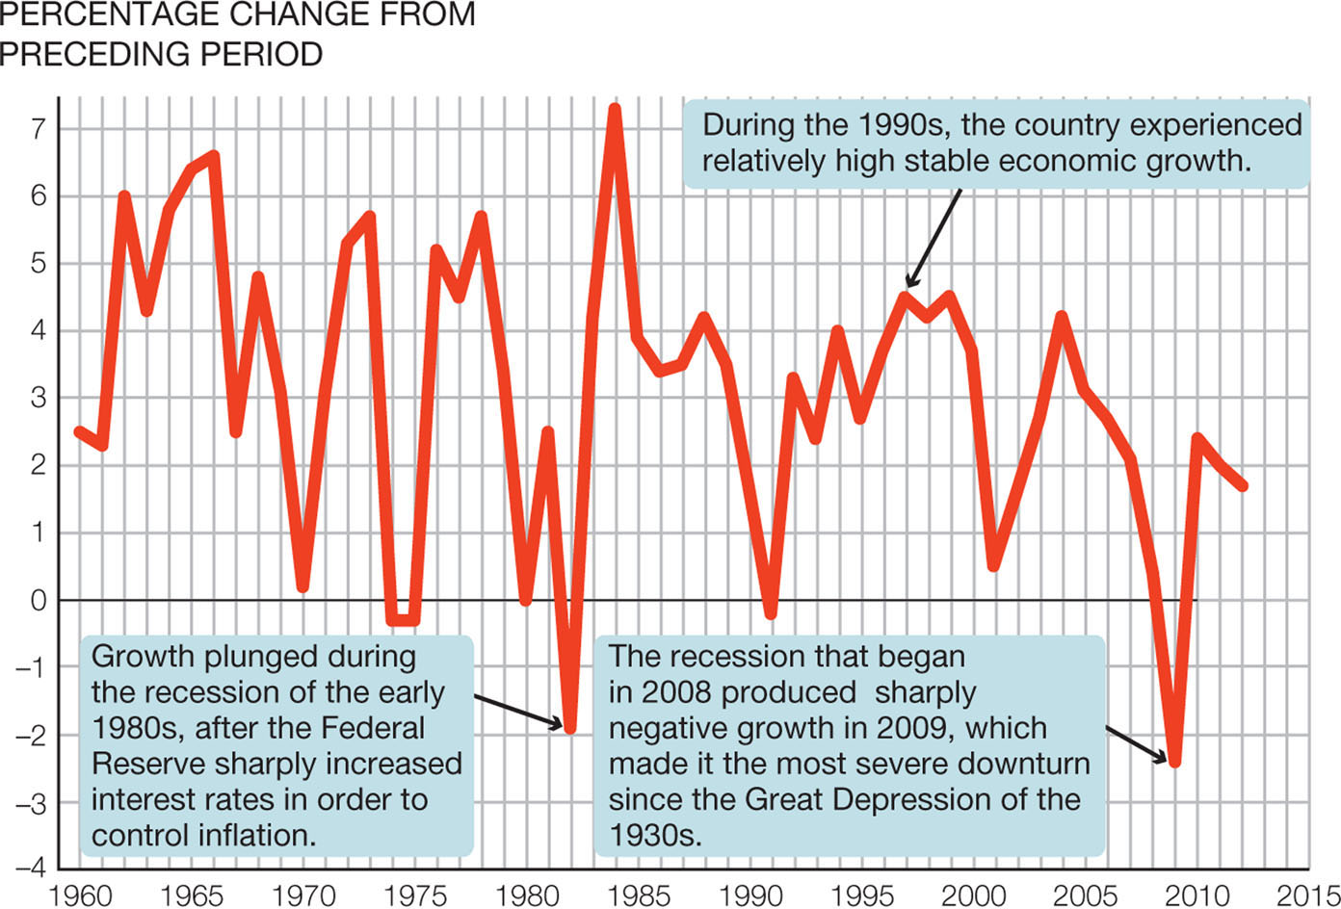
Changes in Real Gross Domestic Product,
1961–2009
Notes:
FIGURE 16.1 Changes in Real Gross Domestic Product, 1961–2009
The rates of growth in gross domestic product have varied over time. They were particularly volatile during the 1980s as the economy first plunged into recession and then rapidly recovered with high rates of growth. What was the pattern of growth during the last five presidential election years?
SOURCE: Bureau of Economic Analysis, “Percent Change from Preceding Period in Real Gross Domestic Product,” www.bea.gov (accessed 8/6/12).

Slide 23
Platform Analysis
Liberal vs. Conservative Ideology (Economic and Social)

Slide 24
Social Welfare Policy is the intent of the government to improve the quality of life for its citizens. There are 4 different types of public policy theories:
  1. Elite Theory (unequal distribution is normal)
  2. Bureaucratic Theory (gov’t so big bureaucrats
  are the dominant power)
  3. Interest Group Theory (gov’t is equilibrium
  between all competing groups at all levels)
  4. Pluralist Theory (no single elite group)

Slide 25
Political Ideology and Social Welfare
Liberal
Conservative

Slide 26
Roots of Social Welfare Policy
Early 19th century attitudes toward social welfare were focused on belt-tightening and charity.
  NO governmental intervention
Late 19th century
  Farmers and rural Americans sought help
    Failing commodity prices; exploitation of railroads
    1890s severe economic depression
    Acceptance and expectance of government intervention

Slide 27
Income Security
Great Depression
  Social and economic thinking began to change
  Idea that government could and should be used as a positive influence in society
  FDR elected in 1932
    Unemployment extremely high; bad for economy
    Created Civil Works Administration by executive order to put people to work
  Creation of Social Security
    1935 law established old-age insurance (Social Security) and assistance for the needy, children, and others, and unemployment insurance

Slide 28
Practice Questions
X2

Slide 29
Health Care
National health insurance considered at time Social Security legislation was passed
  AMA strongly opposed it; so it was omitted
1945 Truman put health insurance on the national policy agenda again
  First idea received favorably by public
  AMA opposed again; fearful of regulation
Medicare introduced by Johnson
  Provide hospital care for the elderly already covered by Social Security
  Wilbur Mills (D-AR) Chair Ways and Means
    Expanded policy: included Medicaid

Slide 30
Public Education
Until the 20th century, public education had been almost the exclusive province of the state and local governments.
Responsibility for public education
  Vested in the local community
1944 GI Bill began federal government’s involvement in helping people pay for education beyond high school
  Pell Grants
  Loan guarantees
  $62 billion in student loans in 2004-2005
Reliance on local property taxes to fund schools
  Disparities among different districts
Today federal government assumes more responsibility for public education than it has in the past.

Slide 31
Social Welfare Policies Today: Income Security Programs
Protect people against loss of income due to retirement, disability, unemployment or deal or absence of family breadwinner
  Non-means-based programs
    Social insurance
      Old age, survivors, and disability insurance
      Social Security
      Unemployment
  Means-tested programs
    Social insurance
      Supplemental Security Income
      TANF
      Family and Child Support Act

Slide 32
Income Security Programs Today
Many income security programs are entitlement programs
Non-means-tested programs
  Social security
  Unemployment insurance
Means-tested programs
  Supplemental security income (SSI)
  TANF and SNAP
  Earned Income tax credit program

Slide 33
Income, Poverty, and Public Policy

Slide 34
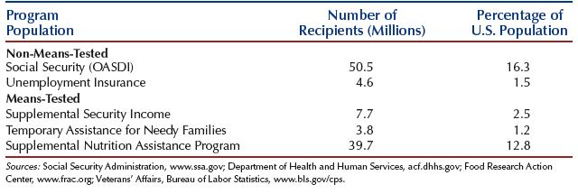
How many Americans benefit from income security programs?

