Slide 1
Do Now
OPINION…Can a nation be too democratic?
What features of the British government are the newly independent Americans going to try to avoid? Why?

Slide 2
Society, Politics, and Economics Under the Articles of Confederation
Mr. Winchell
APUSH 2018-2019
Period 3

Slide 3
AP Prompt
Evaluate the extent to which the Articles of Confederation provided an effective system of governance in the new United States during and after the Revolutionary War.

Slide 4
Key Concepts
3.2.II.B-
The Articles of Confederation unified the newly independent states, creating a central government with limited power. After the Revolution, difficulties over international trade, finances, interstate commerce, foreign relations, and internal unrest led to calls for a stronger central government.

Slide 5
Objective
Students will evaluate the effectiveness of the Articles of Confederation as a system of government by writing a contextualization/thesis statement to be measured on the College Board rubric for writing.

Slide 6
The war is over, now what?
“Which one of us should be the rulers?”
-Philadelphia newspaper during the war

Slide 7
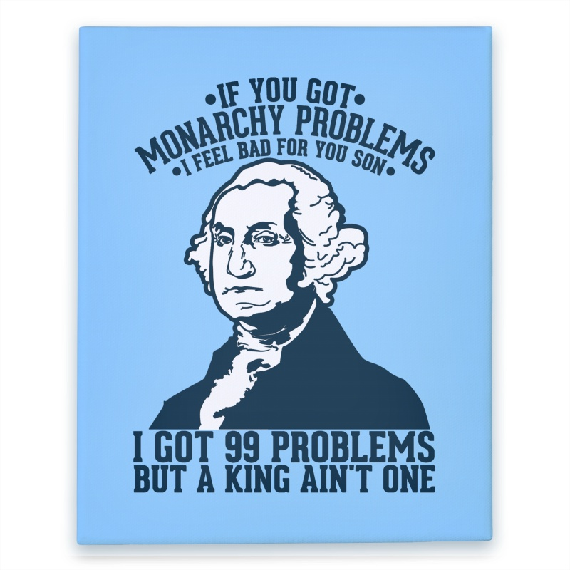

Slide 8
Changes to American Society
Blacks demanded the right to freedom in petitions & lawsuits
The American Revolution led to unintended social changes by forcing many Americans to question the meaning of “equality”
Many wanted to eliminate the idea of an American aristocracy
Fighting British tyranny made slavery seem hypocritical; Abolitionist sentiment grew
Women gained increased status
Many states lowered property qualifications to vote; but none offered universal male suffrage
Franklin, Jay, Hamilton founded abolition societies; Washington manumitted his slaves
VT, PA, MA abolished slavery
“Republican Motherhood”—mothers should instill virtue in their children
Most states clearly separated church & state
Notes:
In North, slavery not economically necessary; immigrants resented competing against slave labor
VT, PA slavery was abolished; in MA slavery “unconstitutional”
But…freed blacks discriminated
In South, some slave owners privately free slaves, but economic motives too powerful (plantations, cotton gin in 1793, & opening of AL & Miss frontier)

Slide 9
Forming New Governments
When independence was declared from England in 1776, colonists considered themselves a new nation & needed a new gov’t:
Colonies became individually sovereign states governed by written state constitutions
A national gov’t was needed to provide basic services like sign treaties & develop a military
In 1776, the American Revolution has just started; The colonists did not wait to gain British recognition of their independence before creating new governments!

Slide 10
States Constitutions
In 1776, the new states created written constitutions which:
Clearly defined the citizens’ rights & the limits of government
Guaranteed natural rights; Eight states had bills of rights
Almost all states reduced the powers of the governor & kept most power in the hands of the people via state legislatures
Notes:
7

Slide 11
Pennsylvania
Pennsylvania Constitution of 1776
Unicameral Legislature
One house with complete power.
No governor
Elementary education provided by state gov.
NO property requirement to serve
John Adams: “TOO MUCH DEMOCRACY!”

Slide 12
Thoughts on Government-Adams
In response to state governments, Adams publishes his thoughts in 1776:
3 branch government (what a concept…)
2 houses in the legislature
Judiciary appointed, not elected.

Slide 13
Text Analysis
John Adams-Thoughts on Government

Slide 14
Defining Republican Culture
But, creating a national gov’t that met everyone’s needs was hard:
How to balance individual liberty with maintaining order?
How to balance property rights with equality?
How to create a centralized gov’t without creating a new tyrannical authority?
Notes:
2

Slide 15
Articles of Confederation
Outset of the war, 2nd Continental Congress urged states to create their own constitution.
“Oppose everything that leans to aristocracy or power in the hands of the rich”

Slide 16
Articles of Confederation
The Articles of Confederation was adopted as America’s 1st national gov’t in 1777 (but ratified in 1781)
The Articles established an intentionally weak central gov’t in order to protect state power
The confederation-style gov’t gave all 13 states 1 vote in a unicameral congress
There was no national president
Each state was treated as a pseudo-nation
Too similar to a monarch
Notes:
The war is still going on (will not end until 1781 with Cornwallis surrender & 1783 Treaty of Paris)

Slide 18
America after the Revolution
Local ties remain predominant.
Most Americans still consider themselves as citizens of their states, not as Americans.
Belief that the sovereignty of the state was more important than that of the power of the central government.
Would prove to be a problem later.

Slide 19
Major Features of the Articles

Slide 20
Weaknesses of the Articles
Provided a weak national government
Congress had no power to tax or regulate trade between the states
Provided for no common currency (money)
Gave each state one vote, regardless of size/pop
Provided for no executive or judicial branches (no president or national court system)

Slide 21
Successes of the Articles of Confederation
Land settlement in the Northwest Territory was the only real success of the AoC.
Land Ordinance of 1785
Since the govt could not tax, it needed a source of $$$.
Sold land to settlers west of the Appalachians, used the $$ to run govt.
Northwest Ordinance - 1787
Opened up the Northwestern territories to settlement
Established the process for territories to become states
Banned slavery in those territories and made the Ohio River the dividing line between free and slave states.
‘No less than 3, no more than 5 new states’

Slide 22
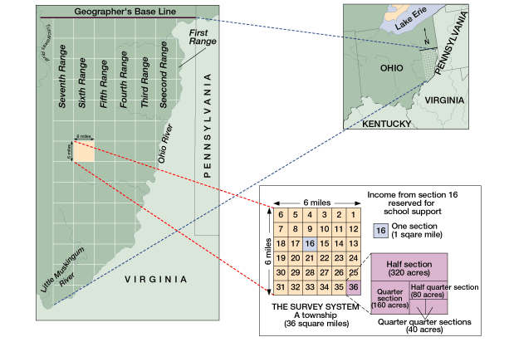

Slide 24
Northwest Territory Legislation
Significance: Allowed for orderly settlement of western territories.
Not colonies!
Pros: Outlawed Slavery, allowed for education, created systems for democracy.
Cons: Created a dividing line between slaves and non-slave states, invalidated Native American claims to the land.

Slide 25
The New Nation’s $$$ Problems… Too much for the Articles of Confederation?
Foreign debt
The nation owed 190 million dollars to foreign countries for their assistance during the war. How to pay it back?
Foreign Relations
Because the U.S. owed money to Loyalists for property damage and were in debt to British merchants, Britain stationed troops and built forts in the Great Lakes area.
Spain closed the Mississippi River to US trade because the U.S. government owed Spain money.
State Debts and Economic Recession
Shays’ Rebellion

Slide 26
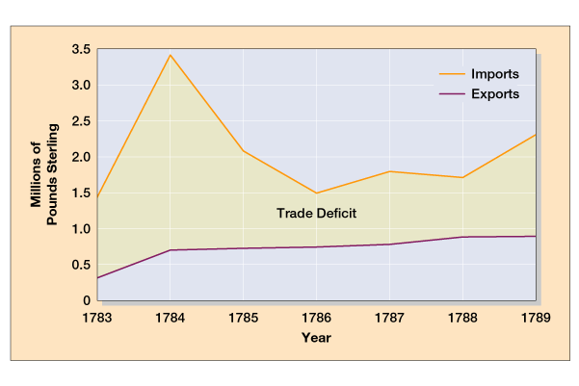
U.S. Trade with Britain, 1783-1789
America could not pay off debts from the Revolutionary War
Debt

Slide 27
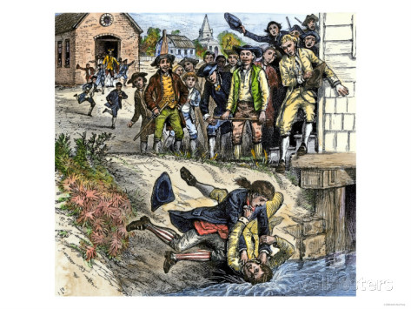
Shays’ Rebellion (1786-1787)
Massachusetts farmers in serious debt
Held meetings protesting “tyrannical Mass. government”
Daniel Shays led 2,000 men to shut down western courts to avoid foreclosures
Virtual civil war in Massachusetts led to Annapolis Convention
Tensions rise
Jay-Gardoqui Treaty
Spain’s rights to Mississippi River
New England’s depression
Mercantilist policies
Foreign manufacturing competition
States refusing/unable to pay debts
Weak defenses

Slide 28
How to Fix This?
A delegation meeting was called at Annapolis to discuss the weaknesses of the Articles.
Only 12 delegates from 5 states showed up and nothing was accomplished.
The failure of the Annapolis Convention prompted Alexander Hamilton to call for another convention to be held in Philadelphia in 1787 to discuss amending the Articles.
(This convention would lead to the writing and signing of the Constitution.)

Slide 29
Toward a Constitution
Annapolis Convention (1786)
After a meeting run by Washington, delegates from five states meet in Maryland to discuss interstate commerce
Decide to reform Articles with other delegates
Constitutional Convention at Philadelphia
All states but Rhode Island
Held in secrecy
Common nationalist viewpoint
Reform Articles or devise new government altogether?
The Delegates
55 total delegates; all white males
Mostly wealthy, middle-aged, professional (especially lawyers or politicians)
19 delegates owned slaves
George Washington, Alexander Hamilton, James Madison, Benjamin Franklin

Slide 30
AP Prompt
Evaluate the extent to which the Articles of Confederation provided an effective system of governance in the new United States during and after the Revolutionary War.

