Slide 1
bit.ly/apushquiz216

Slide 2
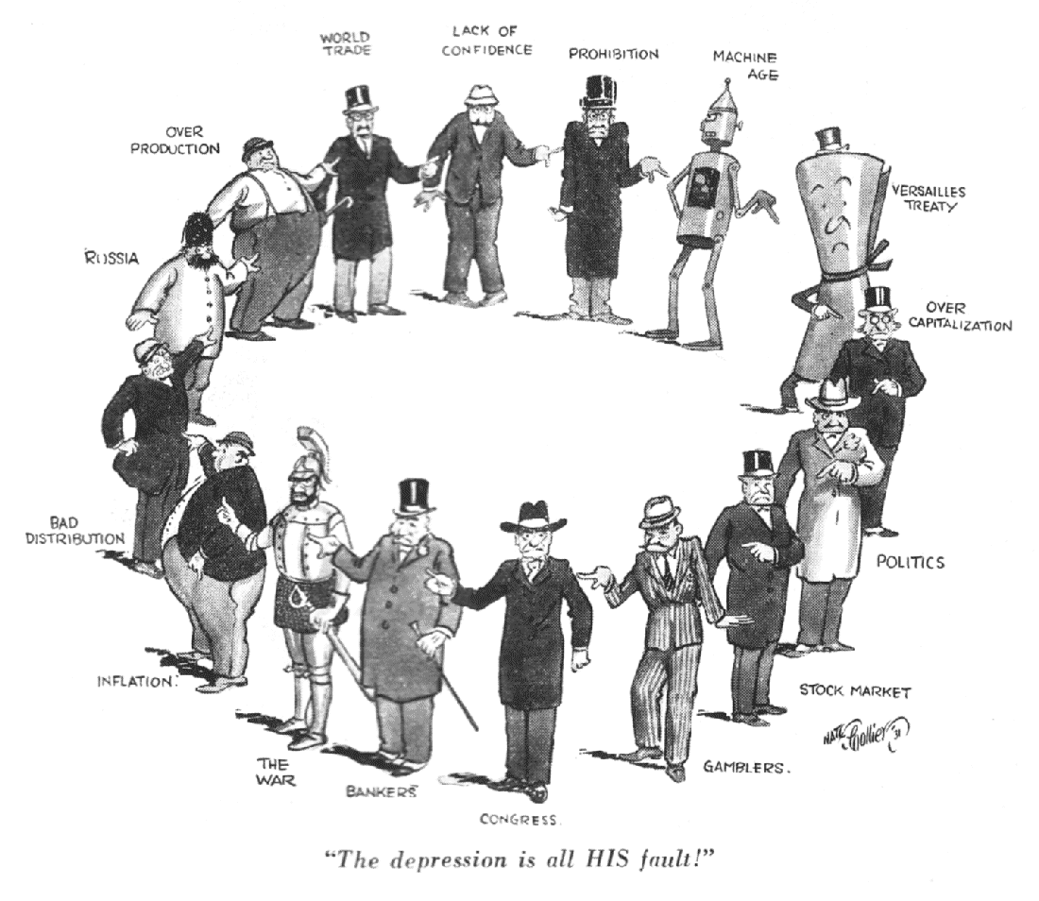

Slide 3
The Coming of the Great Depression & Hoover’s Response
Mr. Winchell
APUSH
Period 7

Slide 4
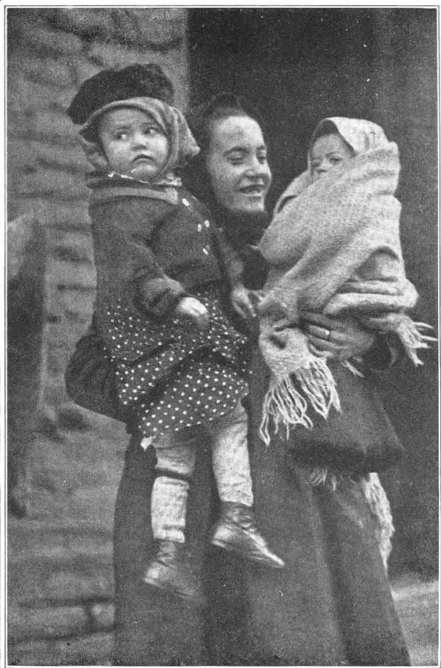
Radical Activity In Post-World War I America Myths Increase To Scare Americans
Belief was that all radicals were either immigrants or illegal aliens.
The enemy becomes the immigrant, especially those of Jewish, Russian, Italian, or Slavic heritage.
Slovak Immigrants
http://www.loc.gov/rr/european/imsk/images/slovakmother2.jpg

Slide 5
Economic Boom Increased Productivity & Profits
Government policies.
Congress and the President are both Republican.
Believed that the “business of America is business.”
Traditionally laissez-faire economics domestically, protectionist internationally.
Most of the big money men in the first place.
Favored the growth of big business.
Raised tariffs to protect American business.
Cut taxes on corporations and individuals.
Did little to enforce antitrust laws.

Slide 6
Impact Of The Economic Boom Impact
Real income rises 30%.
Unemployment fell to its lowest level in years.
Increased research in technology, energy, and chemicals.
Mass production lessens the value of skilled workers.
More people are investing.
A double-edged sword.
Good because more money is available for economic expansion.
Bad because people are looking to get rich quick, which leads to the practice of speculation (betting that a company or industry will do well in the immediate future).
People begin to borrow money from banks to play with on the stock market.

Slide 7
Closing The Gates Establishment Of The Quota System
Growth of immigration from Southern and Eastern Europe, as well as Mexico.
Leads to a widespread fear of competition for jobs.
Many of the new immigrant groups would bring radical views with them.
As a result of the strikes and the Red Scare, many Americans want to close the “Golden Gates” of America.
Law in 1921 set a 3% quote for each nationality in the country, with a specific exclusion for the Asian population.

Slide 8
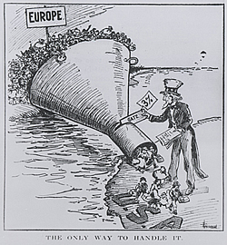

Slide 9
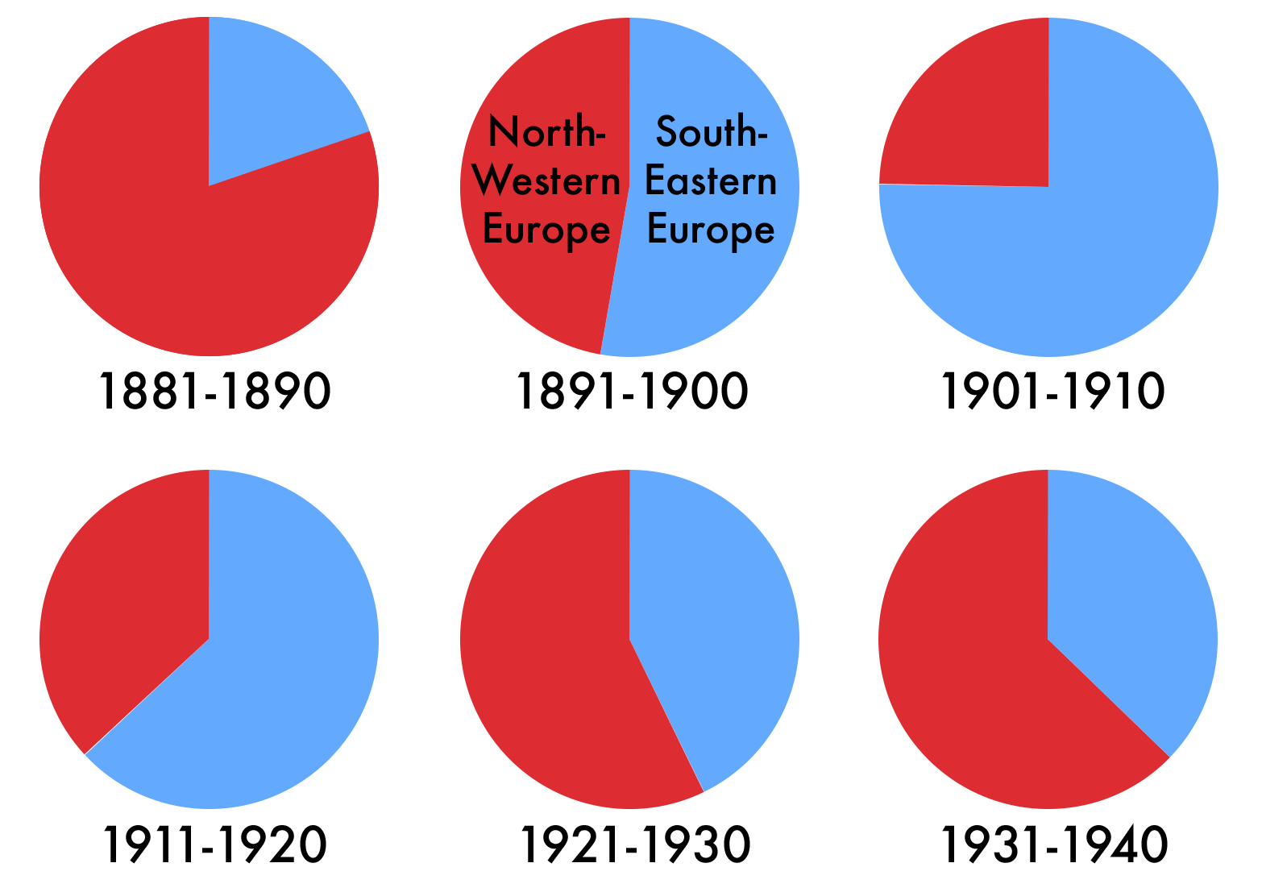
Closing The Gates Immigration Act Of 1924
Reduced the quota to 2% of the immigrant population, but based it on 1890 census.
Aimed specifically at Southern and Eastern Europeans, who did not begin to arrive in large numbers until after 1890.

Slide 10
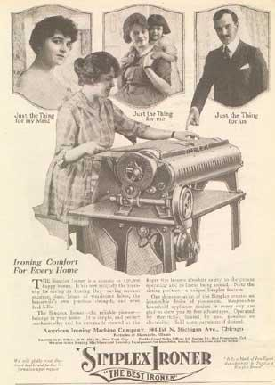
Fundamental Causes of the Depression
Drop in farm prices
Massively uneven distribution of income
“Get rich quick” schemes in real estate and stocks (buying on margin)
Overextension of credit
Increased inventories of goods
Failure of Germany to make war reparation payments to France and Britain. Britain and France then can’t repay debts to US.
Immediate cause: October 1929 stock market crash
Many consumers in the 1920s bought items such as this ironer on credit
Notes:
During the 1920s, few farmers shared in the prosperity that supposedly extended nationwide. This discrepancy in farm prices was a warning sign that the economy was in serious trouble.
Although many viewed the 1920s as an “era of prosperity,” the vast majority of people in America were middle class or poor. Since most of the real wealth in the country lay in the hands of only a few people, most citizens didn’t have the cash to purchase goods.
Many believed that speculation in real estate—and especially in stocks—would result in easy money. People also bought stock “on margin,” putting down 10 percent of the stock’s value and then owing the rest to a broker. If the stock continued to climb in value, the investor was safe. However, if the value of the stock declined the broker would make a “margin call,” demanding payment for the rest of the amount owed. If the investor couldn’t pay the other 90 percent, the broker would sell the stock, hoping to recoup his losses. As the market as a whole declined in value, this process became a vicious circle, further driving down stock prices.
Many consumers in the 1920s overextended themselves financially due to the easy availability of credit. New consumer goods such as washing machines, radios, automobiles, and refrigerators appealed to consumers, even though they might not have had the financial resources to buy them. The ability to pay in installments put these goods in the reach of more people. However, this also led to industries showing only “paper profits,” thereby further creating the illusion of prosperity.
As more people bought products with money they didn’t have, manufacturers continued to produce more and more goods. Soon the supply of goods far exceeded demand, and unsold items piled up in producers’ warehouses.
The October 1929 stock market crash signaled the start of the Depression. While the U.S. economy did not completely and immediately collapse, the crash marked the beginning of a major decline.

Slide 11
The Appearance of Prosperity
Strong Economy
Between 1922 and 1928 the U.S. gross national product, or total value of all goods and services, rose 40 percent.
Though farmers and some other workers didn’t benefit, the overall economy performed well, especially for automakers and those who made auto parts.
Overall unemployment remained low, averaging around five percent between 1923 and 1929.
Union membership slowed as employers expanded welfare capitalism programs, or employee benefits.
This feeling of prosperity encouraged workers to buy new products and enjoy leisure activities such as movies.
Strong Stock Market
The stock market, where people buy stocks, or shares, in companies, performed very well in the 1920s, with stock values sharply increasing each month.
The value of stocks traded quadrupled over nine years.
The steep rise in stock prices made people think the market would never drop, and more ordinary Americans bought stocks than ever before.
The number of shares traded rose from 318 million in 1920 to over 1 billion in 1929.
Business leaders said everyone could get rich from stocks.

Slide 12
Economic Weaknesses
While many Americans enjoyed good fortune in the 1920s, many serious problems bubbled underneath the surface.
One problem in the American economy was the uneven distribution of wealth during the 1920s.
The wealthiest one percent of the population’s income grew 75 percent, but the average worker saw under a 10 percent gain.
For most Americans, rising prices swallowed up any increase in salary.
Coal miners and farmers were very hard hit, but by 1929 over 70 percent of U.S. families had too low an income for a good standard of living.
Four out of every five families couldn’t save any money during the so-called boom years.
Credit allowed Americans to buy expensive goods, but by the end of the decade many people reached their credit limits, and purchases slowed.
Warehouses became filled with goods no one could afford to buy.

Slide 13
Credit and the Stock Market
Buying on Margin
Investors were buying on margin, or buying stocks with loans from stockbrokers, intending to pay brokers back when they sold the stock.
As the market rose, brokers required less margin, or investors’ money, for stocks and gave bigger loans to investors.
Buying on margin was risky, because fallen stocks left investors in debt with no money.
If stocks fell, brokers could ask for their loans back, which was called a margin call.
The Federal Reserve
The board of the Federal Reserve, the nation’s central bank, worried about the nation’s interest in stock and decided to make it harder for brokers to offer margin loans to investors.
Their move was successful, until money came from a new source: American corporations who were willing to give brokers money for margin loans.
Buying continued to rise.

Slide 14
Unemployment, 1929-1942
This downward spiral continued for 4 years; By 1932 unemployment was at 25%

Slide 15
The Stock Market Crashes
The steady growth of the early 1920s gave way to astounding gains at the end of the decade until its September 3, 1929, peak.
Many people were beginning to see trouble as consumer purchasing fell and rumors of a collapse circulated.
On Thursday, October 24, 1929, some nervous investors began selling their stocks and others followed, creating a huge sell-off with no buyers.
Stock prices plunged, triggering an even greater panic to sell.
Toward the end of the day, leading bankers joined together to buy stocks and prevent a further collapse, which stopping the panic through Friday.
But the next Monday the market sank again, and Black Tuesday, October 29, was the worst day, affecting stocks of even solid companies.
The damage was widespread and catastrophic. In a few short days the market had dropped in value by about $16 billion, nearly one half of its pre-crash value.

Slide 16
The Great Crash
Reasons for the depression:
Overproduction of consumer durable goods & agriculture
The post-war conditions in Europe decreased foreign trade
Unequal distribution of wealth, high consumer debt, stock market over speculation led to an overall decrease in consumer purchase power
Consumers already owned durable goods & were not buying more
Notes:
Economic conditions in Europe, Agricultural decline since 1919, corporate mismanagement, excessive speculation all contributed to the GD as well

Slide 17
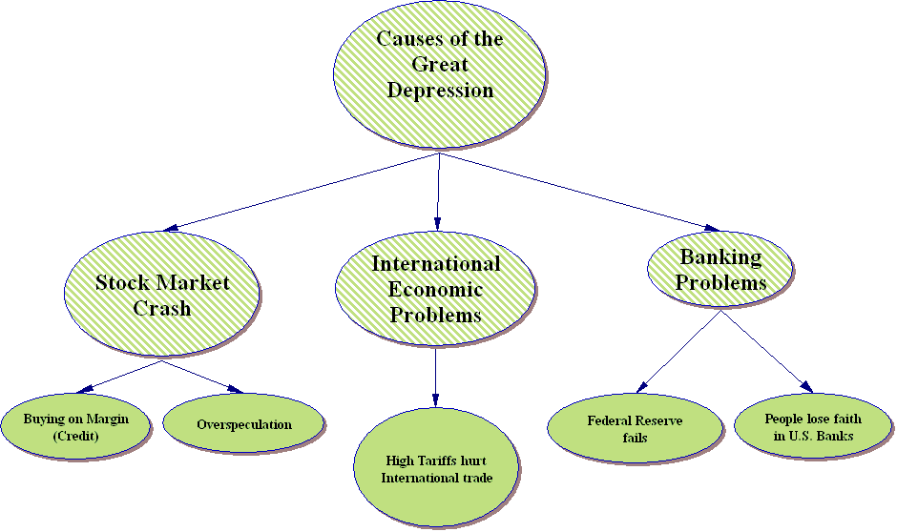

Slide 18
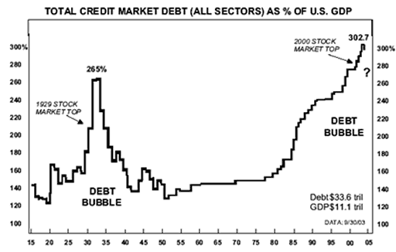
In 1929, the total market debt of the USA was 210% of the value of GDP
By 1934, U.S. debt rose to 265% of GDP
In 2005, the value of U.S. debt was 303% of GDP

Slide 19
Effects of the Crash
Impact on Individuals
Though some thought the market would rally, countless individual investors were ruined.
Margin buyers were hit the hardest, because brokers demanded they pay back the money they had been loaned.
To repay the loans, investors were forced to sell their stocks for far less than they had paid, and some lost their entire savings making up the difference.
In the end, many investors owed enormous amounts of money to their brokers, with no stocks or savings left to pay their debts.
Effects on Banks
The crash triggered a banking crisis, as frightened depositors rushed to withdraw their money, draining the bank of funds.
Many banks themselves had invested directly or indirectly in the stock market by buying companies’ stocks or by lending brokers money to loan to investors on margin.
When investors couldn’t repay margins, banks lost money, too.
These failures drove many banks out of business.

Slide 20
Effects of the Crash
Impact on Business
The crash crushed businesses, because banks couldn’t lend money.
Consumers also cut back their spending on everything but essentials, and companies were forced to lay off workers when demand decreased.
Unemployed workers had even less money to make purchases, and the cycle continued.
In the year after the crash, American wages dropped by $4 billion and nearly 3 million people lost their jobs.
Impact on Europe
The fragile economies of Europe were still struggling from World War I. They had borrowed a great deal of money from American banks that the banks now wanted back.
With U.S. buying power down, foreign businesses were less able to export their products and were forced to fire workers.
Governments tried to protect themselves by passing high tariffs, making foreign goods expensive.
The decline in world trade in the 1930s created misery around the world and contributed to the nation’s slide into the Great Depression.

Slide 21
The Progress of the Great Depression
Crisis would steadily worsen over the next three years
Collapse of much of banking system would follow the stock market crash
over 9,000 American banks either went bankrupt or closed their doors between 1930 –1933
people depositing money lost over $2.5 billion
1/3 decrease in money supply / currency
Role of the Federal Reserve: if they acted more responsibly, a severe depression might have been avoided
GNP plummets from $104 billion in 1929 to $76.4 billion in 1932 (25% decline in three years)
Gross farm income dropped from $12 billion to $5 billion in four years (60% decline)
1932 25% of the workforce unemployed, another third of the workforce experienced cuts in wages or hours or both

Slide 22
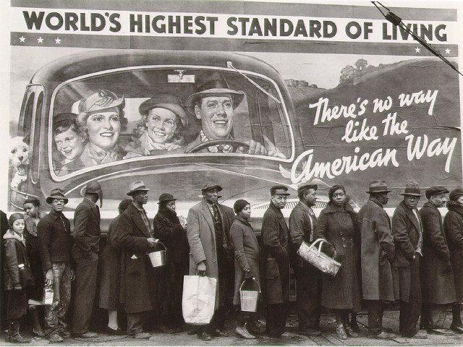
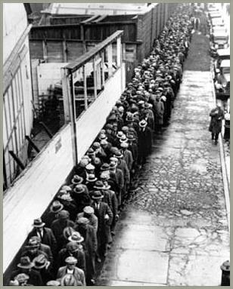
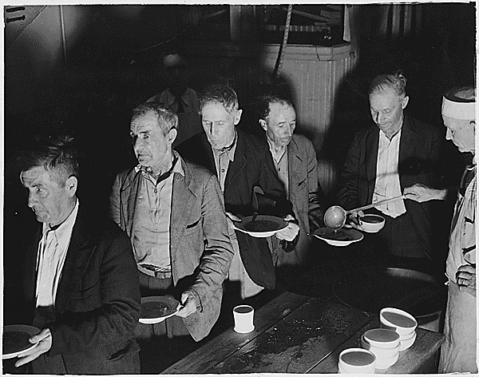
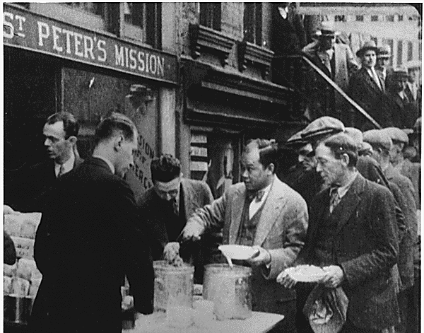
Soup Kitchens & Breadlines

Slide 23
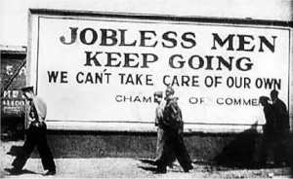
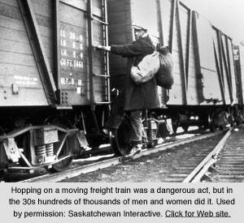
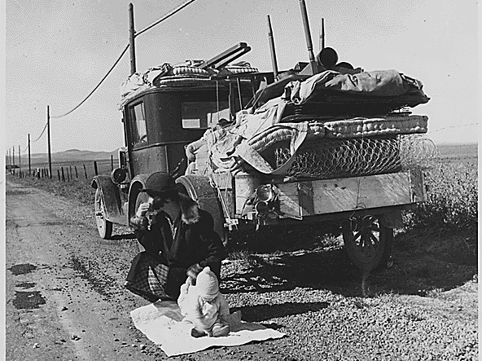

Slide 24
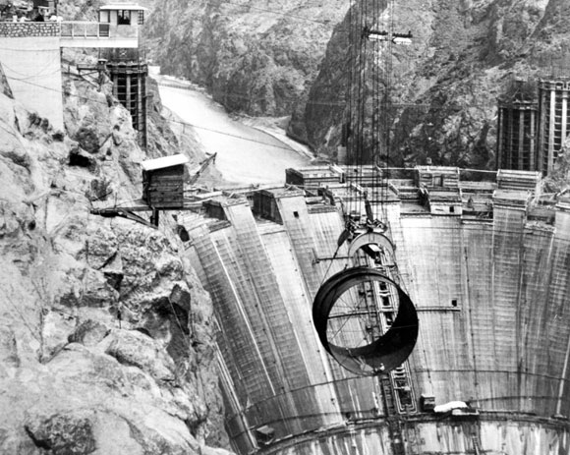
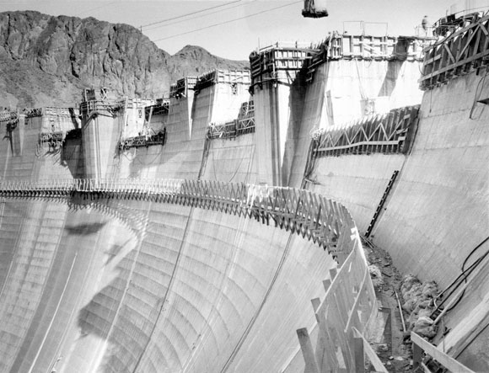
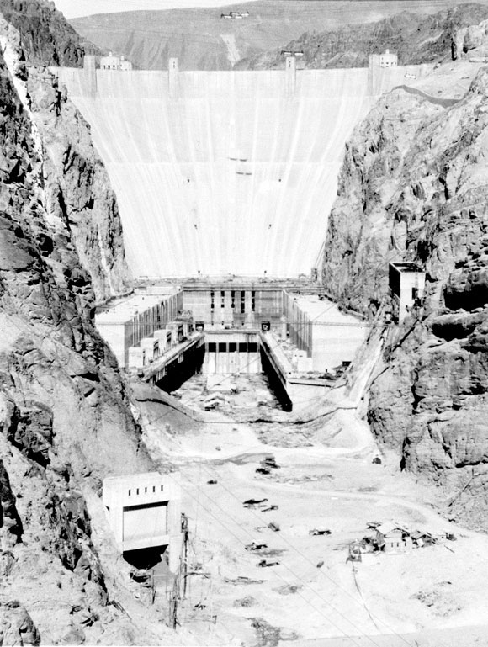
The Hoover administration initiated job-creation programs, like building the Hoover Dam
Notes:
Boulder Dam was renamed Hoover Dam

Slide 25
Hoover and Voluntarism
President Hoover’s initial response was to reassure Americans that prosperity would return
Hoover rejected bold gov’t action & called for volunteerism among charities, local gov’t, & business
As the depression worsened, Hoover called for gov’t projects like the Reconstruction Finance Corps (RFC) which loaned money to failing businesses
“Rugged individualism”

Slide 26
Hoover and Voluntarism
In 1932, Hoover’s presidency suffered two final blows:
When 22,000 war veterans marched to the capital to demand their WW1 bonus checks early, Hoover ordered this Bonus Army to be forcibly removed
The steady rise of bank failures led to a complete collapse of the U.S. banking system

Slide 27
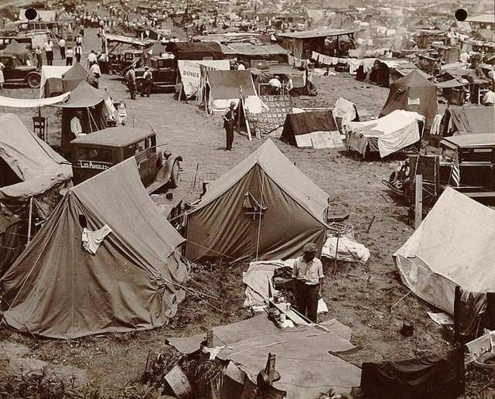
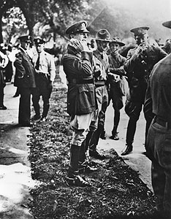
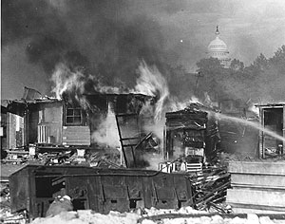
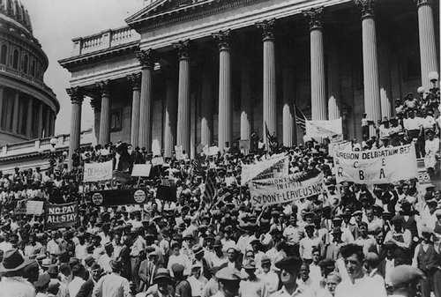
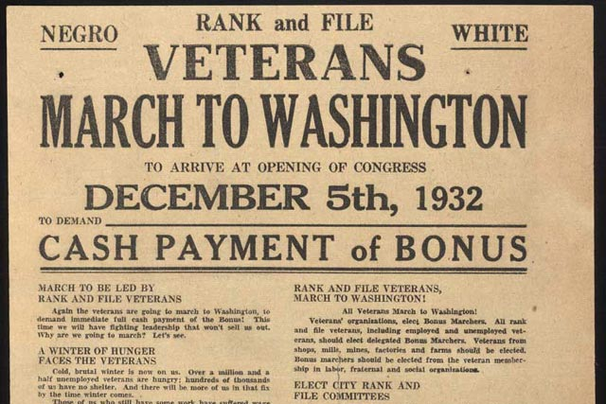
Bonus Army
Douglas MacArthur
Dwight Eisenhower

Slide 28
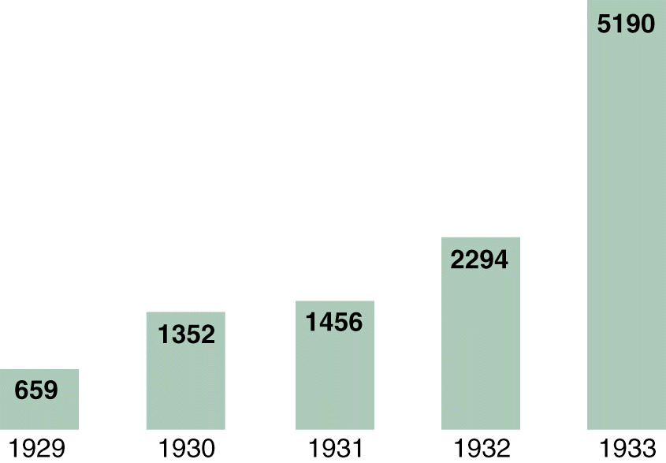
Bank Failures, 1929-1933

Slide 29
The Hoover Program
Hoover made weak attempts to use government spending as a tool for fighting the Depression
proposed to Congress an increase in $423 million in federal works programs (then a large sum of money)
but not willing to spend enough over a long enough period of time to do any good
not willing to tolerate deficits in the budget
In 1932 – at the depth of the Depression – he proposed a tax increase to help the government avoid a deficit (!)
Before the crash, Hoover had begun to construct a program to assist the troubled agricultural economy.
1929 Agricultural Marketing Act: first time a gov’t bureaucracy would be established to help farmers maintain prices
Hawley-Smoot Tariff of 1930 contained protective increases on 75 farm products and raised tariff rates to the highest point in American history (1,000 members of the American Economics Association warn Hoover this is a bad idea… but he signs it anyway)
Neither helped farmers sufficiently
Marketing Act relied on voluntary co-operation and did nothing to limit production
Hawley-Smoot Tariff provoked foreign governments to enact trade restrictions of their own in reprisal which further diminished the market for American agricultural goods (Retaliatory tariffs)

Slide 30
A Deepening Crisis
1930: Democrats win control of the House
Many Americans feel the President is personally responsible for crisis
Shantytowns = “Hoovervilles” (mocking president, Hoover blankets, Hoover Flags, Hoover Hotels, etc.)
Progressive reformers urged Hoover to pass more policies dedicated to social reform, but instead he used economic statistics that showed a slight gain in 1931 as evidence that his policies were working…
May 1931 largest bank in Austria collapses and panic spreads throughout Europe and into the US when
European countries pull out their gold reserves from US banks
European investors pull their US investments in the market to pay off their loans
US economy reaches new lows
Hoover comes up with a sound proposal to allow countries having to pay reparations one year moratorium on payments… French and England grudgingly agreed to accept it… but it came too late

Slide 31
The Election of 1932
Republicans dutifully re-nominate Hoover to head of Republican Party
Democrats nominate the governor of New York, Franklin Delano Roosevelt
on Democrat ticket as VP in 1920 (lost)
stricken with polio less than a year after… would never walk again without the use of crutches
returned to politics, became governor of New York
Winning the election
Roosevelt was able to avoid issues that had divided Democrats in years past: prohibition, race, religion
Emphasized economic grievances that most Democrats shared
In a dramatic break from tradition he flew to Chicago to accept his party’s nomination
“I pledge you, I pledge myself, to a new deal for the American people”
Differences in candidates
Hoover stoic / Roosevelt flashy: cigarette holder, hat, smile, excellent speaking skills
Depression: Hoover blamed it on Europe / Roosevelt called it a domestic problem blamed it on Republicans
Roosevelt wins in a Landslide: receives 57% of the popular vote and won every state but five (in the electoral college FDR = 472, Hoover = 59)
Democrats also take control of both houses of Congress

Slide 33
Fighting the Depression
The inability of Republicans to resolve the economic depression opened the door for a Democratic takeover in politics
Once in power, Democrats succeeded in relieving some suffering, restored hope, & created an unprecedented level of gov’t intervention in the process

Slide 34
Historians on the Record
David Kennedy (Stanford) on Causes of the GD
David Kennedy: Severity of Economic Hardship During the Depression

