Slide 1
Do Now
BRAINSTORM: What was the importance in keeping the number of free and slave states balanced…?

Slide 2
Effects of the Market Revolution
Effects on the Social Structure:
The ability for the poor to become wealthy was greatly exaggerated
The gap between the wealthy and the poor increased as the wealthy became industry leaders and large plantation owners
The wages of workers and the overall standard of living in the US DID greatly increase
FAR more economic opportunities in America than in Europe

Slide 3
Effects of the Market Revolution
Effects on Women:
Women no longer had to work alongside their families on farms
Women gained more control over their lives during this period
Arranged marriages far less common
Single women had some opportunities to seek employment in cities (teachers, domestic workers, some factory jobs)

Slide 4
Effects of the Market Revolution
Effects on the Economy:
Though there was a brief panic in 1819, the American economy experienced great growth during the early 1800s
This growth resulted in the development of a NEW American economy
Prior to 1820, many families were self-sufficient
After the 1820’s, the American economy was forever changed
The farmers of the South and West fed the workers of the cities of the Midwest and North and provided them raw materials, who in turn supplied the farmers with manufactured goods

Slide 5
The Fracturing of the Era of Good Feelings: The Missouri Compromise & Foreign Policy
Mr. Winchell
APUSH 2018-2019
Period 4

Slide 6
AP Prompt
Evaluate the impact of sectionalism on Era of Good Feelings politics.

Slide 7
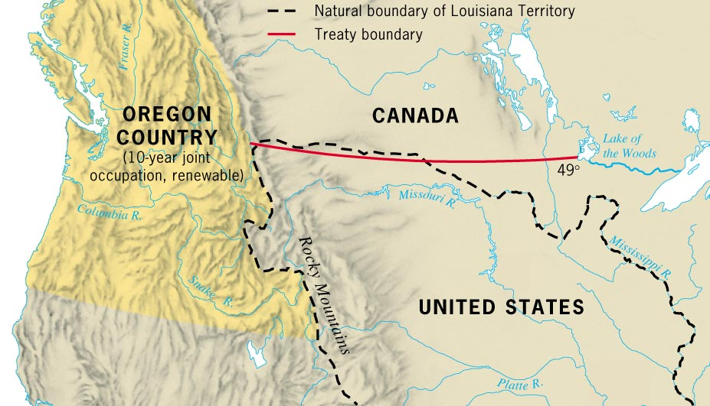
The Convention of 1818

Slide 8
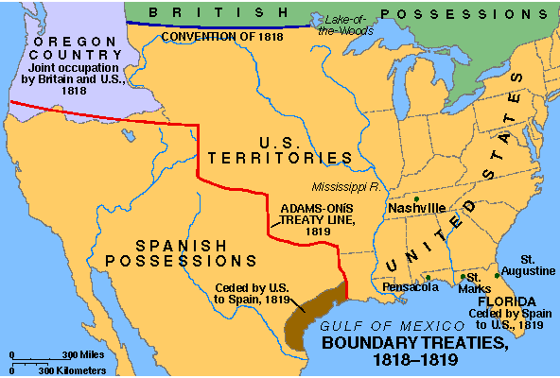
Adams-Onis Treaty, 1819 [“The Transcontinental Treaty”]

Slide 9
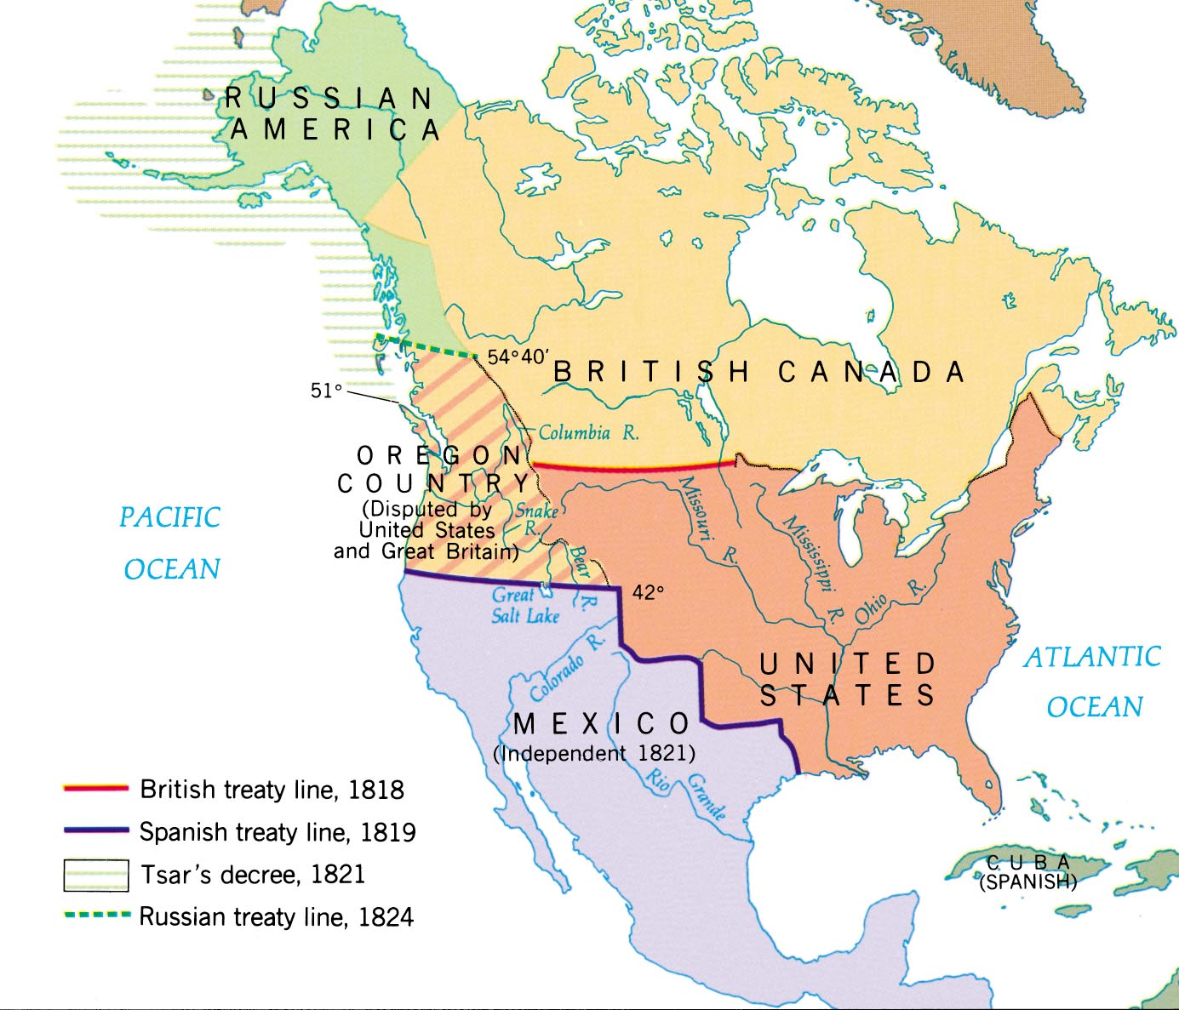
The West & the NW: 1819-1824

Slide 10
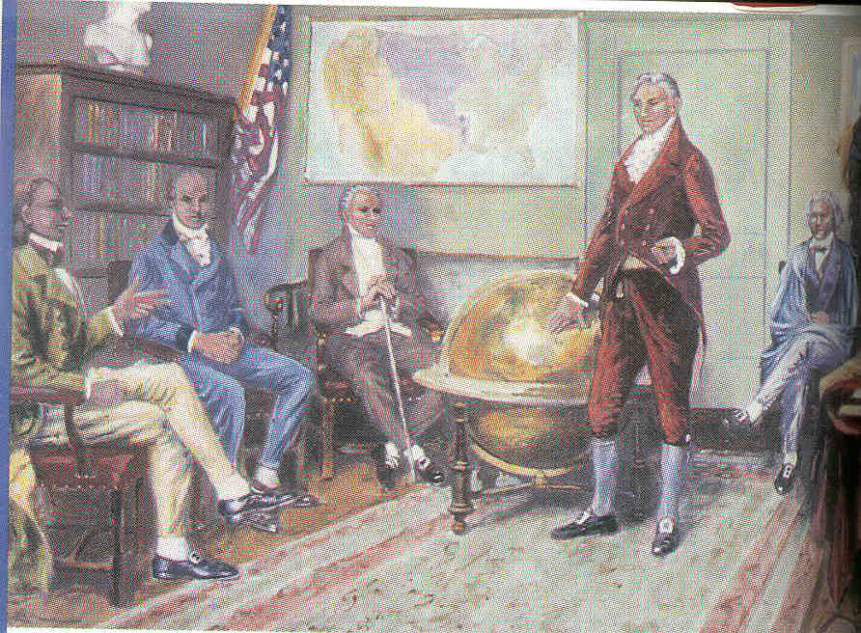
The Monroe Doctrine, 1823
Referred to a“America’s Self-Defense Doctrine”
What warning is given to the European countries?
What foreign policy principles are established?
Monroe Doctrine
What would the US do if the warning was not headed?

Slide 11
Era of Good Feelings Monroe Doctrine (1823)
U.S. and Great Britain concerned about European expansion into Americas
Points
“In the discussions to which this interest has given rise and in the arrangements by which they may terminate the occasion has been judged proper for asserting, as a principle in which the rights and interests of the United States are involved, that the American continents, by the free and independent condition which they have assumed and maintain, are henceforth not to be considered as subjects for future colonization by any European powers.”
“We owe it, therefore, to candor and to the amicable relations existing between the United States and those powers to declare that we should consider any attempt on their part to extend their system to any portion of this hemisphere as dangerous to our peace and safety. With the existing colonies or dependencies of any European power we have not interfered and shall not interfere. But with the Governments who have declared their independence and maintain it, and whose independence we have, on great consideration and on just principles, acknowledged, we could not view any interposition for the purpose of oppressing them, or controlling in any other manner their destiny, by any European power in any other light than as the manifestation of an unfriendly disposition toward the United States.”

Slide 12
Slave Population of the South (1860)
South Carolina - 57%
Mississippi - 55%
Louisiana - 47%
Alabama - 45%
Florida - 45%
Georgia - 44%
North Carolina - 33%
Virginia - 31%
Texas - 30%
Arkansas - 26%
Tennessee - 25%
Kentucky - 20%
Maryland - 13%
Missouri - 10%
Delaware - 1.5%

Slide 13
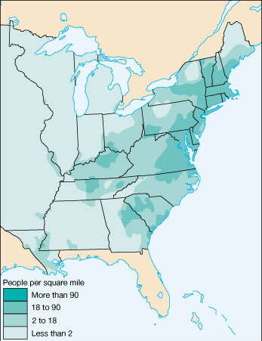
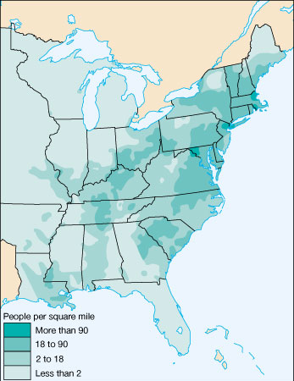
US Population Density
1810
1820

Slide 14
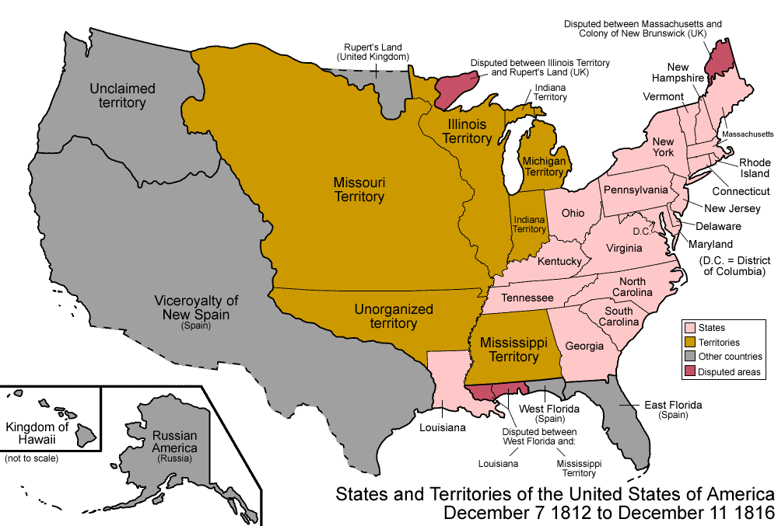
Settlement of the Trans-Mississippi
The end of the War of 1812 unleashed a rush of pioneers into the western territories
Many settled in the West to escape overpopulation, rising land prices, & worn-out soil in the East
The 2nd BUS made credit available for farmers to purchase land

Slide 15
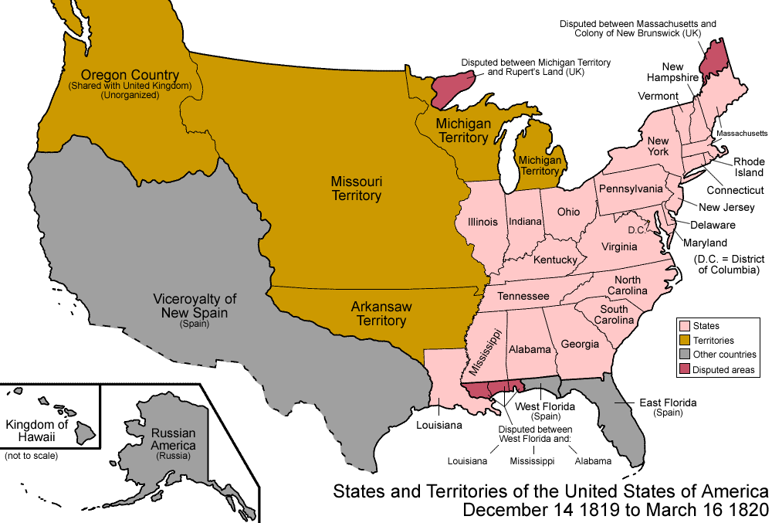
Settlement of the Trans-Mississippi
By 1810, 1/7th of the U.S. population lived in the West; By 1840 over 1/3rd lived in the West
Congress quickly admitted 5 states to the Union:
Indiana (1816)
Illinois (1818)
Alabama (1819)
Mississippi (1817)
Louisiana (1812)

Slide 16
Sectional Disputes
The Era of Good Feelings started with a wave of national unity, but sectional disputes between the North & South emerged & would dominate politics for next 40 years
Disagreed over the use of protective tariffs, especially when cotton prices fell in 1820s
Disagreed over slavery in the western territories & states

Slide 17
Missouri Compromise
Population was growing more rapidly in North, so House of Reps favored Northerners
In 1817, Missouri applied for statehood as a slave state & revealed U.S. sectional rivalries:
North resented Southern control of presidency & its 3/5-inflated representation in House of Reps
South feared a Northern conspiracy to end all slavery
Equality had been maintained by alternating admission of “free” & “slave” states added to the US
NY rep Tallmadge wanted Missouri only if its state constitution provided for the gradual elimination of slavery

Slide 18
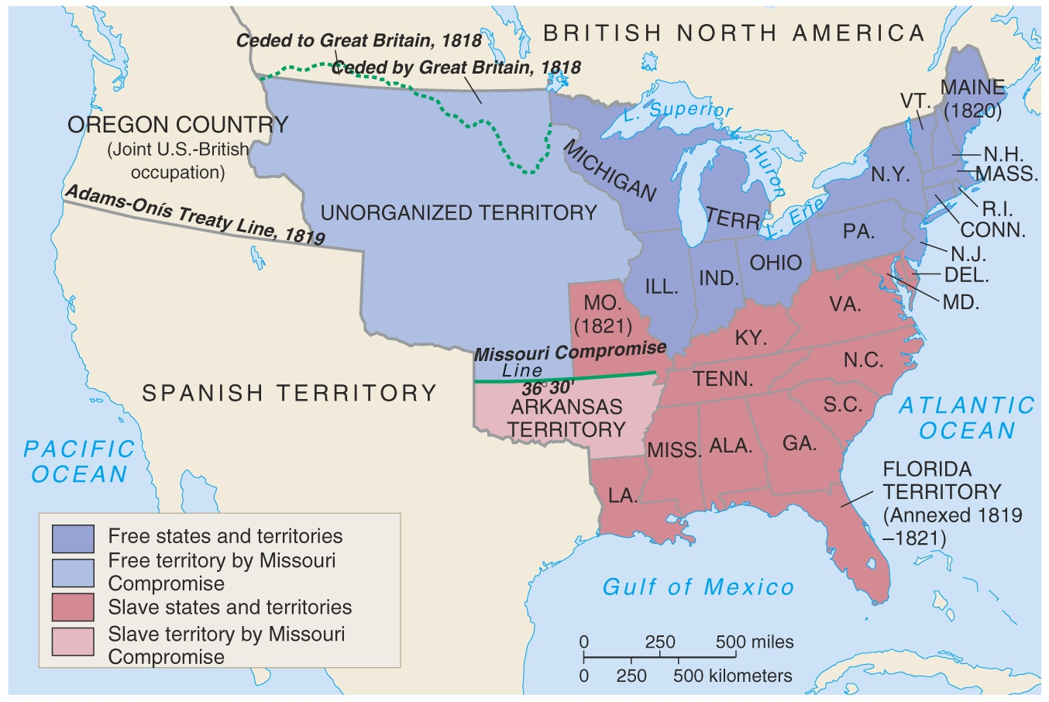
Missouri Compromise, 1820-1821

Slide 19
Missouri Compromise (1820):
Missouri became a slave state
Maine (which broke from Mass) was admitted as free state
Slavery was banned elsewhere in the Louisiana Purchase above the latitude of 36°30'
The Missouri controversy exposed a deep rift between North & South

Slide 20
Conclusions
The “Era of Good Feelings” led to:
An improved American economy
Better transportation
More territory & more clearly-defined borders
A foreign policy in Latin America
But…sectional problems between the North & South

