Slide 1
Do Now
Text Analysis-Northern Race Riots

Slide 2
5. The “Roaring” Twenties
Mr. Winchell
APUSH 2018-2019
Period 7

Slide 3
AP Prompt
Evaluate the extent to which progressive vs. conservative ideals created conflict in American society in the years 1920-1929.

Slide 4
Outline & Assessment
The Red Scare and Palmer Raids
Immigration and the KKK
Prohibition
Harlem Renaissance
Scopes Trial
Flappers
Consumerism
Arts and Culture

Slide 5
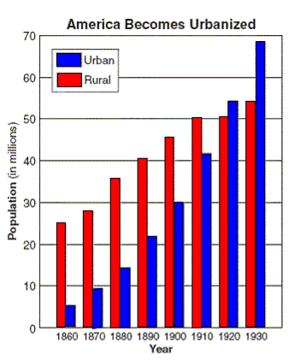
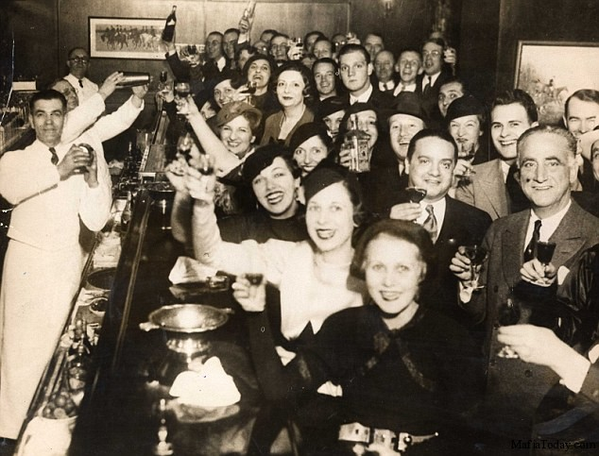
The 1920s was a decade of change
Americans experienced increased wealth, consumerism, leisure time, and new forms of entertainment led to a “Jazz Age”
By 1920, more Americans lived in cities than in rural areas

Slide 6
Themes of the 1920s
OVERARCHING THEME: Modernism vs. Fundamentalism
Theme #1: Politics reflected less gov’t & a retreat to neutrality
Theme #2: A new consumer culture developed
Theme #3: New cultural ideas expressed celebrity & fun
Theme #4: Conflict between urban & rural Americans
Theme #5: The widening gap between the rich & poor

Slide 7
The Red Scare
Communist Party came to power in Russia in 1917 (Bolshevik Revolution)
Strikes occur in 1919, shutting down important industries.
Steel Strike
Seattle General Strike
Boston PD Strike
Race riots
Bombings occur in 8 American cities

Slide 8
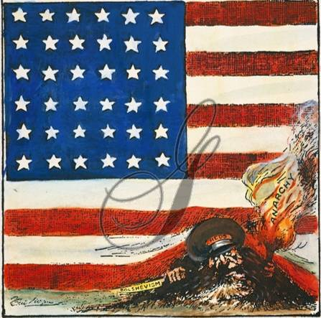
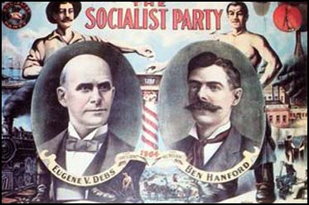
The Red Scare, union strikes, and growth of Eugene Debs’ Socialist Party spread fears of a Russian-style socialist revolution

Slide 9
Palmer Raids

Slide 10
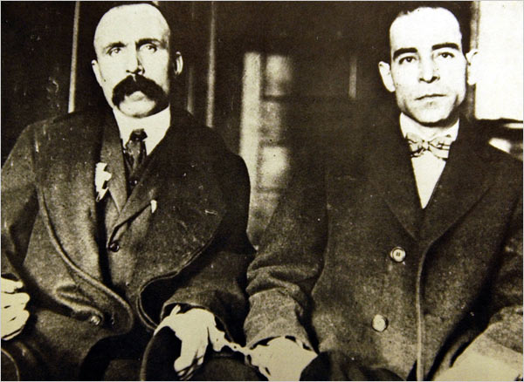
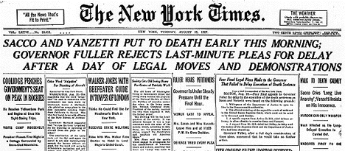
During the Red Scare, immigrants were under attack
In 1920, Nicola Sacco and Bartolomeo Vanzetti were arrested and charged with robbery and murder
Sacco and Vanzetti were Italian immigrants and anarchists
With only circumstantial evidence, they were found guilty and executed

Slide 11
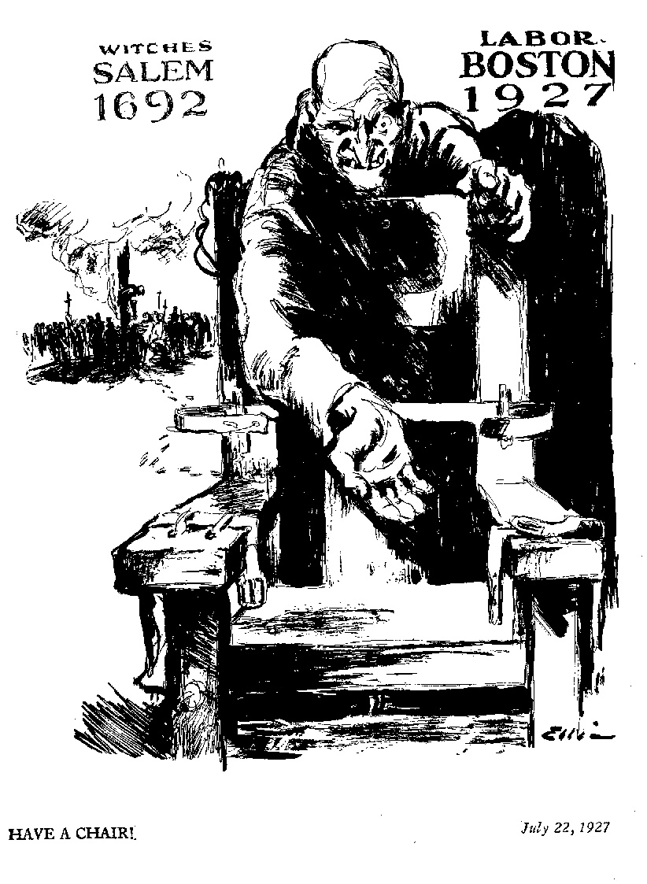

Slide 12
Immigration and the KKK
Continued hatred toward ‘new immigrants’ was fueled by socialism/anarchism and other radical movements
Emergency Quota Act of 1921; 3% of immigrants living in US in 1910
National Origins Act of 1924: 2% of immigrants in the US in 1890
CLEARLY limits new immigration from Southern/Eastern Europe
CLEARLY limits Asian immigration
Unrestricted immigration from the Western Hemisphere

Slide 13
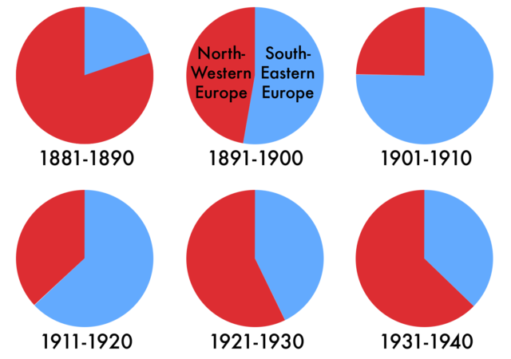
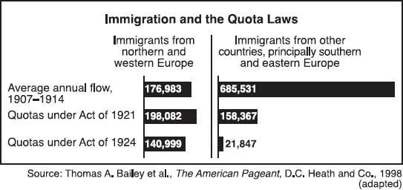
These laws targeted those immigrants who came from Southern and Eastern Europe or Asia

Slide 14
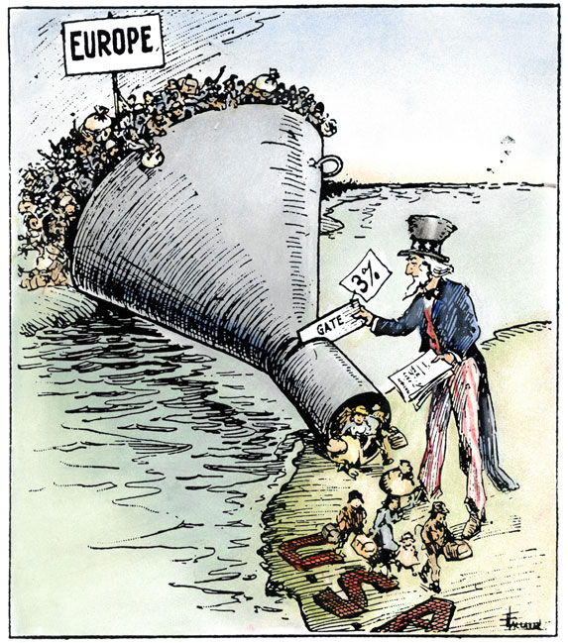

Slide 15
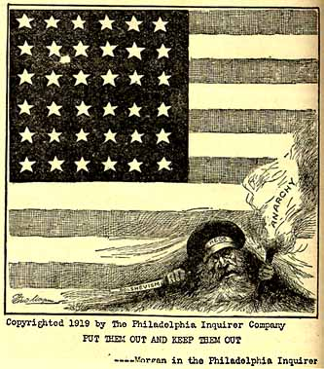

Slide 16
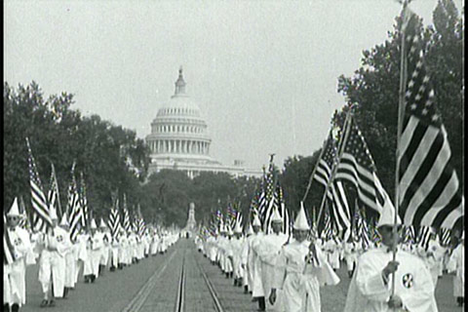
Notes:
Historical Review
a. “Know-Nothings” in 1850s
b. Chinese Exclusion Act, 1882
c. “Gentleman’s Agreement”, 1908
d. World War I
e. KKK in the 1910s and 1920s

Slide 17
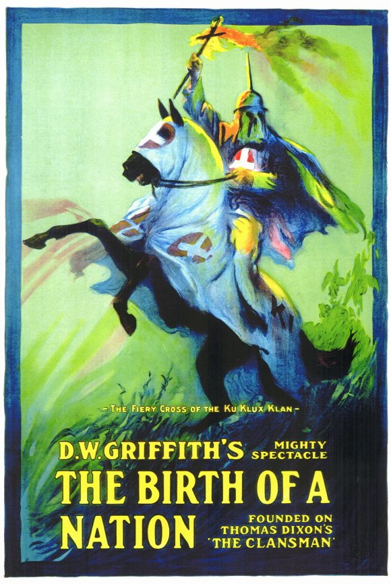
KKK Reborn 1915
Inspired by The Birth of a Nation, movie based on novel The Clansman, that portrayed KKK as hooded avengers and protectors of virtue
Re-born on top Stone Mountain GA, quickly became national, with headquarters in Indiana

Slide 18
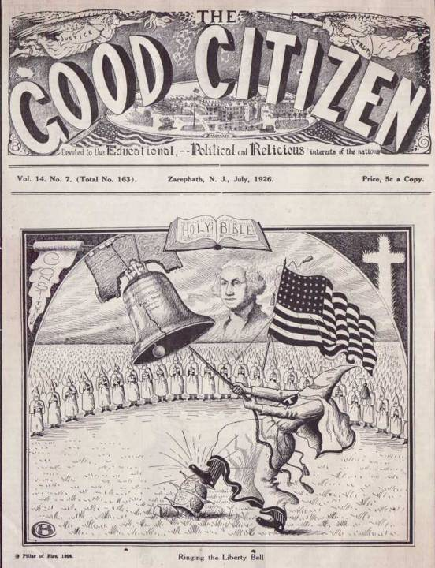
The 1920s saw an increase in membership in the Ku Klux Klan
The KKK promoted traditional “American” values and used violence and fear to attack immigrants, African Americans, Catholics, Jews, socialists

Slide 19
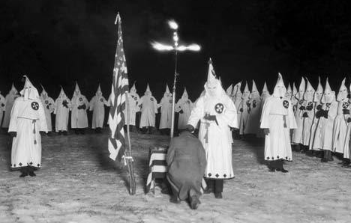
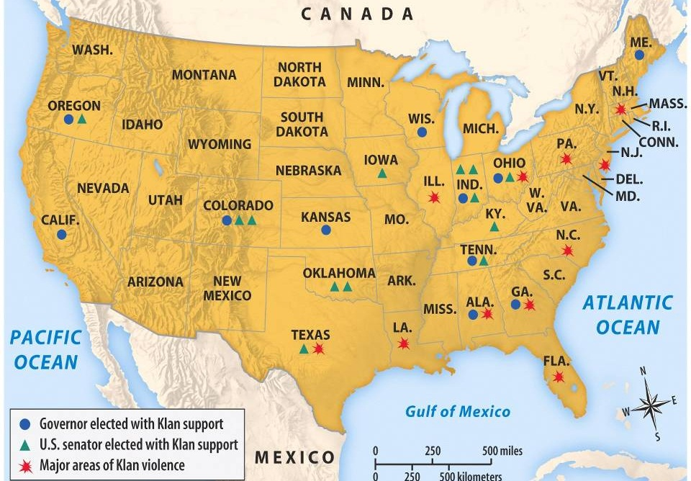
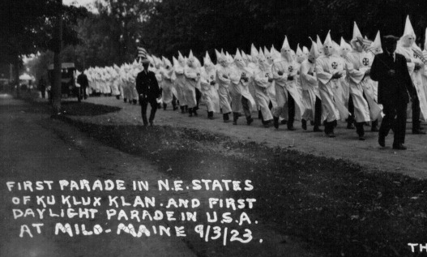
By 1924, the KKK had 4.5 million members and elected politicians to power in several states

Slide 20
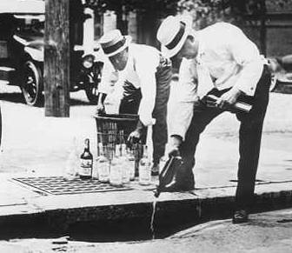
In 1920, the 18th Amendment was ratified and the Prohibition era began
Rural Americans supported this “noble experiment” because they believed drinking led to crime and other social problems
The Volstead Act outlawed the sale and manufacture of alcohol

Slide 21
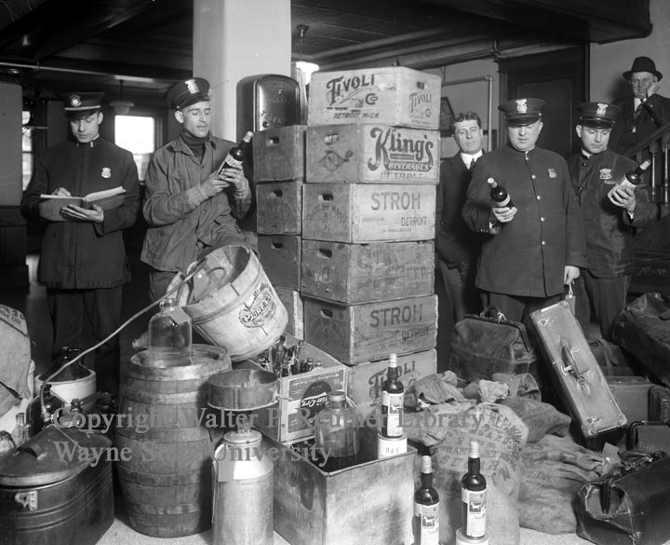
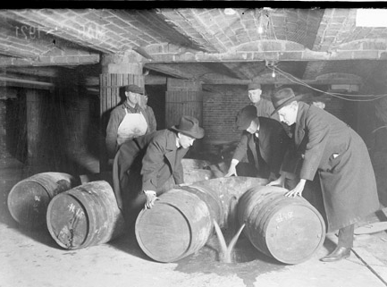
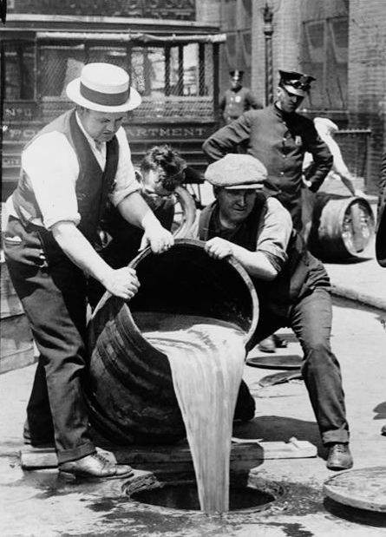
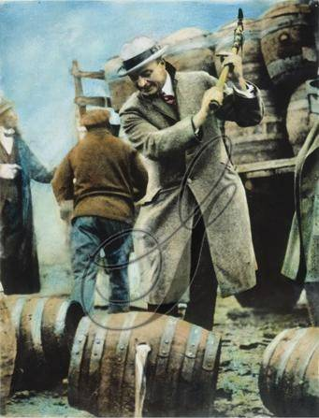
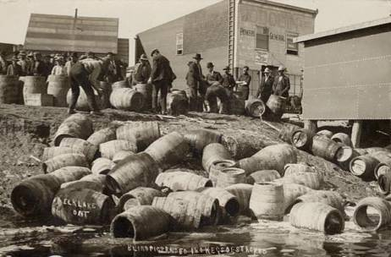
The U.S. Treasury Department was in charge of enforcing the Volstead Act

Slide 22
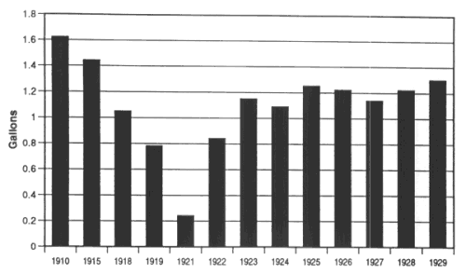
During prohibition, alcohol consumption declined

Slide 23
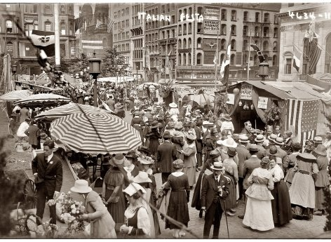
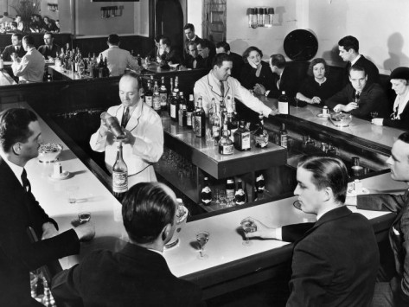
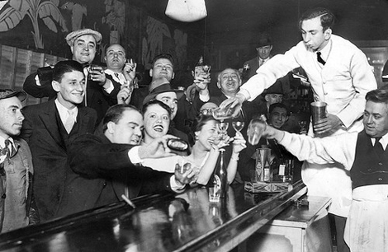
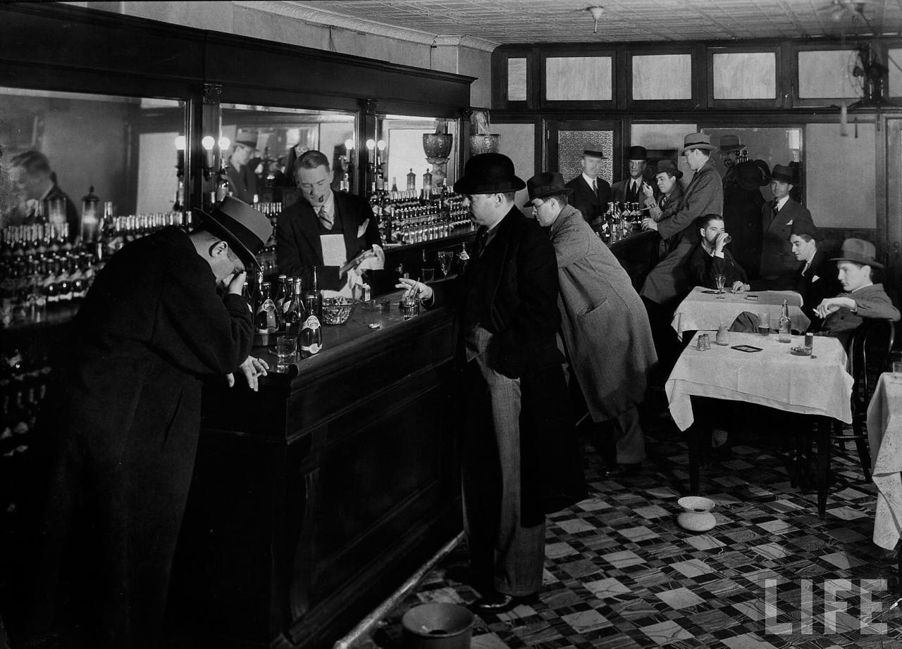
Many urban Americans resisted prohibition
Drinking was a cultural norm for many immigrants
Many urban Americans wanted to enjoy themselves in illegal bars called speakeasies

Slide 24
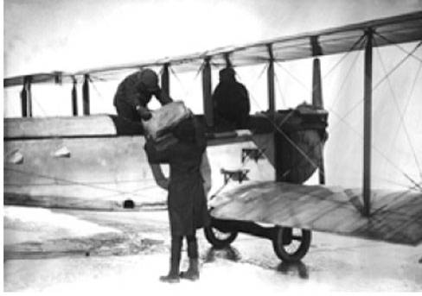
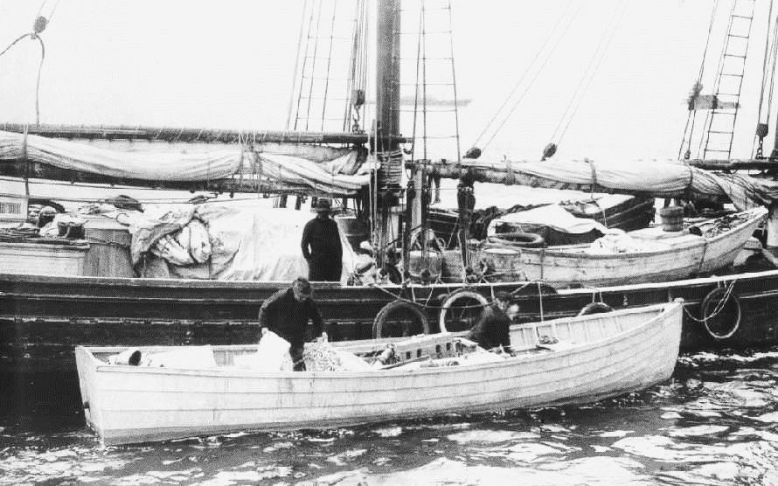
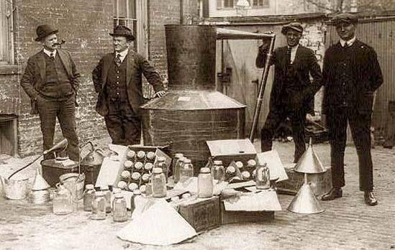
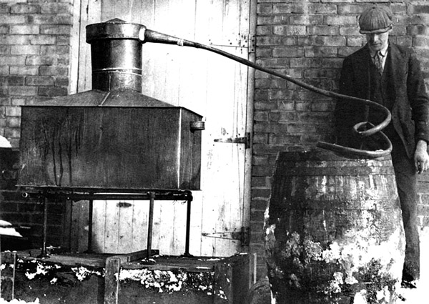
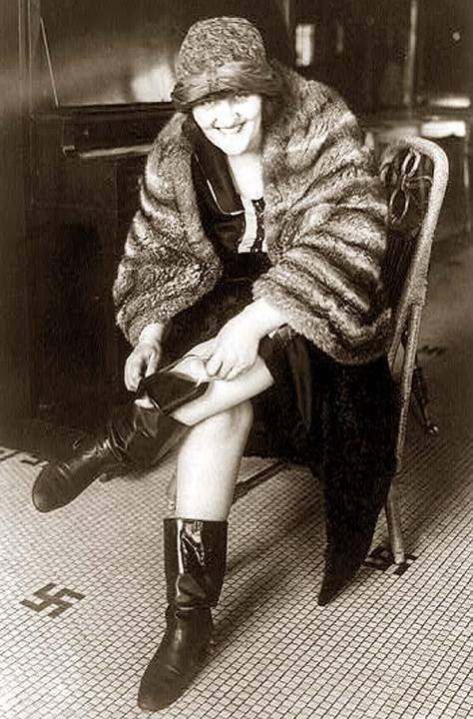
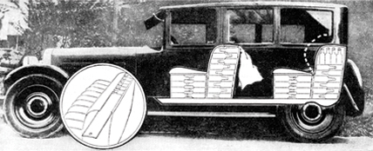
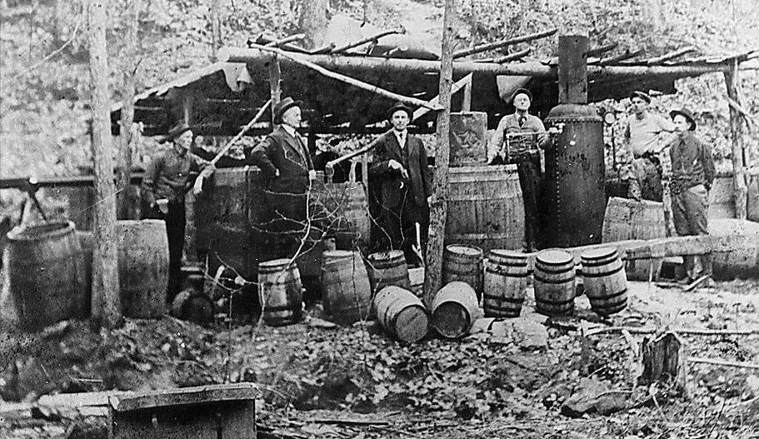
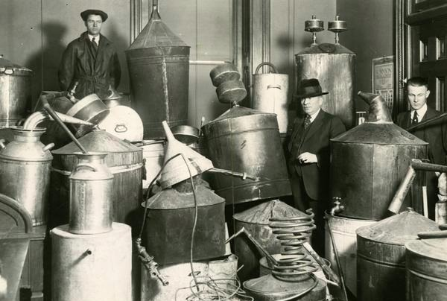
Demand for illegal alcohol led to a rise in smuggling (“bootlegging”), moonshining, crime, death, blindness, paralysis, lack of respect for law…..

Slide 25
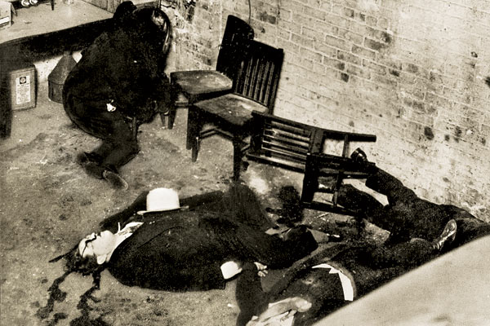
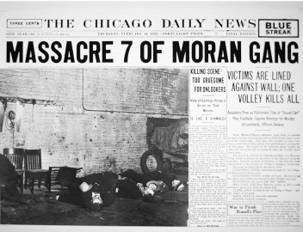
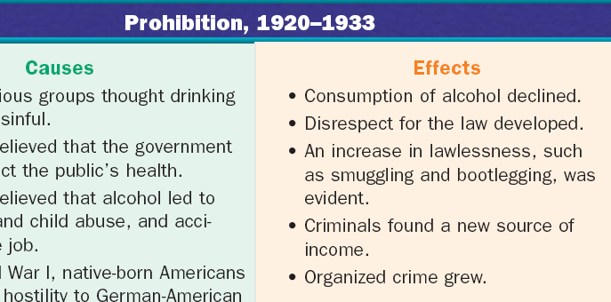
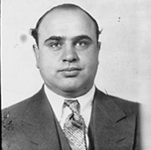
The most notorious mobster was Al Capone who controlled the alcohol trade in Chicago
Organized crime emerged in America as the mafia took control of the illegal alcohol trade
To control the liquor trade, mobsters resorted to gang killings like the St. Valentines Day Massacre in 1929

Slide 26
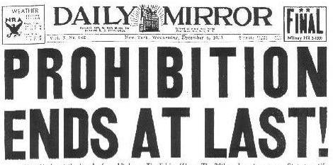
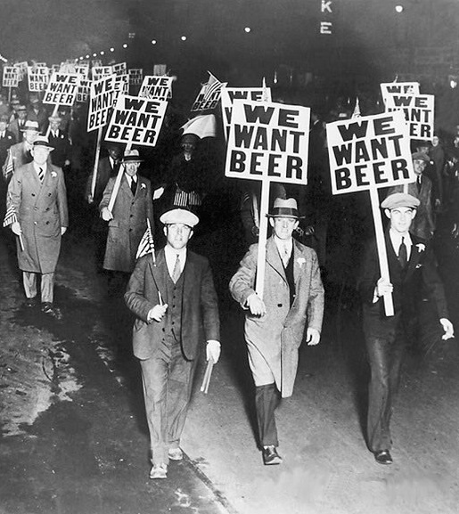
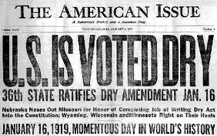
By the end of the 1920s, only 19% of Americans supported prohibition
The strongest defenders of prohibition were rural Americans…
…But, most Americans believed that prohibition caused more problems than it solved
The 21st Amendment was ratified in 1933 to repeal prohibition

Slide 27
Harlem Renaissance
The Harlem Renaissance reflected the explosion of black culture & the “New Negro”:
Jazz & Blues expressed the social realities of blacks; Louis Armstrong became very popular
Langston Hughes’ poetry, novels, & plays promoted equality, condemned racism, & celebrated black culture

Slide 28
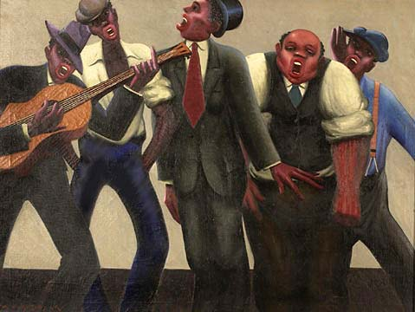
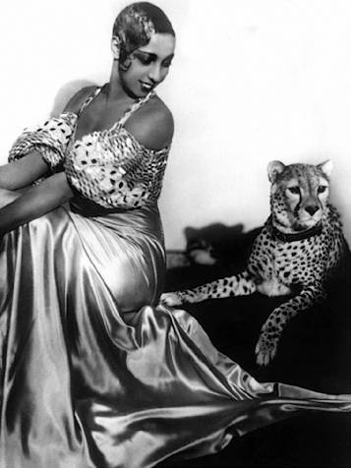
Josephine Baker, internationally renowned singer/dancer
“You could be black & proud, politically assertive & economically independent, creative & disciplined—or so it seemed”
Notes:
Josephine Baker-international singer/dancer

Slide 29
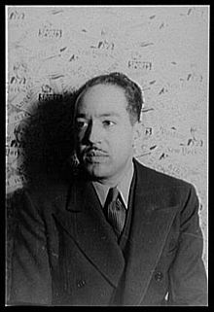
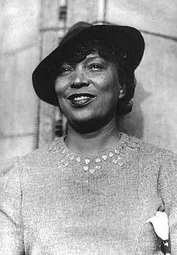
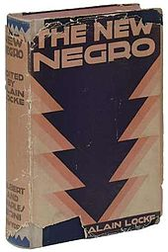
1920s Culture Wars Harlem Renaissance
Fueled by the Great Migration and inspired by black pride
Themes challenged racist stereotypes
“Black is beautiful”
Langston Hughes
Zora Neale Hurston
The New Negro: An Interpretation (1925)

Slide 30
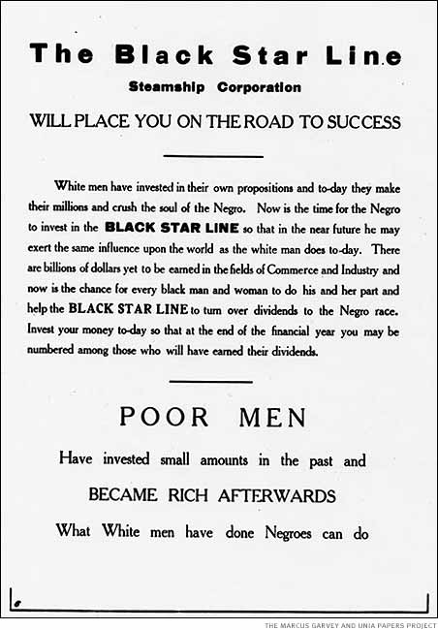
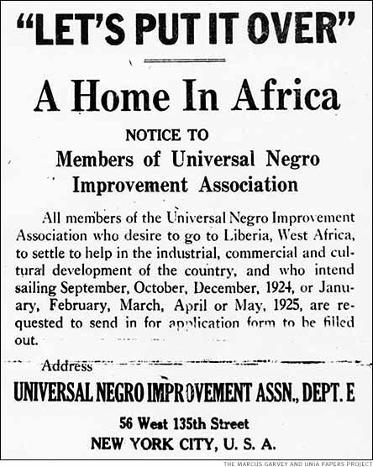
Marcus Garvey
Marcus Garvey was the preeminent civil rights activist of the 1920s
Oppression in the U.S. necessitated strict segregation & black nationalism
He formed the United Negro Improvement Assoc & advocated a return to Africa
“The most dangerous enemy of the Negro race”
—W.E.B. DuBois

Slide 31
Rural Americans found comfort in religious fundamentalism (a literal interpretation of the Bible)
Rural folks rejected the urban values, especially immigrants and flappers
Evangelists used the radio to broadcast Christian messages
1920s evangelist Billy Sunday

Slide 32
Many rural Christians rejected ideas that contradicted the Bible and outlawed the teaching of evolution in schools
Teacher John Scopes was arrested in Dayton, Tennessee for teaching evolution in his biology class

Slide 33
The Scopes “Monkey Trial” was a national sensation
ACLU attorney Clarence Darrow defended Scopes; Represented urban America, science and modernity
William Jennings Bryan served as prosecutor; Represented Christianity and rural values

Slide 34
Scopes was found guilty, but evolutionists believed they won because Darrow got Bryan to admit that the world might not have been made in six 24 hour days

Slide 35
Flappers

Slide 36
America in the 1920s
America was changed by the industrialism of the Gilded Age & the economic boom of WWI
During the 1920s:
The USA was the richest & most developed country in the world
Wages rose, hours declined, & Americans had access to new, innovative consumer goods

Slide 37
The Second Industrial Revolution
The increase of national name brands (rather than locally produced goods) linked Americans more than ever
From 1922 to 1929, the U.S. had a 2nd industrial boom:
Mostly in consumer durable goods like appliances, cars, radios, furniture, & clothing
Electricity replaced steam power
Corporations used salaried executives, plant managers, & engineers to increase efficiency

Slide 38
Glenwood Stove Ad
1920s consumerism led to luxury living:
New appliances like refrigerators, washing machines, & vacuums

Slide 39
1920s advertising

Slide 40
1920s consumerism led to luxury living:
Radios & movies boomed
100 million Americans went to the movies in 1929 per week
The first “talkie”
NBC was the 1st successful radio network

Slide 41
Economic Weaknesses
The “Roaring 20s” was not as prosperous as it appeared:
RR, cotton textile, coal industries suffered due to new competition
Farmers boomed during WWI but a decline in demand after the war deflated farm prices
Farm per capita income of was $273 per year vs. the U.S. average of $681 per year

Slide 42
Consumerism

Slide 43
The Lost Generation-The Flowering of the Arts
“The Waste Land” focused on a sterile U.S. society
The 1920s gave rise to a new class of intellectuals who condemned the new American industrial society & materialism:
Pessimistic Literature: TS Eliot, Ezra Pound, Sinclair Lewis, F Scott Fitzgerald, Hemmingway
Playwrights: Eugene O’Neill
Music: Gershwin & Copland
Poetry discussed a “botched wasteland”
“Main Street”–narrow-minded small towns
“Great Gatsby”—human emptiness
Romantic individualism & violence
Plays of tragic pipedreams

Slide 44
America in the 1920s experienced a decade of change
There was an increase in consumerism…
Government policies favored business and isolationism
Women and African Americans experienced new freedoms while immigrants came under attack
…cars, radios, entertainment

