Slide 1
Do Now
Analyze the promises made in Kennedy’s Inaugural Address. Who is making promises to? On who’s behalf?

Slide 2
5. The Vietnam War and the Society’s Response
Mr. Winchell
APUSH 2018-2019
Period 1-2

Slide 3
AP Prompt
Evaluate the effects of Vietnam on American culture, society and politics.

Slide 4
Outline
Kennedy’s Foreign Policy
Vietnam Pre-US Involvement
Why Fight? The ‘Sides’ of Vietnam
Johnson’s Vietnam-The Gulf of Tonkin Resolution
The War-Conquest vs. Attrition
The Tet Offensive & My Lai Massacre
The Growing Protest Movement
Counterculture 60s
Nixon’s Vietnam

Slide 5
John F. Kennedy (D) (1961-1963) Flexible Response
Secretary of Defense Robert McNamara
Develop conventional military strategies and policies
Nuclear weapon escalation as last phase
Alliance for Progress (1961)
Economic cooperation with Latin America
Peace Corps (1961)
American University Speech (1963)
Nuclear Test Ban Treaty (1963)
Vietnam (1963)
Military advisors for South Vietnam and Ngo Dinh Diem

Slide 6
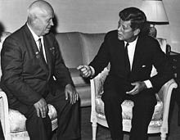
Kennedy & Flexible Response (1961-1963) Berlin Wall
Bay of Pigs
Berlin Crisis (1961)
Berlin Wall (1961)
Checkpoint Charlie
“Ich Bin Ein Berliner” (1963)
Premier Nikita Khrushchev and JFK (1961)

Slide 7
Kennedy & Flexible Response (1961-1963) Cuba
Bay of Pigs Invasion (1961)
Cuban Missile Crisis (1962)
Soviet missiles in Cuba

Slide 8
Cuban Missile Crisis
And…U.S. removal of nuclear weapons in Turkey
The standoff ended when Russia removed its Cuban missiles & the USA vowed to never invade Cuba
The impact of the crisis:
Seen as a political victory for JFK
Installed a “hot line” to improve US-Soviet communications
This near-nuclear war convinced both sides to move from confrontation to negotiation
“Our most basic common link is the fact that we all inhabit this planet. We all breathe the same air. We all cherish our children’s future. We are all mortal.”
—JFK

Slide 9
Vietnam Pre-US Involvement
1400-1800: Struggle between Vietnam and conquering China (Mongols before that)
1858: French conquer Vietnam
1893: French Indochina
1930: Ho Chi Minh forms the Vietnamese Communist Party
1940: Japan takes over Vietnam (WWII)
1945: France reoccupies Southern Vietnam, Ho Chi Minh and the Viet Minh seize Northern Vietnam-Declare Independence and Vietnam War begins
US SUPPORTS FRANCE TO STOP COMMUNISM

Slide 10
Containment in Vietnam
Vietnam proved to be a tough test:
Since 1954, Communist leader Ho Chi Minh gained popularity in North Vietnam; By 1961, he gained a foothold in the South
The U.S. gave aid to unpopular South leader Ngo Dihn Diem
When Diem lost control of the South, JFK gave the OK for a coup against Diem in 1963
“Strongly in our mind is what happened in China at the end of World War II, where China was lost. We don’t want that.”
—JFK

Slide 11
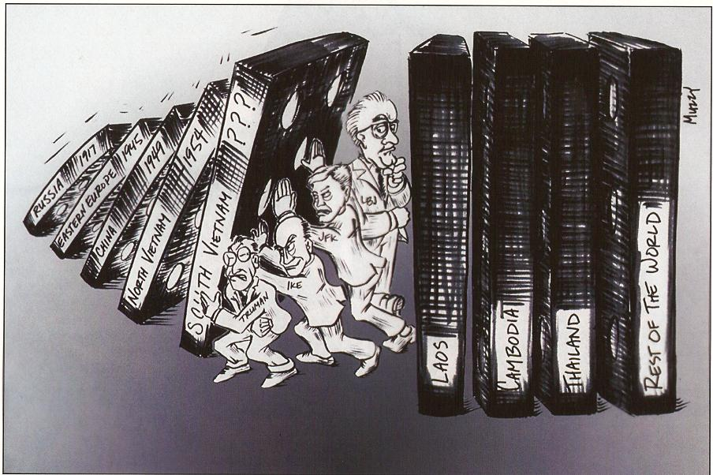
U.S INTERVENTION IN VIETNAM BEGINS

Slide 12
The Costs of Vietnam
“If I left the woman I really loved-the Great Society - in order to get involved in that bitch of a war on the other side of the world, then I would lose everything at home… But if I left that war and let the Communists take over South Vietnam, then I would be seen as a coward and my nation would be seen as an appeaser and we would both find it impossible to accomplish anything for anybody anywhere on the entire globe."
-Lyndon B. Johnson

Slide 13
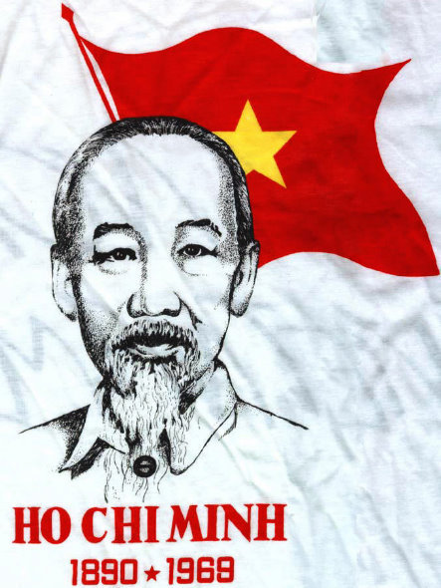
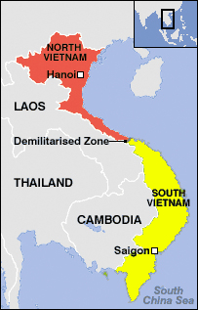
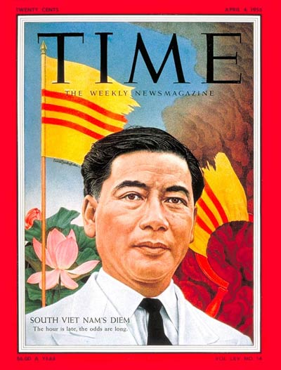
Vietnam
Viet Minh are Vietnamese communists in North Vietnam
Viet Cong are Vietnamese communists in South Vietnam

Slide 14
Why Fight?
The Ho Chi Minh’s
The American Backed ‘Non-Communists’
The Americans

Slide 15
America Is Fighting for a Just Cause in Vietnam; America Is Not Fighting for a Just Cause in Vietnam
Lyndon B. Johnson – Speech at Johns Hopkins University (1965)
Eugene McCarthy – Address at Conference of Concerned Democrats (1967)
Why must this Nation hazard its ease, and its interest, and its power for the sake of a people so far away?... We fight because we must fight if we are to live in a world where every country can shape its own destiny. And only in such a world will our own freedom be finally secure… Over this war – and all of Asia – is another reality: the deepening shadow of Communist China... To leave Viet-Nam to its fate would shake the confidence of all these people in the value of an American commitment and in the value of America’s word. The result would be increased unrest and instability, and even wider war... Because we fight for values and we fight for principles, rather than territory or colonies, pur patience and our determination are unending... This generation of the world must choose: destroy or build, kill or aid, hate or understand...Well, we will choose life. In so doing we will prevail over the enemies within man, and over the natural enemies of all mankind.
Instead of the language of promise and of hope, we have in politics today a new vocabulary in which the critical word is war: war on poverty, war on ignorance, war on crime, war on pollution. None of these problems can be solved by war but only by persistent, dedicated, and thoughtful attention. But we do have one war which is properly called a war – the war in Vietnam, which is central to all of the problems of America. A war of questionable legality and questionable constitutionality. A war which is diplomatically indefensible… Even assuming that both objectives and methods can be defended, the war cannot stand the test of proportion and of prudent judgment. It is no longer possible to prove that the good that may come with what is called victory, or projected as victory, is proportionate to the loss of life and property and to other disorders that follow from this war.

Slide 16
LBJ Escalates the Vietnam War
During the Gulf of Tonkin affair in Aug 1964, the military bombed North Vietnam in retaliation for an attack on the USS Maddox
The Gulf of Tonkin Resolution gave LBJ the authority to:
Defend Vietnam at any cost
Unlimited military intervention to be used at LBJ’s discretion

Slide 17
Escalation
LBJ’s advisors wanted 100,000 troops in 1965 & a plan for 100,000 more in 1966; Estimations were 500 U.S. deaths per month
1965 marked the beginning of full-scale U.S. involvement in Vietnam
LBJ was informed that “without U.S. action, defeat is inevitable”
LBJ authorized bombing raids into North Vietnam & requested 50,000 U.S. soldiers sent to Asia
LBJ never explained to the American people how the gov’t planned to win the war in Vietnam
LBJ took middle road of limited U.S. intervention: not a withdrawal & not a full-scale invasion of North Vietnam

Slide 18
“Operation Rolling Thunder”
In March of 1965 the first U.S. combat troops began arriving in South Vietnam & by June more than 50,000 U.S. soldiers were fighting against the Vietcong
This has become known as the Americanization of the Vietnam War
Above: U.S. B-52 bombers bombing North
Vietnam
Below: U.S. marines arriving in Vietnam

Slide 19
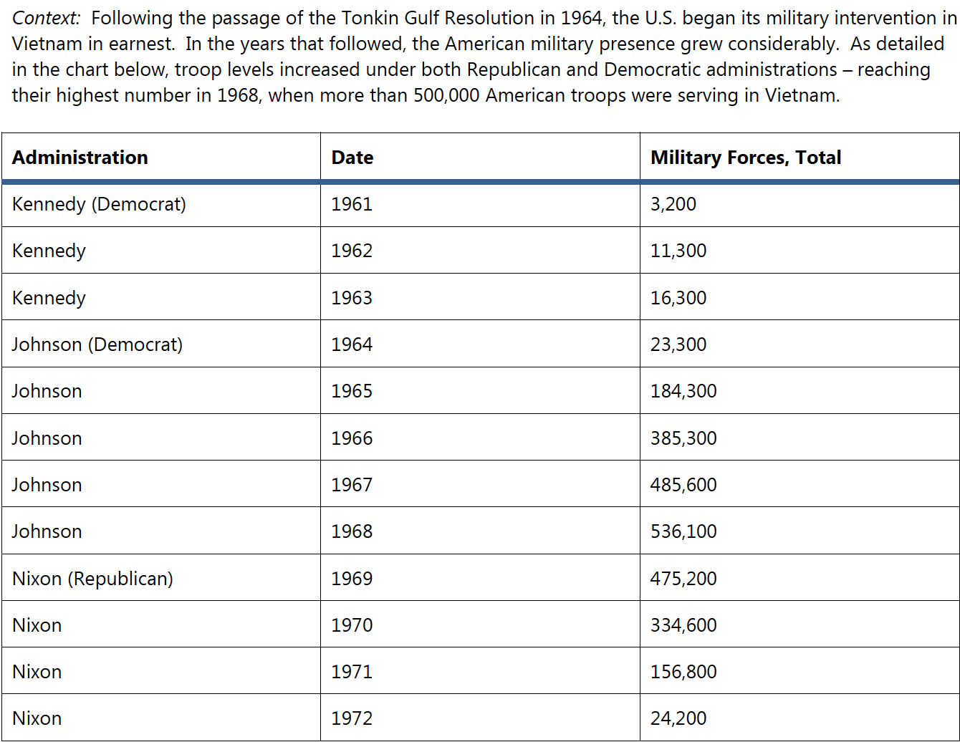

Slide 20
Increased Involvement
In the early stages the American people supported U.S. involvement in Vietnam
But didn’t want a full scale engagement
In the 1964 election President Johnson won b/c his opponent Barry Goldwater was very anti-communist & might push the U.S. into war with the Soviet Union
In campaign speeches Pres. Johnson said that “he was not about to send American boys 9 or 10,000 miles away from home to do what Asian boys ought to be doing for themselves”
In March of 1965 after consulting with Sec. of Defense Robert McNamara and Sec. of State Dean Rusk Pres. Johnson began to send tens of thousands of U.S. soldiers to fight in Vietnam
Polls taken in 1965 showed that 61% of Americans supported Pres. Johnson’s policies in Vietnam while only 24% opposed those policies
People were afraid that if the U.S. stood back & allowed Vietnam to fall that the Soviets would become more aggressive all over the world & we would be fighting another Vietnam somewhere else in a year
If we could just stop them in Vietnam we could prevent them from becoming aggressive elsewhere
Some people however did warn of impending problems
Undersecretary of State George Ball warned that “once on the tiger’s back, we cannot be sure of picking the place to dismount”

Slide 21
Misguided Assumptions
Entering the Vietnam war the U.S. felt that it’s superiority in technology would lead to a quick victory in Vietnam
The jungle terrain, determination of the enemy, and their guerrilla tactics however turned the war into a stalemate
Much like the Americans in the Am. Revolution the Vietcong resorted to hit & run tactics
Ambushing their opponent & slipping away
Using their knowledge of the jungle to harass & lay booby traps for U.S. forces
Also they were indistinguishable from the civilian population & were able to move in and out of villages they were able to attack the U.S. forces in the cities & out in the countryside as well as spy on U.S. forces
It became nearly impossible for U.S. forces to tell between friend or foe

Slide 22
War of Attrition
General Westmoreland decided upon
a war of attrition
One in which they would gradually wear
down the Vietcong by inflicting heavy
losses
The U.S. began to focus on body counts to
determine success
Problem was that often times these body counts were inflated & even the accurate ones didn’t relate to actual success
The Vietcong had been fighting for 30 years & morale was not hurt by taking heavy losses
The U.S. didn’t understand the type of war that was being fought
The U.S. thought in purely military terms & felt that as the body counts rose the Vietcong would give up
The Vietcong were fighting for their very existence & were prepared to pay any price
They were driving out a foreign occupier it didn’t matter to them if that occupier was Japan, France or the U.S.
Ironically the mistakes that the U.S. made in terms of their perception of the war were very similar to the mistakes that the British had made during the American Revolution (AND THE SAME MISTAKES THE FRENCH HAD JUST MADE)
U.S. Marine standing in front of a destroyed
Vietcong headquarters

Slide 23
Friend or Foe?
As is often the case with a civil war it became increasingly difficult for U.S. forces to tell the difference between friend & foe
Soldiers that were subject to ambushes from Vietcong that had blended into the civilian population caused many U.S. soldiers to become increasingly distrustful of all Vietnamese
This distrust occasionally developed into outward hostility
The U.S. military also used many questionable tactics to root out the Vietcong
Napalm, a jelly like gasoline based bomb that set fire to jungle areas was often used
Agent Orange a leaf-killing toxic chemical was used to defoliate the jungles that the Vietcong were hiding in
Saturation of these weapons often wounded civilians and left villages in ruins
Above: Napalm strike on a suspected Vietcong controlled village S of Saigon
Below: Children fleeing accidental napalm strike

Slide 24
Vietnam in 1968
‘There’s light at the end of the tunnel…’ General Westmoreland
In 1968, the Vietcong launched the Tet Offensive against U.S. forces in South Vietnam
The attack was contrary to media reports that the U.S. was winning the Vietnam War
The attack led LBJ to believe that Vietnam could not be won
In 1968, LBJ began discussions to seek a truce & announced that he would not seek re-election
Notes:
‘There’s light at the end of the tunnel…’ General Westmoreland

Slide 25
Aftermath of the Tet Offensive
In a matter of weeks millions of Americans changed their minds about the war in Vietnam
The percent of people who claimed to be hawks dropped from 56% before Tet to just 40% after while Doves rose from 28% to 40%
Even the mainstream journalists began to openly criticize the war
Walter Cronkite one of the most respected journalists of the day began to claim that the war in Vietnam would end in a stalemate
Prompting Pres. Johnson to say that “if I’ve
lost Cronkite then I’ve lost the American
people”

Slide 26
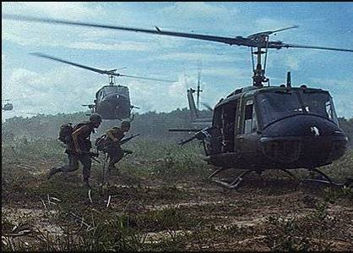
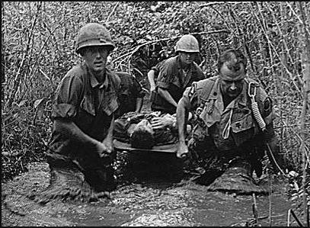
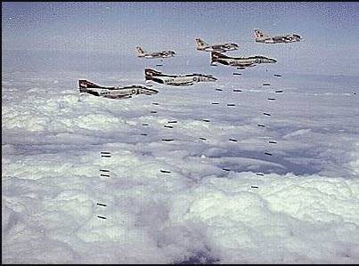
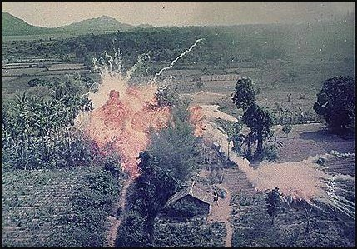

Slide 27
Johnson & Vietnam (1963-1969) War and Tragedy

Slide 28
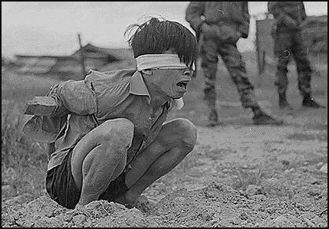
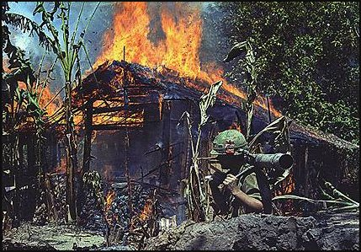
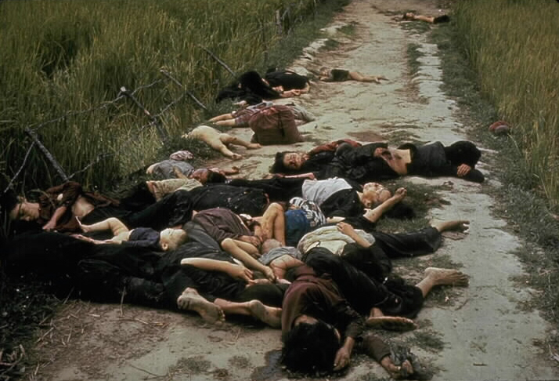
Image of the “My Lai Massacre,” 1968

Slide 29
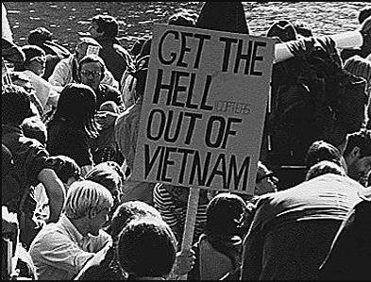
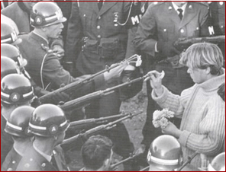

Slide 30
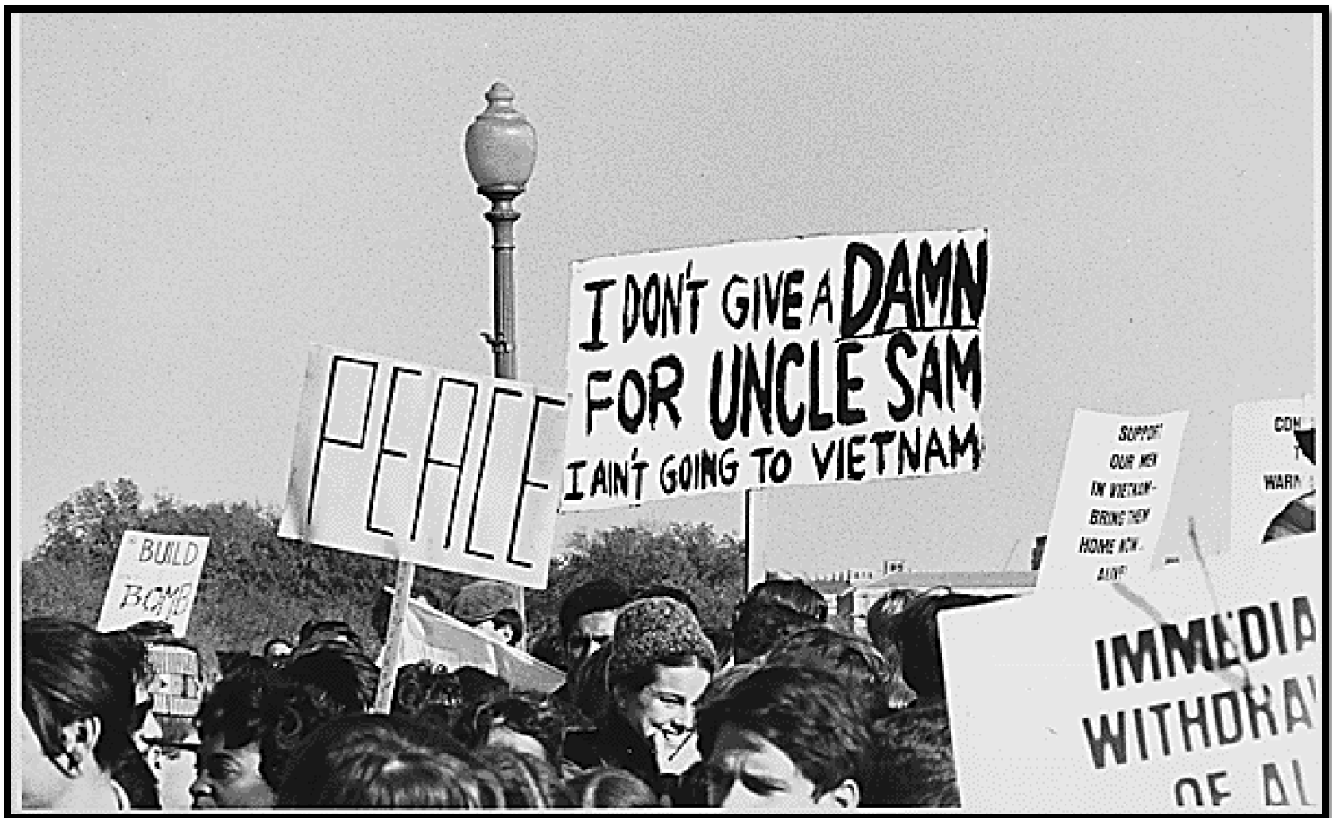

Slide 31
Great Society loses to Vietnam
As the U.S. involvement in Vietnam increased the nation’s economy began to suffer.
Inflation rate increased from 2% to 5.5% by 1969
Pres. Johnson introduced a tax increase but had to cut $6 billion from his Great Society programs
By 1967 the United States
had dropped more bombs than in all theaters of WWII
had close to ½ a million troops on the ground
was spending $2 billion dollars a month on the war
Vietnam was the first war in which television had a major impact
Combat footage appeared in millions of homes nightly
Became known as the “living-room war”

Slide 32
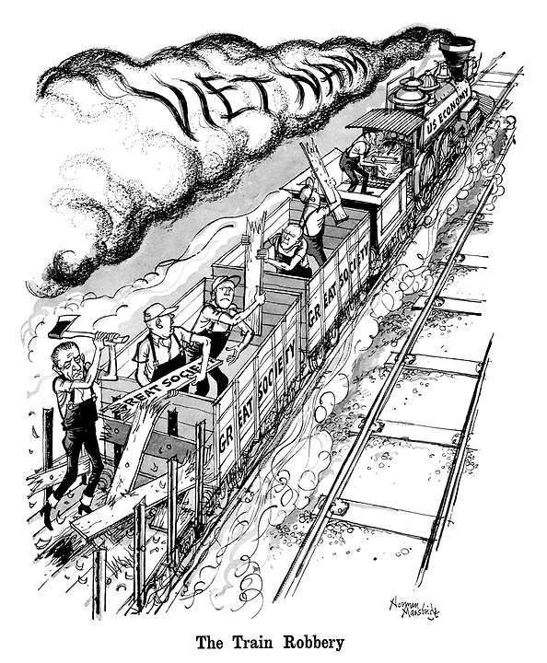

Slide 33
Vietnam Protests
Self-immolation was an extreme form of protest.
Here, Buddhist monk, Thich Quang Duc, before the U.S. escalation. A few Americans engaged in this extreme act of protest during Vietnam.

Slide 34
Counterculture Movement
Hippies/Flower Children
Non-violent anarchism
Rejection of materialism
Concern for the environment
Youth International Party (Yippies)
Abbie Hoffman
Radical hippies known for theatrical protests and tactics
Sexual Revolution (1960s-1980s)
Kinsey studies, novels, magazines
Contraception and premarital sex
Abortion and Roe v. Wade (1973)

Slide 35
Music as Expression
Themes
Anti-Establishment
Anti-war
Promotion of counterculture
War - Edwin Starr
Artists
Bob Dylan
Jim Morrison
Rolling Stones
The Beatles
Joan Baez
Jimi Hendrix
Woodstock (1969)
500,000 attend 3-day rock concert

Slide 36
1968 The Year of Rage
Tet Offensive (Jan. 30)
Nguyen Van Lem Assassinated (Feb. 1)
My Lai Massacre (Mar. 16)
LBJ Withdraws (Mar. 31)
MLK Assassination (Apr. 4)
Columbia University Protests (Apr. 23-30)
Robert Kennedy Assassination (June 5)
Democratic National Convention Riots (Aug. 22-30)
Nixon wins election (Nov. 5)

Slide 37
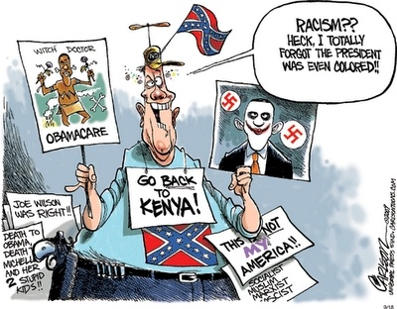
Republican “Southern Strategy”
“State’s rights”…
Split working-class whites away from blacks
New “Solid South” is Republican

Slide 38
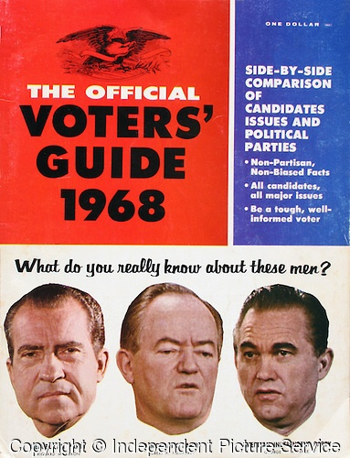
Election of 1968
Richard Nixon (R)
Law and Order
Southern Strategy
Hubert Humphrey (D)
National Convention Riots in Chicago
George Wallace
American Independent Party

Slide 39
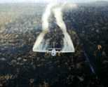
Nixon on Vietnam
Nixon’s 1968 Campaign promised an end to the war: Peace with Honor
Appealed to the great “Silent Majority”
Vietnamization
Expansion of the conflict → The “Secret War”
Cambodia
Laos
Agent Orange (chemical defoliant)
Notes:
Nixon’s “secret” plan never materializes.
He involved us more.
“Peace with Honor” We’ll win befoe we withdraw.
Expansion:Cambodia invaded in 1970: Ho Chi Minh Trail
Laos invaded in 1971: Ho Chi Minh Trail

Slide 40
Protest and Response Escalates
The US invasion of Cambodia-Protest Increase
College students held protests around the country some of them tragically ending in violence
Jackson State University in Mississippi, police killed 2 students and wounded nine others.
After students at Ohio’s Kent state University burnt down the campus’s ROTC building, Ohio governor James Rhodes claimed they were “worse than the Nazis” and vowed to kicked them off the campus.
On May 4, 1970 Ohio National Guardsmen at Kent State opened fire on antiwar demonstrators and killed 4 students. The killings outraged the public and caused an additional wave of student strikes and protests around the country.
By the end of May students at over 400 college campuses had brought classes to a halt. The Nixon administrations’ initial response to the Kent state murders only made things worse: Press Secretary Ron Ziegler stated that the students’ deaths were evidence that when dissent turns to violence it invites tragedy. In the one and half years since Nixon had taken office the situation abroad and at home seemed to have worsened.

Slide 41
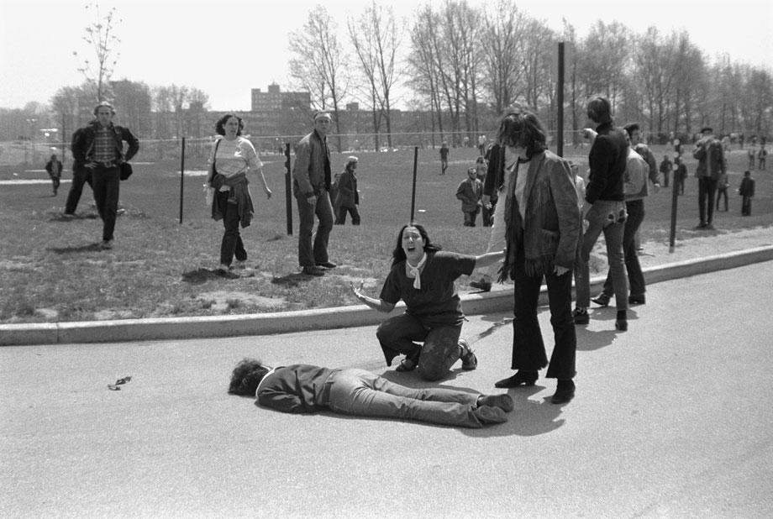

Slide 42
OHIO
Crosby, Stills, Nash, and Young

Slide 43
“Pentagon Papers,” 1971
Former defense analyst Daniel Ellsberg leaked govt. docs. regarding war efforts during Johnson’s administration to the New York Times.
Docs.→ Govt. misled Congress & Amer. People regarding its intentions in Vietnam during mid-1960s.
Primary reason for fighting not to eliminate communism, but to avoid humiliating defeat.
New York Times v. United States (1971) *
Notes:
Nixon resigns over the Watergate Scandal in 1974.
Ford takes the helm.

Slide 44
The Ceasefire, 1973
Peace is at hand → Kissinger, 1972
North Vietnam attacks South
Most Massive U.S. bombing commences
1973: Ceasefire signed between
U.S., South Vietnam, & North Vietnam
Peace with honor (President Nixon)
Notes:
Nixon resigns over the Watergate Scandal in 1974.
Ford takes the helm.

Slide 45
The Ceasefire, 1973
Conditions:
U.S. to remove all troops
North Vietnam could leave troops already in S.V.
North Vietnam would resume war
No provision for POWs or MIAs
Last American troops left South Vietnam on March 29, 1973
1975: North Vietnam defeats South Vietnam
Saigon renamed Ho Chi Minh City
Notes:
Many U.S.-loyal South Vietnamese attempt to flee for fear of execution by the North.

Slide 46
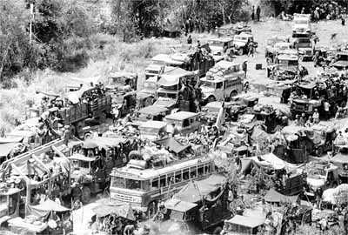
The Fall of Saigon
South Vietnamese Attempt to Flee the Country

Slide 47
The Impact
26th Amendment: 18-year-olds vote
Nixon abolished the draft→ all-volunteer army
War Powers Act, 1973
President must notify Congress within 48 hours of deploying military force
President must withdraw forces unless he gains Congressional approval within 90 days
Disregard for Veterans → seen as “baby killers”
POW/MIA issue lingered
Notes:
War Powers Act., 1973, passed over Nixon's veto, requires the President to
notify Congress within 48 hours of his use of military force in a foreign country or enlarging an ongoing conflict.
The President must secure Congressional approval if he intends to keep these troops overseas for more than 60 days. If he doesn't, he must withdraw the forces.
Congress can pass a joint resolution to withdraw the troops before the 60 day deadline. (Each President since has denied its validity, though the issue has never been tested.)
No welcome home (shamed and ashamed), high unemployment, alcohol & drug abuse; poor care of disabled vets: underfunded vets hospitals, Post-Traumatic Stress Disorder; Agent Orange health problems, birth defects in vets’ children.

Slide 48
The Costs
3,000,000 Vietnamese killed
58,000 Americans killed; 300,000 wounded
Under-funding of Great Society programs
$150,000,000,000 in U.S. spending
U.S. morale, self-confidence, trust of government, decimated
Notes:
Diversion of capital to the war indirectly caused economic recession: 11% inflation and 12% unemployment!

Slide 49
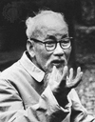
And in the End….
Ho Chi Minh:
If we have to fight, we will fight. You will kill ten of our men and we will kill one of yours, and in the end it will be you who tires of it.

