Slide 1
Do Now
Identify the significant political and economic impact of Congress’ actions during the Civil War, especially towards the “West”. Which party controlled Congress and what did they intend to do with their legislation?

Slide 2
5. The West, the South and the Closing Frontier
Mr. Winchell
APUSH 19-20
Period 6

Slide 3
AP PROMPT
Evaluate the impact of the Civil war on political and economic developments in TWO of the following regions: The South, The North, The West. Focus your answer on the period between 1865 and 1900 (2003).

Slide 4
Outline
Government Involvement (Homestead, Railroad, Subsidies)
Agricultural Changes
Closing of the Frontier
Treatment of Natives-Last West
New South

Slide 5
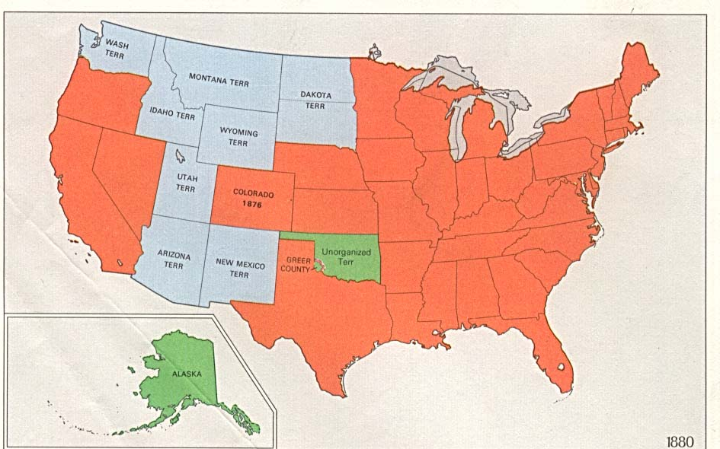
America After the Civil War: 1870-1900
Industrialization & Urbanization
Ranching, Mining, & Farming
Reconstruction &
Rise of Jim Crow Segregation

Slide 6
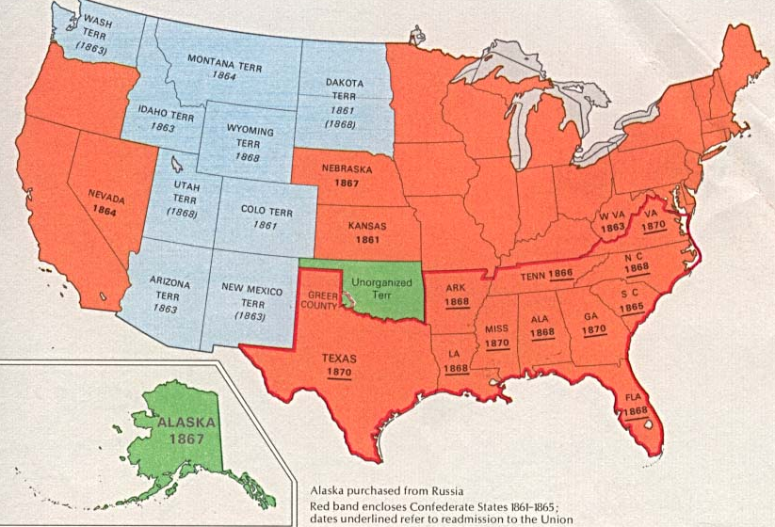
America in the Gilded Age: 1870-1900
The South:
By 1877, the South was recovering from the Civil War but was no longer forced to “reconstruct”
“Jim Crow” reigned supreme as whites legally segregated the South into 2 distinct societies
Notes:
Industry was regional by 1890: (a) NE had 85% of industry, (b) the sparsely-settled West provided raw materials for industry, & (c) the South was still recovering from war (made tobacco, iron & textiles; but ½ as many manufactured goods as NY state)

Slide 7
America in the Gilded Age: 1870-1900
The West:
Manifest Destiny continued after 1865 as miners, homesteaders & ranchers headed West

Slide 8
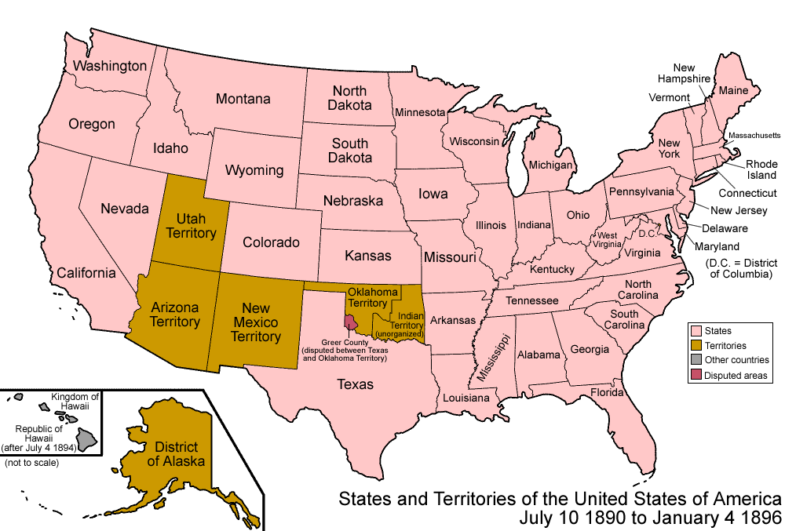
The United States by 1890
Washington
Montana
North Dakota
Idaho
Established new states & closed the frontier by 1890
Colorado
Wyoming
South Dakota

Slide 9
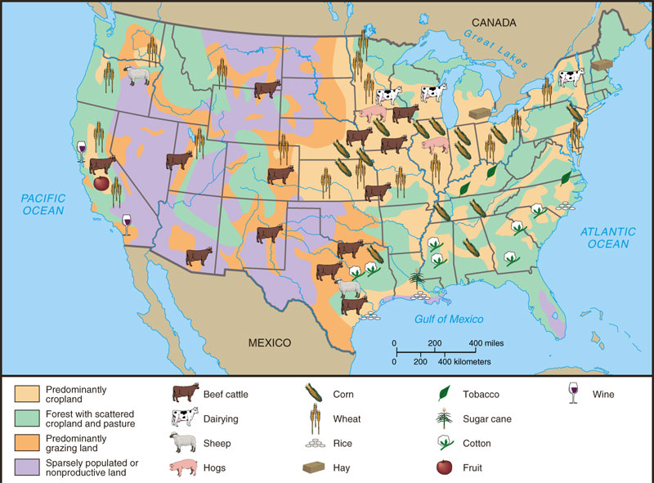
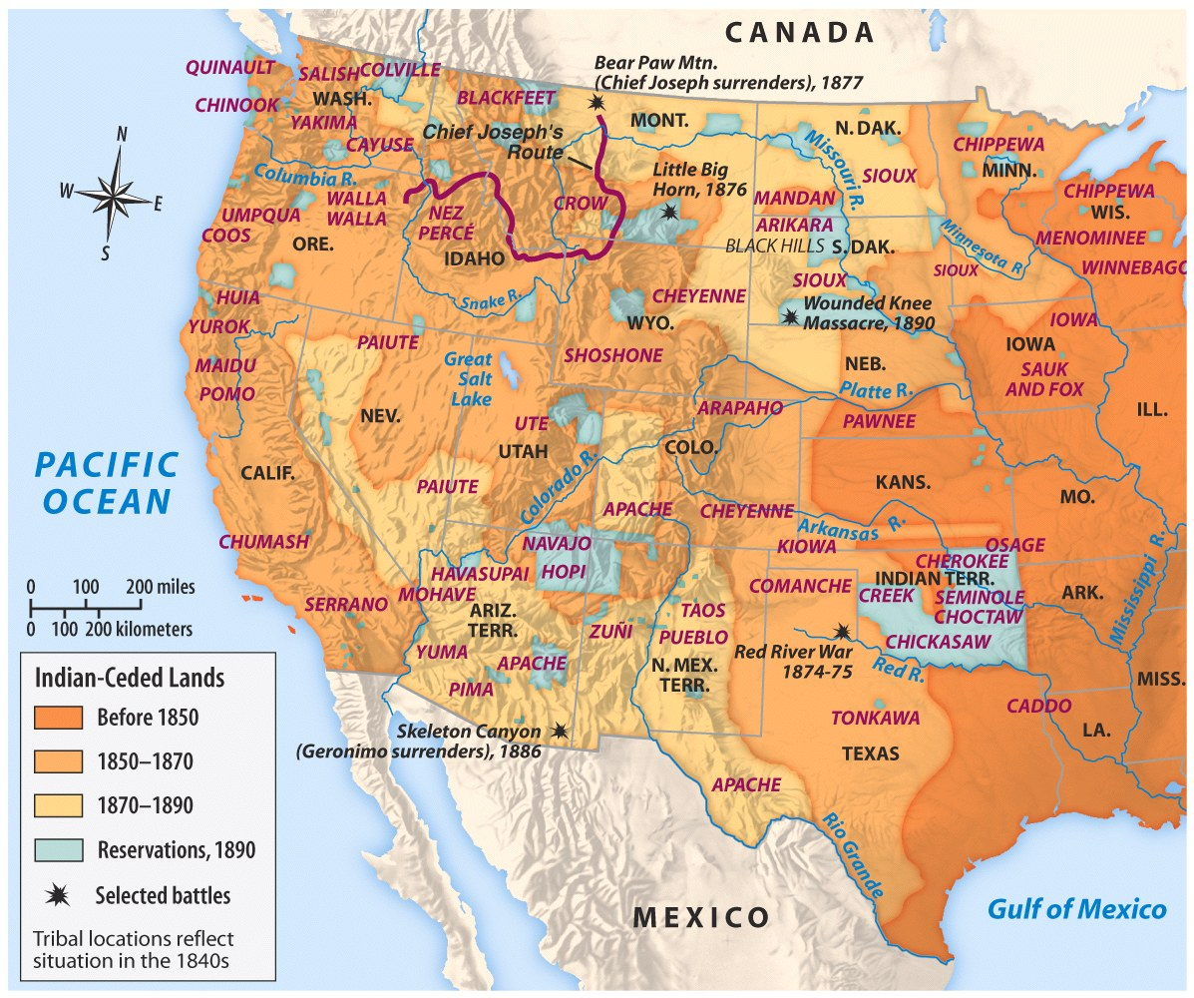
..but this came at the expense of Native Americans
Western raw materials fueled eastern factories
Notes:
Crushed Native Americans

Slide 10
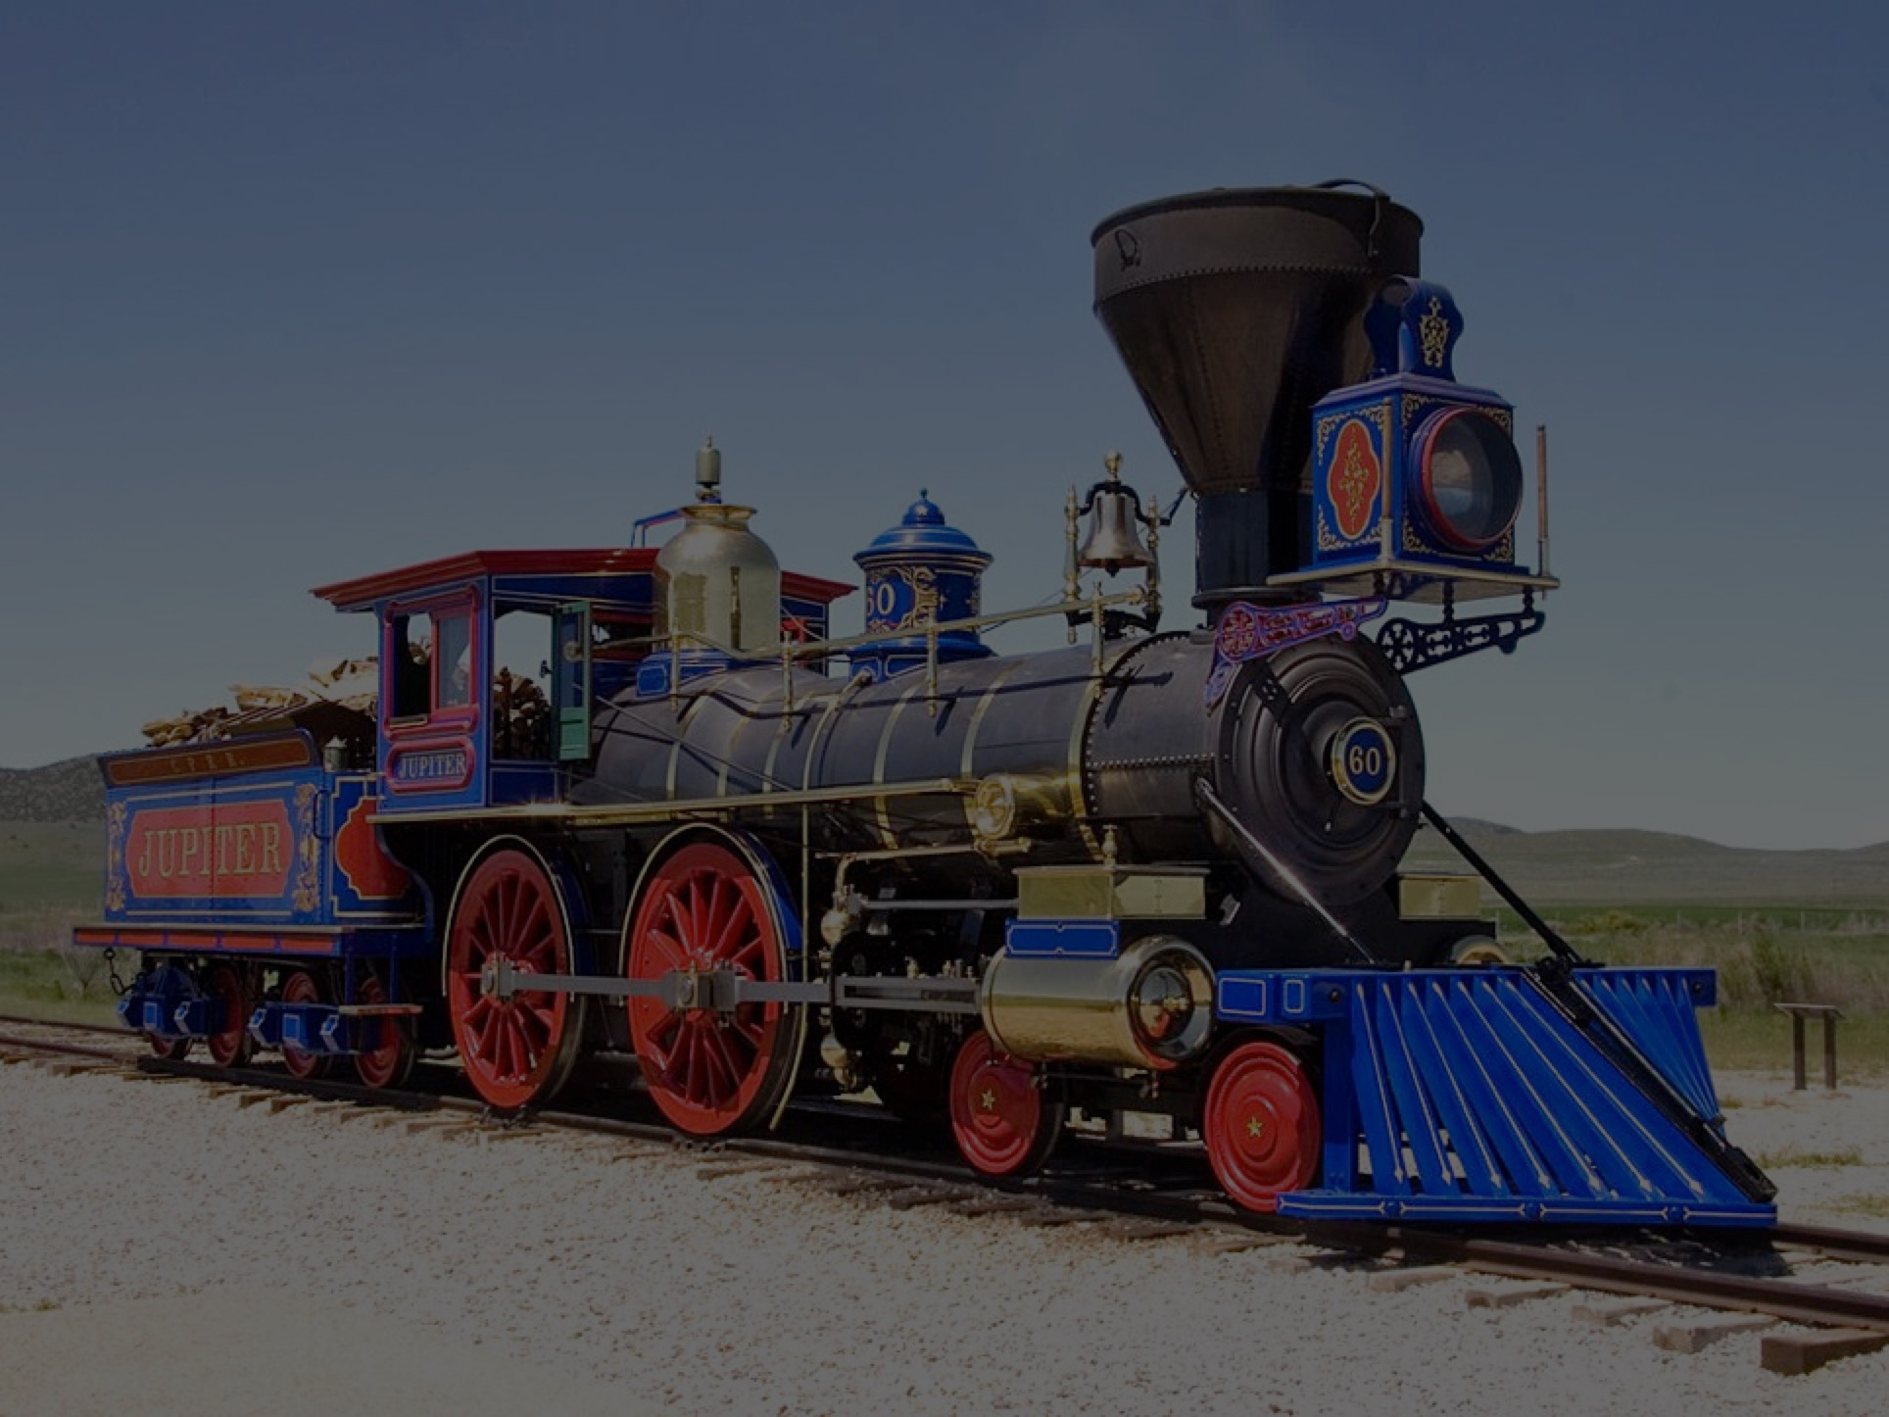
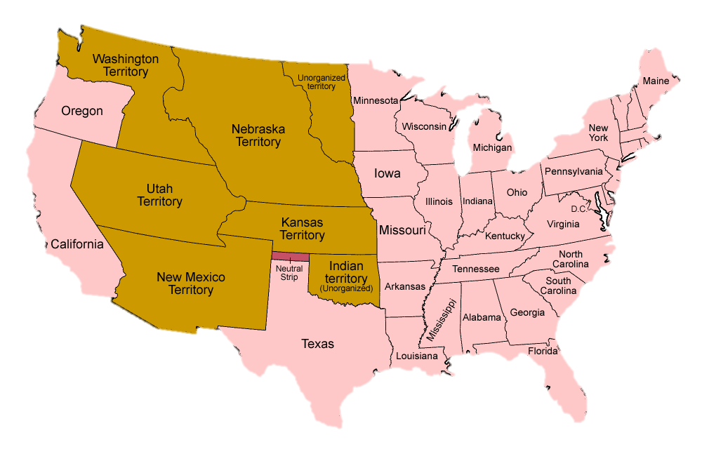
How do we create a national market?
Map Credit: Golbez

Slide 11
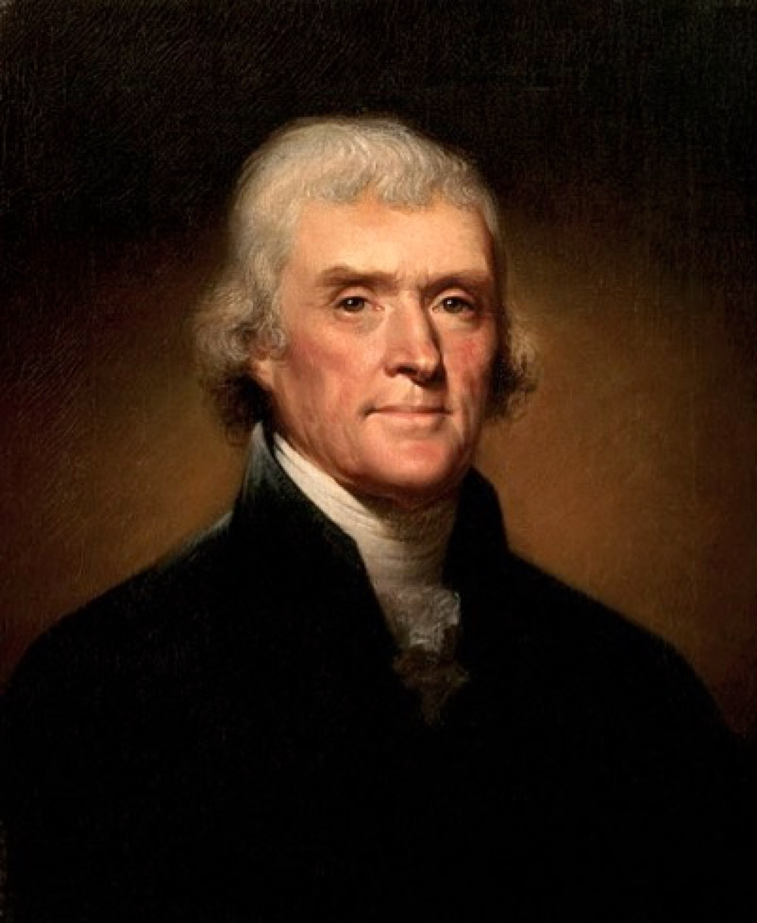
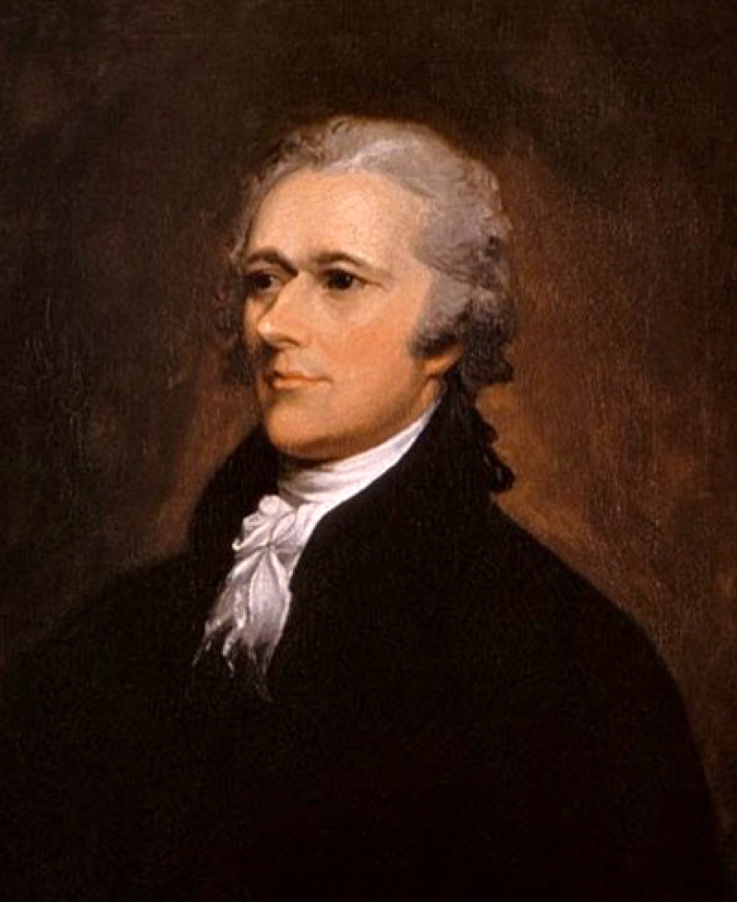
How Are Marketplaces Created?
Jefferson
Laissez-faire
The market will develop on its own.
Hamilton
Government Action
Government needs to assist.

Slide 12
Transcontinental Railroad
Pacific Railway Acts
First Transcontinental Railroad
Central Pacific and Union Pacific
Promontory Point (1869)
Impact
Communication
Settlement and Expansion
35,000 miles (1865)
193,000 miles (1900)
Commerce
Innovations
Standardized gauges
Time zones

Slide 13
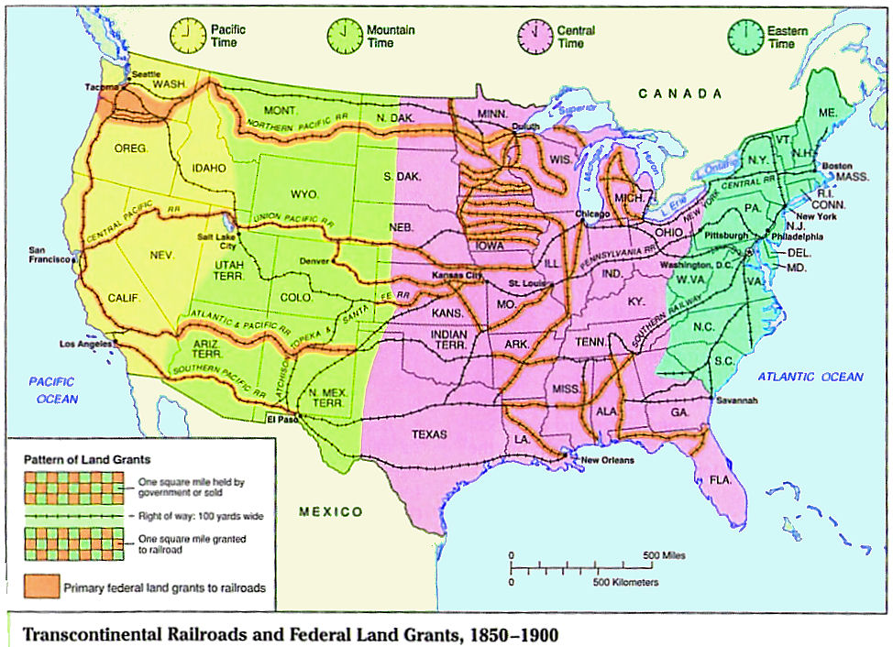
The federal government subsidized several Transcontinental railroads with Land Grants

Slide 14
Homestead Act of 1862
Parameters
160-acre plots for minimum of 5 years
File application, improve the land, file for deed
Demographics
Eastern families
Exodusters
Old Immigrants

Slide 15
The Homesteader
Migration to the west skyrocketed after the Civil War. – mostly native settlers but some German and Irish immigrants.
The Homestead Act (1862) = 160 acres if you live on the land for 5 years
Other land opportunities: Oklahoma Land Rush – sooner state!
In theory…good! – but little rain and no trees = very hard life!
Most new at farming…often picked one crop (called Bonanza farms) - tied to the crop the same way southerners were tied to cotton.
Reliant upon good growing conditions and high prices…which collapsed in the 1880’s and 1890’s.
Settled so fast…the frontier ended (essay by Fredrick Jackson Turner).
Happened at a good time…cities in the east are crowded!
Settlers’ conditions – very hard (esp. for women), lived in Soddy Homes (sod created houses - sodbusters).
Who is coming for this land?…Mostly immigrants who want access to free land and freed slaves (known as Exodusters).

Slide 16
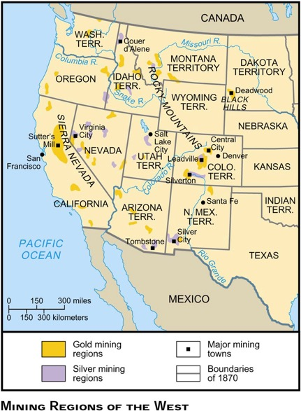
Settling the West: Cattle Frontier and Mining Frontier

Slide 17
The Mining Bonanza
John Mackay earned $25 a minute from his gold/silver lode in Sierra Mountains
Mining was the 1st magnet to attract settlers to the West
CA (1849) started the gold rush, but strikes in Pikes Peak, CO & Carson River Valley, NV (1859) set off wild migrations to the West:
Comstock Lode = $306 million
John Mackay’s Big Bonanza made him richest man in world
¼ to ½ of the mining population was foreign born:
Latin American miners brought experience & new techniques
Chinese brought a tireless ethic
Led to hostility & riots:
Foreign Miners’ Act in 1852 charged a monthly mining fee
Chinese Exclusion Act in 1882 suspended Chinese immigration

Slide 18
The Farm Becomes a Factory
Farming changing:
Now growing single “cash” crops, such as wheat or corn
Used profits to buy foodstuffs at the general store
And manufactured goods in town or by mail order
The Chicago firm of Aaron Montgomery Ward sent out its first catalogue—a singe sheet—in 1872
Farmers were becoming consumers and producers
Large-scale farmers were now both specialists and businesspeople
They were intimately tied to banking, railroading, and manufacturing
Had to buy expensive machinery to plant and harvest their crops

Slide 19
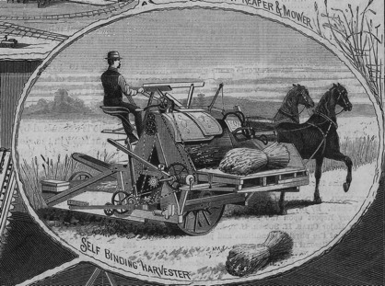
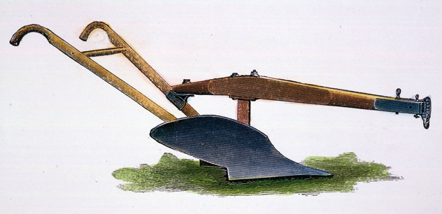
The Farm Becomes a Factory

Slide 20
Rising costs
Monopolistic corporations kept prices high
Middlemen took profit before selling to farmers
Railroads, warehouses, and elevators charges high rates for transportation and storage
Heavy taxes on property and land, but did not tax income from stocks and bonds
Unfair tariffs

Slide 21
Changes in Agriculture
Increasingly commercialized and specialized
Falling Prices
Increased production + global competition
Static money supply
Debt and foreclosure
Rising Costs
Farmers victimized
Corporations and monopolistic trusts
Unfair taxes
Railroad monopolies

Slide 22
Thesis Check
Compare the advances in Gilded Age farming and Gilded Age industry, accounting for similarities and differences.

Slide 23
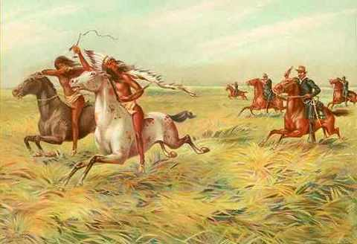
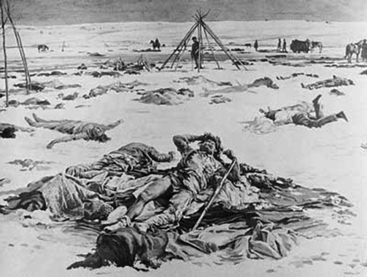
Indian Wars
Native American Leaders and Warriors
Cochise and Geronimo (Apache)
Crazy Horse and Sitting Bull (Lakota)
Chief Joseph (Nez Perce)
Sand Creek Massacre (1864)
Little Big Horn (1876)
“Custer’s Last Stand”
Wounded Knee (1890)
10th Calvary – “Buffalo Soldiers”

Slide 24
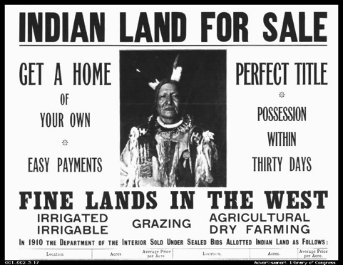
Americanization of Natives
A Century of Dishonor (1881)
Helen Hunt Jackson
“It makes little difference...where one opens the record of the history of the Indians; every page and every year has its dark stain. The story of one tribe is the story of all, varied only by differences of time and place....Colorado is as greedy and unjust in 1880 as was Georgia in 1830, and Ohio in 1795, and the United States government breaks promises now as deftly as then, and with the added ingenuity from long practice....”
Dawes Severalty Act (1887)
160-acre plots of land from tribal territory
Designed to encourage farming among natives
Ghost Dance Movement
Wovoka

Slide 25
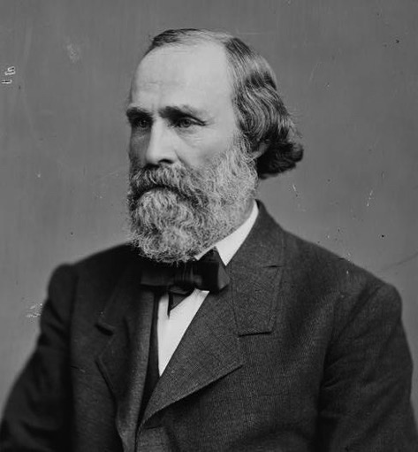
Dawes Severalty Act, 1887
Henry Dawes
“Friend of the Indian”?
Assimilation Policy
Change from communal, nomadic hunting and gathering…
…to individualistic, sedentary farming
Notes:
Kill the Indian, Save the Man

Slide 26
Federal Assimilation Policy
Federal government policy sought to change Indian culture
from communal, nomadic hunting and gathering
to individualistic, sedentary farming
Methods
Dawes Severalty Act divided tribal land into individual plots
Indian Schools separated Indian children from their families and taught them English language and Christian religion
Effects
Further loss of Indian land to farmers, miners, ranchers and railroads
Oklahoma Land Rush
Black Hills mines
Shattered tribal bonds
Decline of native languages
Native Americans did not gain full U.S. citizenship guarantees until 1924

Slide 27
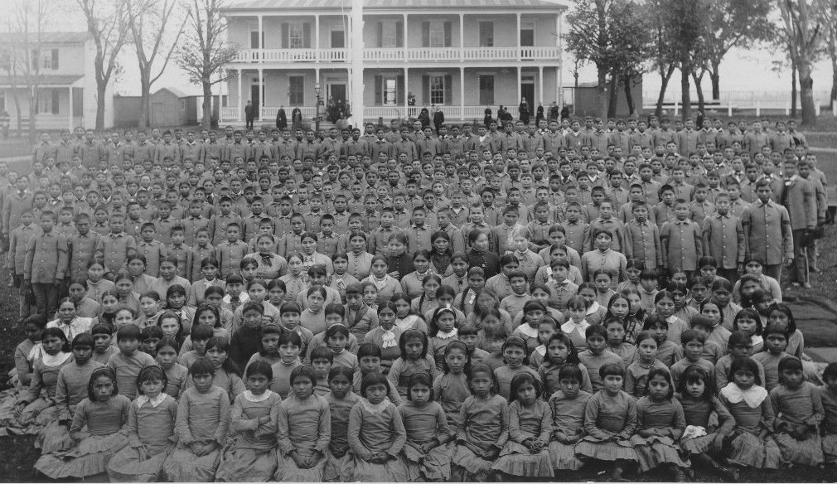
Carlisle Indian School

Slide 28
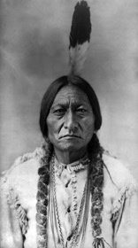
Removal of Native Americans
Reservationist Policy
President Andrew Jackson Removed Eastern Native Americans to Lands West of the Mississippi
Broken as Transcontinental Railroad was Planned, Wagons increased, and Reservations were Increasingly Assigned
Plains Tribes Refused to Cooperate
Indian Wars
Increased Migration of Miners, Cattlemen, and Homesteaders
Fighting Broke Out Between Indians and U.S. Troops
Sioux Wars
Sand Creek, CO
Little Big Horn
Treaties Made and Broken
Most of Buffalo Slaughtered

Slide 29
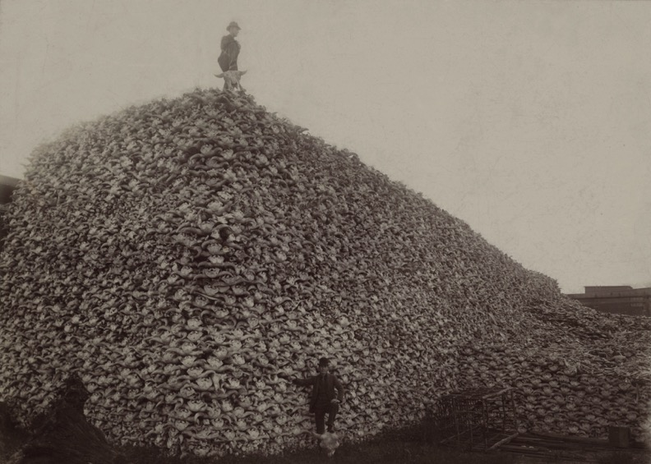
Near-Extinction of Buffalo

Slide 30
Ecological Impact
Near-extinction of the buffalo due to U.S. army, settlers and railroads
Intensive farming depleted soil, contributing to the Dust Bowl of the 1930s
Conservation movement of the later 1800s set aside land for national parks
Black Hills, SD
Mount Rushmore
Crazy Horse Memorial

Slide 31
The Fading Frontier
The nation soon recognized that its land was not inexhaustible:
Seeds were planted to preserve the vanishing resources
Government set aside land for national parks—first Yellow-stone in 1872, followed by Yosemite and Sequoia in 1890
The frontier was more than a place
It was also a state of mind; a symbol of opportunity
Its passing ended a romantic phrase of the nation’s internal development
Created new economic and psychological problems.
The frontier a “safety valve:”
The theory is that when hard times came, the unemployed who cluttered the city pavements merely moved west, took up farming, and prospered.

Slide 32
Frederick Jackson Turner’s Frontier Thesis (1893)
Frontier is “the meeting point between savagery and civilization.”
"begins with the Indian and the hunter; it goes on with the disintegration of savagery by the entrance of the trader... the pastoral stage in ranch life; the exploitation of the soil by the raising of unrotated crops of corn and wheat in sparsely settled farm communities; the intensive culture of the denser farm settlement; and finally the manufacturing organization with the city and the factory system.”
The frontier defined the American identity
"that coarseness and strength combined with acuteness and acquisitiveness; that practical inventive turn of mind, quick to find expedients; that masterful grasp of material things... that restless, nervous energy; that dominant individualism"
U.S. Census of 1890 claims American frontier is closed
"And now, four centuries from the discovery of America, at the end of a hundred years of life under the Constitution, the frontier has gone, and with its going has closed the first period of American history.”

Slide 33
Conclusions: The End of the Frontier
By 1890, the western frontier ended
Miners, ranchers, & cowboys flooded West at the expense of Indians who were restricted to smaller & smaller reservations
Westerners were commercially connected to Eastern markets but would grow increasingly frustrated by the economic & political concentration of power in the East
With no more West to conquer, where would American expansion go next?
A continuation of antebellum “Manifest Destiny”

Slide 34
The New South: Economic Progress
Economic improvement
Birmingham, Alabama: Steel
Memphis, Tennessee: Lumber
Richmond, Virginia: Tobacco
Railroads
Tremendous postwar growth from 1865-1900 in terms of population, industry, and railroads

Slide 35
The New South: Continued Poverty
BUT…still primarily agricultural
Controlled by the North economically
2 chief factors not related to northern capitalists
South’s late start at industrialization
Poorly educated workforce

Slide 36
The New South: Agriculture
Between 1870 and 1900 – acres planted in cotton more than doubled
BUT…increase in cotton supply means decease in cotton prices
By 1900, ½ of white farmers + ¾ of black famers become tenants/sharecroppers
Tied to debt
Formation of the Farmers Southern Alliance

Slide 37
The New South: Segregation
End of reconstruction = end of protection for freedman
Discrimination and the Supreme Court
Civil Rights Cases of 1883
Congress could not legislate against the racial discrimination practiced by private citizens
Plessy v. Ferguson
“separate but equal accommodations”

Slide 38
The New South: Loss of Civil Rights
Political and Legal devises
Literacy Tests
Poll Taxes
Political party nominations for whites only
Grandfather clause
Economic discrimination

