Slide 1
Do Now
Sit Down, Shut Up, and Listen to 2 Songs

Slide 2
Vietnam War-Conflict in SE Asia and Conflict at Home
Mr. Winchell
APUSH
Period 8

Slide 3
Background
France controlled “Indochina” since the late 19th century
Japan took control during World War II
With U.S. aid, France attempted re-colonization in the postwar period
Notes:
Ho Chi Minh had been fighting for Vietnamese independence since World War I.
The U.S. gave France aid to win its support in American anticommunist efforts in Western Europe.

Slide 4
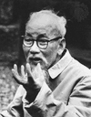
Background
The French lost control to Ho Chi Minh’s Viet Minh forces in 1954 at Dien Bien Phu
President Eisenhower declined to intervene on behalf of France.
Notes:
Ho Chi Minh had been fighting for Vietnamese independence since World War I.
The U.S. gave France aid to win its support in American anticommunist efforts in Western Europe.

Slide 5
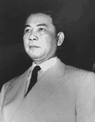
Background
International Conference at Geneva
Vietnam was divided at 17th parallel
Ho Chi Minh’s nationalist forces controlled the North
Ngo Dinh Diem, a French-educated, Roman Catholic claimed control of the South
Notes:
Realizing he would Diem backs out of elections.

Slide 6
Background to the War
A date was set for democratic elections to reunify Vietnam
Diem backed out of the elections, leading to military conflict between North and South
Notes:
Realizing he would lose, Diem backed out of elections.

Slide 7
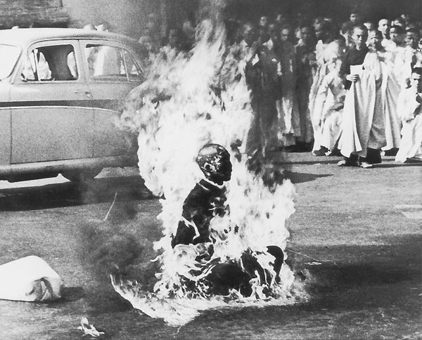
Monk Quang Duc protested Diem’s treatment of Buddhists

Slide 8
U.S. Military Involvement Begins
Repressive dictatorial rule by Diem
Diem’s family holds all power
Wealth is hoarded by the elite
Buddhist majority persecuted
Torture, lack of political freedom prevail
The U.S. aided Diem’s government
Ike sent financial and military aid
675 U.S. Army advisors sent by 1960.
Notes:
Realizing he would Diem backs out of elections.

Slide 9
Containment in Vietnam
Vietnam proved to be a tough test:
Since 1954, Communist leader Ho Chi Minh gained popularity in North Vietnam; By 1961, he gained a foothold in the South
The U.S. gave aid to unpopular South leader Ngo Dihn Diem
When Diem lost control of the South, JFK gave the OK for a coup against Diem in 1963
“Strongly in our mind is what happened in China at the end of World War II, where China was lost. We don’t want that.”
—JFK

Slide 10
U.S. Military Involvement Begins
Kennedy elected 1960
Increases military “advisors” to 16,000
1963: JFK supports a Vietnamese military coup d’etat – Diem and his brother are murdered (Nov. 2)
Kennedy was assassinated just weeks later (Nov. 22)
Notes:
Kennedy’s advisors were clearly fighting a covert war by 1963.
MacNamara has suggested that he believes Kennedy would have pulled the U.S. out, but evidence in inconclusive.
JFK realizes Diem is a liability; offers quiet support to a Vietnamese military coup d’etat.
The coup results in the brutal murders of Diem and his brother
The Vietnamese generals overthrow one another. A relatively stable, but tyrannical government emerges. It is little better than Diem’s.

Slide 11
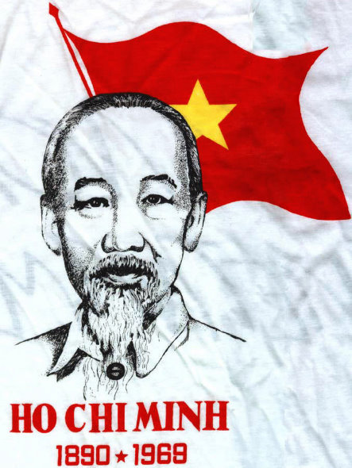
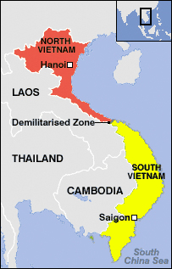
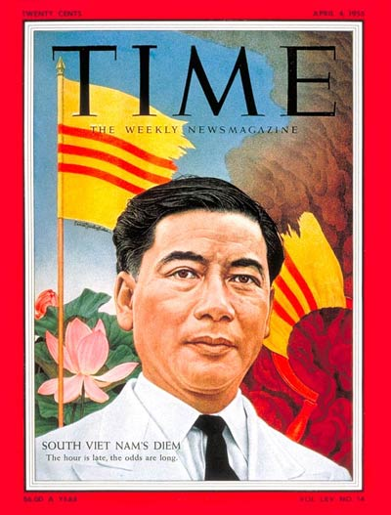
Vietnam
Viet Minh are Vietnamese communists in North Vietnam
Viet Cong are Vietnamese communists in South Vietnam

Slide 12
Johnson Escalates the Vietnam War

Slide 13
LBJ Escalates the Vietnam War
“I am not going to lose Vietnam. I am not going to be the president who saw Southeast Asia go the way China went.”
—LBJ
LBJ continued JFK’s strong foreign policy positions too:
He supported CIA-sponsored coups in Brazil, Panama, & the Dominican Republic
LBJ continued Eisenhower & JFK policies towards Vietnam
But in doing so, LBJ found himself under attack from Congress, the media, & universities

Slide 14
LBJ Escalates the Vietnam War
During the Gulf of Tonkin affair in Aug 1964, the military bombed North Vietnam in retaliation for an attack on the USS Maddox
The Gulf of Tonkin Resolution gave LBJ the authority to:
Defend Vietnam at any cost
Unlimited military intervention to be used at LBJ’s discretion
BLANK CHECK

Slide 15
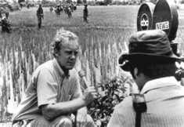
The Ground War 1965-1968
No territorial goals
Body counts on TV every night (first “living room” war)
Viet Cong supplies over the Ho Chi Minh Trail

Slide 16
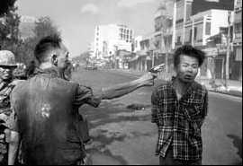
Who Is the Enemy?

Slide 17
The Air War 1965-1968
1965: Sustained bombing of North Vietnam
Operation Rolling Thunder (March 2, 1965)
1966-68: Ongoing bombing of Hanoi nonstop for 3 years! Esp. targets the Ho Chi Minh Trail.
Downed Pilots: P.O.W.s
Carpet Bombing – napalm

Slide 18
Escalation
LBJ’s advisors wanted 100,000 troops in 1965 & a plan for 100,000 more in 1966; Estimations were 500 U.S. deaths per month
1965 marked the beginning of full-scale U.S. involvement in Vietnam
LBJ was informed that “without U.S. action, defeat is inevitable”
LBJ authorized bombing raids into North Vietnam & requested 50,000 U.S. soldiers sent to Asia
LBJ never explained to the American people how the gov’t planned to win the war in Vietnam
LBJ took middle road of limited U.S. intervention: not a withdrawal & not a full-scale invasion of North Vietnam

Slide 19
Vietnam in 1968
In 1968, the Vietcong launched the Tet Offensive against U.S. forces in South Vietnam
The attack was contrary to media reports that the U.S. was winning the Vietnam War
The attack led LBJ to believe that Vietnam could not be won
In 1968, LBJ began discussions to seek a truce & announced that he would not seek re-election
Notes:
‘There’s light at the end of the tunnel…’ General Westmoreland

Slide 20
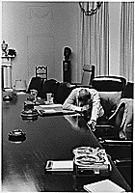
Impact of the Tet Offensive
Domestic U.S. Reaction: Disbelief, Anger, Distrust of Johnson Administration
Hey, Hey LBJ! How many kids did you kill today?

Slide 21
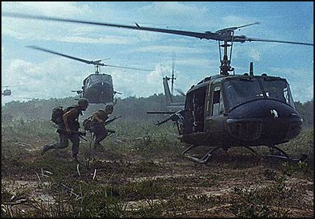
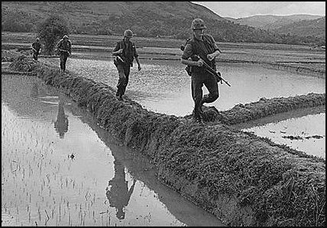
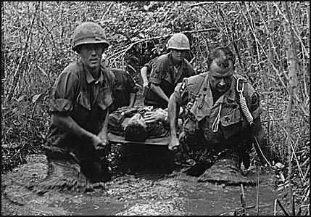
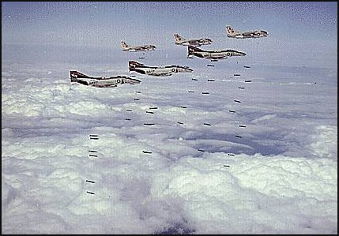
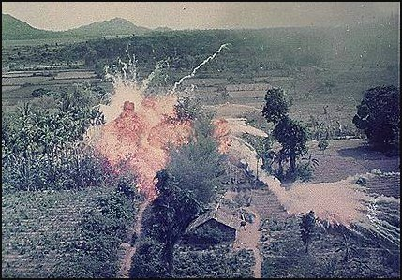
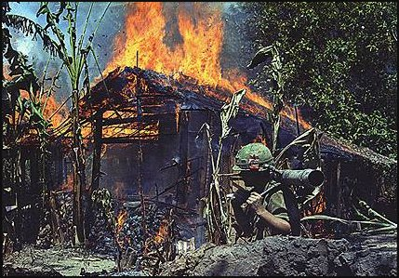
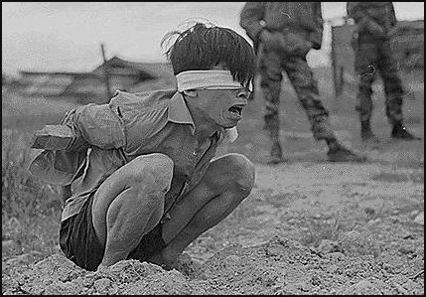
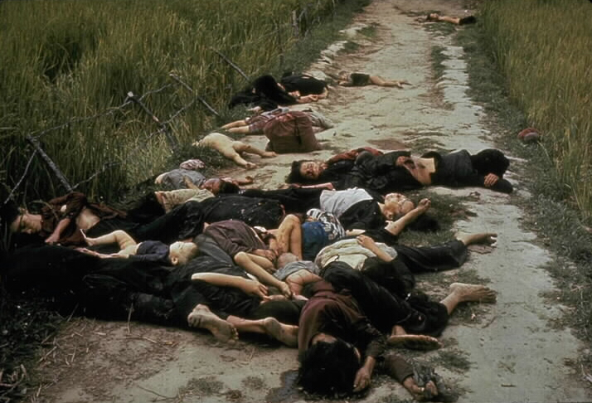
Image of the “My Lai Massacre,” 1968

Slide 22
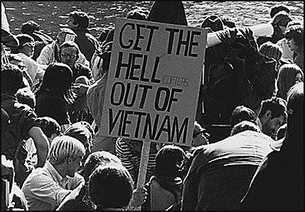
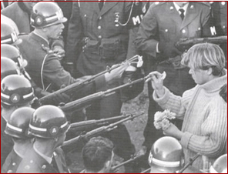

Slide 23
Anti-War
Demonstrations
Columbia University 1967

Slide 24
Hell no, we won’t go!

Slide 25
Anti-War Demonstrations
Student Protestors at Univ. of CA in Berkeley, 1968
Democratic Convention in Chicago, 1968

Slide 26
Anti-War Demonstrations
May 4, 1970
4 students shot dead.
11 students wounded
Jackson State University
May 10, 1970
2 dead; 12 wounded
Kent State University

Slide 27
A Decade of Protest: 1965-1974
The decade from 1965 to 1974 was marked by protest due to:
Escalation of the Vietnam War
Attack on middle-class values
Increased college enrollment
The initial liberal protests began on college campuses but soon inspired other, national protests:
The Sixties generation was the best educated in American history
Protests against Vietnam linked other social criticism—The “war abroad,” intensified a “war at home”
African-Americans
Mexican-Americans
Native-Americans
Women
Hippies

Slide 28
The Student Revolt
Refused to allow Free Speech movement to collect money for off-campus causes
The student protest movement began at UC-Berkeley in 1964 with the Free Speech movement
Students protested the “corporate face” & “1950s rules” of UC-Berkeley
Students rioted when denied a political voice on campus
This inspired the formation of Students for a Democratic Society to end racism, poverty, & violence

Slide 29
1968
1968 was one of the most turbulent years in U.S. history
Martin Luther King Jr. & Robert Kennedy were assassinated
Riots broke out at the Democratic National Convention
The Tet Offensive showed that the USA was not winning the Vietnam War

Slide 30
Johnson’s popularity dropped in 1968 from 48% to 36%.

Slide 31
Stalemate
By 1968, 500,000 U.S. troops stationed to keep Vietnam from falling to Communism
U.S. bombings & “search & destroy” attacks were ineffective
Soviet & Chinese weaponry freely flowed into North Vietnam
Reckless bombings killed thousands of innocent civilians
The bloody stalemate & media depiction of the war led to protests

Slide 32
Conclusions
The early 1960s under JFK represented consumer spending, a strong stance on the Cold War, & more social reforms at home
The transition to LBJ in 1963 brought success at home (civil rights & the Great Society)
But, heightened involvement in Vietnam signaled the onset of the counter-culture movement by 1968

Slide 33
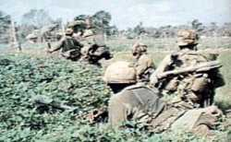
American Morale Begins to Dip
Disproportionate representation of poor people and minorities.
Severe racial problems.
Major drug problems.
Officers in combat 6 mo.; in rear 6 mo. Enlisted men in combat for 12 mo.

Slide 34
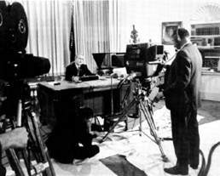
Impact of the Vietnam War
Johnson announces (March, 1968):
…I shall not seek, and I will not accept, the nomination of my party for another term as your President.

Slide 35
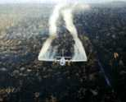
Nixon on Vietnam
Nixon’s 1968 Campaign promised an end to the war: Peace with Honor
Appealed to the great “Silent Majority”
Vietnamization
Expansion of the conflict → The “Secret War”
Cambodia
Laos
Agent Orange (chemical defoliant)
Notes:
Nixon’s “secret” plan never materializes.
He involved us more.
“Peace with Honor” We’ll win befoe we withdraw.
Expansion:Cambodia invaded in 1970: Ho Chi Minh Trail
Laos invaded in 1971: Ho Chi Minh Trail

Slide 36
“Pentagon Papers,” 1971
Former defense analyst Daniel Ellsberg leaked govt. docs. regarding war efforts during Johnson’s administration to the New York Times.
Docs.→ Govt. misled Congress & Amer. People regarding its intentions in Vietnam during mid-1960s.
Primary reason for fighting not to eliminate communism, but to avoid humiliating defeat.
New York Times v. United States (1971) *
Notes:
Nixon resigns over the Watergate Scandal in 1974.
Ford takes the helm.

Slide 37
The Ceasefire, 1973
Peace is at hand → Kissinger, 1972
North Vietnam attacks South
Most Massive U.S. bombing commences
1973: Ceasefire signed between
U.S., South Vietnam, & North Vietnam
Peace with honor (President Nixon)
Notes:
Nixon resigns over the Watergate Scandal in 1974.
Ford takes the helm.

Slide 38
The Ceasefire, 1973
Conditions:
U.S. to remove all troops
North Vietnam could leave troops already in S.V.
North Vietnam would resume war
No provision for POWs or MIAs
Last American troops left South Vietnam on March 29, 1973
1975: North Vietnam defeats South Vietnam
Saigon renamed Ho Chi Minh City
Notes:
Many U.S.-loyal South Vietnamese attempt to flee for fear of execution by the North.

Slide 39
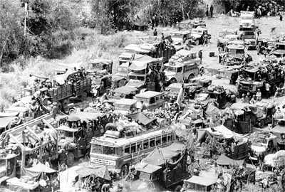
The Fall of Saigon
South Vietnamese Attempt to Flee the Country

Slide 40
The Costs
3,000,000 Vietnamese killed
58,000 Americans killed; 300,000 wounded
Under-funding of Great Society programs
$150,000,000,000 in U.S. spending
U.S. morale, self-confidence, trust of government, decimated
Notes:
Diversion of capital to the war indirectly caused economic recession: 11% inflation and 12% unemployment!

Slide 41
The Impact
26th Amendment: 18-year-olds vote
Nixon abolished the draft→ all-volunteer army
War Powers Act, 1973 ٭
President must notify Congress within 48 hours of deploying military force
President must withdraw forces unless he gains Congressional approval within 90 days
Disregard for Veterans → seen as “baby killers”
POW/MIA issue lingered
Notes:
War Powers Act., 1973, passed over Nixon's veto, requires the President to
notify Congress within 48 hours of his use of military force in a foreign country or enlarging an ongoing conflict.
The President must secure Congressional approval if he intends to keep these troops overseas for more than 60 days. If he doesn't, he must withdraw the forces.
Congress can pass a joint resolution to withdraw the troops before the 60 day deadline. (Each President since has denied its validity, though the issue has never been tested.)
No welcome home (shamed and ashamed), high unemployment, alcohol & drug abuse; poor care of disabled vets: underfunded vets hospitals, Post-Traumatic Stress Disorder; Agent Orange health problems, birth defects in vets’ children.

Slide 42
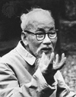
And in the End….
Ho Chi Minh:
If we have to fight, we will fight. You will kill ten of our men and we will kill one of yours, and in the end it will be you who tires of it.

Slide 43
Lessons for Future American Presidents
Wars must be of short duration.
Wars must yield few American casualties.
Restrict media access to battlefields.
Develop and maintain Congressional and public support.
Set clear, winnable goals.
Set deadline for troop withdrawals.

