Slide 1
Do Now
Read, Write, Discuss
Read ‘Hamilton’s Financial Plan’
Write: What were the key components of Hamilton’s Financial Plan?
Discuss: What ideological conflicts arose from Hamilton’s Financial Plan?

Slide 2
Washington’s Presidency and the Birth of the Two-Party System
Mr. Winchell
APUSH
Period 3

Slide 3
AP Prompt

Slide 4
Key Concepts

Slide 5
BIG IDEAS-College Style
Washington’s Presidency and Precedents
What legacy did he leave?
Hamilton vs. Jefferson and the Birth of Political Parties
How did early issues facing the nation lead to two such opposing views on power and the Constitution?
Constitution vs. Articles of Confederation
How was the Constitution different in practice than the Articles of Confederation were?

Slide 7
The Courts
Congress created effective courts under the Judiciary Act of 1789
Judiciary Act organized the Supreme Court with a chief justice & 5 associates
Established federal district & circuit courts
Created office of Attorney General

Slide 8
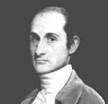
1st Chief Justice
John Jay (NY)
Collaborated w/ Madison on Federalist Papers
A seasoned diplomat
Served as CJ until 1795

Slide 9
Executive Departments are Set Up to Help Washington (CABINET)
Departments
State
Role was to speak to other countries, and work to maintain prosperous relationships
Treasury
Issue currency, pay gov’t debt, and keep the economy growing
War
Responsible for defense of the nation
In control of the Army, Navy, and Marines
Attorney General
Nation’s top lawyer

Slide 10
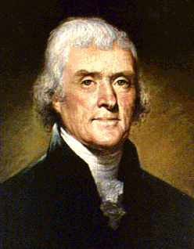
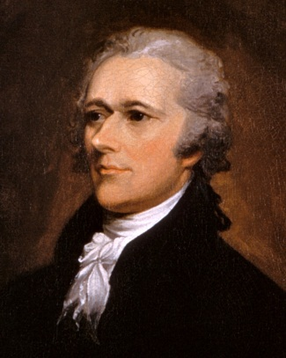
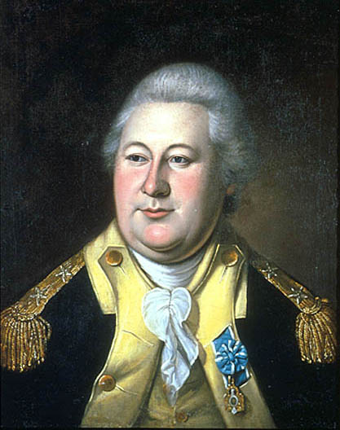
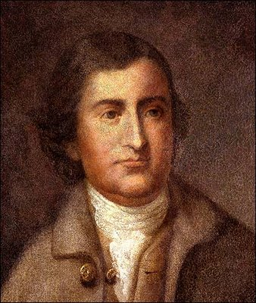
The Departments & Leadership
Department of State
Sec. of State - T. Jefferson
Department of Treasury
Sec. of Treasury - A. Hamilton
War Department
Sec. of War - Henry Knox
Attorney General Edmund Randolph

Slide 11
Washington’s Foreign Policy
Europe
French Revolution
Citizen Genet (1793)
Proclamation of Neutrality (1793)
John Adams Neutrality
Jay’s Treaty (1796)
Most-favored trade status to Britain
Removed British from Northwest forts
Did not end British impressment of U.S. sailors
Pinckney’s Treaty (1796)
Established boundaries with Spain
Unrestricted trade access on the Mississippi River
Natives
Treaty of Greenville (1795)
Battle of Fallen Timbers (1794)
Formal recognition/cession of Northwest Territory by Natives

Slide 12
Washington’s Precedents
Two terms
“Mr. President”
Cabinet
Neutrality
Special Relationship with Great Britain
Farewell Address

Slide 13
Washington’s Farewell
Washington’s Farewell Address
Retired after two terms
Preserve treaties and avoid alliances**
Condemned political parties and partisan conflicts*
Warned of sectionalism and to preserve unity
Religion and morality and diffusion of knowledge (education)
Notes:
FFAPUSH Washington’s Farewell Address

Slide 14
Hamilton vs. Jefferson and the Birth of Political Parties
Issues:
Constitutional Interpretation
Bank & Credit
French Revolution
Taxes
Whiskey Rebellion (Rebellion in general)

Slide 15
Watch this video clip from HBO’s John Adams series As you watch, identify as many things as you can that Jefferson and Hamilton disagree about
Alexander Hamilton
Thomas Jefferson

Slide 16
QUOTES!
‘Hamilton was honest as a man, but, as a politician, believed in the necessity of either force or corruption to govern men.’
Thomas Jefferson, 1811
Jefferson is a man of profound ambition and violent passions.
Alexander Hamilton, 1792

Slide 17
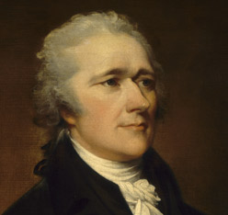
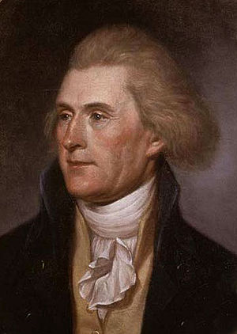
First Political Party System (1789-1824)
Alexander Hamilton
Thomas Jefferson
Federalists
National policies
Strong central government
Loose constructionists
Commerce and manufacturing
Urban
The rich, the well-born, the able; merchants, bankers
Pro-British
Anti-French revolution
Northeast
Democratic-Republicans
States rights
Strong local/state governments
Strict constructionists
Agricultural
Rural
Small farmers, plantation owners, artisans
Anti-British
Pro-French Revolution
West and South

Slide 18
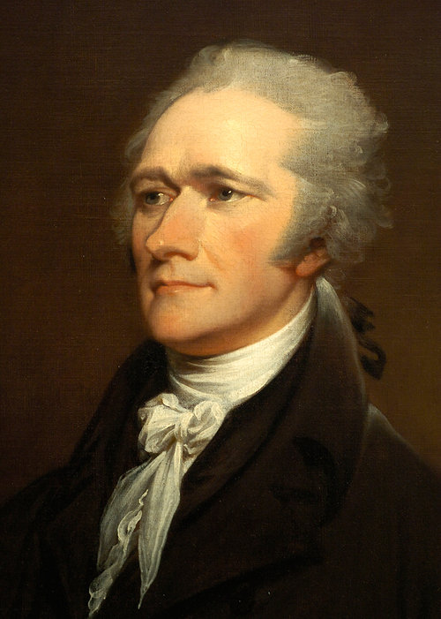
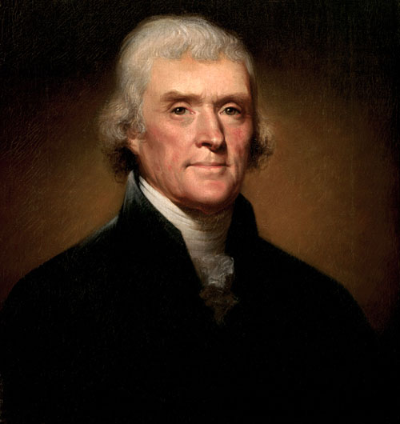
What was their view on the Constitution?
Alexander Hamilton Thomas Jefferson
Hamilton
Supported the Constitution because it included a president and more power to the national government
Constitution can be “loosely” interpreted (“Elastic Clause”)
Jefferson
Supported the Constitution because of the Bill of Rights
Constitution should be “strictly” interpreted with powers not given to the gov’t are reserved to the states

Slide 19
What political party did he form and what were the core ideals of the party?
Alexander Hamilton Thomas Jefferson
Hamilton
Federalist Party
Strong national government and fewer states’ rights
Jefferson
Democratic-Republican Party
Limited national government with more rights reserved to the states

Slide 20
What should be the focus of the American economy?
Alexander Hamilton Thomas Jefferson
Hamilton
The government should promote banking and the growth of American industry so the USA does not have to rely on Britain
Jefferson
The government should promote an economy of self-sufficient farmers who do not need a powerful national gov’t

Slide 21
Should power be in the hands of the “elite” or the “common man”?
Alexander Hamilton Thomas Jefferson
Hamilton
People are motivated by self-interests
Power should be in the hands of the “elite”
Jefferson
The “common man” should be trusted to make good decisions
Corruption occurs when power is in the hands of the “elite”

Slide 22
Which government should be stronger: the national government or the states?
Alexander Hamilton Thomas Jefferson
Hamilton
The national government needs to be stronger than the states
The Articles of Confederation was too weak
Jefferson
Power should remain with the state governments
The national government should be kept as small as possible

Slide 23
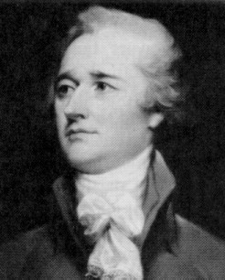
Hamilton
Country needed his drive & brains
Submitted series of reports to Congress from 1/1790 - 12/1791 outlining his programs for finance and economic development
Most of his programs adopted
Notes:
READ EXCERPT OF HAMILTON FINANCIAL PROGRAM

Slide 24
Hamilton’s Financial Plan
Federal Funding of All State Debts
Bank of the US
Tax and Tariff to Promote American Industry
Notes:
PASS OUT FINANCIAL PLAN OUTLINE

Slide 25
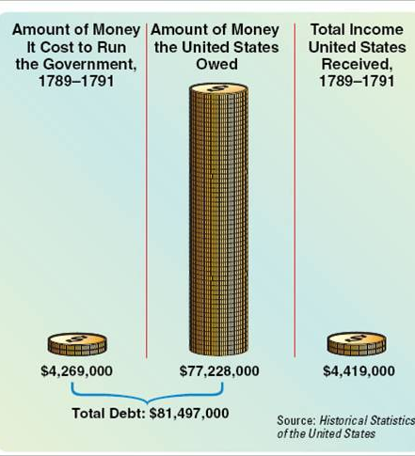
Among their biggest disagreement was over Hamilton’s Financial Plan
In 1789, Hamilton proposed a financial plan that would guide the future of the U.S. economy
1. Hamilton proposed funding and assumption of all state debts incurred during the Revolutionary War
Congress and Washington approved Hamilton’s plan for funding and assumption
By taking the state debts, the USA government would reinforce federal supremacy
By repaying all debts, the USA would gain foreign credit

Slide 26
Assumption of State Debt
Congress passed the measure with a deal
Southern states opposed the plan because they had already paid debts - called others irresponsible
Congress agreed to locate the new federal capitol in the South in return for passage of the plan

Slide 27
2. Establishment of a National Bank
Bank would hold govt. funds
Circulate uniform natl. currency
Lend $ to the govt.
To be privately owned & managed
U.S. would have 20% ownership
Wealthy biz interests - 80%
Proposal caused huge debate

Slide 28
Bank of the U.S.
Jefferson opposed the bank
Not authorized in the Constitution
Powers not granted to Federal govt reserved for states (soon-to-be 10th Amendment)
States should charter banks
A strict interpretation of the Constitution

Slide 29
Bank of the U.S.
Hamilton invoked “necessary & proper” clause which allowed Fed to pass laws necessary for running govt. (Article 1, Sec. 8, par. 18)
A loose interpretation
GW accepted H’s argument and signed the measure into law
Becomes a sectional rift - N vs. S
Hamilton’s financial programs contributed to creation of political parties

Slide 30
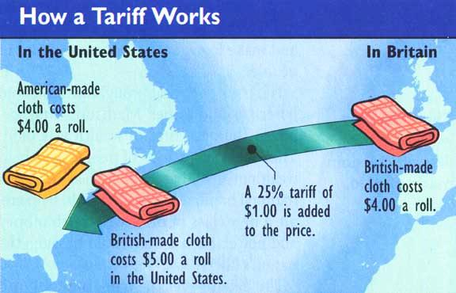
3. To raise money for the new nation, Hamilton proposed a tax on whiskey and a creating a protective tariff on foreign manufactured goods that would promote American industry

Slide 31
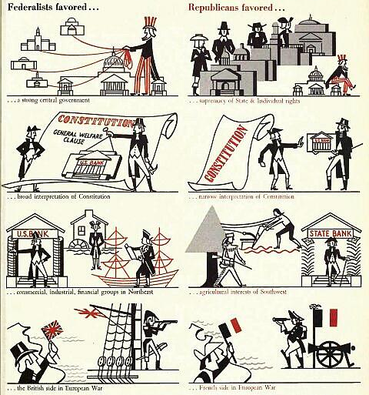
The disagreements between Hamilton and Jefferson led to the formation of America’s first political parties
Federalists supported a strong national government…
…loose interpretation of the Constitution…
Hamilton formed the Federalist Party
…a strong financial system that favored banks and industry…
…supporting England when war broke out with France

Slide 32
The disagreements between Hamilton and Jefferson led to the formation of America’s first political parties
Republicans supported strong state governments…
…strict interpretation of the Constitution…
Jefferson formed the Democratic- Republican Party
…state banks and policies that support small farmers…
…supporting France when war broke out with England

Slide 33
Constitution vs. Articles of Confederation

Slide 34
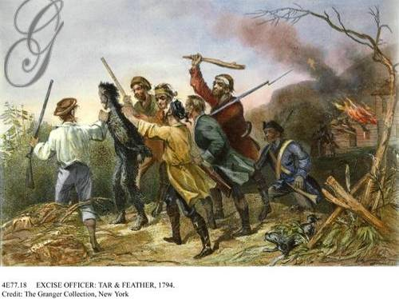
In 1794, Washington faced another crisis: the Whiskey Rebellion
Hamilton’s whiskey tax frustrated western farmers in Pennsylvania who saw it as an unfair tax on the poor
Notes:
10
10

Slide 35
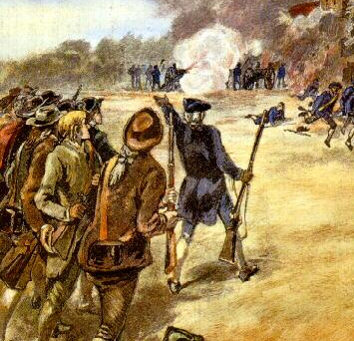
Reminder!
When Shays’ Rebellion broke out in 1787, the weak government under the Articles of Confederation could not stop the rebellion
When the Whiskey Rebellion began in 1794, President Washington saw the uprising as a threat to public safety
Notes:
10
10

Slide 36
“Whenever the government appears in arms [against a riot or insurrection], it ought to appear like Hercules, and inspire respect by the display of strength”
“A little rebellion now and then is a good thing, and necessary in the political world as storms in the physical. It is a medicine necessary for the sound health of government”

Slide 37
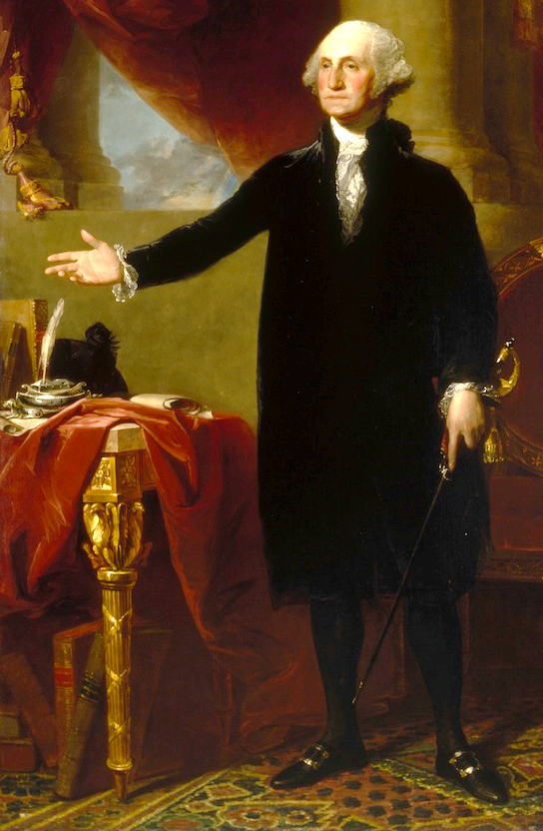
In 1796, Washington chose not to run for a 3rd term as president
He was afraid that if he died in office, it would create a precedent that presidents can serve for life
There was no term limit in the Constitution, but Washington created the precedent that no president serve more than two terms
Notes:
10
10

Slide 38
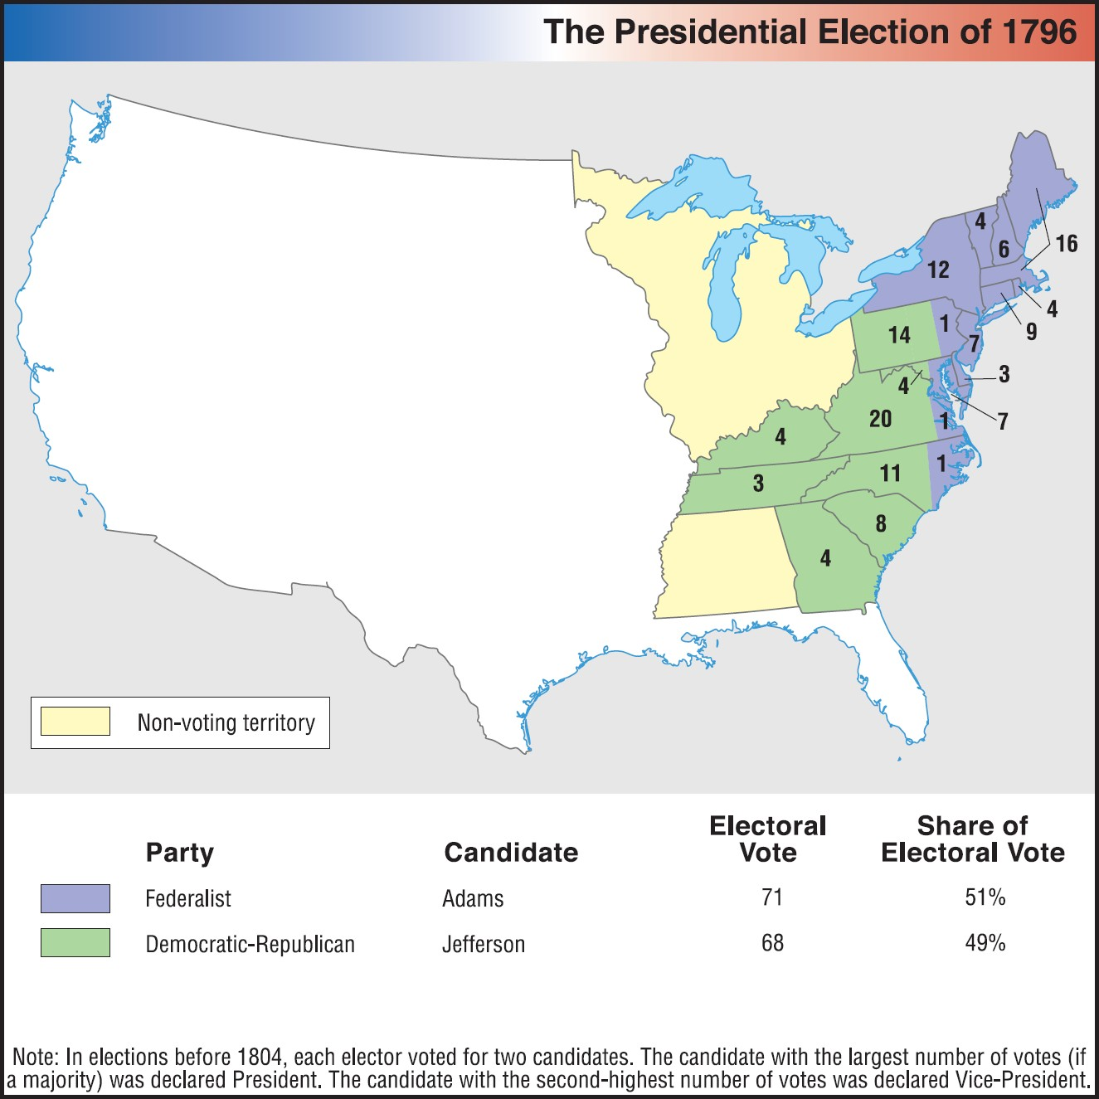
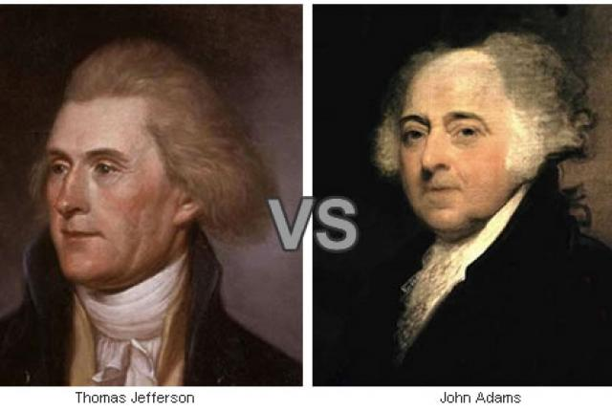
Election of 1796

