Slide 1
Do Now
Identify characteristics that all colonies in British North America shared and characteristics that were specific to one colony and/or region:

Slide 2
Colonial Society and the Development of a Colonial Identity
Mr. Winchell
APUSH 2018-2019
Period 1-2

Slide 3
AP Prompt
Evaluate the impact of the Great Awakening and Enlightenment on the development of colonial identity.

Slide 4
Outline
Colonial Economic & Infrastructural Development
Colonial Social and Cultural Development
Colonial Religious Development
First Great Awakening
The Enlightenment

Slide 5
Colonial Economic Development

Slide 6
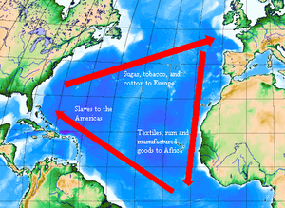
Industries in the colonies
Although manufacturing in the colonies was only secondary to agriculture they did produce, rum, beaver hats, lumber, and iron ore.
Shipbuilding was one of the most important manufacturing segments in the colonies.
One feature of the American economy that strained the relationship between Britain was the growing desire of Americans to trade with other nations (not just England)

Slide 7
Problems with transportation
Transportation was very slow in colonial America with very poor dirt trails and roads connecting various points in the colonies.
Travelers of all ethnicities, places of origin, occupation, religion, etc frequently jammed into taverns dotting places of travel where the mixing groups talked about all sorts of subjects, especially politics.
Transportation struggles kept the colonies economically dependent on GB.

Slide 8
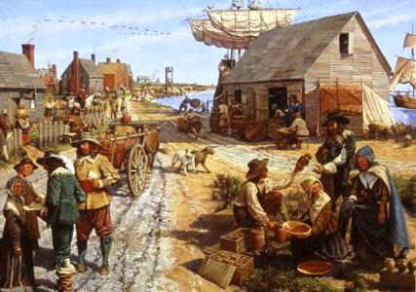
Colonial Society And Colonial Culture
American Social Structure
Wealthy landowners
Merchants
Small farmers
Craftspeople
Slaves
Regional differences
Opportunity
Less dependent on heredity
Gender Roles
Men
Patriarchal society
Landowners/laborers
Women
Submissive to men but respected
domestic responsibilities
limited to no political rights

Slide 9
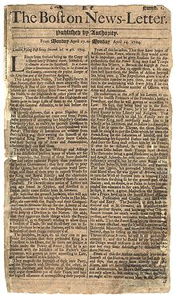
Colonial Culture - The Arts
Architecture
Early colonies centered around a meetinghouse/church
Urban structures typical of English structures
Frontier log cabins
Literature
Newspapers
Religious sermons, political essays, non-fiction books
Poor Richard’s Almanac - Benjamin Franklin

Slide 10
Colonial Culture - Education
Limited to wealthy males; females learned domestic chores
Higher Education
Most established for ministry/theological studies
New England Colonies
Education by mothers
Towns with over 50 families required primary schools; over 100 families, required grammar schools
Middle Colonies
Private and church education
Southern Colonies
Limited education due to agricultural lifestyle

Slide 11
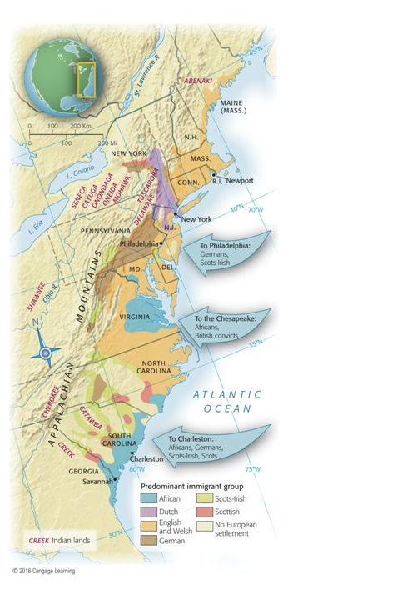
Colonial Diversity
Melting Pot
Germans
Scots Irish
Paxton Boys
Regulator Movement
Dutch
African-American
Population Growth
Migration & Birthrate

Slide 12
Colonial Religion
Diverse among colonies regarding strict adherence and religious toleration
“We find there Lutherans, Reformed, Catholics, Quakers, Menonists or Anabaptists, Herrnhuters or Moravian Brethren, Pietists, Seventh Day Baptists, Dunkers, Presbyterians, . . . Jews, Mohammedans, Pagans.” – visitor to Pennsylvania, 1750

Slide 13
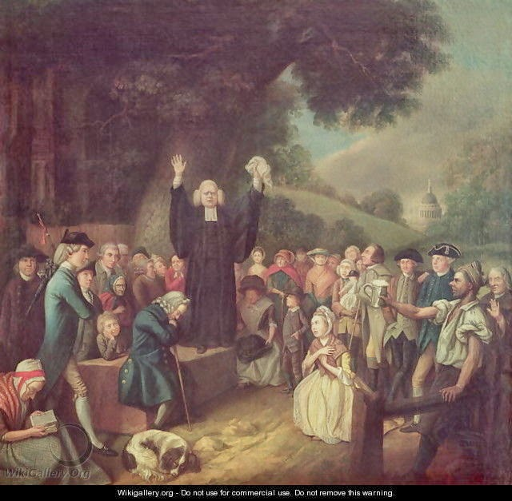
First Great Awakening (1730s-1740s)
Evangelism
Spreading the “Good News”
Revivalism
Appeal to salvation rather than doctrine and governance
Appeal to emotion rather than intellect
Jonathan Edwards
Itinerant preachers
George Whitefield
Old Lights and New Lights
Old Lights - rationalists
New Lights - revivalists
Impact
Decline in Congregationalists, Quakers, Anglicans
Increase in Presbyterians, Baptists, Methodists
Educational institutions
Increase in acceptance and conversion of African Americans and Native Americans
Women granted rights to speak and vote in Church
George Whitefield Preaching
c. 18th century

Slide 14
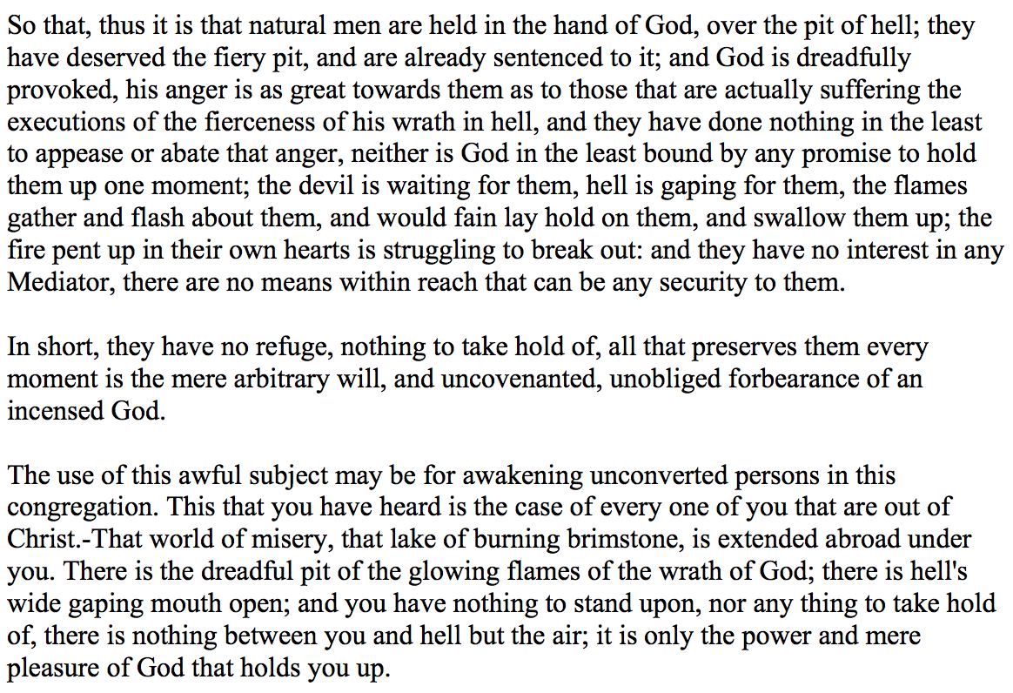
The First Great Awakening Jonathan Edwards
Sinners in the Hands of an Angry God (1741)

Slide 15
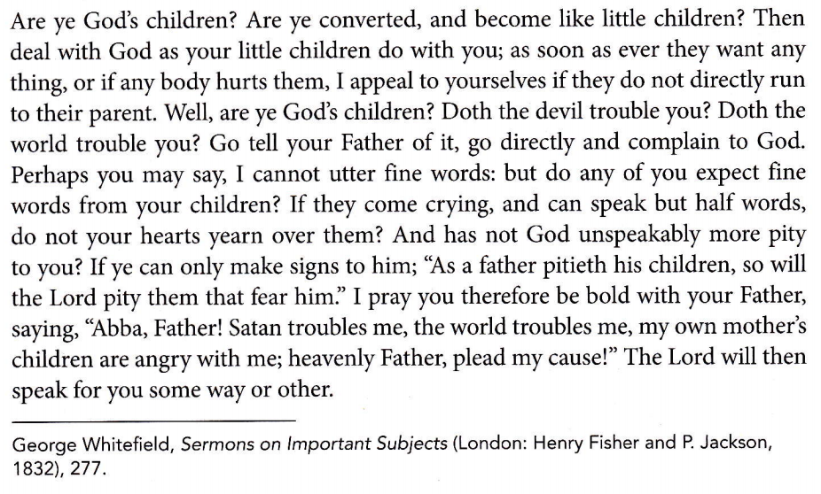
The First Great Awakening George Whitefield
Marks of a True Conversion

Slide 16
The Enlightenment
‘Intellectual ferment’
17th and 18th centuries.
Influenced by 17th century European Enligthenment
Science and Reason Politics & Religion
Moral Philosophy > Theology
Ben Franklin: Science and Politics
Thomas Jefferson: Politics
Benjamin Rush: Medicine

Slide 17
Major Ideas of Enlightenment Thinkers
Idea | Thinker | Impact
Natural rights—life, liberty, property | Locke | Fundamental to U.S. Declaration of Independence
Separation of powers | Montesquieu | France, United States, and Latin American nations use separation of powers in new constitutions
Freedom of thought and expression | Voltaire | Guaranteed in U.S. Bill of Rights and French Declaration of the Rights of Man and Citizen; European monarchs reduce or eliminate censorship
Religious freedom | Voltaire | Guaranteed in U.S. Bill of Rights and French Declaration of the Rights of Man and Citizen; European monarchs reduce persecution

Slide 18
 | Enlightenment | Great Awakening
Type of movement?
Leaders?
Ideas?
Actions?
Intellectual
Reason-based
Philosophical
Religious movement that sweeps through England and the colonies
Colonies: Ben Franklin and Thomas Jefferson
Europe: John Locke
Jonathan Edwards
George Whitefield
All have Natural Rights: Life & Liberty
Can understand the world through reason and logic
Salvation does not come from following the church’s rules, but is between you and God
Challenge & question authority
Think for yourself
Challenge the authority of the church (Puritans, Quakers, Anglican)
New churches formed (Methodist, Baptist)

Slide 19
Enlightenment/Great Awakening Compare and Contrast
Enlightenment focuses more on thought and scientific ideas as opposed to religious ideas
Enlightenment plays major impact on government and society whereas Great Awakening focuses more on religious prosperity
Both play a major role in developing individualism where people can think on their own and determine what is best for them, not what is passed down from religious or governmental authorities.

