Slide 1
Do Now
INDIVIDUALLY: Read the excerpt on the top of your notes and respond to the question:
When done: define ‘liberalism’ on the top of your notes for the day.

Slide 2
Counterculture of the 1960’s-Rise of the New Right 1970s
Mr. Winchell
APUSH
Period 7

Slide 3
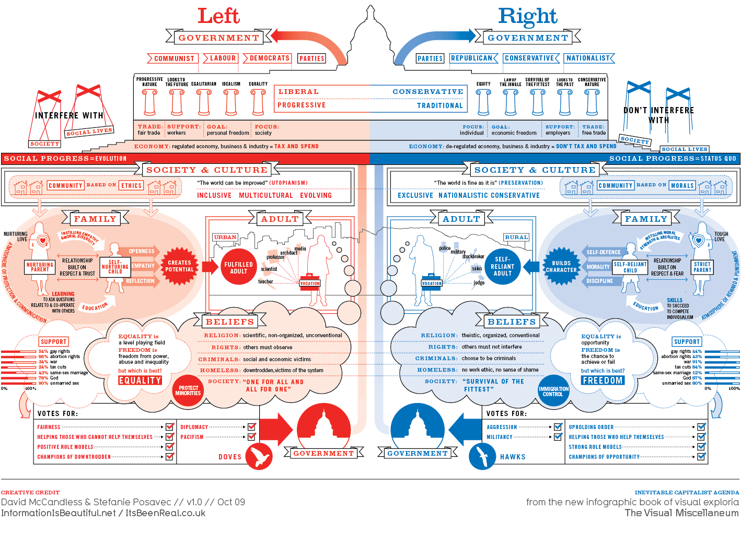
One impact of the 1960s was the rise of the “New Left” – youth and minority movements focusing on liberalism, anti-militarism and awareness of injustices (poor, minorities, adolescences, etc.).
VS.
By the early 70’s these new movements created such upheaval in society - “The Silent Majority” pushes back (conservativism, a return to status quo, middle class mainstream, etc.).
- believed the youth movement was destroying traditional American values.

Slide 4
Protesting the Vietnam War
The most dramatic focus of youthful rebellion was Vietnam:
Mostly led by college students who escaped the draft
Students protested the draft, military research on college campuses, & disproportionate use of black & Hispanic soldiers
Protests got stronger as fighting intensified in Vietnam in 1966

Slide 5
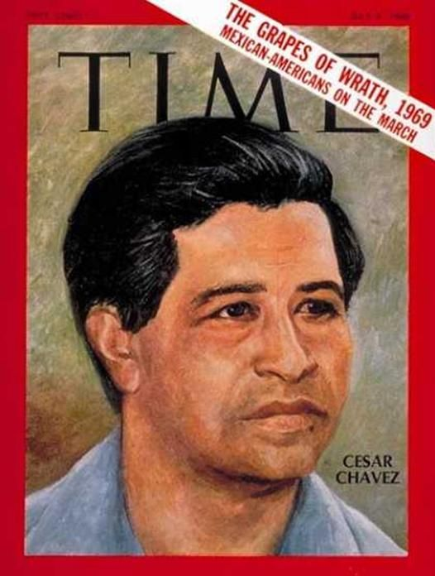
Voices of Protest
Native American Protest
1961
67 tribes created Declaration of Purposes
Criticized termination policies
Lobbied for inclusion with war on poverty
Johnson established National Council on Indian Opportunity 1965
1968
“Red Power”
Younger movement
Mocked Columbus Day
American Indian Movement
Most militant
Occupied Alcatraz for 19 months
Goal to protect way of life
Reassertion of Native American Culture
Hispanic-American
Fastest-growing minority
Impatient
Cesar Chavez 1965
“La Causa”
Non-violence, led agricultural strikes
Chicano/Chicana movement
More militant
Boycotts to demand bilingual classes, more Latino teachers
Spread to other minorities
Notes:
Read ‘La Causa’

Slide 6
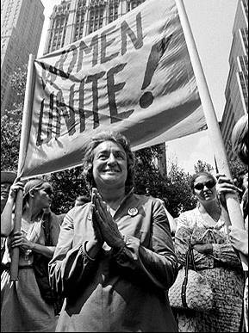
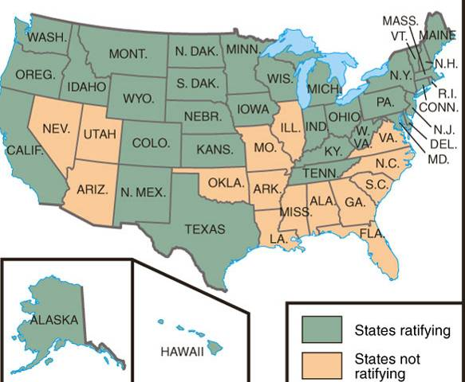
Other Movements – Women’s Liberation
“Pink Power”
Feminism: Started with Betty Freidan publishing Feminine Mystique in 1963 - a dissatisfied housewife who wants equality for all women.
Drew attention to sexual discrimination & unequal pay for women - Betty Freidan co-founded the National Organization of Women (NOW) to advocate for women.
Demanded an Equal Rights Amendment (ERA) to ban sexism - defeated in the 1970s by conservatives & anti-ERA women.
Phyllis Schaffly
Gained abortion rights in Roe v Wade (1973).
Congress passed Title VII to protect women from sexual harassment.
Congress passed Title IX that outlawed sexual discrimination in education programs.
Notes:
READ-Excerpt Feminine Mystique
READ-Phyllis Schlafly

Slide 7
“Each suburban wife struggles with it alone. As she made the beds, shopped for groceries, matched slipcover material, ate peanut butter sandwiches with her children, chauffeured Cub Scouts and Brownies, lay beside her husband at night- she was afraid to ask even of herself the silent question-- 'Is this all?” ― Betty Friedan, The Feminine Mystique

Slide 8
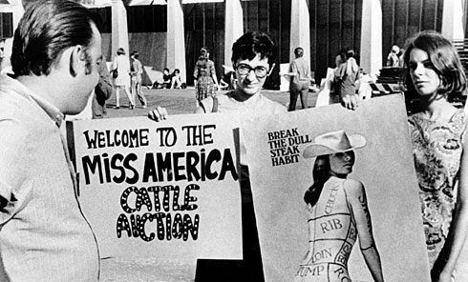

Slide 9
Counter-Culture
Hippies and Drugs
Marijuana
60% of college students tried
No real “evidence” against it
LSD
Films
“Hair” 1967
“Alice’s Restaurant” 1969
Music
Jim Morrison “the Doors”, Bob Dylan
Jefferson Airplane, Rolling Stones, Beatles
Revolt
Surplus military clothing
Torn jeans, tie-dyed shirts
Music Revolution
1960’s College Folk
Bob Dylan
Beatlemania
Woodstock 1969, 800,000 people
Sexual Revolution
“if it feels good, do it”
“the pill” debate
1970 1/3 fetuses aborted
Roe v. Wade (1973)
Publications
Playboy
Gore Vidal’s “Myra Breckenridge” 1969
Films
“Easy Rider”
“Midnight Cowboy”
Divorce rate increased
Cohabitation increased
“open marriages”
Gay Liberation
Public June 1969
Raid on a gay bar in NY
“gay pride”
Supported mainly in cities
Change stigmas
American Psychiatric Association
Not a “mental disorder”
1975 US Civil Service Commission ended ban on employment
Notes:
LISTEN TO-Doors COMPARE TO FOLK/50s

Slide 10
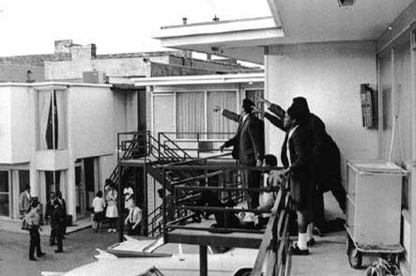
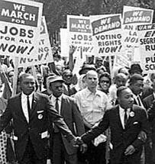
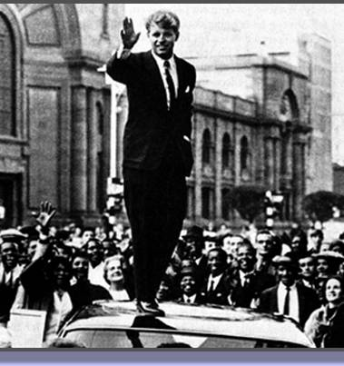
Assassinations in 1968
In 1968, Martin Luther King was assassinated in Memphis & race riots broke out in over 100 cities
In 1968, leading Democratic presidential candidate Robert Kennedy was shot during the California primary
Notes:
James Earl Ray & Sirhan B. Sirhan

Slide 11
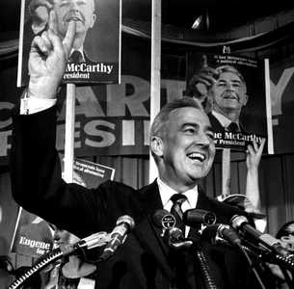
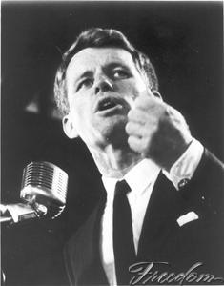
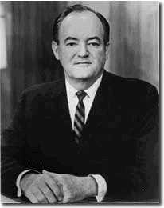
The 1968 Democratic Convention
The withdraw of LBJ & death of RFK, left 2 candidates for the Democratic nomination in 1968:
MN Senator Eugene McCarthy
VP Hubert Humphrey
TV showed angry protestors & police fight outside the convention when Humphrey was nominated
Idealistic & anti-war—supported by upper-middle class whites & college students
Truman-style Cold Warrior—supported by Democratic party leaders; Did not campaign

Slide 12
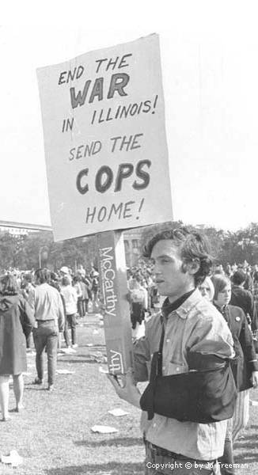
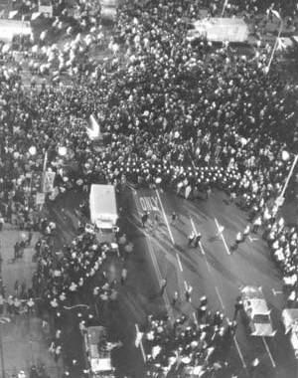
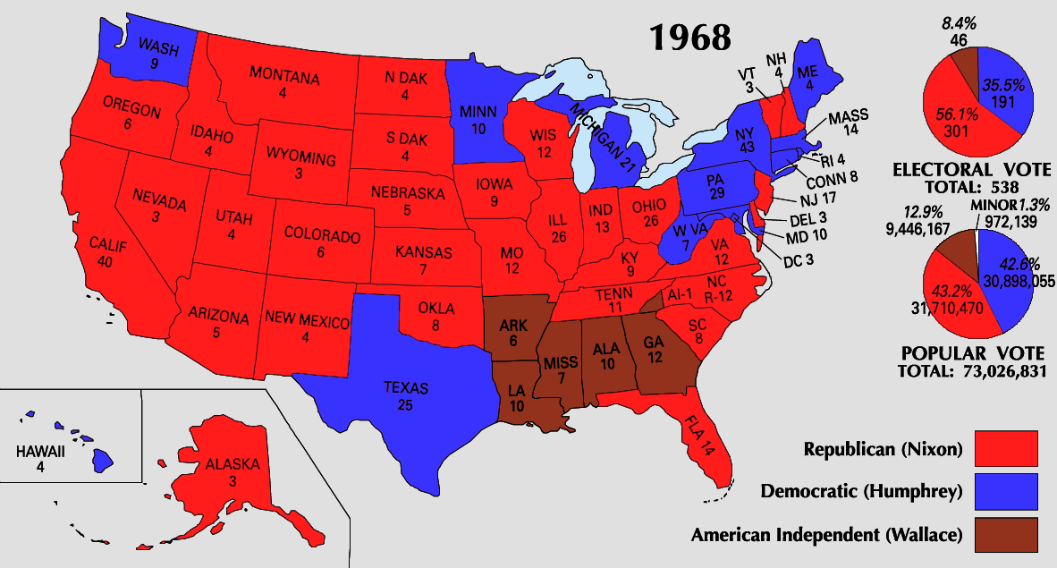
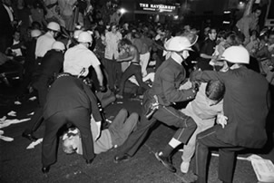
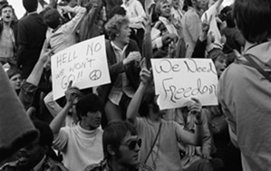
1968 Democratic National Convention
Republicans benefited from the Vietnam disaster & a shattered Democratic party; Nixon won the election as a reconciler

Slide 13
Nixon and World Politics
Vietnamization
When Nixon takes office, 500,000 troops in Vietnam
Nixon Doctrine 1969
US role “helpful partner” not military protector in 3rd world
Support with money, not troops
Called Nixon Doctrine
Gradual withdraw
Vietnam a MESS
Morale, drugs, murder
My Lai massacre 1968
Vietnamization
More S. Vietnamese troops
1972 down to 30,000 US troops
Kissinger sent to negotiate
Nixon’s War
Secret B-52 bombings on Cambodia
Widened Indochina War
America’s longest war ends
1972 “peace at hand”
Snag with demands
Christmas bombing of Hanoi
Paris Accords Jan 1973
Ended hostilities
Left situation unresolved
Results
58,000 dead
300,000 wounded
$150 billion
Psychological effects
“Put Vietnam behind us”
US could care less about Indochina
Détente-’the easing of hostility’
1970 “three-dimensional” game
1972- China
Formal recognition
1972- Moscow
Strategic Arms Limitation Talks

Slide 14
Foreign Policy
Nixon proved to be an effective foreign-policy president:
Most foreign policy decisions were made by Nixon & National Security Advisor Henry Kissinger
Developed a plan for détente:
An “honorable” exit from Vietnam
Using U.S. trade to induce cooperation from the USSR
Improved relations with China
Nixon hoped for a relaxing of Cold War tensions

Slide 15
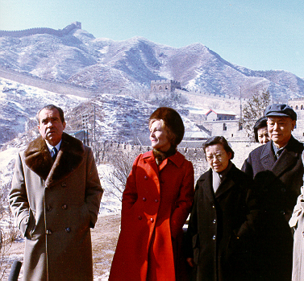
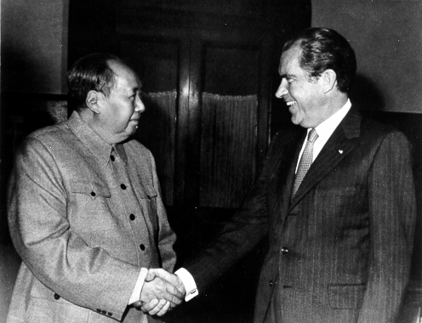
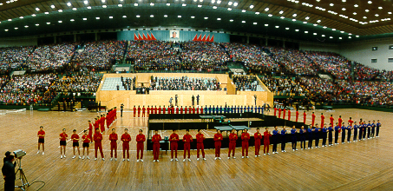
In Search of Détente
“Ping-pong diplomacy”
In Feb 1972, Nixon became 1st U.S. president to visit & recognize the People’s Republic of China:
These improved Sino-American relations helped eased Cold War tensions & forced the USSR to consider diplomacy with the U.S.
Presented the U.S. with its 1st economic access to China

Slide 16
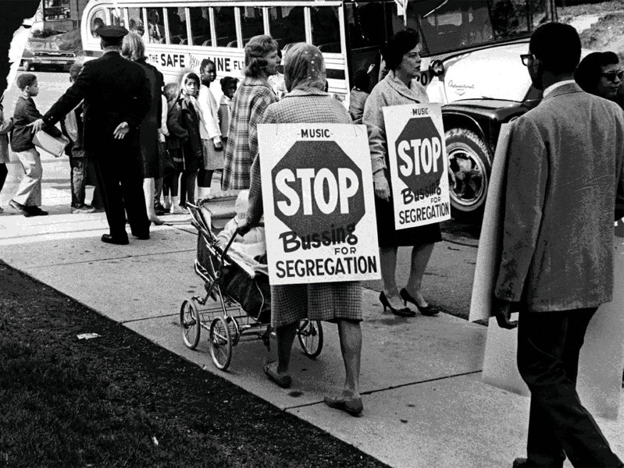
Nixon – Domestic Events
Promoted New Federalism – transfer some federal powers back to the states (ex: de-segregation/busing dealt with at the state level) – most everything passed was vetoed by Nixon!
Expansion of affirmative action – Griggs vs. Duke Power Co (hire more minority workers to avoid charges of discrimination).
Congress created the EPA (Environmental Protection Agency) – a result of new awareness about chemicals and pollution.
Muckraker Rachel Carson’s Silent Spring (exposes the effects of farm pesticides).
Endangered Species and Clean Air Act
Created the Occupational Health and Safety Administration – creates regulations and inspections of work places to ensure safety!
OPEC announces an embargo of oil to the US – triples prices and leads to mass energy crisis!
Expanded Food Stamps, Medicaid but to only certain groups…
Notes:
READ SILENT SPRING EXCERPT

Slide 17
Election 1972
Southern Strategy
Court whites upset with racial equality
Opposed extension of Voting Rights Act
Hindered Fair Housing Act
Slow desegregation
Supreme court nominations
More conservative
Nominated Chief Justice Warren Berger
Shift to the right
Election
Re-election certain
Democrats divided
Wallace shot May 1972
Democratic Nominee
George McGovern
CREEP
Results
Nixon Wins
Less people vote
Watergate, June 1972
Arrest of individuals caught wire-tapping Democratic party center
Paid $400,000 to quiet before election
“Deep Throat”
Bob Woodward/ Carl Bernstein
Feb. 1973
Senate investigation
No solid proof of ordering activities
Guilty of trying to cover it up
Firings/resignations
televised
Disgrace
VP Agnew charged with tax evasion Oct. 1973
House minority leader Gerald R. Ford becomes VP
March ’74
Nixon tapes subpoenaed
July unedited tapes appear
Indicted on 3 articles of Impeachment
Aug 9, 1974 1st president to resign

Slide 18
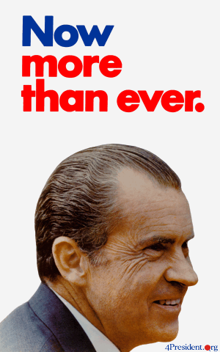
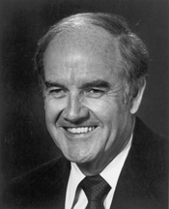
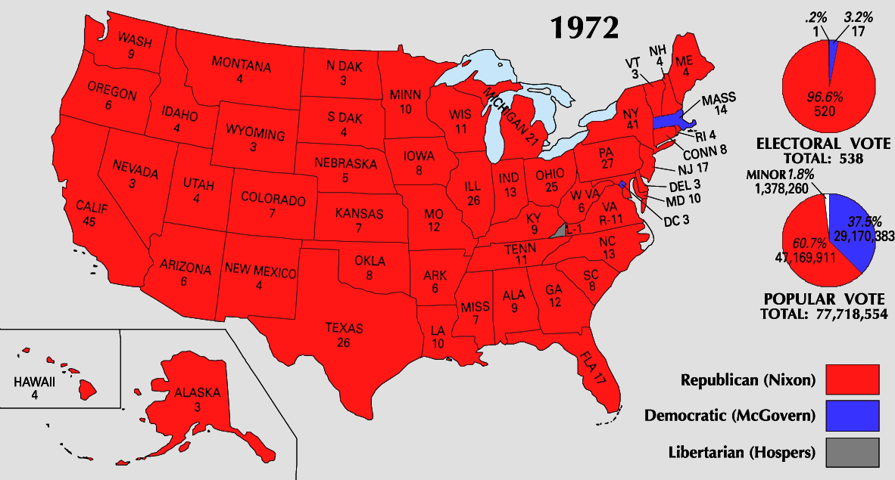
The Election of 1972
The 1972 election saw a shift in voting patterns:
Only blacks, Jews, & the poor voted overwhelmingly Democratic while the GOP continued its dominance in the Sunbelt
In 1972, Nixon ran for re-election
Democrat George McGovern was labeled an “outsider” who supported “acid, abortion, & amnesty”
Nixon won in the 4th largest margin of victory in history
But…the Watergate scandal ended the Nixon presidency

Slide 19
The Watergate Scandal
The Watergate scandal began to unravel in 1973:
The discovery that Nixon recorded conversations proved most damning
The Supreme Court ordered Nixon to turn over all tapes to a Senate investigative committee
The House brought 3 articles of impeachment against president
Obstruction of justice
Abuse of power
Contempt of Congress

Slide 20
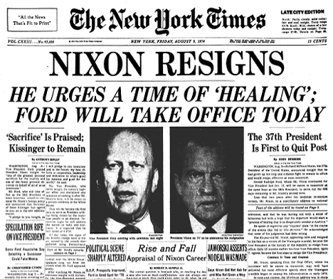
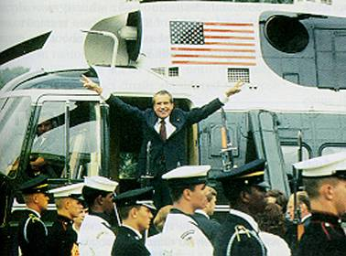
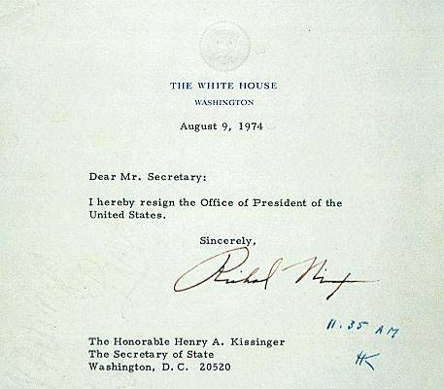
Notes:
May 2005, Deep Throat was revealed as FBI Deputy Secretary W. Mark Felt

Slide 21
Conclusions: Politics After Watergate
The Watergate scandal eroded public trust in their own gov’t
The growing tension between president & Congress prevented strong, effective leadership from meeting foreign & domestic problems in the 1970s
The discontent of the 1960s & 1970s revealed an America at war with itself
This DEFINES the 70’s politically: Watergate + Pentagon Papers + Bad economy + decrease in US global status = MISTRUST and DISALLIONMENT!

Slide 22
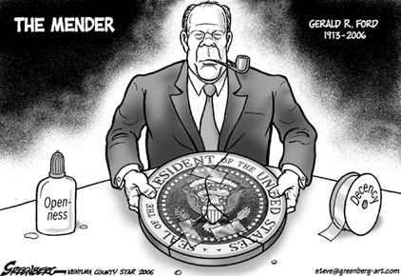
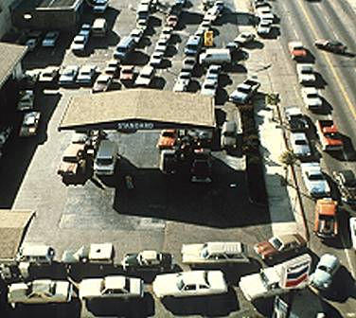
Ford as President
Ford was seen as an “honest man” - hoped to move America past the Watergate scandal.
Grants full pardon to Nixon – enrages Dem’s and hurts his reputation as an honest politician.
Faced a TROUBLED economy - Restricted credit which led to recession and inflation (called Stagflation).
Tried to curb inflation with “tight” money (plan called “WIN” – Whip Inflation Now).
Remember Org. of Petroleum Exporting Countries (OPEC)…economic situation worsens.
In retaliation for American support of Israel, OPEC cut off oil to the U.S. in 1973
Leads to Oil Crisis - Gas prices soared & shortages led to long lines at the pump.
1975 – attends the Helsinki Accords (furthered efforts of détente in Europe).
Also Saigon falls – Vietnam unified under Communist rule.

Slide 23
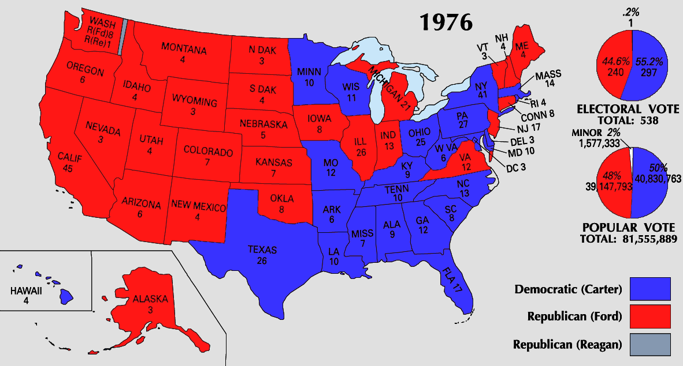
Carter – Domestic Events
Election of 1976 - Stagflation and gas crisis continues…
Carter ran as an “outsider” (No involvement in Vietnam, Watergate, or the recession) – it was a close election!
Carter tried to attack the energy crisis, stagflation, & the recession - None of his efforts worked!
Inflation hit 14%, interest rates neared 20% - a new oil embargo in 1979 increased gas prices.
Affirmative Action challenged – Bakke v. Regents (claimed reverse discrimination in college admissions).
Upheld affirmative action, but its image decreases and looks like an “unfair advantage” to minorities.
Three mile island nuclear plant explodes – leads to questioning new energy ideas.
Green movement continues! - protecting the earth, clean energy, solar and wind power, etc.

Slide 24
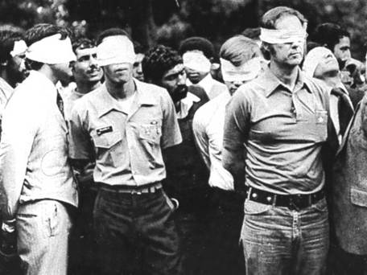
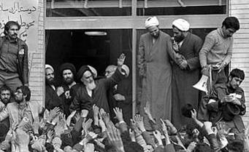
Carter – Foreign Events
Carter stresses “human rights” as basis of U.S. foreign policy - stopped supporting foreign governments that violated human rights.
Brought Egyptian leader Anwar el-Sadat & Israeli leader Menachem Begin to the U.S. for the Camp David Accords in 1977 – started to move towards “peace in the Middle East.”
Then...fundamentalist Islamic cleric Ayatollah Khomeini led the Iranian Revolution.
Over threw the pro US leader the “Shah” and instated a theocratic radical regime – hated the US!
Iranian protests stormed US embassy – held 52 American hostages for 444 days – known as the Iran Hostage Crisis.
Carter tried diplomacy, negotiations, rescues – nothing worked (he looks very weak!)
At the same time…Russia invades Afghanistan – signals détente is ending and the Cold War is “heating up” again!

Slide 25
The Cold War Resumes
During the Carter years, the Cold War rivalry between the U.S. & USSR grew due to:
A new arms race as the U.S. adopted new MX missiles & Trident submarines
SALT II failed to make lasting arms reduction
Increased U.S.-Chinese relations put the USSR on the defensive

Slide 26
The Cold War Resumes
Détente ended when the USSR invaded Afghanistan in 1979
The U.S. interpreted the attack as a move to take the Middle East & responded with:
Economic embargo of the USSR
Boycott of the Moscow Olympics
Aid to the Afghani resistance
Great idea at the time…
Carter hoped to limit nuclear arms & advance human rights, but found himself in a heightened Cold War

Slide 27
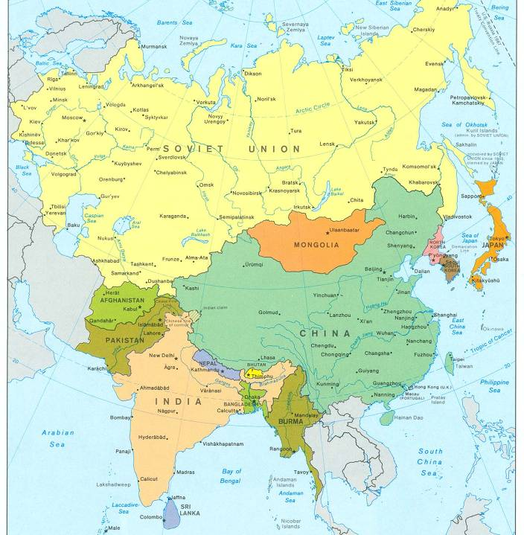
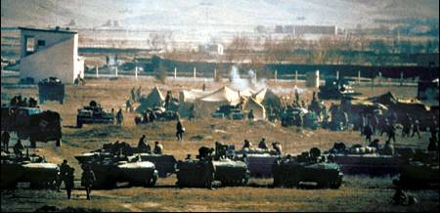
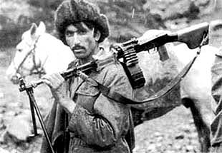
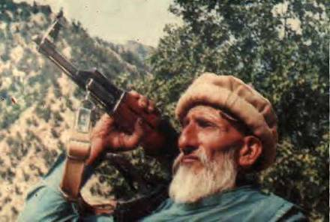
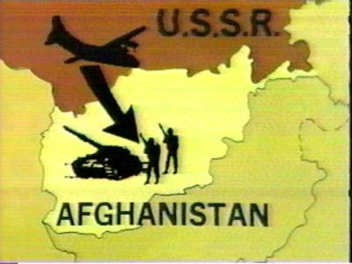
Soviet Invasion of Afghanistan, 1979

Slide 28
A Failed Presidency
Carter’s failures with inflation, Iran, & Afghanistan overshadowed his foreign policy victories with the Panama Canal & the Middle East
The failures of Johnson, Nixon, Ford, & Carter led to a desire among Americans for a strong leader who could face both domestic & foreign challenges
Carter’s 1980 approval rating was 23%

Slide 29
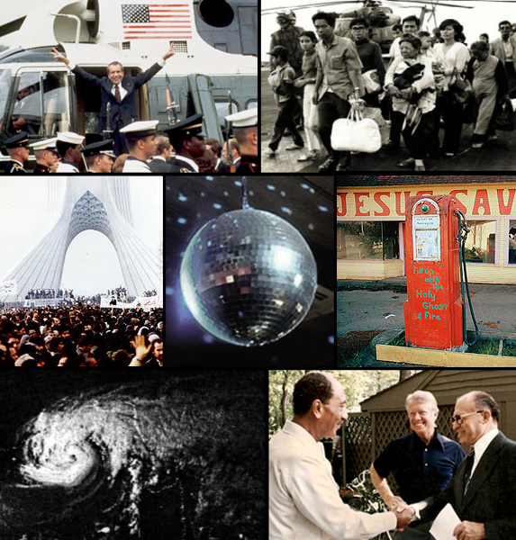
Conclusions on the 60’s and 70’s:
By 1980, the USA seemed to be losing its place as the top nation in the world:
The 1970s presented failures in the Cold War & new problems in the Middle East.
The social protests & counter culture seemed to divide liberals & conservatives.
Stagflation & the economic recession were growing worse, not better .
The failures of Johnson, Nixon, Ford, & Carter left citizens in search of optimism, strong leadership, & conservative policies.

