Slide 1
FDR’s New Deal
Mr. Winchell
APUSH
Period 7

Slide 2
Do Now
How did Roosevelt’s approach to the Great Depression differ from that of Hoover?
How would the framers of the Constitution have felt about the expansion of executive power through the New Deal? Why?

Slide 3
Essential Questions:
Evaluate the extent to which Franklin Roosevelt’s New Deal provided relief, recovery, & reform during the Great Depression?

Slide 4
Franklin Roosevelt & the First New Deal (1933-1935)

Slide 5
The Election of 1932
The depression made Hoover the victim, but Franklin Roosevelt emerged as the “savior”:
In the 1932 election, FDR was able to unite the rural & urban factions of the Democratic party & won a landslide victory
FDR appealed to Protestants & Catholics, farmers & workers, native-born & immigrants

Slide 6
FDR’s 3 R’s
Relief
Reform
Recover

Slide 7
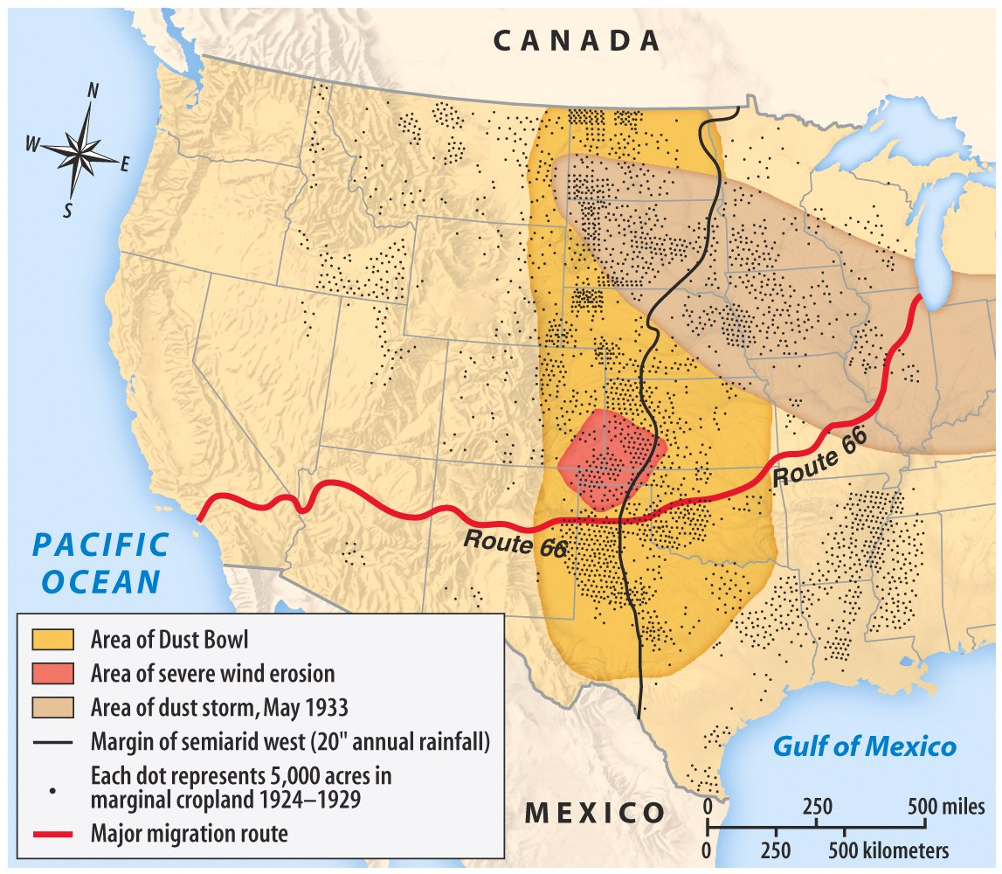

Slide 8
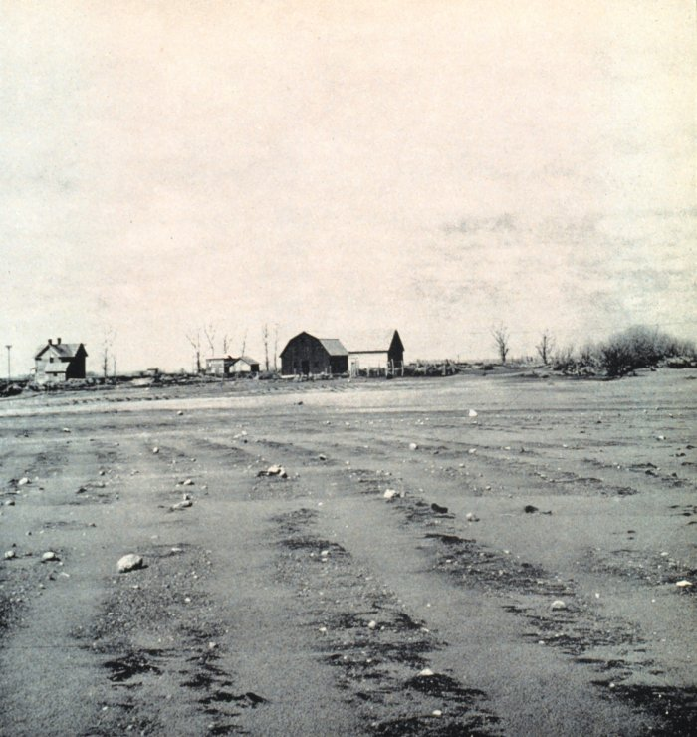
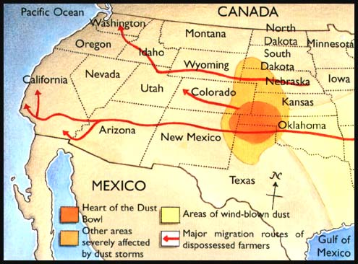
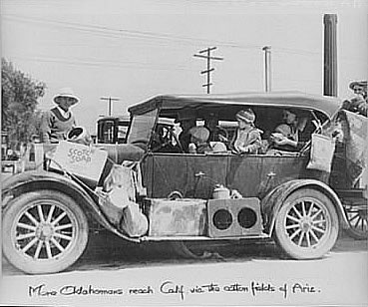
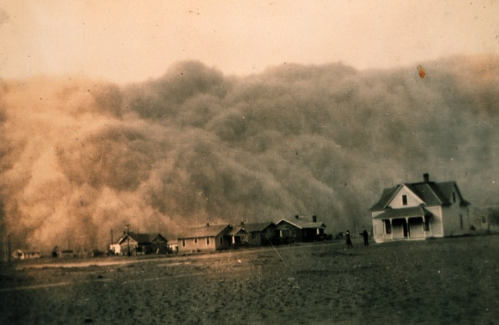
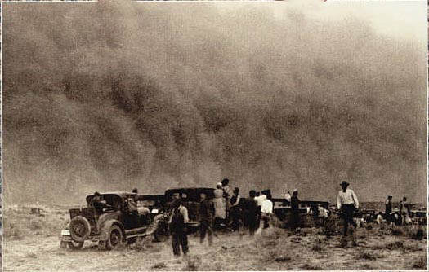
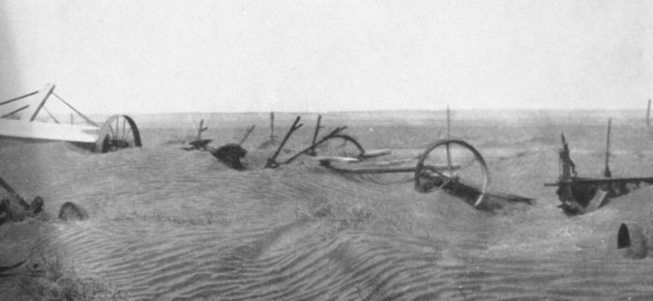
The Dust Bowl (1931-1939) worsened the effects of the Depression
“Okies” & “Arkies”
Areas Affected by the Dust Bowl drought
Notes:
Woody Guthrie

Slide 9
The Hundred Days
When FDR took over in 1933, the U.S. economy was on the brink of collapse:
Unemployment was at 25%
38 states had total bank failure
FDR requested from Congress broad executive power to begin his “New Deal” program of economic relief, recovery & reform
FDR asked for “broad executive power that would be given to me if we were in fact invaded by a foreign foe.”

Slide 10
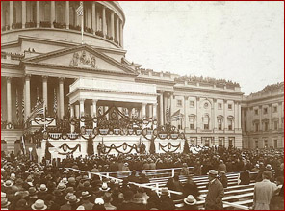
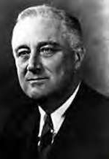
“Let me assert my firm belief that the only thing we have to fear is fear itself; nameless, unreasoning, unjustified terror which paralyzes needed efforts to convert retreat into advance.”

Slide 11
The Hundred Days
In his 1st hundred days, FDR began his 1st New Deal (1934-35)
FDR’s 1st order of business was to restore confidence in banking:
Declared a 4-day bank holiday: closed or funded weak banks & opened new gov’t-aided banks
Glass-Steagall Act created the FDIC which guaranteed all bank deposits over $5,000
Banks were regulated (not nationalized); the economic system was reformed
(not drastically changed)
Now, the FDIC insures deposits up to $100,000
Emergency Banking Act of 1933
Notes:
The First Hundred Days
Americans voted for Franklin Delano Roosevelt in 1932 on the assumption that the Democrats would dole out more federal assistance than Hoover and the Republicans had. Indeed, immediately after taking the oath of office, FDR set out to provide relief, recovery, and reform in his bundle of programs known as the New Deal.
Roosevelt drew much of his inspiration for the New Deal from the writings of British economist John Maynard Keynes, who believed that a government’s deficit spending could prime the economic pump and jump-start the economy. With the support of a panicked Democratic Congress, Roosevelt created most of the “alphabet agencies” of the First New Deal within his landmark First Hundred Days in office.
The Banking Acts
On March 6, 1933, two days after becoming president, Roosevelt declared a five-day national bank holiday to close banks temporarily. During Hoover’s presidency, roughly 1,500 banks had closed each year, and FDR hoped that a short break would give the surviving banks time to reopen on more solid footing. Several days later, Congress passed the Emergency Banking Relief Act, which gave Roosevelt the power to regulate banking transactions and foreign exchange.
Several months later, Congress passed the Glass-Steagall Banking Reform Act to protect savings deposits. The act, in turn, created the Federal Deposit Insurance Corporation (FDIC), which insured an individual’s savings of up to $5,000 (today, it insures deposits of up to $100,000). The act also regulated lending policies and forbade banks from investing in the stock market. After the banking crisis was resolved, Roosevelt aired the first of his “fireside chats” to over 50 million radio listeners, encouraging Americans to redeposit their money in the newly opened banks.
The president quickly pushed ahead on other fronts. The Federal Emergency Relief Act pumped $500 million into state-run welfare programs. The Homeowners Loan Act provided the first federal mortgage financing and loan guarantees. By the end of Roosevelt's first term, the Homeowners Loan Act provided more than 1 million loans totaling $3 billion. The Glass-Steagall Act provided a federal guarantee of all bank deposits under $5,000, separated commercial and investment banking, and strengthened the Federal Reserve's ability to stabilize the economy.
In addition, Roosevelt took the nation off the gold standard, devalued the dollar, and ordered the Federal Reserve System to ease credit. Other important laws passed during the 100 days included the Agricultural Adjustment Act--the nation's first system of agricultural price and production supports; the National Industrial Recovery Act--the first major attempt to plan and regulate the economy; and the Tennessee Valley Authority Act--the first direct government involvement in energy production.

Slide 12
“Capitalism was saved in eight days”

Slide 13
The Hundred Days
The greatest success of the First New Deal was its ability to offer relief to unemployed citizens via the Reconstruction Finance Corps
Modest relief checks were doled to 15% of Americans
Federal Emergency Relief Act (FERA) pumped $500 million into state welfare programs
Notes:
The Federal Emergency Relief Administration
The “Hundred Days Congress” also created the Federal Emergency Relief Administration (FERA), in May 1933, to dole out roughly $500 million to the states. About half of this money was earmarked to bail out bankrupt state and local governments. States matched the other half (three state dollars for every one federal dollar) and distributed it directly to the people. FERA also created the Civil Works Administration (CWA), which helped generate temporary labor for those most in need.

Slide 14
The Hundred Days
Relief efforts of the First New Deal created more “alphabet agencies”
Civilian Conservation Corps (CCC) employed urban men
Civilian Works Admin (CWA) hired 4 million men & women
Agricultural Adjustment Admin (AAA) subsidized farmers
Notes:
The Civilian Conservation Corps
In March 1933, Congress created the Civilian Conservation Corps (CCC), which hired unemployed young men to work on environmental conservation projects throughout the country. For a wage of thirty dollars a month, men worked on flood control and reforestation projects, helped improve national parks, and built many public roads. Approximately 3 million men worked in CCC camps during the program’s nine-year existence.
The Agricultural Adjustment Administration
Roosevelt also encouraged the creation of the Agricultural Adjustment Administration (AAA) to assist America’s farmers. The AAA temporarily reset prices for farm commodities, including corn, wheat, rice, milk, cotton, and livestock, and then began subsidizing farmers to reduce production. Before the depression, many debt-ridden farmers had increased crop production in order to earn more money. Ironically, this increased production had led to overproduction, which flooded the market and drove prices down, forcing farmers to plant even more the next year in a never-ending cycle. The AAA, however, began paying farmers extra to plant less or destroy their surplus crops in order to raise prices again. Congress also passed the Farm Credit Act to provide loans to farmers in danger of bankruptcy.
The AAA was quite controversial, as many critics wondered why landowners rather than sharecroppers and tenant farmers were receiving federal aid. Indeed, some landowners who received aid unjustly used it to purchase farm equipment, which had the potential to eliminate farm owners’ need for sharecroppers and tenant farmers entirely. Furthermore, many poorer and hungrier Americans were outraged that the government was paying farmers money to destroy perfectly edible crops in order to inflate prices. Despite these criticisms, however, the AAA did manage to raise prices to their pre–World War I highs.

Slide 15
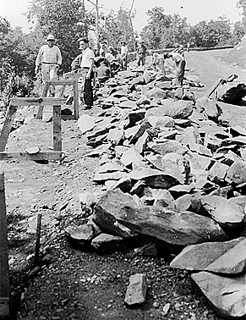
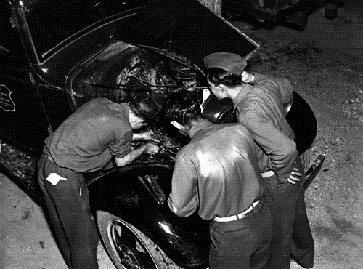
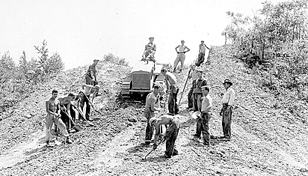
CCC workers paved roads, planted trees, built bridges

Slide 16
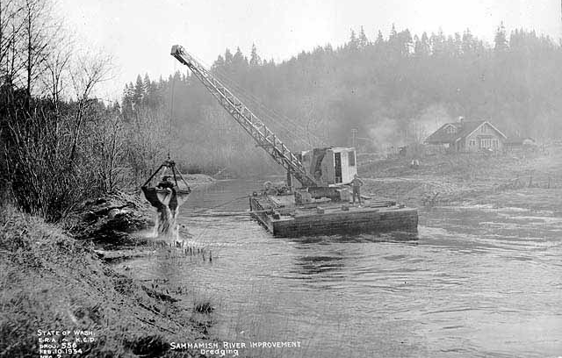
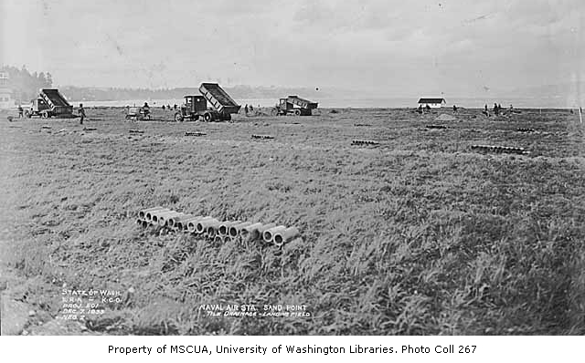
CWA
Creating drainage system for an airfield
Dredging a lake

Slide 17
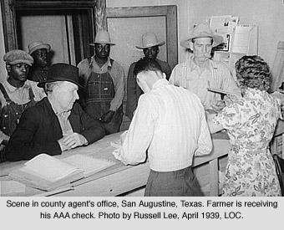
AAA

Slide 18
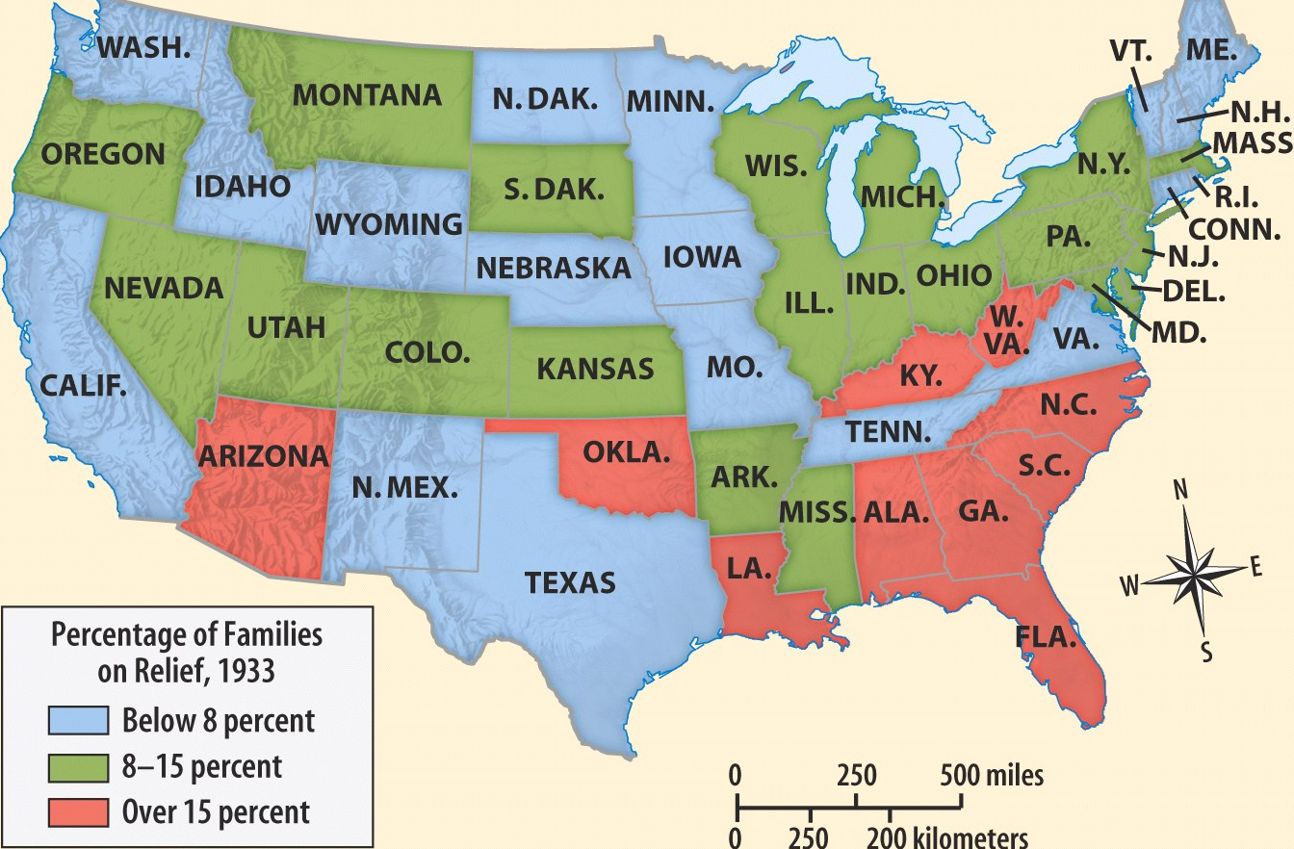
Percentage of American Families Accepting Government Relief in 1933

Slide 19
The Hundred Days
The National Industrial Recovery Act (NIRA) was the 1st attempt at economic recovery:
Created the National Recovery Admin (NRA) set max hours & minimum wages for workers & stimulated industry by fixing prices & setting production limits
Created the Public Works Admin (PWA) to build public roads, bridges, & buildings
Additional attempts to stimulate the economy include taking the U.S. off the gold standard & ending prohibition (21st amendment)
Notes:
The National Industrial Recovery Act
The 1933 National Industrial Recovery Act was the federal government’s first attempt to revive the economy as a whole. The bill created the National Recovery Administration (NRA) to stimulate industrial production and improve competition by drafting corporate codes of conduct. The NRA also sought to limit production of consumer goods to drive up prices. Furthermore, the act helped set up the Public Works Administration (PWA) to construct public roads, bridges, and buildings. In accordance with Keynesian economic theories, Roosevelt believed that improving the public infrastructure would put more money into the economy.

Slide 20
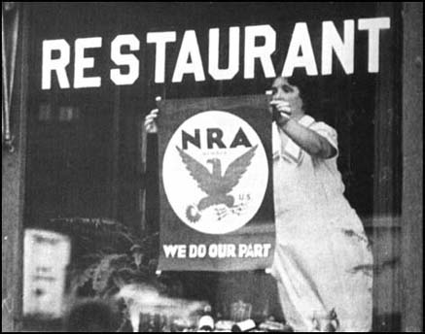
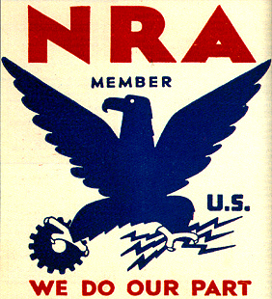
National Recovery Administration
The NRA ended up being too bureaucratic; business cooperation gave way to self-interest & greed

Slide 21
The Hundred Days
Some of FDR’s First New Deal focused on long-term reforms
Tennessee Valley Authority (TVA) created dams in 7 states to provide cheap hydroelectric power & create jobs
Securities & Exchange Commission (SEC) to regulate the stock market & prevent another stock market crash
Notes:
The Tennessee Valley Authority
Congress also created the Tennessee Valley Authority (TVA), whose goal was to modernize and reduce unemployment in the Tennessee River valley, one of the poorest and hardest-hit regions in the country. The agency hired local workers to construct a series of dams and hydroelectric power plants, which brought cheap electricity to thousands of people. The public corporation also created affordable employee housing, manufactured cheap fertilizer, and drained thousands of acres for farming. The TVA, like the AAA, was highly controversial. Many conservatives claimed that government production of electricity was a mild form of socialism and that it disrupted market prices too much. Competing electric companies also attacked the TVA for selling cheaper electricity and lowering their profits. Still, the TVA had such a profound impact on the economy and quality of life in the Tennessee River valley region that the federal government initiated similar projects throughout the West and South. Within a decade, many major U.S. rivers were set up to produce hydroelectric power that provided both electricity and jobs.
Restructuring American Finance
Finally, Roosevelt also lobbied Congress to establish new regulations on the financial sector of the economy. After taking office, he took the country off the gold standard, which allowed citizens and foreign countries to exchange paper money for gold. To prevent people from hoarding the precious metal, the president also ordered all private gold stocks to be turned over to the U.S. Treasury in exchange for paper dollars. Congress also created the Securities and Exchange Commission (SEC) to regulate trading on Wall Street and curb the out-of-control speculation that had led to the Crash of 1929.

Slide 22
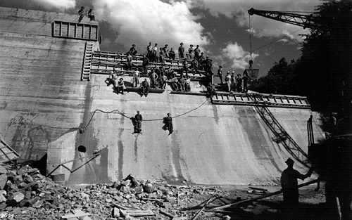
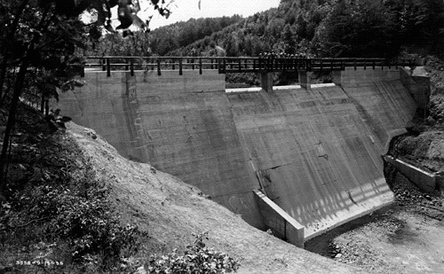
The Tennessee Valley Authority
Critics claimed the TVA was too socialistic; Competing electric companies attacked the TVA for selling cheaper electricity & eliminating competition

Slide 23
The Hundred Days
The 1st hundred days of FDR’s administration were temporary solutions to solve problems, but…
…psychologically, Americans believed that FDR was actively responding to the Depression

Slide 24
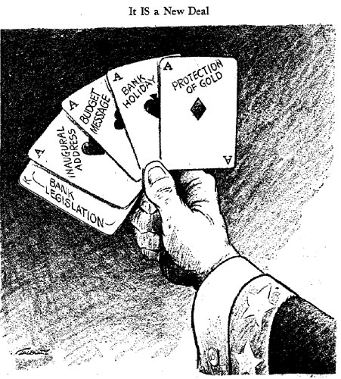
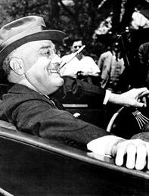
The Hundred Days
“The whole country is with him, just so he does something. If he burned down the capitol we would cheer and say ‘well, we at least got a fire started anyhow.’”
—Will Rogers
“Even the hand of an iron dictator is in preference to a paralytic stroke”
—Alf Landon (Repub nominee in 1936)
Notes:
Alf Landon ran against FDR as a Republican candidate in 1936

Slide 25
Franklin Roosevelt & the Second New Deal (1935-1938)

Slide 26
Criticism of the First New Deal
The failure of the New Deal to end the depression led to growing frustration among Americans
From 1933-1934, the New Deal focused on immediate problems & did very little to help unskilled workers & farmers
In 1935, FDR shifted approach from economic relief to reform
Notes:
GLASS/STEAGALL ACT -- gave government power to investigate banking conditions, vested greater regulatory powers in Federal Reserve Board.
FEDERAL DEPOSIT INSURANCE CORPORATION [FDIC] -- insured savings of bank depositors and monitored soundness of insured banking institutions.
FEDERAL SAVINGS & LOAN INSURANCE CORPORATION [FSLIC] -- insured savings of depositors in savings & loan institutions and monitored soundness of insured S&Ls.
SECURITIES AND EXCHANGE COMMISSION [SEC]: regulated stock and bond trading; regulated exchanges where stocks and bonds are sold, and legislated requirements for disclosure of fair stock information.
WAGNER ACT created NATIONAL LABOR RELATIONS BOARD [NLRB] which reaffirmed labor's rights to bargain for wages, hours, and working conditions, to strike, and to arbitration of grievances.
FAIR LABOR STANDARDS ACT [FLSA]: 1938 -- set minimum wages and maximum working hours.
TENNESSEE VALLEY AUTHORITY [TVA] and RURAL ELECTRIFICATION
AUTHORITY [REA]: helped to bring electricity to rural "pockets of poverty" that could not afford lines.
SOCIAL SECURITY: Provided for unemployed, aged, dependent, and handicapped. Financed by FICA taxes paid by employee, matched by employer and Federal government.

Slide 27
Challenges to FDR
By 1935, signs of discontent with the New Deal were evidenced as 3 critics gained national attention:
Father Charles Coughlin called for nationalizing U.S. banks; used anti-Semitism in radio sermons
Francis Townsend appealed to the elderly with a $200/mo payment plan to anyone over 60 in order to stimulate the economy

Slide 28
Challenges to FDR
Louisiana Senator Huey Long proposed his Share the Wealth plan to:
Take from the rich—a 100% tax on all personal income over $1 million
Give to the poor—give every American $2,500 per year

Slide 29
The Second New Deal
The 1st act of the 2nd New Deal was Works Progress Admin (WPA), the most comprehensive, direct-assistance program of the New Deal
The national gov’t hired 10 million Americans in an attempt to stimulate the economy
WPA created building projects, funded artists, & pumped $10 billion into the economy
WPA helped but never employed enough people to stimulate consumer purchase power—it made the Depression bearable
Notes:
In January 1935, Congress created the Works Progress Administration (WPA). Roosevelt's program employed 3.5 million workers at a "security wage"--twice the level of welfare payments, but well below union scales. Roosevelt, again, turned to Harry Hopkins to head the new agency. Since the WPA's purpose was to employ men quickly, Hopkins opted for labor-intensive tasks, creating jobs that were often makeshift and inefficient. Jeering critics said the WPA stood for "We Piddle Along," but the agency built many worthwhile projects. In its first five years alone, the WPA constructed or improved 2,500 hospitals, 5,900 schools, 1,000 airport fields (including New York's LaGuardia Airport), and nearly 13,000 playgrounds. By 1941 it had pumped $11 billion into the economy.
The WPA's most unusual feature was its spending on cultural programs. Roughly five percent of the WPA's spending went to the arts. While folksingers like Woody Guthrie honored the nation in ballads, other artists were hired to catalog it, photograph it, paint it, record it, and write about it. In photojournalism, for example, the Farm Security Agency (FSA) employed scores of photographers to create a pictorial record of America and its people. Under the auspices of the WPA, the Federal Writers Project sponsored an impressive set of state guides and dispatched an army of folklorists into the backcountry in search of tall tales. Oral historians collected slave narratives, and musicologists compiled an amazing collection of folk music. Other WPA programs included the Theatre Project, which produced a live running commentary on everyday affairs; and the Art Project, which decorated the nation's libraries and post offices with murals of muscular workmen, bountiful wheat fields, and massive machinery.
Valuable in their own right, the WPA's cultural programs had the added benefit of providing work for thousands of writers, artists, actors, and other creative people. In addition, these programs established the precedent of federal support to the arts and humanities, laying the groundwork for future federal programs to promote the life of the mind in the United States.
In 1939, a Gallup Poll asked Americans what they liked best and what they liked worst about Franklin Delano Roosevelt's New Deal. The answer to both questions was: “the WPA, the Works Projects Administration.”
Work crews were criticized for spending days moving leaf piles from one side of the street to the other. Unions went on strike to protest the program's refusal to pay wages equal to those of the private sector. President Ronald Reagan, a staunch critic of large-scale government programs, was one of the WPA's defenders, however. "Some people," he said, "have called it boondoggle and everything else. But having lived through that era and seen it, no, it was probably one of the social programs that was most practical in those New Deal days."
Approximately five percent of its budget was devoted to the arts. WPA alumni include writers Saul Bellow, John Cheever, Ralph Ellison, and Richard Wright, the artist Jackson Pollack, and actor and director Orson Welles.
The WPA was not especially efficient. In Washington, D.C., construction costs typically ran three-to-four times the cost of private work. Although, this was intentional. The WPA avoided cost-saving machinery in order to hire more workers. At its peak, the WPA spent $2.2 billion a year, or approximately $30 billion annually in current dollars.
The Works Progress Administration
The first major legislation that Roosevelt and Congress passed in the Second New Deal—in response to the critics—was the Works Progress Administration (WPA). Created in 1935, the WPA was an effort to appease the “Longites” who clamored for more direct assistance from the federal government. The WPA was similar to the Public Works Administration of the First New Deal, this time hiring nearly 10 million Americans to construct new public buildings, roads, and bridges.

Slide 30
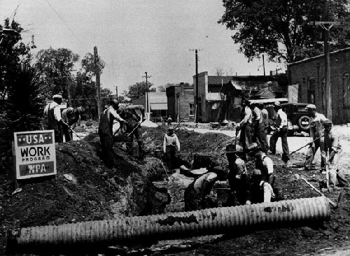
WPA Public Work Project
WPA cared less about what got done as long as work was done: built hospitals, schools, airport fields… but also moved leaf piles & dug ditches

Slide 31
Social Security
Social Security Act (1935) was the 1st U.S. welfare program for the aged, disabled, & unemployed
Old-age pensions to be funded by employers & workers
Unemployment compensation to begin in 1942 funded nat’l taxes but administered by states
Welfare payments for the blind, handicapped, & needy children

Slide 32
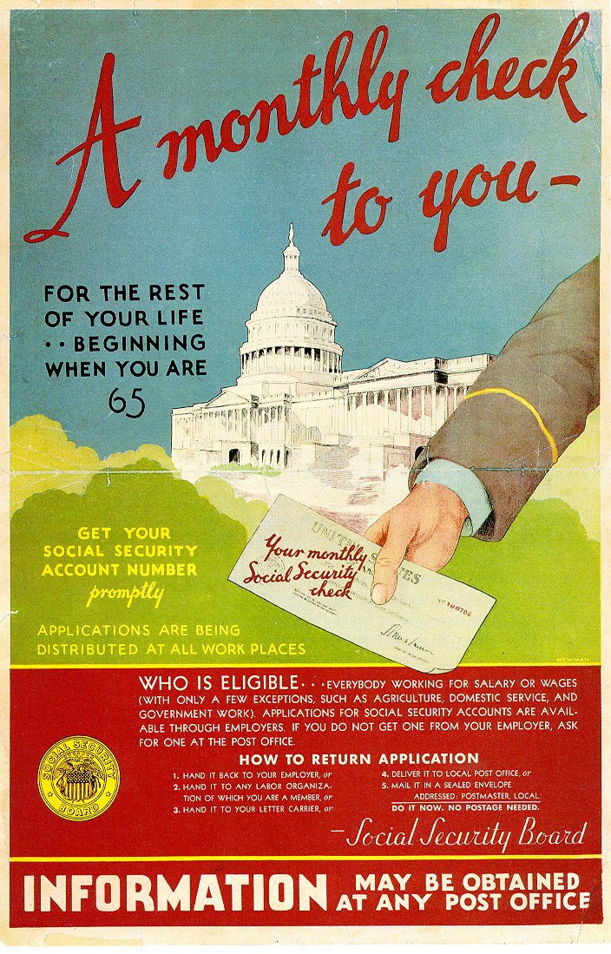
Liberal critics argued that SS did not do enough
Conservative critics argued that SS violated individualism & self-reliance
Social Security created America’s 1st welfare program to help individuals

Slide 33
Labor Legislation
Wagner Act (1935) created the Nat’l Labor Relations Board to oversee labor-management affairs
Mandated management to negotiate with unions regarding pay, hours, conditions if majority of workers vote for a union
Fair Labor Standards Act (1938) created 1st minimum wage & maximum hour laws (aimed at helping non-unionized workers)
The “Magna Carta” for labor
40 hours per week
40¢ per hour

Slide 34
Conclusions
For the 1st time, the gov’t used Keynesian economics (deficit spending & gov’t spending to stimulate the economy)
The gov’t assumed responsibility for the health of the nation's economy & citizens
The New Deal was made up of 3 parts: relief, recovery, & reform
New Deal was most successful in providing immediate relief to ease economic suffering
The New Deal did not bring economic recovery or an end to the depression
The New Deal brought major reforms that changed America
The New Deal signaled the beginning of the welfare state
Notes:
The New Deal did not end the Depression. Nor did it significantly redistribute income. It did, however, provide Americans with economic security that they had never known before. The New Deal legacies include unemployment insurance, old age insurance, and insured bank deposits. The Wagner Act reduced violence in labor relations. The Securities and Exchange Commission protected stock market investments of millions of small investors. The Federal Housing Administration and Fannie Mae enabled a majority of Americans to become homeowners. The New Deal's greatest legacy was a shift in government philosophy. As a result of the New Deal, Americans came to believe that the federal government has a responsibility to ensure the health of the nation's economy and the welfare of its citizens.
The New Deal represented a significant shift in political and domestic policy in the U.S., with its more lasting changes being increased government control over the economy and money supply; intervention to control prices and agricultural production; the beginning of the federal welfare state, and the rise of trade union organizations. The success and effects of the New Deal still remain a source of controversy and debate amongst economists and historians. The historian David Kennedy comments that "debate about the New Deal's historical significance, its ideological identity, and its political, social, and economic consequences has ground on for more than half a century. Roosevelts' reforms have become an unavoidable touchstone of American political argument, a talisman invoked by all parties to legitimate or condemn as the occasion requires, an emblem and barometer of American attitudes towards government itself."
THE NEW DEAL: RELIEF
BANK HOLIDAY: 6 March 1933 -- closed all banks; government then investigated banks and only those that were sound were allowed to reopen.
FEDERAL EMERGENCY RELIEF ASSOCIATION [FERA]: 1933 -- gave direct relief in the form of money as aid to states and localities for distribution to needy. Ultimately FERA distributed about $3-billion in relief to 8 million families -- one-sixth of the population.
CIVIL WORKS ADMINISTRATION [CWA]: Money to states to build 225,000 miles of roads, 30,000 schools, and 3,700 playing fields and athletic grounds.
PUBLIC WORKS ADMINISTRATION [PWA]: Loans to private industry to build public works such as dams, ports, bridges, sewage plants, government buildings, power plants, airports, hospitals, and other useful projects.
FARM CREDIT ASSOCIATION [FCA]: 1933 -- helped the 40% of farms that were mortgaged by providing low-interest loans (2.25% per year) through a Federal Land Bank for 50-year terms.
CIVILIAN CONSERVATION CORPS [CCC]: 1933 -- provided jobs and relocation for young men (18-25) in rural settings under direction of U.S. Army. CCC workers built public parks, cut fire trails, planted trees, built small dams, helped with flood control, reclaimed ruined land, drained swamps, and helped with conservation.
HOMEOWNERS' LOAN CORPORATION [HOLC]: 1933 -- lowered mortgages to stop foreclosures
The Three Rs and Their Legacy
Although the New Deal sometimes comes across as a cohesive package, much of the individual legislation passed during the First Hundred Days was conceived on the fly. So many special interest groups, such as big business and organized labor, were hounding the government for change that Roosevelt and Congress often felt they were being pulled in opposite directions.
Nevertheless, the New Deal policies did much to get Americans back on their feet. They not only provided relief, recovery, and reform but also drastically changed the federal government’s role in politics and society. Roosevelt’s successful application of Keynes’s economic theories transformed the Democrats into social welfare advocates. Even decades after the Great Depression, Democratic politicians would continue fighting for more government intervention in the economy, redistribution of wealth, and aid for the neediest.
Relief
Much of the legislation that the Hundred Days Congress drafted doled out immediate relief for the American people that President Hoover and the Republicans had failed to provide. The Federal Emergency Relief Administration’s relief assistance, for example, provided millions of Americans with enough money to make ends meet. The Civil Works Administration put the unemployed to work, and the Agricultural Adjustment Administration, the Tennessee Valley Authority, the National Recovery Administration, and the Public Works Administration kept millions of others alive as well. Americans were so relieved by the federal government’s quick action that many became die-hard Democrats and Roosevelt fans. The president’s optimism and can-do attitude, combined with the success of his immediate relief programs, made him almost politically untouchable during his first term.
Recovery
Many of the same programs designed to provide immediate relief were also geared toward long-term economic recovery. The Civilian Conservation Corps and the Public Works Administration put millions of men to work not only to keep them employed but also to improve the national infrastructure. When the United States finally emerged from the Great Depression during World War II, it had hundreds of new roads and public buildings, widespread electrical power, and replenished resources for industry.
Reform
The third goal of the New Deal policies was to reform the banking and financial sector of the economy to curb bad lending practices, poor trading techniques, and corruption. The president’s decision to take the country off the gold standard proved to be a smart move because it boosted people’s confidence in the U.S. dollar. The Federal Deposit Insurance Corporation, created under the Glass-Steagall Act, eliminated untrustworthy banks that had plagued the country for more than a century. Once Americans became confident that their funds would be safe, the number of bank deposits surged. Likewise, the Securities and Exchange Commission in 1934, which weeded out bad investment habits, gave Americans more confidence in the stock market.

