Slide 1
Do Now-Respond to the prompt on your notes using the quote below:
"My paramount object in this struggle is to save the Union, and is not either to save or to destroy slavery. If I could save the Union without freeing any slave I would do it, and if I could save it by freeing all the slaves I would do it; and if I could save it by freeing some and leaving others alone I would also do that." —Abraham Lincoln, 1862

Slide 2
Fighting the War-The Intertwining Nature of Military and Political Actions in Civil War America
Mr. Winchell
APUSH
Period 5

Slide 3
Key Concepts

Slide 4
AP Prompt
Evaluate the impact of military actions on Civil War politics.

Slide 5
Outline
Civil War Civil Liberties
Civil War Military Progress
Gettysburg Address
Civil War Politics and Economics
Election of 1864

Slide 6
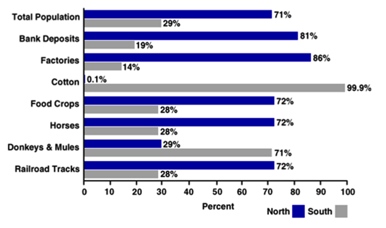
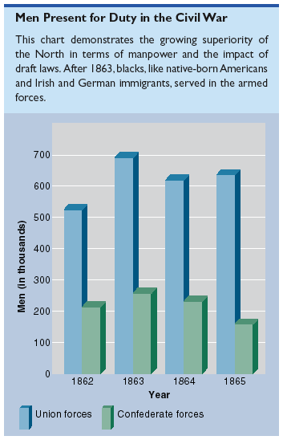
Resources

Slide 7
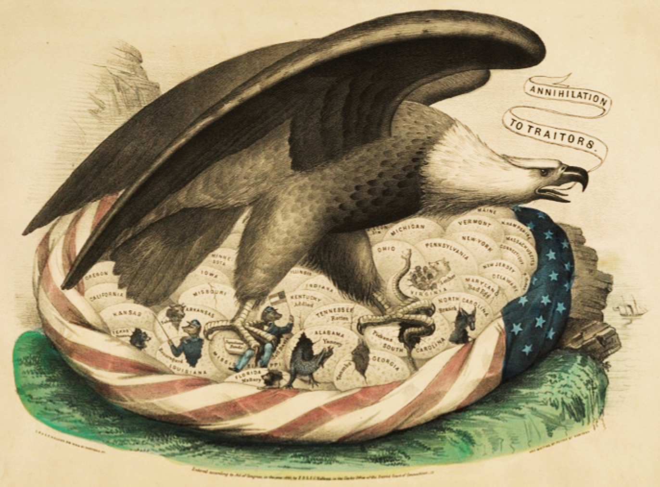
The Union

Slide 8
Union Strategy
Preserve the union
Blockade to deny foreign aid to Confederacy
Military offensives & occupation of the south

Slide 9
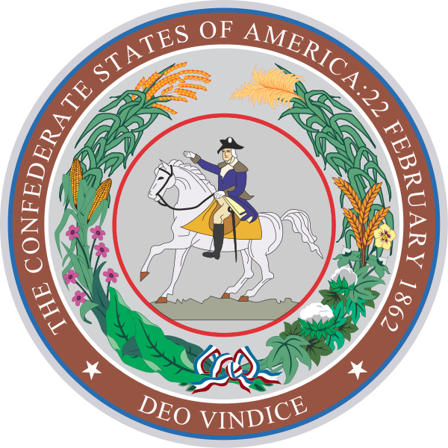
Confederate Strategy
Independence
Defense and delay
Counteroffensives into Maryland & Pennsylvania
Blockade-running & foreign diplomacy

Slide 10
Lincoln and civil liberties
Habeas Corpus
Lincoln Suspended the right, Taney ruled he couldn’t do that, he did it anyway…
Vallandigham Case
Congressman, spoke against the war, elected out of office, wouldn’t shut up.
Freedom of the Press
Closed down 2 newspapers in NY that were publishing fake stories about war and Lincoln. (Journal of Commerce and The World)

Slide 11
Lincoln and the draft
Ongoing problem recruiting Union soldiers
“Cause” of the war was vague – “Preserving the Union?”
Both sides resorted to conscription (draft) by 1863
Union law allowed purchase of a substitute recruit for $300 fee
“Rich man’s war, poor man’s fight”

Slide 12
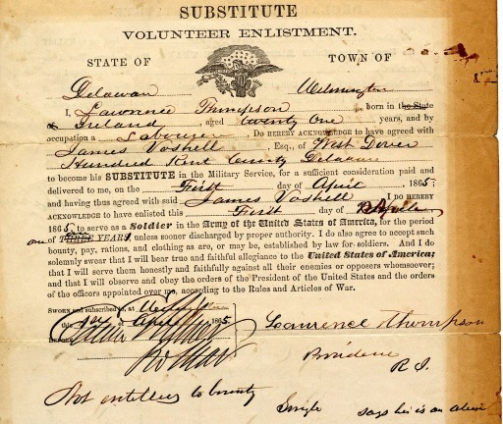
Conscription & Substitutes

Slide 13
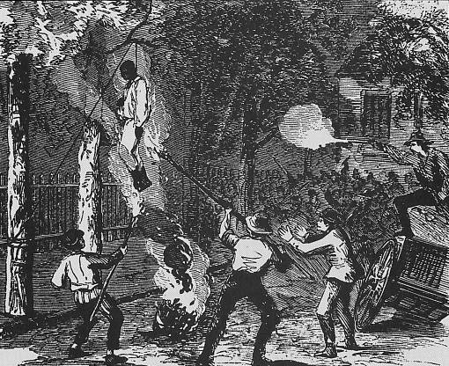
NYC Draft Riots

Slide 14
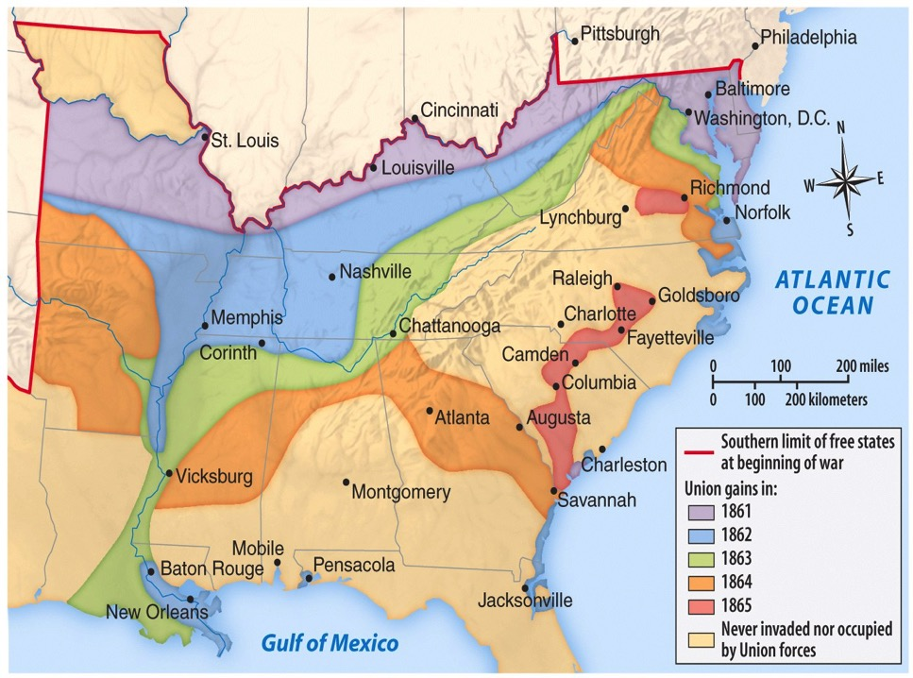
Eastern Theater
Western Theater

Slide 15
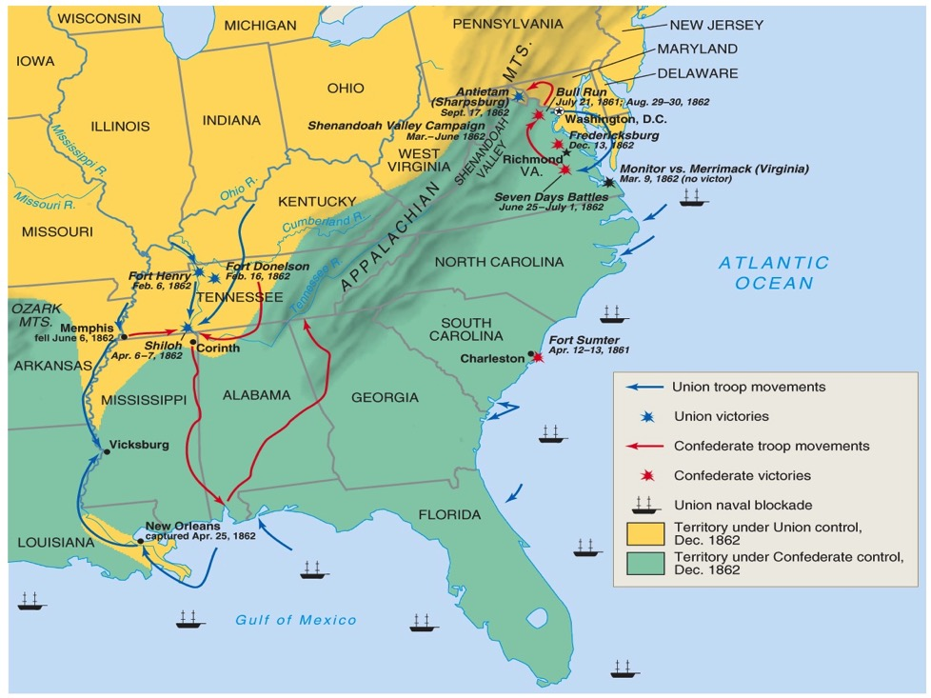
Theater/Battles 1862

Slide 16
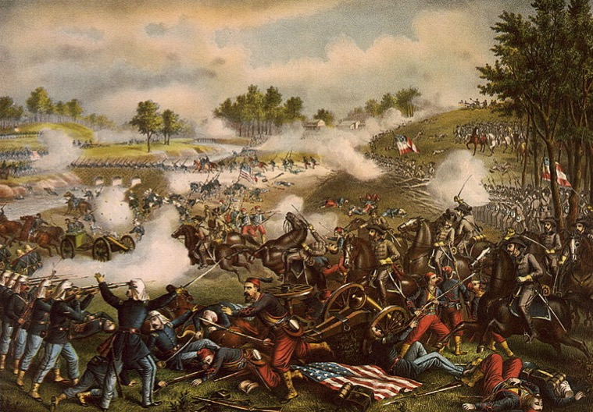
1st Battle of Bull Run

Slide 17
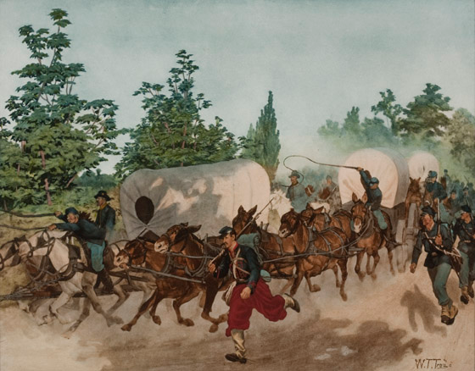
“The Great Skedaddle”

Slide 18
1st Battle of Bull Run
Battle | Date | CSA General | USA General | Winner | Significance
1st Battle of Manassas/ 1st Battle of Bull Run | July 1861 | Beau-regard | McDowell | CSA | Shattered hopes of a quick Union victory

Slide 19
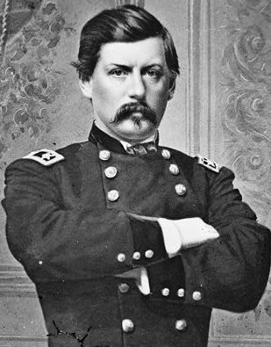
McClellan in the Peninsula
“Make no movement until the preparations are as complete as circumstances permit.”

Slide 20
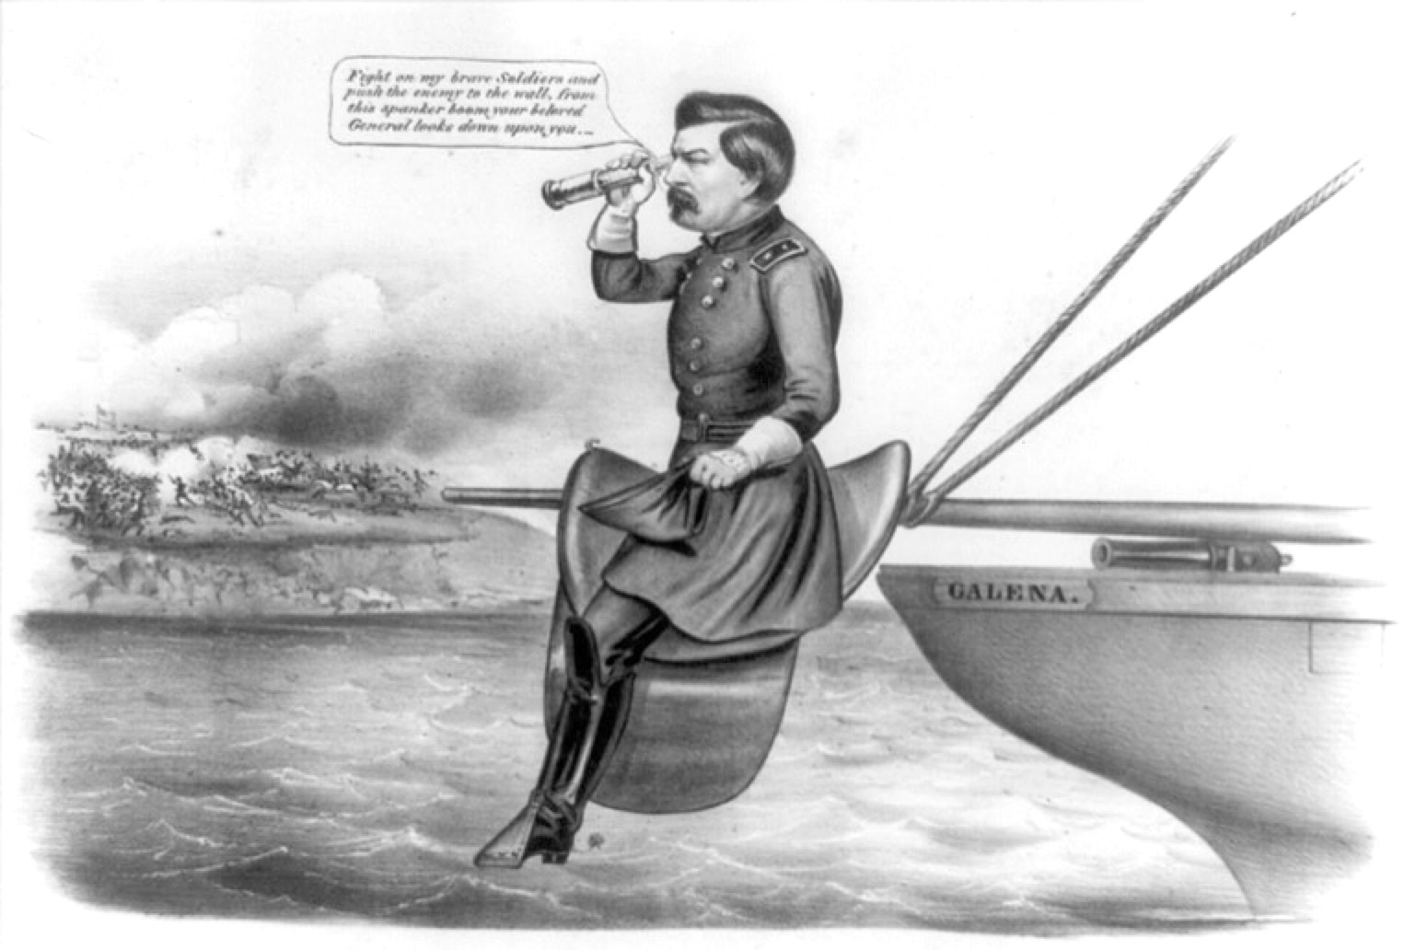
McClellan in the Peninsula

Slide 21
Peninsula Campaign
Battle | Date | CSA General | USA General | Winner | Significance
Peninsula Campaign | Mar.- July 1862 | Johnston & Lee | McClellan | CSA | McClellan was overly cautious Union failed to seize Richmond; withdrew from the peninsula Lincoln temporarily removed McClellan from command

Slide 22
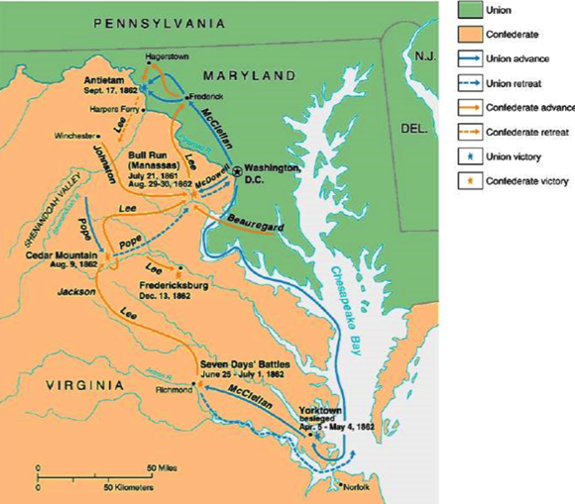
Battle of Antietam

Slide 23
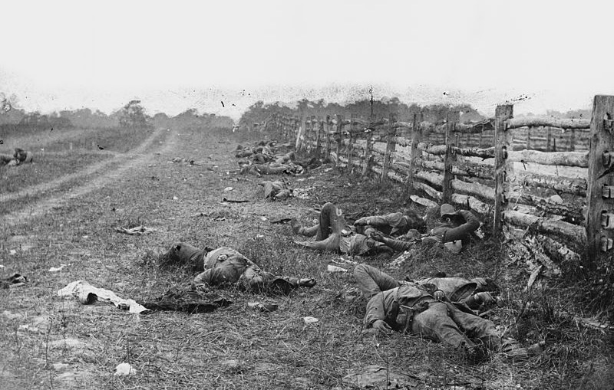
Battle of Antietam

Slide 24
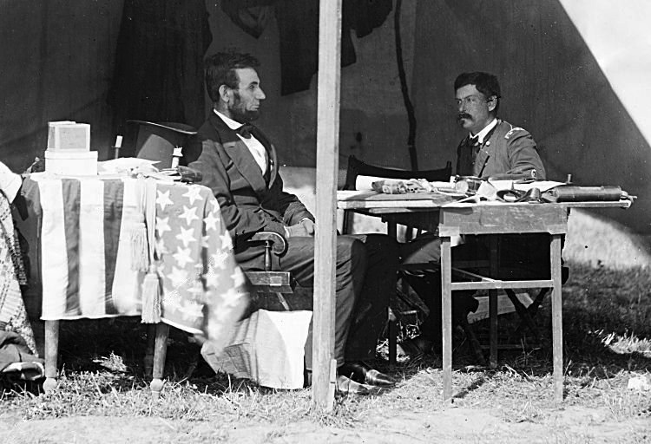
Lincoln & McClellan

Slide 25
Battle of Antietam
Battle | Date | CSA General | USA General | Winner | Significance
Battle of Antietam | Sept. 1862 | Lee | McClellan | USA | Union foiled Lee’s invasion of the North Lincoln issued Emancipation Proclamation Ended hopes of foreign aid for CSA McClellan didn’t pursue, so Lincoln permanently revoked McClellan’s command

Slide 26
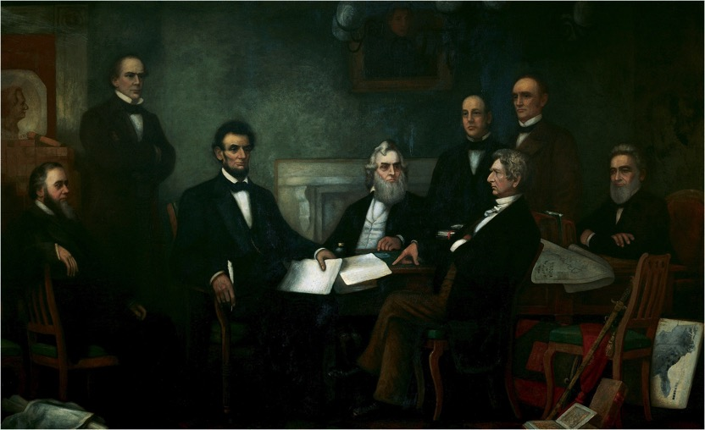
Emancipation Proclamation

Slide 27
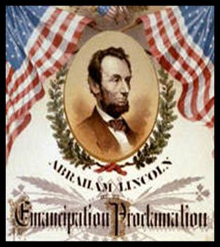
EMANCIPATION PROCLAMATION
Abolitionists pressured Lincoln to free the slaves.
After the Battle of Antietam, he announced that the slaves would be freed.
Became effective on Jan. 1, 1863, in those states still in rebellion.
Emancipation Proclamation did not end slavery in US
Lincoln’s “first” step towards ending slavery.
“Final step” 13th Amendment to the Constitution on Dec. 1865 would legally and constitutionally abolish slavery.
On January 1, 1863, Lincoln said,
“the character of the war will be changed. It will be one of subjugation . . . .The (Old) South is to be destroyed and replaced by new propositions and ideas.”

Slide 28
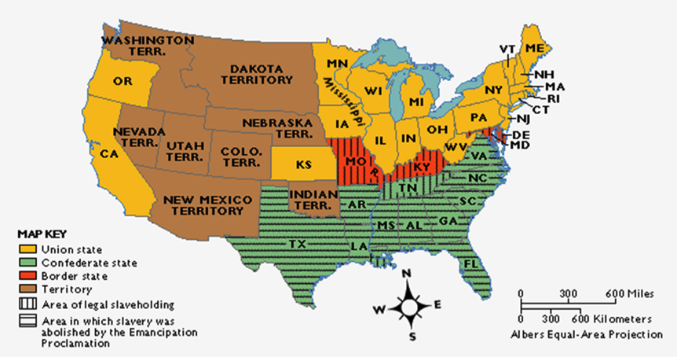
Emancipation Proclamation

Slide 29
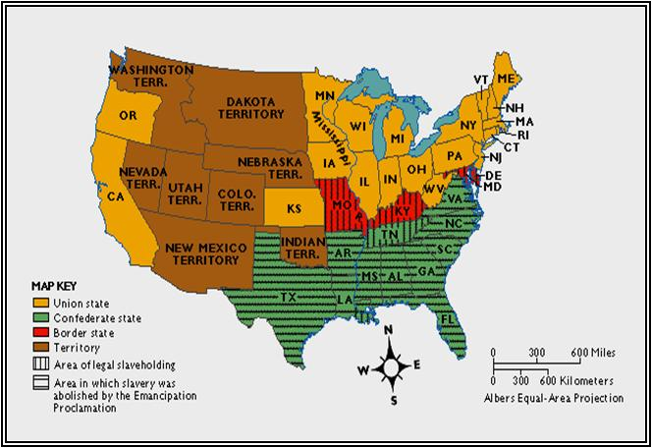
EMANCIPATION PROCLAMATION
Kept Great Britain from siding with the South
and becoming an ally.
War was now a war to
abolish slavery
destroy the South
preserve the Union
ALSO…no chance of a negotiated settlement

Slide 30
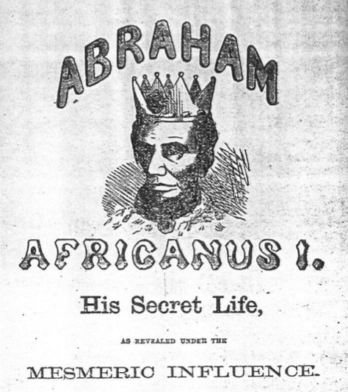
Emancipation Controversy

Slide 31
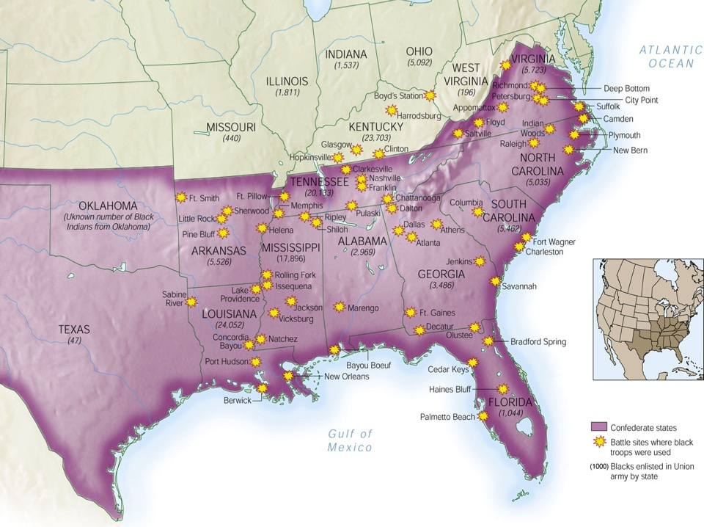
African Americans in Civil War

Slide 32
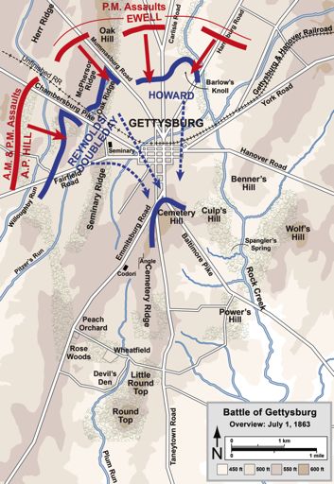
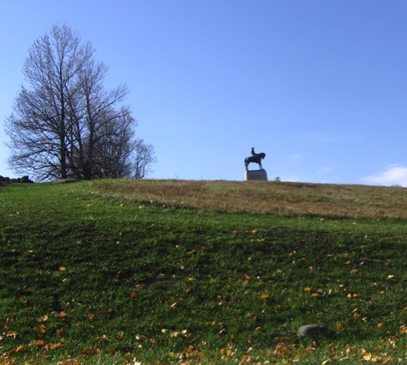
Day One: The High Ground

Slide 33
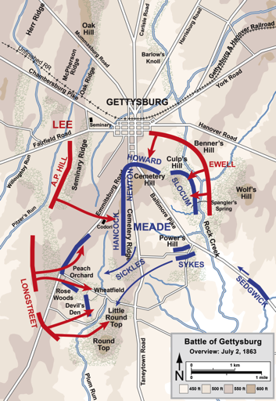
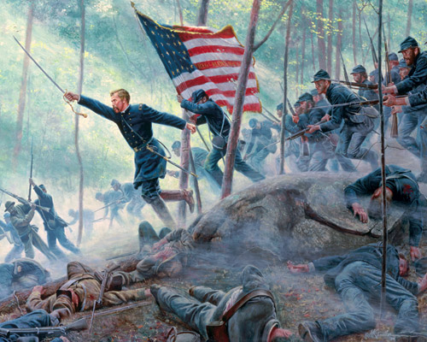
Day Two: Little Round Top

Slide 34
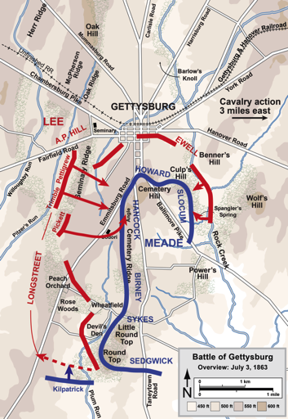
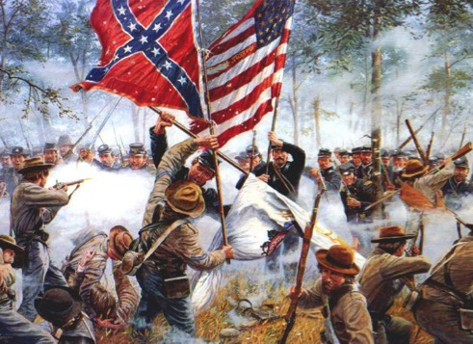
Day Three: Pickett’s Charge

Slide 35
Battle of Gettysburg
Battle | Date | CSA General | USA General | Winner | Significance
Battle of Gettysburg | July 1863 | Lee | Meade | USA | Union foiled Lee’s 2nd invasion of the north Confederacy could not continue to replace large losses of soldiers HIGH POINT OF THE CSA Lincoln’s Gettysburg Address redefined the meaning of the war

Slide 36
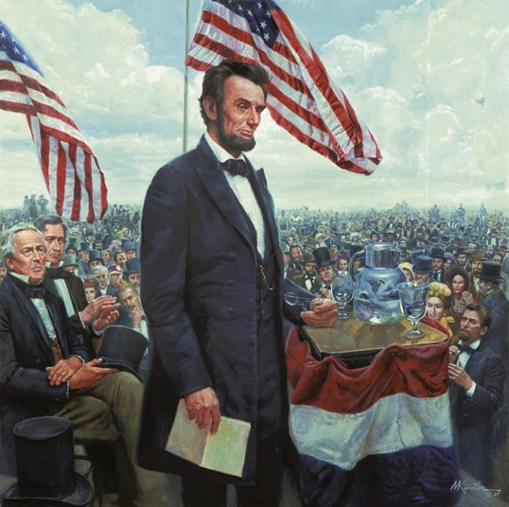
Gettysburg Address

Slide 37
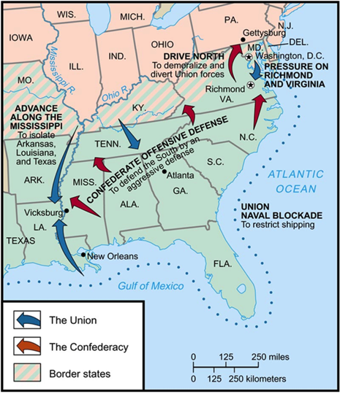
Siege of Vicksburg

Slide 38
Siege of Vicksburg
Battle | Date | CSA General | USA General | Winner | Significance
Siege of Vicksburg | May-July 1863 | Pemberton | Grant | USA | Union gained control of the Mississippi River Confederacy was split in half, east from west

Slide 39
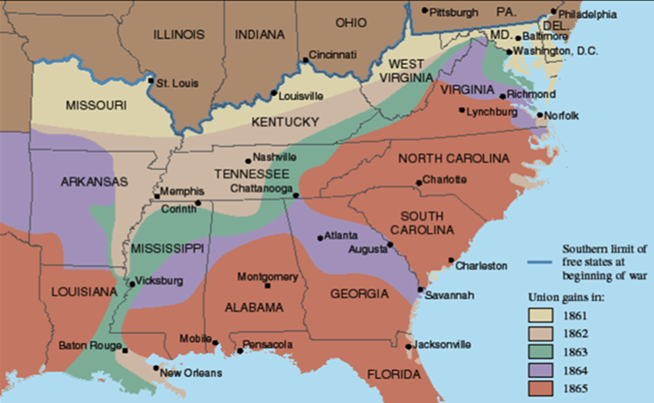
Slow Progress of the War

Slide 40
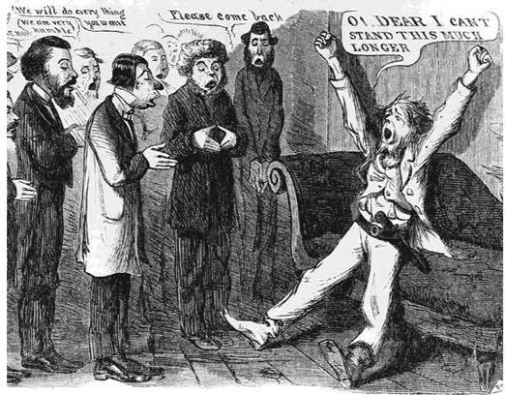
“Peace” Democrats
Opposed emancipation
Wanted immediate end to war
Wanted to restore Confederacy to the Union through negotiation
Nicknamed “Copperheads”

Slide 41
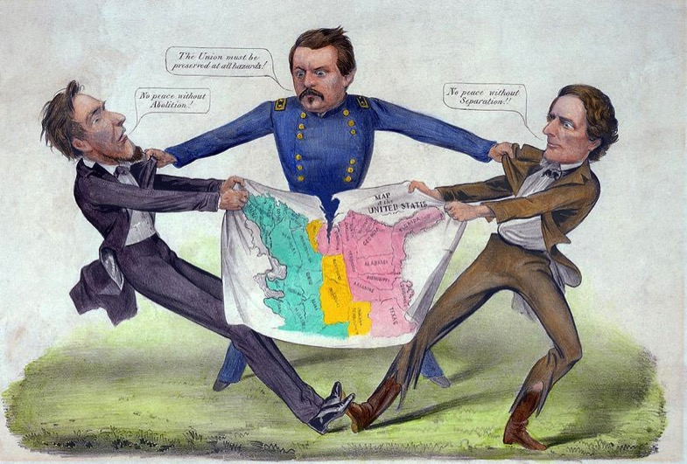
McClellan the Peacemaker?

Slide 42
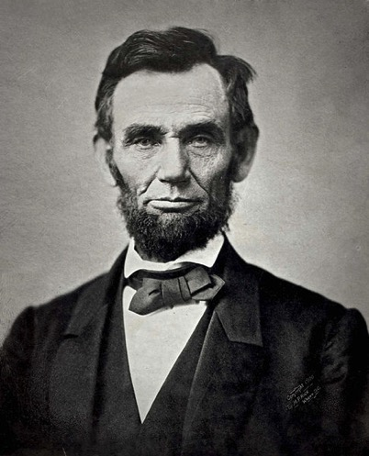
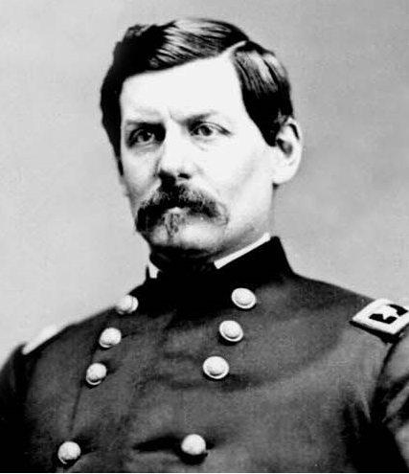
Election of 1864
Abraham Lincoln
Republican
George McClellan
Democrat

Slide 43
Sherman Scorches Georgia
Georgia’s conquest:
It was entrusted to General William Tecumseh Sherman
He captured Atlanta in September 1864, burned the city in November 1864
Sherman with 6000 troops cut a sixty-mile swath of destruction through Georgia
Major purposes of Sherman’s march:
destroy supplies destined for the Confederate army
weaken the morale of the men at the front by waging war on their homes

Slide 44
Sherman Scorches Georgia
Sherman was a pioneer practitioner of “total war”:
His success in “Shermanizing” the South was attested by increasing numbers of Confederate desertions
All his methods were brutal
He probably shortened the struggle and hence saved lives
The discipline of his army at times broke down
After seizing Savannah as a Christmas present for Lincoln, his army veered north into South Carolina, where the destruction was even worse:
Sherman’s conquering army rolled deep into North Carolina by the time the war ended

Slide 45
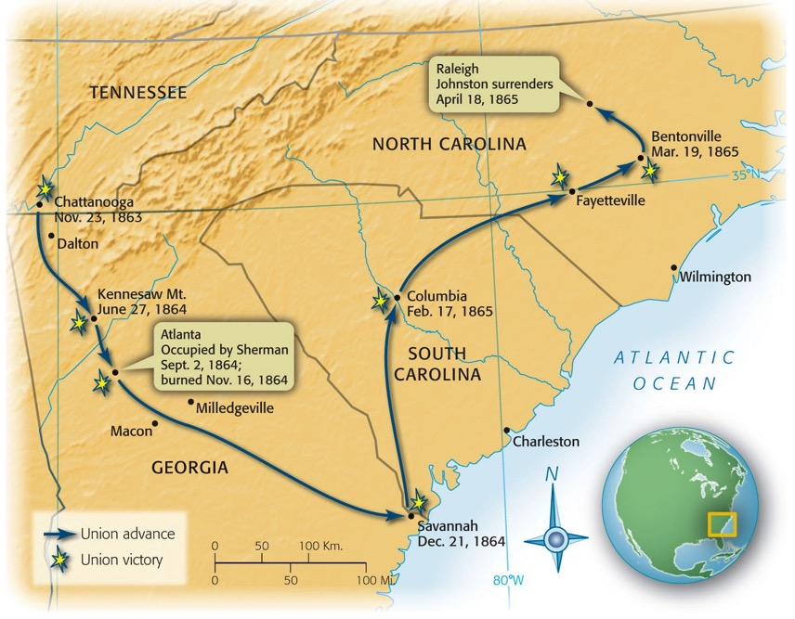
Map 21-6 p450
Notes:
Map 21.6 Sherman’s March, 1864–1865

Slide 46
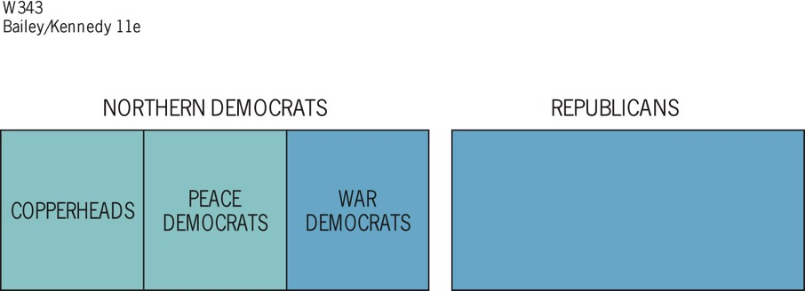
Figure 21-1 p452
Notes:
Figure 21.1 Union Party, 1864 The blue area
represents the Union party.

Slide 47
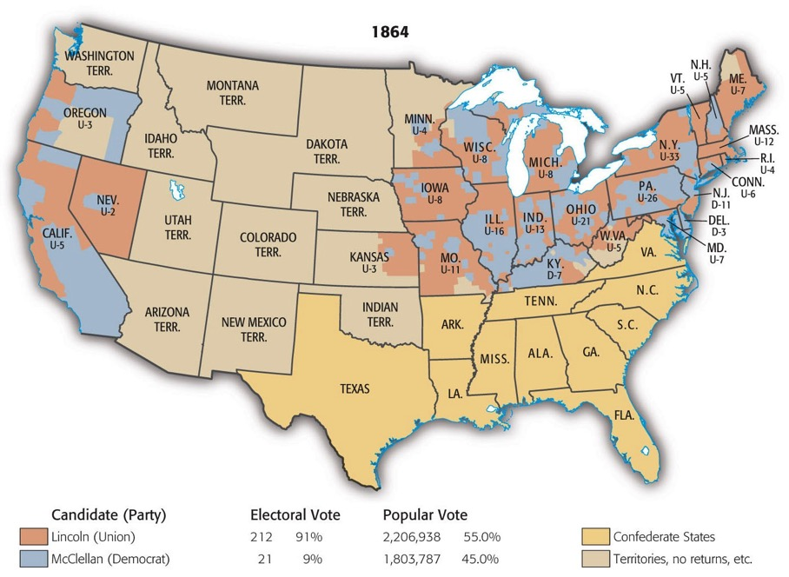
Map 21-7 p454
Notes:
Map 21.7 Presidential Election of 1864 (showing popular vote by county) Lincoln
also carried California, Oregon, and Nevada, but there was a considerable McClellan vote
in each. Note McClellan’s strength in the Border States and in the southern tier of Ohio,
Indiana, and Illinois—the so-called “Butternut” region.

Slide 48
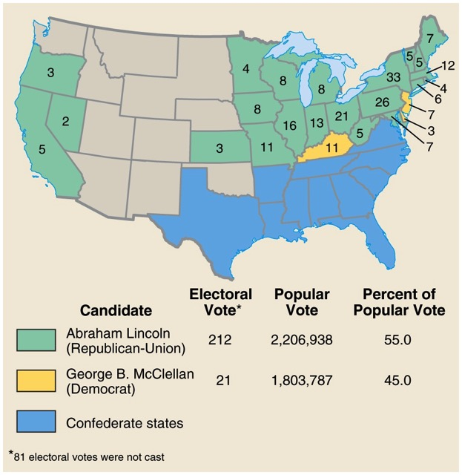
Presidential Election of 1864

