Slide 1
Silent Do Now
What problems did big business create in both urban and rural settings? Be specific:

Slide 2
Review of Gilded Age Politics and the Populists-The Election of 1896
Mr. Winchell
APUSH 2018-2019
Period 6

Slide 3
Key Concepts
6.3: The Gilded Age produced new cultural and intellectual movements, public reform efforts, and political debates over economic and social policies.
6.1.III.C: Economic instability inspired agrarian activists to create the People’s (Populist) Party, which called for a stronger governmental role in regulating the American economic system.

Slide 4
AP Prompt

Slide 5
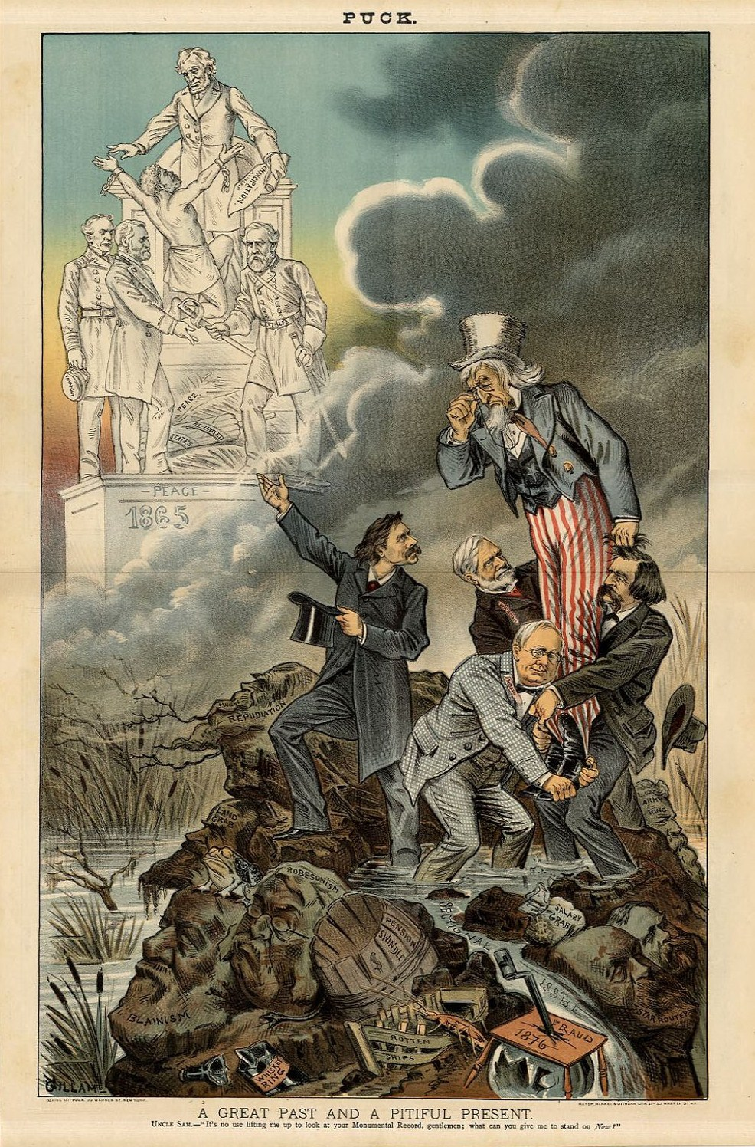
What does this cartoon demonstrate about Gilded Age politics?

Slide 6
Gilded Age Political Issues
Civil Service Reform
Role of Government in Business
Social Darwinism
Machine Politics

Slide 7
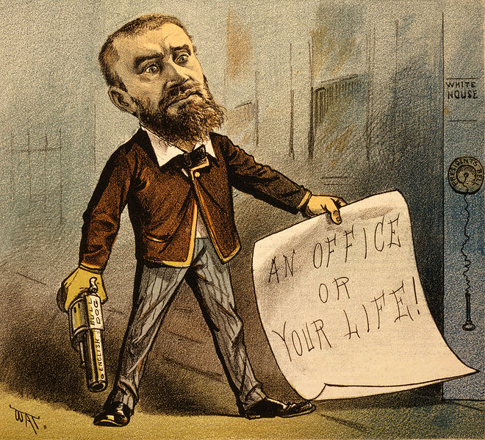

Slide 8
Gilded Age Economic Issues
Tariffs
Currency Reform
Labor Unions

Slide 9
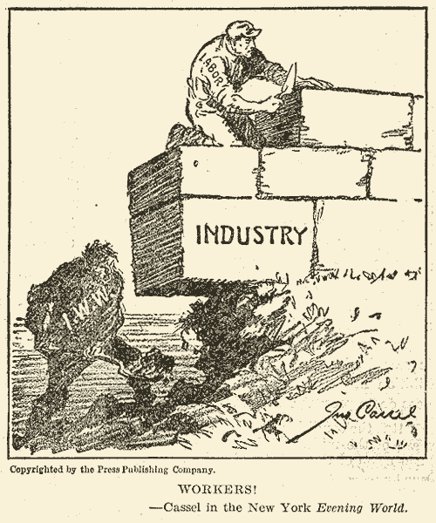

Slide 10
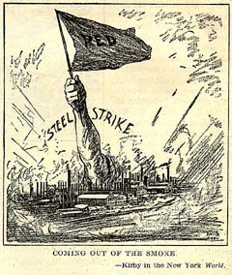

Slide 11
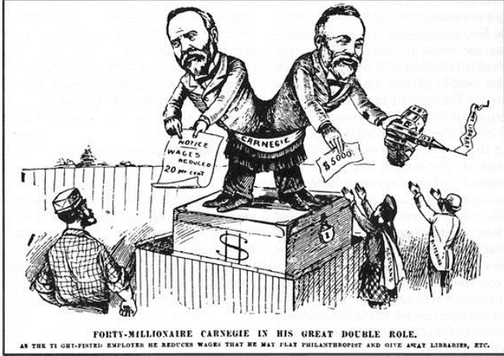

Slide 12
Gilded Age Politics
The American Presidents who resided in the White House from the end of the Civil War until the 1890s are sometimes called "the forgettable Presidents.”
Congress strong, but tied to corporate interests.
Local politics (state, city, county) stronger, but controlled by political machines.

Slide 13
Well-Defined Voting Blocs
Democratic Bloc
Republican Bloc
White southerners (preservation of white supremacy)
Catholics
Recent immigrants (esp. Jews)
Urban working poor (pro-labor)
Most farmers
Northern whites (pro-business)
African Americans
Northern Protestants
Old WASPs (support for anti-immigrant laws)
Most of the middle class

Slide 14
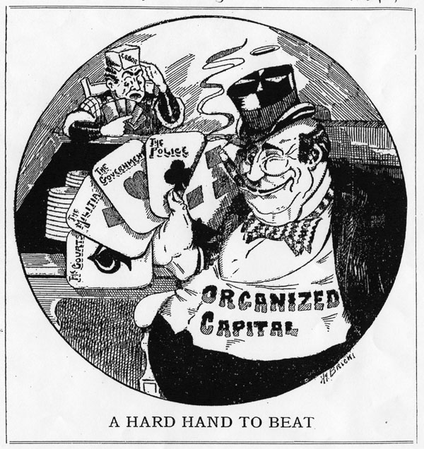

Slide 15
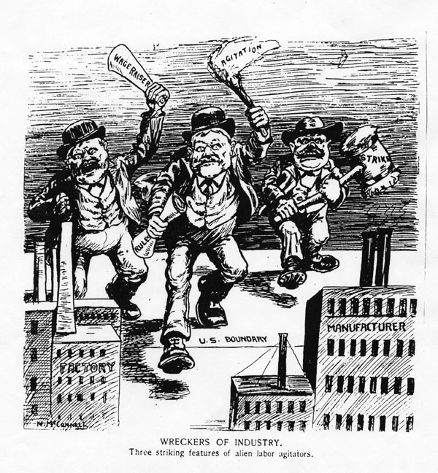

Slide 16
Very Laissez Faire Federal Govt.
From 1870-1900 → Govt. did very little domestically.
Main duties of the federal govt.:
Deliver the mail.
Maintain a national military.
Collect taxes & tariffs.
Conduct a foreign policy.
Exception → administer the annual Civil War veterans’ pension.

Slide 17
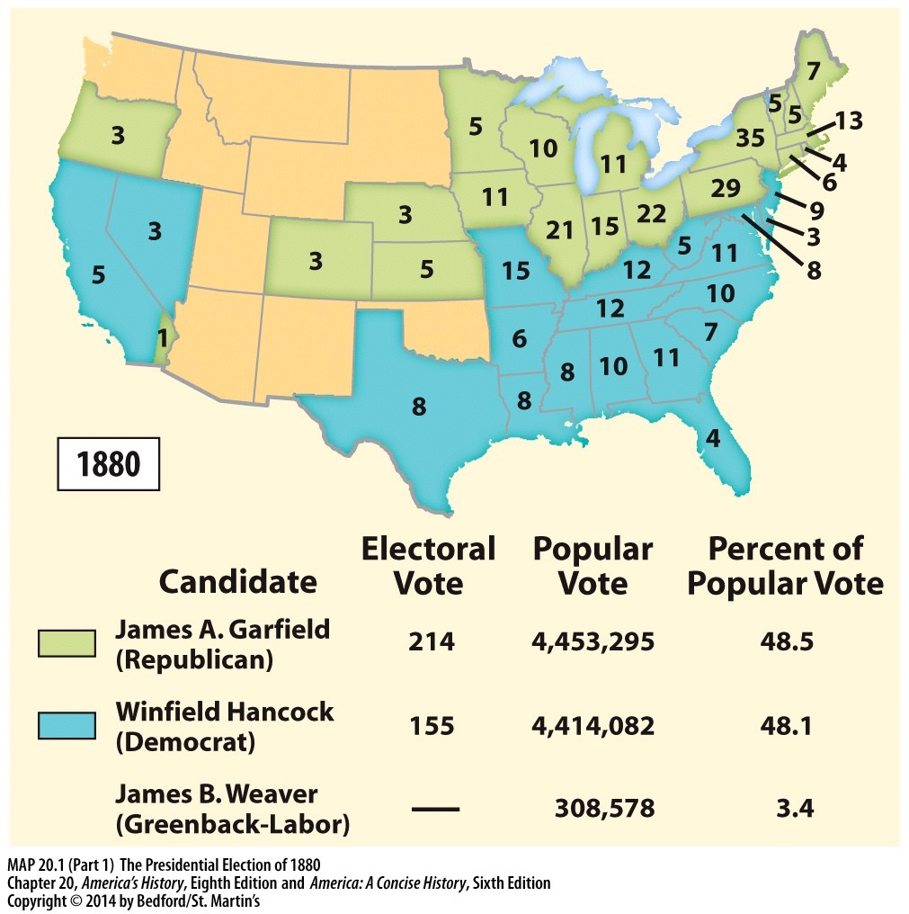
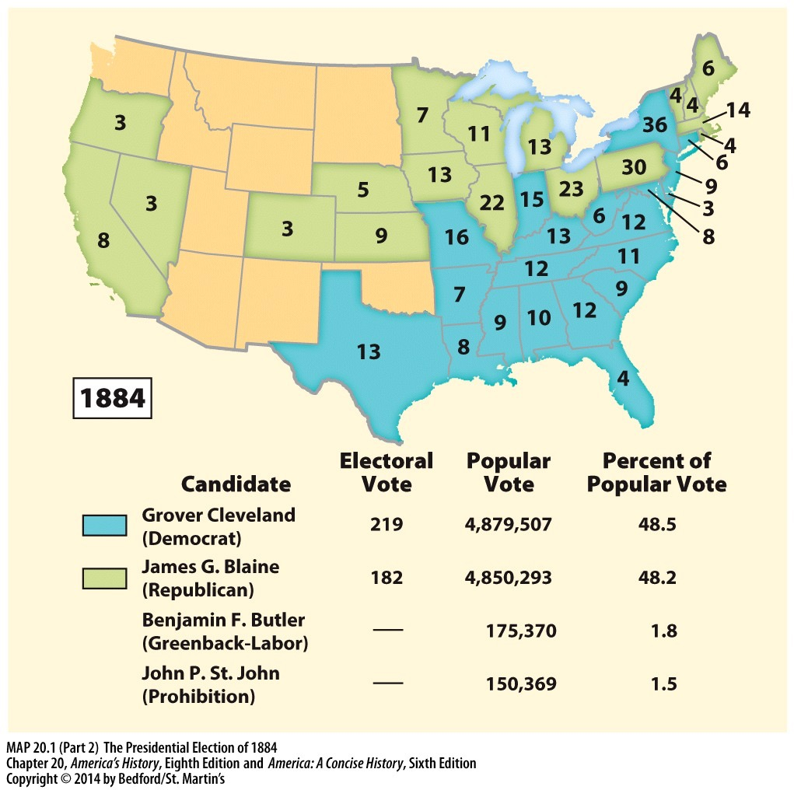
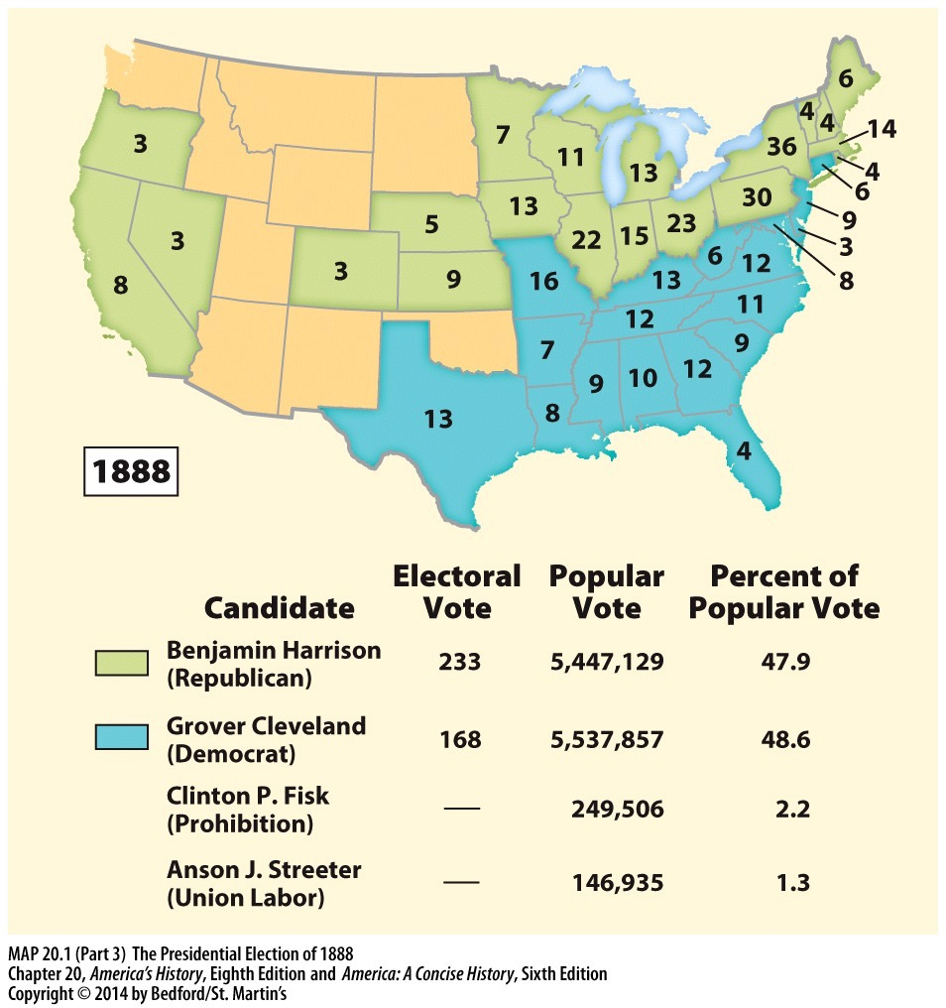
THE ELECTIONS OF THE GILDED AGE
2. What does the popular vote in these elections say about the nature of US politics in the Gilded Age?
1. What does the pattern of electoral votes say about the nation’s unity after the Civil War?
3. In these elections, Republicans promoted tariffs and Democrats opposed them? What groups would support each party? Why would they support them?

Slide 18
Gilded Age Presidents
Grant: covered him Period 5-Corruption
Rutherford B. Hayes: Ineffective. Wanted patronage reform but his own election was corrupt
James Garfield: Wanted reform for the Civil Service-
so he got shot.
Chester Arthur: Supported the Pendleton Civil Service Act of 1883 (merit system for all gov. civil service jobs)
SUPER UNINTENDED CONSEQUENCE: drove politicians and businesses together (money/influence)
Leads to a new era where politics are controlled by business

Slide 19
Gilded Age Presidents Cont’d
Grover Cleveland round 1: First Democrat to be president since James Buchanan.
Laissez-faire capitalism: no government involvement in the economy.
Against public bills and army pensions due to abuse post-Civil War
Supported lower tariffs
Benjamin Harrison: Billion dollar Congress
Sherman Silver Purchase Act
McKinley Tariff Bill of 1890: Highest tariff since the war. Hurts Western Farmers and Southerners
Leads to hostility
Grover Cleveland round 2: Panic of 1893. Thanks to loss of value of dollar. JP Morgan bails out the government. Angers Westerners who view as government ‘selling out’ to Wall Street.

Slide 20
Panic of 1873: The Long Depression
Causes
Expansion of railroads, enterprises in industries and mines outpaces market demand
Coinage Act of 1873
Demonetizes silver contracting the money supply
“Crime of 73”
Jay Cooke & Company bankrupt
Major financing investment firm leads to chain reaction of banks
Effects
Over 100 railroads fail; 16,000 businesses fail
Unemployment at 14%

Slide 21
Panic of 1893
Causes
Overexpansion
Railroad speculation
Pennsylvania and Reading Railroad bankruptcy
Silver Purchase Act repealed
Impact
Unemployment to 18.4%
16,000 businesses and 500 banks bankrupt/failed
Pullman Strike (July 1894)
Coxey’s Army (1894)
March on Washington by unemployed workers and farmers $500 million for jobs
Dispersed by federal troops
J.P. Morgan and the Treasury
Cleveland and U.S. borrowed $65 million in gold

Slide 22
Disenfranchisement of the African Americans
Voting:
Poll taxes – annual voting tax (if you were poor, you couldn’t pay to vote)
literacy tests – reading test in order to vote (more difficult for Afams as they are not provided good education)
Grandfather clause – if your grandfather can vote=you vote (made sure former slaves ancestors couldn’t vote)
Separation:
Plessy v. Ferguson – ruled that Black and White populations could be “separate but equal” – legalized racial segregation for almost 60 years.
Violence:
Lynching's (with no punishment) were very common!

Slide 23
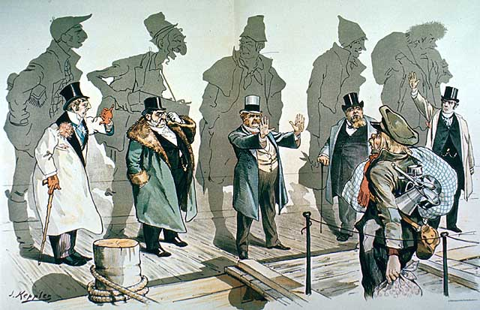

Slide 24
Populists Time!

Slide 25
Farmers Plight
Farm Becomes a Factory
Environmental Factors
Drought/Over-farming
Overproduction-Falling Prices
Loans
Railroad Monopolies
Tariffs
Panics

Slide 26
COMBINATIONS
MONOPOLISTS
[Trusts]
Government Policy
FARMERS?
Although the farmers still made up the plurality of the work force in the late 19th century, they were the last to organize as an interest group.
LABORERS
[UNIONS]

Slide 28
Farmers Unite!
Social:
Economic:
Political:
The Grange
Farmers’ Alliances
Populist Party

Slide 29
Populist Party
Some Democrats
Grange
Farmers Alliances
Green-back Labor
Populist Party, 1892

Slide 30
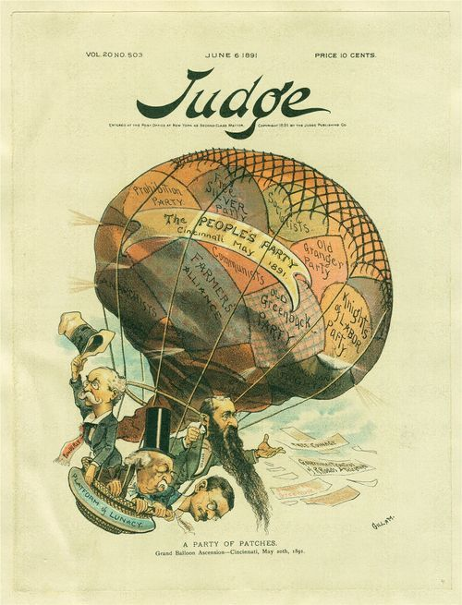
The Populist Movement

Slide 31
Omaha Platform
Text Analysis
Omaha Platform (July 4, 1892)
Coinage of silver
Direct election of Senators
Graduated income tax
State laws through referendums/initiatives
Government regulation/ownership of infrastructure
8-hour workday
Abolition of national banks
Civil service reform
Notes:
Omaha Platform (July 4, 1892)
Coinage of silver
Direct election of Senators
Graduated income tax
State laws through referendums/initiatives
Government regulation/ownership of infrastructure
8-hour workday
Abolition of national banks
Civil service reform

Slide 32
The Populist Platform
Political Reform Proposals | Economic Reform Proposals
Graduated [Progressive] Income Tax
Unlimited Coinage of Silver
Nationalization of Railroads
Direct Election of Senators
Ballot Initiatives
Secret Ballot

Slide 33
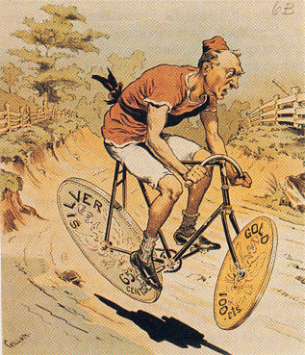
Bimetallic Instability?

Slide 34
Election of 1896
William McKinley
William Jennings Bryan
Republican
Pro-Big Business
Pro-Tariff
Pro-Gold Standard
Coalition of business/skilled workers/rich farmers
HUGE campaign budget
Backed by business
Democrat/Populist
Pro-Farmers
Anti-Tariff
Pro-Silver
Farmers/Unskilled Labor/Immigrants
SMALL budget
‘passing the hat’ at rallies

Slide 35
William Jennings Bryan ‘Cross of Gold’
The gentleman from Wisconsin has said he fears a Robespierre. My friend, in this land of the free you need fear no tyrant who will spring up from among the people. What we need is an Andrew Jackson to stand as Jackson stood, against the encroachments of aggregated wealth’
There are two ideas of government. There are those who believe that if you just legislate to make the well-to-do prosperous, that their prosperity will leak through on those below. The Democratic idea has been that if you legislate to make the masses prosperous their prosperity will find its way up and through every class that rests upon it.
You come to us and tell us that the great cities are in favor of the gold standard. I tell you that the great cities rest upon these broad and fertile prairies. Burn down your cities and leave our farms, and your cities will spring up again as if by magic. But destroy our farms and the grass will grow in the streets of every city in the country.
If they dare to come out in the open field and defend the gold standard as a good thing, we shall fight them to the uttermost, having behind us the producing masses of the nation and the world. Having behind us the commercial interests and the laboring interests and all the toiling masses, we shall answer their demands for a gold standard by saying to them, you shall not press down upon the brow of labor this crown of thorns. You shall not crucify mankind upon a cross of gold.

Slide 36
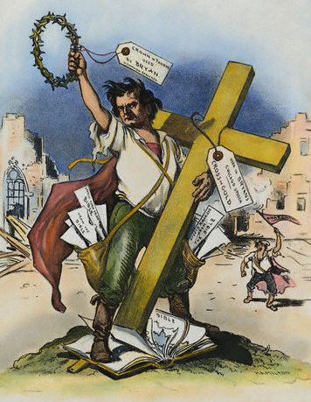

Slide 37
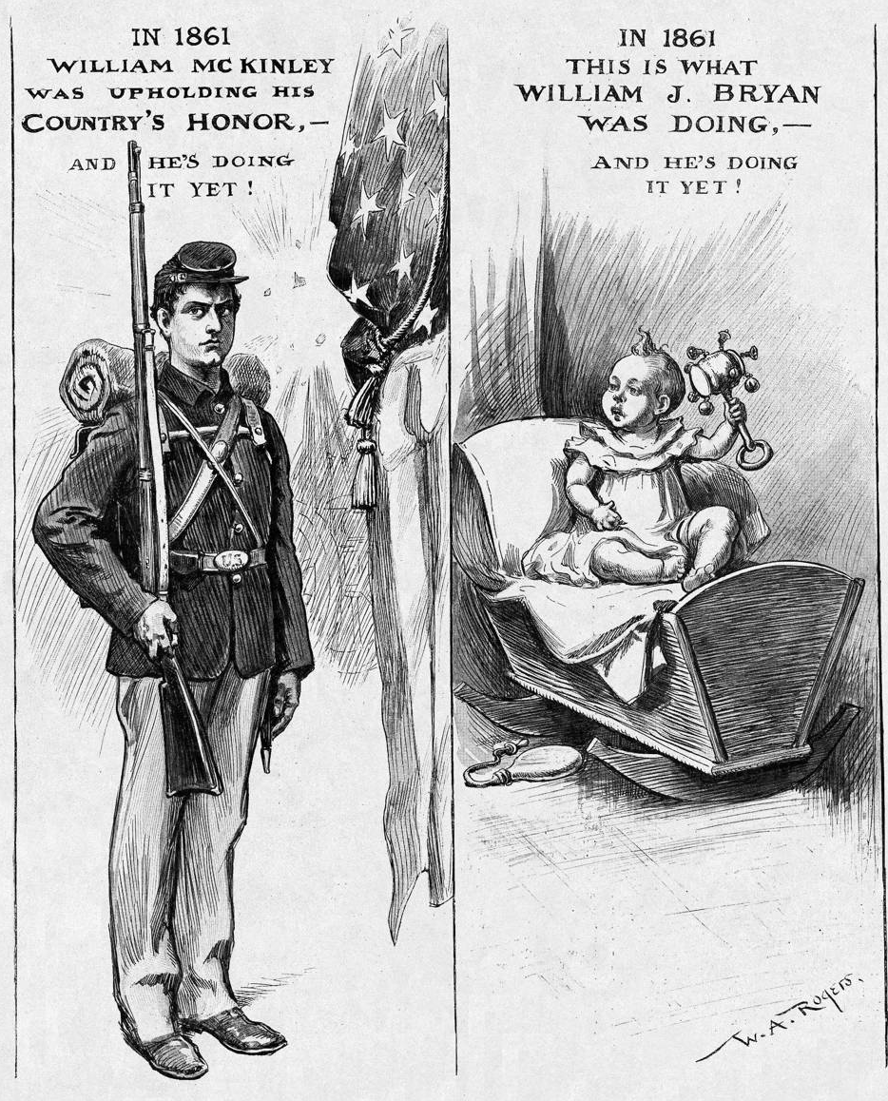

Slide 38
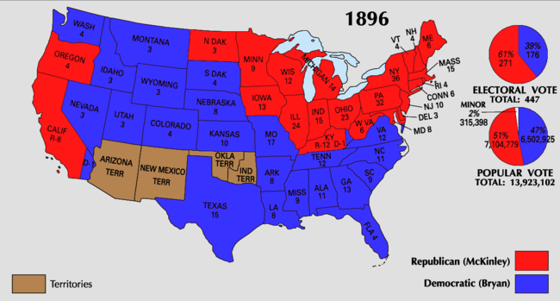
Election of 1896

Slide 39
Why Did Bryan Lose?
His focus on silver undermined efforts to build bridges to urban voters.
He did not form alliances with other groups.
McKinley’s campaign was well- organized and highly funded.

Slide 40
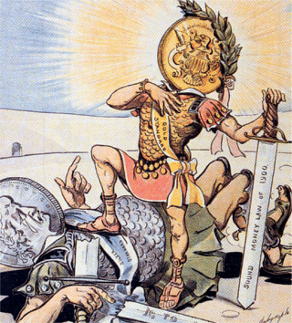
Gold Triumphs Over Silver
1900 → Gold Standard Act
confirmed the nation’s commitment to the gold standard.
A victory for the forces of conservatism.

Slide 41
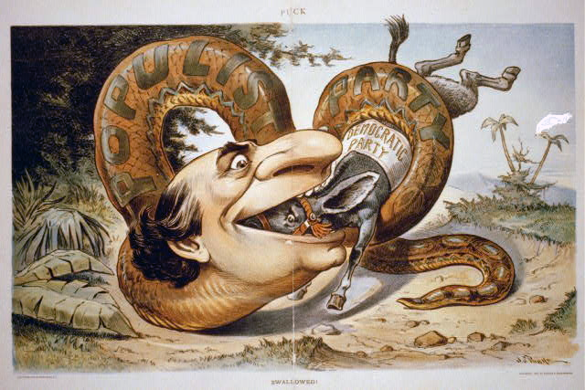
Populism Devours Democratic Party

Slide 42
Impact of Populists
Many of the reforms they advocated eventually became law
A major factor in local, state, and national politics – elected representatives on every level
Failed Presidential bids – W.J. Bryan
Political apparatus and ideals co-opted by Democrats – lost to Republicans in 1896, dooming Populist Party
Major impact: kept small “r” republican tradition (“the producers”) alive and strong in American reform tradition
Both radical and exclusionary aspects – uniters and dividers

