Slide 2
John Adams’ Presidency and the Fall of the Federalists
Mr. Winchell
APUSH
Period 3-Last Instructional Day

Slide 3
AP Prompt
Evaluate the causes of the downfall of the Federalist Party, accounting for financial and political factors. (1st Hour)
How did differing interpretations of the Constitution lead to conflict over the Alien and Sedition Acts? (2nd Hour)

Slide 4
Key Concepts
3.2.III: New forms of national culture and political institutions developed in the US alongside continued regional variations and differences over economic, political, social, and foreign policy issues.
3.2.III.B: Political leaders in the 1790s took a variety of positions on issues such as the relationship between the national government and the states, economic policy, foreign policy, and the balance between liberty and order. This led to the formation of political parties.

Slide 5
First Political Parties
 | Federalists | Democratic-Republicans
Leaders | John Adams and Alexander Hamilton | Thomas Jefferson
National Govt | Believed in a strong national government | Believed in a weak national government
Economy | Industrial economy | Agricultural economy
Supporters | Bankers and business interests in the Northeast. | Farmers, artisans, and frontier settlers in the South

Slide 6
The French Question
During Washington’s first term (1788-1792), the French Monarchy was overthrown by the people in an attempt to establish their own republic.
French declared themselves a “republic” but carnage heavier than in American Rev.
Jeffersonians thought it unfortunate, but probably necessary
Hamiltonians thought it downright frightening
FEAR OF MOB RULE
During the Revolution, the US formed an alliance with the French monarchy
The British attempted to take advantage of the situation and also began a war with France.

Slide 7
The French Question
Republicans pushed for the US gov to honor the alliance and come to the aid of the French
The Federalists stated that the alliance had been formed with the French Monarchy, and therefore no longer existed.
They actually openly supported the British as they did not want to support a bloody and violent revolution in fears of it happening again in the US

Slide 8
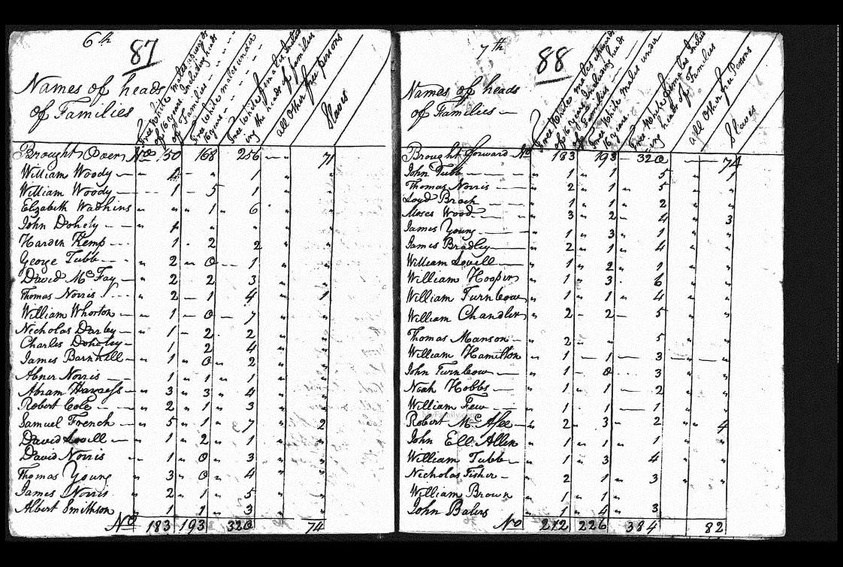
America in 1790
Population nearly 4 million
doubling every 25 years
90% of Americans lived on farms
Public debt large ($52 million) – revenue low.
Threats from GB and Spain threatened fragile unity of US

Slide 9
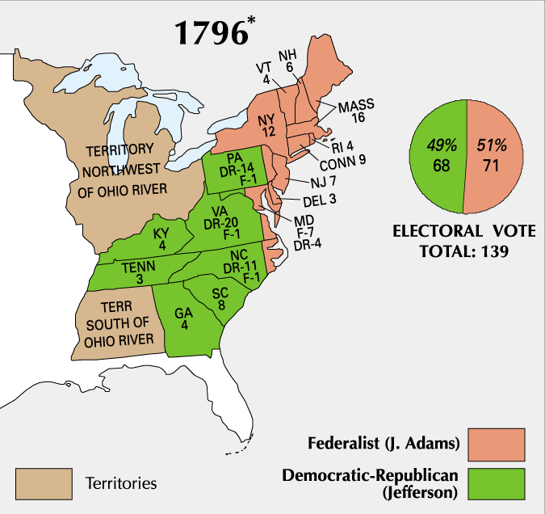
Election of 1796

Slide 10
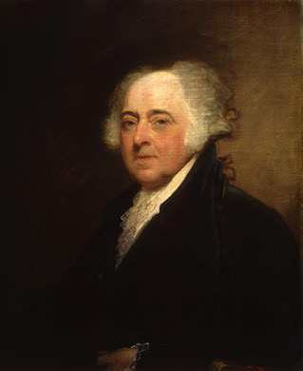
A New President
John Adams
Boston
Federalist

Slide 11
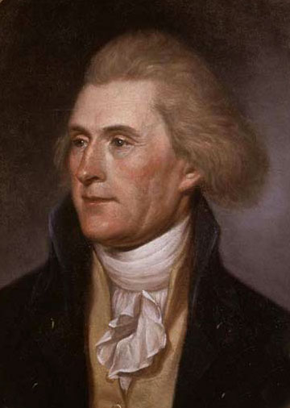
Vice President
Thomas Jefferson
Virginian
Republican (Democratic-Republican
Became VP because he received second-most votes
At odds with Adams

Slide 12
Relations with France
France very upset about Jay’s Treaty
Saw it as a precursor to an alliance with Britain
France wanted the U.S. to honor the Franco-American Alliance of 1778
France began to attack U.S. ships and seizing American cargo
300 ships and $20 million of cargo was lost

Slide 13
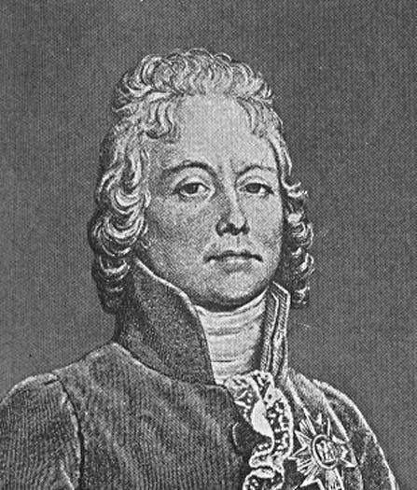
XYZ Affair (1797)
Delegation sent to France to meet with French Foreign Minister Charles Talleyrand
Three French delegates X, Y, & Z demanded $12 million loan & a cash bribe just for a meeting
Americans insulted & came home
Report published & started Anti-French sentiment at home

Slide 14
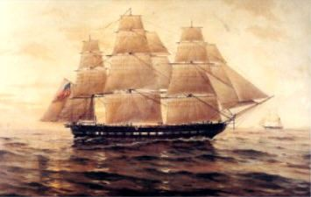
Quasi-War (1798-1800)
U.S. began an undeclared war against France
Was purely navel – fought mainly in the Caribbean
Adams had to quickly expand the 3 ship navy & an army of 10,000 men was authorized

Slide 15
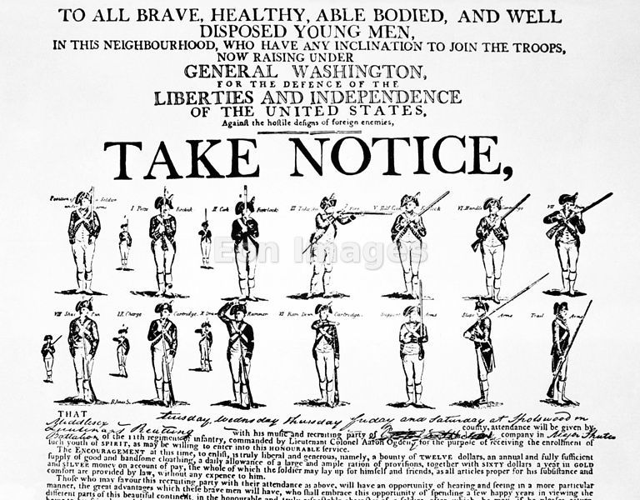
War Avoided
John Adams sent new envoy to France in 1800
Napoleon accepted – more bent on European conquest, not war with US
Improved Relations made Louisiana Purchase possible 3 years later.
Adams felt dodging this bullet was his finest achievement.

Slide 16
President Adams’ handling of the conflict with France led to criticisms by Democratic-Republicans
Federalists in Congress passed the Alien & Sedition Acts
The laws made it a crime to criticize government leaders, restricted citizenship for new immigrants, and made deporting immigrants easier
This attack on free speech and citizenship backfired and badly damaged President Adams and the Federalist Party

Slide 17
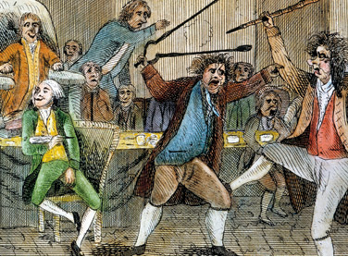
Alien and Sedition Acts (1798)
Purpose: to reduce power of Jeffersonians and silence anti-war opposition
Alien Act
Attack on pro-Jeffersonian “aliens”
Raised residency requirements for US citizenship from 5 yrs to 14 yrs.
President could deport “dangerous” foreigners.
Sedition Act
Anyone who impeded policies of the gov’t or falsely criticized its officials would get heavy fine and imprisonment.
Direct violation of 1st Amendment
Expired day before Adams left office.

Slide 18
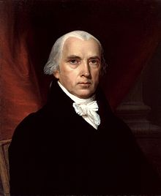
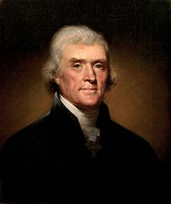
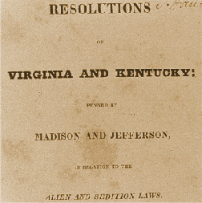
Virginia and Kentucky Resolutions (1798)
Republicans felt Alien and Sedition Acts were unconstitutional
Jefferson and Madison secretly penned two resolutions that asserted that states have the right to nullify unconstitutional laws passed by Congress.
Federalists retorted that the people, not states created Constitution and that the Supreme Court and not states determined the constitutionality of laws.
No other states but VA and KY adopted resolutions, but southern states would use this later in 19th century to support nullification and secession.

Slide 19
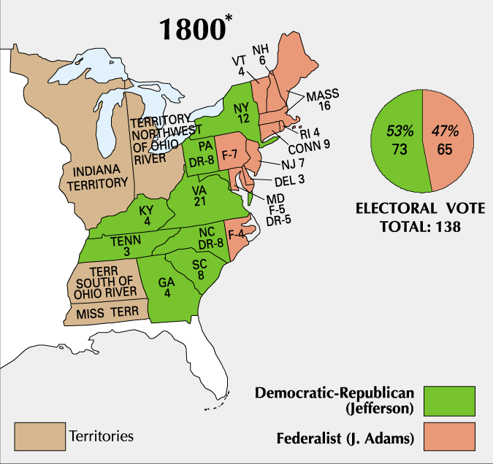
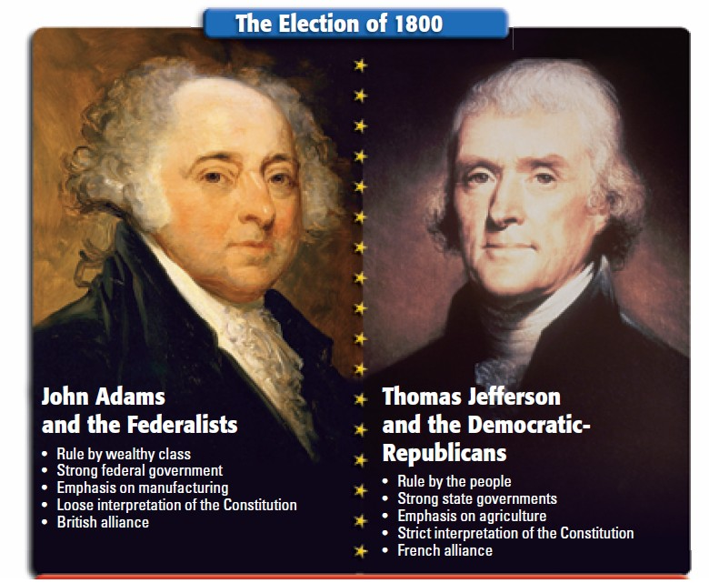
Adams and his Federalist Party were unpopular by the election of 1800
Republican Jefferson defeated Adams in the election of 1800
The 1800 election marked the first time in U.S. history when one political party transferred power to another political party
Jefferson’s victory over Adams marked the beginning of 30 years of dominance by the Democratic-Republican Party

Slide 20
The End of the Federalist Era
Though their time in power was a brief 12 years, the Federalist Party left a significant legacy
Strengthened the national government.
Established a solid financial system
Encouraged American industry growth
Avoided war with both Britain and France, signed key treaties with Britain and Spain

Slide 21
Thesis Write CFU
AP Prompt
Thesis Formula
Evaluate the causes of the downfall of the Federalist Party, accounting for financial and political factors.
ATFP!
Although _________, The Federalists lost their political power for political reasons like __________and economic reasons such as ____________.

Slide 22
HOW TO ACE THE SAQ
ACE it - A - Answer
C – Cite
E – Expand
A = Answer. Directly answer the question by identifying your claim.
C = Cite. Briefly define/describe your claim.
E = Expand. Connect your claim through historical context. Explain how and/or why it connects to the prompt.

Slide 23
SAQ-EXAMPLE
Prompt (i.e. Part A): Briefly explain ONE important political development of the sectional conflict over slavery during the 1850’s.
ANSWER: The Kansas Nebraska Act in 1854 was another attempt to settle the sectional conflict over slavery during the 1850’s.
CITE: The act split the Nebraska Territory into two new territories, Nebraska and Kansas, and allowed each territory to determine free state or slave state through popular sovereignty.
EXPAND: Although the Kansas Nebraska Act attempted to settle the conflict over slavery through a more democratic means, it consequently allowed slavery to expand beyond the Missouri Compromise line of 36’30 and was considered a political victory for “slave power.”

